Slide 1
NASP Webinar: Empowering the Social Prescribing Workforce
Thank you for joining us. The webinar will begin shortly.

Slide 2


Housekeeping
Please note we are recording this webinar - you will be sent the slides and the link to the recording, and they will be on NASP's website too.
Please submit questions via the Q&A function. We will hold a Q&A session at the end of presentations.
Please use the chat function for introducing yourself and networking. If you have any technical issues, please raise these in the chat, and a member of the NASP team will assist.
Closed Captions are available (turn these on at the bottom of your screen.)

Slide 3

Overview
Chair:
Monica Boulton, Strategic Lead for Neighbourhood Health at National Academy for Social Prescribing
Speakers:
Sophie Bartsch, Senior Programme Manager, NHS England Workforce, Training and Education Directorate
Siân Brand, Health, Wellbeing & Social Prescribing Consultant
Aaron Mansfield, Head of Education and Assessment at the Royal Society for Public Health
Kelly Walker, Head of Social Prescribing - Merton

Slide 4
Workforce Development Framework
Sophie Bartsch, Senior programme manager within NHS England Workforce, Training and Education Directorate

Slide 5
Workforce Development Framework
Social Prescribing Link Workers
Presented by:
Sophie Bartsch
Senior Programme Manager
Education & Training – Primary, Community & Personalised Care
Notes:
Standard title slide

Slide 6
Workforce Development Framework
Framework Updates
Updated education and training requirements to mirror PCN DES requirements
Updated terminology to replace CCGs with ICBs.
Completed for all 3 personalised care roles:
  Social Prescribing Link Workers
  Heath and Wellbeing Coaches
  Care Co-ordinators
Updates have been approved by NHS England, currently awaiting publishing (expected imminently)
Notes:
Plain slide with subhead and bullets

Slide 7
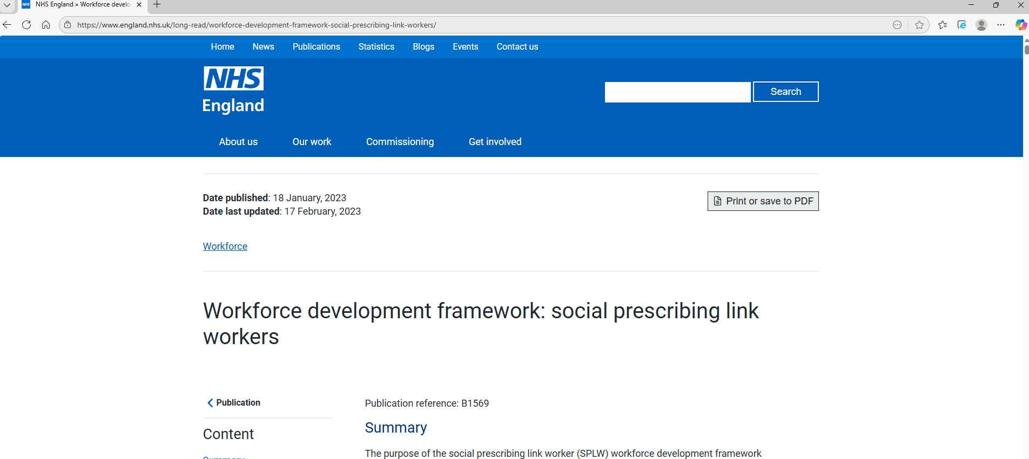
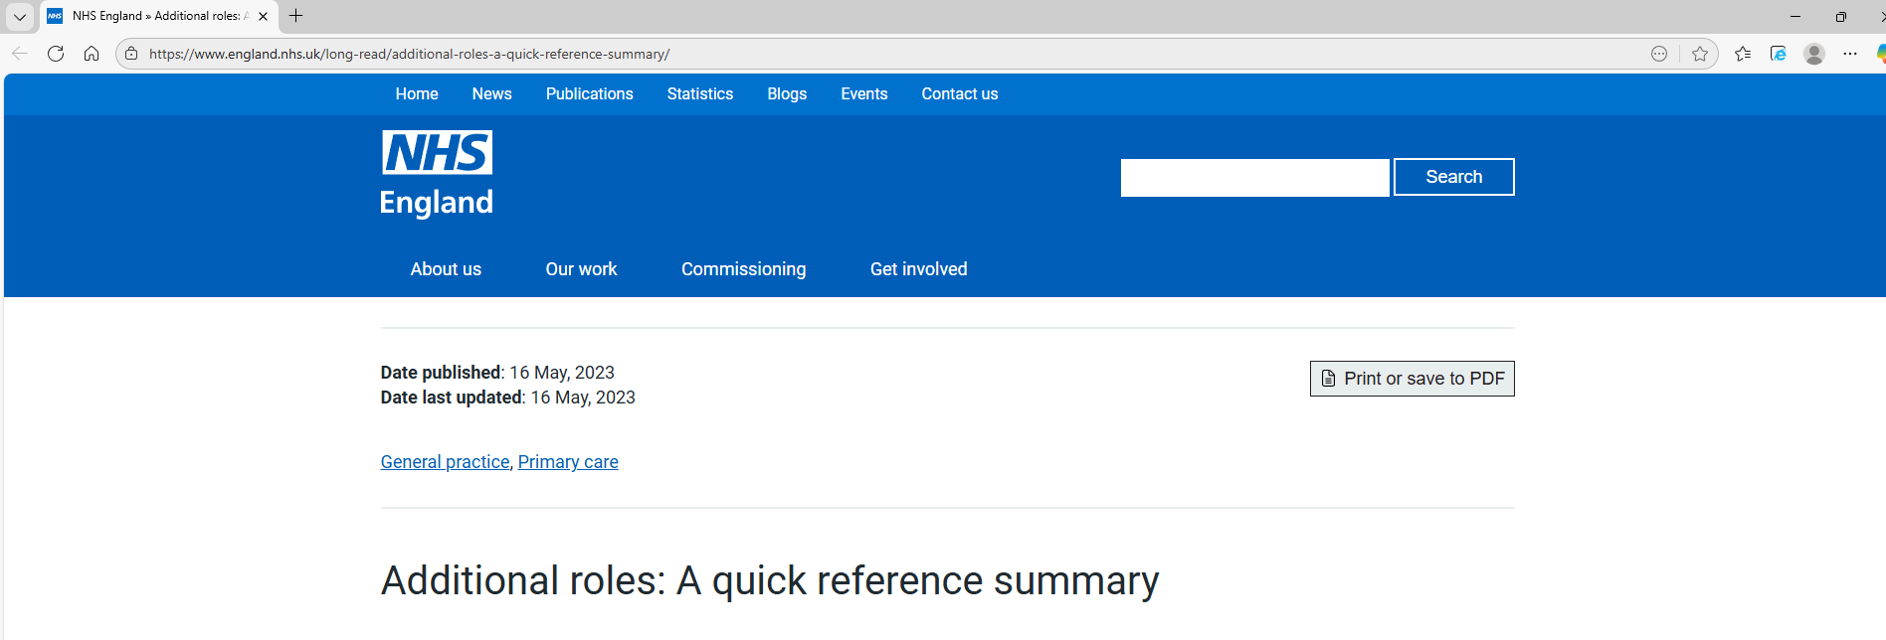
Workforce Development Framework
Webpage Links (Not yet updated)
NHS England » Workforce development framework: social prescribing link workers
NHS England » Additional roles: A quick reference summary
Notes:
Plain slide with subhead and bullets

Slide 8
Workforce Development Framework
Education and Training Updates
Updated text in Education and Training requirements to mirror PCN DES:
Where the Social Prescribing Link Worker does not already have any level 3 qualification (e.g. A level or other equivalent post-16 education), the PCN should ensure that they are enrolled in or, undertaking, appropriate training or an apprenticeship to obtain a level 3 occupational standard, accredited by the Personalised Care Institute.
For those workers who already have a qualification at level 3, a level 3 social prescribing course is recommended but not mandatory.
Notes:
Plain slide with subhead and bullets

Slide 9
Workforce Development Framework
Next Steps
Work with NASP and SPLWs to develop the frameworks further
  Alignment with roadmaps
  Neighbourhood Teams
  Future Policy
Updating e-learning modules
Notes:
Plain slide with subhead and bullets

Slide 10
10 Year Workforce Plan
Next Steps
10 Year Workforce Plan - call for evidence document - GOV.UK (November 2025)
  Expected Spring 2026
10 Year Health Plan working group: people (December 2025)
  Role in delivering preventative interventions
Notes:
Plain slide with subhead and bullets

Slide 11
End slide

Slide 12
Link Worker Development
Siân Brand, Health, Wellbeing & Social Prescribing Consultant

Slide 13

Link Worker Development
Siân Brand
Health, Wellbeing & Social Prescribing Consultant
sianbrand@livingsafeandwell.co.uk

Slide 14
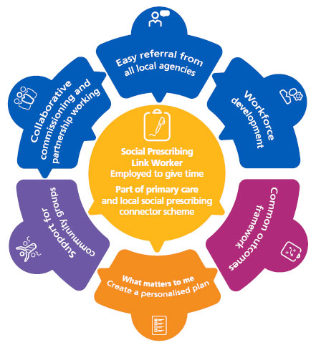
Social Prescribing Link Worker Model – England
NHS England » Social prescribing
Notes:
2019 NHSE - L&D at heart of English model of SP
Collaboratively developed model
Rooted in community - VCFSE central & ABCD approaches
Part of whole system SP approach
Strength/asset-based approach

Slide 15

Link Worker backgrounds
VCFSE
Social care
Leisure
Mental health
Counselling
Nursing & other clinical
OT
Anywhere!
Notes:
NHSE – developed general JD
Essential skills and knowledge means the SPLW draws from many different backgrounds
Adds to the richness of the role and an emerging SPLW team supporting a PCN and primary care
Knowledge of locality is essential to success of the SPLW – connecting function

Slide 16
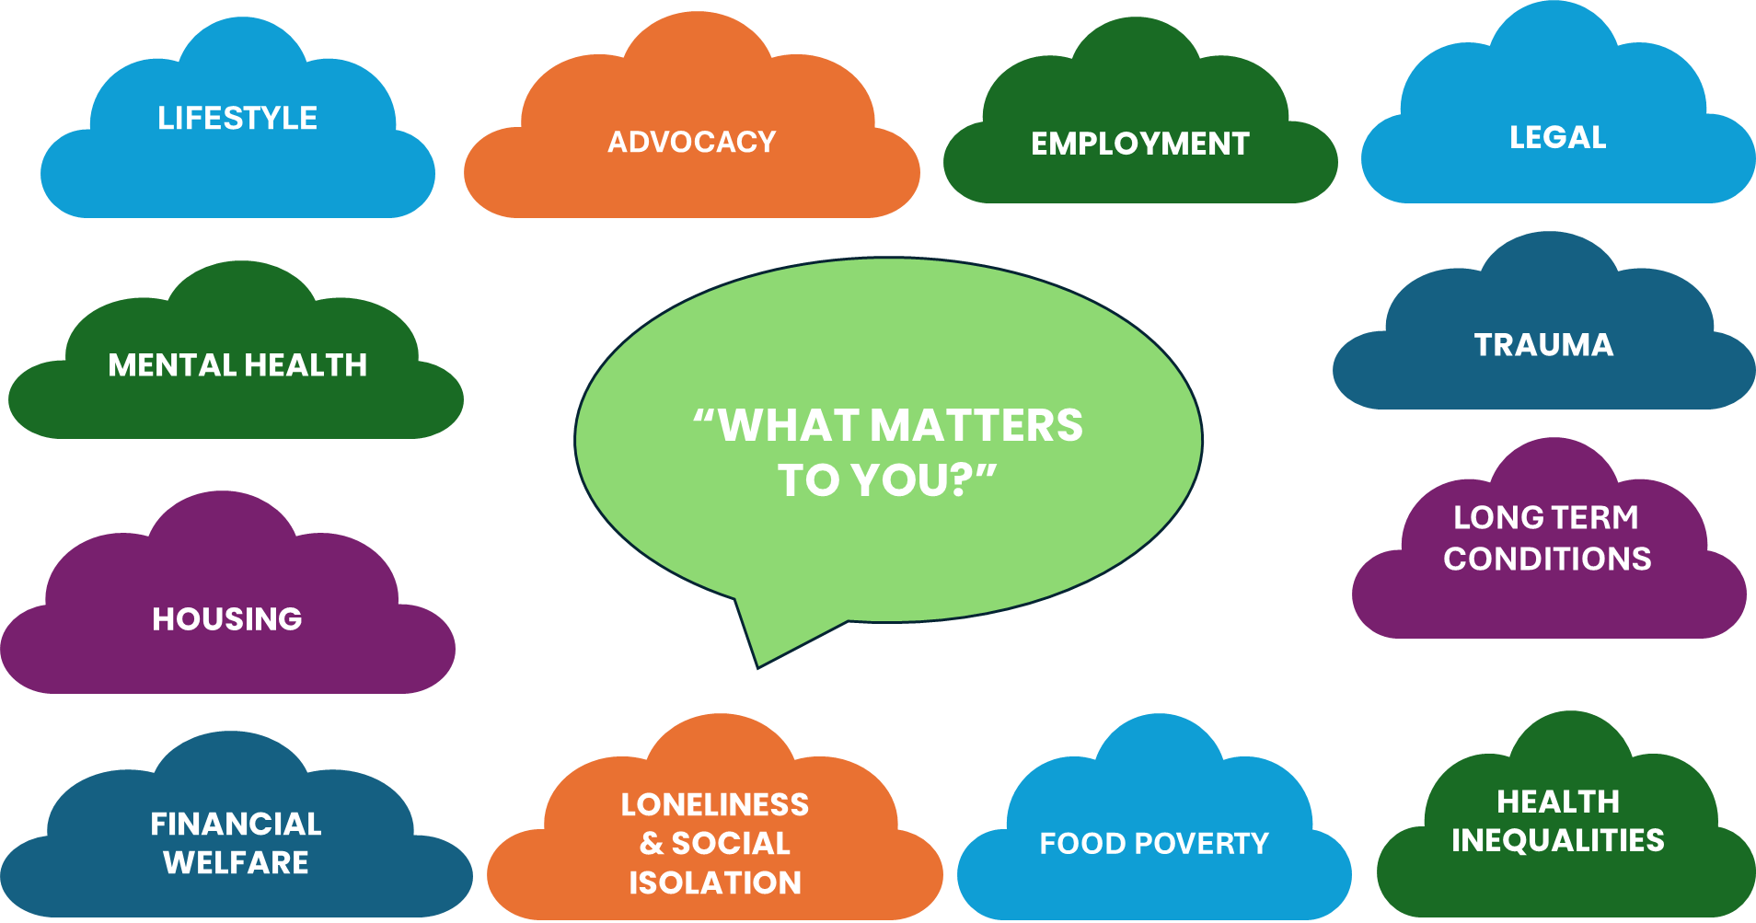
Notes:
But as we know the role is demanding – because of its breadth of support
Some of the areas that people need support with
Jack of all trades but master of none, - this is the strength and superpower of the link worker
Truly focus on the what matters to you conversation - only role in primary care whose sole focus is what the person presents with

Slide 17

Link Worker Development – why?
Notes:
So, it’s because of this breadth that the link workers L&D is so important
If a link worker has a well designed and available suite of L&D support – more likely to stay, can manage demanding workloads with better boundaries, keeps patient and link worker safer, can deliver high quality service where patients leave better equipped to self-serve in the future – reducing demand

Slide 18
Types of learning & development
Formal training
  Level 3 qualification or other accredited courses
  Online e.g. E-learning for health modules
  Localised – e.g. MHFA, welfare advice, trauma informed,
  Mandatory – e.g. safeguarding, GDPR & data protection, lone working
Community mapping & stakeholder engagement – VCFSE & wider – whole system social prescribing – ongoing
Supervision & peer support – reflective/ reflexive practice – safety & quality – ongoing
Wider linked agendas – e.g. data collection and evaluation, population health management, health inequalities, neighbourhood health & multidisciplinary team meetings
Notes:
And needs to cover such a wide range of L&D – information/ knowledge as well as formalised training & supervision
Key to note for the link worker that some time regularly dedicated to building and maintaining a knowledge base of the VCFSE and community offers – not a one off – offers change over time - part of building local social capital – of both the individual they support and the community – therefore building resilience
Supervision and peer support is key – challenging caseloads – numbers and presentations – need primary care to understand SP and also keep link worker and individual safe

Slide 19
Competencies & Skills
Workforce development framework – NHS England
Coaching skills / motivational interviewing
Creates boundaries for the Link Worker
Enhances person centred, personalised engagement
Supports behaviour change
Focuses on what matters to person
Reduces dependency & promotes self-serving self-care
Improves system efficiency use of local assets
NHS England » Workforce development framework: social prescribing link workers
Notes:
Framework is key guidance document for anyone employing a link worker
Good for link workers to work to themselves as well
Key skill is coaching/motivational interviewing
Key facilitator of behaviour change for people
Shifts from “do to” to support with
Helps in boundaried support – maintaining safety of link worker and person
Keeps “responsibility for change with the person and not the link worker
2 day and 4 day courses
PCI – accredited providers – ICF International Coaching Federation and EMCC European Mentoring and Coaching Council

Slide 20

Level 3 Social Prescribing Qualification
Bromley by Bow, Conexus Healthcare and the University of East London
Developed in 2019
Funded by NHS England
Accredited level 3 qualification
Original Conexus course - RSPH & PCI
Mandated by NHSE in Primary Care Network guidance
Home - Social Prescribing Qualification
Notes:
Recognised need for national course on SP
Not limited to aspiring or current link workers to attend – commissioners and managers
PCI accredited

Slide 21
SPLW Roadmap and RSPH Pathways
Aaron Mansfield, Head of Education and Assessment at the Royal Society for Public Health

Slide 22



Royal Society for Public Health
SPLW Roadmap and RSPH Pathways

Slide 23

What have we learnt from the workforce?
In 2024 we launched our landmark report the Unusual Suspects: Unlocking the Potential of the Wider Public Health Workforce. Our engagement with the wider workforce which formed the foundation for the report taught us three key things:
People want to do more in public health. However, there are few clear entry points into the public health system for people from non-traditional routes.
Crucially, there are almost no clear educational pathways for the continued professional development needed pursue a career in public health.
There needs to be recognition for the impact the wider workforce has on the health and wellbeing of the nation.

Slide 24


Our work in Social Prescribing

Slide 25
Level 3 Certificate in Social Prescribing
40 hours guided learning and 120 hours total qualification time
Units on:
  Principles and concepts of social prescribing
  Theories and principles of behaviour change
  Impact of health inequalities and wider determinants of health
  Conducting a motivational consultation
Available from RSPH centres and Unit 1 via RSPH Learn

Slide 26

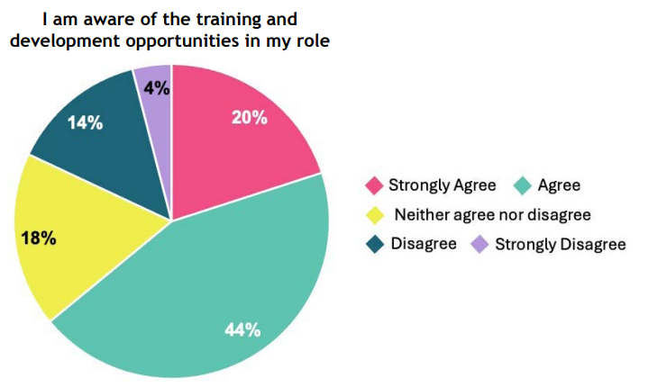
SPLW Training Roadmap

Slide 27

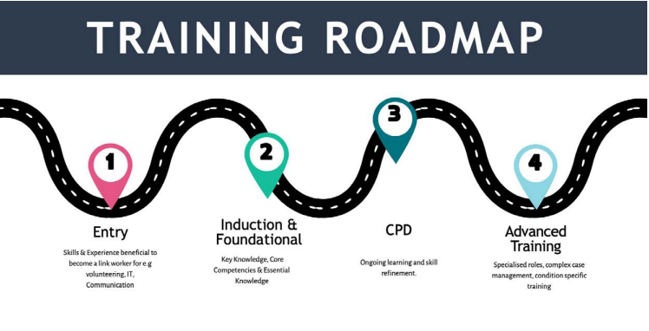
SPLW Training Roadmap

Slide 28
Next steps
Review of Level 3 qualification
Development of RSPH SP Pathway, including Level 4 Advanced qualification
Scoping of CPD package for SPLWs
Feedback on training roadmap

Slide 29
Merton Social Prescribing
Kelly Walker, Head of Social Prescribing, Merton

Slide 30


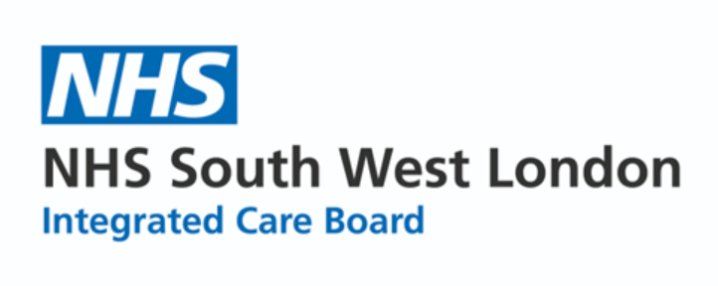

Kelly Walker
Head of Merton Social Prescribing

Slide 31
Where my journey began… Career Timeline
Early Years/Childcare – Managing Childcare settings
SEN and LD Support work and team management within the voluntary sector
Return to Education – H&S Care, Social Work
Supporting vulnerable families
Drug & Alcohol support
Young Carers
Social Prescriber – Senior – Deputy – Head of Social Prescribing for the London Borough of Merton.

Slide 32

What skills do you need for a social prescribing role?
A social prescriber needs strong relational skills, community knowledge, systems navigation ability, emotional resilience, and a person-centred mindset, combined with solid safeguarding and organisational competence.
1) Core Interpersonal & Relational Skills
2) Person-Centred Practice Skills
3) Knowledge of Communities & Systems
4) Safeguarding & Professional judgement
5) Practical & Organisational Skills
6) Partnership & Team Working
Desirable Skills include Coaching or counselling skills, Mental health first aid, Knowledge of welfare benefits, housing, or employment support, Lived experience of health or social challenges (handled reflectively), connections to the location you work.

Slide 33
Recruitment – What stands out to me!

Slide 34
Supporting my team with their professional development.

Slide 35
Training and qualifications and how these can benefit future career progression
Future Career Paths
Mental Health Practitioner
Counselling
Coaching
Care Coordinator
Social work
Benefits Advisor
Health Inequalities or Inclusion Lead
Patient Experience / Engagement Lead
Community Development / Wellbeing Lead
Leadership and Management
Training & Qualifications
Social Prescribing qualifications
Counselling
Health and well-being coach
Motivational interviewing
Health & social care
Mindfulness Awareness
Trauma-Informed Practice
Safeguarding Adults & Children
Mental Health awareness / Mental Health First Aid
Suicide Awareness & Prevention
Health Inequalities & Wider Determinants of Health
Asset-Based Community Development (ABCD)
Benefits, Housing, and Debt Awareness
Leadership & Management Qualifications

Slide 36

Thank you

Slide 37


Get in touch
socialprescribingacademy.org.uk
Q&A

Slide 38

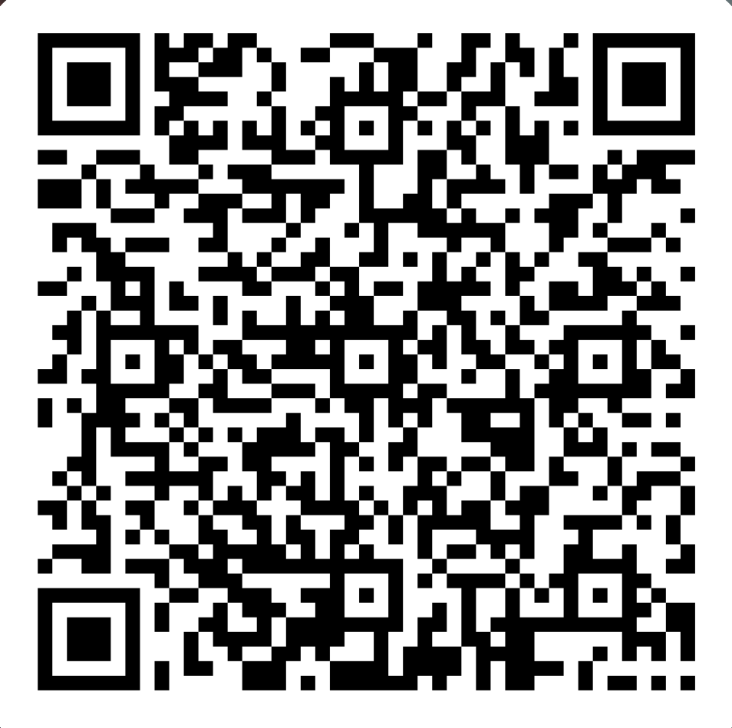
Get Involved
Apply to become a NASP Social Prescribing Champion
Champions raise awareness of social prescribing within their workplace or profession.
Open to a variety of clinical and non-clinical professionals working across the healthcare system
Join a network of over 300 professionals, receive an email badge & lanyard to recognise your contribution, and gain access to exclusive learning opportunities and other resources.
Become a member of our Integrated Care Board Community of Practice
This online Community of Practice (CoP) is for those working in Integrated Care Boards (ICBs) who have a role and interest in social prescribing, its commissioning, quality, sustainability, and implementation across communities.
Next meeting: Tuesday January 27th 2026, 14:00-15:30
LEARN MORE HERE
spchampions@nasp.info
Complete the form to become a member
Or email workforce@nasp.info

Slide 39
Topics include:
Supporting people with Long Term Conditions: Case studies and examples
Supporting mental health through social prescribing
Building effective referral pathways: connecting people to the right support at the right time
Events | NASP
20th Jan - NASP Tutorial: Embedding Green Social Prescribing – Insights from Forestry England
COMING SOON!
Keep an eye out for our upcoming SPLW webinar series:

