Slide 1






Welcome to the NASP's Green Social Prescribing Process Journey Collection
Capturing and Utilising Data for Green Social Prescribing with, University of Northampton and Delapré Abbey

Slide 2
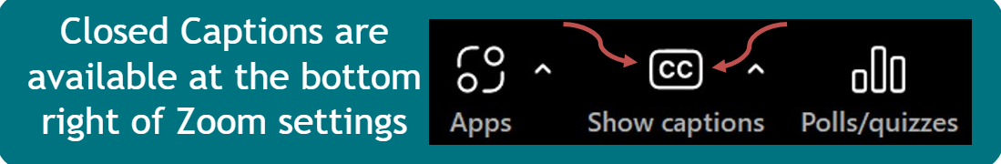
Welcome to the NASP's Green Social Prescribing Process Journey Collection
Housekeeping
This is an interactive tutorial; there will be a discussion at the end, please enter questions into the Q&A feature.
Please introduce yourself in the chat.
The session will be recorded & slides will be shared.
Captions are available.
There will be a quick poll at the end, we’d love to hear your thoughts.

Slide 3
12:05pm:
Delapré Abbey, University of Northampton and Active Quarter: Process Journey
12:35pm:
Wider Discussion & Questions
12:55pm:
Close & Poll
Today’s Agenda

Slide 4
Richard Clinton
CEO, Delapré Abbey
Dr Declan Ryan
Associate Professor, University of Northampton

Slide 5
The Background and Question:
How do we make the places people already love work harder for wellbeing and prevention?
Heritage estate repositioned as a preventative health and wellbeing asset
Frustration with fragmented systems and underperforming place coordination created momentum for change
Recognition that communities were facing growing health inequality, isolation and barriers to accessing nature
Opportunity to move beyond activity delivery toward system level influence
Partnership approach developed to connect heritage, health, environment and active travel
Notes:
The idea that we need to see Heritage as a true community asset.
Declan – I think this focusses on our priorities from DAPT but should include what the motivation was from the UON. - Hand to me so I can say a couple words about UON motivation

Slide 6
Opportunities
Where momentum already existed [Follow The Energy]
• Communities already using green space informally for wellbeing
• Strong VCSE and grassroots partners ready to collaborate
• Growing NHS and Public Health focus on prevention
• Active Travel and Green Infrastructure investment aligning locally
• Academic partners supporting local priorities:
- Developing research portfolio for Early Career Researchers
- Providing research experiences for students
- Providing live briefs for student projects
Approach
Follow existing energy rather than create new systems:
• Support what communities are already doing
• Connect partners instead of duplicating provision
• Translate local activity into system language
Result: ➡ Heritage becomes infrastructure for prevention
Notes:
Declan what did UoN see as the opportunities, academic growth, student placements etc - Added a couple sub bullet points that I can speak to

Slide 7
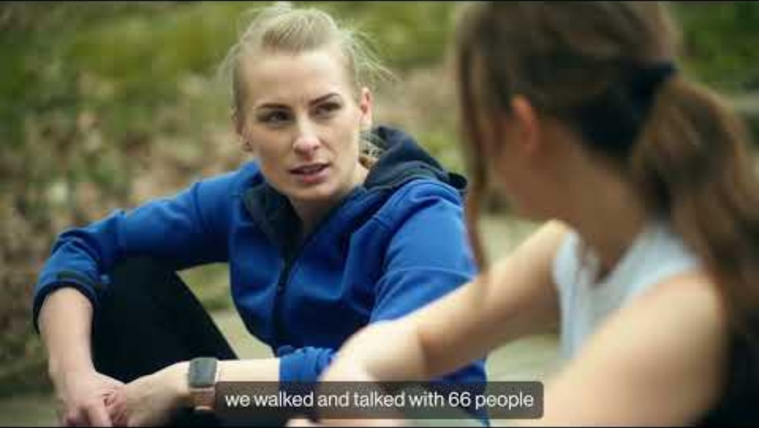

Slide 8
Challenges
System Challenges
• Heritage not recognised as a health asset
• NHS level data expectations unfamiliar to VCSE sector
• Informal open access engagement difficult to measure
• Evaluation capacity and workforce pressures
• Funding cycles limiting long term tracking
Operational Reality
Moving from:
Activity provider → Trusted referral partner
Nice project → System infrastructure
Required cultural as well as technical change.

Slide 9
System Impact
• Recognised social prescribing destination
• Over £5 million secured for wellbeing infrastructure
• UON evidence influencing parks, transport and estate planning decisions
UON more involved in system-wide evaluation support
Greater use of monitoring and evaluation to inform decision-making
Participation and Reach
• 1,500+ programme participants
• 1.2 million park visits (2022–24)
• 84% local users within 3 miles
• Increased physical activity and repeat engagement
Health Outcomes
• Reduced isolation
• Improved wellbeing and confidence
• Increased active travel participation
Outcomes & Impact
Notes:
Stronger community connection
Declan was there any lasting impacts internal to UoN did this work help secure other research projects? - Added 3 bullet points up top

Slide 10
Key Learning
✔ Work at landscape scale
✔ Embed evaluation from the start
✔ Use universities as critical friends
✔ Invest in physical infrastructure
✔ Combine lived experience with numbers
✔ Share findings back with communities
✔ Celebrate success to get more buy-in
✔ Local data is a strong influencer of local policy
Most Important Insight
Relationships across systems matter more than programmes.
What Works Well?
Notes:
Declan @ anything from your side, how did it work well with student opportunities and linking through to previous research – I can talk from Combine Lived Experience with Numbers

Slide 11
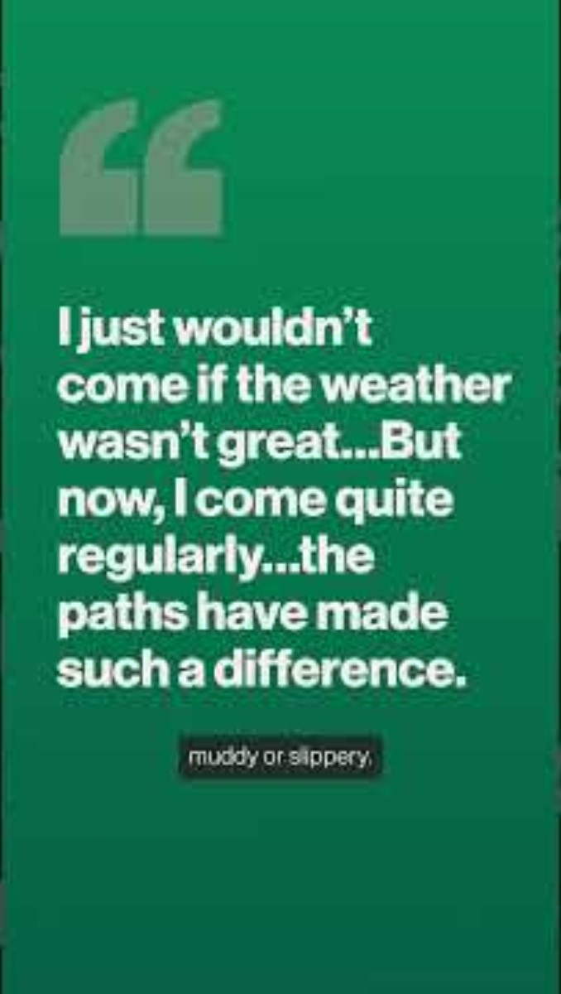
Notes:
Stronger community connection
Declan was there any lasting impacts internal to UoN did this work help secure other research projects? - Added 3 bullet points up top

Slide 12
Future Plans
Next Phase: Scaling Prevention
• Opening of Stables Wellbeing Hub (2026)
• Integrated health, recovery and community services
• Expanded green social prescribing pathways
• Social Return on Investment modelling
• Targeted work with deprived communities
• Continued infrastructure and accessibility improvements
• Long-term monitoring of NHS and LA data to measure the impact
• Build on UONs SPRING Social Prescribing Evaluation
Vision:
A heritage landscape functioning as everyday preventative health infrastructure.
Notes:
Curation of Tenants
Anything from your view point new research and partnerships? - Added a final two bullet points – awaiting hyperlink for last bullet point

Slide 13
Links & Evidence Base
Frameworks and Supporting Evidence
• Place Informatics Footfall Data
• Scaffold Evaluation Framework
• Natural England Green Infrastructure Framework
• Historic England Wellbeing Strategy
• Active Quarter Case Study Evaluations
• UON Northamptonshire's Whole System Approach Guide
• UON Physical Activity Intervention Evaluation Framework
• University of Northampton Research Programme
• WHO Urban Greenspaces: a brief for action
Notes:
Include links – do not forget – added some for you

Slide 14
Prevention works best when it happens in places people already trust

Slide 15
Over to You:
Discussion & Q&A 💬

Slide 16
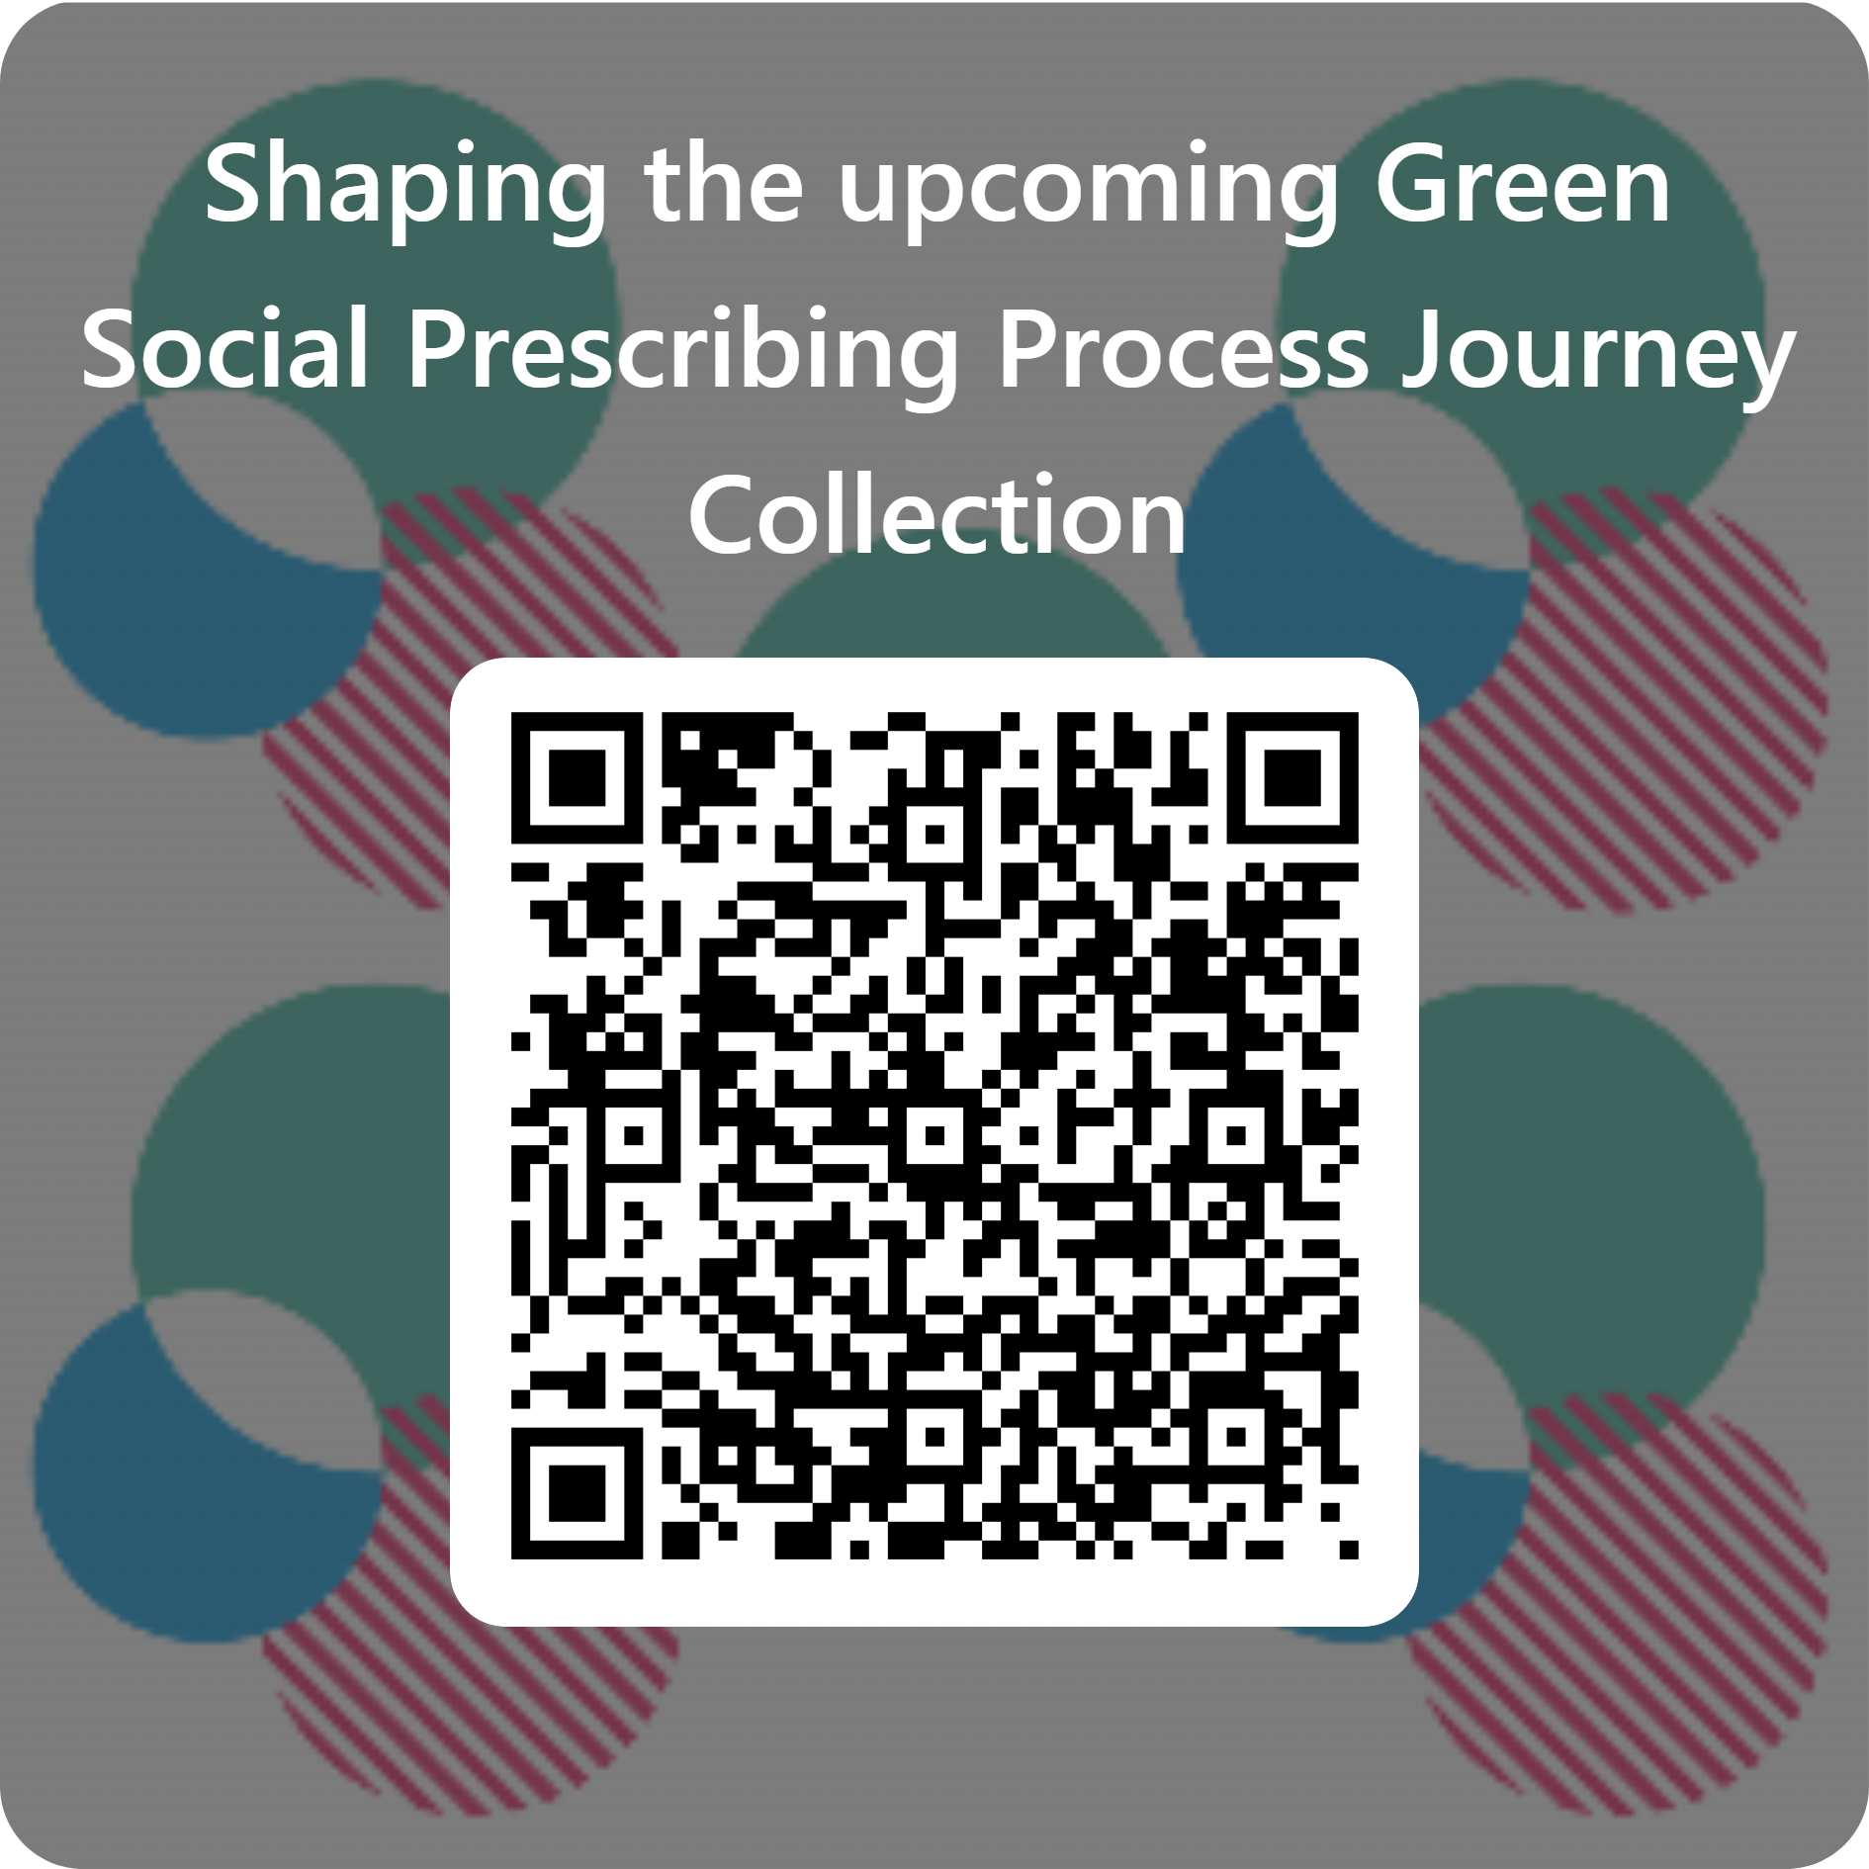
The Green Social Prescribing Process Journey Collection
A new national resource bringing together GSP Process Journeys, sector insights, and practical tips showcasing how green social prescribing supports people, communities, and the environment.
Early access for the GSP Innovation Community
24th of March
GSP Community Live Launch Event
10th of April
Public Release
31st of March

Slide 17
The Green Social Prescribing Process Journey Collection
Contribute here or scan the QR code ​
A new national resource bringing together GSP Process Journeys, sector insights, and practical tips showcasing how green social prescribing supports people, communities, and the environment.
Early access for the GSP Innovation Community
24th of March
GSP Community Live Launch Event
10th of April
Public Release
31st of March

Slide 18
Want to get involved with Delapré Abbey?
www.volunteerpassport.co.uk
www.delapreabbey.org/volunteer
info@delapreabbey.org
Next Steps
Upcoming Delapré Community Events
Park Play – Saturday 21st March
SENDS 4 Dad – Saturday 11th April
Menopause Meet-Up – Wednesday 15th April
This Grief Thing – Sunday 19th April
Abbey Joggers – Thursdays 10:15
Pilates – Mondays 11:00
Notes:
Encourage those to volunteer within local communities.

