Slide 1




Making the Case for Movement-Based Social Prescribing: Evidence, Data and Local Insight
Thursday the 29th of October 2026
Thank you for joining us. The webinar will begin shortly.

Slide 2


Housekeeping
MOVEMENT ON PRESCRIPTION / WEBINAR SERIES
Today's format: Based on questions and feedback shared during registration, we've adapted today's webinar to a shorter, more focused 30-minute session, with an emphasis on insights from our speakers.
We are recording this webinar (you will be sent the slides and the link to the recording, and they will be on NASP's website)
We won't be holding a live Q&A today, but please do share your questions using the Q&A function. We'll collate these alongside questions submitted during registration and follow up with our speakers to produce a Q&A resource after the session.
Please use the chat function for introducing yourself and networking. If you have any technical issues, please raise these in the chat, and a member of the NASP team will assist.
Closed Captions are available (turn these on at the bottom of your screen)
We’ll share a webinar learning summary capturing the key points and, where possible, addressing questions and themes we haven’t been able to cover during the session.

Slide 3
MOVEMENT ON PRESCRIPTION / WEBINAR SERIES
Agenda
1pm - Welcome to Movement on Prescription
With chair Sian Brand, NASP
1:05pm – Understanding the evidence: what do we know?
With Joelle Bradly, NASP
1:15pm – Putting evidence into practice: RISE Northeast
With Michael Ali, RISE
1:27pm – Close and Poll

Slide 4

MOVEMENT ON PRESCRIPTION / WEBINAR SERIES
Joelle Bradly
Deputy Director of Evidence and Impact, NASP

Slide 5






Who are the audiences for evidence and what are their needs?
Government
& Gov Bodies
Community Groups & Patients
Clinicians
Practitioners
Departments, NHS England, Elected Officials
Good practice; professional development (e.g. working with different patient groups, or interventions for specific conditions)
Impact of investment at scale (economic impact; service usage)
Impact of investment at sub-regional/local scale, and against local needs
Impact of activity (“is it working?”)

Slide 6

What is the social prescribing evidence landscape?
WHERE WE STARTED
WHERE WE ARE
WHERE WE NEED TO GO
Social Prescribing started organically in the UK, with many local initiatives designed to suit local need
Large investment from Department of Health and Social Care in 2019
Changed context of delivery
NASP collaborated with a large range of academics to identify research gaps and commissioned 15 evidence reviews
NASP have partnered on or supported a number of new research projects in key priority areas
NASP have collated various local evaluations of the economic impact of social prescribing
There is a growing body of evidence, particularly on the benefits of SP activities
Support development of national data driven system for social prescribing
Ensure that research and evaluations can inform policy and practice
Notes:
Wealth of qualitative evidence, but we need more than this for commissioners & policy
The context changed to being more focused on the health sector and health related outcomes
NASP are supporting & Sharing Research: Blogs summarising new evidence, monthly themed evidence newsletters (Qual studies, Older people, Canadian research, employment, LTC, CYP, Economic, Men, Poverty, Faith), briefing papers and webinars. We are also currently supporting 8 research studies in 25/26: 3 CYP, 1 dementia, 1 secondary care, 1 creative health, 1 LW roll out, 1 VCSE workforce.

Slide 7

Who is accessing social prescribing?
Analysis in 2024 looking at who gets referred to social prescribing (n=160,128) found that, in England:
61% of referrals were female
Over 20% were aged 60-69
People referred were more likely to live in deprived areas.
85.3% were referred via medical routes
The most common reasons for referral were mental health and wellbeing (33.5%), practical support (26.1%) and social relationship (22.5%).
Bu, F., Hayes, D., Burton, A., & Fancourt, D. (2024). Equal, equitable or exacerbating inequalities? Patterns and predictors of social prescribing referrals in 160,128 UK patients. medRxiv (Cold Spring Harbor Laboratory). https://doi.org/10.1101/2024.03.26.24304896
This Photo by Unknown Author is licensed under CC BY

Slide 8
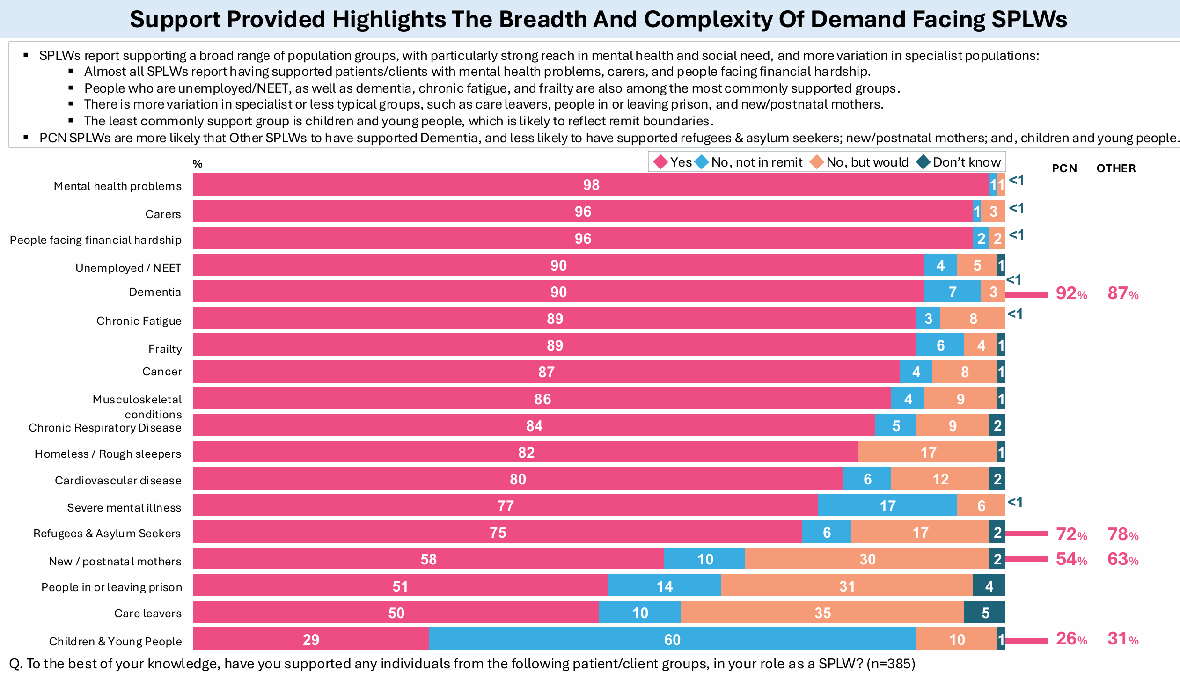
Notes:
98% supporting patients with MH problems, 77% supporting patients with SMI. New analysis of CPRD data also suggests that, among 112,334 patients with SMI, 0.8% received a social prescribing consultation in 2019 increasing to 9.5% in 2023 Social prescribing for patients with severe mental illnesses: an English primary care longitudinal observational study | medRxiv

Slide 9

Impact of the rollout of the national social prescribing link worker programme on population outcomes: evidence from a repeated cross-sectional survey | British Journal of General Practice
Anna Wilding, Efundem Agboraw, Luke Munford, Matthew Sutton, Stewart W. Mercer, Chris Salisbury, Morgan Beeson, John Wildman and Paul Wilson
June 2025

Slide 10
This study estimated the impact of ARRS-funded social prescribing link workers on population outcomes and found that the rollout of link workers was associated with small improvements in patient experience and slightly better outcomes for population groups specifically targeted for social prescribing.
An additional full-time equivalent link worker per 50,000 patients was associated with
higher probabilities of having confidence in managing long-term condition(s) and having enough support from local services, for respondents with long-term conditions
a higher probability of having their mental health needs understood, for respondents with mental health needs
a higher probability of having a good experience at their general practice, for all respondents
Notes:
This is the first study to quantitatively estimate the impact of the national rollout of social prescribing link workers in England, with a large sample size of over four million individuals from 2018 to 2023, addressing previous concerns regarding small sample sizes, lack of counterfactuals and uncontrolled studies with short time frames. The inclusion of data on all ARRS funded roles in the model supported the findings that impacts were due to the number of social prescribing link workers rather than an increased number of roles within primary care. Although the study did not use self-reported measures of physical or mental health, the paper suggests that findings of patients having increased confidence in managing conditions may also be associated reduced healthcare utilisation, as reported in other research studies.

Slide 11
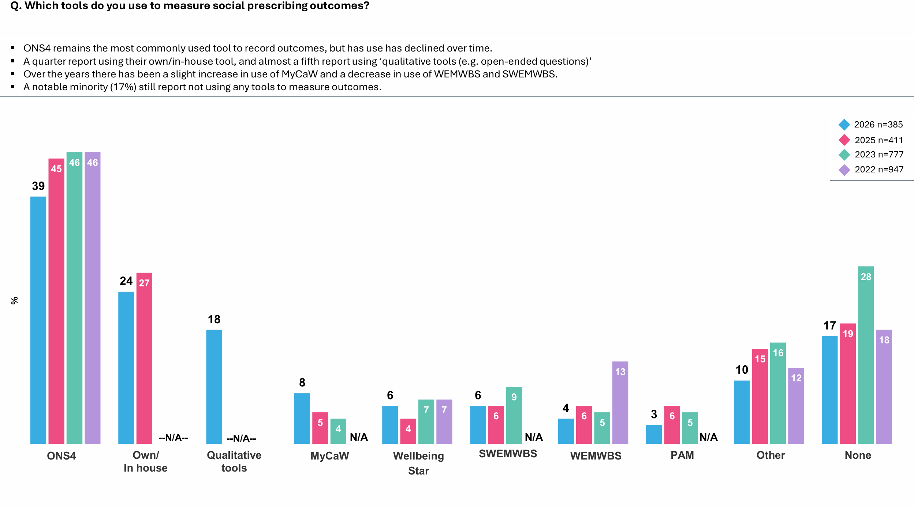
Which tools do you use to measure social prescribing outcomes? (%)
Fewer respondents report using no outcome measurement tools – while this indicates improved adoption of measurement tools, nearly 1 in 5 respondents still report not using one.
ONS4 remains the most commonly used tool to record outcomes.
The introduction of ‘Own/In house’ category in 2025 demonstrates substantial use of locally developed/customised approaches.

Slide 12
1. Overall, how satisfied are you with your life nowadays?
2. Overall, to what extent do you feel that the things you do in your life are worthwhile?
3. Overall, how happy did you feel yesterday?
4. On a scale where 0 is “not at all anxious” and 10 is “completely anxious”, overall, how anxious did you feel yesterday?

Slide 13
WELLBY approach​
​
​
The WELLBY or Wellbeing-adjusted Life Year, is a wellbeing valuation method that provides a holistic measure of societal welfare by combining life length with quality ​
A WELLBY is defined as a one-point change in life satisfaction (on a scale from 0 to 10) affecting one person for one year. ​
This metric aids policymakers in evaluating the effectiveness of various programs and initiatives in enhancing overall life satisfaction. ​
​
The WELLBY approach is based on the idea that a good society is one that enables its people to live long, fulfilling lives. Here’s how it works: ​
Measurement: Wellbeing is measured using surveys that ask individuals to rate their life satisfaction on a scale from 0 to 10. ​
Calculation: Changes in life satisfaction are tracked over time, with each point increase for a year equating to one WELLBY. ​
Monetisation: The Green Book sets a central value of £13,000 for one WELLBY, based on 2019 prices. ​
Evaluation: The total WELLBYs generated by a policy or intervention is calculated to assess its overall impact on societal wellbeing. ​
​
How to measure wellbeing using the WELLBY approach | MeasureUp​

Slide 14
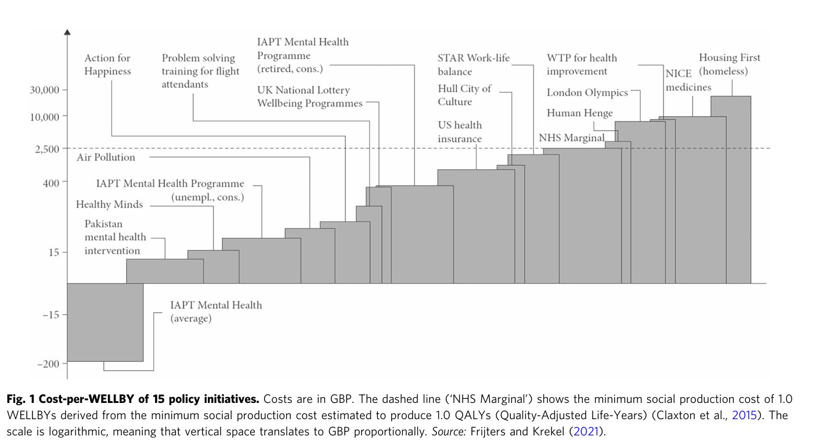

Slide 15


National Evaluation of the Preventing and Tackling Mental Ill Health through Green Social Prescribing (GSP) Project
March 2021 to June 2023
Commissioned by Department for Environment, Food & Rural Affairs (Defra)
Research consortium: Universities of Sheffield, Sheffield Hallam, Exeter & Plymouth

Slide 16
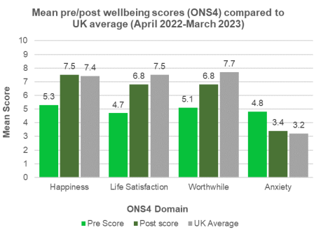
GSP had a positive impact on participants' mental health and wellbeing
National Participant Demographics:
  8,339 individuals participated across T&L sites.
  57% from socio-economically deprived areas
  21% from ethnic minority populations
National Wellbeing Benefits (ONS4):
  Happiness: Increased from 5.3 to 7.5.
  Life Satisfaction: Increased from 4.7 to 6.8.
  Feeling Life is Worthwhile: Increased from 5.1 to 6.8.
  Anxiety: Reduced from 4.8 to 3.4.
Mental Health Benefits (1 pilot site used Hospital Anxiety and Depression Scale):
  Depression: Reduced from 8.1 to 5.6.
  Anxiety: Reduced from 11.1 to 8.5.
Notes:
Main Message: GSP had a measurable, positive impact on participants' mental health and wellbeing.
The majority of post outcome measures were collected between six weeks and 12 weeks following referral.
The evaluation of the GSP programme found that, across seven pilot sites, there was a statistically significant improvement in wellbeing after accessing nature-based activities through the GSP Project. The authors estimated a social return on investment of £ 1.88 for every £ 1 invested in the project overall.

Slide 17
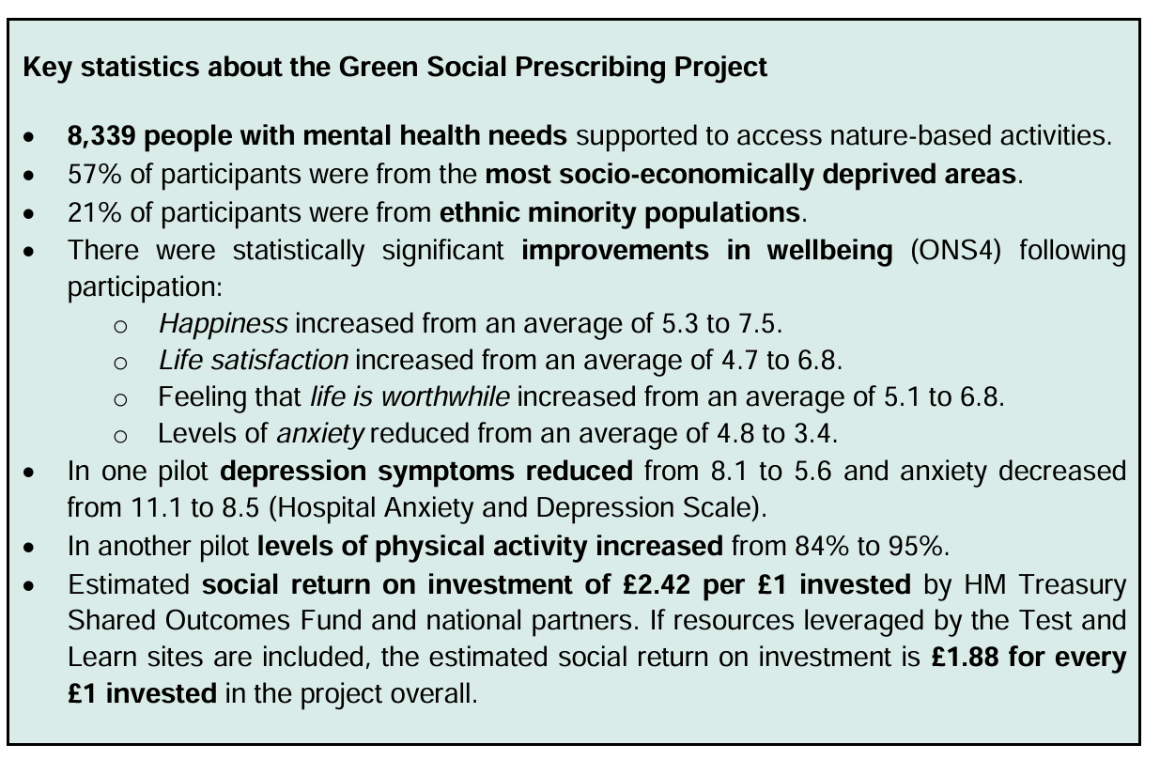
Notes:
The majority of post outcome measures were collected between six weeks and 12 weeks following referral.
The evaluation of the GSP programme found that, across seven pilot sites, there was a statistically significant improvement in wellbeing after accessing nature-based activities through the GSP Project. The authors estimated a social return on investment of £ 1.88 for every £ 1 invested in the project overall.

Slide 18
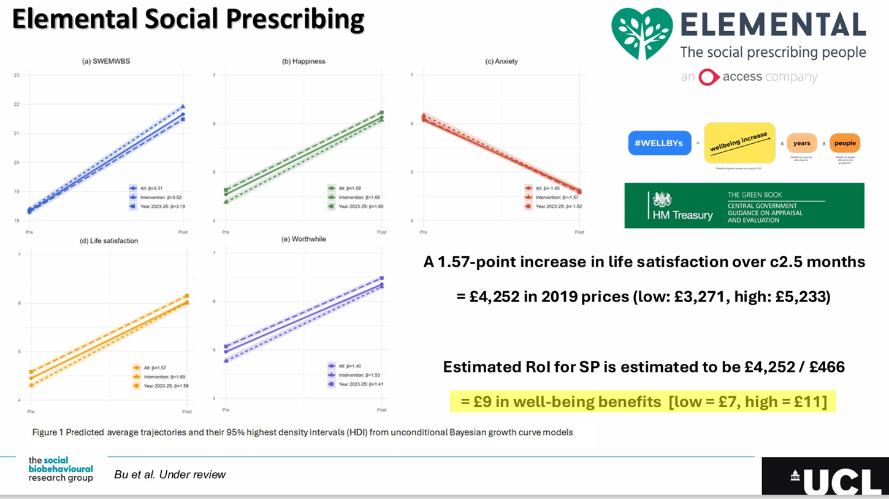
Notes:
UCLs analysis of elemental data- and the life satisfaction Q (ONS4) which can beer converted into a WELLBY – the value to the individual, as recommended by the treasury. They found £9 in wellbeing benefits for every £1 invested.

Slide 19
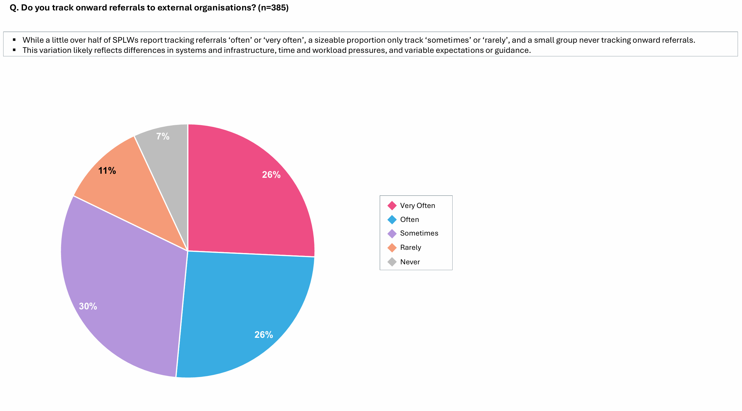

Slide 20
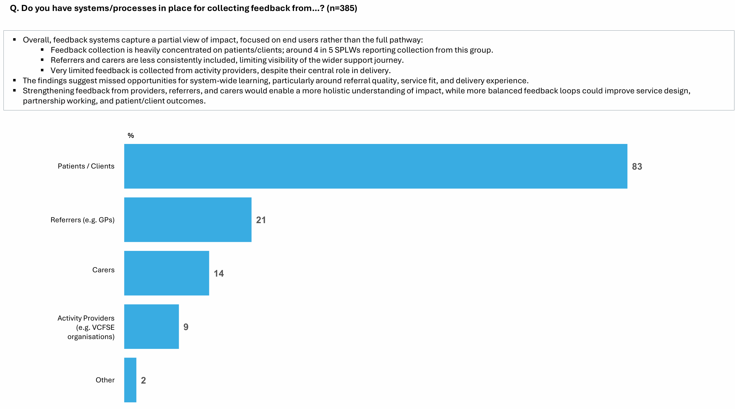

Slide 21

MOVEMENT ON PRESCRIPTION / WEBINAR SERIES
Michael Ali
Health Integration Strategic Lead, Rise Northeast

Slide 22

MOVEMENT ON PRESCRIPTION / WEBINAR SERIES
What we’ll explore
Every Move Matters – prescribing movement through general practice
Utilising existing digital systems to identify and engage patients
Demonstrating impact through relevant data metrics

Slide 23
MOVEMENT ON PRESCRIPTION / WEBINAR SERIES
Every Move Matters – prescribing movement
Co-developed with primary care and third sector partners – iteratively designed over an extended period
Multiple phases of evaluation undertaken by academic partner NENC ARC ; Acceptability, feasibility and adaptability
Moving beyond traditional referral models by focusing on proactively prescribing and delivering movement through a dedicated Activity and Wellbeing coach.
Enhances delivery of personalised care, aligned with integrated neighbourhood health and population health management models

Slide 24
MOVEMENT ON PRESCRIPTION / WEBINAR SERIES
Utilising existing digital systems…
Key considerations during development -
Make better use of resources and technology through digital tools (EMIS, SystmOne, Accurx)
Support people and communities to take greater control of there health through preventative care
Empower health and care professionals to work differently

Slide 25
MOVEMENT ON PRESCRIPTION / WEBINAR SERIES
Demonstrating impact through relevant data…
Key considerations during development -
Metrics should reflect the health and care outcomes that stakeholders need to see and evidence.
Balance the need for quality, proportionate data collection with a recognition of the capacity and burden implications.
Outcome measurements should support decision-making and investment.
Use common measurement tools across multiple patient cohorts to support standardisation, reduce variation in data collection, and improve the confidence and capability.

Slide 26
MOVEMENT ON PRESCRIPTION / WEBINAR SERIES
What we collect and why….
Consistently use a combination of behavioural, PROMS,PREMS and economic outcomes
Attempt to speak a shared language with primary care colleagues and commissioners
EQ-5D-5L / EQ-VAS
Cost per QALY / Net Health Value
Friends and Family test
BW / Waist circumference
Functional Mobility (3M TUG)
GPPAQ

Slide 27
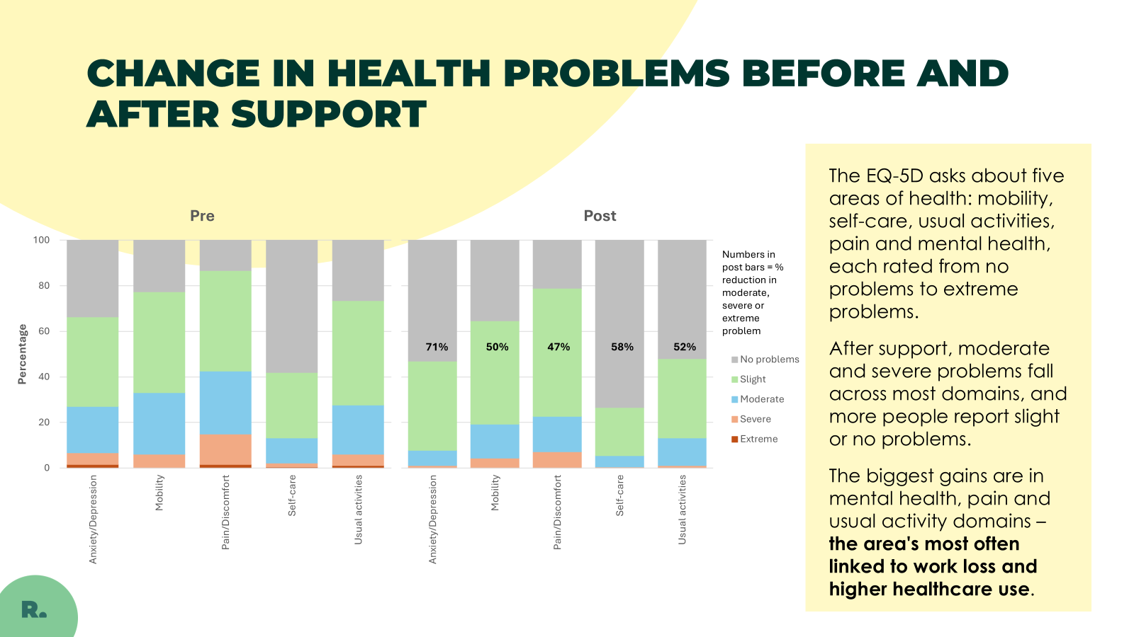
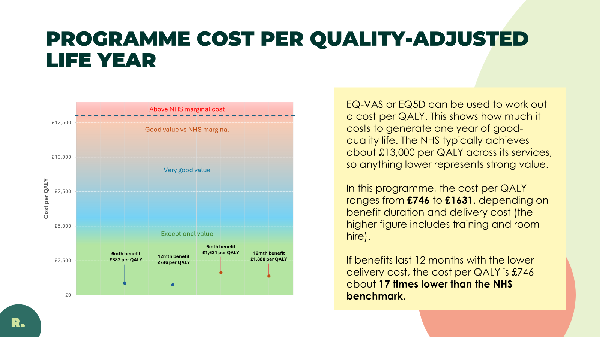
MOVEMENT ON PRESCRIPTION / WEBINAR SERIES
How we present our data to partners…..

Slide 28
MOVEMENT ON PRESCRIPTION / WEBINAR SERIES
What next….
Continue to advocate for movement on prescription using health outcomes and value for money to frame conversation
Expand use of health system tech services – digital nudge offer, evaluate impact against health utilisation

Slide 29
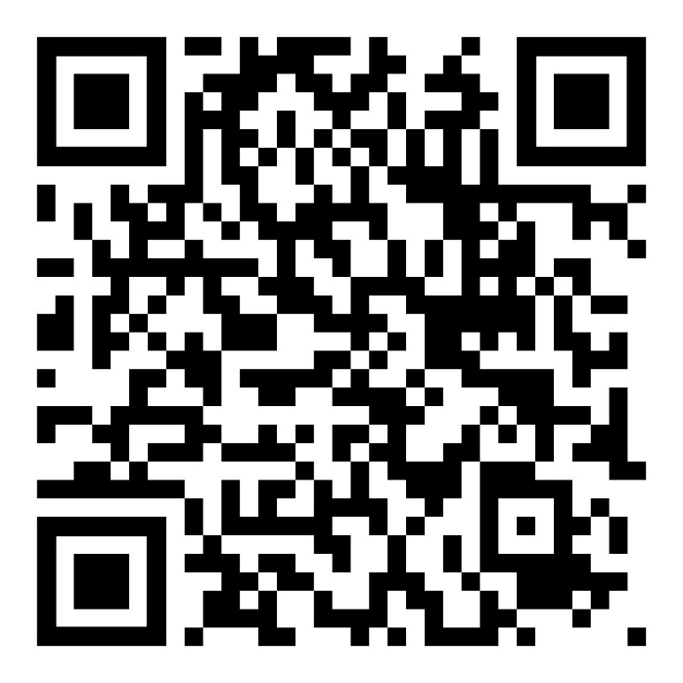
MOVEMENT ON PRESCRIPTION / WEBINAR SERIES
Please complete the poll on screen!
Keep the momentum going
Stay connected
Discover future Movement on Prescription and NASP webinars and events.
Contribute a Case Study
Today’s resources
Help us showcase how social prescribing is connecting people with movement opportunities
A webinar summary, slides and recording will be shared soon.
Get MoP updates - Sign up to the programme mailing list

