Slide 1
NASP Webinar Series: Supporting people with long-term conditions: A whole-person approach for Social Prescribing Link Workers
Thank you for joining us. The webinar will begin shortly.

Slide 2


Housekeeping
Please note we are recording this webinar (you will be sent the slides and the link to the recording, and they will be on NASP's website too.)
Please submit questions via the Q&A function. We will hold a Q&A session at the end of presentations.
Please use the chat function for introducing yourself and networking. If you have any technical issues, please raise these in the chat, and a member of the NASP team will assist.
Closed Captions are available (turn these on at the bottom of your screen)

Slide 3

Overview
Chair:
Monica Boulton, Strategic Lead for Healthcare Integration & Neighbourhood Health at the National Academy for Social Prescribing
Speakers:
Jenny Box, and Jat Sharma, Richmond Group of Charities
Sandra Mitchell Phillips and Thomas Lovedawn, Ways to Wellness
Bridget Mangan, Link Worker, Five Valleys Medical Practice

Slide 4

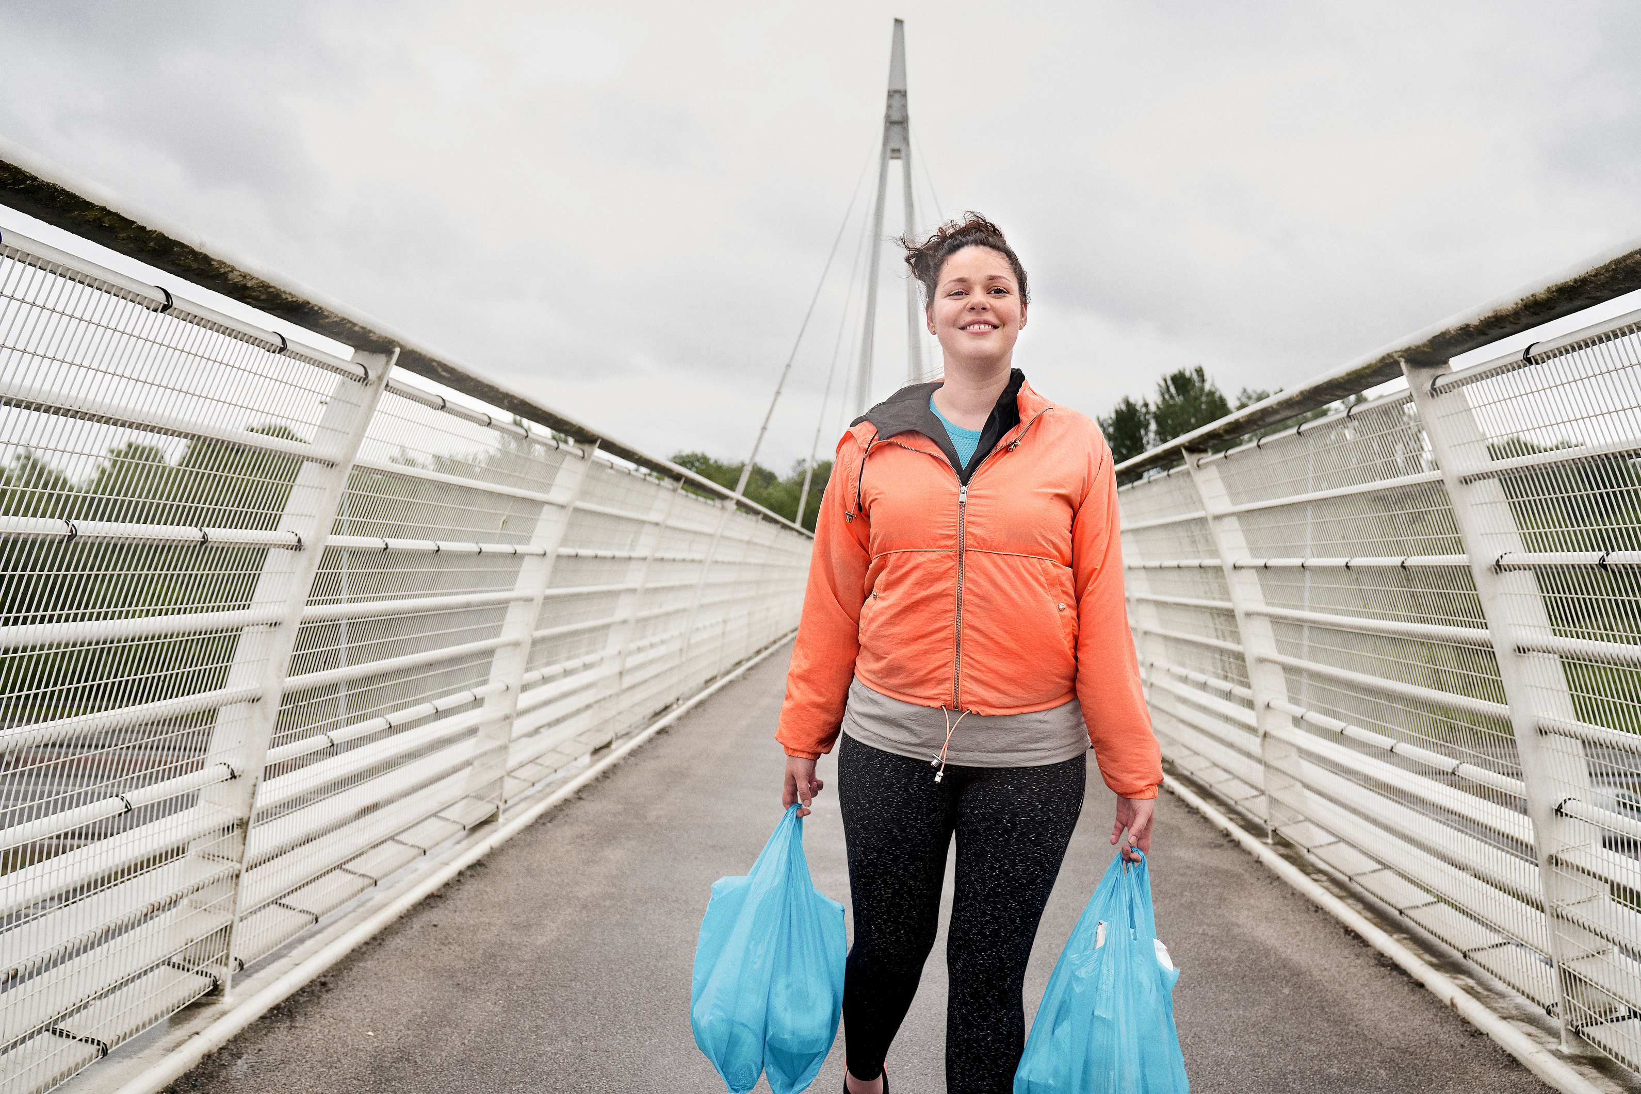



WE ARE UNDEFEATABLE
POWERED BY
THE RICHMOND GROUP
OF CHARITIES

Slide 5
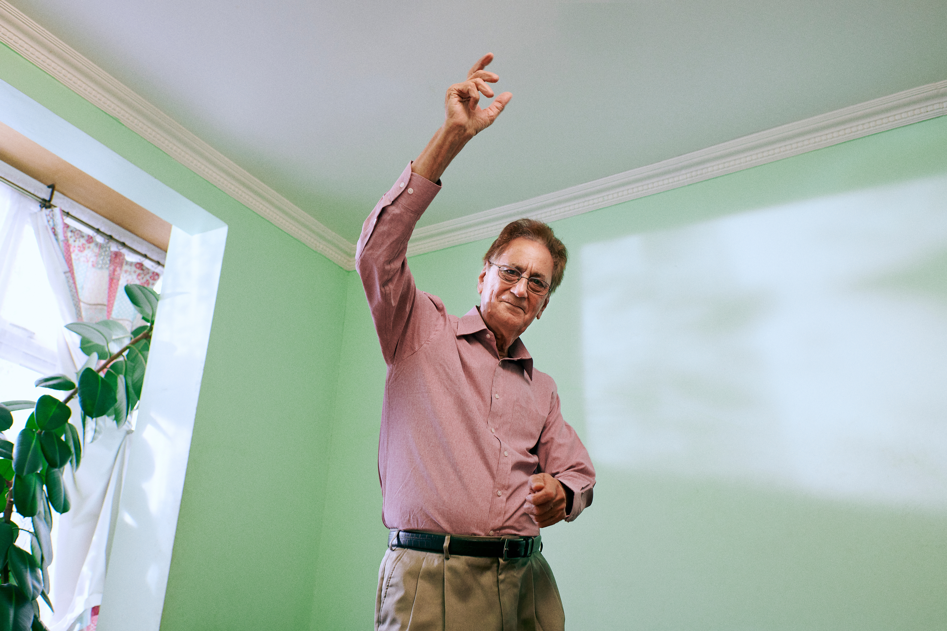
CONTENTS
01
02
03
04
INTRODUCTION
WHAT THE DATA SHOWS US
WE ARE UNDEFEATABLE LIVED EXPERIENCE INSIGHTS
JAT AND HIS STORY
05
WHAT’S HERE TO HELP?

Slide 6
01
INTRODUCTION
‘We Are Undefeatable’ is the physical activity programme delivered by the Richmond Group of Charities, a coalition of 15 leading health and care charities​.
Funded and supported by Sport England, we work together to support people living with long term conditions to move in the ways that work for them.
Our work is informed by people with long-term conditions, led by our We Are Undefeatable team, working in collaboration with members and external partners​.
The We Are Undefeatable programme which two key workstreams:
  A marketing behaviour change campaign and support offer
  System influencing, lobbying and place-based engagement.
We work collaboratively across the different team workstreams to influence system level change and create social norms about moving with a health condition.

Slide 7

THE PROBLEM: IN NUMBERS
43%
of adults over 16 in England live with at least one long term condition (LTHC)¹
People with LTHCs are twice as likely as those without a LTHC to be inactive
Physical inactivity is associated with
£7 in every £10 spent on health and social care
is spent on people with LTHCs⁵
The Health Foundation estimates that
Under
with 1 in 6 deaths in the UK⁴
30
mins
2.6m
people of working age living with
a health condition are out of work⁶
27%
% live with multiple long-term conditions²
of physical activity per week³
The estimated cost the UK is
The cost of
inactivity to
the care
system has been estimated at
£7.2bn a year⁵
£7.4bn
41% are inactive
vs 21% of people without LTHCs³
annually (including £0.9 billion to
the NHS alone)⁴
These numbers are rising…
Sources: ¹NHS Health Survey for England. ² National Institute for Health and Care Excellence. ³Sport England Active Lives 2022-2023. ⁴ OHID Physical activity: applying All Our Health - GOV.UK ⁵NICE estimate. ⁶The Health Foundation 2023 What we know about the UK’s working-age health challenge - The Health Foundation

Slide 8
PRIMARY BARRIERS TO ACTIVITY
02
Top 10 barriers to physical activity cited by people with LTHCs

Slide 9
THE ‘SYSTEM’ UNDERSTANDING OF THE
PHYSICAL BARRIERS FACED BY PEOPLE WITH LTHCs
02
People with LTHCs cite
top barriers to PA:
VS.
What others think are the top barriers for them:
Family/friends carers
Health & social
care professionals
Charity / voluntary professionals
Sport & physical activity professionals
Government professionals
1st
Pain
(21%)
Motivation/
mindset (23%)
Motivation/
mindset (36%)
Cost
(40%)
Cost
(21%)
Cost
(24%)
2nd
Lack of
energy (19%)
Pain
(19%)
Cost
(29%)
Lack info/ knowledge (32%)
Location/
access
(16%)
Motivation / mindset (23%)

Slide 10
THE STARTING POINT FOR TRUSTED ADVICE IS THE NHS
02
Most trusted sources of physical activity advice/information
People naturally turn to the healthcare system for advice on how to get active with a LTHC.
However, many verbatim responses point to the challenges faced by the NHS and the fact that the healthcare system cannot succeed alone in the mission of supporting more people with LTHC to be physically active.

Slide 11
02
1 IN 4 HAVE TAKEN ACTION TO BECOME MORE ACTIVE
AFTER A CONVERSATION WITH THEIR HEALTHCARE PROFESSIONAL
Proportion of those whose HCP spoke about being physically active:
Impact of conversation on physical activity:
Source: DJS tracking research on behalf of We Are Undefeatable, Summer 2023
Base: 1,435 who have visited/spoken with any type of HCP/ 606 who have had conversations with HCP about physical activity

Slide 12

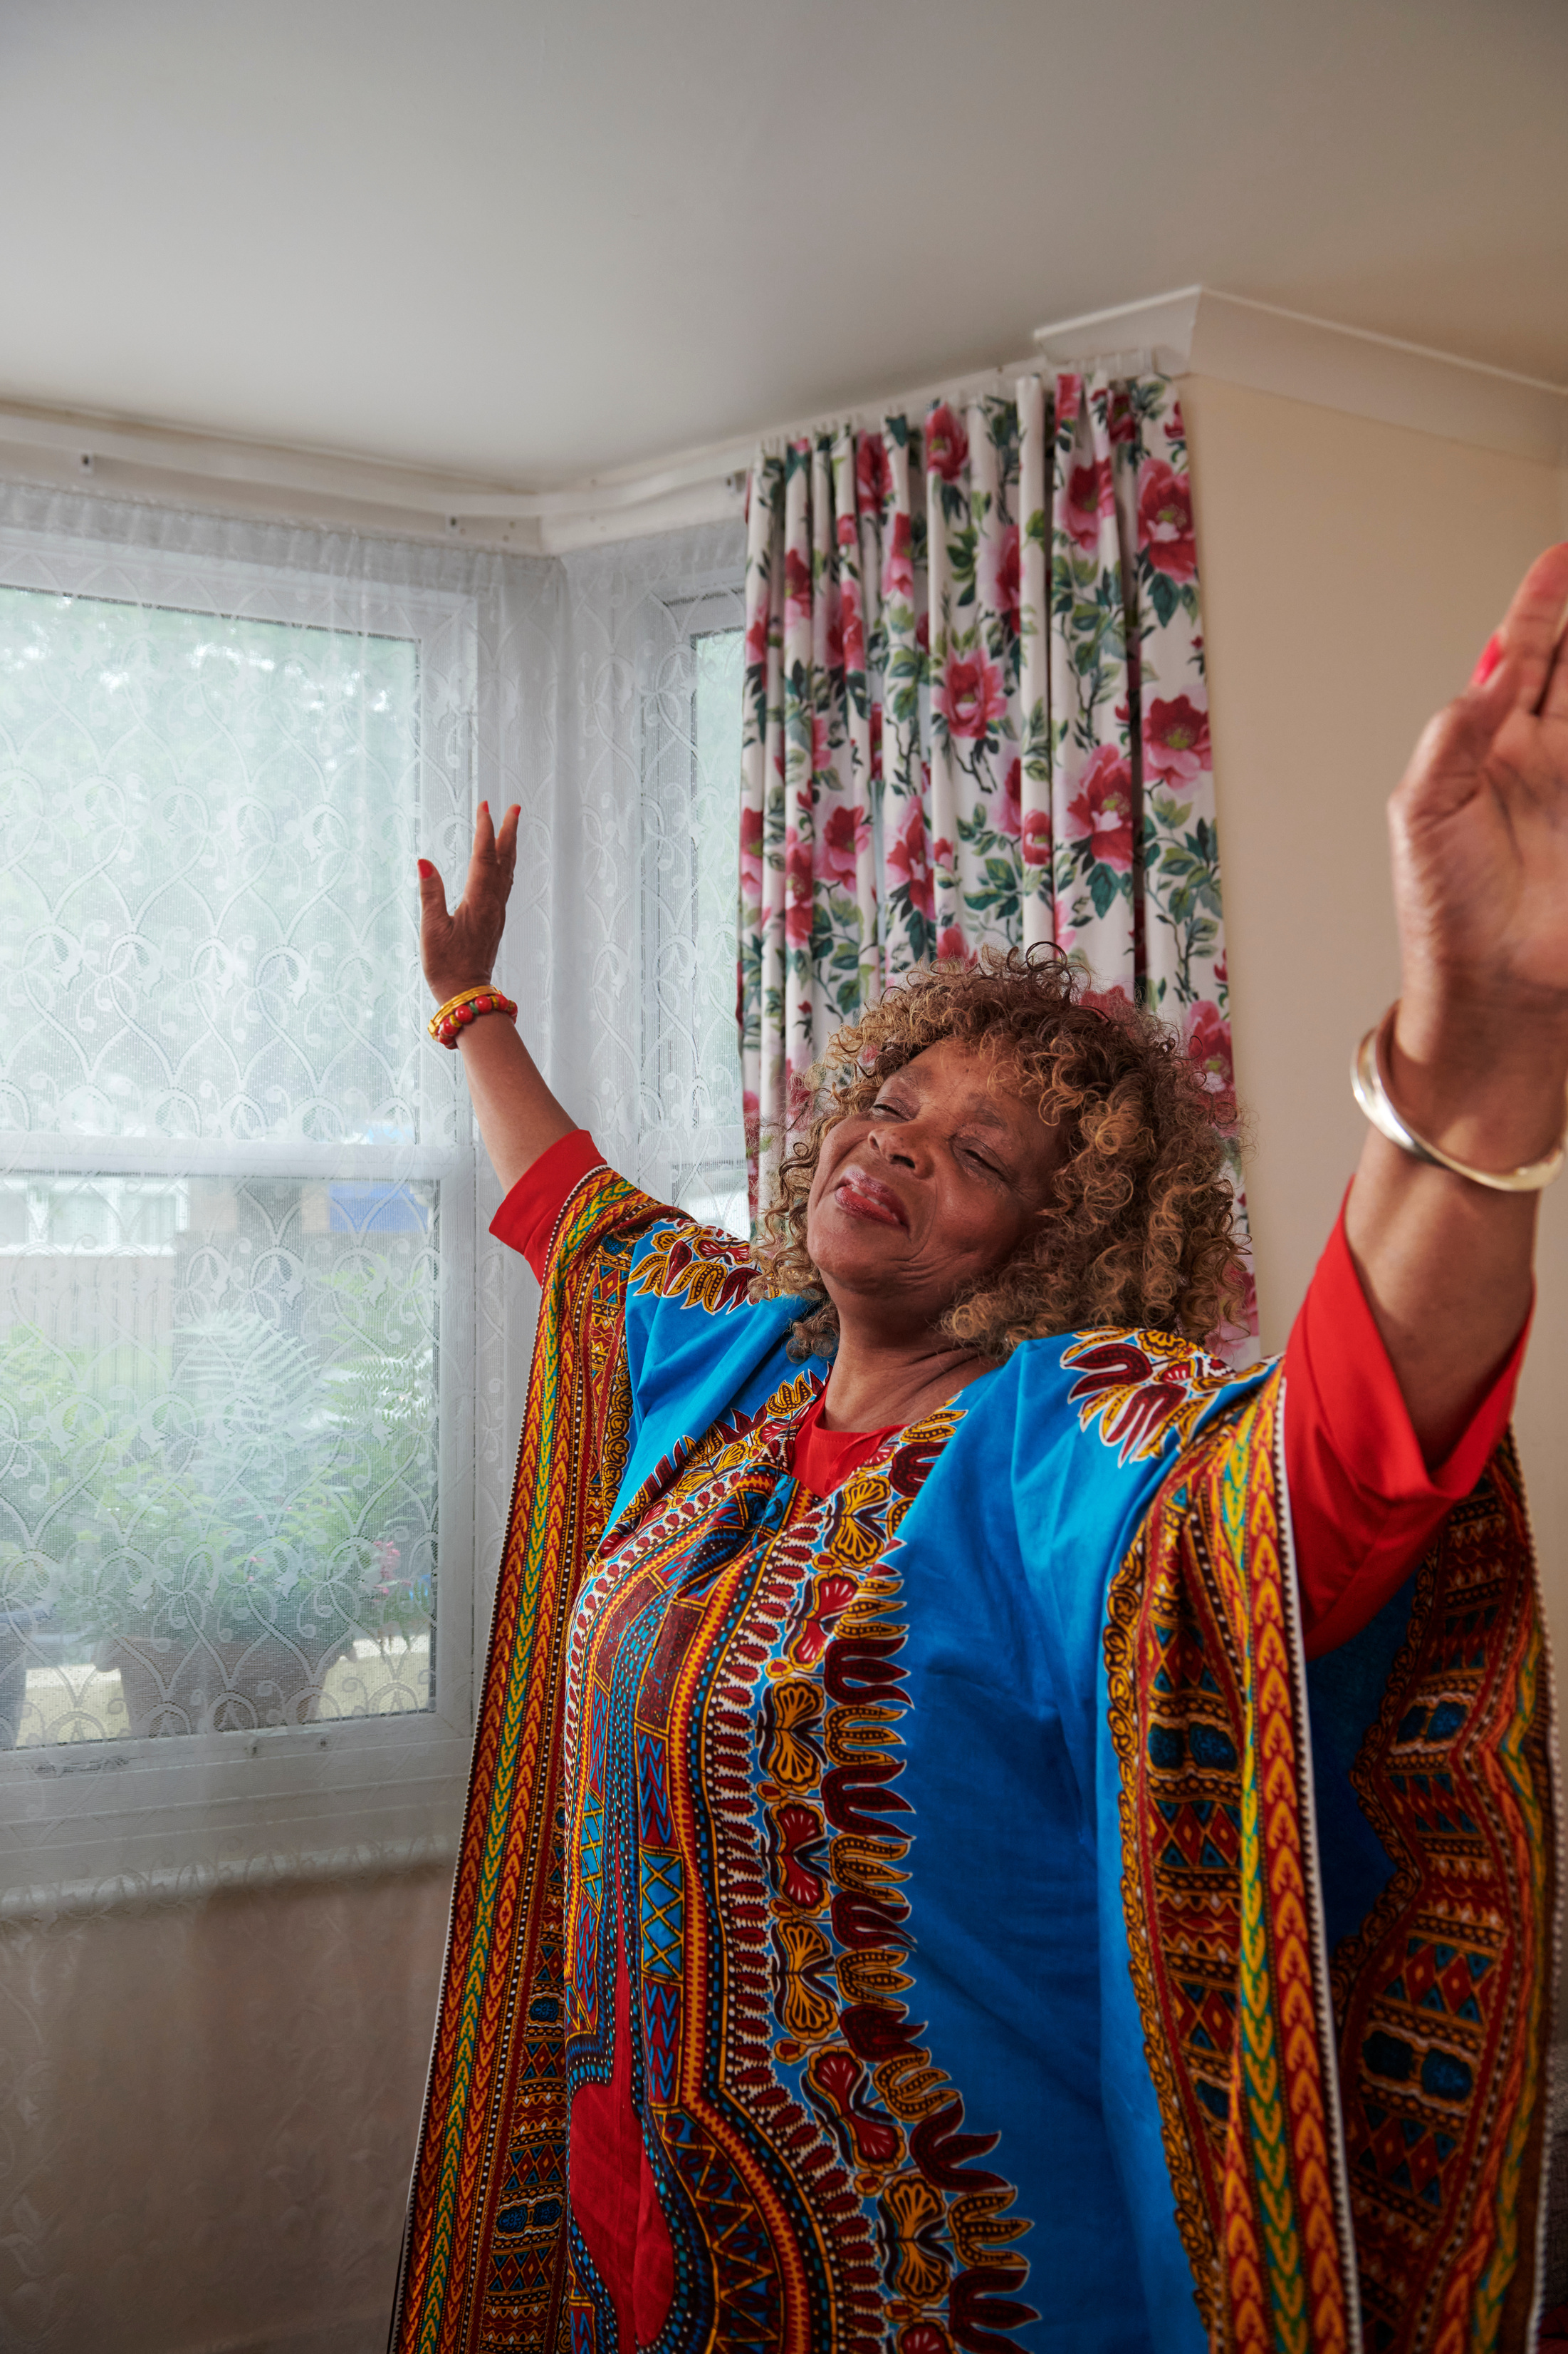
03
LIVED EXPERIENCE INSIGHTS
We Are Undefeatable embeds lived experience insights throughout all development and delivery of the programme.
Lived Experience data dashboard
Campaign quant tracker
Story tellers and user generated content
Lived Experience network

Slide 13
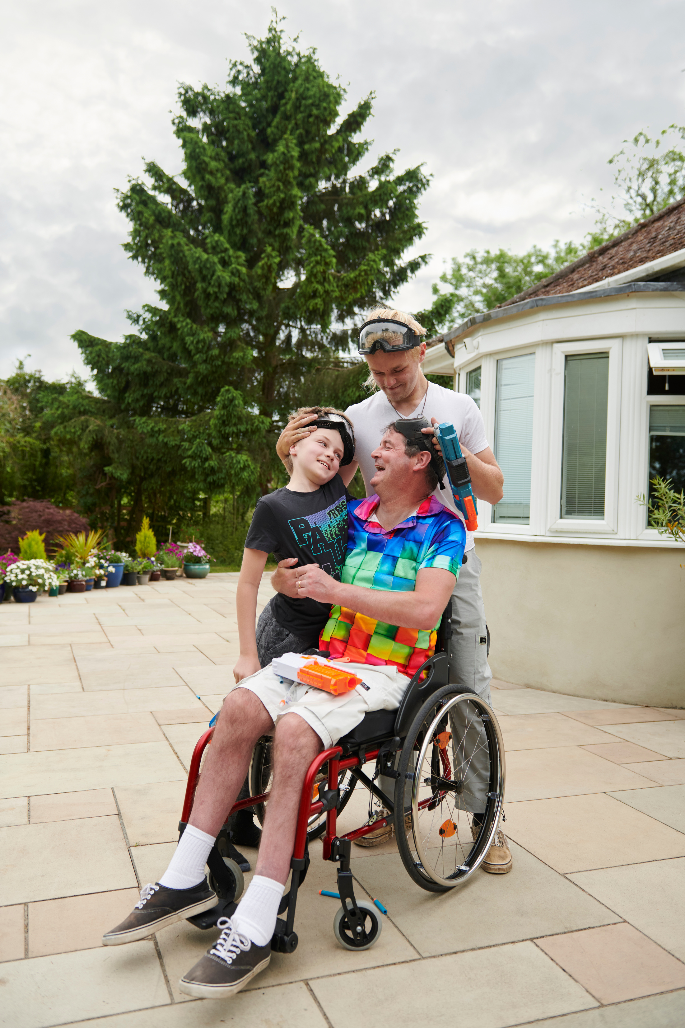
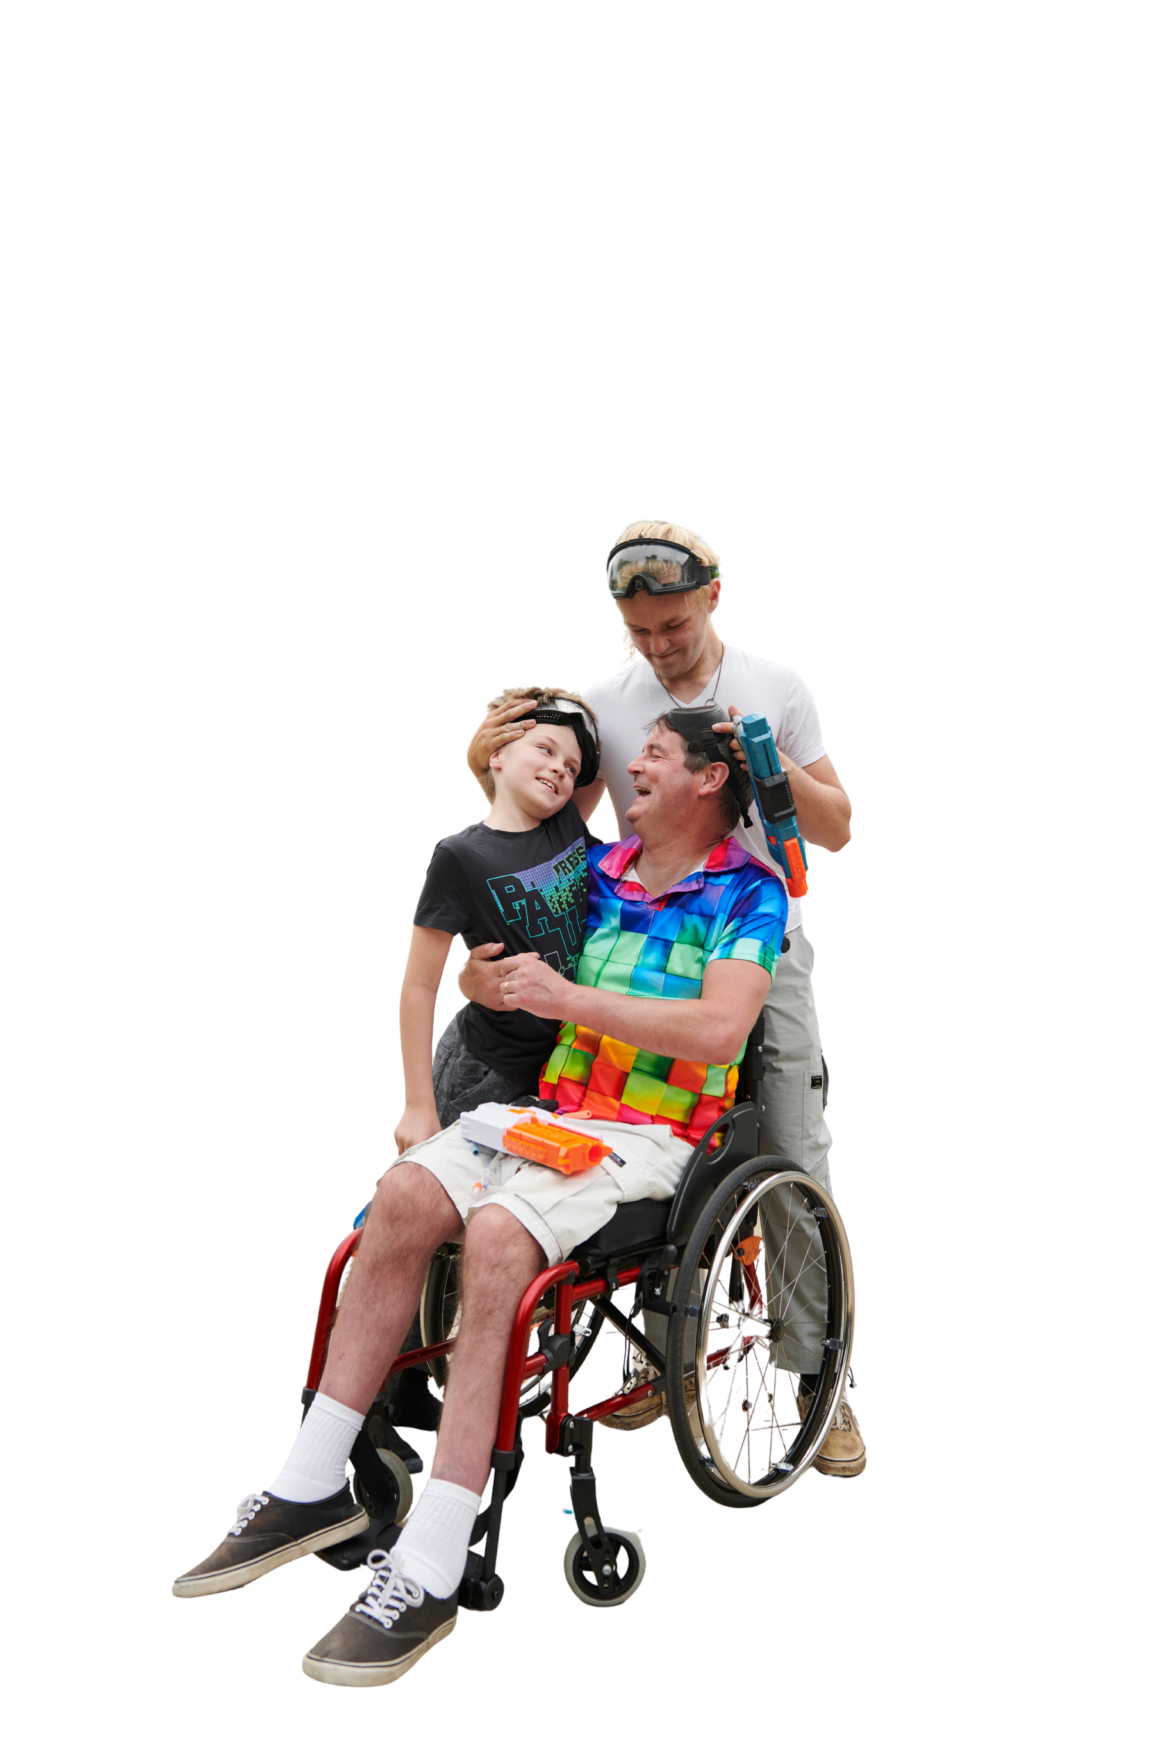
03
LIVED EXPERIENCE NETWORK (LEN)
Acting in an advisory capacity, helping shape decision making from the beginning.
Acting as advocates for the programme.
Sharing personal experiences with the system as additional insight to existing channels.
Providing additional perspectives and feedback.
Supporting the case for the involvement of people with lived experience to reinforce the value and reliability of lived experience insights and voices.

Slide 14

03
LEN INVOLVEMENT
Two Programme Board members – contributing to overall programme governance and strategic/high level oversight of the programme​
We Are Undefeatable storytellers have supported various events and webinars as speakers (Parliamentary event, Policy report webinar, Blackburn with Darwen report launch, today!)​
Social Media community engagement and content creation​, and wider media opportunities
Big Talk Public Consultation, surveys and data dashboard insights​
App and website user testing​
Campaign responses to brief feedback
Insight to wider sector projects, including the Moving Together programme for Active Partnerships/Faculty of Sport & Exercise Medicine
Qualitative research as necessary regarding such things as messaging, and adhoc topics​

Slide 15

04
JAT’S STORY

Slide 16
05
WHAT’S AVAILABLE TO HELP?
The We Are Undefeatable programme has a wide range of tools and resources to support with understanding lived experience in providing services to people living with long term health conditions. While these don’t replace the benefit and importance of local knowledge and insight, they’re a toolkit to help along the way.
01
02
03
ACTIVITES AND WORKOUTS
INSIGHTS AND RESOURCES
DATA!
Lived Experience Dashboard:
https://insight-angels.datatile.eu/view/41898085-02d3-4d9a-849b-91cf98092b3f
7 years of survey data, available for free.
https://weareundefeatable.co.uk/resources/
We Are Undefeatable App
5 in 5
https://weareundefeatable.co.uk/campaign-hub/resources-for-use/
Lived Experience insights, Campaign reports and communications packs.

Slide 17
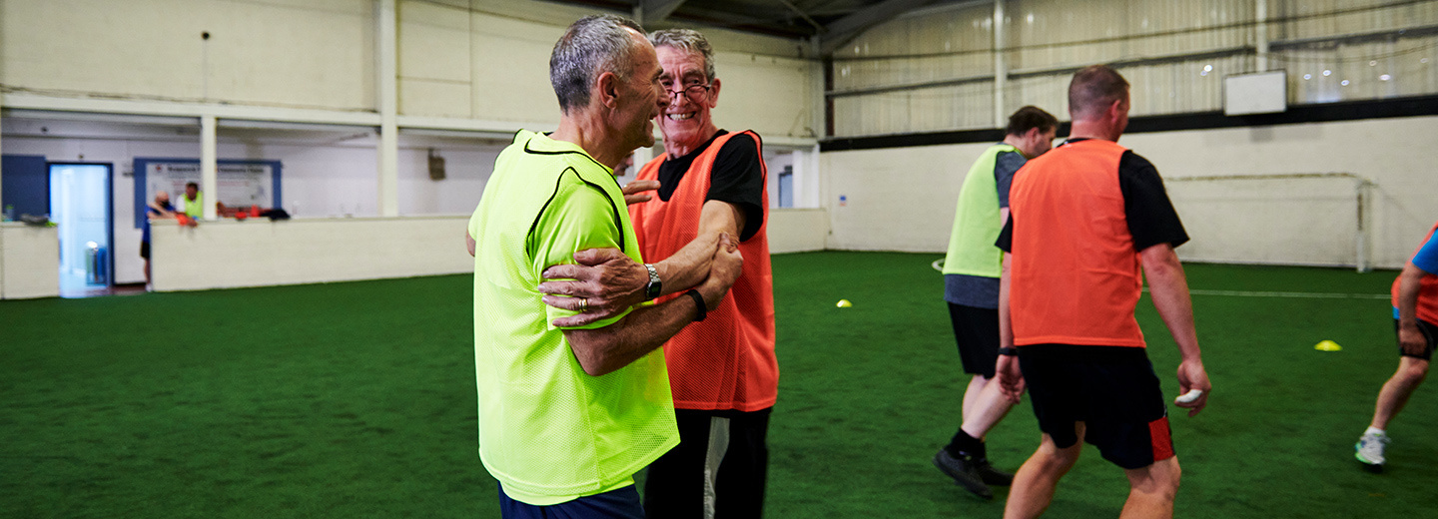
THANK YOU
WE ARE UNDEFEATABLE | THE RICHMOND GROUP OF CHARITIES

Slide 18
Long Term Conditions
Sandra Mitchell-Phillips & Thomas Lovedawn

Slide 19
Created in 2015
Protype and test the impact of link workers
Targeted approach to health inequalities
Long term conditions and specific age range

Slide 20
Chronic Obstructive Pulmonary Disorder
Asthma
Diabetes (type 1 or 2)
Coronary Heart Disease / Congestive Heart Failure
Epilepsy
Osteoporosis

Slide 21
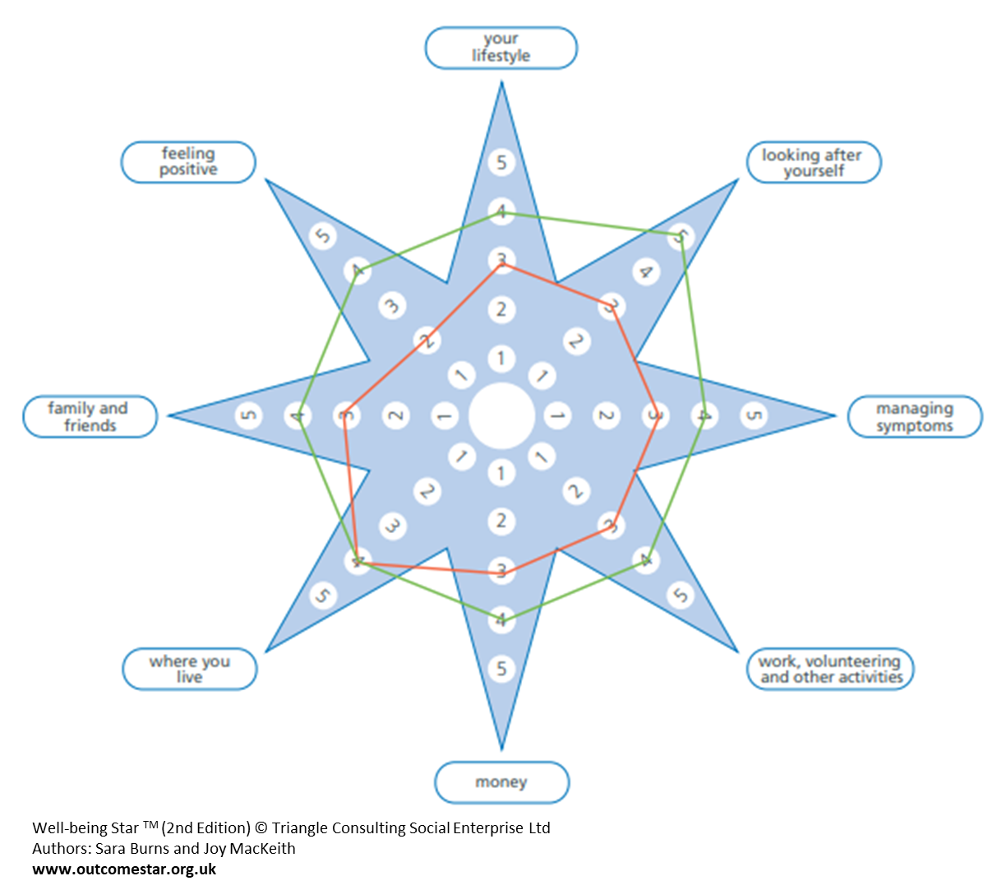

Slide 22
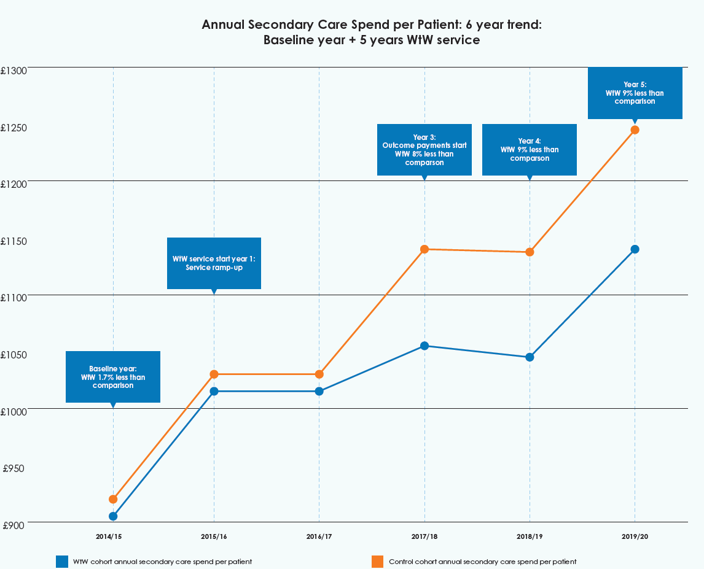

Slide 23
£4.6m over 5 years

Slide 24
14% reduction in GP appointments (approx.)

Slide 25
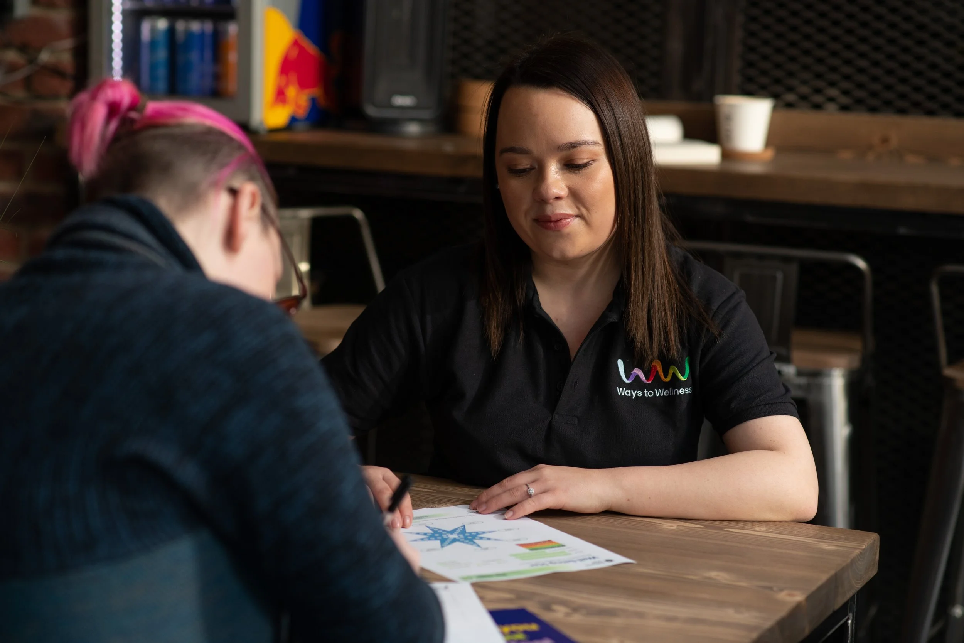
Supporting people with long term conditions: A holistic approach
Living with a long-term condition is much more than just managing physical symptoms.
Link Workers need to understand the whole person- including what matters to them, their challenges and strengths.
At Ways to Wellness, we use the Wellbeing Star to support people and measure their progress over time.
Rather than focusing on one aspect of health, it explores multiple areas of a person's life.

Slide 26
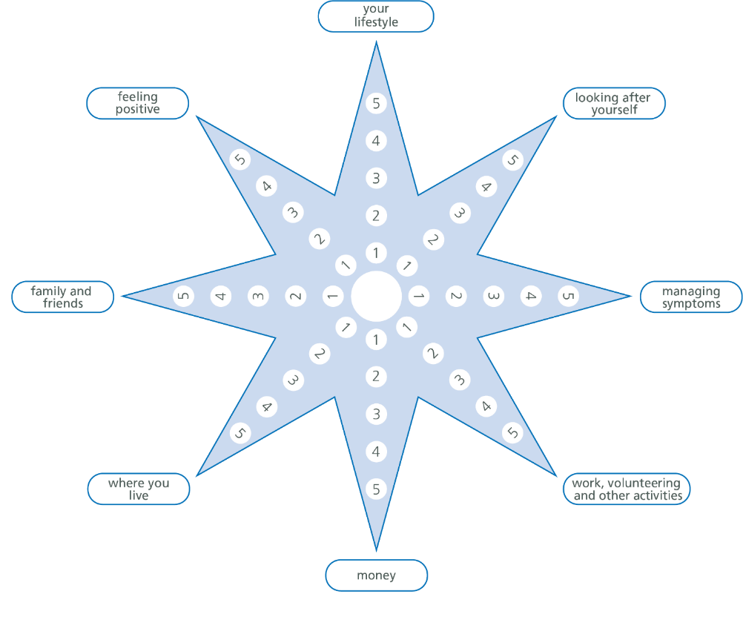
The Wellbeing Star tool explores:
Lifestyle (diet, sleep and exercise)
Their ability to look after themselves
How they’re managing their symptoms
Work, volunteering and daily activities
Finances
Housing issues
Their relationships with others
Mental health and emotional wellbeing

Slide 27
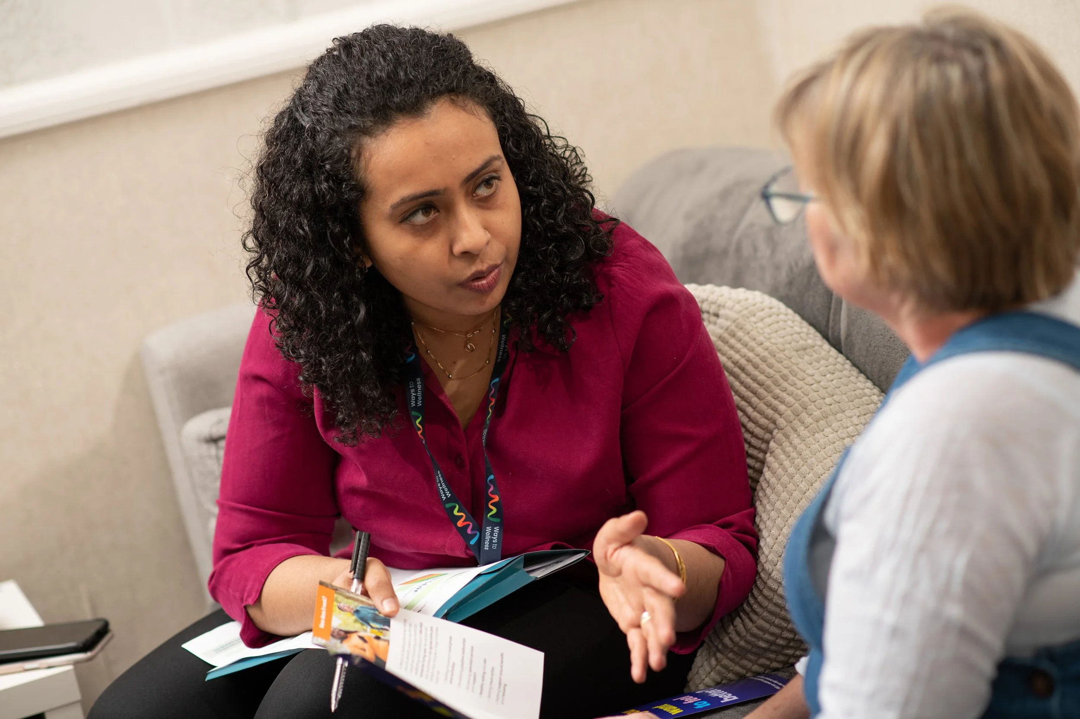
How we use the Wellbeing Star tool:
A collaborative, person-centred process.
Focuses on what matters to the individual, not what we think they need.
Helps us identify priorities and create meaningful action plans.
Used at the start, reviewed every 3-6 months and at the end of their journey.
Provides clear, measurable progress data.
Highlights improvements and areas needing further support.
Helps build strong case studies and demonstrate impact.

Slide 28
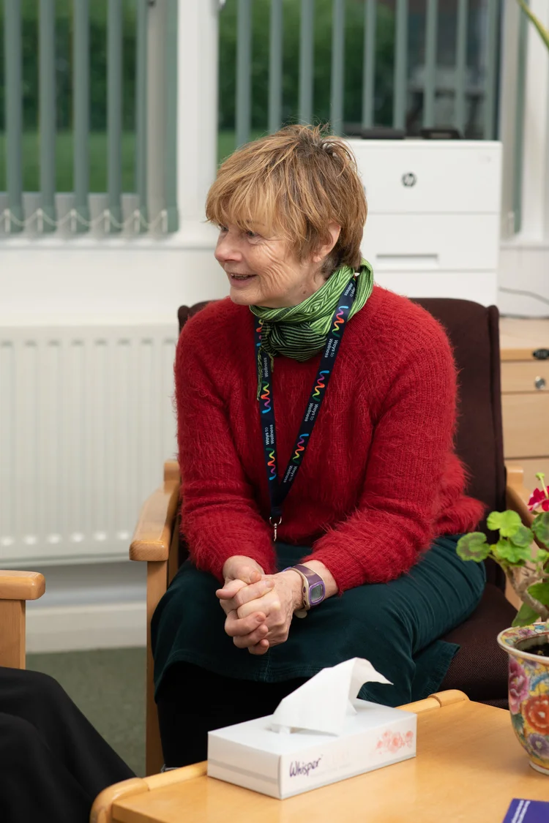
Common challenges faced when supporting someone with a long-term condition:
Managing multiple and complex needs.
Building trust and maintaining engagement.
Supporting behaviour change can be challenging.
Poor mental health alongside physical conditions.
System barriers (e.g. long waiting lists, limited local resources, eligibility restrictions and digital exclusion).
Progress can often seem slow and non-linear.
Managing boundaries.
Emotionally demanding nature of the role.

Slide 29
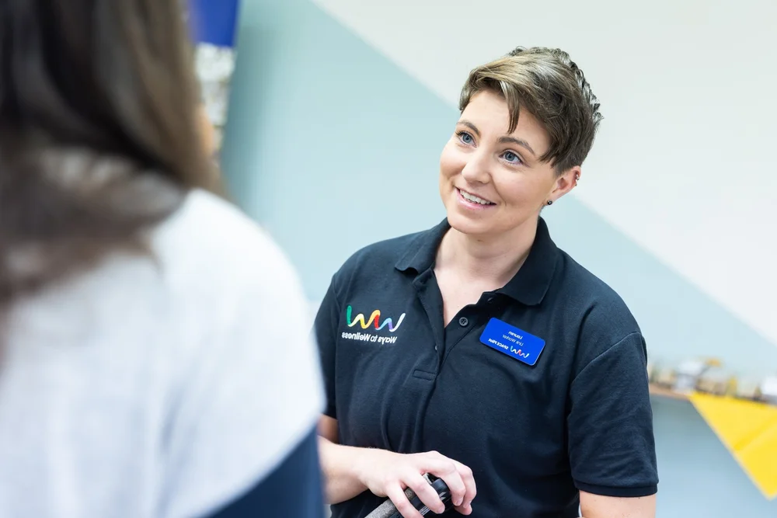
Summary
Demonstrating impact to commissioners can be difficult.
The impact of social prescribing is far reaching.
The importance of collecting data and how to use that data.
Telling the story using the data available to you.

Slide 30

Social Prescribing within the Gloucestershire Post Covid Assessment Service
Bridget Mangan – Social Prescriber

Slide 31
The Post Covid Assessment Service in Gloucestershire was originally established as an assessment and rehabilitation service in 2021.
Social Prescribing was introduced into the service in October 2023. At that time, the team included a GP, specialist rehabilitation physiotherapists, occupational health, and clinical psychology.
The service was scaled down in March 2025 and continues to offer Long Covid assessment and support with a smaller team, including a GP, a Social Prescriber, and access to a psychological therapist.

Slide 32
What has Social Prescribing added to the Long Covid Service?
Social Prescribing added to the offer by giving patients the opportunity to talk about the social, emotional, practical, and financial impacts of living with Long Covid.
It supports them to explore ways of managing these impacts through personalised planning and access to peer support, commissioned groups, local services, community hubs, and activities.
Given the nature of Long Covid, supported self-management is central to living well with the condition. Social Prescribing provides the space for patients to reflect on what exacerbates symptoms and what helps to reduce them. These conversations enable individuals to develop plans and strategies, including how to adjust their routines to integrate pacing. They also create space to acknowledge both progress and setbacks.

Slide 33
Whilst Long Covid has wide-ranging impacts, there are common themes, symptoms, and shared experiences among those living with the condition.
As a Social Prescriber focusing on this condition, my understanding of these impacts has enabled me to develop a resource database of relevant local and national programmes, services and peer support and a comprehensive set of resources for patients on a variety of aspects of the condition.
Being part of the Long Covid support team has enabled me, as a Social Prescriber, to hone my skillset in supporting people with the condition, learning from patient’s experiences and from the expertise of other members of the team.
One of the most significant areas of learning for me has been how to work with uncertainty with a condition where there are few definite answers. Supporting people with Long Covid has taught me the value of listening and providing a space for people to be heard, validated and understood, often for the first time, and to focus on what might be most helpful going forwards.

Slide 34
Social Prescribing within a multidisciplinary team (MDT)

Slide 35
Social Prescribers working in primary care do not always have access to MDT meetings or opportunities for close co-working with clinical colleagues.
The Gloucestershire Long Covid Service holds regular MDT meetings for patient discussions involving all members of the team.
Bringing a Social Prescribing perspective to the MDT brings the whole-person approach to the thinking around each patient. Discussions encompass practical, social, and wellbeing impacts, alongside clinical and psychological perspectives.

Slide 36
Bringing Social Prescribing into the MDT, not only places it more centrally within patient care, broadening the range of support offered, it also raises awareness and understanding of the Social Prescribing role among healthcare professionals, supporting better integration and more holistic patient care.
This increased insight into the Social Prescribing role, which is often more at arm's length in Primary Care settings, has resulted, over time, in almost every patient referred into the Long Covid Service having access to Social Prescribing support.

Slide 37




Get in touch
socialprescribingacademy.org.uk
@NASPTweets
@NASP_insta
Q&A

