Slide 1
NASP webinar: Community-led Social Prescribing - Lessons from Big Local and Beyond
Thank you for joining us. The webinar will begin shortly.

Slide 2
Housekeeping
Please note we are recording this webinar (you will be sent the slides and the link to the recording, and they will be on NASP's website too.)
Please submit questions via the Q&A function. We will hold a Q&A session at the end of presentations.
Please use the chat function for introducing yourself and networking. If you have any technical issues, please raise these in the chat, and a member of the NASP team will assist.
BSL Interpreters will be on screen throughout. Closed Captions are available (turn these on at the bottom of your screen)
There will be a short poll at the end asking you for your feedback about the webinar.

Slide 3
Overview
Chair:
Joelle Bradly, Deputy Director of Evidence and Impact, National Academy for Social Prescribing
Speakers:
Lucy Terry, Research Manager, Local Trust
Chris Dayson, Professor of Voluntary Action, Health and Wellbeing, Sheffield Hallam University
Rachel Rowney, Chief Operating Officer, Local Trust
Jim Burt, Director of Strategy, National Academy for Social Prescribing

Slide 4
Lucy Terry, Research Manager, Local Trust Why Local Trust commissioned the research

Slide 5
Chris Dayson, Professor of Voluntary Action, Health and Wellbeing, Sheffield Hallam University Community-led Social Prescribing: Lessons from Big Local and Beyond Report available here

Slide 6
Community-led Social Prescribing: Lessons from Big Local and Beyond
Dr Ellie Munro & Prof. Chris Dayson
21st January 2025
e.munro@shu.ac.uk ~ c.dayson@shu.ac.uk

Slide 7
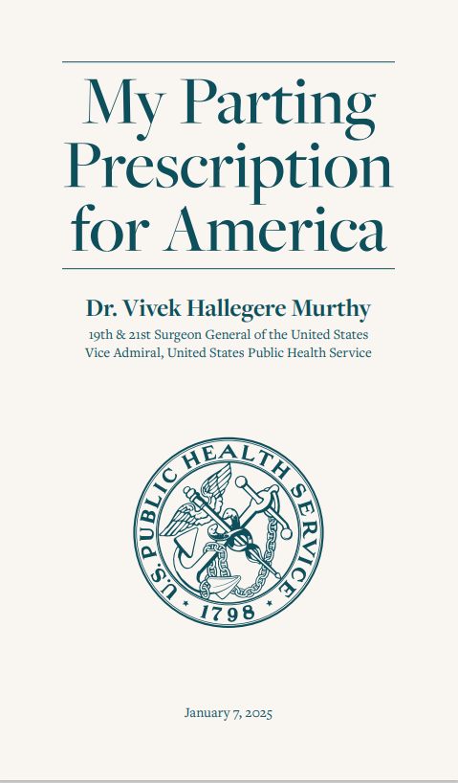
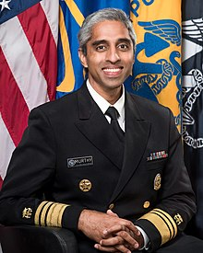
“As I finish my tenure as Surgeon General, this is my parting prescription, my final wish for all of us:
Choose community”
https://www.hhs.gov/sites/default/files/my-parting-prescription-for-america.pdf

Slide 8
Introduction

Slide 9
Background
Three-way research partnership between:
Local Trust: interested in understanding more about how Big Local partnerships have been involved in social prescribing in their neighbourhoods
National Academy for Social Prescribing: committed to developing the evidence base for social prescribing – impact, but also ‘what works’ and how it can be improved and made more sustainable
Sheffield Hallam: 10+ years involvement in social prescribing research – committed to re-centring communities within social prescribing research and policy
Social prescribing arguably ‘over researched’ - but still a glaring gap in the evidence base around how communities can be involved more effectively.
This project was an opportunity to fill that gap!

Slide 10
What is social prescribing?
SP not new, but explosion of policy interest in SP in past 10 years, leading to several shifts:
From bottom-up to top-down?
From community-led to system-led?
From non-medical to clinical framing?
Now an internationally accepted SP definition:
(SP is) a means for trusted individuals in clinical and community settings to identify that a person has non-medical, health-related social needs and to subsequently connect them to non-clinical supports and services within the community by co-producing a social prescription—a non-medical prescription, to improve health and well-being and to strengthen community connections (Muhl et al., 2023, p. 9).

Slide 11
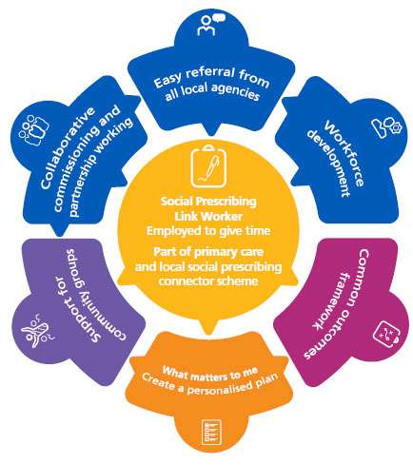
How does social prescribing work in England?
Individual needing support
GP referral
Link worker assessment
Existing community activities

Slide 12
What do we mean by community-led social prescribing?
This is not about a new social prescribing model.
Reframing SP as a bottom-up community-based approach to health creation – as was originally intended
We developed a working definition for this research, and refined it in response to what we found, to encompass community leadership and involvement
“Community involvement in and/or leadership of social prescribing is where residents have been able to influence and/or take a lead in the design, delivery and evaluation of local social prescribing programmes, based on residents’ needs and identified solutions.”
Intended to be a start point rather than an end point.
To aid discussion amongst and between policy makers, practitioners and researchers moving forward.

Slide 13
Our approach to the research

Slide 14
Mixed methods
Project undertaken September 2023-December 2024
A range of methods were used:
Evidence review
Interviews with 12 Big Local areas with experience of social prescribing
Interviews with 7 non-Big Local voluntary organisations and community groups involved in community led social prescribing
Interviews with 6 social prescribing system stakeholders– link workers, commissioned voluntary organisations, commissioners and strategic leads
3 area-level workshops with Big Local residents and others
Project also guided by an Advisory Group – involving other academics and sector leaders

Slide 15
Key findings

Slide 16
What did we find?
Strong awareness of health and wellbeing needs locally, and framing of the benefits of community activity for meeting those needs
Setting up new groups and activities in their communities to plug gaps
"Selling" activities into local health systems
Receiving referrals from LWs (and others in/beyond the health system)
Pilot programmes and partnership boards
Running (or trying to run) social prescribing projects
BL areas not involved in complex commissioning arrangements & conversations – other areas were (e.g. Sheffield).
Level of leadership (low to high) | Level of involvement (operational to strategic)
 | Operational level of involvement High leadership | Strategic level of involvement High leadership
 | Operational level of involvement Low leadership | Strategic level of involvement Low leadership

Slide 17
“A lot [of the work of the Big Local partnership] was informal social prescribing. We partnered with the GP practice so they could refer into those type of things. Because before people [thought it was] just a coffee session, just an activity, just a walk. And we realised it’s not just a walk; it’s good for physical and mental health. It’s good for supporting people with social isolation.” Big Local partnership member and former worker

Slide 18
Benefits, risks, barriers....
Real potential benefits if:
The right support and resources
Flexible funding and commissioning scopes
Time to build trusting relationships
Reality = mixed picture
Variation in link worker practice and expectations
Safety, capacity and levels of need determine what is possible on the ground
Benefits | Risks
Community knowledge, connection and ownership | Lack of meaningful representation at neighbourhood level
Drawing focus to the role of community groups | Underinvestment in both services and communities

Slide 19
“I think people still think you can get something for nothing with communities which I don’t think is fair… But I think community delivering with support, activities that are needed locally, is a great idea and I think it is also a way that you will get those volunteers of tomorrow through the door in some way, shape or form.”
Big Local partnership member

Slide 20
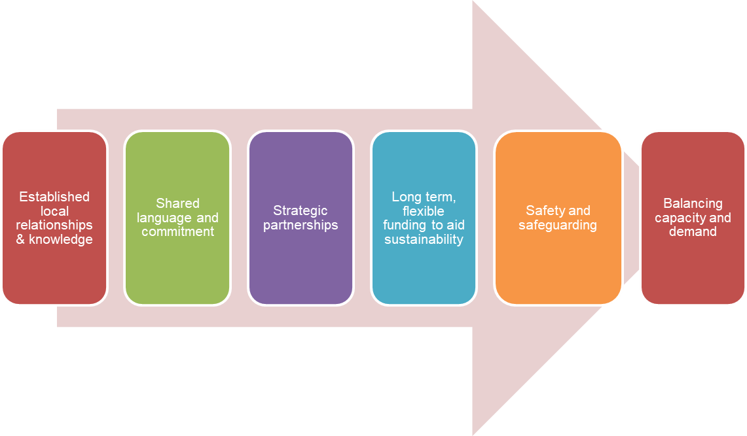
Enablers of community involvement and leadership

Slide 21
Policy implications and recommendations

Slide 22
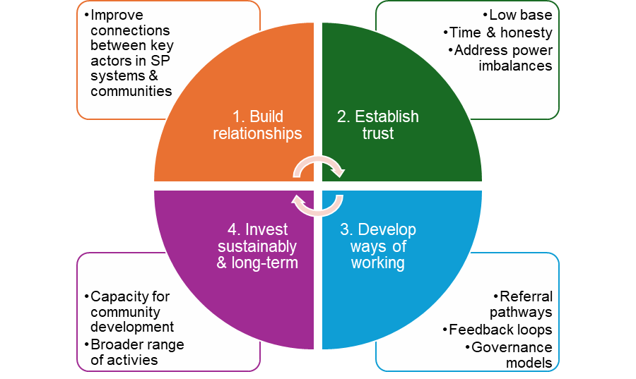
How do we create community-led social prescribing systems?
CLSP remains an ambition, not the reality, in most areas...
Our evidence suggests four key steps are needed If the ambitions of CLSP are to be realised...

Slide 23
How do we create community-led social prescribing systems?
Next 6 months could be a tipping/turning point...action and change needed at all levels...

Slide 24
Community-led Social Prescribing: Lessons from Big Local and Beyond
Thank You! Please feel free to ask us any questions
e.munro@shu.ac.uk ~ c.dayson@shu.ac.uk

Slide 25
Rachel Rowney, Chief Operating Officer, Local Trust Response to the research

Slide 26
Jim Burt, Director of Strategy, National Academy for Social Prescribing Envisioning a Social Prescribing Fund in England

Slide 27
Envisioning a Social Prescribing Fund in England
Jim Burt
Executive Director, Strategy

Slide 28
Social Prescribing
Social prescribing is “a means for trusted individuals in clinical and community settings to identify that a person has non-medical, health-related social needs and to subsequently connect them to non-clinical supports and services within the community by co-producing a social prescription—a non-medical prescription, to improve health and well-being and to strengthen community connections.”
Muhl C, Mulligan K, Bayoumi I, Ashcroft R, Godfrey C. (2023) Establishing internationally accepted conceptual and operational definitions of social prescribing through expert consensus: a Delphi study. BMJ Open. Jul 14;13(7)
Co-produced prescription and support to connect
Trusted individuals
Clinical or community setting
Support and services
In the community
Improved health and wellbeing

Slide 29
Gov’ts strategic health shifts
Moving care from hospitals to communities
Focussing on preventing sickness, not just treating it
Making better use of technology

Slide 30
Resource landscape
Demand for social prescribing is growing
£100 million spent each year on 3,600 link workers. (3m referrals to date)
NHS Long Term Workforce Plan estimates 9,000 link workers by 2036/2037.
Social prescribing is growing rapidly across the public sector.
Supply of community groups and activities is shrinking
Income for small/micro charities reduced by a quarter in a year (£700m)
Three quarters of charity grants are now for less than 12 mths.
NCVO ‘charities are in a dire situation as they try and meet the demands of rising need in communities while their own costs escalate and funding declines’
Urgent need to address the inadequate, fragmented and short-term funding to build social prescribing capacity.

Slide 31
National Social Prescribing Fund
Envisaging a Social Prescribing Fund sets out options for establishing new models of shared investment funds to build social prescribing capacity, that would:
Support the growth of existing social prescribing activities and services
Widen the reach and range of SP addressing gaps in provision and improving access for all
Empower local VCFSE organisations and community groups to develop greater community-led decision making in the fund management
Tackle inequalities through effective targeting and distribution of funds

Slide 32
Co-designing the solution
100 organisations from the private, public and philanthropic sectors – strong consensus for:
Proportionality: For every pound the NHS invests in social prescribing link workers (£100m annually), we need at least as much investment to increase community capacity.
Leverage: Incentivise new investments and the pooling existing funds.
Build on existing structures and partnerships: Integrated Care Partnerships and their VCSE Alliances
Long-term funding to unleash the productivity of the VCSFE

Slide 33
Generating a Social Prescribing Fund
Total annual fund of £100m. Double the size of a national investment (£50m), with local matched funding - average of 90p per head of ICS population. ‘Buy one get two’ model, creates a highly attractive investment vehicle.
Secure a 10-year commitment to locally-generated funding, enabling a long-term approach to capacity-building for community organisations (totalling £1billion).
Achieve greater impact through effective collaboration: ICPs partnership broker with NHS, VCFSE , local government, and local employers/philanthropists.
Avoid any places being left behind: through a comprehensive England-wide approach which also targets investment to where it is most needed;
Local by default: Reflect the different assets, needs and ambitions of different places and communities, through a locally-led approach to determining the footprints of local Funds, their organisation, governance and grant-making with a focus on co-production with local communities.
Sustainability: Demonstrate quantified impacts of the Fund (improved wellbeing, reduced loneliness etc), by building in the use of data and an evidence to drive and inform sustained investment;
Make rapid progress: from discussions with Integrated Care Partnerships in England, we know there is a strong ambition right now to develop a Social Prescribing Fund along the lines envisaged in the report.

Slide 35
Get in touch
socialprescribingacademy.org.uk
@NASPTweets
@NASP_insta
Q&A

