Slide 1
NASP webinar: Learning from Phase One of the National Cross Government programme: Preventing and Tackling Mental Ill-health through Green Social Prescribing
Thank you for joining us. The webinar will begin shortly.

Slide 2
Housekeeping
Please note we are recording this webinar (you will be sent the slides and the link to the recording, and they will be on NASP's website too.)
Please submit questions via the Q&A function. We will hold a Q&A session at the end of presentations.
Please use the chat function for introducing yourself and networking. If you have any technical issues, please raise these in the chat, and a member of the NASP team will assist.
BSL Interpreters will be on screen throughout. Closed Captions are available (turn these on at the bottom of your screen)
There will be a short poll at the end asking you for your feedback about the webinar.

Slide 3
Overview
Chair:
Jules Ford – National Implementation Manager for the Cross Government Green Social Prescribing Programme
Speakers:
Professor Chris Dayson – Professor of Voluntary Action, Health and Wellbeing, Sheffield Hallam University
Dr Becca Lovell - Senior Lecturer in Biodiversity, Health and Policy, University of Exeter
Dr Harriet Hunt - Research Fellow, University of Exeter
Dr Louise Montgomery – National Lead for the Natural Environment, NASP

Slide 4
Professor Chris Dayson – Professor of Voluntary Action, Health and Wellbeing, Sheffield Hallam University Dr Becca Lovell - Senior Lecturer in Biodiversity, Health and Policy, University of Exeter Dr Harriet Hunt - Research Fellow, University of Exeter

Slide 5
Haywood, A. et al. National Evaluation of the Preventing and Tackling Mental Ill Health through Green Social Prescribing Project. 2024. Defra.
National Evaluation of the Preventing and Tackling Mental Ill Health through Green Social Prescribing Project

Slide 6
Haywood, A. et al. National Evaluation of the Preventing and Tackling Mental Ill Health through Green Social Prescribing Project. 2024. Defra.
What is Green Social Prescribing?
Green Social Prescribing (GSP) is the practice of supporting people to engage in nature-based activities to tackle and prevent mental ill health.
Social Prescribing Link Workers, and other trusted professionals in allied roles, connect people to community groups for practical and emotional support, based on a ‘what matters to you’ conversation.
There are that many different types of nature-based activities and therapies people may reach through a social prescription. Typical activities include: conservation activities; wilderness focused; horticulture and gardening; care farming; exercise and sport focused; creativity focused; talking therapies in the outdoors; and alternative therapies in the outdoors

Slide 8
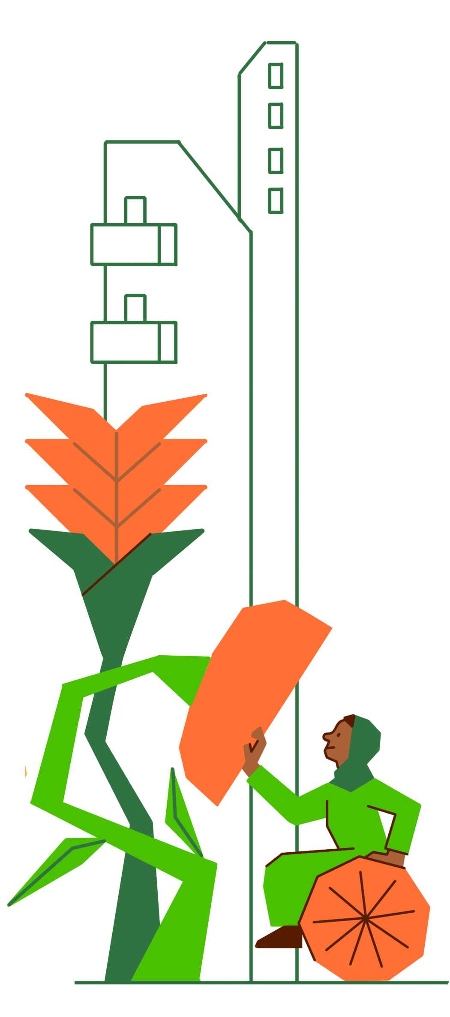
Haywood, A. et al. National Evaluation of the Preventing and Tackling Mental Ill Health through Green Social Prescribing Project. 2024. Defra.
The Preventing and Tackling Mental Ill Health through Green Social Prescribing Project
The Preventing and Tackling Mental Ill Health through Green Social Prescribing Project (GSP Project), was a two year £5.77 million cross-governmental initiative focused on how to improve the use of nature-based settings and activities to promote wellbeing and improve mental health (£4.27M from HM Treasury’s Shared Outcomes Fund and £1.50M from various central government departments and external agencies).
Partners included: Department of Health and Social Care, Department for Environment, Food and Rural Affairs, Natural England, NHS England, OHiD, Sport England, Department for Levelling Up, Housing & Communities and the National Academy for Social Prescribing.

Slide 9
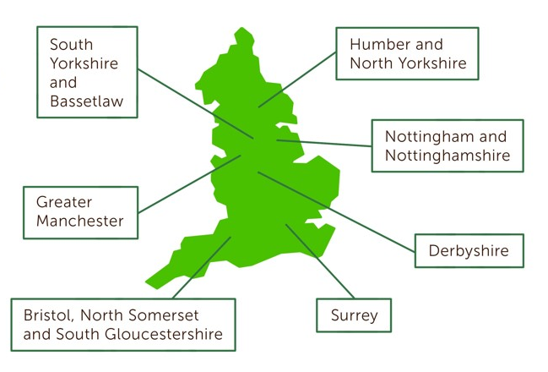
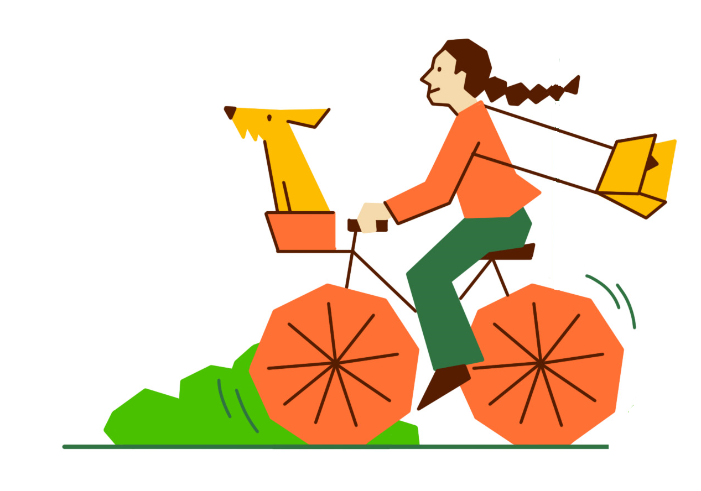
Haywood, A. et al. National Evaluation of the Preventing and Tackling Mental Ill Health through Green Social Prescribing Project. 2024. Defra.
The Preventing and Tackling Mental Ill Health through Green Social Prescribing Project
The aims of the GSP project were to:
Improve mental health outcomes.
Reduce health inequalities.
Reduce demand on the health and social care system.
Develop best practice in making green social activities more resilient and accessible

Slide 10
Haywood, A. et al. National Evaluation of the Preventing and Tackling Mental Ill Health through Green Social Prescribing Project. 2024. Defra.
Reach of the Green Social Prescribing Project
Through the Green Social Prescribing Project 8,339 people with mental health needs were supported to access nature-based activities accross the seven Test and Learn sites
The GSP Project was able to reach a broader range of people compared to many other social prescribing initiatives, including:
children and young people aged under 18
ethnic minority populations (21%)
people from socio-economically deprived areas (57% in IMD deciles 1-3).

Slide 11
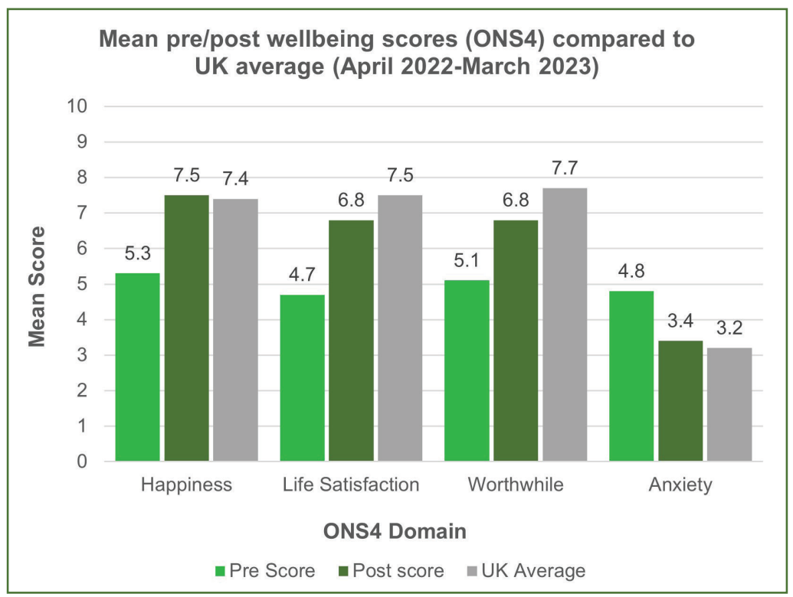
Haywood, A. et al. National Evaluation of the Preventing and Tackling Mental Ill Health through Green Social Prescribing Project. 2024. Defra.
Outcomes for people with mental
health needs

Slide 12
Haywood, A. et al. National Evaluation of the Preventing and Tackling Mental Ill Health through Green Social Prescribing Project. 2024. Defra.
Outcomes for people with mental health needs
Across the seven pilots there was a statistically significant improvement in wellbeing for each of the ONS4 wellbeing domains after accessing nature-based activities through the GSP Project
Happiness increased from an average of 5.3 to 7.5
Life satisfaction increased from an average of 4.7 to 6.8
Feeling that life is worthwhile increased from an average of 5.1 to 6.8
Levels of anxiety reduced from an average of 4.8 to 3.4
Prior to accessing nature-based activities participants’ happiness, anxiety, life satisfaction and feeling that their life was worthwhile was much worse than the national average
After accessing nature-based activities this had improved so that their happiness and anxiety was in line with the national average, and the gap to the national average for levels of life satisfaction and feeling that their life was worthwhile had narrowed significantly

Slide 13
Haywood, A. et al. National Evaluation of the Preventing and Tackling Mental Ill Health through Green Social Prescribing Project. 2024. Defra.
Understanding the value for money of the
Green Social Prescribing Project
Nature-based providers supported between 12 and 183 people depending on the level of resources they had, and the severity of mental health their project targeted.
The average cost per participant engaged in nature-based activities was £507 but costs ranged from £97 to £1,481.
The average cost per mental health or wellbeing outcome improvement was £619 with costs ranging from £225 to £1,777.
Compared with other interventions for people with mental health needs such as behavioural activation (£231- £250 for ten sessions), Cognitive Behavioural Therapy - CBT (£1,060 for ten sessions) and collaborative care for depression (£858 over six months), nature-based activities appear to be a relatively cost-efficient way to support people across a wide spectrum of mental health needs. It is important to recognise, however, that for many people, the most appropriate course of action to support their mental health will be to access different types of intervention in combination

Slide 14
Haywood, A. et al. National Evaluation of the Preventing and Tackling Mental Ill Health through Green Social Prescribing Project. 2024. Defra.
Understanding the value for money of the Green Social Prescribing Project
WELLBYs were used to estimate the value of improvements in individual life satisfaction experienced following participation in nature-based activities.
The central estimated value of WELLBYs created through the GSP Project was £14.0 million.
The estimated social return on investment of the GSP project was £2.42 per £1 invested by HM Treasury Shared Outcomes Fund and national partners. If resources leveraged by the Test and Learn sites are included, the social return on investment was estimated to be £1.88 of wellbeing for individual participants for every £1 invested in the project overall.

Slide 15
Haywood, A. et al. National Evaluation of the Preventing and Tackling Mental Ill Health through Green Social Prescribing Project. 2024. Defra.
Key learning about how to scale and spread Green Social Prescribing
Lack of awareness and recognition of GSP has resulted in a lack of leadership and investment, and vice versa
GSP seen as a ‘nice to have’ not core business
When political and strategic influence is directed to support GSP it can lead to shifts in policy and budgeting.
To get strategic, political buy-in requires motivated people driving the agenda, as well as evidence for the value of GSP.
Leadership with explicit accountability and investment is required.
Ensure that GSP is recognised in key strategies and policies.
Getting GSP embedded in policy is necessary but not sufficient – requires commitment about how to support and fund it.
VCSE partners, including smaller organisations, need to be part of strategic decision making
Notes:
Cross governmental commitment nationally has provided critical leadership support and funding for GSP.
Locally, GSP Project leaders have influenced local practices, systems and cultures and leveraged additional funding to support GSP.
There is now greater connection and understanding between parts of the system in relation to GSP, allowing priorities to become aligned and for power imbalances between sectors to be lessened.

Slide 16
Haywood, A. et al. National Evaluation of the Preventing and Tackling Mental Ill Health through Green Social Prescribing Project. 2024. Defra.
Key learning about how to scale and spread Green Social Prescribing
Multiple interdependencies are necessary for the GSP system to ‘work’.
The lack of alignment of ambitions, systems and processes poses challenges to delivery, and addressing these was a key component of all seven pilots.
There is a need to remove barriers and create aligned structures, to ensure coherence and clarity of roles and responsibilities across the system.
Sufficient time to build alignment is needed
Strategic, systemic and procedural alignment is a fundamentally important factor and should be considered in the scale up and out of GSP.
A plural, systems level approach needs to be used, backed up with sufficient time and resources, and those with the power to address key factors (such as funding/ commissioning) must be involved.
Perverse incentives, such as rapid ongoing cycles of change, that make working towards alignment an irrational option should be addressed.

Slide 17
Haywood, A. et al. National Evaluation of the Preventing and Tackling Mental Ill Health through Green Social Prescribing Project. 2024. Defra.
Key learning about how to scale and spread Green Social Prescribing
Nature-based providers are funded in a fragmented and unsustainably way resulting in sector fragility and potentially unnecessary competition.
Precarious, short-term funding cycles barrier to GSP engagement and capacity building.
Sustained collaboration resulting in shared values and vision hard to achieve given turnover of staff owing to funding cycles.
Smaller or micro-providers are often unheard and facing greatest challenges.
There is a need for new commissioning and procurement arrangements to ensure that nature-based providers can be embedded within health service delivery and the wider social prescribing landscape.
There is a need to end precarious, short term and piecemeal funding for voluntary, community and social enterprise (VCSE) organisations.
The GSP Project demonstrated how advocacy, at different levels (local, regional, national), and co-designed approaches to addressing funding challenges, can lead to more joined-up commissioning processes that mean green providers can work together on funding bids

Slide 18
Haywood, A. et al. National Evaluation of the Preventing and Tackling Mental Ill Health through Green Social Prescribing Project. 2024. Defra.
Key learning about how to scale and spread Green Social Prescribing
Key statutory partners lacked recognition of the ways VCSE work, and what they were doing.
VCSE partners delivering nature-based activities lacked capacity, knowledge or skills to work with SP referrals systems.
This resulted in few referrals through formal SP routes (eg LWs)
Mutual accountability and shared problem solving is necessary, but this requires trust and respect so that people understand and are aware of how different actors in the system may operate
Investment in partnerships, collaboration and knowledge sharing opportunities is required.
Diverse partnership in decision making fora may require creative solutions to ensure that appropriate representation for all key partners is possible.
Initial codesign work can ensure that partner & community needs and priorities and incorporated - time to do this well is required.
Partners need to be flexible and be responsive to innovation if mutual accountability and shared problems solving is to develop.

Slide 19
Haywood, A. et al. National Evaluation of the Preventing and Tackling Mental Ill Health through Green Social Prescribing Project. 2024. Defra.
Key learning about how to scale and spread Green Social Prescribing
Evidence for GSP considered to be limited, not compelling, or not sufficiently rigorous by wider system partners.
Data collection poses multiple challenges but allows the demonstration of reach, scale, acceptability and effectiveness.
Linking data is often difficult or not possible, meaning understanding anything other than the local picture is a challenge
Improvements to the gathering and sharing of data about GSP outputs and outcomes are necessary to build confidence in the efficacy of GSP.
Greater clarity is needed from commissioners around specific requirements for data collection and evidence. Whatever these requirements, sufficient relevant training (and data templates) should be delivered to organisations expected to conform.
Resourcing a role, or part of a role, around data collection and collation is key to sustainability of evidence generation.
A single dataset would be a useful outcome, but coherence is difficult to negotiate.
Notes:
There is a persistent perception at local and national level that evidence for GSP is not sufficiently compelling or rigorous and a lack of agreement around what evidence is needed.
The complexity of GSP poses multiple data collection challenges. Training, guidance, and payments to support data collection were provided but these challenges remained. It is likely that data collection and reporting will remain challenging for smaller VCSE organisations regardless of the support provided.
Technical solutions offer some hope and securing funding for these to be implemented consistently was seen as a vital milestone for some pilots.

Slide 20
Haywood, A. et al. National Evaluation of the Preventing and Tackling Mental Ill Health through Green Social Prescribing Project. 2024. Defra.
Key learning about how to scale and spread Green Social Prescribing
The network of providers, Link Workers, referrers, and funders was initially fragmented, with unclear responsibility for strengthening connections, leading to participant disengagement.
While hyper-local networks were strong, communication and interaction across networks were less so.
Improving processes to support information flow and feedback loops within the system between providers, Link Workers, referrers and funders helps create better connected, efficient and effective pathways
Networks should be resourced so that they can outlast the GSP programme, which also demonstrates tangible commitment.
The existing model of networks should be expanded by pooling resources and increasing buy-in from external partners.
To further improve the resilience of provider networks, strategic links should be developed and built to create a ‘web of webs’ so they can connect to wider strategies.
Notes:
Implications
Spending time understanding existing local networks and individual champions is important to take the next step in developing links between these.
Understanding that GSP and aligned aims are not always the same as aims of existing networks or organisations and so finding common ground and working to develop shared vision is important.

Slide 21
Haywood, A. et al. National Evaluation of the Preventing and Tackling Mental Ill Health through Green Social Prescribing Project. 2024. Defra.
Key learning about how to scale and spread Green Social Prescribing
There was widespread uncertainty around GSP referral routes, their structure and what was available to whom.
Self-referral was the most common route to nature-based activities across all sites, and this was often a surprise to project teams who had assumed that referral via a GP or LW was the more usual route.
If we build referrers’ capability, opportunity and motivation to refer to GSP, then we can improve access to appropriate green opportunities.
Clear locality-wide guidance is needed to bridge information and understanding between referrers and nature-based providers.
Allocate enough time and resource to meaningfully explore inequalities in both access and provision.
Improve training and access to support for those involved in providing GSP in key areas such as dealing with complex mental health needs and assessing risk.
Ensure that activities targeting communities reflect the diversity of those
communities both in planning and delivery.
Notes:
Implications
We found that many would value development of a single referral form gathering necessary participant information, clear guidance on who is expected to provide support for participants, and what level this support needs to be, and basic requirements in terms of evaluation and participant safety.
Further training on safeguarding and mental health support may be useful for future delivery.
Link Worker capacity and engagement in GSP must be addressed to improve referrals to GSP.

Slide 22
Haywood, A. et al. National Evaluation of the Preventing and Tackling Mental Ill Health through Green Social Prescribing Project. 2024. Defra.
Key learning about how to scale and spread Green Social Prescribing
Connection and linking up with the wider social prescribing system, and the capacity of nature-based providers to receive referrals, was sometimes challenging.
Fragmentation and variability across the system can be compounded by a lack of communication between parts of the system around capacity, availability and appropriateness of referrals.
If we grow or harness nature-based assets, there will be a range of appropriate, diverse, geographically spread opportunities for service users
Sufficient funds should be invested in order to make sure that basic practical elements for organisations and participants are available, such as equipment, transport and personal support. Sometimes very small amounts make a substantial difference.
It is important to develop a collective vision and action for the availability and organisation of providers, and for that vision to be clearly articulated across all parts of the system.
Notes:
Implications
Funding gives validation to the system, which means resources are allocated for staffing and dedicated time for social prescribing activities that would otherwise not be possible. This allows for greater input and creates a virtuous circle of involvement.
Increased levels of matching need to provision helps a greater number of people to be referred to appropriate activities or redirected to other parts of the system, increasing flow.
An increase in the number of appropriate, successful and large funding applications from the VCSE improves provision and therefore throughput, and also contributes to the virtuous cycle of involvement noted above.
Buy-in from senior strategic partners further validates involvement, raises awareness across a wider set of stakeholders, and further enables pathways to provide appropriate support at the right time for the right groups of people.

Slide 23
Haywood, A. et al. National Evaluation of the Preventing and Tackling Mental Ill Health through Green Social Prescribing Project. 2024. Defra.
Key learning about how to scale and spread Green Social Prescribing
Challenges with the complexity and severity of referred needs are sometimes compounded by gaps in culturally appropriate services for minority groups.
Geographical complexities, including urban/rural disparities, isolation, and uneven access to resources, further hindered equitable engagement and support.
If we want equitable access to appropriate green opportunities, within a person-centred system, then decision making must be made through an inequalities and instructional lens, as well as drawing on the user voice to illuminate changes across the pathway
Involve people most likely to be subject to health inequalities at every stage of the process, including question setting and commissioning services. Allocate enough time and resource to meaningfully explore inequalities in access and provision.
Improve training and access to support for people providing GSP in key areas like dealing with complex mental health needs and assessing risk.
Ensure that activities targeting communities reflect the diversity of those communities both in planning and delivery. Follow established principles of user involvement, and sufficiently resource strategies and activities, and sufficiently empower individuals to contribute.
Ensure involvement is sufficiently broad and deep.
Notes:
Implications
Meaningful user engagement with people most likely to be subject to health inequalities should be standard practice for national and regional initiatives.
Full and careful consideration should be given to sensitive involvement of groups most likely to be subject to health inequalities within specific geographies.
Decision makers need to consider creative and non-standard ways to include the voices and views of people most likely to be subject to health inequalities, such as peer research and engaging community gatekeepers, in good time.

Slide 24
Haywood, A. et al. National Evaluation of the Preventing and Tackling Mental Ill Health through Green Social Prescribing Project. 2024. Defra.
Key learning about how to scale and spread
Green Social Prescribing
Service users frequently disengaged from the GSP pathway due to barriers like lack of finance, transport issues, and mental health challenges.
Vulnerable populations faced disproportionate barriers to participation, leading to drop-off at various points in the social prescribing pathway.
If we want referrals to be fulfilled, then service users must have a positive experience across the GSP pathway
Providing patient-centred care is vital to understanding participant needs.
The cost-of-living crisis has a disproportionate and uneven impact upon service users. Individual needs assessments allow tailored and specific support for people with higher or more complex needs.
Creative approaches are needed to support service users through the GSP system, and there must be resources behind this to allow these creative approaches to be used strategically.
Greater understanding of the disproportionate challenges faced by service users would allow the considered allocation of resources to better support them through the GSP system.
Notes:
Implications
Central to improving participant retention were the following actions:
providing patient centred care in order to understand participant needs,
supporting participants to attend initial sessions,
providing consistent contact along the pathway,
Where needed, referring to other providers either within the same organisation or close by,
working with external organisations (such as food banks) and
addressing the underlying barriers preventing engagement with GSP.

Slide 25
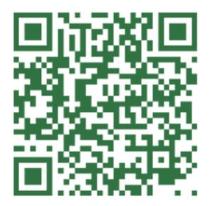
Haywood, A. et al. National Evaluation of the Preventing and Tackling Mental Ill Health through Green Social Prescribing Project. 2024. Defra.
Conclusions and recommendations
Nature-based activities are complex interventions, operating within the complex social prescribing system. This makes scaling up and embedding GSP challenging. Important to take time to link up and build understanding and trust between different parts of the system, including nature-based providers, as a founding principle. This helps visions and structures for GSP to be agreed and aligned and enables reach into target and so-called hard to reach communities.
Short-term and piecemeal funding for VCSE nature-based providers is a major challenge and inhibits sustainability. Investment, funding and how best to commissioning or procure GSP and nature-based is a critical issue. Networking, relationship building, partnership work and advocacy for GSP are key, but it takes time for structural or systems change to emerge.

Slide 26
Haywood, A. et al. National Evaluation of the Preventing and Tackling Mental Ill Health through Green Social Prescribing Project. 2024. Defra.
Conclusions and recommendations
There are ongoing challenges capturing data to evidence the impact and value for money of GSP. These mirror challenges affecting the whole social prescribing system at local and national levels. Establishing, and resourcing data systems that can best capture movement of people through the GSP system, understand drop-out, and provide robust evidence of impact on participants is a complex and expensive undertaking. There is a need to agree the priority data needs of partners, and ensure sufficient resources are available to support quality data collection. Feedback loops can improve understanding and participant experience, but this may be hampered by capacity and workload issues.

Slide 27
Haywood, A. et al. National Evaluation of the Preventing and Tackling Mental Ill Health through Green Social Prescribing Project. 2024. Defra.
National Evaluation of the Preventing and Tackling Mental Ill Health through Green Social Prescribing Project
Suggested citation: Haywood, A., Dayson, C., Garside, R ., Foster, A ., Lovell, R ., Husk, K ., Holding, E ., Thompson, J ., Shearn, K ., Hunt, H.A ., Dobson, J ., Harris, C ., Jacques, R ., Witherley, D ., Northall, P ., Baumann, M ., Wilson, I . National Evaluation of the Preventing and Tackling Mental Ill Health through Green Social Prescribing Project. January 2024. Department for Environment, Food and Rural Affairs (London).
The accompanying briefing document, summary, full final report, and appendices, are published by Defra (Defra Project Code BE0191) and are available from the Department’s Science and Research Projects Database at https://randd.defra.gov.uk. Whilst the research was commissioned by Defra, the views expressed reflect the evaluation findings and the authors’ interpretation; they do not necessarily reflect Defra policy.

Slide 29
Dr. Louise Montgomery – National Lead for the Natural Environment, NASP

Slide 30
Department of Health and Social Care (DHSC) Commissioned Research for Phase 1: Study 1 National GSP delivery capacity assessment (Natural England) Study 2 Exploring perceptions of green social prescribing among clinicians and the public (IFF Research)

Slide 31
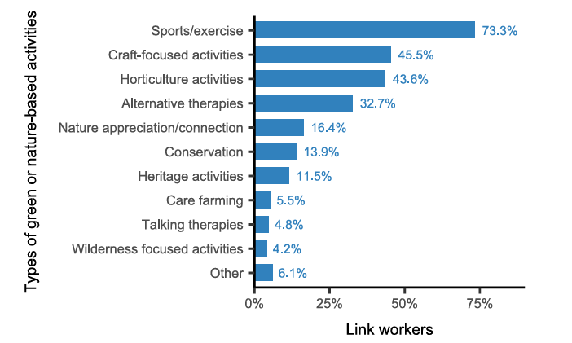
Study 1 Highlights: Delivery Capacity Assessment
Nature of GSP Provision:
Diverse variety of offers but inconsistent across regions.
More green activity providers operating in an area than are currently being referred to by link workers.
Narrow range of referrals by link workers - predominantly sports and exercise
National green social prescribing delivery capacity assessment: final report - GOV.UK
Notes:
This gives holistic picture of activies that are referred to - check about nature volume offers

Slide 32
Study 1 Highlights: Delivery Capacity Assessment
Capacity Challenges:
Barriers:
Providers: Short-term funding, low staffing, inadequate training for complex needs.
Link Workers: High workloads, limited resources for complex mental health cases.
Service Users: Barriers include transport, lack of interest, and competing priorities.
Transport cost and availability limit access to green spaces.
Stress and anxiety of travelling.
Local green spaces and better-managed sites could help address this.
National green social prescribing delivery capacity assessment: final report - GOV.UK

Slide 33
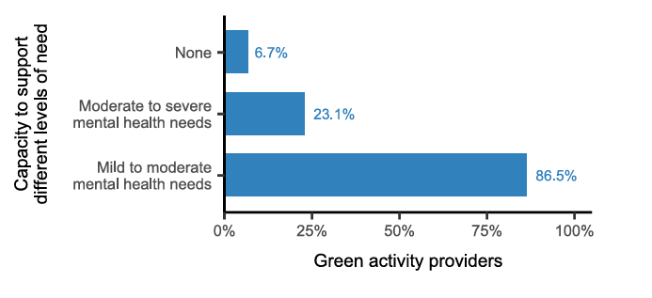
Study 1 Highlights: Delivery Capacity Assessment
GSP & Mental Health
Widely utilised for mental health need
Further maturity of work force training and practice support is required to meet complexity of need of referrals
Risk that GSP acts as a holding system for service users who require more specialised support that is not available to them
National green social prescribing delivery capacity assessment: final report - GOV.UK
Notes:
Ensure use need instead of ‘support’

Slide 34
Study 1 Highlights: Delivery Capacity Assessment
System-Wide Changes Needed:
Funding: Shift to long-term, stable funding to support continuity.
Awareness: Educate GPs, link workers, and users on GSP benefits.
Consistency: Create a standardised framework with metrics and accreditation.
Collaboration: Build strong cross-sectoral networks to share resources and knowledge.
National green social prescribing delivery capacity assessment: final report - GOV.UK

Slide 35
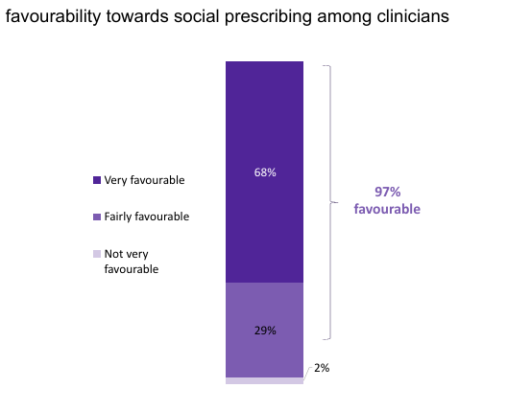
Study 2 Highlights - Perceptions of GSP
Perceptions of (G)SP:
Clinicians (n=501): High awareness of social prescribing, lower awareness of GSP as distinct intervention
Patients or potential users of GSP services (n=4000): Familiar with the concept but less experience with organised nature-based activities.
Appetite for Nature-Based Interventions:
Nearly all clinicians willing to refer patients to social prescribing.
Public sees value in nature for mental health but prefers activities tailored to individual needs.
Exploring perceptions of green social prescribing among clinicians and the public - GOV.UK

Slide 36
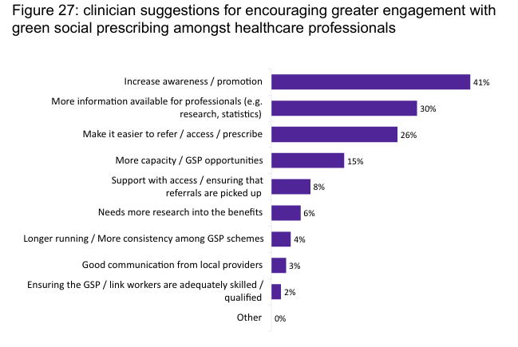
Study 2 Highlights - Perceptions of GSP
Challenges:
Clinicians lack of knowledge about local nature-based activities and referral processes.
Need feedback on patient outcomes post-referral to gauge intervention success.
Patient barriers include cost, logistics, and lack of confidence to participate alone.
Exploring perceptions of green social prescribing among clinicians and the public - GOV.UK

Slide 37
Implications for Stakeholders
General Public:
Raise awareness about local GSP opportunities.
Raise awareness of GSP benefits (e.g. mental and physical health, confidence, sense of purpose, employability)
Practitioners (Green, SPLW, Clinicians):
Educate clinicians about GSP benefits (incl. patients and health systems) and referral pathways.
Develop systems to integrate GSP into routine care and provide outcome feedback.
Community Organisations (VCSE):
Foster partnerships with healthcare providers.
Enhance capacity for delivering diverse and inclusive GSP services.
Ensure affordability and accessibility for underserved populations.
Commissioners:
Invest in sustainable funding models and infrastructure.
Address transport and accessibility challenges to enable equitable access.
Researchers:
Further studies on psychological benefits of nature, mechanisms of meaningful participation, and systemic scalability of GSP.
Policy Makers:
To ensure recommendations are embedded into national policy

Slide 38
Get in touch
socialprescribingacademy.org.uk
@NASPTweets
@NASP_insta
Q&A

