Slide 1
NASP webinar: The Latest Evidence for Social Prescribing
Chair - Anthea Terry, Head of Evidence and Evaluation, NASP
Olivia Engle, Katy Knight, Senior Evidence and Evaluation Specialists, NASP
Dr Kerryn Husk, Associate Professor of Health Services, NIHR Applied Research Collaboration (ARC) South West Peninsula, University of Plymouth
Jennifer Brooks, Programme Manager (Social Prescribing and Community-led Prevention), Transformation Partners in Health and Care, and Diana Norris, Lead Social Prescribing Link Worker, Bromley GP Alliance
Devon Elliot, Head of Evidence and Evaluation (Primary Care, Community Health Services and Personalised Care), NHS England

Slide 2

Housekeeping
Please note we are recording this webinar (you will be sent the slides and the link to the recording, and they will be on NASP's website too.)
Presentations, then a Q&A session at the end.
Please submit questions via the chat.
Please use the chat for introducing yourself and networking.
Please stay on mute and camera off.

Slide 3
Accessibility
Closed Captions are available – turn these on at the bottom
of your screen
BSL interpretation is available – the interpreters will be spotlit
Please put any technical questions into the chat

Slide 4

Overview of session
Anthea Terry, Olivia Engle and Katy Knight - Update on NASP’s evidence programme
Dr Kerryn Husk - Children and young people
Jennifer Brooks and Diana Norris - Evaluating SP in the VCSE sector
Devon Elliott - Evidence and data in NHSE
Q&A

Slide 5
NASP’s Evidence and Evaluation Programme
Anthea Terry, Head of Evidence and Evaluation
Olivia Engle and Katy Knight, Senior Evidence and Evaluation Specialists

Slide 6

What is NASPs role in social prescribing evidence?
We bring stakeholders together to share knowledge, identify and address evidence gaps, research challenges and opportunities through collaboration, being convenors and communicators of evidence, and increasing capability for evidence-based approaches.
NASP'S Evidence and Evaluation programme
Notes:
IEC
Evidence advisory group
Access to practitioners/
*Unique position

Slide 7
Where does the evidence come from?
Academic research
Evaluations from other social prescribing projects
Individual
Referrer
Link worker function
VCSE provider/ activities
NHS patient records
Demographics
Social determinants (e.g. deprivation)
Other contextual factors
NHS data, various sources/systems and scales
Evaluations
Small scale
Variable
Non-specialists
NASP'S Evidence and Evaluation programme
Notes:
Simple diagram that only represents one of the multiple pathways for people to be connected with activities
Even this simple diagram immediately draws out some of the key evidence challenges:
Many stakeholders across multiple sectors. Simply knowing what is out there/who is doing what is an immense task
inconsistent evaluations (different data collected; often disconnected from health data)
Access to NHS data – hidden treasures
Specialist data analysis skills required
Significant methodological challenges in measuring some benefits of SP (trying to compare a totally different treatment pathway with e.g. trad health interventions)

Slide 8

NASP Evidence reviews
13 evidence reviews produced with our academic partners
New publications since February:
  The impact of social prescribing on children and young people’s mental health and wellbeing
  How can social prescribing support older people in poverty? A rapid scoping review of interventions
  Building the economic case for social prescribing
  Supporting the voluntary, community, faith and social enterprise (VCFSE) sector to evaluate social prescribing
socialprescribingacademy.org.uk/evidence-on-social prescribing/
NASP'S Evidence and Evaluation programme
Notes:
Responded to government consultations and enquiries (e.g. Major Conditions strategy; Horticulture parliamentary inquiry)
Arts culture and heritage:
Increased social interaction, healthy behaviours, physical movement and activity, decreased stress, and preventing and treating long-term conditions
Social prescribing can have a positive impact on a very wide range of outcomes, including reduction in loneliness, and improvements to mental health & wellbeing and social connectivity.
Who is and who isn’t being referred to social prescribing?
Research lacking in children and young people
Small amount of research on ethnicity; suggestion SP is mainly accessed by white people

Slide 9

Highest priority needs
Understand what works for social prescribing across the life-course, especially older people and children and young people
Support VCFSE organisations in the UK to deliver evaluations of social prescribing that are of use to them and to their commissioners
Develop better ways to report on the economic value of social prescribing in the UK
NASP'S Evidence and Evaluation programme
Notes:
Develop better ways to report on the economic value of social prescribing in the UK (across all sectors but with focus on expressing value to the health sector in the immediate term)
Support Voluntary, Community, Faith and Social Enterprise organisations in the UK to deliver evaluations of social prescribing that are of use to them and to their commissioners (and that will encourage more consistent evaluation approaches)
The aim is that both these strands of work over the next 3 years will move us towards being able to justify the cost effectiveness of SP and for activity providers to be able to report more easily on key common metrics such as wellbeing, volunteering, loneliness, and impact on the health system (eg impact on GP appointments, pharma prescribing , A&E attendances).
These 2 pieces of work are intimately linked, as justifying the value/cost effectiveness of SP will rely on more effective evaluation of the costs of delivering SP activities by the VCFSE sector.

Slide 10
Economic case for social prescribing: report
Marie Polley, Helen Seers, Olivia Toye, Todd Henkin, Hannah Waterson, Marcello Bertotti, Helen Chatterjee
Rapid scoping review aimed to:
  Update previous summary of economic evidence
  Understand effectiveness of current methods
  19 studies on economic impact; 7 studies on health service usage
Headlines:
  5 methods used; finding from studies using each of these methods suggests that social prescribing can have a positive economic impact
  Impact on health service usage in 5 key areas: GP appointments, A&E attendance, planned and unplanned secondary care use, and nurse appointments
    Reductions in primary and secondary care usage found in each of these areas
NASP'S Evidence and Evaluation programme
Notes:
Social Return on Investment (SROI) most common method (not necessarily the best)
Range of SROI values for 6 studies of full social prescribing schemes was £2.14-£8.56 for every £1 invested
Three of the more robust studies found a range of £3.42-£8.56 per £1 invested
A robust Cost Description Analysis study (Ways to Wellness programme in Newcastle upon Tyne) assessed data for >4,500 participants with multiple long-term conditions; demonstrated the secondary care cost was 27% lower in the social prescribing group
One study used Regression Modelling on SP intervention for type 2 diabetes and found a reduction in care cost of £77.57 per patient, per year. Cost reductions were higher for non-white patients, older patients, and those without additional co-morbidities
An increase in costs was reported by 2 out of 7 studies. However, in the Grow Well Social Prescribing Pilot Evaluation, cost data was only collected for 9 people. In the other study, the cost data was collected for 86 people. Just 13 percent of the total group accounted for more than half of cost increases, particularly among the severely frail. Both studies highlight the need for higher ‘n values’ as well as using control groups and statistical analysis to ensure that any findings are significant and representative of the larger population.

Slide 11

Older people in poverty: review and survey
Abby Sabey, Helen Seers, Helen Chatterjee, Marie Polley (2023)
Rapid evidence review:
  22 studies on older people
  5 themes: food insecurity, fuel poverty, income/financial management, digital exclusion and general social vulnerability
  Holistic approach due to multi-dimensional nature of poverty
Survey:
  131 responses
  To explore what social prescribing for older people currently looks like Barriers, e.g., internalised stigma, financial challenges
    Enablers, e.g., personalised approaches, accessibility
    Gaps, e.g., EDI, co-production/design
    Opportunities, e.g., 'what good looks like', supporting care homes
NASP'S Evidence and Evaluation programme
Notes:
Food insecurity: Overall these research articles demonstrate a range of approaches to supporting people with food insecurity are effective, including education, community-based food activities and food bank provision across mobile and other community settings. At least two studies have identified multiple outcomes including improved fatigue, physical functioning, increased skills, connectivity and use of other community-based services, as well as improved access to food.
Fuel poverty: In this section, the seven studies provide overlapping and confirmatory results. Firstly, educating and empowering older people to be more energy efficient can improve their home environment and as well as their health and wellbeing. Secondly all interventions that improved the home temperature improved the physical and mental health of most of the participants. Some participants were still at risk of fuel poverty and it is possible that their housing needs a range of energy efficient measures, as opposed to one intervention in isolation.
Income management: These six papers reveal several target groups of people that may be experiencing financial issues and who may be too ashamed and embarrassed to tell anyone about them. The repercussions are extreme, including job loss, loss of home as well as health and wellbeing issues. The need for joined up coordinated multi agency support is once again recommended, in recognition that financial poverty is interlinked with other situations in a person’s life.
Digital exclusion: These three sources of information have identified a range of approaches to engaging older people to promote digital inclusion and improve digital skills, including building into the care journey where appropriate for the individual. Intergenerational and community-based skills programmes may reduce barriers to digital inclusion for older people helping to promote social wellbeing.
Social vunerability: Social vulnerability is an important dimension of poverty to consider in interventions. A common thread in these three papers was the importance of community connectedness through activities that offer social interaction and the provision of local services that support this such as education and the arts. The importance of wider infrastructure in enabling this such as better local transport links should be noted. Supporting socially vulnerable older people with home improvements around warmth, safety and repairs can also benefit health and wellbeing. Providing informal (peer) support with navigating health information and communicating with care providers may also be beneficial.

Slide 12
VCFSE evaluation: report
Marie Polley, Abby Sabey, Helen Seers, Helen Chatterjee
Rapid scoping review aimed to:
  Identify and collate resources to support evaluations of SP programmes
  Assess the appropriateness/quality of these resources
Headlines:
  61 resources identified that met inclusion criteria
    15 comprehensive toolkits
    13 partial toolkits
    33 resources focused on one aspect of evaluation
  Developing a shared language across sectors could facilitate a more consistent approach (glossary of evaluation terms could be produced)
  Difference in cultures across funders/sectors is a limitation on evaluation activity
  A range of learning and training needs were identified
NASP'S Evidence and Evaluation programme

Slide 13
Children & young people: review and survey
Dan Hayes, Paul Jarvis-Beesley, Dawn Mitchell, Marie Polley, Kerryn Husk
Rapid evidence review:
  5 studies on children and young people's social prescribing (CYPSP)
  Benefits of social prescribing for young people, particularly for those aged over 17, on personal and mental wellbeing, including loneliness
  Potential favourable return on investment (ROI)
  Treat findings cautiously
Survey:
  208 responses
  54% of respondents reported that CYPSP was available locally, but 45% of these services had only been launched within the previous year
  Both specialist and all-age services
  Schools and community settings
  Lack of link worker confidence to work with younger children and families
NASP'S Evidence and Evaluation programme

Slide 14
Dr Kerryn Husk
Associate Professor of Health Services, NIHR Applied Research Collaboration (ARC) South West Peninsula, University of Plymouth

Slide 15





CHildren and young people’s Options In the Community for Enhancing wellbeing through Social prescribing (CHOICES)
Kerryn Husk – Associate Professor of Health Services Research, University of Plymouth, UK
Vashti Berry – Associate Professor in Prevention Science, University of Exeter, UK
@kerrynhusk
@vashtilou

Slide 16
Overview
Background
Our previous research
The CHOICES Project
Links to other work
Future plans and request for help!

Slide 17
Social prescribing
Our work is informed by our assertion that social prescribing is:
(a) a pathway of relationships to link people to (b) a set of activities for their health and wellbeing.

Slide 18
PenARC – previous work
Track record in social prescribing and CYP mental health research
Projects examining the ‘process’ of SP, the linkworker role, community-based SP, green social prescribing and policy facing work – often using novel methods
Set up and core members of the NASP IEC

Slide 19
CYP Social Prescribing
Young people are experiencing increasing mental health difficulties, and services are struggling
Community-based activities through social prescribing pathways is one potential way to address
Existing knowledge on social prescribing is primarily about adults
‘Where’ do we position social prescribing to be of most use?
Evidence is building, but a lack of detailed guidance

Slide 20
The CHOICES Project
CHildren and young people’s Options In the Community for Enhancing wellbeing through Social prescribing (CHOICES)

Slide 21
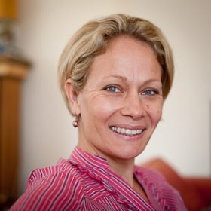

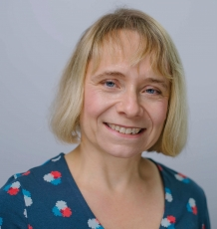

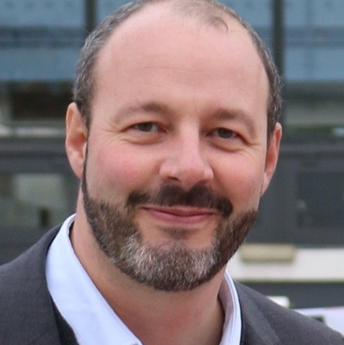
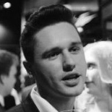
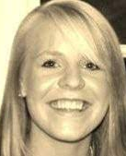
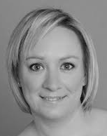
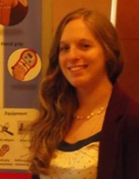

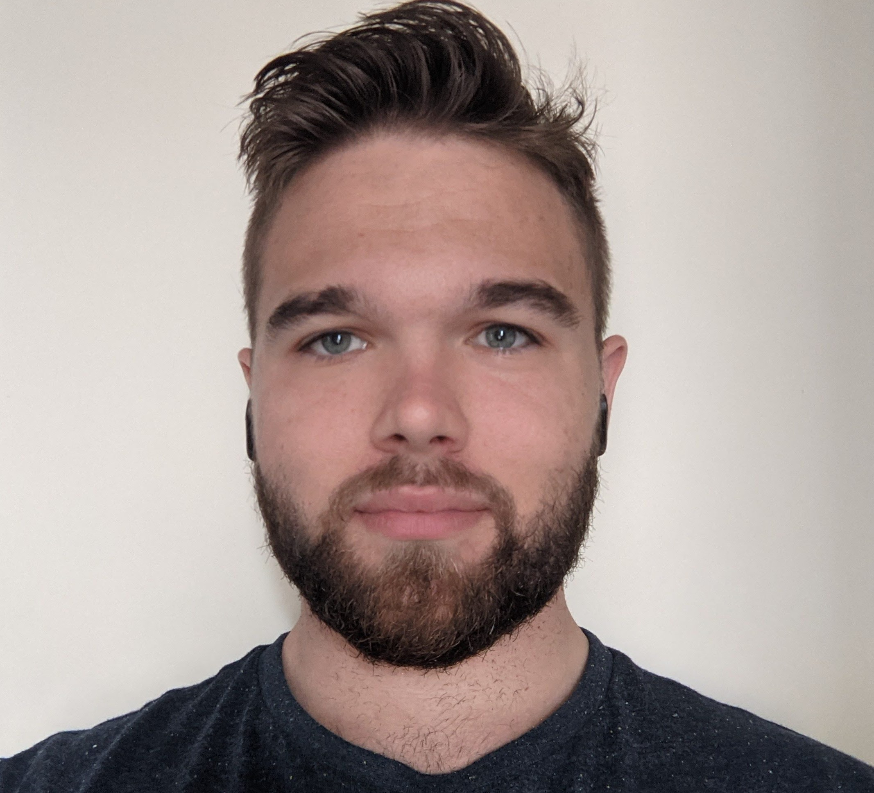

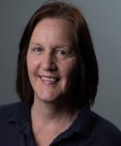
The CHOICES team
Dr Vashti Berry
Dr Kerryn Husk
Dr Jane Smith
Paul Jarvis-Beesley
Principal Investigator, University of Exeter
Co-Principal Investigator, University of Plymouth
University of Exeter
StreetGames
Dr Marcello Bertotti
Dr Daniel Hayes
Lucie Vickers
Dawn Mitchell
University of East London
Anna Freud Centre/University College London
StreetGames
StreetGames
Dr Siobhan Mitchell
Lucy Cartwright
Joe Coombes
Isabel Farina
Christine Anning
Research Fellow
University of Exeter
Research Assistant
University of Exeter
Research Assistant
University of Exeter
PhD student
Politecnico di Milano
Project Administrator

Slide 22
CHOICES
To understand how existing social prescribing projects work with children & young people (CYP) to improve mental health
Recruit 5 sites offering a variety of CYP-SP models across England
Undertake 2 work packages
Place children and young people front and centre

Slide 23
WP1 - Pathways
Aim:
Explore how SP pathways operate for CYP with mental health difficulties to access and participate in SP and community activities.
​Method:​
Review existing literature.
Gather routine data from participating sites.
Interview staff, young people and carers in each site to help us understand how links to community activities are made, who makes them and how successful they are.
Illustrate pathways visually

Slide 24
WP2 – ‘Communities’
Aim:
To better understand how community-based support can improve the wellbeing of young people​
Methods: ​
Interviews with CYP to explore concept of 'community' for them.
Community days with CYP explore what community meant to them
Focus groups with commissioners and service managers.​
Rapid review of qualitative research in this area.

Slide 25

Top-level findings – WP1
Huge variation in pathway
It has been possible to distil different models for understanding CYP-SP, most often cross-sector/collaborative
Not always linear or community asset linked
Presentation organisations are broader than adult services
Routine data are…tricky…

Slide 26

Top-level findings – WP2
Held 4 community events using photo elicitation; total of 99 CYP participated
What does community mean to you?
What do CYP want?
People/social | Online
School | Anxiety/danger
Play/sport | Consistency with specifics across sites
Trusted people | Shared identities
Access/afford | Safety
Participation | Sports clubs/activities

Slide 27

The Young People's Advisory Group
8 members aged 14-25
Convened by StreetGames
Differential involvement of young people in all aspects of the project
To provide opportunities for YAG members to gain experience of research processes
Consulted on what members wish to get from their involvement, and gained feedback on CYP PIS

Slide 28
Future work
CHOICES1: exploratory with few cases describing programmes and community offers
CHOICES2 – 20-25 sites
  Identify implementation strategies that help/hinder impacts
  Assess CYP definitions of outcome 'success' and economic value
  Cost analysis: where are costs accrued, by which organisations?
  Outputs: CYP-SP 'Platform', set of compiled resources, cost tools

Slide 29
Links to other national work
NASP Academic Partners Collaborative
Green Social Prescribing Evaluations (Defra et al.)
Link Worker Evaluations (NIHR et al.)

Slide 30
Thank you – any questions?
Email: Kerryn.husk@Plymouth.ac.uk
CHOICES:
https://arc-swp.nihr.ac.uk/research/projects/cyp-social-prescribing-mental-health/

Slide 31
Jennifer Brooks and
Diana Norris
Jennifer Brooks, Programme Manager (Social Prescribing and Community-led Prevention), Transformation Partners in Health and Care
Diana Norris, Lead Social Prescribing Link Worker, Bromley GP Alliance

Slide 32
Social Prescribing and Evaluation across London
November 2023
Jenny Brooks (TPHC)
Diana Norris - Lead Social Prescribing Link Worker, Bromley GP Alliance

Slide 33
How we are supporting demonstrating the impact of social prescribing and VCSE activity in London
Social Prescribing and Evaluation Community of Practice
Monthly sessions sharing best practice, holding discussions and helping co-producing plans for regional support in this area
Open to all roles at any level. Get in touch if you’d like to join. We are reviewing the group in the new year.
What this has led to…
Paper on how VCSE and Health can work together to demonstrate impact
In depth case studies and mapping of examples – to be published soon
The London Social Prescribing Evaluation Toolkit – to be published soon
Plans and content co-produced with a group of SPLWs, managers and PCN managers
Currently developing content with the system
Community Chests
Shared investment funds bringing together funding from the NHS and local authorities, and other sources, to support the voluntary and community sector to deliver local health and wellbeing activities across NEL boroughs and Haringey.
Work with each borough steering group to develop plans for reporting impact, involving VCSE.
TPHC supported grantees in Barking and Dagenham with more hands on support, f2f and on teams.
Reflection sessions led with boroughs to capture learnings in a way that benefits teams.
Supported borough teams with data analysis and report making (presentations, skeleton reports and creating visual templates)

Slide 34
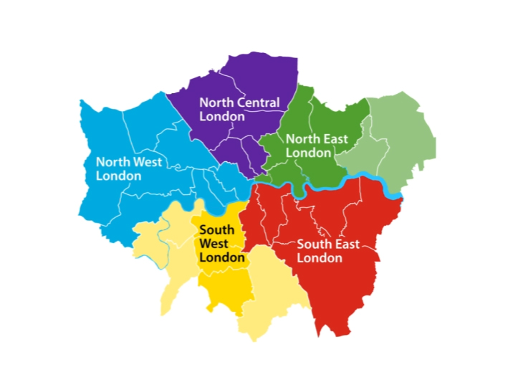
NCL
Developed list of recommended patient outcome measures for SP
Looking at what outcomes are being captured across different boroughs to understand how consistency could be improved
ICB wide use of MyCaw as part of Long Terms Conditions work within personalised care support planning.
Wide variety of case management systems being used
Supports Pop health strategy
NEL
Pilot site for National Minimum data set work
Developed template for EMIS/SystmOne/Joy including minimum dataset and extra information
Data is feeding into the ICB wide PowerBI dashboard
They hold a regular evaluation group focused on embeddingr data collection into SPLW consultations and data analysis using the dashboard
Barnet, Age UK:
Borough wide system for regular reporting SP data. Working with public health on yearly report and GP attendance yearly report, linking data. Elemental shares a gap report about services with SPLWs.
NWL
Commissioning Joy across all boroughs for Social Prescribing
Working with NAPC (National Association of primary care) on evaluation. Action Learning Sets being undertaken with each borough to look at:
Controls: Tools and Technology within the work systems; Colleagues: People's behaviours, the process used, culture of MDTs etc; Caseloads: patient management, task generation, onwards support, patient activation.
Evaluation frameworks being designed by 3ST (VCSE alliance) and the Bi-borough partnership
Camden: Working to embed evaluation in VCSE employers and SP, working with UCL evaluation exchange
Tower Hamlets: Co-produced 6 outcome, 40 indicator measure what makes a good life (BBBC). Rolling this out for SPLWs and wider.
Harrow:
Used data from Joy on services, to support recommissioning of Housing support
Lambeth: Social prescribing innovators project designed a process for evaluation with SPLWs at the core including joint staff and resident feedback forums, and yearly report
Westminster:
Holding borough wide group for all connector roles – called Octopus, now looking at KPIs for services, to show impact
Merton:
Undertook separate evaluations of HWBCs and SPLWs
Hammersmith and Fulham: Healthwatch is carrying out an evaluation of the SP service
Bromley:
Collecting monthly cumulative referrals via EMIS (GP fed)
SP activity providers are running their own evaluation – Bromley Well.
Healthwatch evaluation of SP service at the patient, SPLW and GP level
Sutton:
Procured Joy and has designated a lead to implement the system.
Southwark: Feedbacks data on gaps across borough to ICBs to inform commissioning through SP oversight group.

Slide 35













Bromley Social Prescribing 2023
Self - Neglect and Hoarding Panel
PCN Social Prescribing Link Workers
Wellbeing Cafes
Bromley Mental Health Hub
Proactive Care Pathway
Mottingham, Downham & Chislehurst
Primary Care Network
Frailty Pathway
Princess Royal University Hospital
Emergency Department
A&E Front Door
High Intensity User Liaison
Homeless Health Team

Slide 36
Devon Elliot
Head of Evidence and Evaluation (Primary Care, Community Health Services and Personalised Care), NHS England

Slide 37
International Evidence Collaborative (IEC)
What is it?
  A network for anyone with an interest in social prescribing evidence and for new partnerships
  Supporting social prescribing policy, practice and research to thrive, by bringing people together to share evidence better
300+ members
2023 'lunch time seminar' series ended
Planning new programme of activity [survey forthcoming]
Sign up to the International Evidence Collaborative
International Evidence Collaborative (IEC)

Slide 38

What next?
What works for whom?
Better evidence on:
  particular population groups
  specific conditions
  health inequalities
…for both intervention and implementation
Consistency and consensus
Simple, consistent impact measures for evaluation
‘Gold standard’ measures for economic impact/service usage
Data sharing

Slide 39
Any Questions?

Slide 40




Get in touch
socialprescribingacademy.org.uk
@NASPTweets
@NASP_insta

