Slide 1

NASP Webinar: Green Social Prescribing Practitioner Guidance -ensuring safe and effective referrals from the health system
Thank you for joining us. The webinar will begin shortly.

Slide 2


Housekeeping
Please note we are recording this webinar - you will be sent the slides and the link to the recording, and they will be on NASP's website too.
Please submit questions via the Q&A function. We will hold a Q&A session at the end of the presentation.
Please use the chat function for introducing yourself and networking. If you have any technical issues, please raise these in the chat, and a member of the NASP team will assist.
Closed Captions are available (turn these on at the bottom of your screen.)

Slide 3

Overview
Chair:
Molly Aldam, National Lead for the Natural Environment, National Academy for Social Prescribing
Speakers:
Molly Aldam, National Lead for the Natural Environment, National Academy for Social Prescribing
Damien Newman, Training, Education and Consultancy Manager, Thrive
Ben Thomas, Chief Executive Officer, Thrive

Slide 4





The National Academy for Social Prescribing
NASP is a national charity that champions social prescribing. We support and connect people, communities and organisations so that more people across the UK can enjoy better health and wellbeing.
Connection
Innovation
Investment
Evidence
Awareness

Slide 5
What is Social Prescribing?
“A means for trusted individuals in clinical and community settings to identify that a person has non-medical, health-related social needs and to subsequently connect them to non-clinical supports and services within the community by co-producing a social prescription—a non-medical prescription, to improve health and well-being and to strengthen community connections.”
Establishing internationally accepted conceptual and operational definitions of social prescribing through expert consensus: a Delphi study
Trusted individuals
in clinical or community setting
Co-produced prescription
Support and services
in the community
e.g. nature-based interventions
Improved health and wellbeing

Slide 6
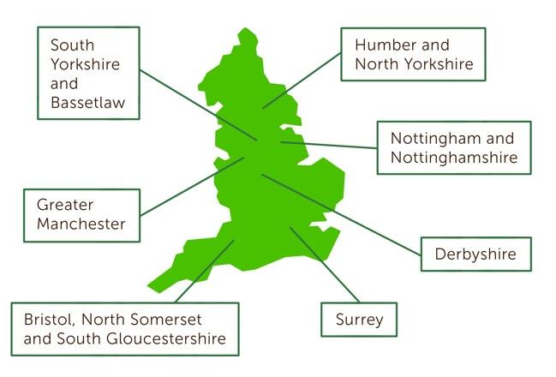
Cross-Govt Green Social Prescribing Programme to tackle and prevent mental ill health
£5.77m funded by Treasury and core partners in 2021-2023, with £2.3m extension 2024-5
Aimed to test how to embed nature-based interventions into our health system via social prescribing, and the efficacy of GSP
7 test and learn sites across England
Evaluation found 57% of participants were from socio-economically deprived areas, ONS4 wellbeing scores rose significantly post intervention, and there was a Social Return on Investment of £2.42 per £1 invested by Treasury

Slide 7
To grow and develop nature-based providers to ensure there are a range of appropriate, diverse, geographically spread GSP opportunities.
Recommendation: "investment for nature-based providers, co design of referral pathways and the introduction and maintenance of “trusted provider” information resources"
To improve information flow and feedback loops between providers, Link Workers, referrers and funders to create more efficient and effective pathways.
Recommendation: "Improving understanding and communication about what levels of need can be supported by which activities"
Green Social Prescribing Project Evaluation
Green Social Prescribing Toolkit

Slide 8
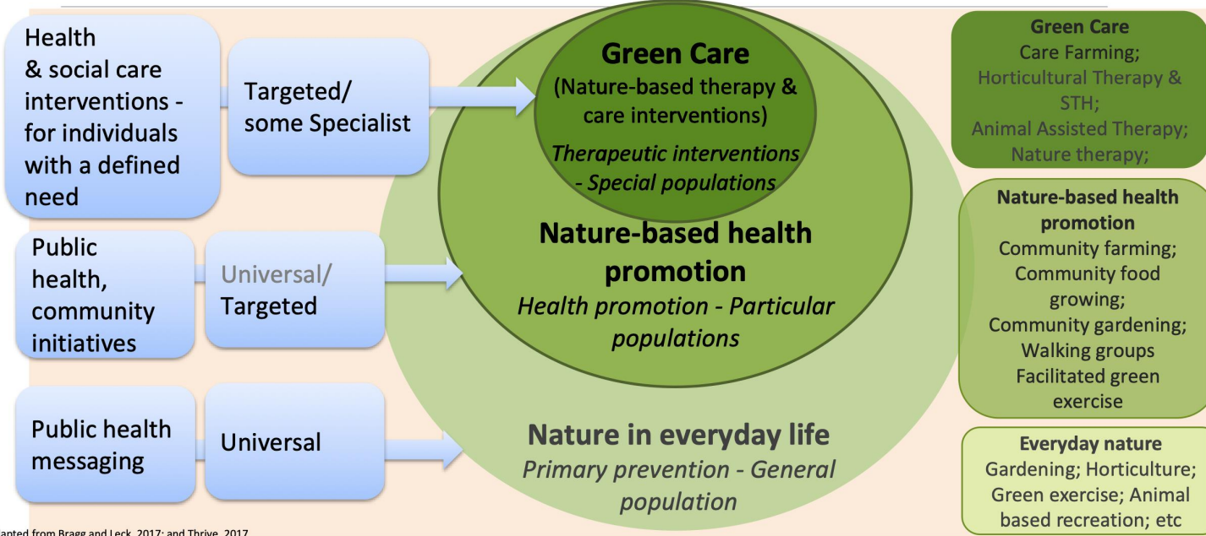
Nature in everyday life
Nature-based community initiatives
Nature-based therapies
Therapeutic Horticulture
Animal-assisted therapy
Talking therapy in nature
Gardening groups
Facilitated green exercise e.g. health walks, wild swimming
Conservation volunteering
Gardening
Green exercise
Animal-based recreation
Notes:
This is a useful diagram to explain nature-based interventions, which shows that we need to think about them differently for different population groups.
The outer circle refers to the general population without specific health needs. It is assumed that this group is able to increase their connection with nature in everyday life for the upkeep of their wellbeing, provided they have access to local greenspace. ​
​
The middle circle is at risk groups who need more support to access nature. They benefit from targeted provision such as Walking for Health schemes.
​
The inner circle represents specific populations with an identified health need. This group is best served by therapeutic interventions led by trained professionals, such as therapeutic horticulture, which is normally delivered in small closed groups.
So with GSP we’re not talking about something self-led, because there are often barriers to this for people with health needs – nature connection needs to be facilitated by a GSP provider. So the inner 2 circles are the ones that a Social Prescriber would refer to.

Slide 9
Type of nature-based provision matched to mental health levels
Nature-based Therapies - clinical settings
Nature-based community initiatives
Nature-based therapies
Nature-based therapeutic interventions
- ‘defined need’ individuals
Level 4
Nature in everyday life
Organised community or group nature engagement activities
– ‘at risk’ populations
A person feeling generally well but who wants to look after their mental & physical health.
Activities are done independently or alongside friends or family.
A person seeing their GP about their mental health or getting some support from health worker or social prescriber.
Setting provides a supportive environment.
Activities designed to help combat feelings of loneliness and/or low mood & offer support to increase motivation and to manage symptoms of anxiety and/or mild depression
A person currently getting support from their GP for their mental health & receiving talking therapies (such as CBT or counselling) and possibly taking short term medication and/or under ongoing regular mental health reviews.
Sessions specifically designed for mental health/ wellbeing support & allow for volunteer or support worker attendance if required
Activities support individual towards identified recovery goals, set with a mental health care professional
A person who is experiencing an acute mental health crisis which requires inpatient or intensive crisis team support; OR with a long-term serious mental health condition and who needs regular care & support.
Sessions in a hospital-based location, such as a hospital community garden or therapy garden.
Activities facilitated by a specialist team ensuring help & support is available (including doctors, nurses and others with expertise in working with people with a range of complex mental health needs, both long term & acute.)
Activities support individual towards identified recovery /care goals, set with a mental health care professional
A person who has more complex needs and requires more than one area of support, including specialist and local mental health team support.
Short-term programmes or packages that are specifically designed to meet individual’s needs. Sessions allow for support worker attendance.
Providers work closely with existing mental health support to form an extended team specializing in working with people who have longer-term and/or more series mental ill health difficulties
Activities support individual towards identified recovery goals, set with a mental health care professional
Level 3
Engagement with nature as part of everyday lifestyle
- General population
Level 2
Level 1
Level 0
Sources: Adapted by R Bragg from GreenSpace 2026, Bragg, 2024, Bragg and Leck, 2017; Thrive, 2017; THSG 2024 and here ; and GreenMe here

Slide 10
Developing the Guidance
Damien Newman, Training, Education and Consultancy Manager, Thrive

Slide 11
Process
NASP created a Commissioning document to enlist Thrive to lead on the development of the document.
•Audience
•Aim
•Objectives
•Scope of content

Slide 12
Audience:
Nature Practitioners delivering green social prescribing activities
Aim:
To develop clear, practical, and applicable practitioner guidance for nature-based activity providers, ensuring safe and informed referrals from social prescribers.
Objectives:
•Outline minimum principles to consider for safe and effective practice.
•Outline competencies and skills to consider for practitioners.
•Outline guidance on supervision, training needs, and continuous professional development.
•Suggest quality improvement principles to enhance standards over time.
•Suggest clear processes for receiving referrals, providing feedback to referrers, and ensuring effective referral pathways.
•Ensure the document is accessible, practical, and easy to implement for providers across different settings.

Slide 13
Scope of Work and Content
Minimum Principles & Practitioner Competencies
•Outline baseline principles for practitioners to consider, ensuring alignment with existing frameworks and suggest support, supervision and training needs
•Identify essential knowledge, skills, and confidence levels suitable to address diverse social and health needs.
•Consider complexity in care needs and the scope of practice for different levels of practitioners
Supervision & Support Guidance
•Suggest guidance on supervision, including principles, best practices, and when it is required.
•Outline policy commitments needed for supervision to be effective.
Training & Development Needs
•Review existing accessible, free training and suggest training offers for levels of need.

Slide 14
Consultation
The final product will reflect a collaborative approach informed by on the group practice, involving key stakeholders, including NASP and expert contributors from the social prescribing and green care sector.
Delivery group- Practitioners and Nature based Intervention(NBI) organisations managers from wider NBI approaches.
Expert group- Policy and research understanding, test and learn site involvement, long standing expertise in NBI and input from integrated care boards and link worker.

Slide 15
Areas of Guidance
•Aligning NBIs with different levels of mental health
•Foundational principles for safe and effective practice
•Legal obligations and guidance
•Recommended competency and skills
•Supervision for Practitioners
•Training and Continuous Professional Development (CPD) recommendations
•Quality improvement principles to support continuous development

Slide 16
Foundational principles for safe and effective practice
Presented across 2 levels in line with the mental health levels introduced.
Generally linear, in line with the general journey people engage in within NBIs. Placing value on how we induct, and planning for the end of access.
Recognising the importance of information exchange, ensuring NBIs are well placed to identify and manage risk in relation to their specific use of nature.
Recognising the skillsets and processes practitioners use to ensure people access a service that feels safe and accessible.
Levels representing real world delivery at different levels of NBIs and the utilising of wider methodologies and underpinning philosophy of care.

Slide 17
Legal obligations and guidance
Signposting to green care quality mark
Existing frameworks for safeguarding

Slide 18
Competencies and skills
Training and CPD
Presented in line with the 2 levels of foundational principles
Split between skills/knowledge and attitudes/values
Recognising the existing skillsets found across the NBI sector
Supportive of NBIs to plan training and recruitment.
Training and CPD
Lists the key training new practitioners could engage in or how others could round of their skills.
Recognises the breadth of potential CPD areas.

Slide 19
Supervision for practitioners
Recognises the challenge of supervision in a diverse and emerging sector.
Recognises how reflection and supervision are interlinked in providing full value for practitioners to manage their health and workload, and practice challenges.
Defines how supervision supports practice
Stipulates that supervision can be critical to good practice, and recommends who can support with the processes

Slide 20
Quality improvement principles to support continuous development
As with other areas of the document, it identifies how standards of practice are dependent upon organisational resources and culture.
Highlights the importance of engaging with stakeholders and in particular people accessing the service for health needs.
Highlights the importance of evaluation and good culture to create continuous development.

Slide 21
Ben Thomas
Chief Executive Officer, Thrive

Slide 22


Get in touch
Socialprescribingacademy.org.uk
Hello@nasp.info
Thrive.org.uk
Info@thrive.org.uk for general enquiries
Training@thrive.org.uk for education enquiries
Q&A
Read the guidance: https://socialprescribingacademy.org.uk/resources/launch-of-the-green-social-prescribing-practitioner-guidance/

Slide 23
Links mentioned in the chat during the webinar…
https://www.meccgateway.co.uk/nenc
https://www.trellisscotland.org.uk/professional-development
https://gardening4health.co.uk
https://www.naturalacademy.org/
https://www.forestryengland.uk/forest-bathing
https://circleofliferediscovery.com/
https://tfb.institute/
https://rfs.org.uk/news-list/forest-bathing-benefits/
https://www.nationaltrust.org.uk/discover/nature/trees-plants/a-beginners-guide-to-forest-bathing
https://www.nottinghamcvs.co.uk/projects/greenspace/big-green-book
https://www.rspb.org.uk/helping-nature/what-we-do/nature-prescriptions
https://www.aliss.org/
Academic and Practitioner Internation Research in Nature Network

