Slide 1

Wellbeing While Waiting
How can social prescribing help young people waiting for mental health support?
In partnership with the Anna Freud National Centre for Children and Families, National Academy for Social Prescribing and the Streetgames
Generously funded by the Prudence Trust
Notes:
Outline myself and background
SPYN – 1300 organisations committed to evidence and embedding youth social prescribing
National Centre – collaboration between National academy for Social Prescribing and UCL, to help evidence inform policy
Explore youth social prescribing in the context of practice, policy and research

Slide 2
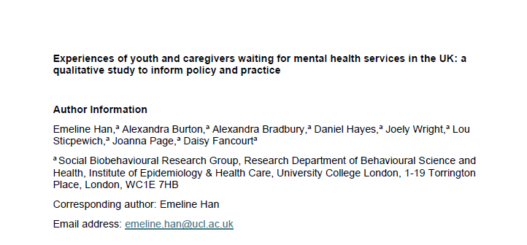
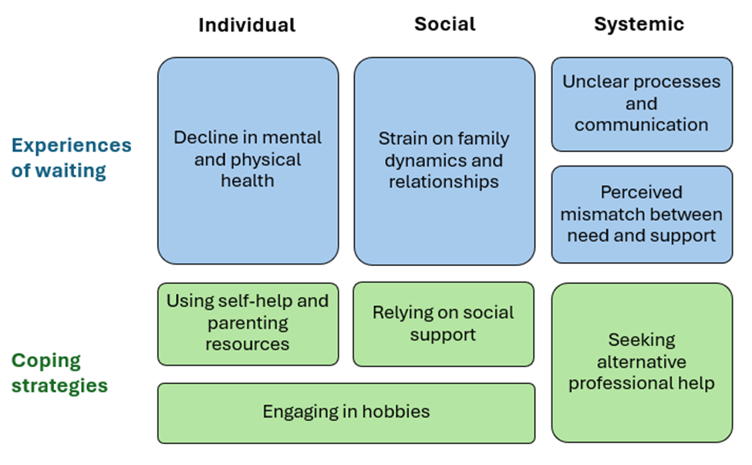
Background
“I got angry at myself more often. And loads of intrusive thoughts, self-harm and I think it did get worse.”
(young person)
Notes:
CAMHS are struggling to meet service demand.
In 2022/23, nearly one million children were referred, of which 32% received support, 28% were still waiting, and 39% had referrals closed before receiving care.

Slide 3

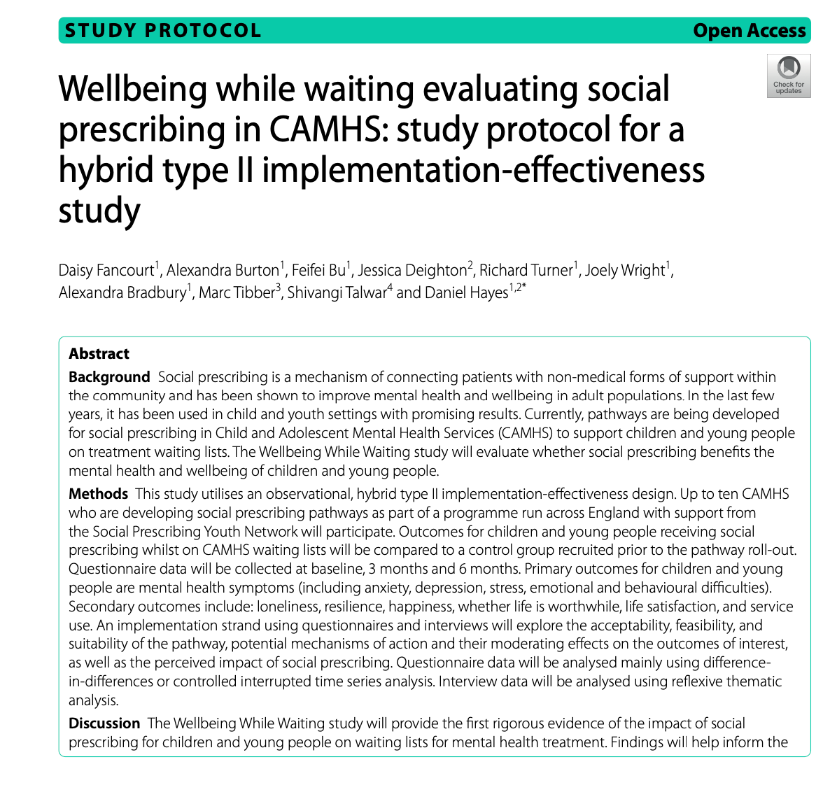
Wellbeing While Waiting: Overview
Phase 1
Co-design of social prescribing pathway
Phase 2
Mixed-methods trial with 600 CYP
Phase 3
Development of implementation model for scaling the pathway nationally
Notes:
To begin to further develop the evidence, we launched Wellbeing While Wating in 2022, which aimed to evaluate the impact of social presciving as an approach to support young people whilst they wait for mental health treatment – as context waiting lists for menta health support are long int the UK, (in the study longest was 1.5 years)
Phase one will involve co-designing a Social Prescribing pathway for CYP on CAMHS waiting lists for moderate mental health conditions, developing protocols, resources, and training for the delivering of this pathway and manualising its development.
Phase two will involve undertaking a mixed-methods hybrid type 2 effectiveness-implementation study to assess i) the pathways impact on CYP,, and ii) its acceptability, suitability, feasibility, delivery and cost.
Phase three will involve assessing the overall potential for scaling the pathway to more CAMHS sites, developing an implementation model, and disseminating findings to key stakeholders within policy, practice and research.

Slide 4
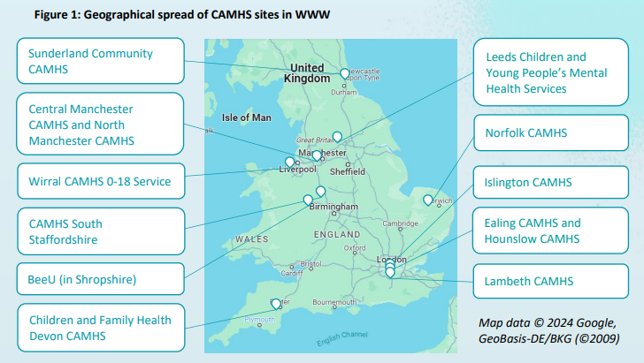
Wellbeing While Waiting: Method
Setting: 11 CAMHS sites across England.
Notes:
Geographically diverse…

Slide 5
Wellbeing While Waiting: Method
Setting: 11 CAMHS sites across England.
Schedule: Recruitment ran from May 2023 to March 2025.
Participants: 568 CYP (224 Control and 344 Intervention) who:
  were aged 11-18 years old
  had capacity to give assent (11-15 year olds) or consent (16-18 year olds)
  who have been on the waiting list for CAMHS treatment for less than one month.
  who were RAG-rated as green/low amber.
  we did not recruit CYP with eating disorders, psychosis or severe and complex difficulties (judged by the assessing clinician).
Control group: Prior to the Social Prescribing pathways going live, a smaller control group of CYP on the waiting list for CAMHS treatment were recruited, who do not currently have access to Social Prescribing.
Data collection: Quantitative measures included: Strengths and Difficulties (SDQ), Depression and Anxiety (RCADS), Stress (PSS), Resilience (Student Resilience Survey), Wellbeing metrics (ONS 3)

Slide 6

Wellbeing While Waiting: Social Prescribing in practice
A snapshot of the interests & hobbies of the young people aged 11-18 we’ve worked with:
Notes:
To begin to further develop the evidence, we launched Wellbeing While Wating in 2022, which aimed to evaluate the impact of social presciving as an approach to support young people whilst they wait for mental health treatment – as context waiting lists for menta health support are long int the UK, (in the study longest was 1.5 years)
Phase one will involve co-designing a Social Prescribing pathway for CYP on CAMHS waiting lists for moderate mental health conditions, developing protocols, resources, and training for the delivering of this pathway and manualising its development.
Phase two will involve undertaking a mixed-methods hybrid type 2 effectiveness-implementation study to assess i) the pathways impact on CYP,, and ii) its acceptability, suitability, feasibility, delivery and cost.
Phase three will involve assessing the overall potential for scaling the pathway to more CAMHS sites, developing an implementation model, and disseminating findings to key stakeholders within policy, practice and research.

Slide 7







Wellbeing While Waiting: Social Prescribing in practice (remote sessions)
Creative prompts
Designing weekly art activities – like themed drawing prompts – that can be completed over video, creating consistent expectations for sessions and opportunities for young people to express themselves and share their feelings
Mentoring exercises
E.g. ‘the ladder of success’
Using individually-adapted mentoring resources to help young people identify their goals, explore what steps they need to take to achieve them, and consider who can help them get there – can take place over the phone!
What matters to you?
Encouraging young people to set their own agenda for sessions and bring topics, feelings, and ideas to discuss – or even their favourite artwork, football jersey or Lego kit as a conversation starter
Notes:
To begin to further develop the evidence, we launched Wellbeing While Wating in 2022, which aimed to evaluate the impact of social presciving as an approach to support young people whilst they wait for mental health treatment – as context waiting lists for menta health support are long int the UK, (in the study longest was 1.5 years)
Phase one will involve co-designing a Social Prescribing pathway for CYP on CAMHS waiting lists for moderate mental health conditions, developing protocols, resources, and training for the delivering of this pathway and manualising its development.
Phase two will involve undertaking a mixed-methods hybrid type 2 effectiveness-implementation study to assess i) the pathways impact on CYP,, and ii) its acceptability, suitability, feasibility, delivery and cost.
Phase three will involve assessing the overall potential for scaling the pathway to more CAMHS sites, developing an implementation model, and disseminating findings to key stakeholders within policy, practice and research.

Slide 8






Wellbeing While Waiting: Social Prescribing in practice (in person sessions)
Getting outside
Providing the support, rationale, and opportunity for young people to get out of the house and into nature or their neighbourhood
Meeting in local spaces
Empowering young people to meet with their link worker in the community and practise the skills needed to engage in activities and everyday life
Accompaniment
Going with young people to groups and activities or supporting them to try something new for themselves
Notes:
To begin to further develop the evidence, we launched Wellbeing While Wating in 2022, which aimed to evaluate the impact of social presciving as an approach to support young people whilst they wait for mental health treatment – as context waiting lists for menta health support are long int the UK, (in the study longest was 1.5 years)
Phase one will involve co-designing a Social Prescribing pathway for CYP on CAMHS waiting lists for moderate mental health conditions, developing protocols, resources, and training for the delivering of this pathway and manualising its development.
Phase two will involve undertaking a mixed-methods hybrid type 2 effectiveness-implementation study to assess i) the pathways impact on CYP,, and ii) its acceptability, suitability, feasibility, delivery and cost.
Phase three will involve assessing the overall potential for scaling the pathway to more CAMHS sites, developing an implementation model, and disseminating findings to key stakeholders within policy, practice and research.

Slide 9
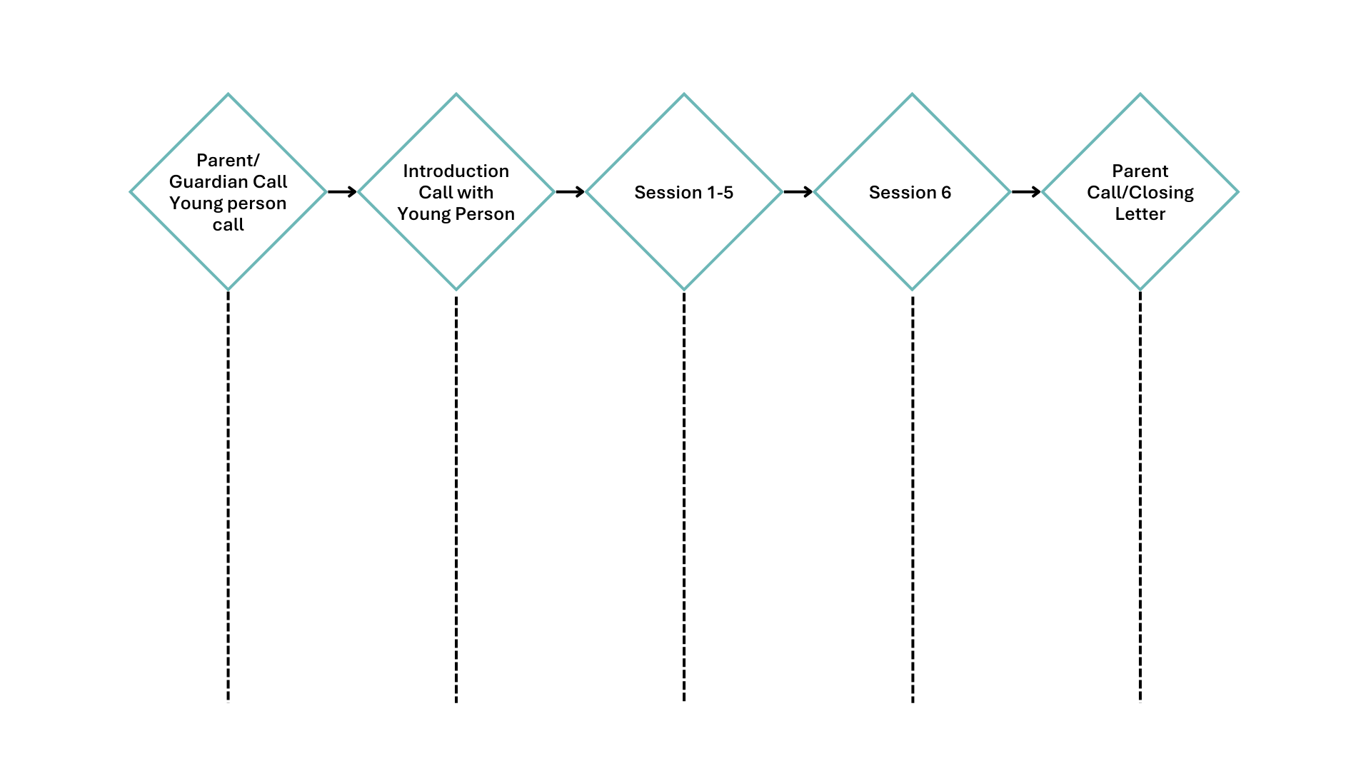




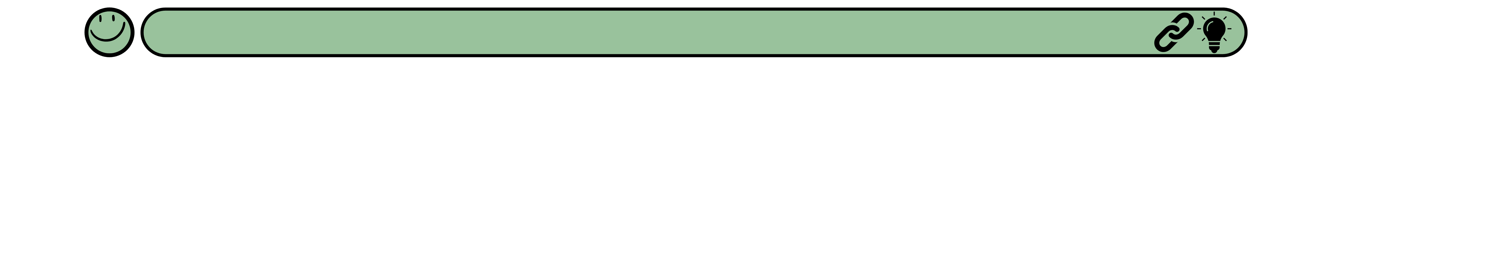
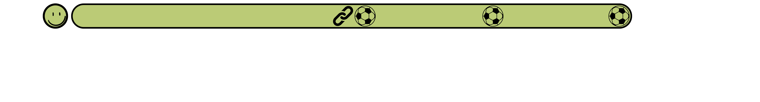

Wellbeing While Waiting: Social Prescribing in practice
Notes:
To begin to further develop the evidence, we launched Wellbeing While Wating in 2022, which aimed to evaluate the impact of social presciving as an approach to support young people whilst they wait for mental health treatment – as context waiting lists for menta health support are long int the UK, (in the study longest was 1.5 years)
Phase one will involve co-designing a Social Prescribing pathway for CYP on CAMHS waiting lists for moderate mental health conditions, developing protocols, resources, and training for the delivering of this pathway and manualising its development.
Phase two will involve undertaking a mixed-methods hybrid type 2 effectiveness-implementation study to assess i) the pathways impact on CYP,, and ii) its acceptability, suitability, feasibility, delivery and cost.
Phase three will involve assessing the overall potential for scaling the pathway to more CAMHS sites, developing an implementation model, and disseminating findings to key stakeholders within policy, practice and research.

Slide 10
Wellbeing While Waiting: Results
 | Total (n=449) |  | Control group (n=201) |  | Intervention (SP) group (n=248)
 | Freq | Mean (SD) / % | Freq | Mean (SD) / % | Freq | Mean (SD) / %
Age | 449 | 13.97 (1.72) | 201 | 13.94 (1.79) | 248 | 14.00 (1.68)
Gender: male | 140 | 31.2% | 59 | 29.4% | 81 | 32.7%
Gender: female | 298 | 66.4% | 134 | 66.7% | 164 | 66.1%
Gender: other | 11 | 2.4% | <10 | 4.0% | <5 | 1.2%
Ethnicity: white | 369 | 82.2% | 157 | 78.1% | 212 | 85.5%
Ethnicity: other | 80 | 17.8% | 44 | 21.9%* | 36 | 14.5%
School meals: yes | 151 | 33.6% | 68 | 33.8% | 83 | 33.5%
School meals: no | 298 | 66.4% | 133 | 66.2% | 165 | 66.5%
IMD 1 (most deprived) | 139 | 31.0% | 51 | 25.4% | 88 | 35.5%*
*IMD 2 | 108 | 24.1% | 55 | 27.4% | 53 | 21.4%
IMD 3 | 91 | 20.3% | 41 | 20.4% | 50 | 20.2%
IMD 4 | 73 | 16.3% | 36 | 17.9% | 37 | 14.9%
IMD 5 (least deprived) | 38 | 8.5% | 18 | 9.0% | 20 | 8.1%
Notes:
In total, 449 participants were included in the analysis (Table 1). The mean age of the analytical sample was approximately 14 years (SD=1.72). About two thirds of participants identified themselves as females, 31.2% as males and 2.4% as other. Regarding ethnicity, 17.8% of participants were from minority backgrounds. Around one third of participants took free school meals. There were 31.0% participants from the most deprived IMD quintile in contrast to only 8.5% from the least deprived quintile. Broadly speaking, the intervention and control groups shared similar socio-demographic profiles except that there was a higher percentage of participants from minority ethnic backgrounds in the control group (21.9% vs 14.5%), and a higher percentage of participants from the most deprived IMD quintile in the intervention group (35.5% vs 25.4%).
Data were analysed using growth curve modelling to depict changes in each of the outcome measures across three time points (baseline, 3-month and 6-month follow-up). Time was modelled as a discrete variable, allowing for non-linear trajectories. In addition to intervention group, predictors in each model included age (centred at age 11), gender, ethnicity, free school meal, and IMD quintiles to account for potential differences at baseline. Moreover, we included an interaction term between intervention group and time variable to assess differences in growth rate by intervention groups. We allowed intercept to vary across participants. Time, however, was treated as fixed across participants due to a small number of time points. All analyses were conducted in Stata V18.0. A p-value < 0.05 was considered statistically significant, and p-value < 0.1 as marginally significantly

Slide 11
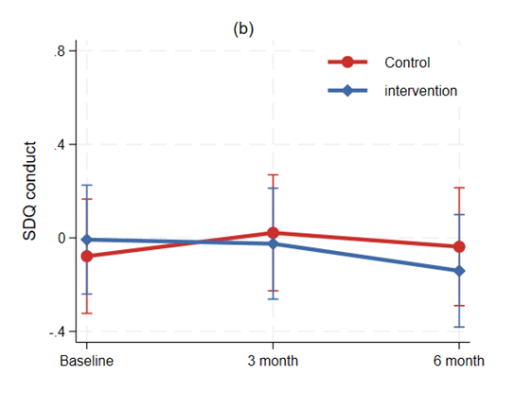
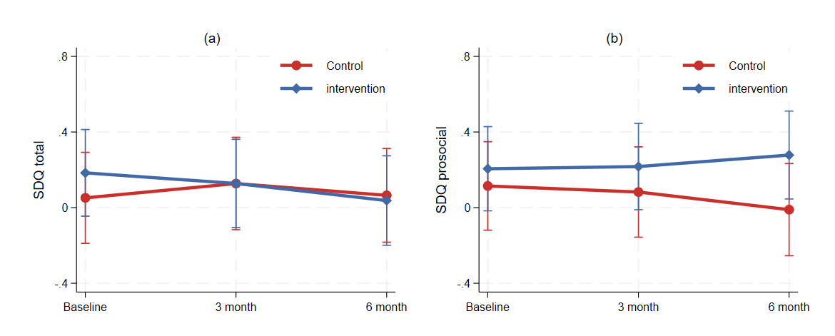
Wellbeing While Waiting: Results
SDQ conduct difficulties*
SDQ total difficulties*
SDQ prosocial behaviour*
Notes:
SDQ is a validated emotional and behaviorula screening questionnaire used in CAMHS to understand the difficulties are facing when it comes to their mental health. It asks young people about their: emotional, conduct, hyperactiviy and peer difficulties, as well as prosocial behaviour. Scores can be looked at by looking across the 4 difficulties subscales (emotional, conduct, hyperactiviy and peer difficulties) to estimate total difficulities, or looked at individually
This shows predicted trajectories by intervention group from the growth curve model on total SDQ difficulties. For the intervention group, total SDQ difficulties decreased by 0.15 SD (95% CI: -0.25 to -0.04, p=0.006) between baseline and 6-month follow-up. In contrast, there was little change by 6-month for the control group (slope: 0.01, 95% CI: -0.10 to 0.13, p=0.822). Zoning in specific domains of SDQ difficulties (Table S1 & Figure S2), we found significant or marginally significant group differences in the rate of change in conduct problems, hyperactivity and peer relationship domains, but no difference in emotional symptoms domain. Figure 1b shows the predicted trajectories of a positive SDQ domain, prosocial behaviour (see also Table S1). The intervention and control groups showed significantly different trajectories between baseline and 6-month (slope difference: 0.20, 95% CI: 0.02 to 0.38, p=0.032). Specifically, the control group experienced a decrease in prosocial behaviours (slope: -0.13, 95% CI: -0.26 to 0.01, p=0.066) in contrast to a slight increase (not statistically significant) for the intervention group (slope: 0.07, 95% CI: -0.05 to 0.19, p=0.242).

Slide 12
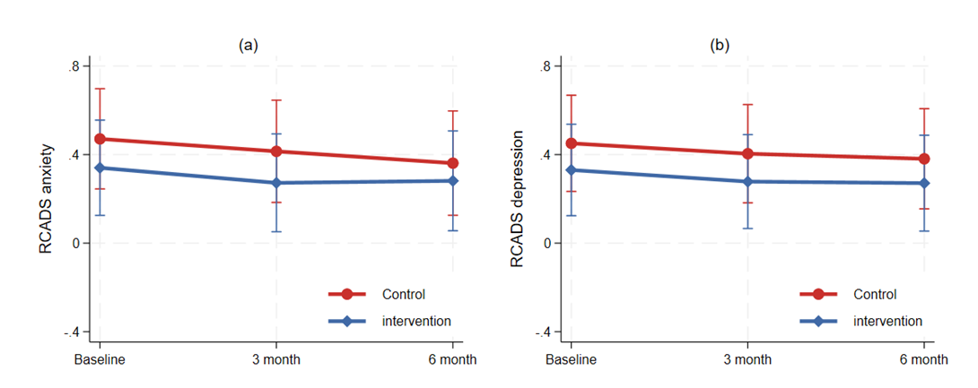
Results: Mental health
RCADS anxiety
RCADS depression
Notes:
RCADS is a validated questionnaire exploring anxiety and depression people. We used the RCADS 11 (11 questions) which explores anxiety and depression.
There were no significant difference at 3 or 6 months for anxiety or depression

Slide 13
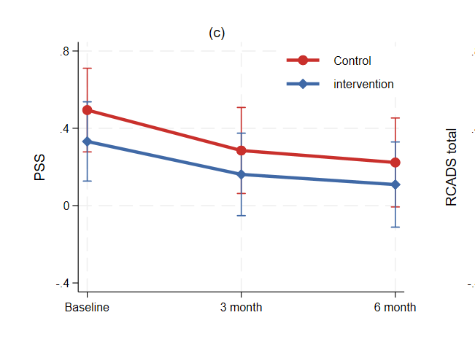
Results: Mental health
PSS total score
Notes:
RCADS is a validated questionnaire exploring anxiety and depression people. We used the RCADS 11 (11 questions) which explores anxiety and depression.
There were no significant difference at 3 or 6 months for anxiety or depression

Slide 14
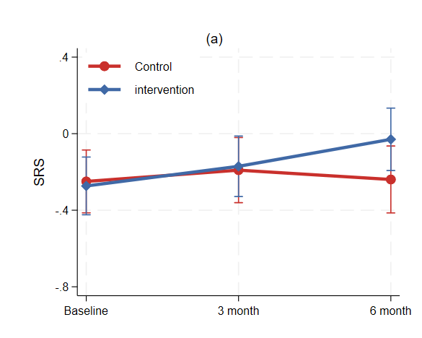
Wellbeing While Waiting Results: Resilience
SRS: Resilience*
Notes:
The student resiliabce survey is a validates meaure of resilisence for young people. It has 12 subscalesmeasuring perceptions of their individual characteristics as well as protective factors embedded in the environment. However, after consultation with our youth advisory group, we only used the following ones, which asked young people about: community connection, participation in community life, self-esteem, empthy, problem solving, and goals and aspriations.

Slide 15
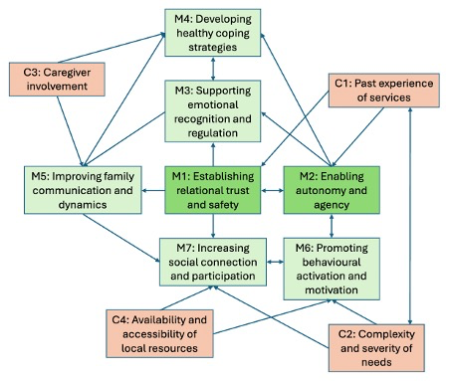
Wellbeing While Waiting: Qualitative Findings (young people and caregivers)
Purposefully sampled 15 young people and 17 caregivers allocated to the social prescribing arm
Majority of young people aged under 14 years
Range of difficulties but age mood difficulties were the most common
7 distinct mechanisms and 4 contextual factors were identified
Notes:
Purposeful sampling included age, gender, difficultues, and location
These were not necessarily dyads of chilren and yonung people
Here is a diagrame showing the 7 different mechanisms and the 4 contextual factors on how they relate, the mechanisms in the darker green were deemed by the research team to be core mechansism based on participants analysis and were present across all young people , whilst those in lighter green are additoinal mechnaisms, which were experienced by some, but not all particpiants

Slide 16
Wellbeing While Waiting: Qualitative Findings
“He was asking stuff about you, trying to get you out of that bubble you have, but not being too invasive... to say this is like your safe space, you can open up.” (Young person_001)
M1: Building Trusting Relationships
“She just had that connection with him, and that's quite unusual for someone that's so unfamiliar to just be able to connect with him on that sort of level. And I think that was because she was so interested in what he was saying to her and she was actually listening and taking in the details and then bringing them up at a later date to make conversation with him.” (Caregiver_007)
“I think one of the things he liked a lot was that [the link worker] said, do you want mum to be there on the phone call or not? And he could just say no, I don't want her on the phone. So, it became his. I could see his face light up. It was almost like this has got nothing to do with you, mum. This is just me.” (Caregiver_015)
M2: Enabling autonomy and agency
Notes:
M1: Nuilding Trusted relationships
Building a trusted relatoinship as foundatoinal between the link worker and young person that enabled engagemnt and therapeutic benefit. Many young people felt nervous about meeting a new professional (often as they had had previous negative experieces with sevrices, as well as due to undelying anxiety from mental health. Building a trusted relatoinship hiunged on the link workers non0judgemental and stregtns based approach [quuote
Caregivers were often surprised at how well their child connected with their link worker, attributing this to strong listening and communication skills [quote]
Another central mechanism of social prescribing was the opportunity for young people to exercise autonomy and agency over where, how, and with whom support was delivered. Young people particularly valued the opportunity to co-create session plans and referrals to activities based on their preferences and interests. Often yong people hadbt bene able to excerise choice nefore so this was the first opportunity they had, this ranged form how to socal prescrbing was delivered, to the activities they were interested in

Slide 17
Wellbeing While Waiting: Qualitative Findings
C2: Complexity and severity of needs
“I think every child is obviously going to be different and some children will happily engage... It might be that a child who has just got mental health issues will probably be able to engage, whereas children with SEN won't necessarily be able to, they will probably need different accommodations depending on the child.” (Caregiver_006)
““It’s very difficult supporting a child who's got anxiety and trying to react to the anxiety with your own anxiety about it. So, just having somebody to help navigate the deep waters and knowing that they are there if you need them really does mean a lot.” (Caregiver_004)
C3. Involvement of caregivers
Notes:
Some young people with more complex presentations – such as neurodivergence, trauma, and severe social anxiety – faced greater barriers to engaging in link worker meetings and community activities. Ti successfully7 navigate this, link worker had to be more creative in terms of how they approached social prescribg with young people, but this also took up more time [quote]
Caregiver involvement, when in line with the young person’s wishes (M2), enhanced the impact of social prescribing by reinforcing key mechanisms, particularly in relation to developing healthy coping strategies (M4) and improving family communication (M5). When appropriately engaged, caregivers often felt better equipped to support their child and more supported with their own mental health [quote]
Conversely, lack of caregiver involvement could create gaps in understanding by the link worker and missed opportunities to address young people's evolving needs:

Slide 18
Innovation
Evidence for innovation
Relative advantage
Individuals
Social prescribers
Outer setting
Adaptability
Inner setting
Partnerships and connections
Financing
Local attitudes
Work infrastructure
Available resources
IT infrastructure
Staff
Implementation process
Assessing needs
Adoptability
Implementability
Anticipated implementation outcomes
Doing
Engaging recipients
Sustainability
Innovation outcomes
Innovation recipient impact
Innovation deliverer impact
System impact
CFIR Framework (2022)
COM-B barriers and facilitators
COM-B barriers and facilitators
COM-B barriers and facilitators
Wellbeing While Waiting: Qualitative Findings (CAMHS Staff a Link Workers)
Purposefully sampled 23 participants (11 LWs and 12 CAMHS staff
Analysed using Consolidated Framework for Implementation Research 2022 to help investigate implementation factors (and COM-B where relevant)

Slide 19
Wellbeing While Waiting: Qualitative Findings
“The evidence base for depression is that the behavioural activation part of it actually makes the biggest difference. Other parts of adult mental health services, for example, if you look at the first episode of psychosis service or chronic like long-term illness services… they'll have specific vocational workers. And the vocational worker in essence is a social prescriber.” (CAMHS worker)
Innovation: Evidence
“Social prescribing depends upon an active and thriving voluntary sector. So it's all well and good to say we've got a team of social prescribers, and we're gonna refer people out to voluntary sect activities. If that voluntary sector is not adequately resourced and adequately funded you, social prescribers have got nothing to link people in with” (CAMHS worker)
Outer setting: partnerships and financing
Notes:
Whilst the evidence base was descibed as promising in terms of social prescribing and hence the aim of the trial, CAMHS woker could pull out specific aspcts of it which had evidence bases which they could see would have a clear benefit, including behaviorual actibvation, motivational intervieinwg
Potentila barrier was partnerships an financing. Howeverm, in general in WWW we, and link workersfound lots of differen activities, during asset mapping, even in very rural locations

Slide 20
Wellbeing While Waiting: Qualitative Findings
“I think the main challenges for us really were kind of embedding the support within CAMHS services. So that was more from like their data security requirements and ensuring that we were able to, yeah, fully embed ourselves within the support that they provided.” (Link Worker)
Inner setting: Infastructure
“Young people could still be deteriorating, so if a young person has gone in with, say, an autism diagnosis, they really need specialist support to help them in their day-to-day life. Then I'm not the person for that, I'm there for a chill and a hang out and we can have fun together. But I can't talk about the specialist things. I can't put things in places with school to kind of sort that.” (Link Worker)
Individual barriers
“I think a really big thing is retaining link workers and that includes upskilling them. I think that includes good clinical supervision and also managing workload and capacity.” (Link Worker)
Notes:
Infasturcture – whilst aspects such as saefgurading were prt and parcel of everybodies role, Link workers, who were not empoyed by CAMSHS but worked alongside CAMHS did speak about information sharing and data security requirements, including where to store records and what information could be shared by CAMHS with them, having an honoary clinical contract often mitigated against this
Individul barriers were making sure referrals were approprate and making sure that stakeholders were clear about what social prescirbing is and how it cudl help and not leaving the young person 'stck' withoonly the link eowker when they have specific questions on medications or how to get support form schools with mental health
Good clinical supeorvisoin was ongoing as part of WWW, however, we know more widely this is quite hit and miss

Slide 21

Wrapping up
This is the first robust trial to demonstrate social prescribing can positively impact mental health difficulties for young people
Novel findings, in addition to above, are an increase in resilience
This suggests that social prescribing could be an effective tool in helping support youth mental health in specialist setting whilst they wait for treatment

Slide 22
Our vision
To have a fully developed and tested model
for embedding Social Prescribing within CAMHS waiting lists
that can be implemented for all CYP across CAMHS nationally
Notes:
Our overall vision when we set out with this grant was that we would have a fully developed and tested model for embedding Social Prescribing within CAMHS waiting lists that can be scaled nationally, bringing Social Prescribing to more CYP who could benefit from it.

Slide 23

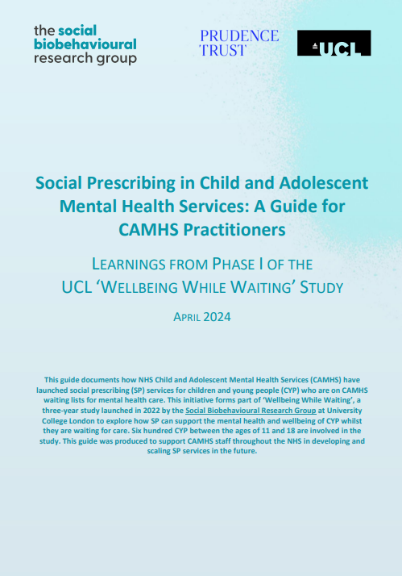
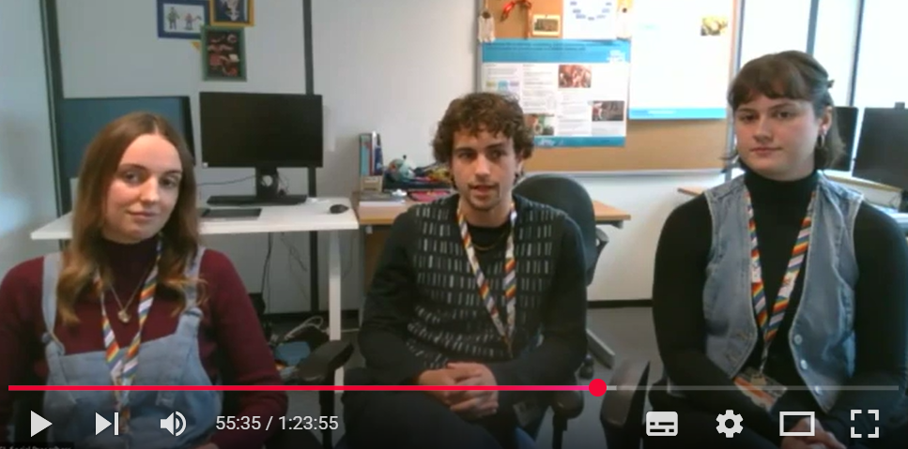
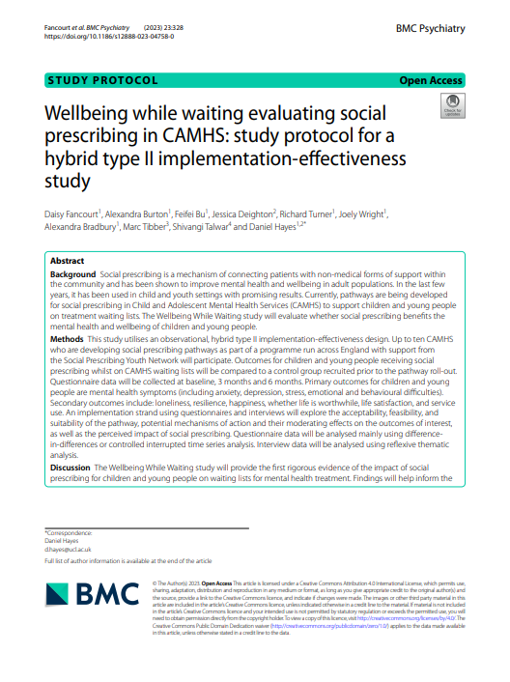
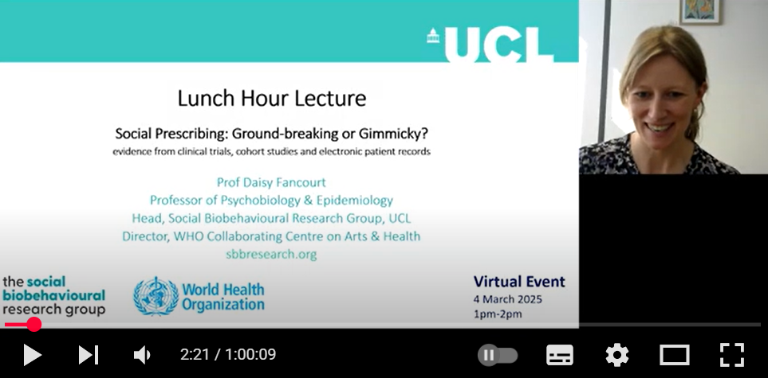
Further Resources
sbbresearch.org/projects/wellbeing-while-waiting-inspyre/
More to follow – subscribe to our newsletter for updates…
Practical guides Webinar recordings Academic papers
Notes:
Tracking uptake of CAMHS

Slide 24


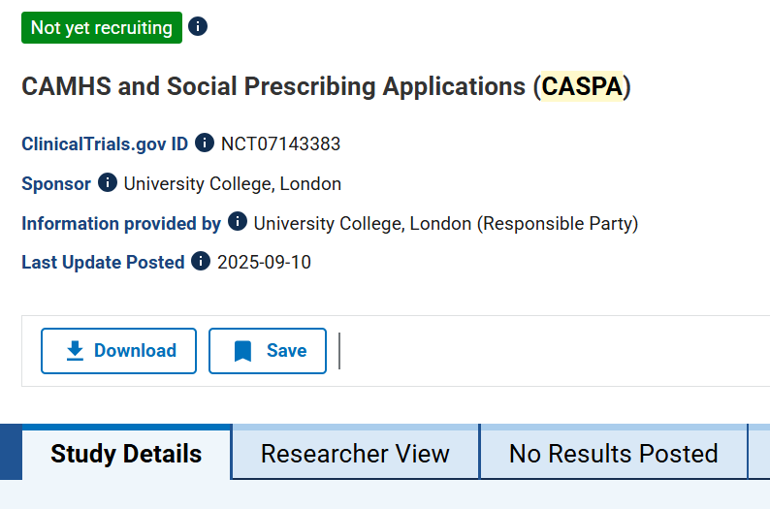


CASPA
CAMHS And Social Prescribing Applications
Hayes et al. (under review)
Notes:
We are also continuing research into SP in CAMHS…

Slide 25
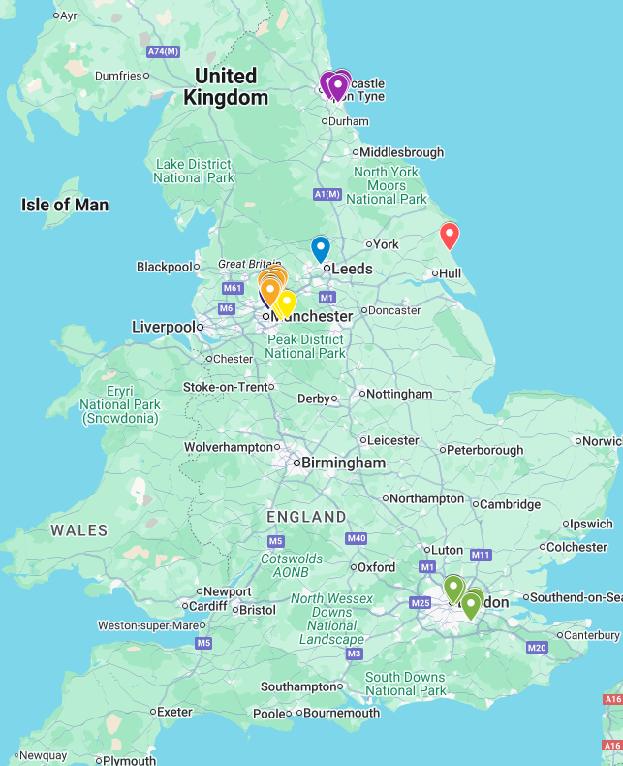
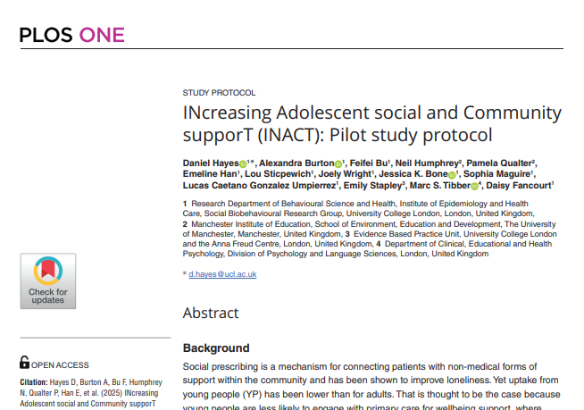
INACT
INcreasing AdolesCent social & community supporT
Hayes et al. (2025) Plos One
Notes:
And broadening to consider other pathways that could help to prevent CYP needing CAMHS support later on

Slide 26








SPYN members can access:
Networking events & peer support
Opportunities to shape policy
Practical resources
News from the sector
Latest research
Training
Members include…
Link workers
Social prescribing coordinators
Voluntary and community workers
Commissioners
Funders
Policymakers
Health professionals
Researchers
… in the UK and beyond
Notes:
For people interested in CYP SP, we highly recommend that they join SPYN
Membership of SPYN is free and open to all. We see representation from all kinds of stakeholders (give examples from slide).
Members can get involved with a range of opportunities, including:
Coming to our online events to connect with other people working in the field
Helping to shape policy by sharing their insights with decisionmakers
Accessing resources on our website as well as practical training
Receiving latest updates and research from the sector, shared via our regular newsletter and webinars presenting new developments in youth social prescribing

Slide 27
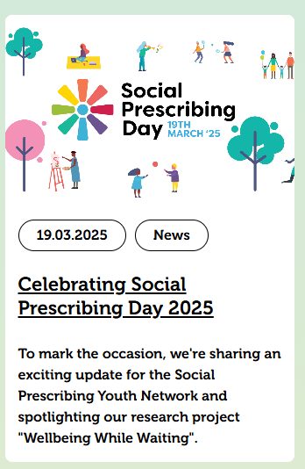
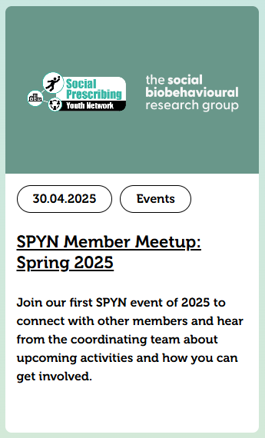
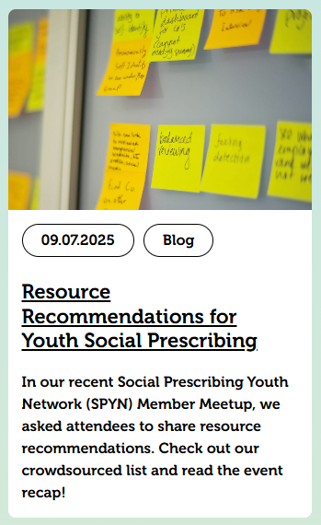

SPYN activities so far this year:
Notes:
Note: I have framed as so far this year as we only really started SPYN activities in Spring 2025 once we had funding confirmed, although it was handed over to us in late 2024.
We celebrated Social Prescribing Day in March by announcing we had secured new funding for the Social Prescribing Youth Network, enabling us to undertake an exciting programme of activities engaging with network members and identifying best practice for the field.
We have since brought together SPYN members in two online Meetups to connect with each other and shape the network’s upcoming activities (Note: the second will take place 16th October, which I assume will be before you present this).
We have refreshed the resources available to SPYN members on our website, drawing on SPYN’s past work with NHS England & NHS Improvement and pilot projects across the country, our latest research into youth social prescribing at UCL, and crowdsourced resources suggested by SPYN members.
In addition to convening our Advisory Board, we have set up a brand new Youth Advisory Group – a diverse group of 10 young people (aged 16-21) from across the UK. Members have experience of health difficulties/challenges and are interested in sharing their voice and improving healthcare and support for young people. We have had three extremely valuable meetings so far, informing our policy work (next slide).

Slide 28
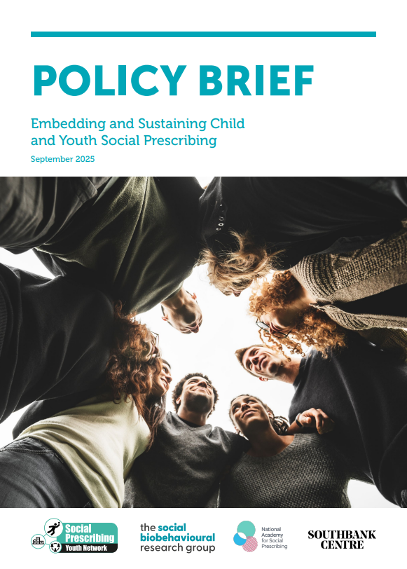
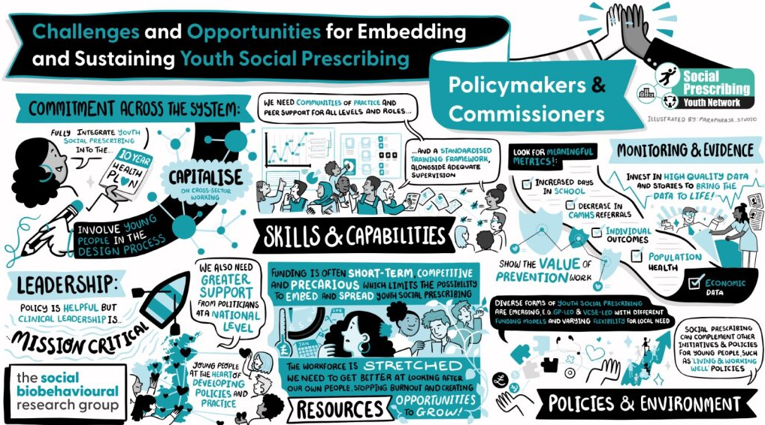
SPYN’s current work to identify best practice for youth social prescribing
Join the Network to take part: sbbresearch.org/spyn
Notes:
Furthermore, right now SPYN is in the middle of an exciting programme of work to convene different stakeholders and identify best practice for youth social prescribing.
So far this year we have hosted three roundtables with 1) policymakers and commissioners from across England, 2) researchers and academics internationally and 3) link workers and practitioners from a range of services. We’ll be continuing the conversation with 4) young people and 5) third sector organisations shortly (scheduled for 17th Nov and 13th Nov respectively).
On the slide you can see the outputs from our first policy-focused roundtable: an illustration of the conversation accompanied by a policy brief. In summary, we heard that some brilliant youth social prescribing work is already taking place across England. However we also identified the gaps which need addressing when it comes to embedding and sustaining social prescribing for young people. Our message to policy stakeholders is that with greater commitment, leadership, training, resourcing, evidence and policy support we can scale youth social prescribing and realise its potential as a tool to address urgent health challenges.
We will continue to share back our learning from these discussions in the form of illustrations, blogs and events for SPYN members. This work will be completed by early 2026, at which point we will produce best practice guidelines and a free online training to summarise and disseminate our findings. We will launch these resources at an event with national policy stakeholders at the Southbank Centre in February.
If you aren’t already a member then do join SPYN to get involved in this work and receive our latest updates straight to your inbox.

Slide 29
Quote from a young person and parent/caregiver
“[My link worker] really helped me get back into social groups and social settings... [The group sessions] are really fun and I've been able to make a lot of friends from them. They’re a big support in my life and they've definitely helped... 'Cause I can talk to people easier and just be in the same room as a bunch of people easier [sic].” (Young person_012)
“The people on the team, which I think is quite a social thing for him, being part of a team and being good enough to be on the team because [my child] has always struggled with low self-esteem. And he seems to be quite popular with older kids too. So, it's building him up, he's really benefiting from it.” (Caregiver_015)
Notes:
Our overall vision when we set out with this grant was that we would have a fully developed and tested model for embedding Social Prescribing within CAMHS waiting lists that can be scaled nationally, bringing Social Prescribing to more CYP who could benefit from it.

Slide 30












Wellbeing While Waiting Team
Professor
Principal Research Fellows
Coordinators & Managers
Rachel Marshall
Dr Feifei Bu Dr Dan Hayes
Prof Daisy Fancourt
Nikita Arslanovski
Research Fellows/Senior Research Fellows
Research Assistants and Link Workers
Joely Wright India Stuttard Lou Sticpewich Joanna Page

