Slide 1
NASP Webinar: Social Prescribing Link Workers and Occupational Therapists - Working Together in Practice
Thank you for joining us. The webinar will begin shortly.

Slide 2


Housekeeping
Please note we are recording this webinar - you will be sent the slides and the link to the recording, and they will be on NASP's website too.
Please submit questions via the Q&A function. We will hold a Q&A session at the end of presentations.
Please use the chat function for introducing yourself and networking. If you have any technical issues, please raise these in the chat, and a member of the NASP team will assist.
Closed Captions are available (turn these on at the bottom of your screen.)
Everyone comes with different experiences and viewpoints. Let’s keep an open mind and learn from one another.

Slide 3

Overview
Chair:
Monica Boulton, Strategic Lead for Neighbourhood Health at National Academy for Social Prescribing
Speakers:
Co-host: Joanna Vallom-Smith, Royal College of Occupational Therapists
Claire Shanahan, Highly Specialist occupational Therapist in older people’s mental health and dementia, Bradford District Care NHS Foundation Trust
Kimberley Dutton, Senior Occupational Therapist and Primary Care Lead, Sport for Confidence
Yasmin Zaman, SPLW, Sea City Partnership in Southampton

Slide 4

Working together: Guidance for occupational therapists and social prescribing link workers

Slide 5

Why this matters now
d
  People want more involvement in their healthcare decisions ⁴
  There is a rising complexity of need in both health and social care systems. Demand is often being driven by social determinants. This has led to system, workforce and capacity constraints.
  Neighbourhood health represents a shift to place-based care with personalised, prevention-focused models key to success. This will lead to the growth of multidisciplinary neighbourhood teams.
  Widening gap between life expectancy and healthy life expectancy ²
  Policy direction within both DHSC & DWP is shifting due to the recognition of the link between work, health and inclusion, particularly the link between economic inactivity and long-term conditions.
  Increase in people living with Long Term Health Conditions³

Slide 6
01
02
03
Moving from fragmentation to collaboration
Current reality
What people need
The opportunity
Clinical & Non-clinical working in silos with unclear roles and boundaries often leading to parallel working.
Personalised, whole-person support focused on what matters to them with support across function, confidence & social connection.
People get the right support at the right time due to seamless MDT working and shared ownership of patient outcomes.

Slide 7
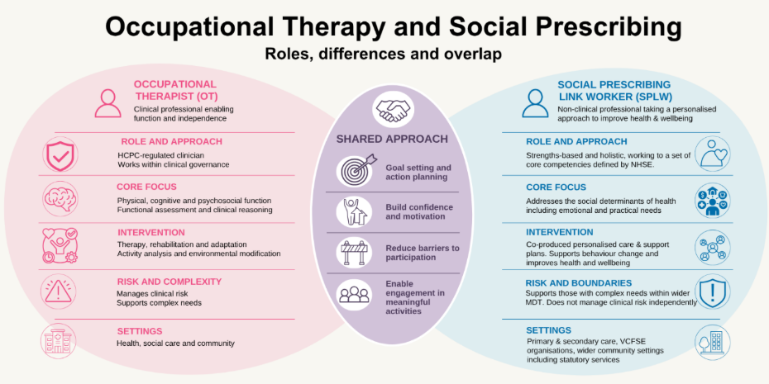

Slide 8
Shared values & principles whilst encouraging role clarity, boundaries and identifying areas of overlap.
Our guidance for SPLWs and OTs includes
Tips for establishing referral pathways and how SPLWs & OTs strengthen multidisciplinary team working
Guidance on risk management, supervision and governance considerations to ensure safe & effective practice.
Case studies and examples of where collaboration is working well
Notes:
Government has previously recognised employment as “one of the most important determinant of physical and mental health”
On the final point: Health worsens as the number of negative job aspects, such as low job satisfaction and securtiy, increases.

Slide 9

Occupational Therapist and Social prescribing Link Worker Joint work case studies
By Claire Shanahan, Highly Specialist OT in Older people’s mental health and dementia/memory services

Slide 10
Enabling the client’s transfer back to primary care
Gentleman in late 60s
Health Anxiety
Care coordinated in Community Mental health services for a year
Complex family dynamics
Needed time for himself and his social life
Wanted to be in a walking group and enjoyed talking about cars
Need to continue practice of anxiety management
Notes:
An occupational therapist (OT) had been supporting a gentleman with recovering from health anxiety in a community mental health setting, and he had reached a stage of recovery where primary care was more appropriate. He was then referred to a social prescribing link worker (SPLW) for further support. The OT and SPLW completed 2 joint visits to introduce the client and to make sure the social prescribing link worker was comfortable with lone working while considering family dynamics. The SPLW was happy to continue supporting the client to find suitable activity groups and facilitate some short-term mindfulness to support the gentleman to manage his anxiety. The gentleman completely recovered, joined a walking group and has not returned to secondary mental health care. Additionally, the SPLW maintained access to supervision through a mental health professional working at the GP surgery and could consult and raise concerns with the OT in the community mental health team if needed

Slide 11
Occupational Therapist (OT) Supervising Social Prescribing Link Workers (SPLWs)
Band 7 OT supervising 3 SPLWs in an Ageing Well Service targeting those who don’t engage with the GP often and frailty
Individual supervision once every 3 months and more frequent when joint working with complex clients
Group supervision the following month
Each SPLW has supervision from the Clinical Director/GP once every 3 months
Supervision is a safe space to bring challenging situations, complex cases, also for identify training needs, exchanging information and ideas
Notes:
As part of our ageing well service an occupational therapist (OT) supervises three social prescribing link workers (SPLWs). The OT supervises each SPLW individually once every three months. The other two months are split into facilitating group supervision and then each SPLW has supervision from the clinical director on the following month. This is formal supervision built into the service and informal supervision is also included when people need it. Supervisions are spaces where people can bring complex cases, identify training needs, discuss new projects, utilise as a safe space to bring challenging situations and exchange new information. Social prescribing Link Workers have identified this as a good support system that enhances their roles, responsibilities, and professional practice.

Slide 12
Joint working in Primary Care
Lady with long term condition of Fibromyalgia
Physical symptoms including pain and fatigue and enjoys gardening
OT-Assessment of current ability to garden then Pacing/energy conservation advice and equipment purchase (advice to grade/adapt the activity)
Referral to Social Prescriber from OT through the electronic system
Joint visit to introduce the lady and situation
Social Prescriber-few visits to support gardening advice put in place and signpost to services/groups. OT will supervise SP here
Notes:
The social prescribing Link worker (SPLW) and occupational therapist (OT) both work in primary care. After referral to the SPLW the SPLW and OT conducted a joint visit to the person’s house as they enjoy gardening but have been unable to participate due living with the physical symptoms of fibromyalgia. The OT was able to go through pacing/energy conservation advice with the person, as well as review their outdoor mobility to adapt the activity making it more accessible. The SPLW colleague now plans to carry out a few visits with the person to do some gardening with them, help build a rapport and further signpost to services in the local area. The OT continues to support their SPLW colleague with this person through supervision/advice and guidance and support the person with building fatigue management strategies. The supervision enables the SPLW to continue to socially support the client to reach their goals.

Slide 13
Thank you for your time. Questions at the end!

Slide 14
Kimberley Dutton, Senior Occupational Therapist and Primary Care Lead, Sport for Confidence

Slide 15


Working Together: Social Prescribing and Occupational Therapy
Yasmin Zaman
Social Prescribing Link Worker

Slide 16

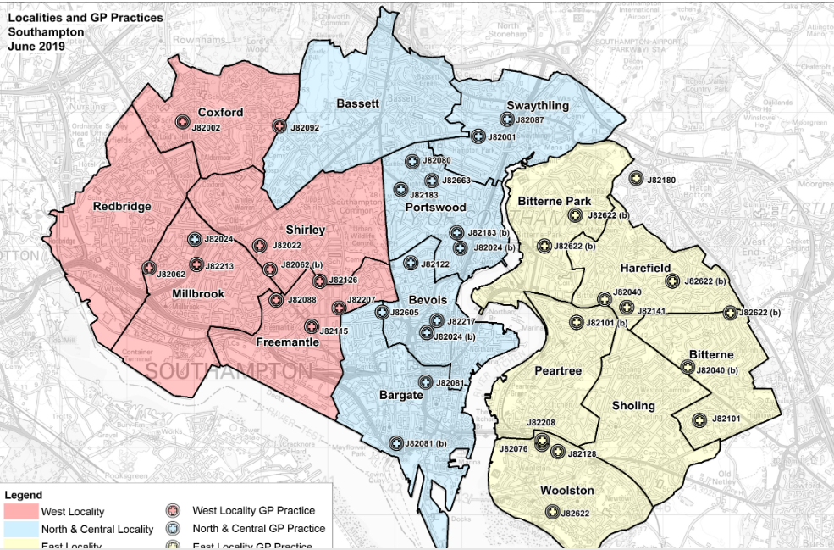

Sea City Partnership Context:
Deprivation:
Sea City Patients: 38,000
Ranked 76TH out of 296 local authorities
29% live in 10% most deprived LSOAs in England
11.8% living with fuel poverty
(Source: Index of Multiple Deprivation 2025)
Notes:
Central is the most populated neighbourhood and is culturally and ethnically diverse - large student population.
Unemployment is significantly higher than the city average.
Central has some of the most deprived areas of the city.
29% of residents here live in IMD1 (England’s most deprived 20% LSOAs). LSOA E01032755 in St Marys is the second most deprived LSOA in Southampton.

Slide 17


Working Together 1:
A 62 year-old woman with sight impairment referred by OT from East Hampshire Community Learning Disability Team.
OT support: confidence building & activities in supported living.
SPLW support: a) explored preferences (support worker involved); (b) social interaction outside home – befriender for walks & café visits.
SPLW regularly updated external OT on progress and outcome – pen pal group for LD.

Slide 18
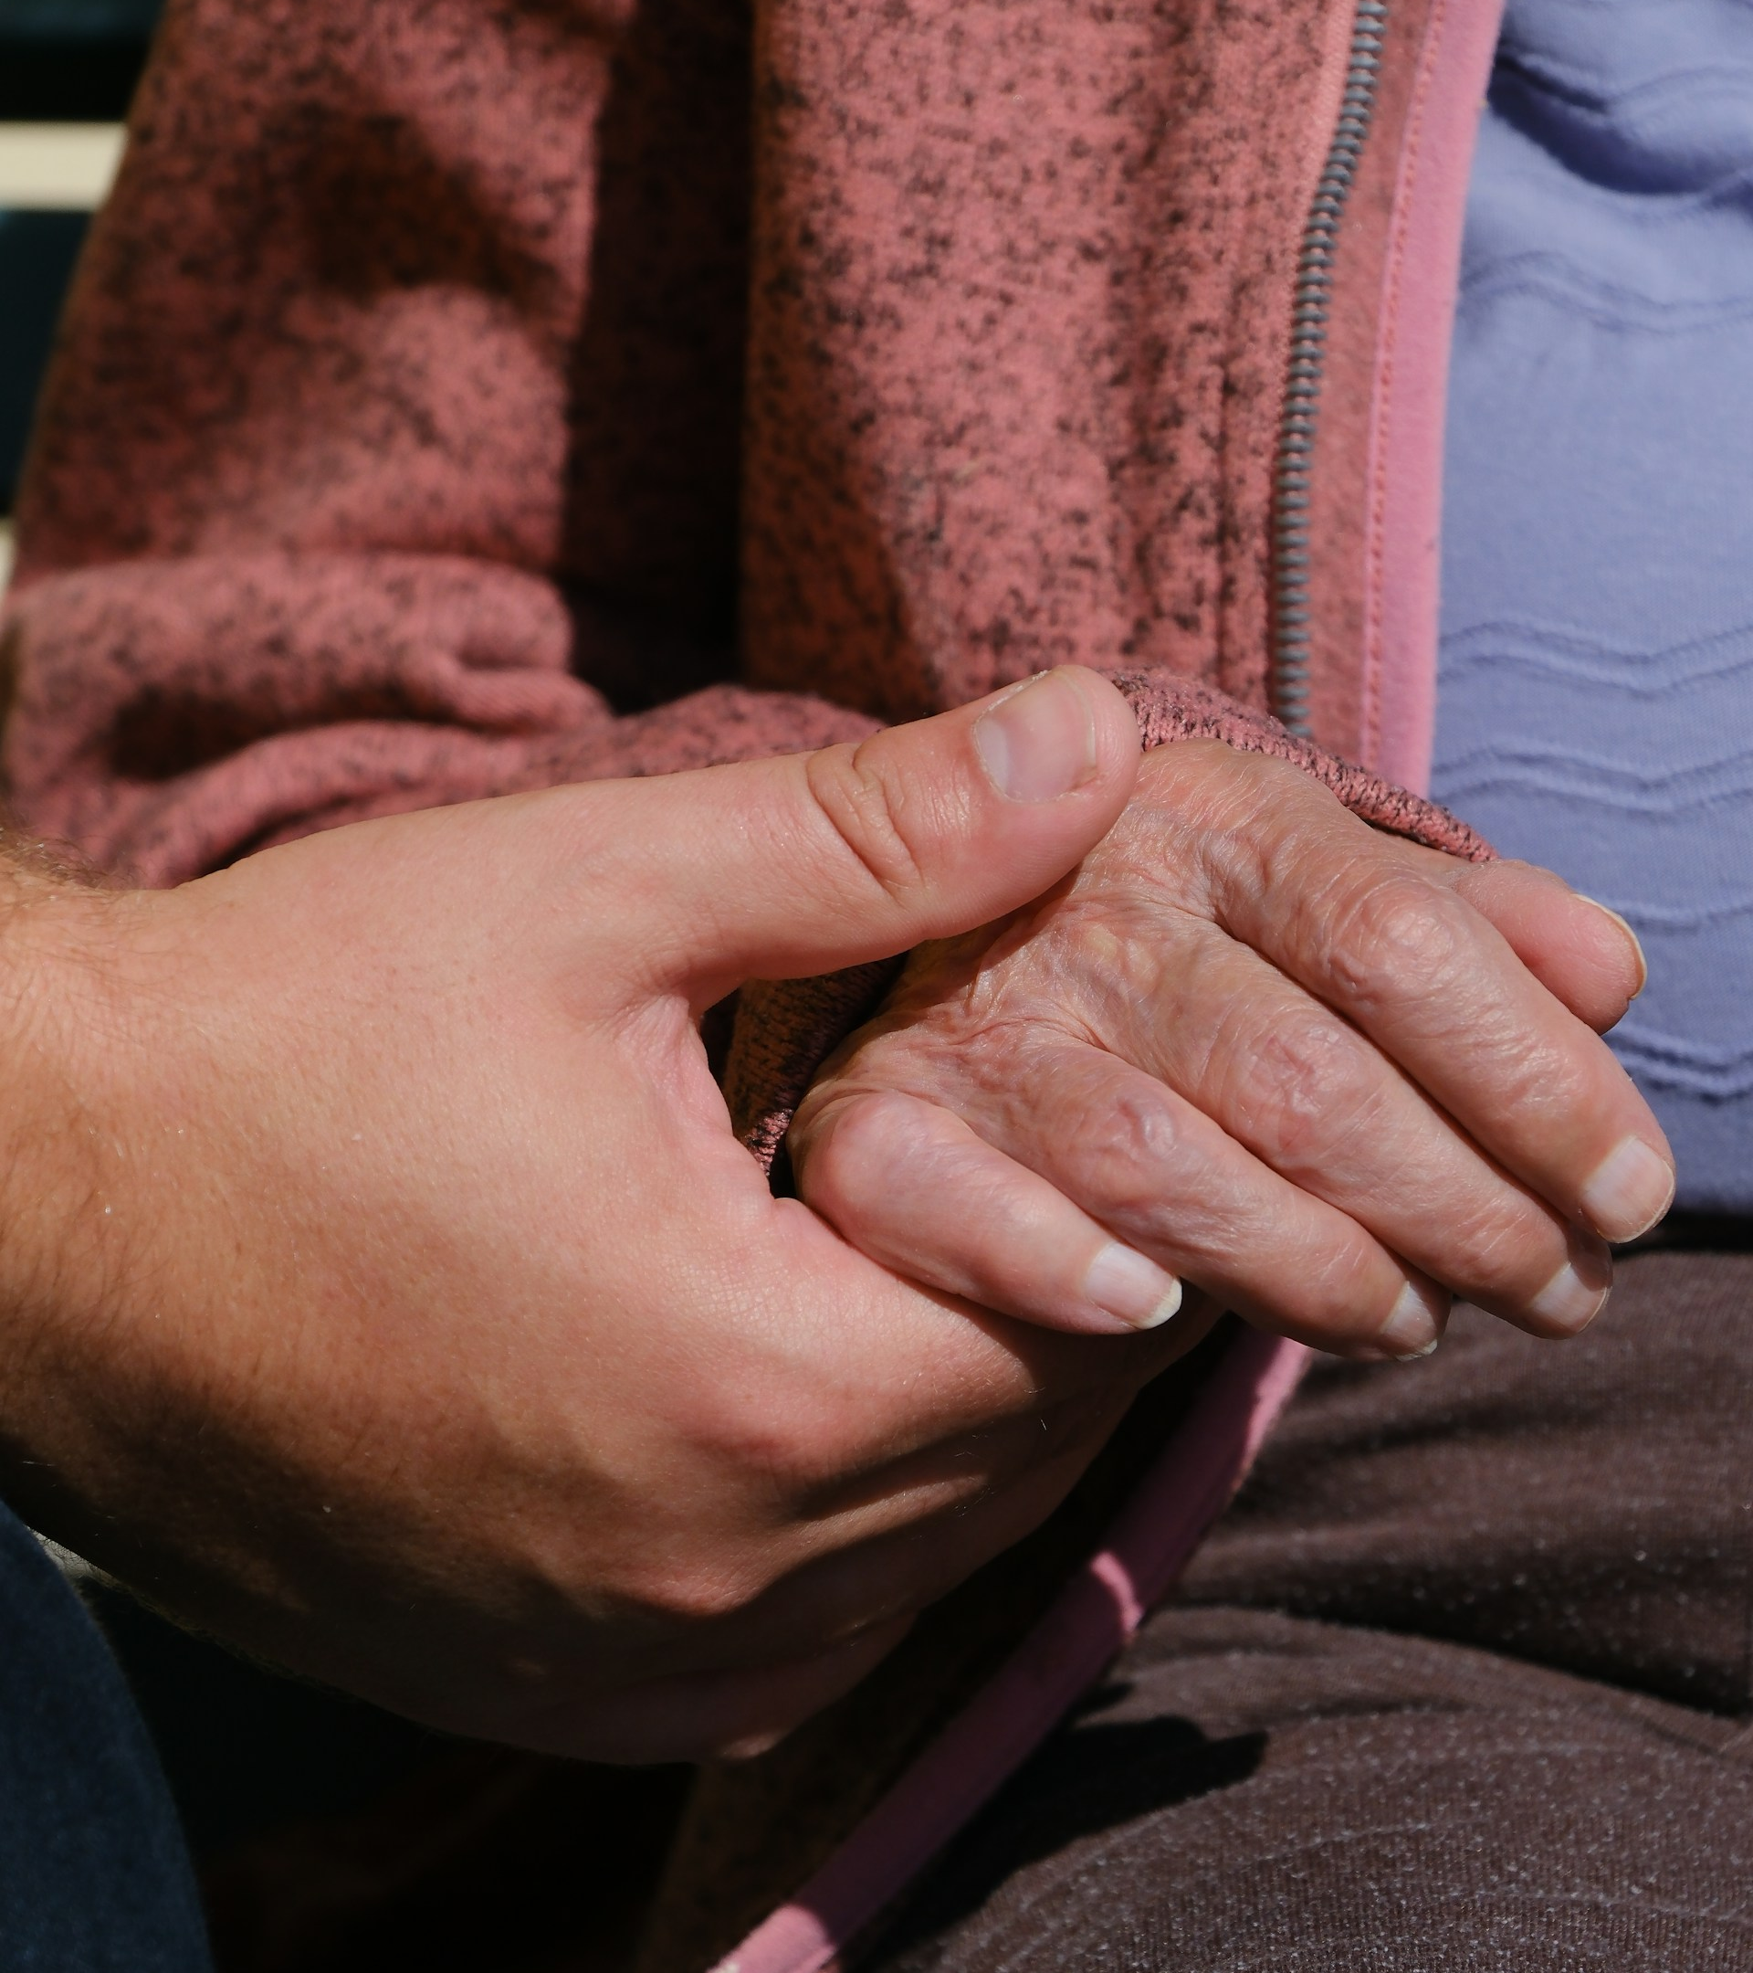
Working Together 2:
A 79 year-old man referred to SPLW by GP for housing support.
Initial visit raised concerns about financial abuse & unsafe living conditions.
SPLW: safeguarding referral to Adult Social Care, Housing & local mosque, highlighting need for home assessment.
Set up MDT, co-ordinated communication and decision making across teams, ensured actions completed and opportunities for joint reflection during and post case closure.
OT: assessed functional needs, environmental risks and arranged immediate safety adaptations.
This approach enabled timely risk management with SPLW co-ordinating person-centred support.

Slide 19
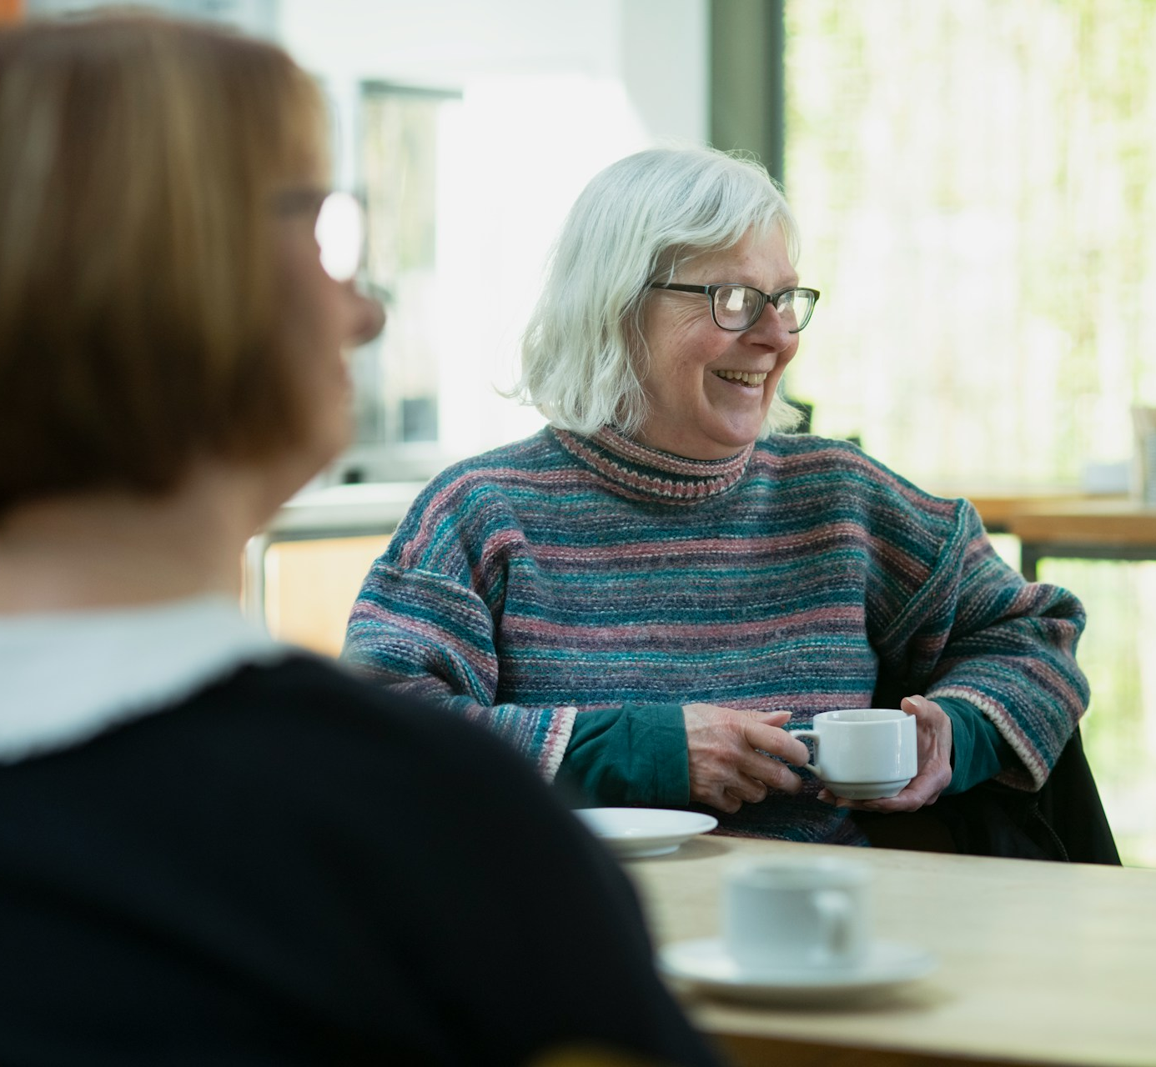
Working Together 3:
Sea City OT supporting 50 year-old visually impaired woman with significant mental health issues & deteriorating respiratory health.
SPLW asked to support with (a) benefits, (b) housing due to damp and mould & risk using stairs in building without lift.
SPLW support: Personal independence Payment, local environmental agency for help with the damp and mould, Adult Social Care referral to ensure earlier Care Act referral in progress.
Co-working with internal OT & agreement on areas of intervention.

Slide 20


Get in touch
socialprescribingacademy.org.uk
Q&A

Slide 21

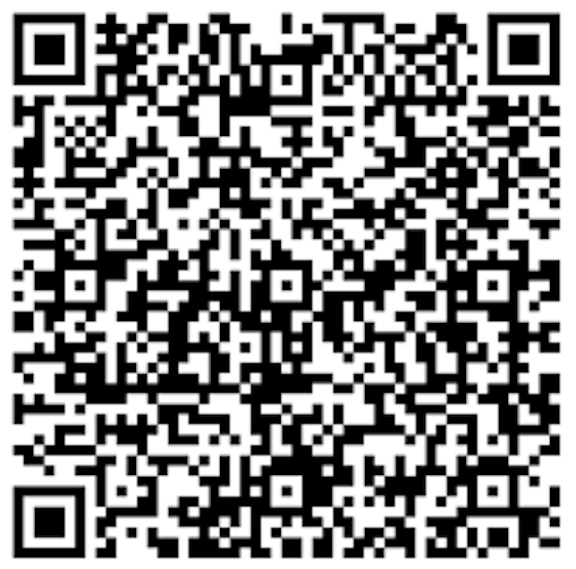

Become a Social Prescribing Champion!
Champion the role of social prescribing in supporting people’s health & wellbeing
Raise awareness of social prescribing within your workforce, locality & region
APPLY HERE
NASP Social Prescribing Champions raise awareness of social prescribing within their workplace or profession. The scheme is open to a variety of clinical and non-clinical professionals working across the healthcare system to raise the profile of social prescribing.
When you become a Social Prescribing Champion, you will join a network of over 400 professionals, receive a digital badge & lanyard to recognize your contribution to social prescribing, and receive access to exclusive learning opportunities and resources to support your role.
spchampions@nasp.info
Advocate, promote and share the work of NASP
Support a collaborative, whole system approach to social prescribing
Feedback any local initiatives, case studies & exemplars of social prescribing practice
Commit to a core set of values

