Slide 1
NASP webinar: Faith and social prescribing
Thank you for joining us. The webinar will begin shortly.

Slide 2
Housekeeping
Please note we are recording this webinar (you will be sent the slides and the link to the recording, and they will be on NASP's website too.)
Please submit questions via the Q&A function. We will hold a Q&A session at the end of presentations.
Please use the chat function for introducing yourself and networking. If you have any technical issues, please raise these in the chat, and a member of the NASP team will assist.
Closed Captions are available (turn these on at the bottom of your screen)
There will be a short poll at the end asking you for your feedback about the webinar.

Slide 3
Overview
Chair:
Jim Burt, Executive Director of Strategy, The National Academy for Social Prescribing
Speakers:
Esther Platt, Senior Consultant, Good Faith Partnership
Dr Marianne Rozario, Senior Researcher and Projects Lead, Theos
Dr Shahzad Amin, Trustee Khizra Mosque/Lead for community outreach and health promotion
Geetha Maheshwaran, Director for RE, Culture & Communities

Slide 4
Jim Burt, Executive Director of Strategy The National Academy for Social Prescribing Welcome and Introduction

Slide 5
Esther Platt, Senior Consultant, Good Faith Partnership and Dr Marianne Rozario, Senior Researcher and Projects Lead, Theos Creating a Neighbourhood Health Service: The role of churches and faith groups in social prescribing

Slide 6
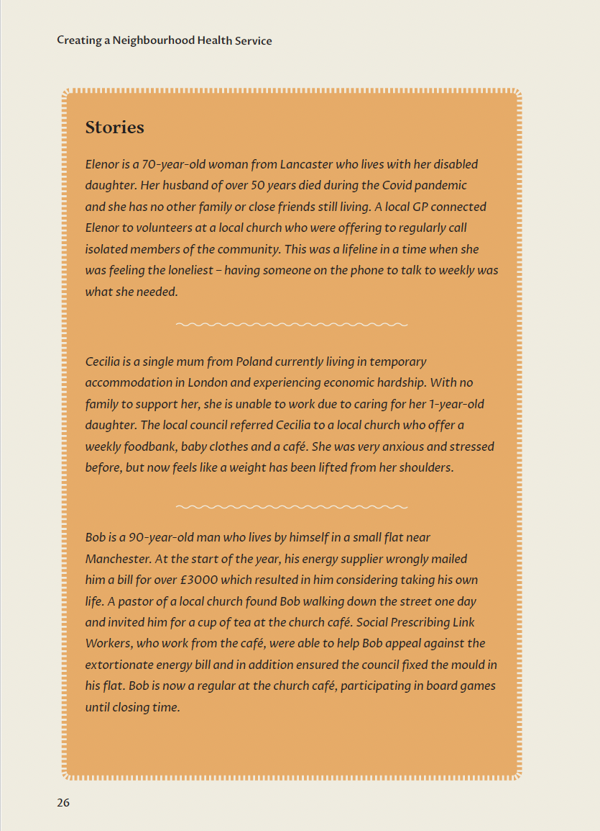
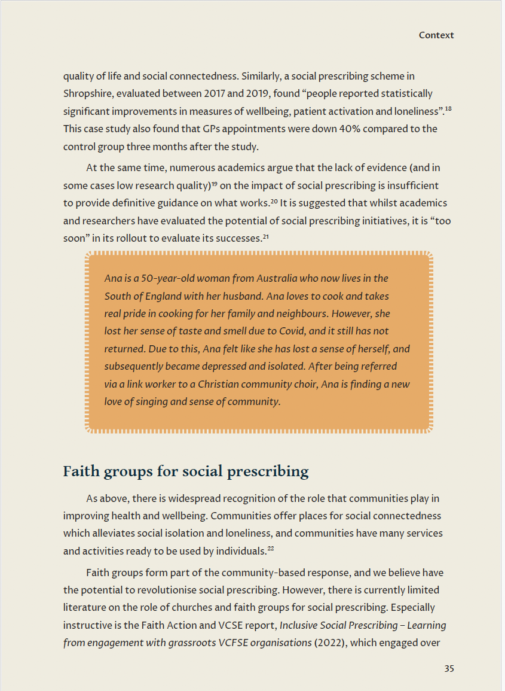
Faith and Social Prescribing
Key research areas:
Examples of social prescribing groups or activities run by or supported by faith groups
The relationship between faith groups and social prescribers locally and nationally
Advantages and barriers to a better integrative approach between faith groups and social prescribers
Methodology:
Scoping survey completed by over 50 link workers
Interviews with 37 individuals
3 focus groups
Participant observation whilst visiting numerous activities and services

Slide 7
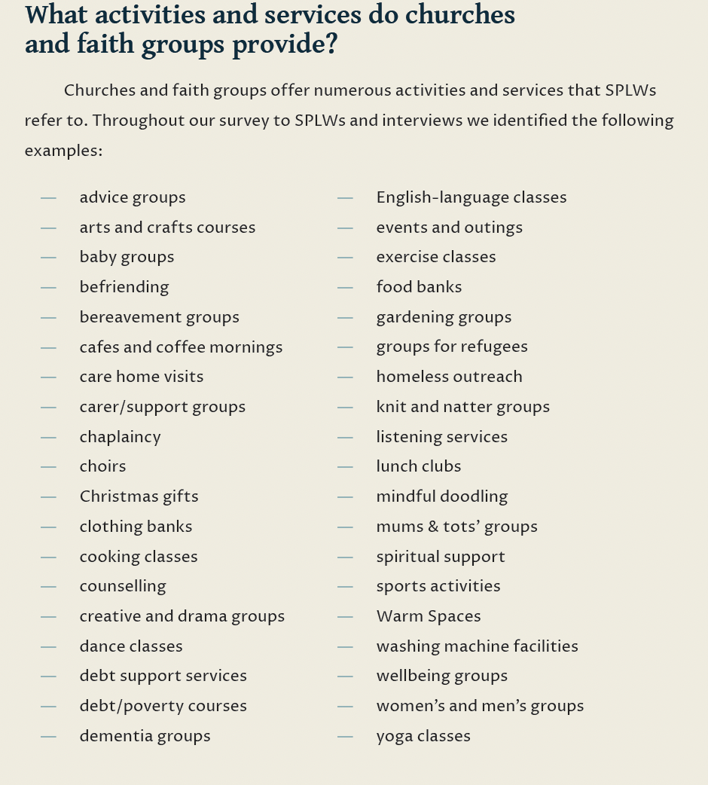
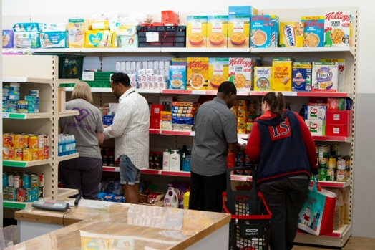
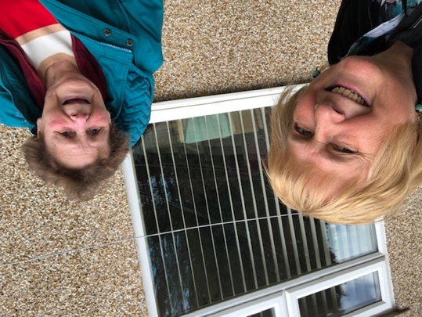
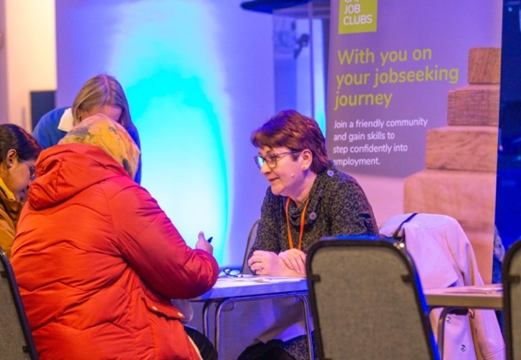
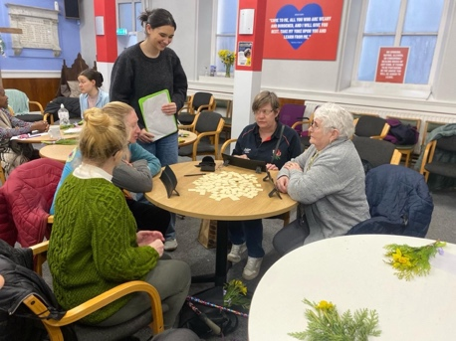
Faith and Social Prescribing- our findings

Slide 8
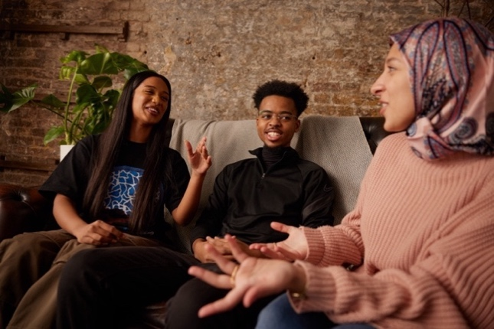
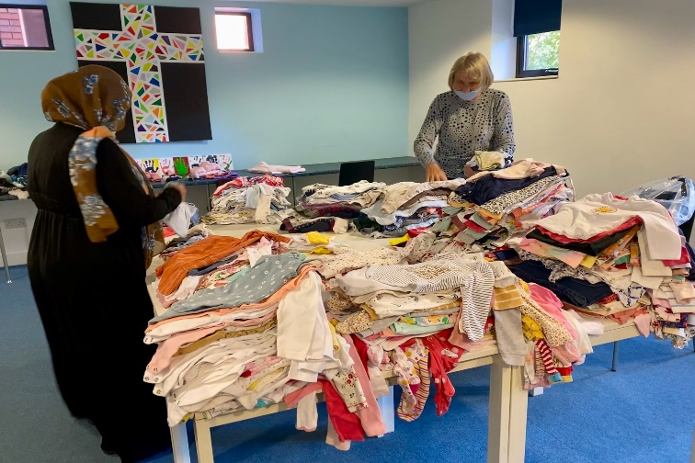
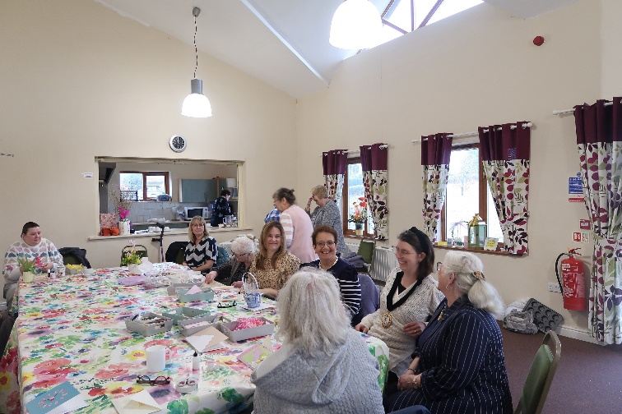
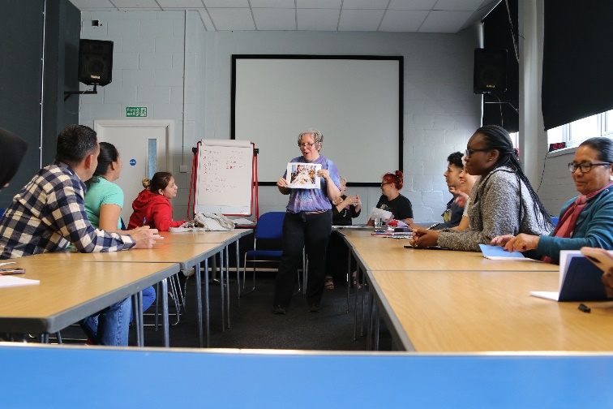
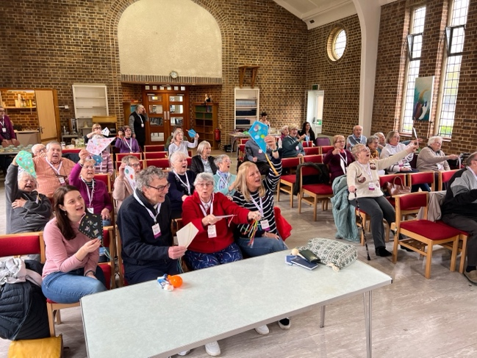
Faith and Social Prescribing- our findings
Assets and Resources of Faith Groups:
“Anchors of the community”
Networks: convening power
Resources: buildings and volunteers
Pastoral and spiritual care

Slide 9
Faith and Social Prescribing- our findings
Barriers to collaboration:
Relationship-building:
Active networking
Engaged partnering
Forward planning
Mismatched language
Limited connections
Stretched capacity
Complex and slow processes
No single database
No additional funding or training
Fear of religiosity

Slide 10
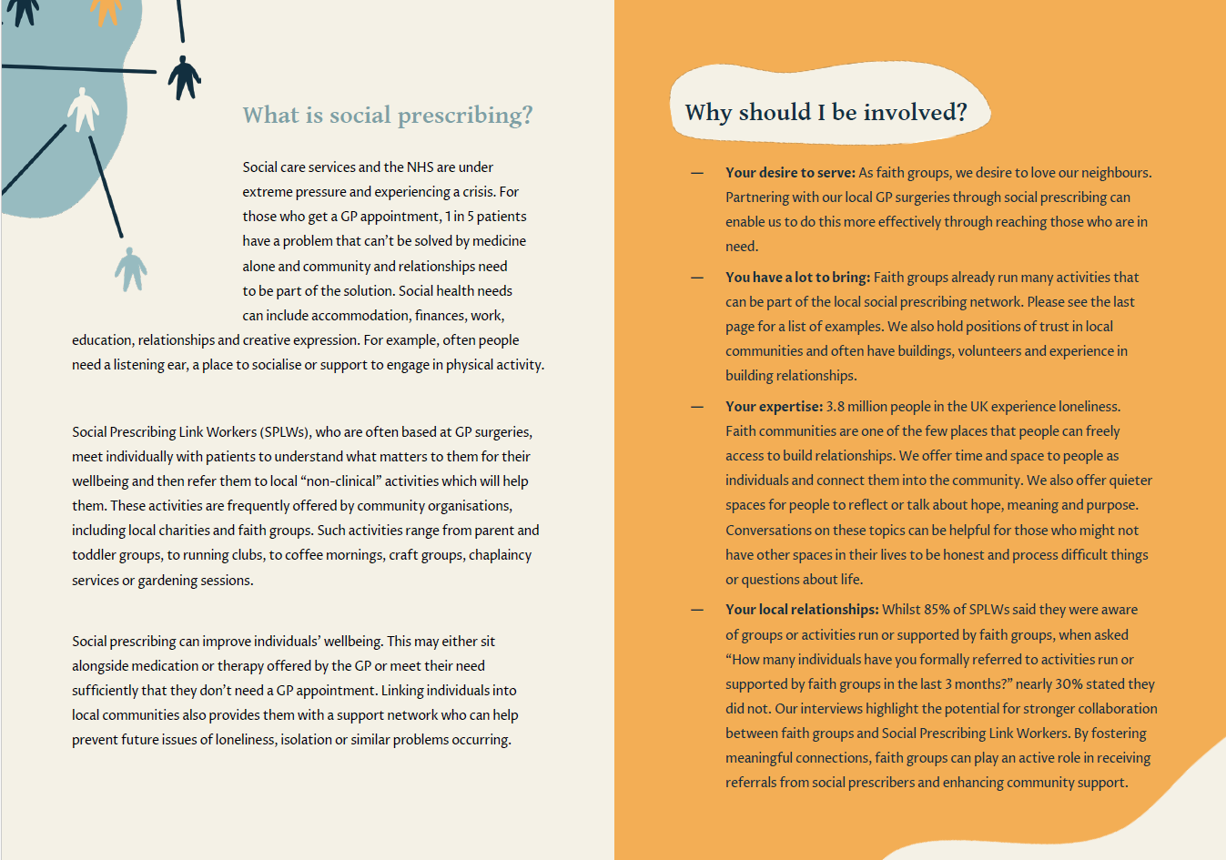

Slide 11
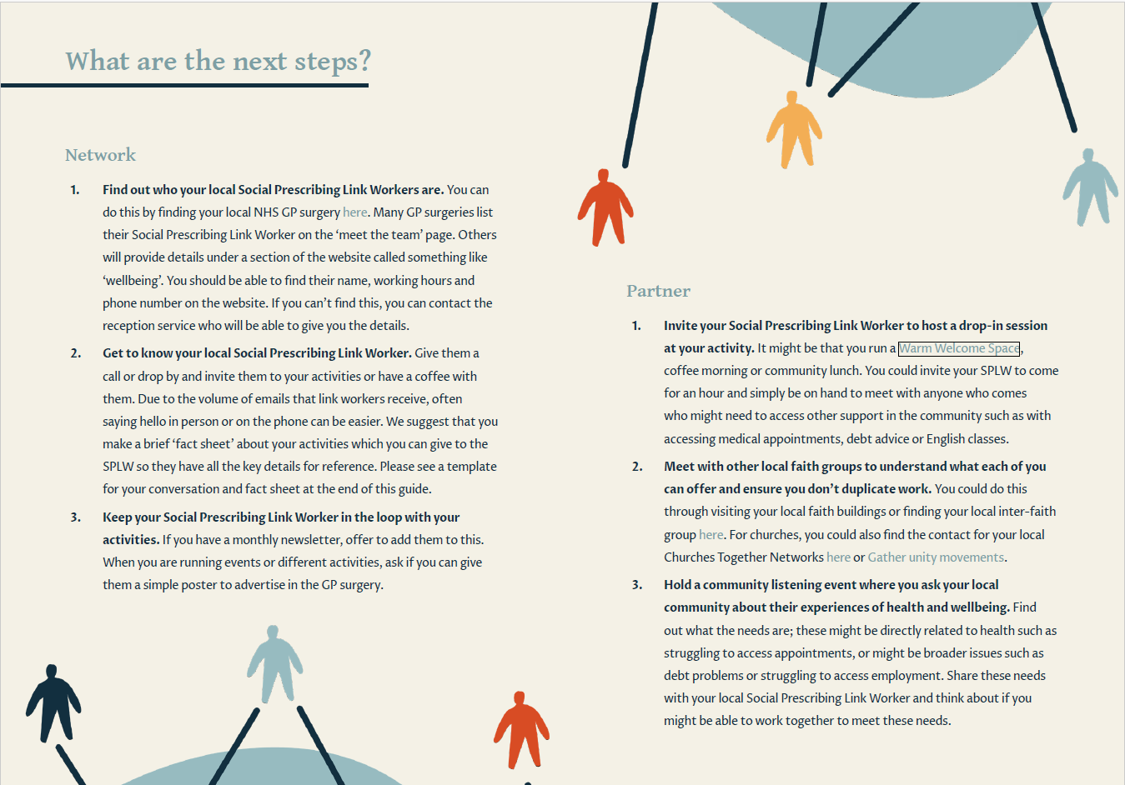
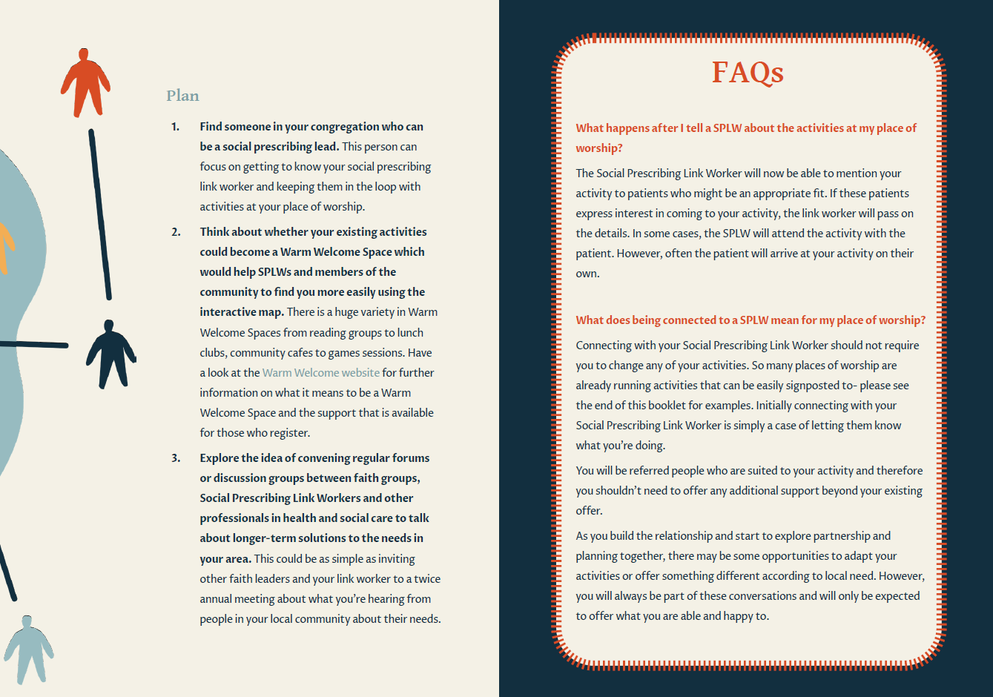

Slide 12
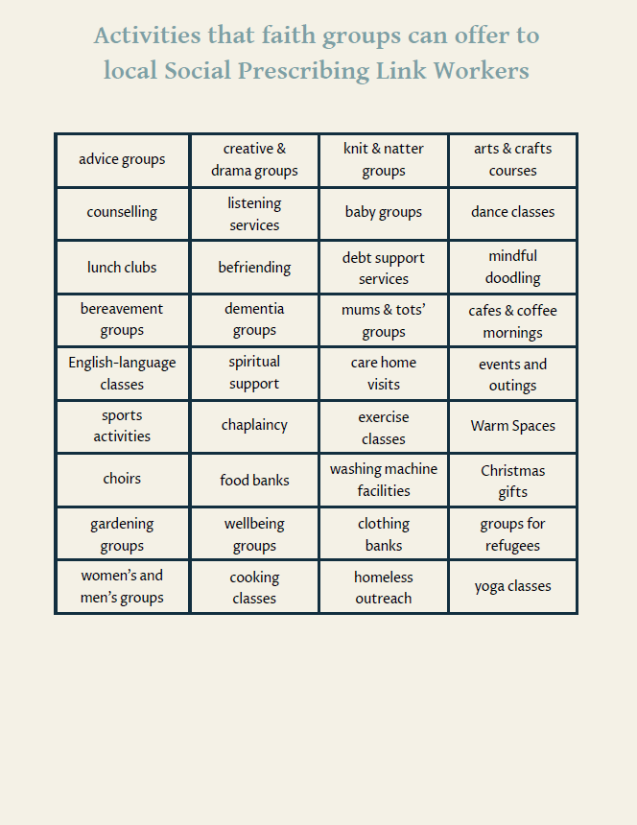
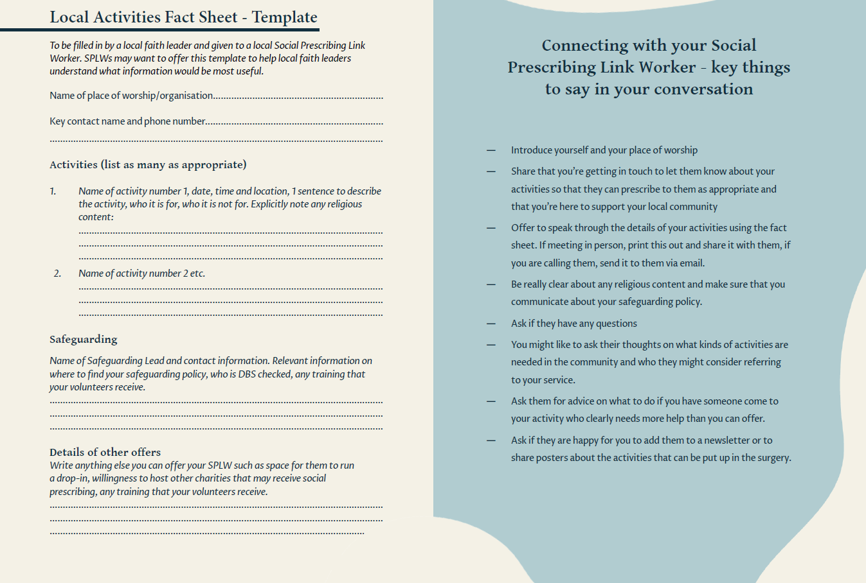

Slide 13
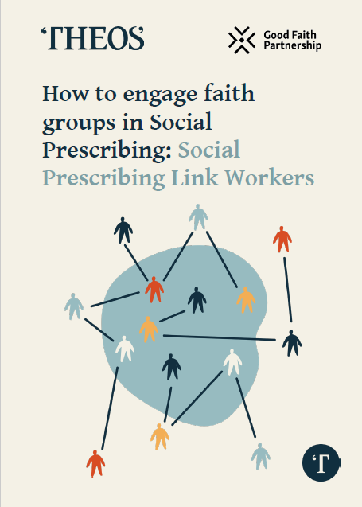
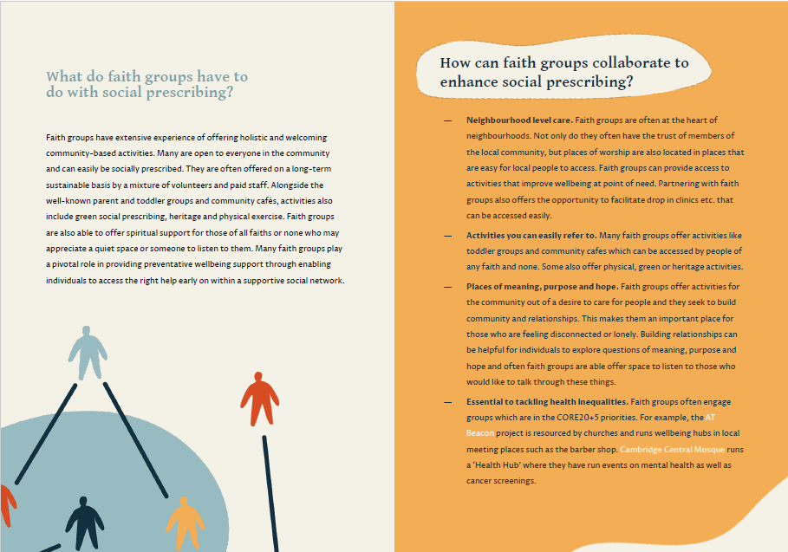

Slide 14
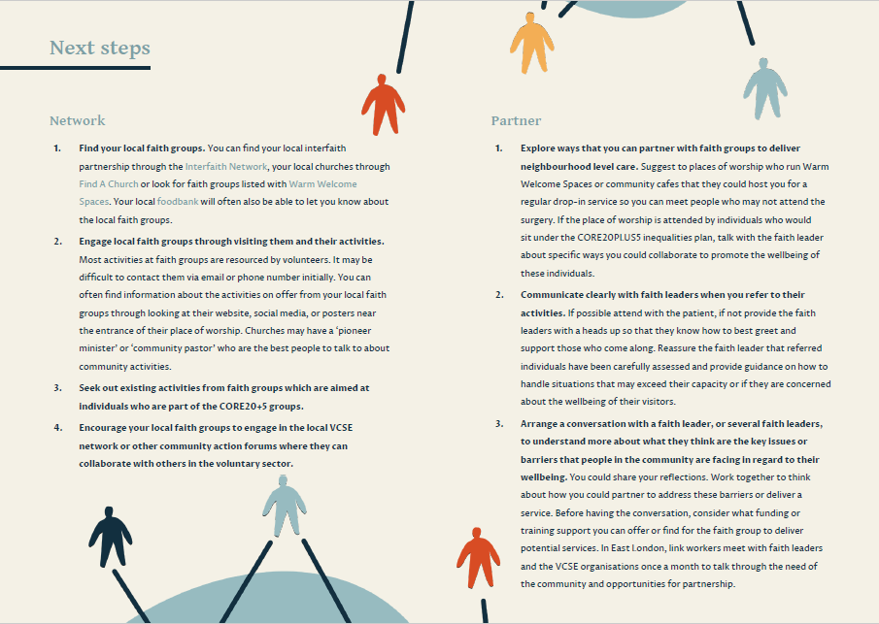
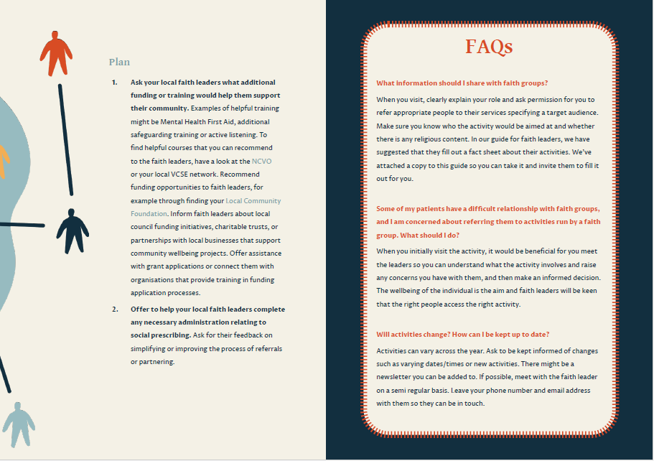

Slide 15
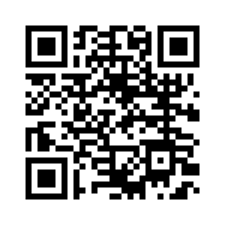
How-to guides and Creating a Neighbourhood Health Service report
www.churchworks.org.uk/our-work/wellbeing
www.theosthinktank.co.uk/research

Slide 16
Report Recommendations
Neighbourhoods
Places
Systems

Slide 17
Report Recommendations
Neighbourhoods
Faith leaders and SPLWs network together
Use How To Guides to connect and increase referrals
Partner and plan together at local forums

Slide 18
Report Recommendations
Places
More faith leaders represented at regional forums
Involve faith leaders in preventative, public health and health inequalities strategies
Prioritise faith literacy and health literacy training

Slide 19
Report Recommendations
Systems
More faith leaders represented at national forums
Involve faith leaders as stakeholders in policy making
Create a Faith Lead post within the National Academy of Social Prescribing

Slide 20
Dr Shahzad Amin- Trustee Khizra Mosque/Lead for community outreach and health promotion– Mosques and Social Prescribing

Slide 21
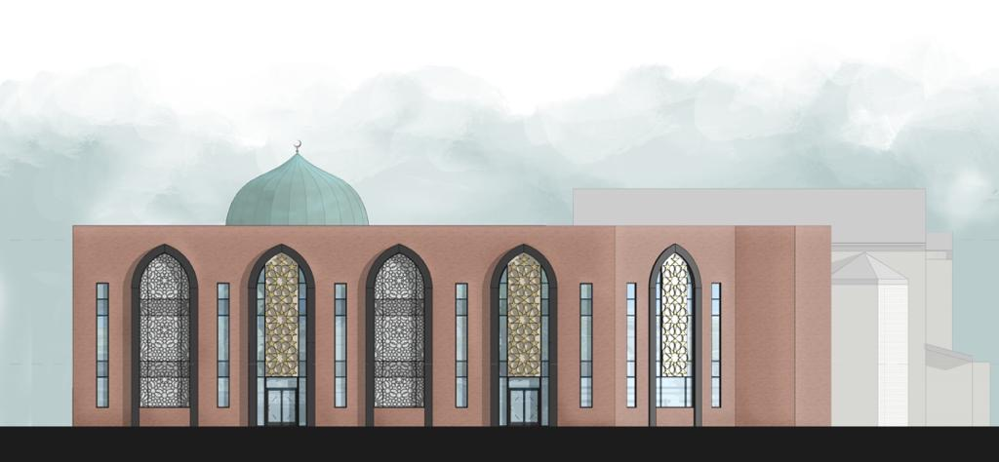
Dr Shahzad Amin- Trustee Khizra Mosque/Lead for community outreach and health promotion.
Social Prescribing – A narrative from Khizra Mosque

Slide 22
How Mosques can support Social Prescribing
Mosques are trusted, accessible spaces that can improve community well-being by connecting people to local activities, support groups, and services. Working with GPs, NHS link workers, and local providers, mosques can become hubs for social prescribing, offering faith-sensitive support, particularly for those facing barriers to mainstream services.
Ways Mosques Can Get Involved:
• Health & Fitness: Signpost to health checks, walking groups, exercise, and healthy living programmes.
• Mental Well-being: Offer listening services, men’s/women’s circles, and mental health support.
• Reducing Isolation: Host coffee mornings, befriending schemes, and youth/elderly gatherings.
• Practical Support: Provide access to food banks, advice on housing, finance, and English classes.
• Faith & Spirituality: Organise educational classes, study circles, and encourage imams to discuss well-being alongside faith.

Slide 23
Khizra Mosque’s Social Prescribing Initiative
Khizra Mosque, located in Manchester, has been a leading example of how mosques can support the community through innovative social prescribing initiatives.
By integrating holistic well-being services such as gardening sessions, the Warm Welcome Campaign, food parcel distribution, advice sessions, and health talks, the mosque has become a hub for promoting physical, mental, and social well-being within the wider community.
Khizra Mosque has expanded its community support through a range of practical services, helping to address social, financial, and health-related challenges:
Key Projects Include:
• Gardening Sessions: Weekly sessions offering light exercise, stress relief, and social connection, benefiting older people and those facing isolation.
• Warm Welcome Campaign: Providing a warm, safe space during winter for those struggling with heating costs, offering hot drinks, snacks, and social support to both Muslim and non-Muslim community members.

Slide 24
Khizra Mosque’s Social Prescribing Initiative
• Food Hub: Hundreds of families, over the years and during the cost of living crisis have received essential food supplies, offering vital support to vulnerable households.
• Advice Sessions: Regular sessions provided guidance on housing, benefits, immigration, and financial matters, helping individuals find practical solutions and reduce stress.
• Health Talks: Partnering with local health professionals, the mosque delivered culturally sensitive talks on topics like diabetes, mental health, and healthy eating, empowering the community to improve their health.
Community Engagement:
Khizra Mosque actively collaborates with charities, healthcare providers, and other places of worship, creating an inclusive, welcoming environment that fosters understanding across diverse groups.

Slide 25
Khizra Mosque’s Social Prescribing Activities
Health & Well-being
• Walking Group (Women)
• Exercise and Gym Sessions (Women)
• Indoor Cycling (Women)
• Physical Activity Referral Service (Women-only and Open to All, GP Referral Needed)
• Taekwondo (Under 9s & Over 9s)
• Boxing (Under 12s)
• Football (Under 12s & Football Academy)
• Cycling and Walking Group
• Community Walk (Open to All)
• Gym Session (Community Get Together)
• Health Awareness Sessions (Twice a Year) – Covering diabetes, heart health, cancer awareness, and healthy lifestyle choices.
• Health Checks – Blood pressure, blood sugar, BMI checks, and screening events in partnership with health professionals.
• Mental Health Signposting – Information and support for accessing mental health services in a faith-sensitive setting.

Slide 26
Khizra Mosque’s Social Prescribing Activities
Faith & Learning
• Spiritual and religious learning Classes (Women only)
• Study Circle (Women)
• Men’s Study Circle and Refreshments
• Mosque Open Days – Welcoming the wider community to build understanding and community cohesion.
• Interfaith Iftar and Gatherings (Held Over the Years) – Bringing people of all faiths and none together, promoting unity, respect, and social connection.
Social & Support Groups
• Mother and Toddler Group, Coffee Morning & Exercise
• Youth Clubs (Boys 12 and Under, Boys 12 and Over, Girls) – Providing a safe, positive space for young people to socialise, gain life skills, and take part in sports and creative activities.
• Inclusive Session (For Those with SEND)
• Gardening and Befriending Session
• Cooking Sessions (Women’s Cooking and Advice, Men’s Explore Food)
• Talk English Class
• Eid with Refugees – Celebrating Eid with refugee families, offering friendship, support, and a sense of belonging.
Community Support & Outreach
• Food Hub and Food Bank – Providing food parcels and emergency support to families and individuals in need.
• Winter Hampers for Elderly & Those in Need – End-of-year food and essentials hampers, supporting elderly and vulnerable members of the community.

Slide 27
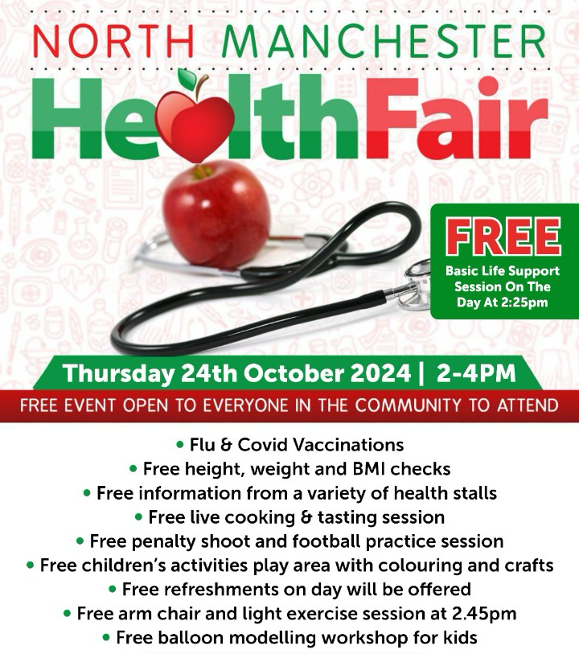
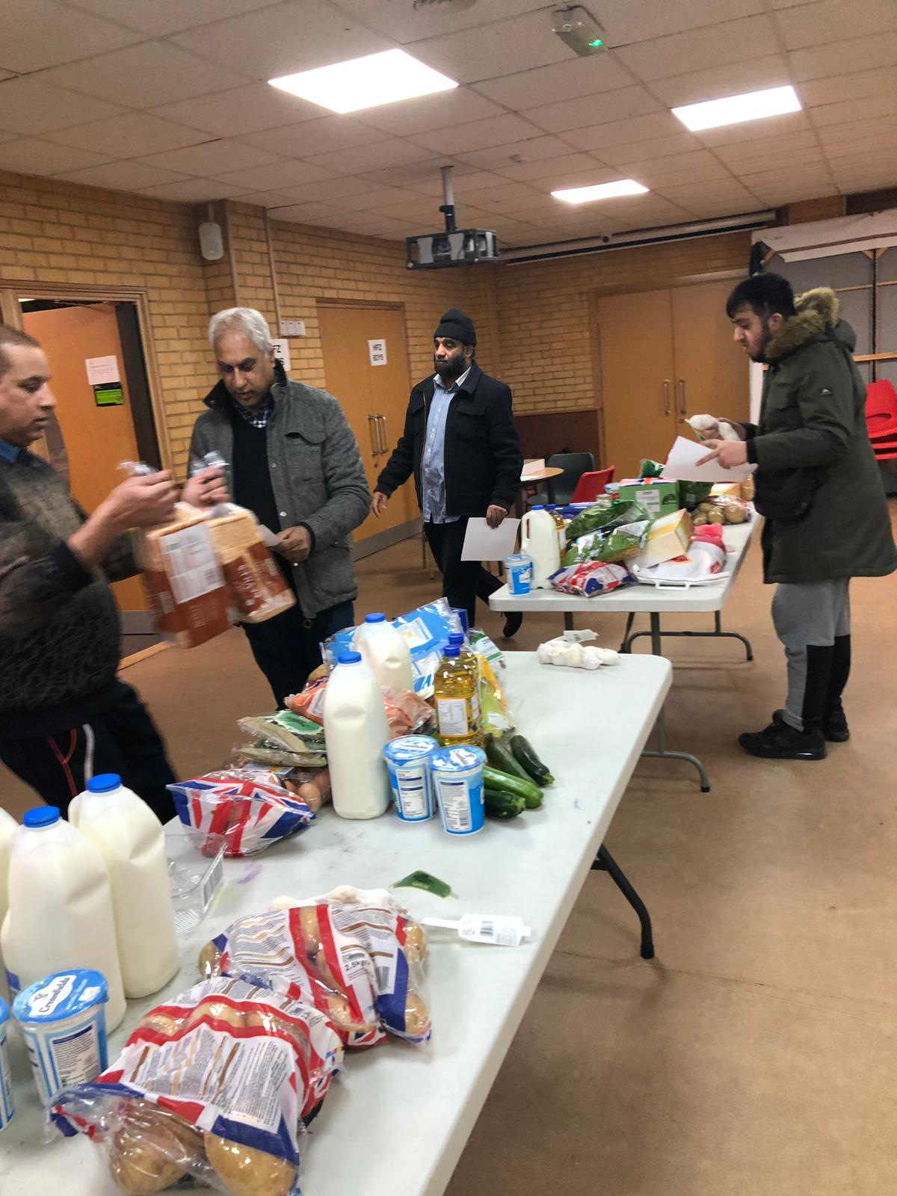

Slide 28
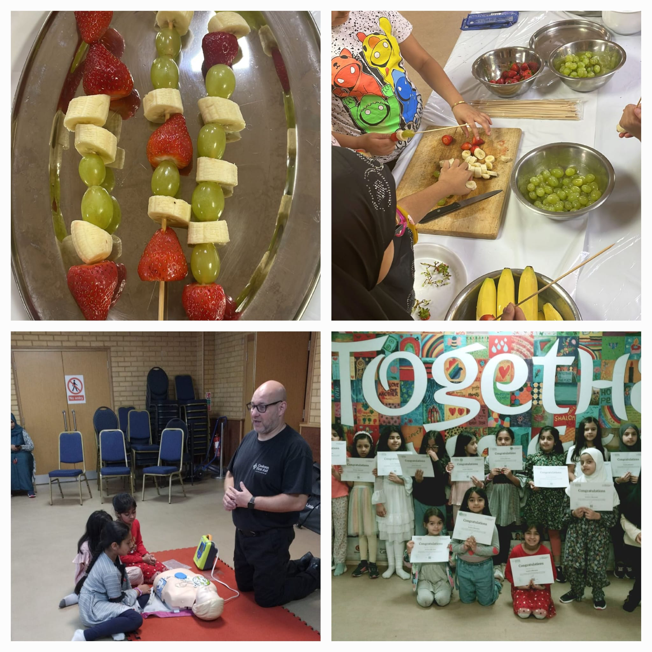
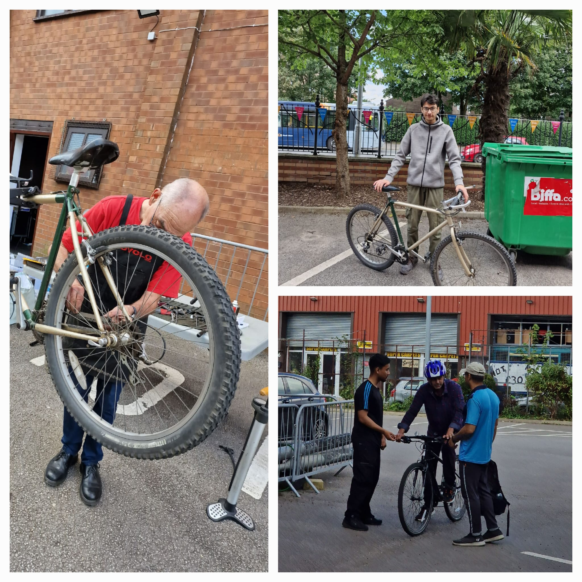
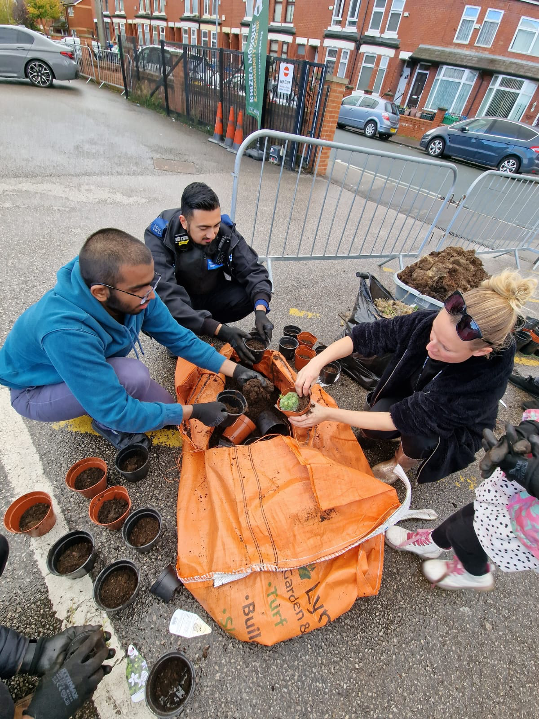

Slide 29
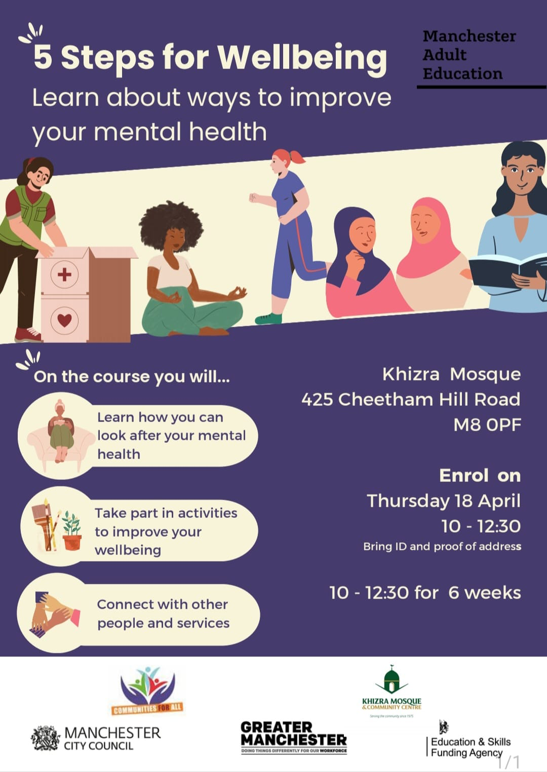
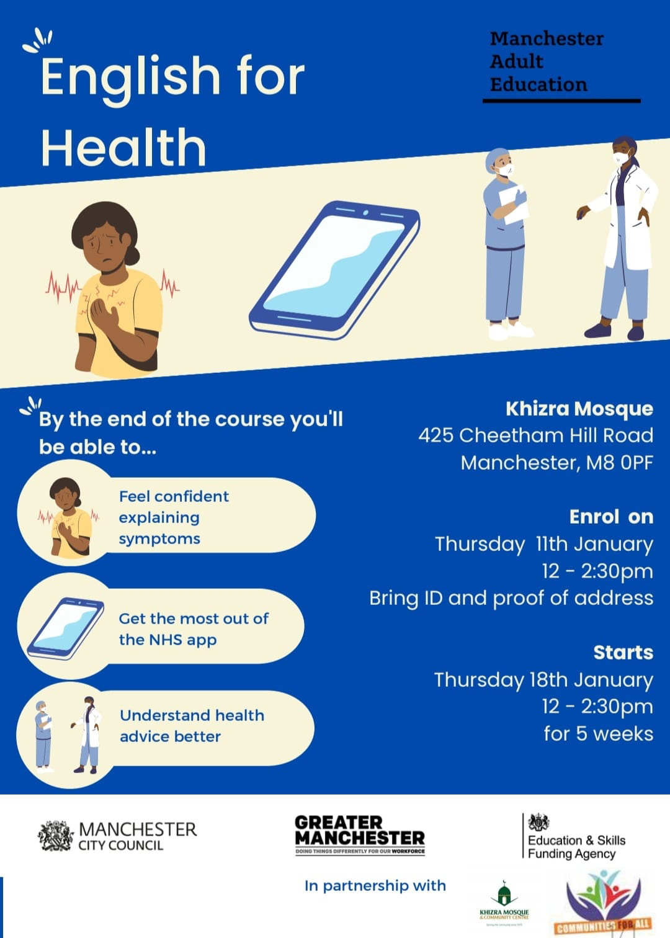
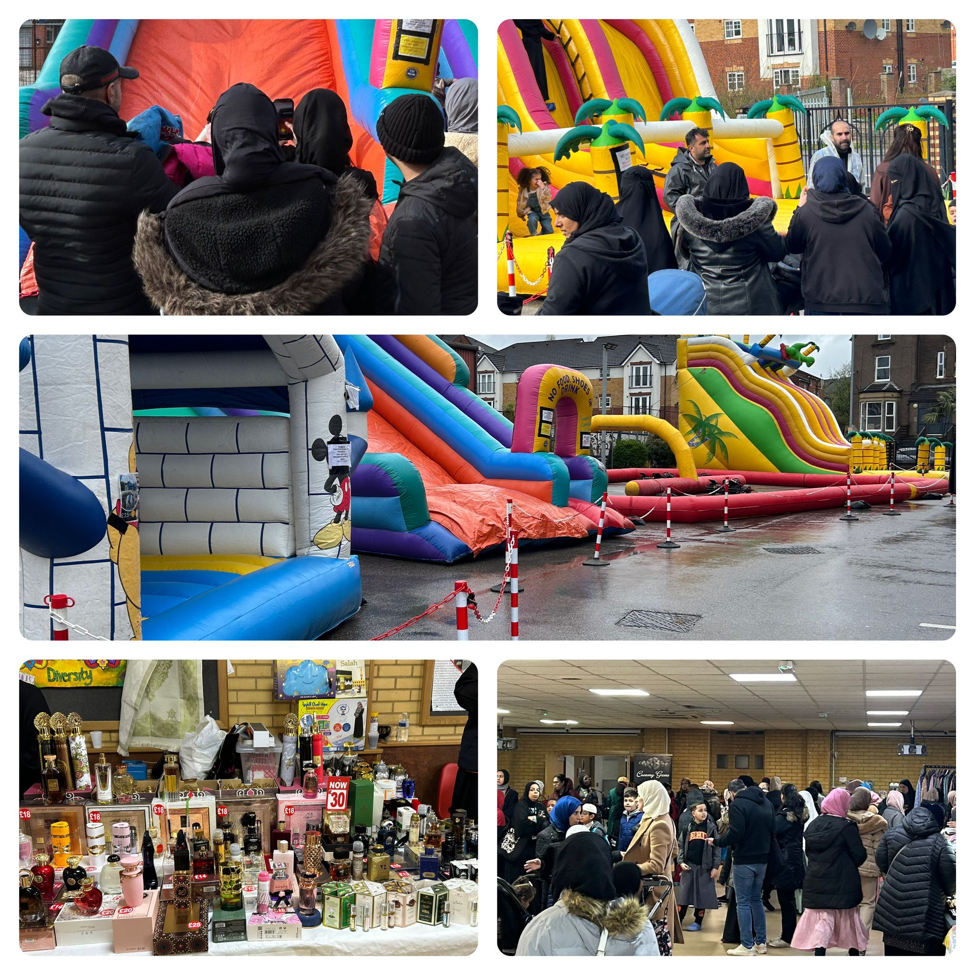

Slide 30
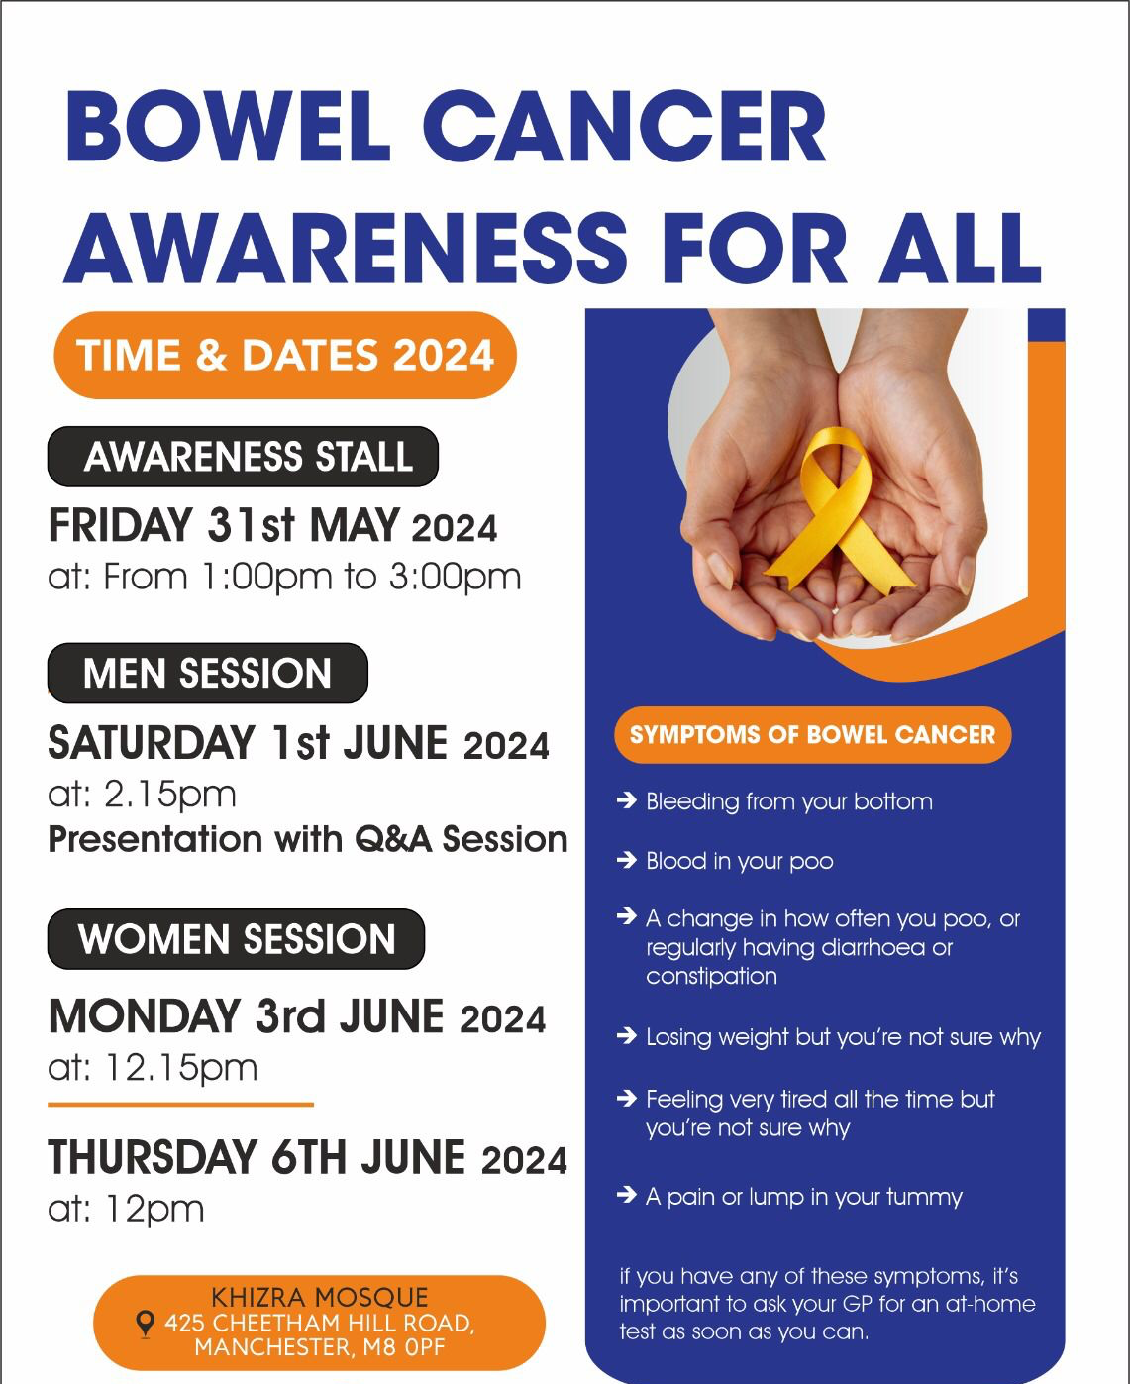

Slide 31
Khizra Mosque’s Social Prescribing Initiative
Impact and Reach
• Number of People Benefited: Over the past year, more than a thousand individuals benefited directly from Khizra Mosque’s social prescribing services.
• Gardening Sessions: Attracted around 10 regular participants on a weekly basis, many reporting improvements in mental health and social connectivity.
• Warm Welcome Campaign: Welcomed over 50 people per week throughout the winter months, offering essential warmth and companionship.
• Food Parcel Distribution: Distributes hundreds of food parcels each year, supporting approximately hundreds of families in need.
• Advice Sessions: Provided direct support to numerous individuals, helping them resolve housing and financial issues.
• Health Talks: Engaged hundreds of local attendees, leading to increased health awareness and proactive steps toward better self-care.

Slide 32
Khizra Mosque’s Social Prescribing Initiative
Outcomes and Benefits
• Improved Well-being: Participants in the gardening sessions reported feeling more relaxed and socially connected, with many indicating a reduction in stress and anxiety.
• Social Inclusion: The Warm Welcome Campaign created a space where people could come together, breaking down social isolation and fostering a sense of belonging.
• Food Security: The food parcel distribution provided crucial support to struggling families, reducing food insecurity and ensuring access to basic necessities.
• Practical Solutions: The advice sessions empowered individuals by providing them with the knowledge and resources to tackle their challenges, improving their financial and personal stability.
• Health Improvements: The health talks resulted in greater health literacy, with participants taking proactive steps to manage chronic conditions like diabetes and hypertension.

Slide 33
5 Ways Mosques Can Begin Social Prescribing
1. Build Partnerships with Local Health and Community Services
• Connect with GP practices, social prescribing link workers, and NHS services.
• Reach out to local councils, charities, and voluntary organisations.
• Encourage health professionals to refer people to mosque-based activities.
Partnerships increase referrals, build trust, and strengthen the mosque’s role as a community well-being hub.
2. Understand the Needs of Your Community
• Speak to the congregation to understand health, social, and emotional needs.
• Survey community members or hold feedback sessions to identify gaps.
• Focus on groups who may need extra support (e.g., elderly, women, young people, or those with disabilities).
Tailoring activities ensures the right support is provided, increasing participation and impact.
3. Offer a Variety of Activities
• Provide physical activities (e.g., walking, exercise, sports).
• Create social and mental well-being groups (e.g., befriending, study circles, youth clubs).
• Include advice and support services (e.g., housing, benefits, finance, English classes).
• Run faith-based and culturally appropriate health talks.
A range of activities attracts different groups, promotes holistic well-being, and builds a supportive community.

Slide 34
5 Ways Mosques Can Begin Social Prescribing
4. Make Activities Welcoming and Accessible
• Offer women-only sessions, language support, and SEND-friendly spaces.
• Keep sessions free or affordable to ensure no one is excluded.
• Create a warm, non-judgemental environment where people feel comfortable.
Removing barriers makes it easier for people to attend, especially those from vulnerable groups.
5. Promote Your Activities and Success Stories
• Use mosque announcements, WhatsApp groups, and social media to advertise activities.
• Share success stories to encourage more people to join.
• Engage imams to highlight the importance of health and well-being during sermons.
Raising awareness ensures people know about the support available, and positive examples inspire others to get involved.
By embracing social prescribing, mosques can become hubs of healing, connection, and hope—supporting healthier, happier communities.

Slide 35
Thank you for listening

Slide 36
Geetha Maheshwaran, Director for RE, Culture & Communities Shree Ghanapathy Temple – Hindu faith communities and Social Prescribing

Slide 37
Get in touch
socialprescribingacademy.org.uk
@NASPTweets
@NASP_insta
Q&A

