Slide 1
NASP Webinar Series: It's not one size fits all in children and young people's social prescribing
Thank you for joining us. The webinar will begin shortly.

Slide 2


Housekeeping
Please note we are recording this webinar (you will be sent the slides and the link to the recording, and they will be on NASP's website too.)
Please submit questions via the Q&A function. We will hold a Q&A session at the end of presentations.
Please use the chat function for introducing yourself and networking. If you have any technical issues, please raise these in the chat, and a member of the NASP team will assist.
Closed Captions are available (turn these on at the bottom of your screen)

Slide 3

Overview
Chair:
Rachel Quinn, Executive Director of Strategy and Partnerships, National Academy for Social Prescribing
Speakers:
Dawn Foster, Consultant, National Academy for Social Prescribing
Becky Rice, Senior Policy Advisor in Children's Mental Health and Wellbeing at Barnado’s
Sunita Pandya, Executive Arts and Culture Consultant
Hayden Roters, Wellbeing Team Lead at Healthy Hyde

Slide 4
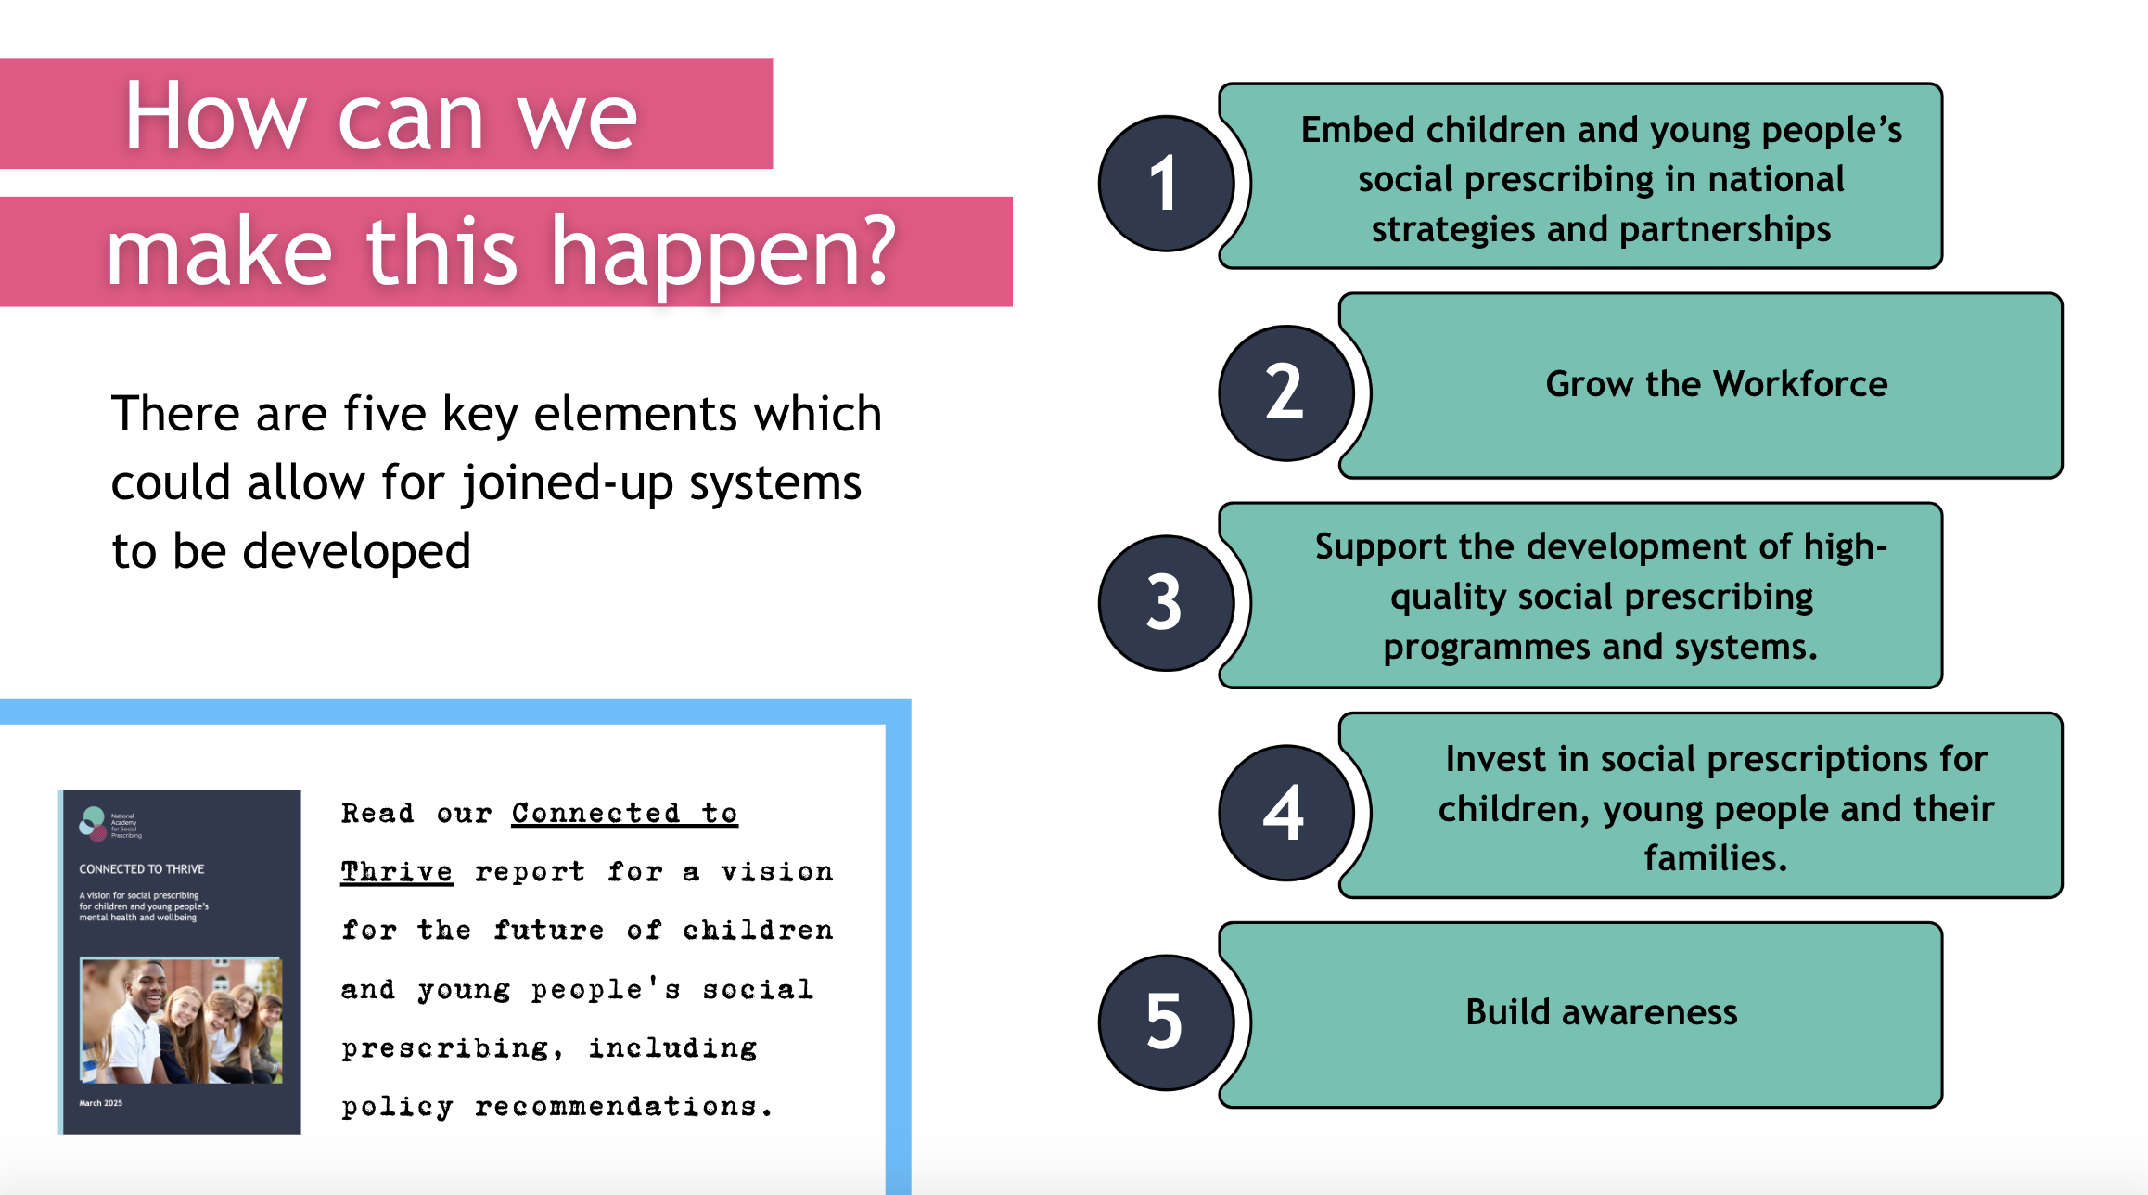

Slide 5
Connecting the System
Dawn Foster, Consultant, National Academy for Social Prescribing

Slide 6
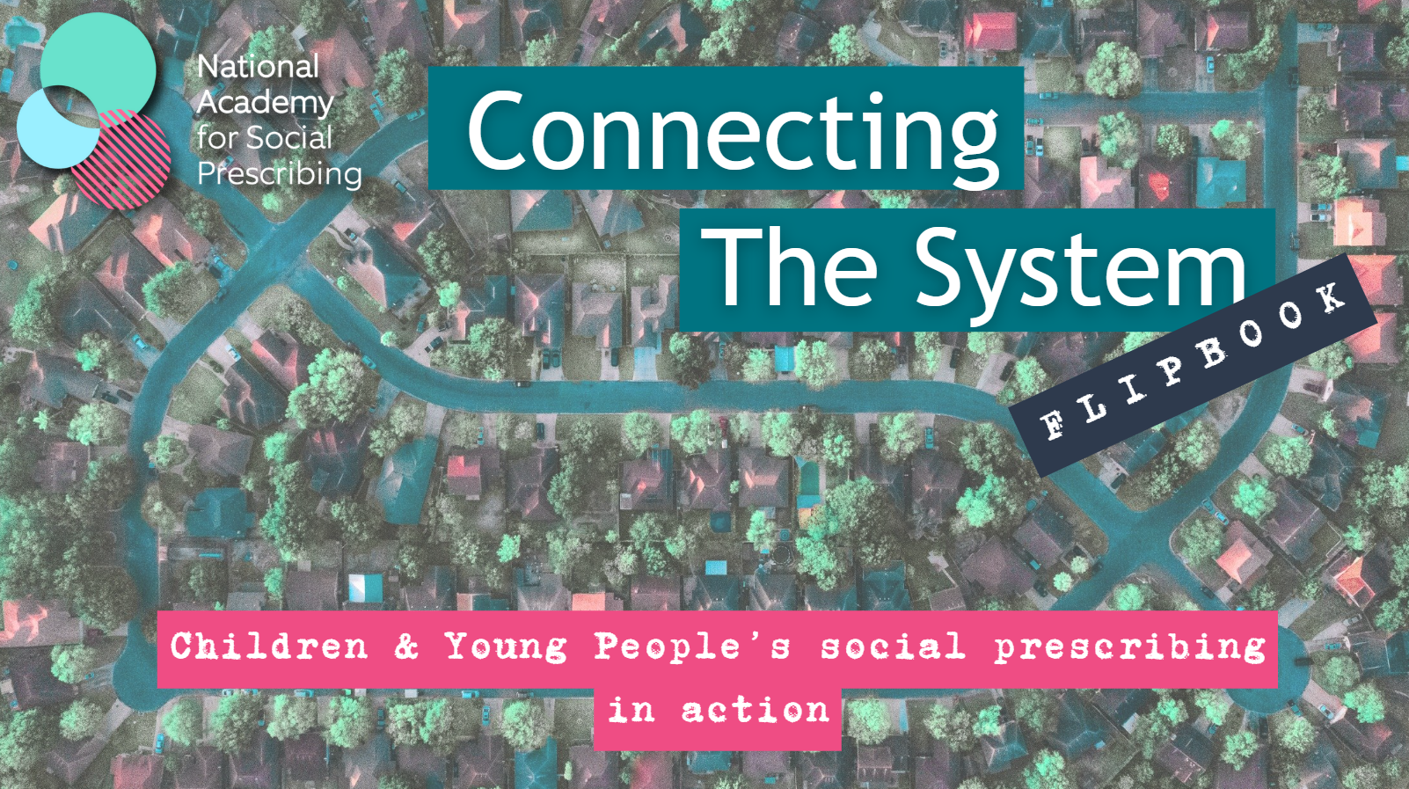

Slide 7
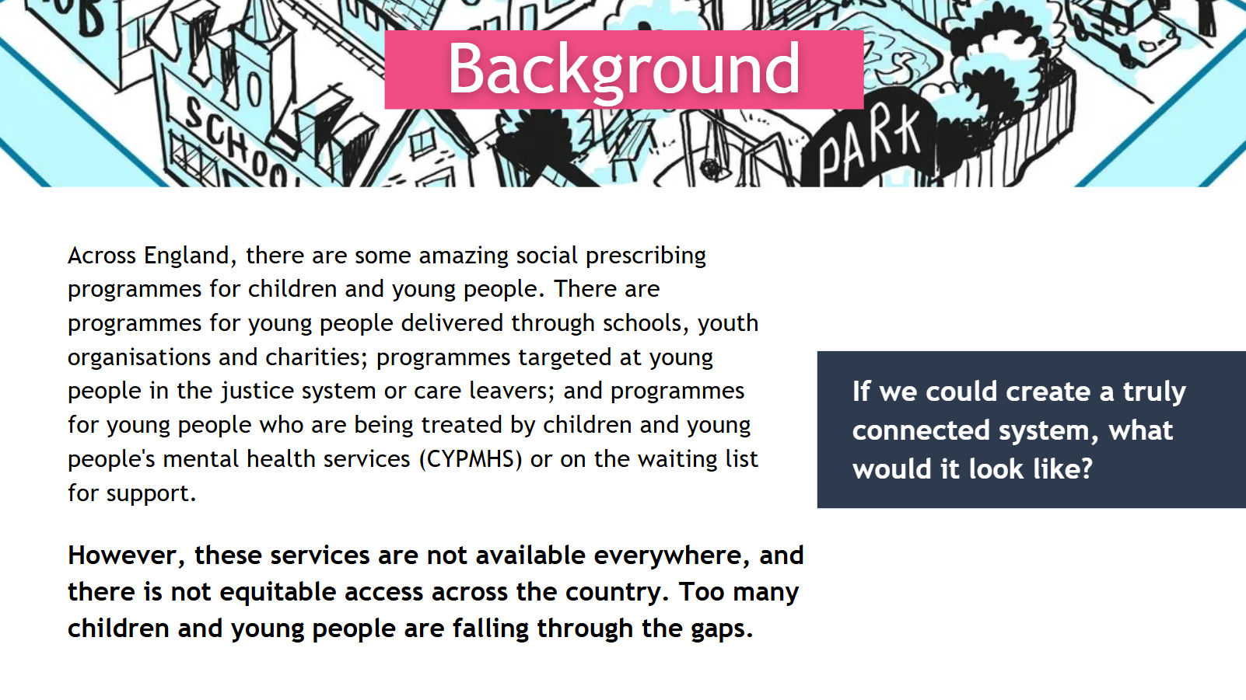

Slide 8
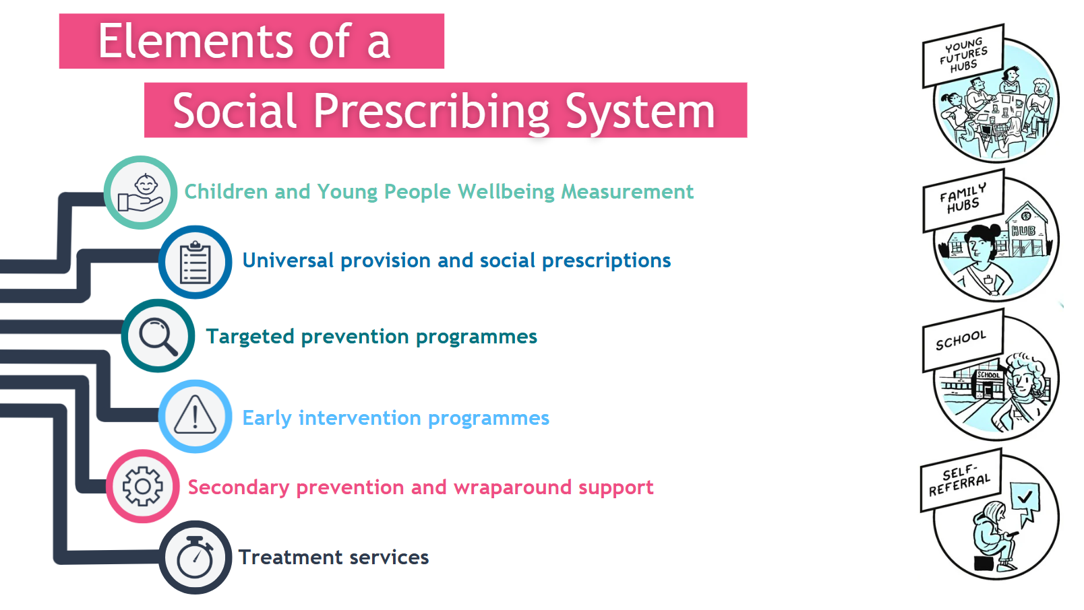

Slide 9
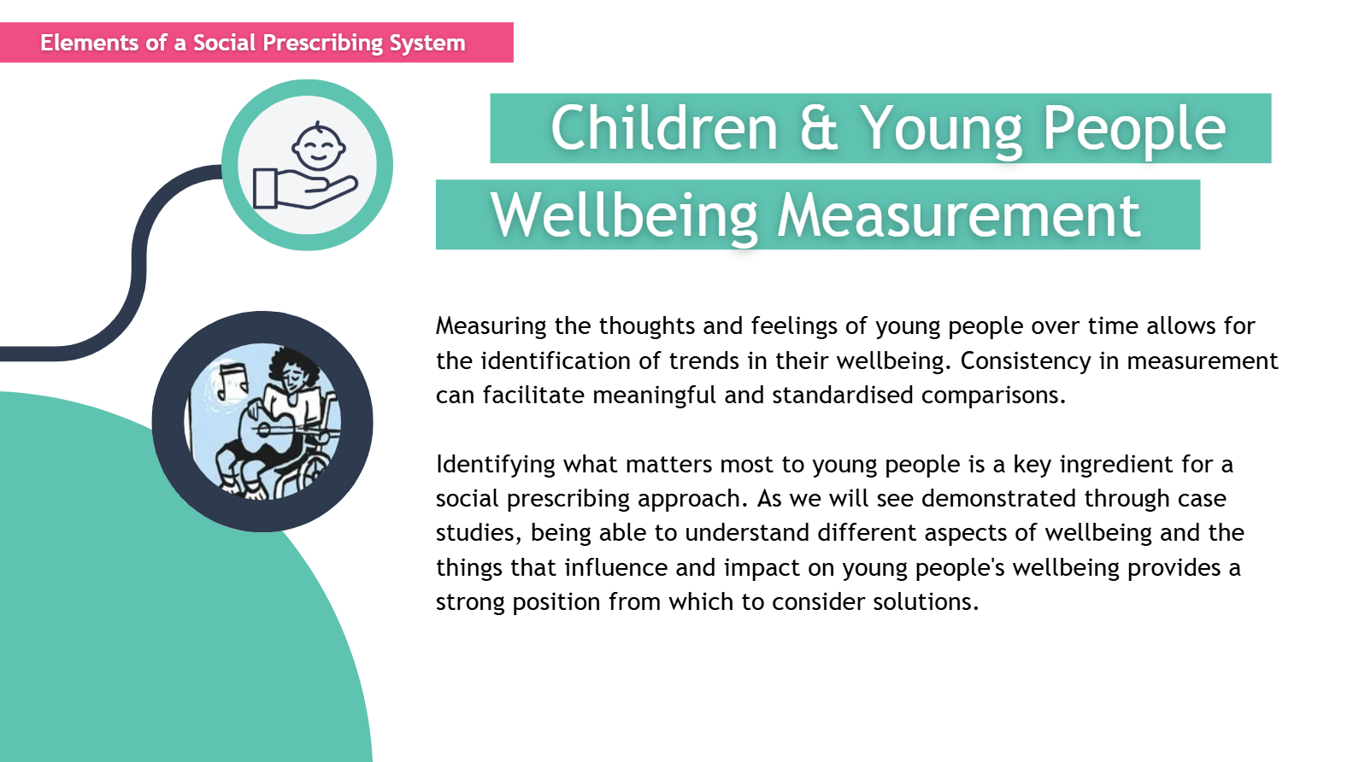

Slide 10
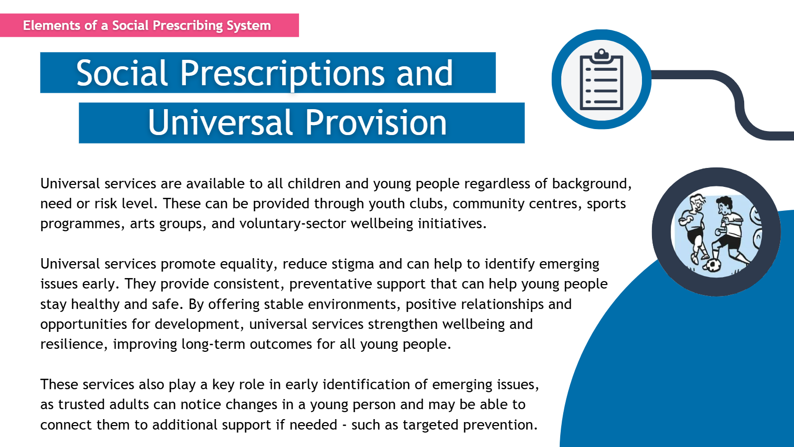

Slide 11
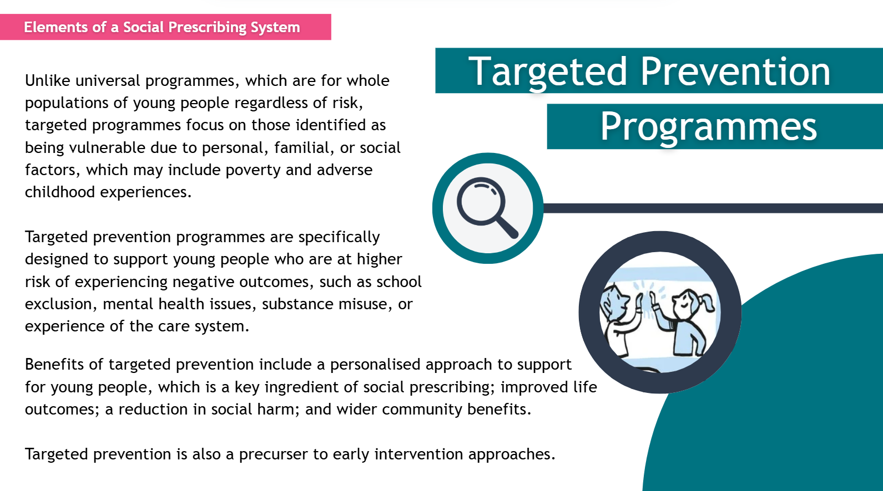

Slide 12
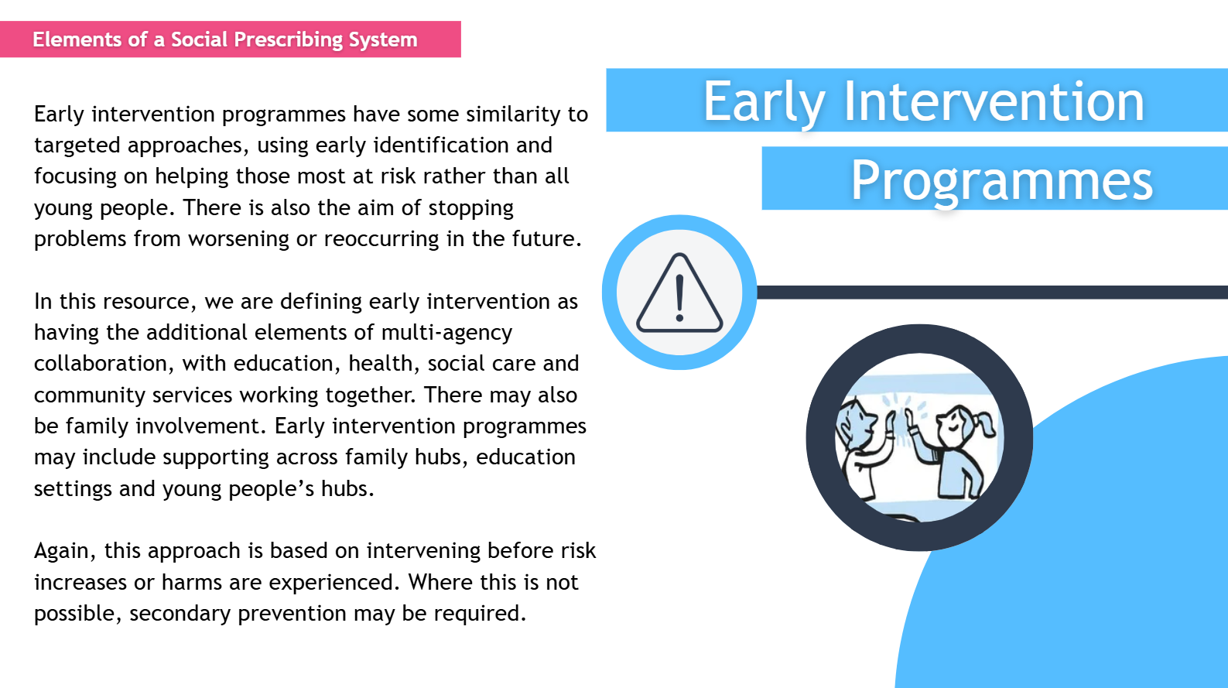

Slide 13
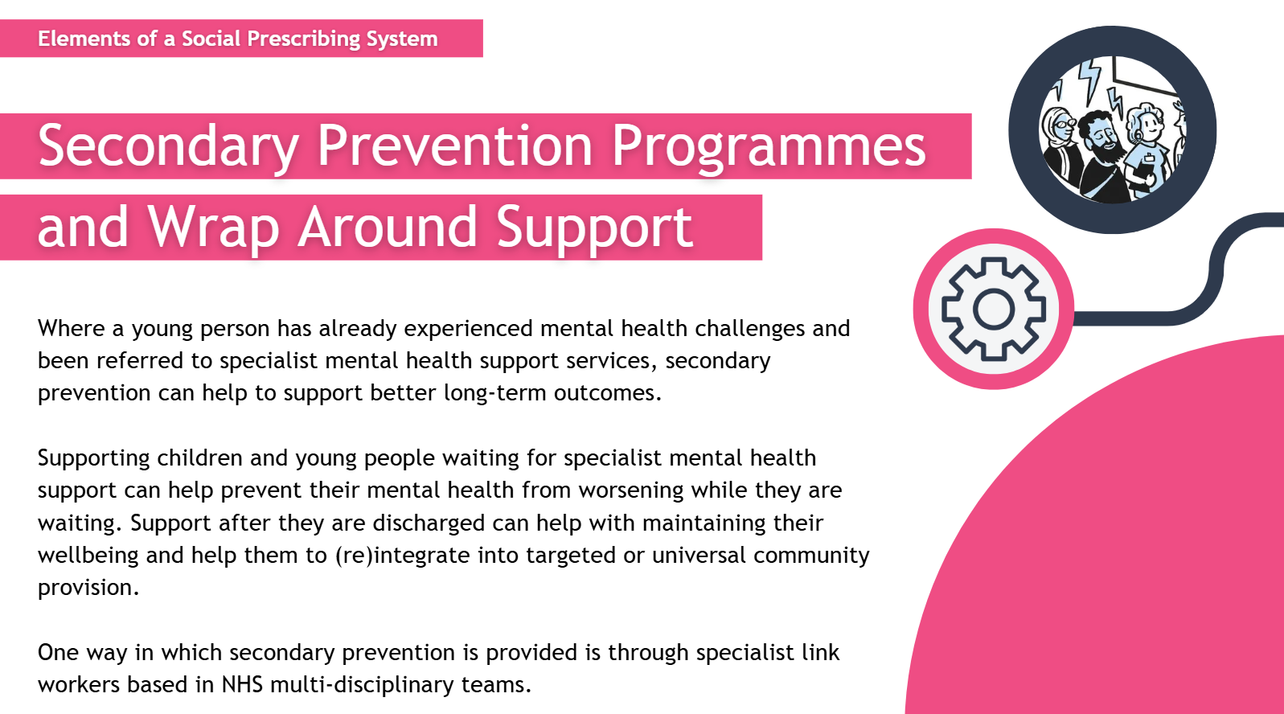

Slide 14
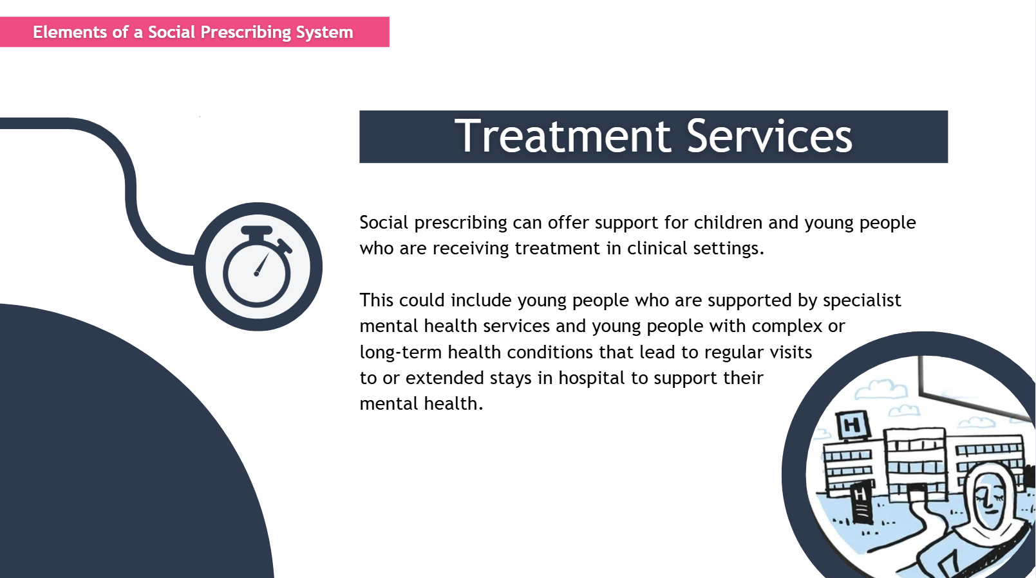

Slide 15
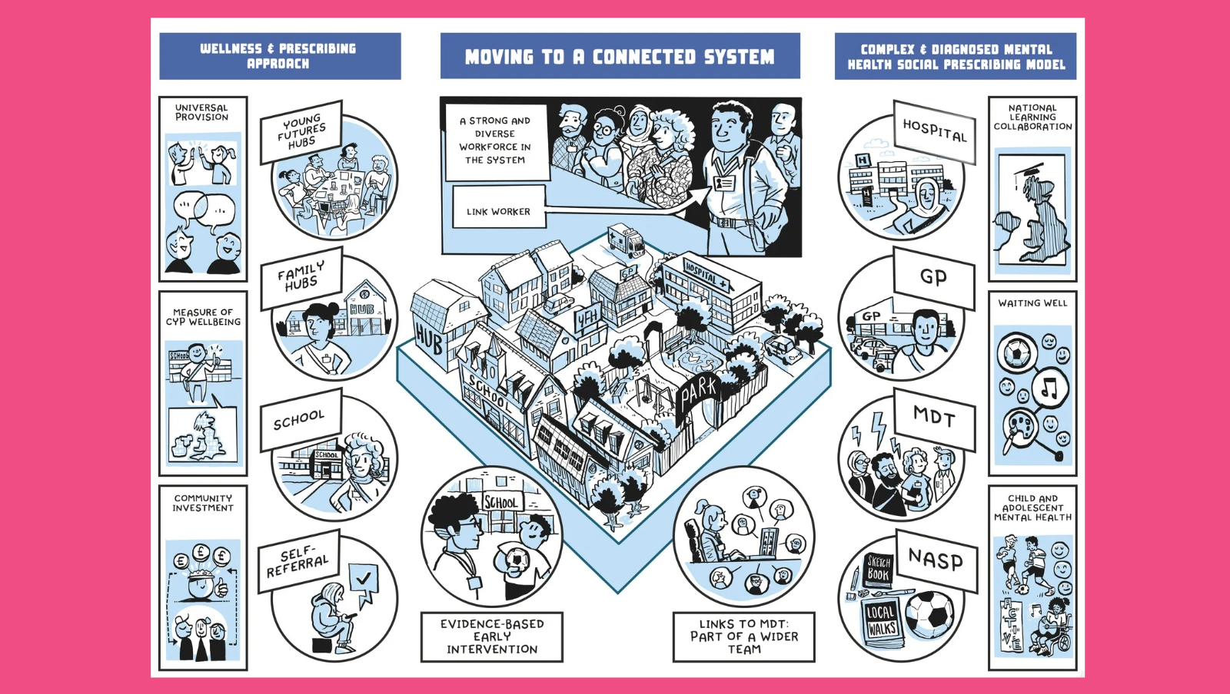

Slide 16
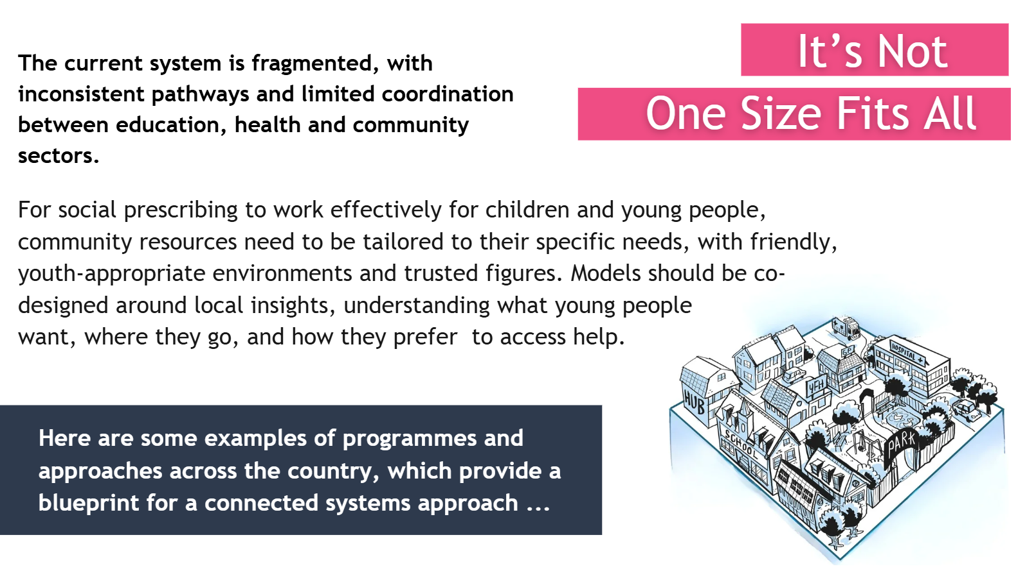

Slide 17


















Thank you to all our contributors

Slide 18
Case study: Barnardo’s
Becky Rice, Senior Policy Advisor in Children's Mental Health and Wellbeing at Barnardo’s

Slide 19

Barnardo’s social prescribing model
Becky Rice
Strategic Group
May 2025

Slide 20
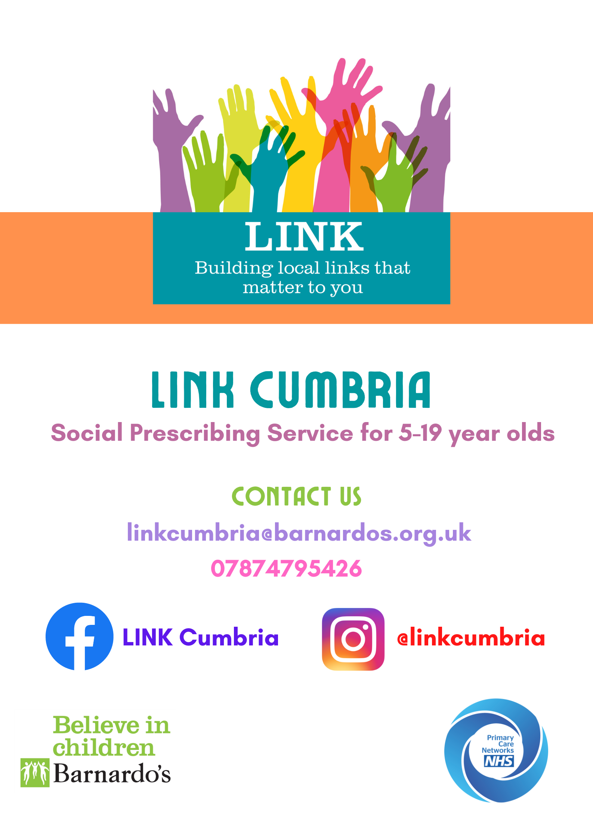
LINK Cumbria
  LINK is a service for children and young people aged 5 to 19 in Cumbria.
  LINK works alongside GP practice teams in six Primary Care Networks (PCN) to support children and young people with their emotional health and wellbeing.
  LINK is a personalised service – every child and young person works with a link worker to establish what is important to them as individuals and to find a solution that works for them.
  Referrals accepted from GPs, schools and other professionals.
  Each young person receives a comprehensive holistic assessment of need.
Notes:
Ellen

Slide 21
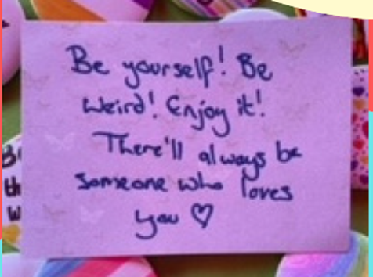
The Difference Social Prescribing Makes
The average age at time of referral is 15, with a range of 6 to 19 and an average acceptance rate of 90%
The most common reason for a rejected referral was due to the severity of a child’s condition. These referrals were signposted to other services in agreement with the child/young person and family.
Common referral categories include:
• Anxiety, low mood or withdrawal
• Emotional regulation
• Self-harm or expressing a desire to self-harm
• Significant life events (e.g. bereavement, a family member in prison, a family member experiencing illness, or trauma)
• Bullying, school pressures or exclusion
• Unexplained physical symptoms
• PTSD

Slide 22
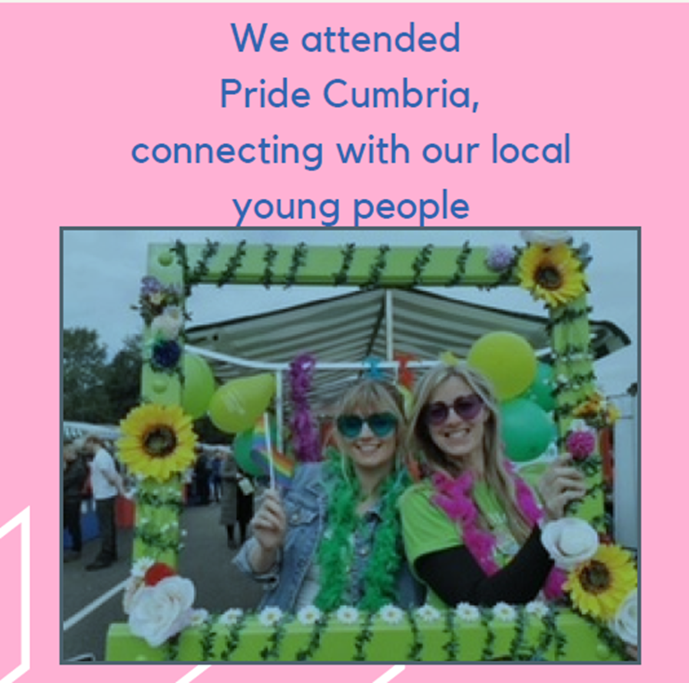
Types of support
Direct Support: ​Up to 12 weeks of tailored social and emotional wellbeing support. ​Designed to help before higher-level mental health services are needed.
​
Co-ordination Support: ​Understanding needs and connecting families to appropriate services

Slide 23

Direct support for children and young people
LINK is a personalised service, where children and young people spend time with their Link Worker, putting together a programme of interventions that works for them and establishing goals, regularly reviewing their progress and experiences of receiving support.
Support is provided in multiple formats including:
Regular Assessments
1:1 Support
Group Sessions
Drop-in Clinics
Green and Blue Social Prescribing

Slide 24
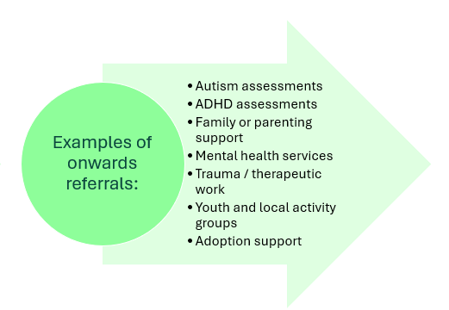
Accounts up to 50% of the work completed. Some have co-ordination only support, and others have co-ordination throughout 1:1 of group support.
Co-ordination Support
Feedback from parent of 13 year old girl who received 1:1 and co-ordination support alongside each other:
“… a personal thank you to LINK for getting X on the right track with her autism assessment. She finally had this last week and this has been confirmed so you were absolutely right. X has done so well since your support, she has full time learning support and is only taking English, Maths and Animal Care GCSEs, but this is the perfect balance for her and she’s even applied for 6th form! She tried other therapies but just didn’t connect with anyone like she did with you. Also … the detail you gave in your initial referral for the autism assessment (even though this was not accepted) has been used moving forward and has avoided X having to have another appt with another health care professional your referral has been invaluable to us .Your service is the only one she connected positively with. She found other services treat her too much like a child and she didn’t appreciate their approach. Thanks again”
Notes:
Bethan
Example of LP – Becky case study

Slide 25
Improving outcomes
66% children using the service experience significant improvement with the rest of the cases experiencing a smaller improvement or no change.
Positive outcomes including improved emotional awareness, resilience, confidence and help seeking behaviour.
Barnardo’s cost benefit analysis demonstrates a return to the state of £1.80 for every £1 invested due to reduced need for more intensive mental health support as less children and young people reach crisis point.
However, these outcomes do not measure the additionality in services including early identification and referrals across health and social care services and financial support through Barnardo’s Cost of Living fund.
Notes:
Barnardo’s evaluated ORS and CORS outcomes measures for 44 children and young people using the LINK Cumbria service. Of the 44 closed cases, 66% made a statistically significant improvement with the rest of the cases experiencing a smaller improvement or no change.
These findings are supported by an external evaluation of Barnardo’s LINK Cumbria social prescribing service which interviewed 13 children, young people, and parents and identified several positive outcomes including improved emotional awareness and resilience. It also increased their confidence to seek help when needed and led to more positive experiences when using statutory services.

Slide 26
Children and young people tell us it works
“The sessions with you have been incredible and have really helped me control my anxiety and help others with it too. I feel a lot better after speaking about it. Thank you for all your help.”
“LINK has been a huge help for me. My anxiety was awful, I wouldn’t leave the house or talk to people, my attendance was awful, I couldn’t bring myself to go in. It’s had such a positive impact on my life, I can do stuff now, my attendance picked up, I can go outside. It’s sad to know that others in my position don’t have access. I never thought I’d come this far, from where I was to a college place.”
“I found the support really good and having you there to talk to honestly meant the world. I feel so much better than I did from when you first came, and I feel so much better with my mental health and myself in general – thank you so much for being there for me and helping me.”

Slide 27
Cost per LINK contact = £184
Comparison National Average Unit costs per contact (2022-23 data)
Service | Unit cost per contact
Primary care Mental Health Service | £282
Specialist parenting Service | £675
Mental health & wellbeing hubs | £612
Bed Stays: Average cost of CAMHs in-patient admission | £61,000 Anne Longfield OBE – Children’s Commissioner for England
Notes:
Ellen

Slide 28
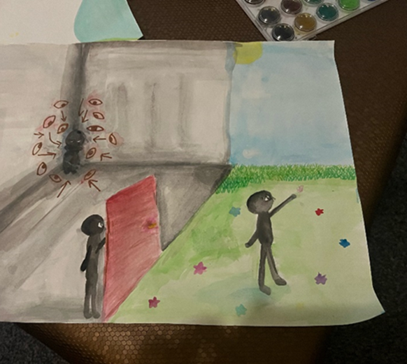
Integrated working
Schools
GP surgeries
School nurses
Third sector organisations
CAMHS, MyTime, MHST.
Place based delivery through outreach bus

Slide 29
Southbank Centre: Creative Health Youth Programme
Sunita Pandya, Executive Arts and Culture Consultant

Slide 30
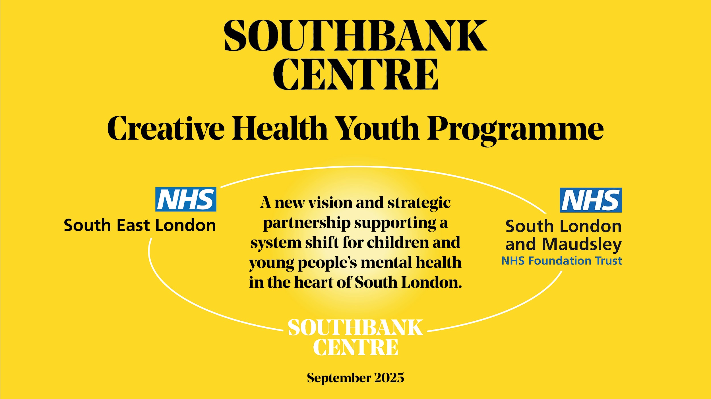

Slide 31
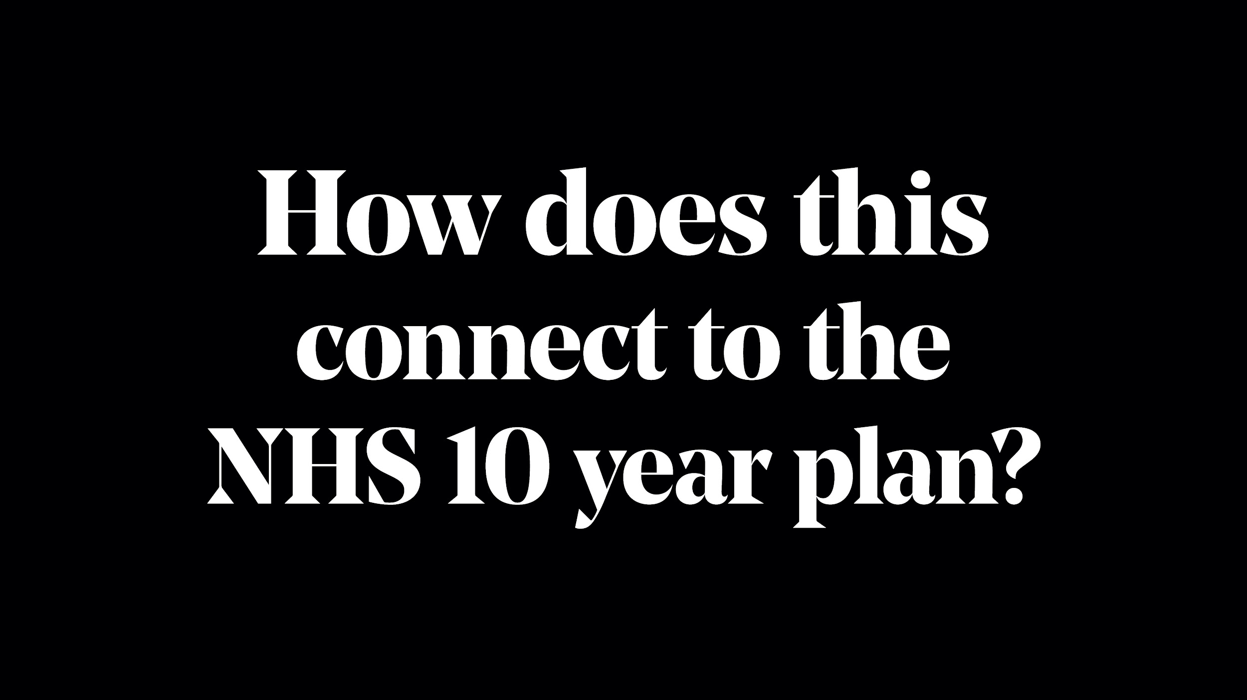

Slide 32
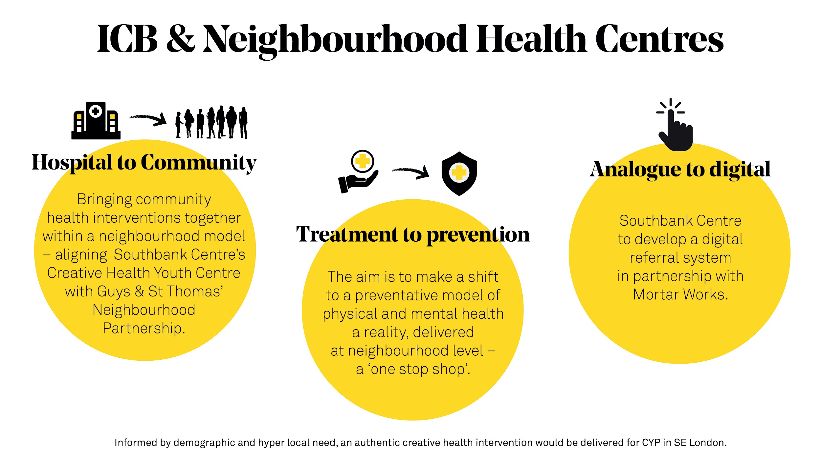
Notes:
The Ten-Year Plan is a significant moment for the NHS and the broader health and care system, committing to key changes to deliver the government's three central shifts: from hospital to community, treatment to prevention, and analogue to digital. These shifts are designed to reduce demand on hospitals and staff, shorten waiting times, and achieve high-quality healthcare efficiently.
key focuses are;
Hospital to community: The Darzi review revealed the stark need to rebalance more NHS funding to primary, community and other settings outside of hospitals, creating neighbourhood health centres. At the heart of the plan is the establishment of a neighbourhood health service – expansion of burgeoning integrated, multi-professional, multi-sector teams working in local communities and often colocated. This will help deliver a model of care that is preventative and better supports those most in need, including those with long-term conditions. We hope the planning process will ensure the NHS can meet added demand by bringing primary, community and allied services together under one roof - which absolutely chimes with SE London ICB’s, SLAM’s and Southbank Centre’s partnership - supported by local government plans.
Treatment to prevention: The plan outlines action on social, economic and commercial determinants of health to half the gap in healthy life expectancy between the richest and poorest regions. It aims to make a shift to a preventative model of physical and mental health a reality. A more preventative model of care delivered at neighbourhood level - a “one stop shop”, and the enhanced role of strategic authorities, will support the development of cross-sector partnerships that are rooted in communities, supported by pooled budgets. This speaks directly to the Prevention strand of work lead by Southbank Centre which is being co designed by their Youth Advisory Committee in partnership with Black Thrive, and will be realised in the Creative Health Youth Centre.
Local flexibility and authenticity:. Flexibility at a local level will be needed to enable trust leaders, and their partners, to implement the 10YHP in a way that best suits local needs and populations. Different approaches may be needed to get to the intended outcome, depending on factors such as geography, demography and deprivation with a focus on SE London CYP.

Slide 33
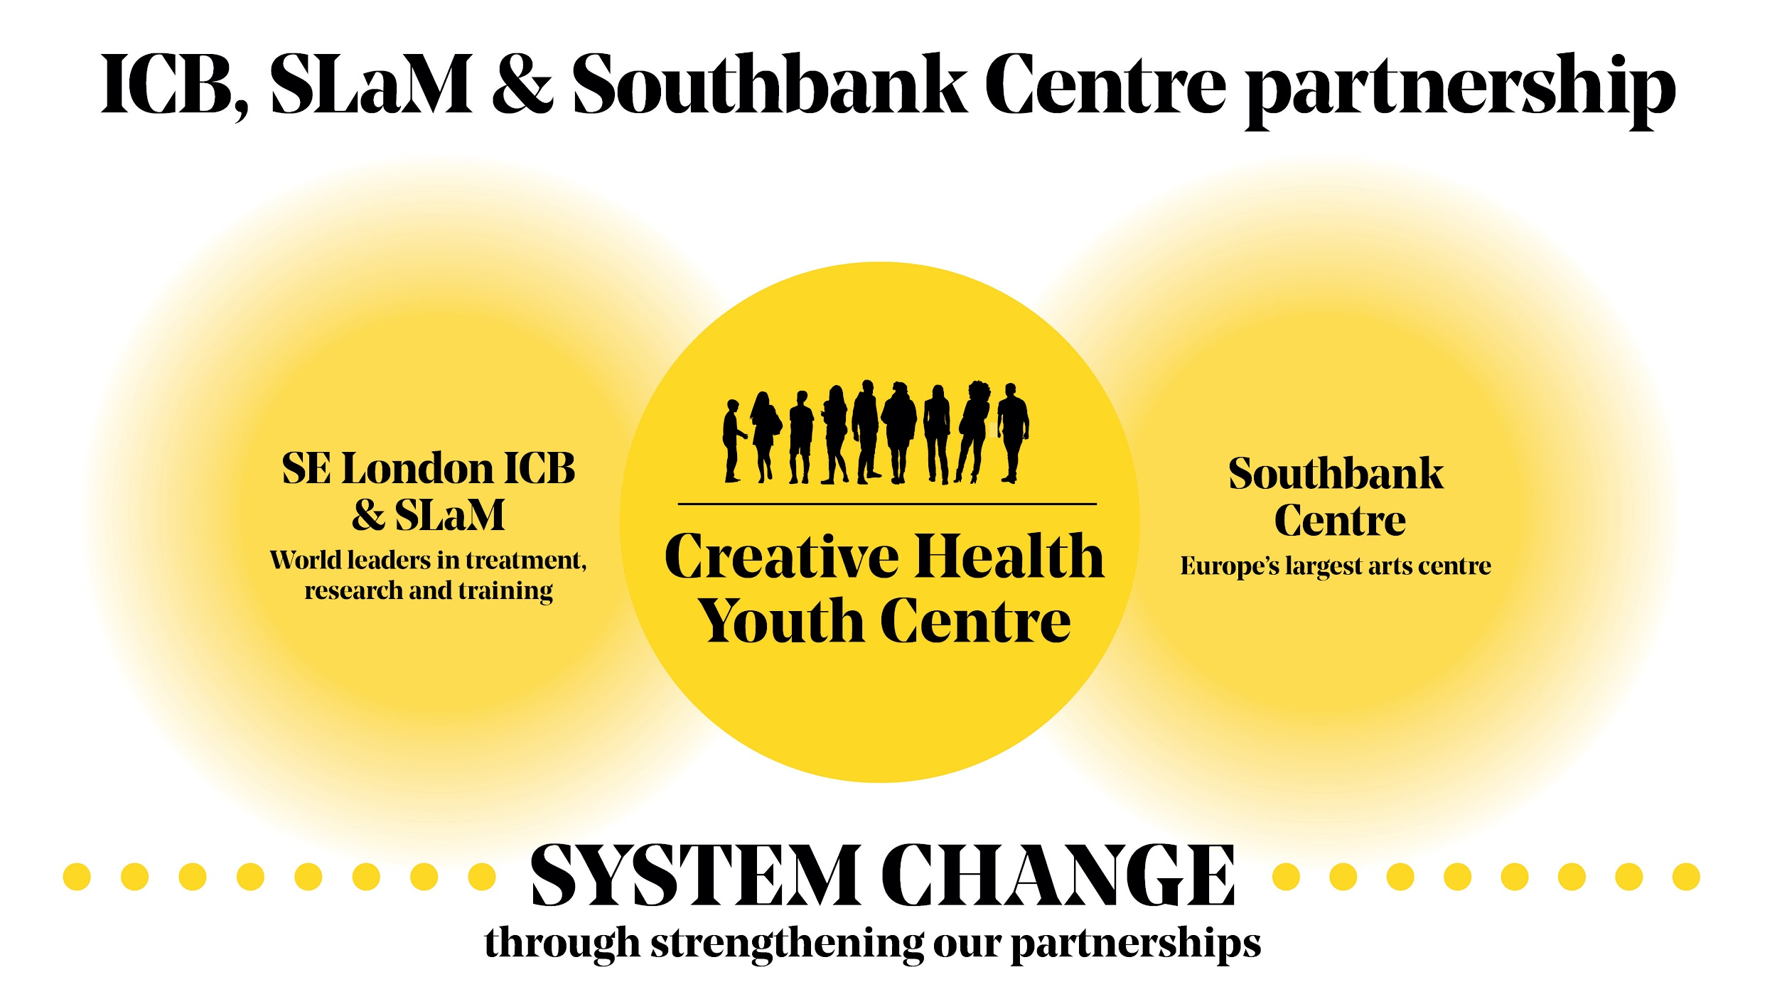

Slide 34
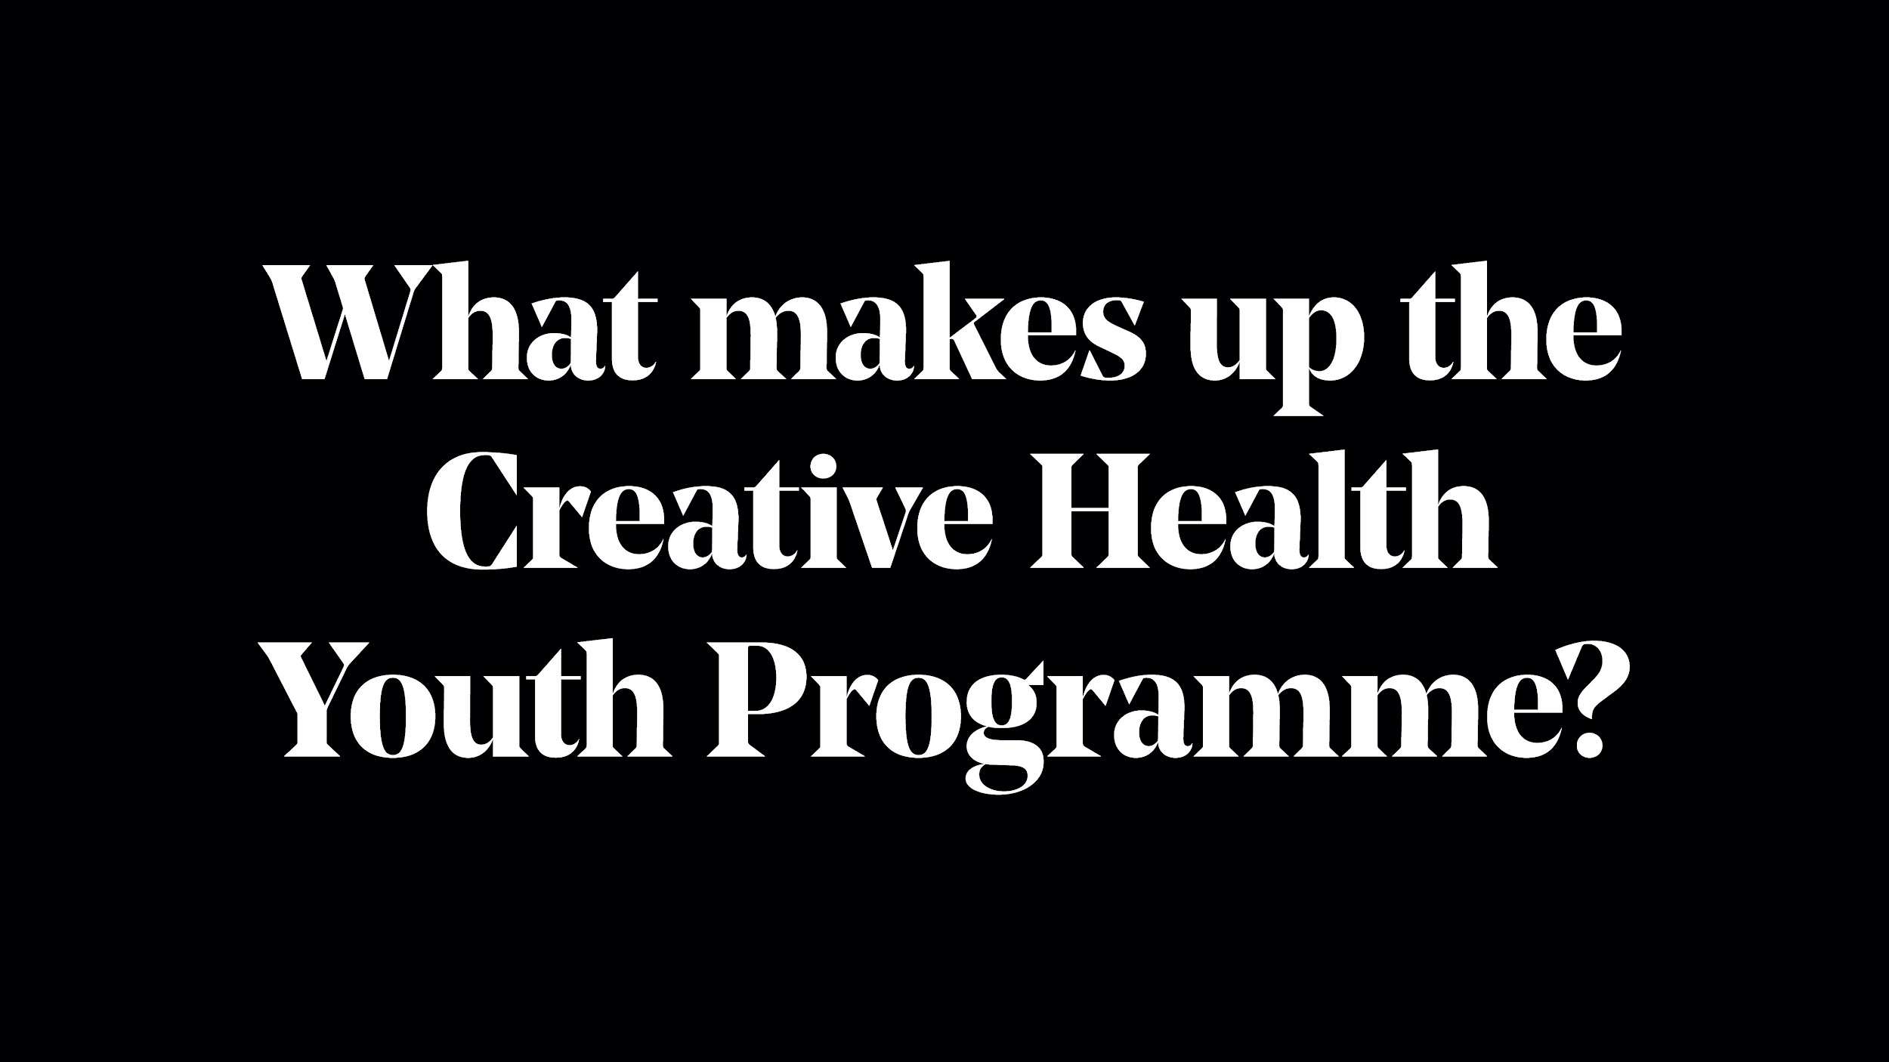

Slide 35
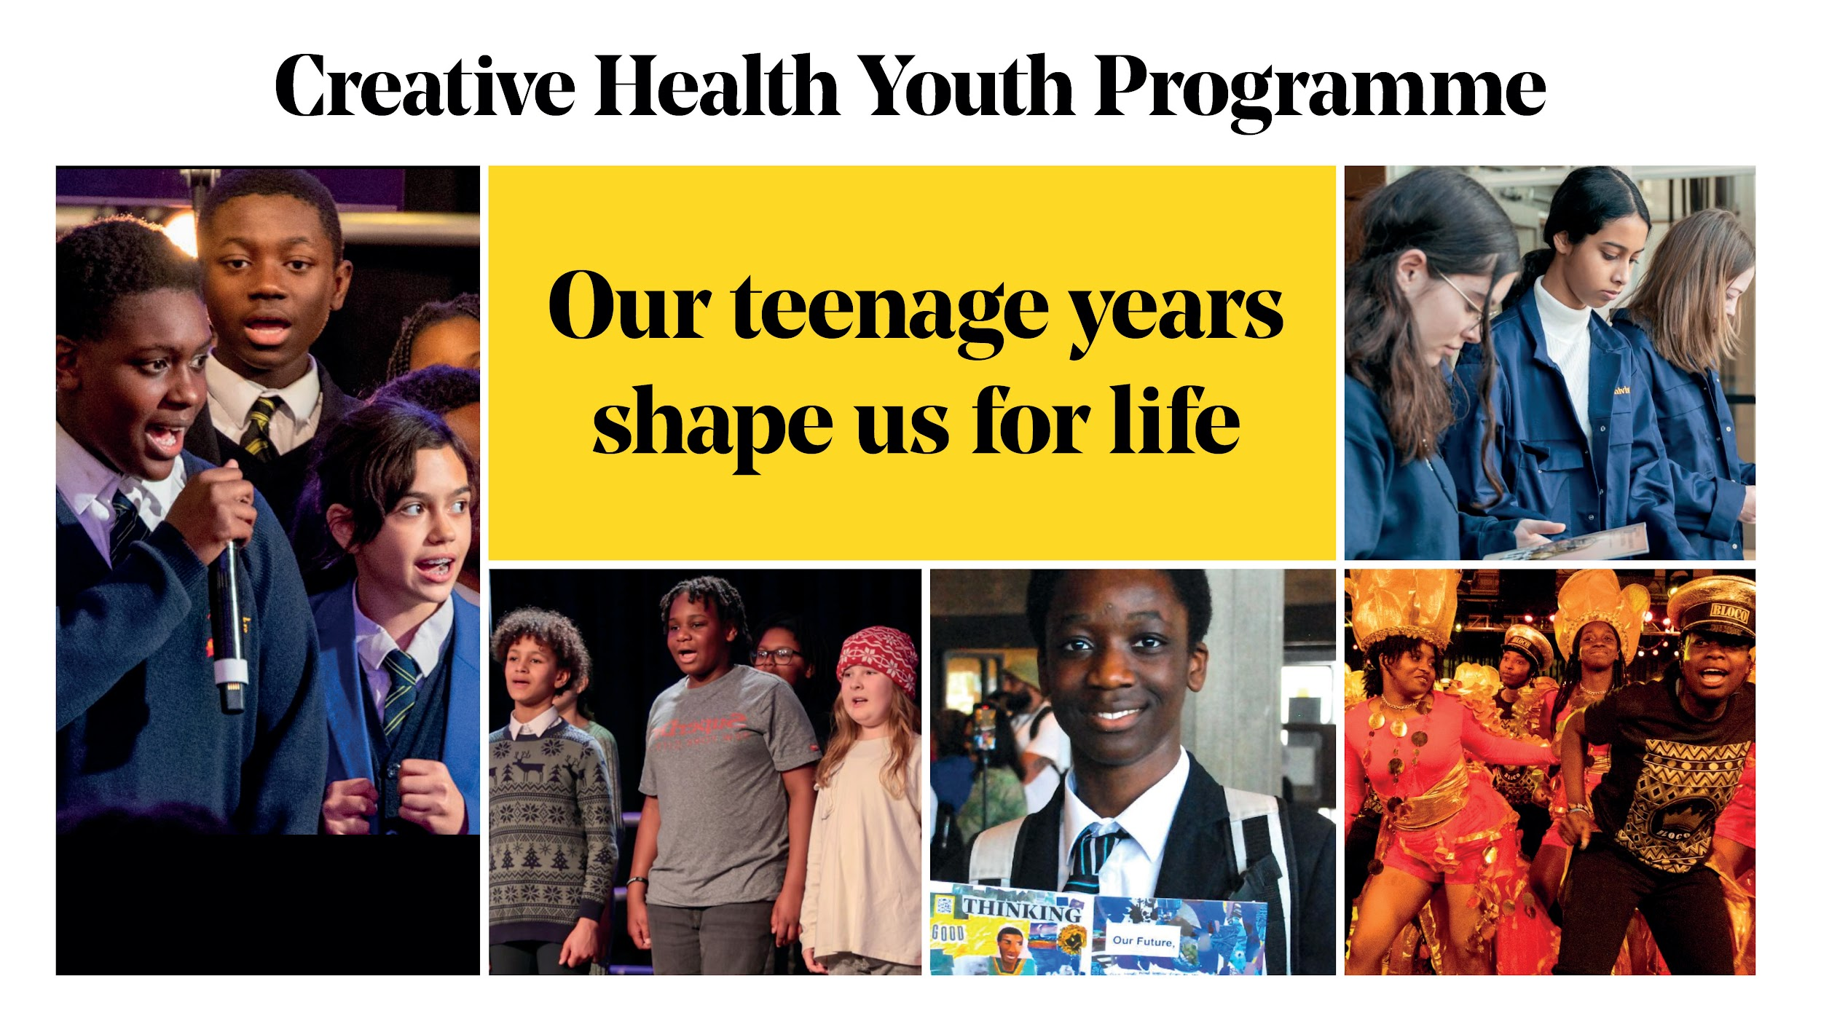
Notes:
Our long term vision is to open a Creative Health Youth Centre
In 2026 during our 75th Anniversary - young people will be at the heart of this Festival - as participants, artists, producers and audience.
Emblematic of Southbank Centre’s foundational purpose in 1951, this new space will be a key legacy coming out of our 75th anniversary year - and will be a permanent space for engagement, providing young people with transformational encounters with the arts
It will be a dedicated space on Southbank Centre’s world renowned site, codesigned with young people, that will offer a creative health programme to support young people’s mental health, and provide a safe space, a sense of community and the opportunity to develop new skills.
Subject to fundraising, we hope that this newly refurbished part of our building will be ready by 2028
And this building is the long term system change impact we want to deliver.
…and will pivot the existing expertise in the team to a new focus to support young people, aged 11 to 25 and deliver a creative health youth programme.
What the evidence tells us is that 50% of all lifetime mental health challenges are established by age 14, and 75% established by 25 years (JSNA 22/23).
National estimates suggest 1 in 10 school-age children have a clinically diagnosable mental health problem, including depression, anxiety or psychosis. It is felt that these are likely to be underestimates. (JSNA 22/23)
Referrals have tripled - in London some CAMHS waiting lists are now up to 2 years - with a 250% increase in south London in the last 3 years (GLA).
NHS specialist mental health services are turning away 1 in 3. 75% of CYP experiencing a mental health problem wait so long their condition gets worse, or are unable to access any treatment at all (LGA, 2023).
Over the last few months, we have undertaken a huge amount of research, and I have met with over 100 stakeholders, organisations and potential partners working across health, the youth sector, the arts, community and voluntary sectors, local and national policy, and research in order to understand the scale of the challenge, and how this specifically impacts young people in south London.
The purpose of this initial research phase has been to understand where best SC can have impact; what excellent practise is already out there that we should be learning from, including in south London; what partnerships we could form and opportunities to enable smaller community based organisations to scale their work; and what are the key needs of our immediate boroughs.
--------
We also know teenagers are not going to their GP - GPS report seeing a huge fall off from 10 yrs old, and start seeing them again at 21 when they are more confident at self-determining

Slide 36
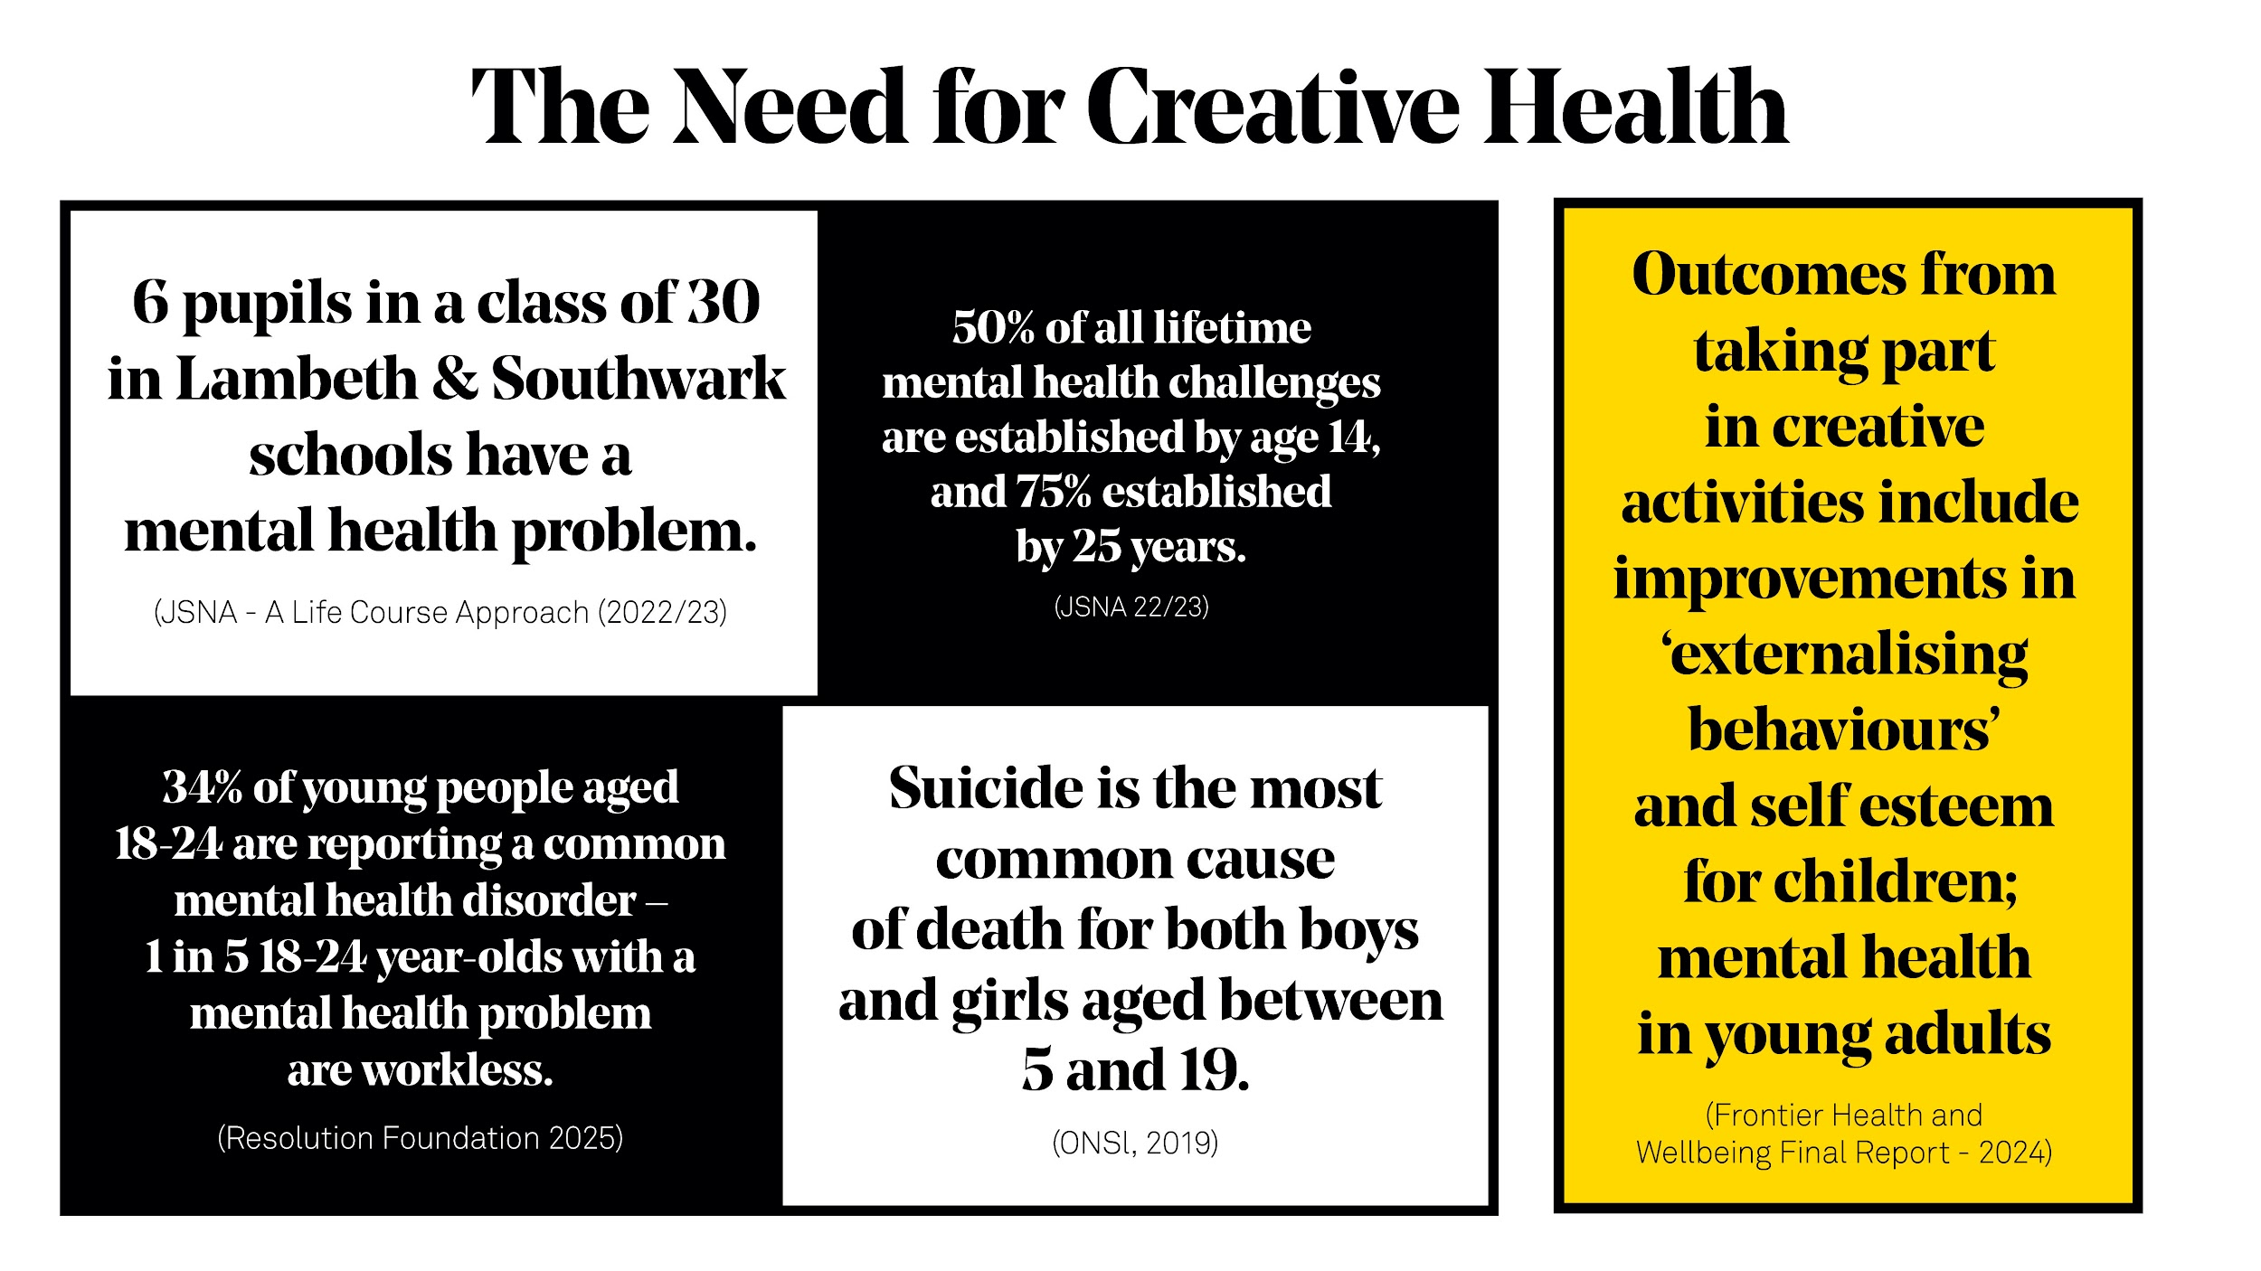
Notes:
This refocus of our Arts & Wellbeing programme is a natural and logical progression and evolution for CE - it means that now all of our department’s output will be focused on young people as a united strategic purpose. And builds on our current year round successful work with young people that ranges from school schemes to youth engagement, most of which have attracted multi-year funders and national partnerships.

Slide 37
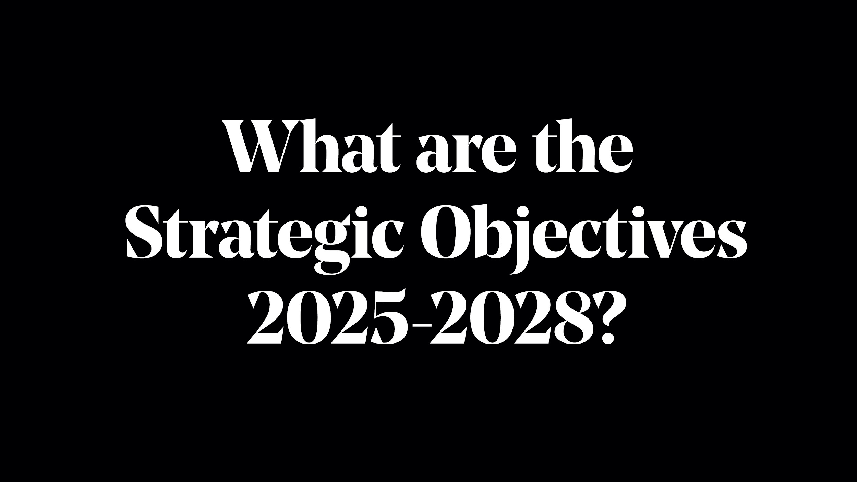

Slide 38
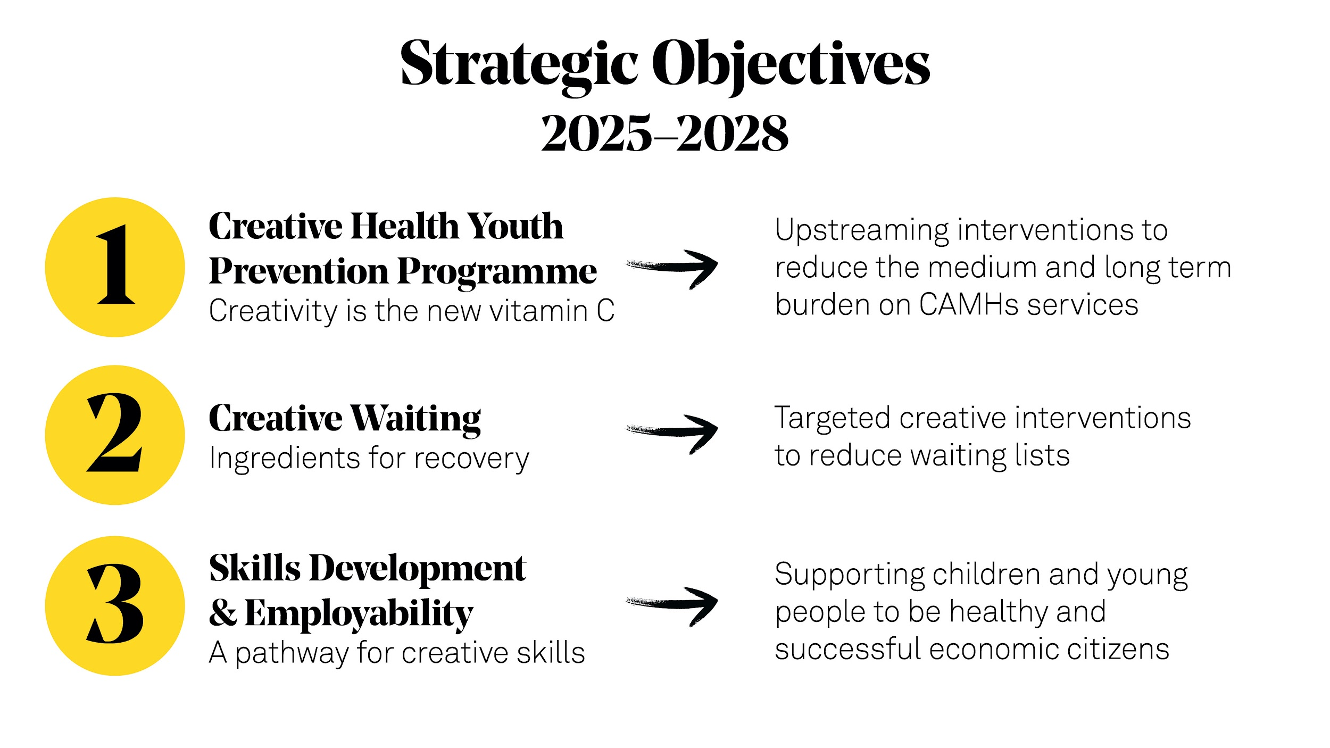
Notes:
So across 2024 - 2025 we are designing our new programme with 3 overarching OBJECTIVES
Core A&W programme = PREVENTION PROGRAMME - creativity is the new vitamin C
Young people come to us through a variety of referral routes, but before any CAMHS involvement - this is about early intervention.
They will access, explore and develop their creative voice and creative skills
We will draw on our expertise as a multi-artform arts centre and will design projects and programmes - some of them co-delivered with relevant partner organisations - using music, performance & dance, poetry and visual arts.
We will facilitate young people creating a sense of community and connection, building resilience, a sense of purpose and agency
The programme will support young people to establish their toolkit for life.
‘The youth mental health crisis’ NPC report:
Preventative work and early intervention: Research shows that early intervention is more effective than addressing mental health problems after they present. The return on investment is 3x higher for preventive care than specialist treatment.
However, we have to acknowledge that whilst prevention is the goal, waiting lists are in crisis now - this leads us to
2. WAITING WELL - ingredients for recovery
Subject to pending funding applications, our plan is to work with the SE London ICB, King’s College, Raw Material and Breathe Arts Health Research to create a dedicated intervention programme, designed in partnership with the ICB and SLaM to support CYP who are waiting to be seen by CAMHS. The creative health projects will:
Meet identified needs and particularly support those from marginalised backgrounds to be active participants in their recovery and better health.
Create robust evidence on the impact of creativity on maintaining young people’s health while they are waiting, and possibly even demonstrate that participating in such a programme could reduce the need for CAMHs entirely for some participants.
3. Our third objective is to link our Arts & Wellbeing programme to our Talent & Artist Development strand
We will create a pathway for young people accessing the Arts & Wellbeing programme to get serious about their art and develop their skills.
This will connect two areas of Southbank Centre’s expertise and will:
empower emerging creatives from marginalised communities, with lived experience of mental health needs, to receive support to develop their careers;
receive validation from their peers, and gain access to high profile professional artists and Southbank Centre.
----------

Slide 39
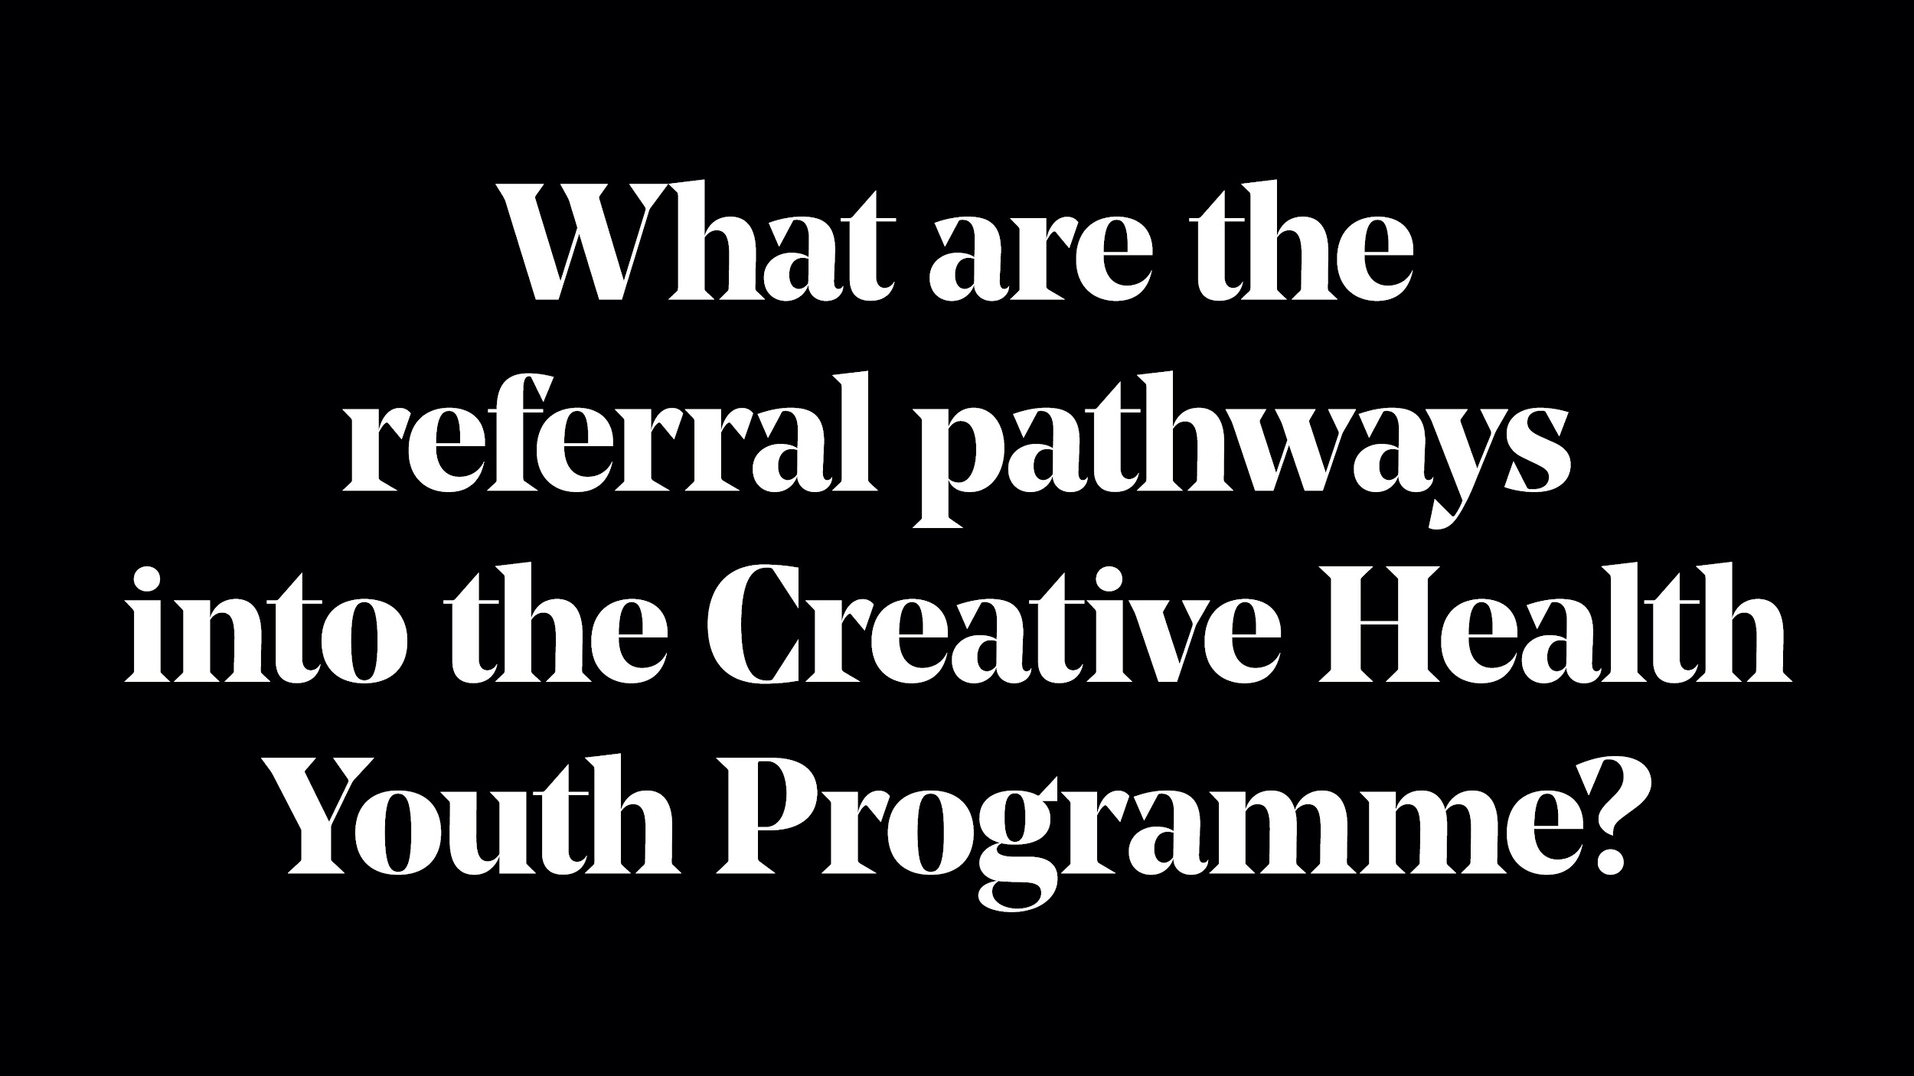

Slide 40
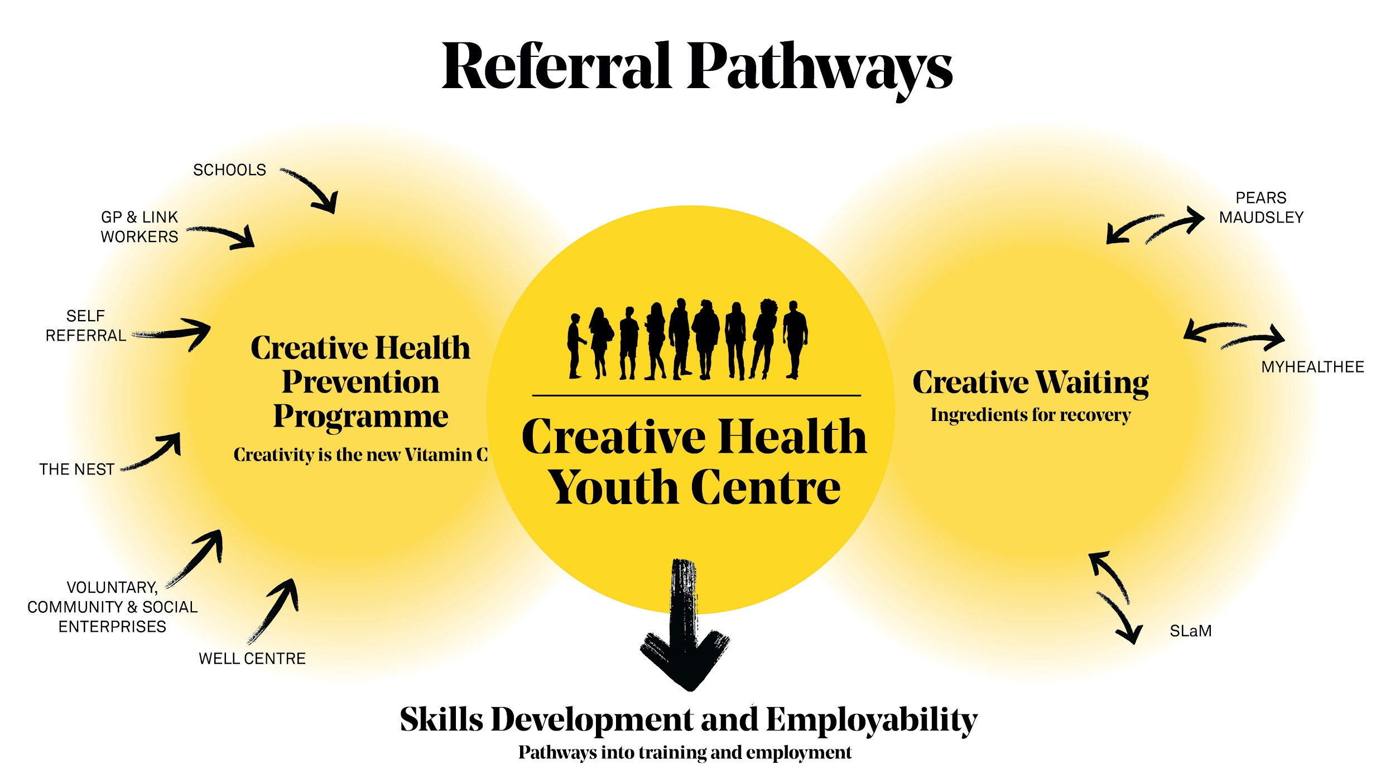
Notes:
This is a visual representation of our plan.
Multiple referral routes into our programmes
Our research and evaluation partners - Kings and Brunel - are in place for both programmes to help us track and demonstrate impact for both parts of our programme
For those of you with good eyesight you will see in the middle of the diagram - Creative Health Youth Centre. We feel that, running in parallel to the crisis in CYP’s mental health, is the lack of safe and inclusive spaces for young people to congregate, be themselves and build community and friendships.
Across the last decade, £240 million has not been invested in London’s youth due to local authority cuts. 10m young people do not have access to a safe space outside of school or home.

Slide 41
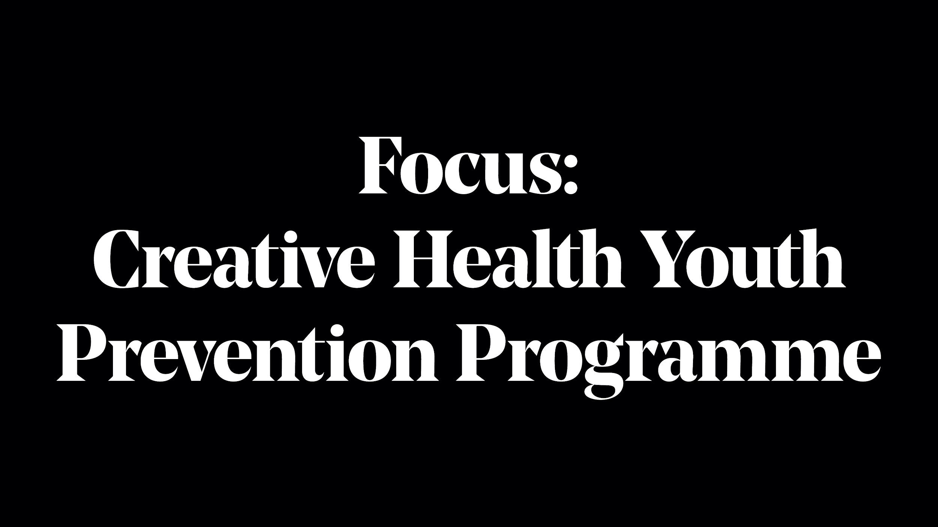

Slide 42
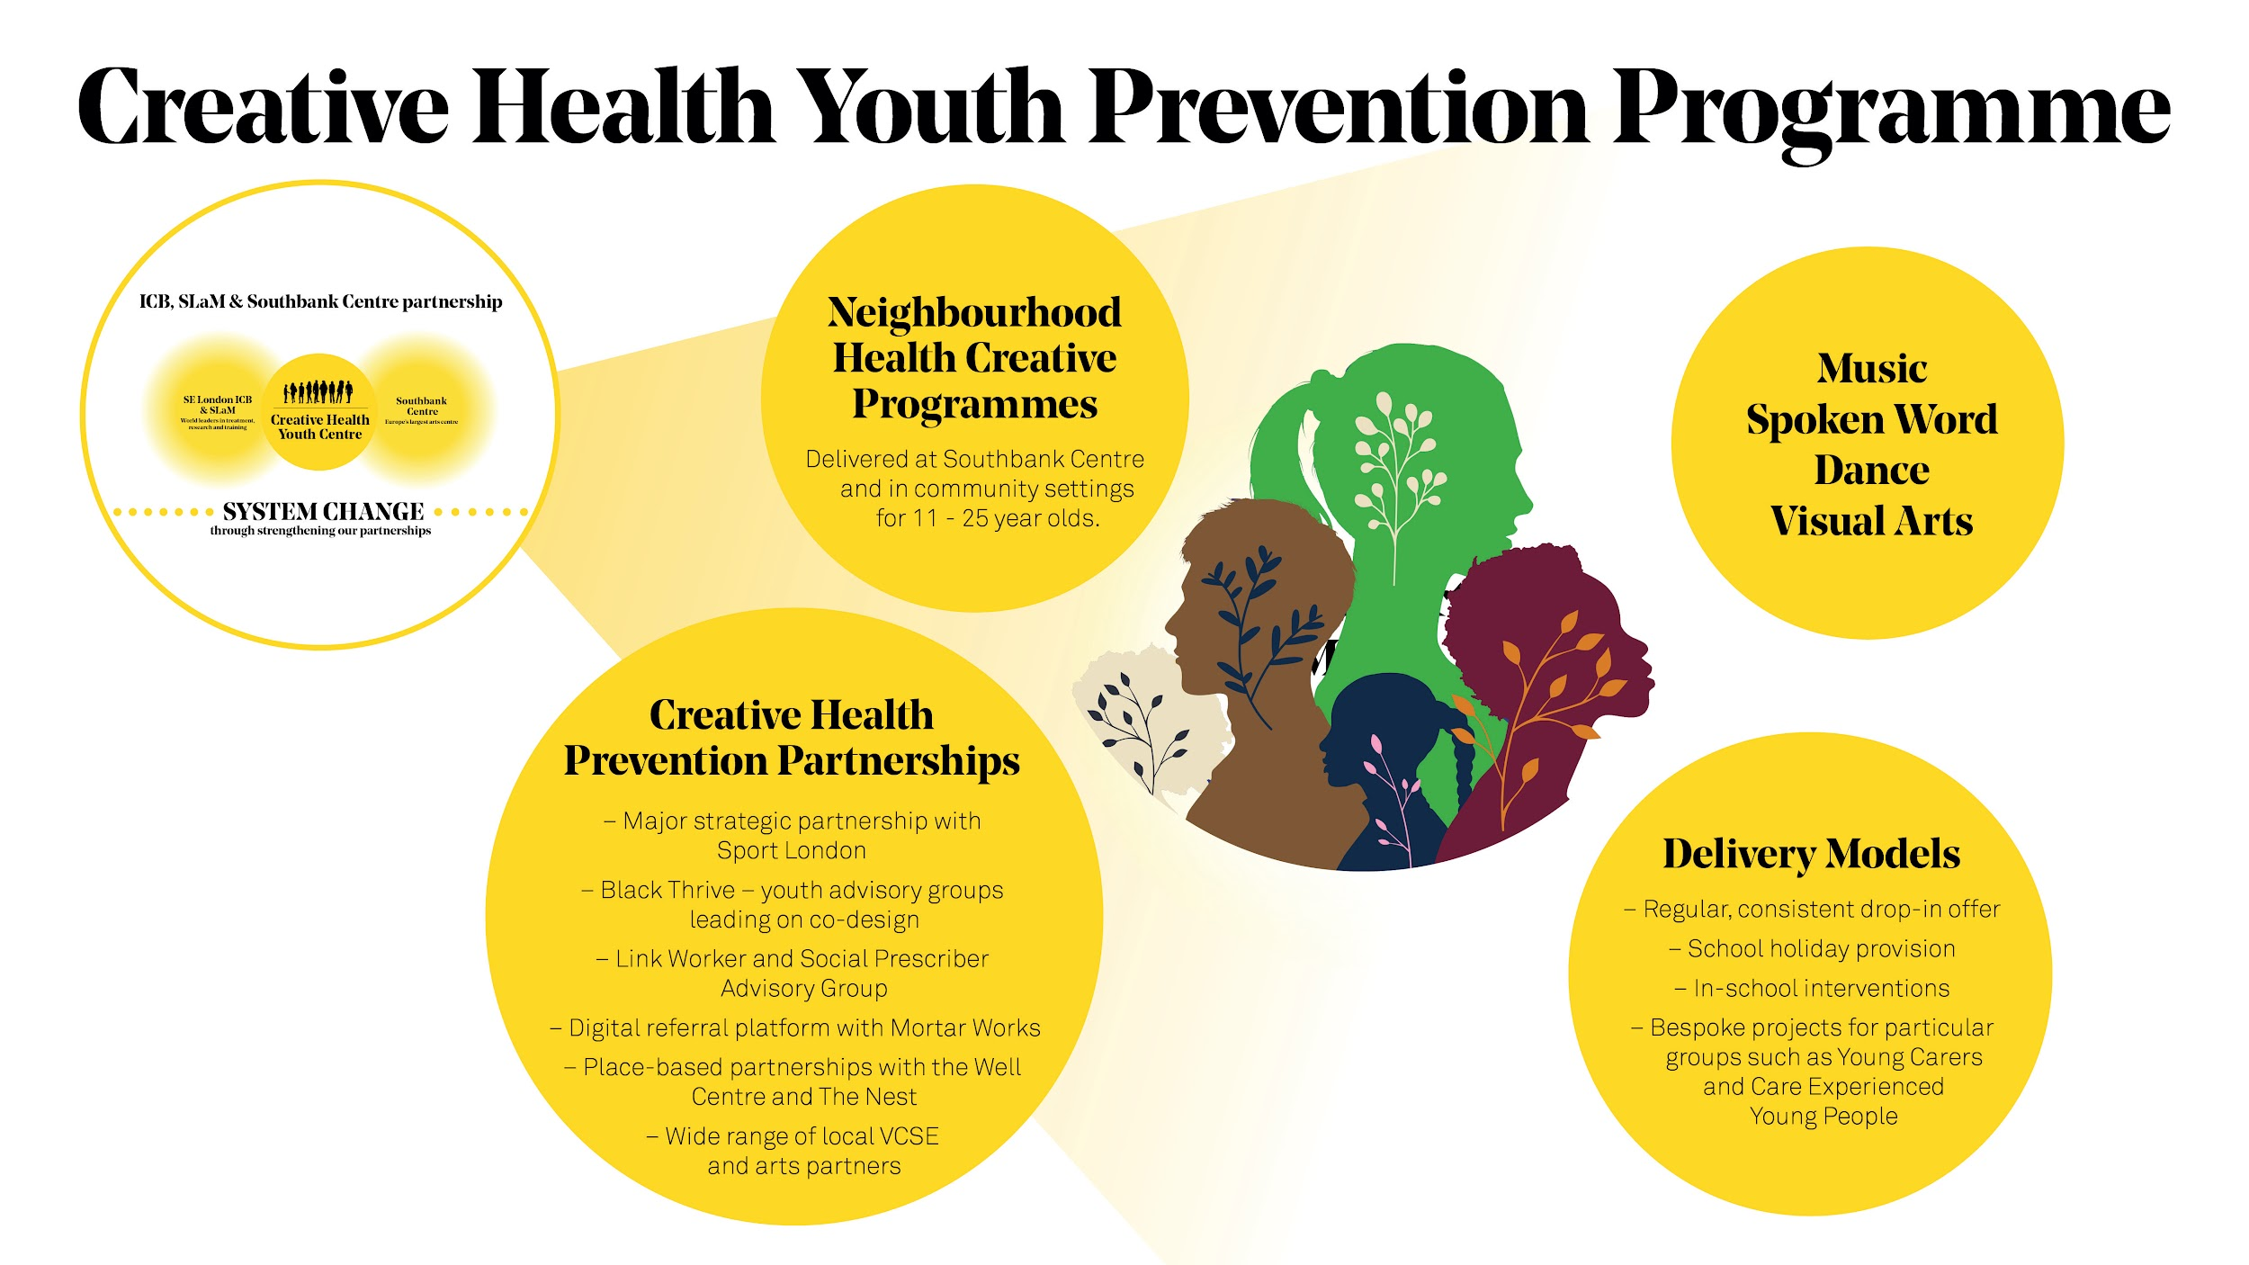
Notes:
Underpinning our planning for our Prevention programmes is to ensure we have embedded evaluation and monitoring impact from the outset - we are doing this through the following two ways:
Investing in a new referral pathway with Mortar Works
Co-designing with young people a new wellbeing scale, in partnership with Brunel University - hand over to Emma

Slide 43
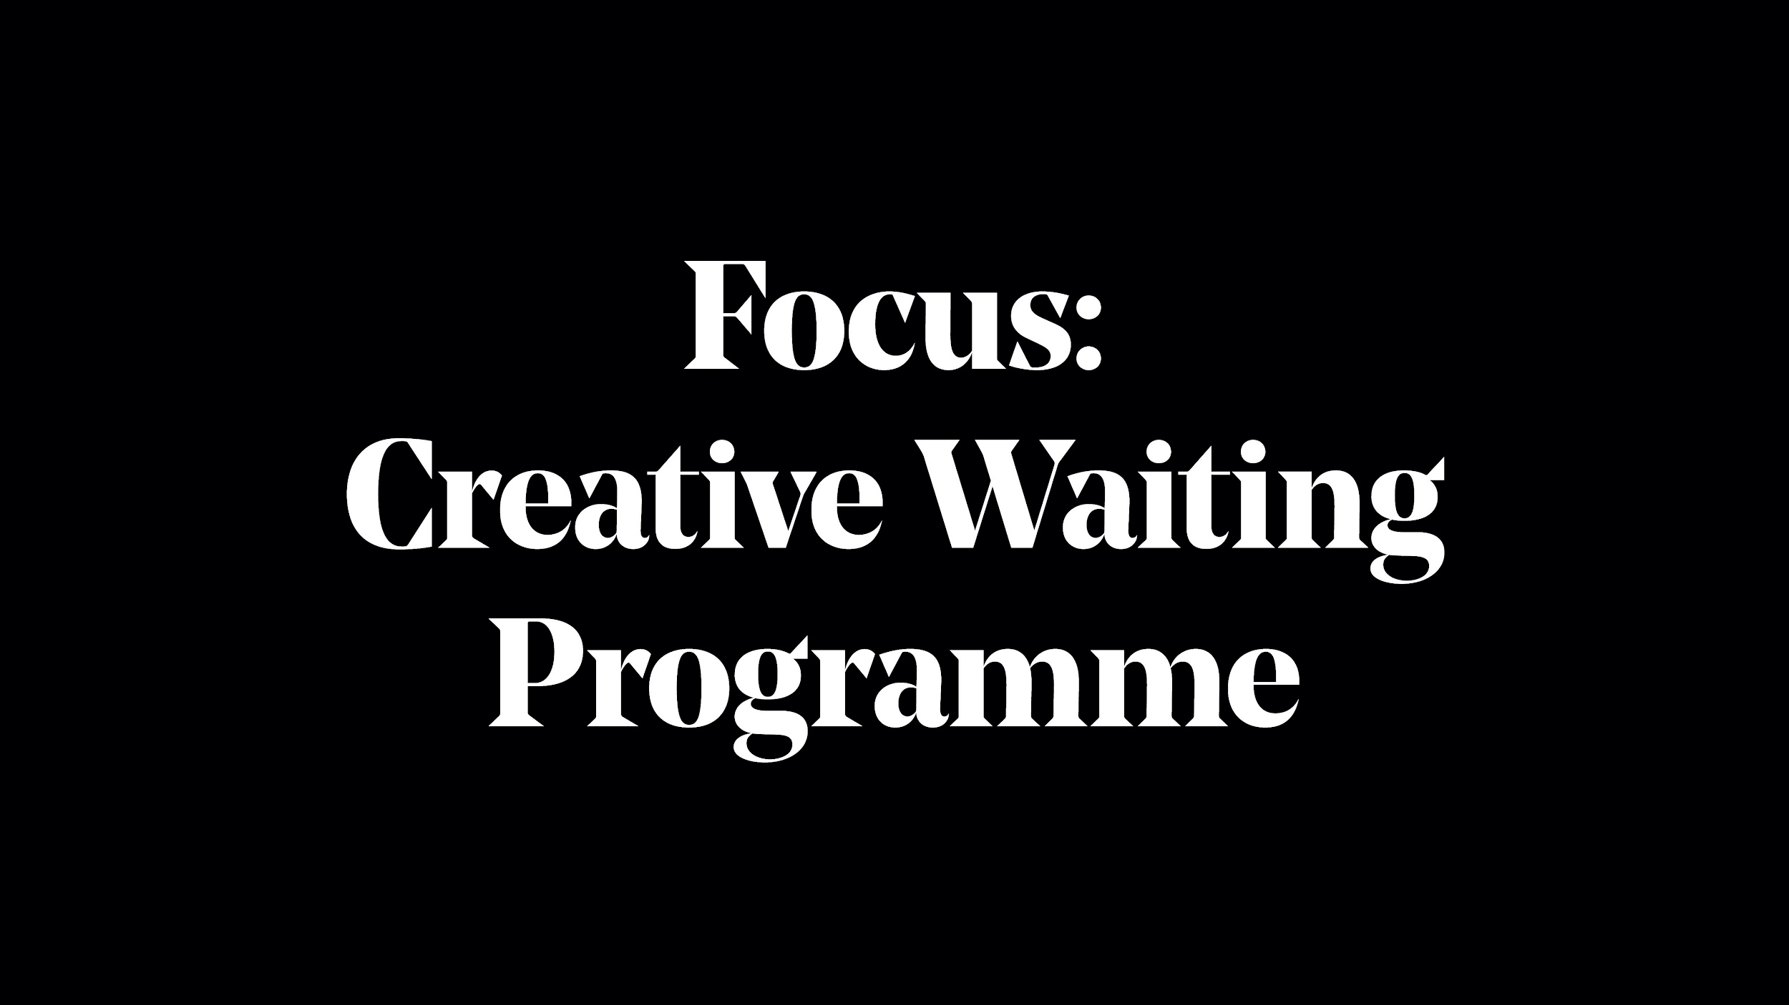

Slide 44
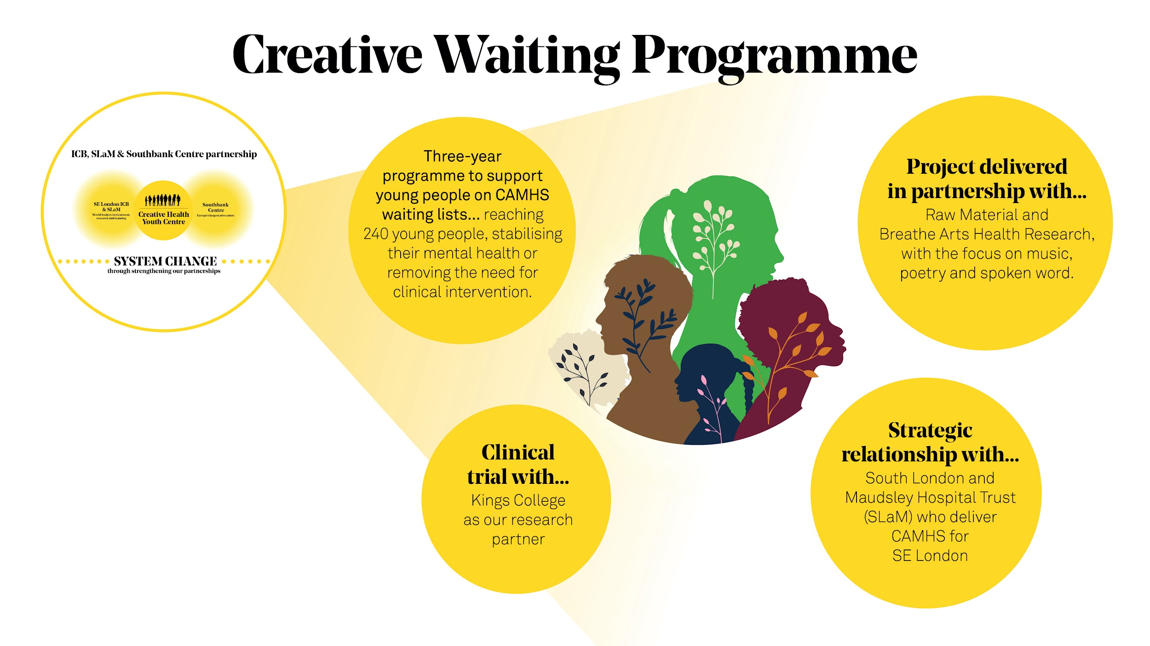

Slide 45


Slide 46
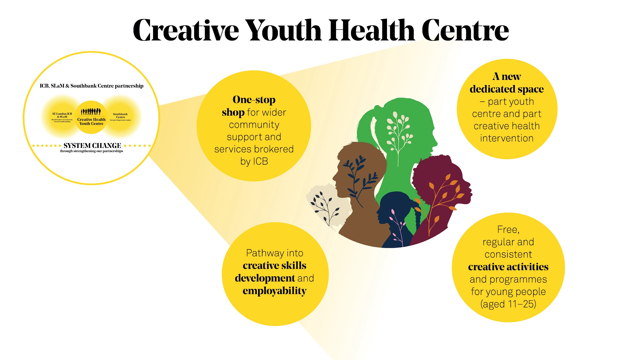
Notes:
This new space will be part youth centre and part creative health intervention - and will sit at the heart of a new emerging pan-London strategy to combat the mental health crisis by using creativity to support better outcomes for children and young people.
At its heart, the CHYC will offer a range of free creative activities and programmes for young people (aged 11 - 25), providing a space to explore their creativity, build a community, learn new skills and experience the joy of participating in live art.
Embedded within the centre, young people and their families will also be able to access the help and support they need. The CHYC will tackle health inequalities experienced by many in our community by being a one-stop shop for wider community support linking them to employment, GP and mental health services.
A footprint in SE1, a blueprint for sector change
Mental Health -alignment to NHS 10 year plan;
• Mental health services will be transformed into 24/7 neighbourhood care models. Assertive outreach care and treatment will be improved to ensure 100% national coverage in the next decade, with a focus on narrowing mental health inequalities.
The expansion of mental health support teams in schools to reach full national coverage by 2029/30; providing additional support for children and young people’s mental health through Young Futures Hubs; and recruiting 8,500 mental health staff.
The government and the NHS will work with local authorities to ensure children with the most complex mental health needs in residential care get the treatment and support they need.
Specific actions in tackling health inequalities include: moving closer to fair share of funding locally, based on health need, supported by better data and a more sophisticated understanding of lifetime health risk;
Helping our children to flourish
expansion of the Mental Health Support Teams in schools and new Young Future Hubs will provide additional support for children and young people’s mental health.
Employment and work – patient employment goals will be part of care plans and local NHS services targets will be set for reducing unemployment and economic inactivity

Slide 47
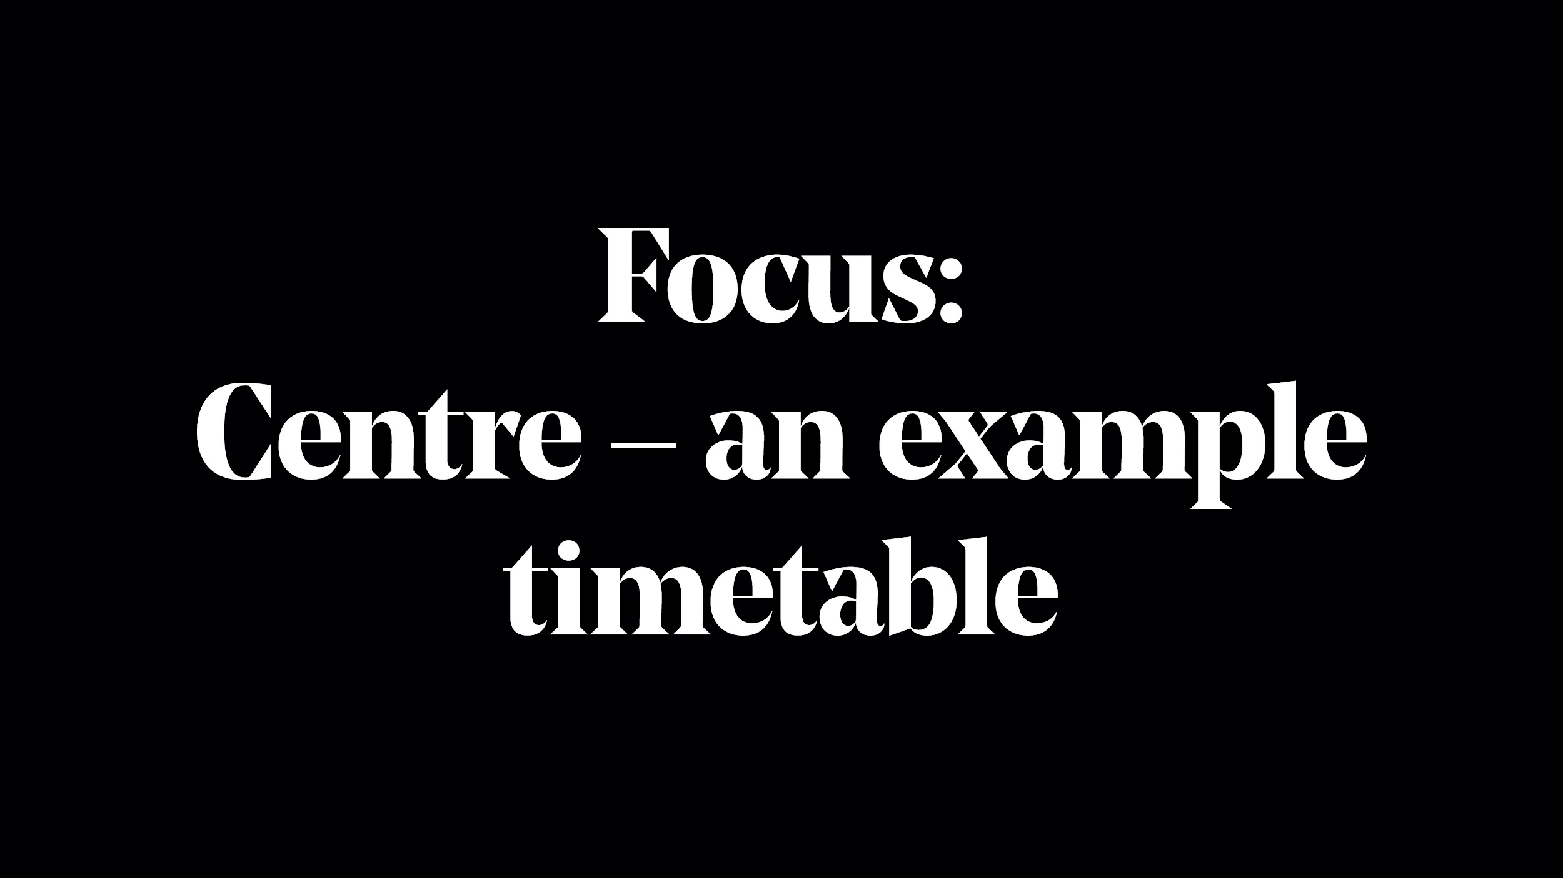

Slide 48
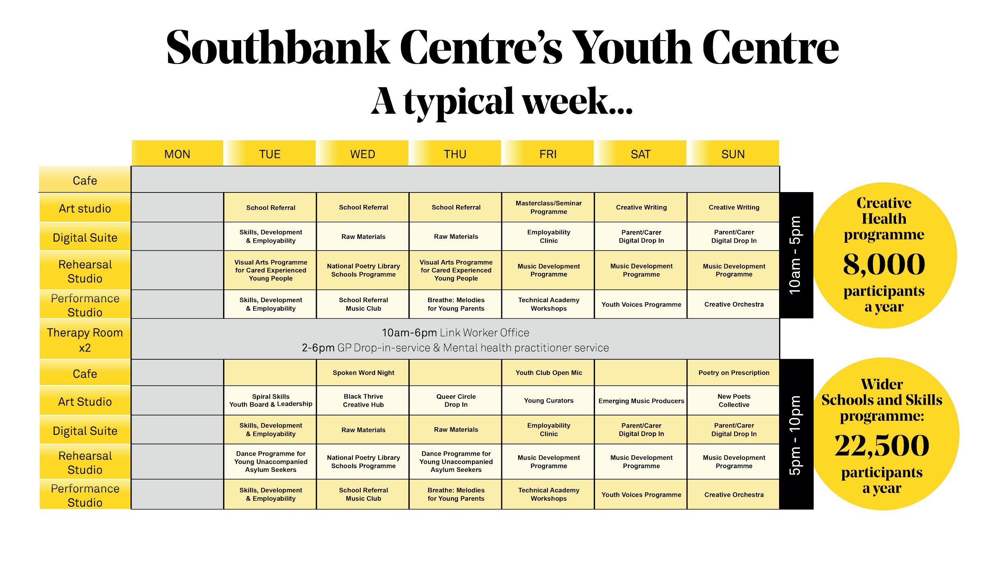
Notes:
A week in the life of:
- a vibrant, busy space offering consistent, regular programmes either delivered by SC or our partners with a range of brokered wider community support services.
You can see:
We would have multiple spaces all running simultaneously with activity - from a rehearsal room, to an art studio, a digital suite for all our Apple kit, and a cafe and social space
We would run a range of regular consistent drop in clubs for young people - offering music, creating writing and visual arts activities
We would be able to offer consistent holiday clubs and programmes
We would work with specific groups of young people that need additional support from those with special needs, to those who are care experienced.
Our work to date, and the momentum we are building around this vision, has generated lots of interest from many local partners - we imagine they would help us deliver this scale and reach - we won’t be doing this alone, and it will build on our long history of working in partnership with a wide variety of organisations, including our existing resident youth music partners Kinetika Bloco and Tomorrow’s Warriors.
With a new dedicated space, we would be able to scale all parts of Creative Engagement’s offer - across Schools, Youth A&W and Talent & Development, bringing everything together under one roof.
Once we are fully up and running and established, we anticipate reaching 8000-10000 young people a year through our Arts & Wellbeing programme, and an additional 20,000 through the Schools and T&AD programmes

Slide 49
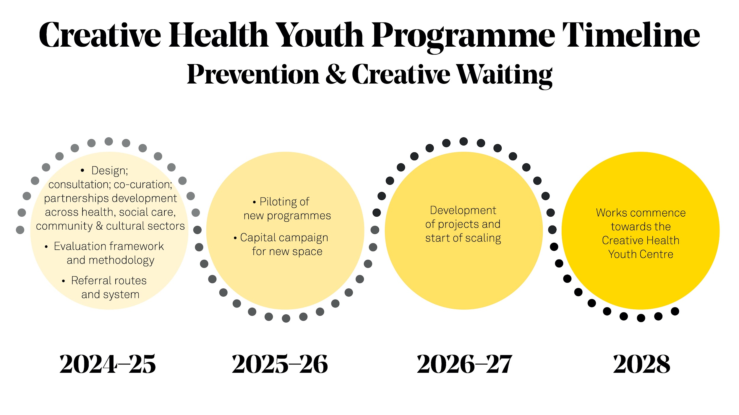

Slide 50
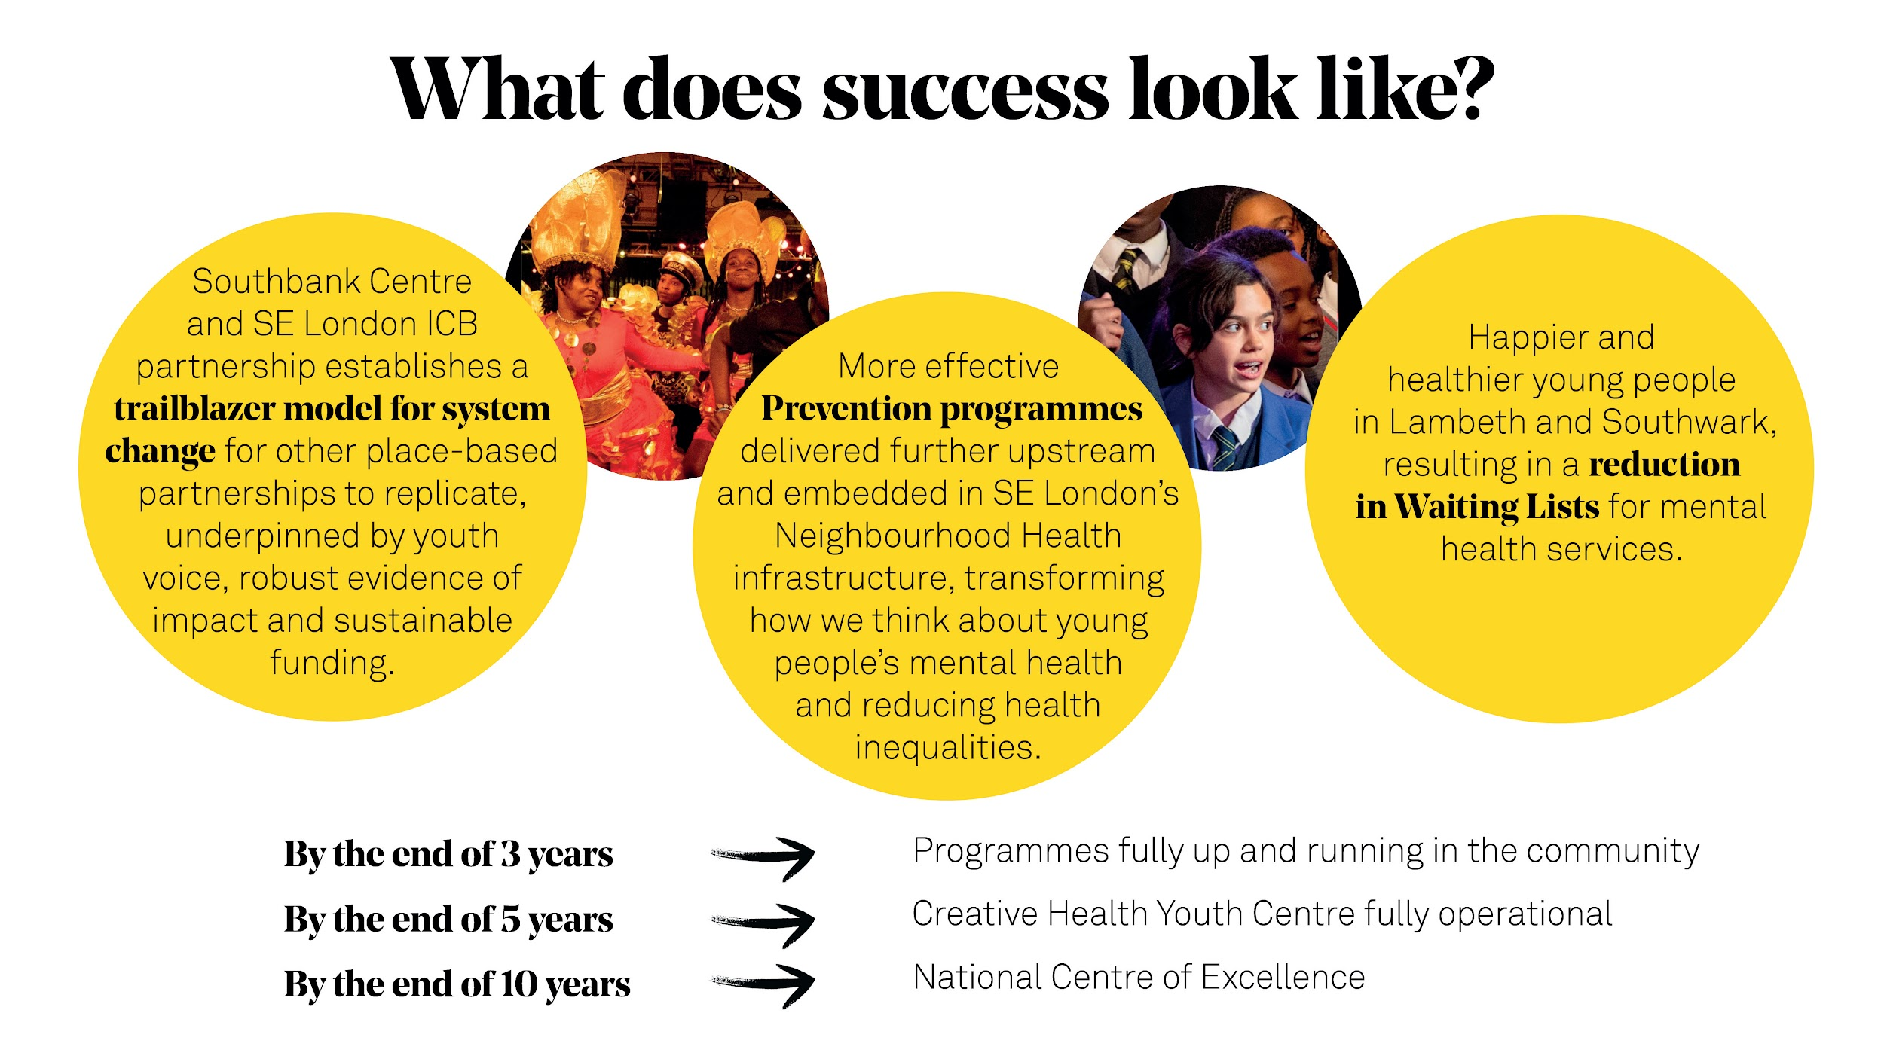

Slide 51
Case study: Healthy Hyde
Hayden Roters, Wellbeing Team Lead at Healthy Hyde

Slide 52


Get in touch
socialprescribingacademy.org.uk
Q&A

