Slide 1
NASP Webinar - Social Prescribing and Neighbourhood Health:
Looking to the Future
Thank you for joining us. The webinar will begin shortly.

Slide 2


Housekeeping
Please note we are recording this webinar. you will be sent the slides and the link to the recording, and they will be on NASP's website too.
Please submit questions via the Q&A function. We will hold a Q&A session at the end of presentations.
Please use the chat function for introducing yourself and networking. If you have any technical issues, please raise these in the chat, and a member of the NASP team will assist.
Closed Captions are available (turn these on at the bottom of your screen)

Slide 3

Overview
Chair:
Dr Radha Modgil, GP and broadcaster
Speakers:
Dr Minal Bakhai, Director of Primary Care Transformation, NHS England
Charlotte Osborn-Forde, Chief Executive, National Academy for Social Prescribing
Jag Mundra, National Academy for Social Prescribing
Meena Patel, Senior Lead, Personalised Care, NHS England South-East
Dr Connie Junghans Minton, GP
Q&A chair: Professor Kamila Hawthorne, Chair, National Academy for Social Prescribing
Speakers: Gay Palmer, Social Prescribing Link Worker, Southwark
Joe Fraser, London Region Head of Healthcare Inequalities Improvement, Prevention & Personalisation, NHS England
Matthew Walker, Chief Executive, National Association of Primary Care

Slide 4
An introduction to neighbourhood health
Dr Minal Bakhai, Director of Primary Care Transformation, NHS England

Slide 5




From Vision to Action: Turning the Dial on Neighbourhood Health
Dr Minal Bakhai
SRO National Neighbourhood Health Implementation Programme
Director for Primary Care and Community Transformation and Improvement
General Practitioner
NHS England

Slide 6

Decades of policy documents have committed to delivering personalised, integrated, proactive care delivered closer to home

Slide 7
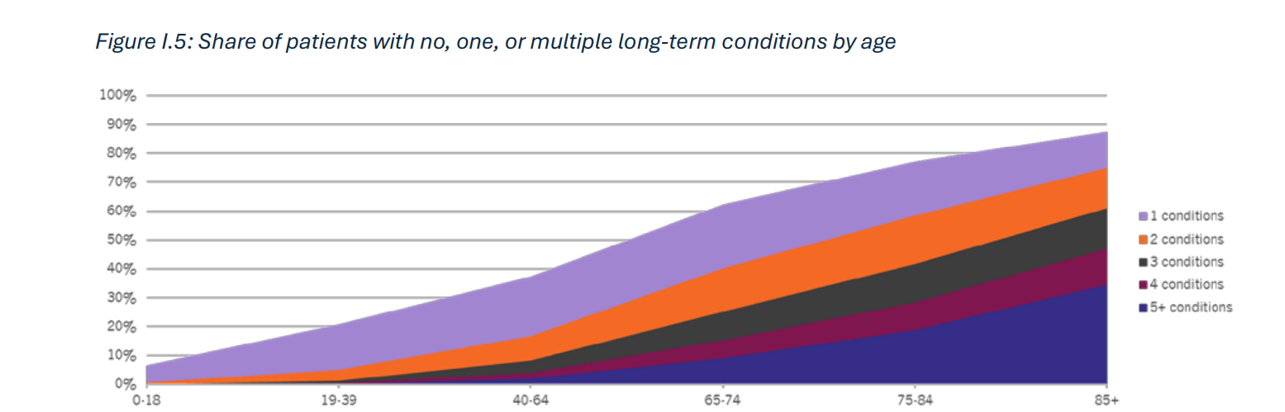
Urgent need to change
Aging population with a rapid increase in long-term conditions
Health inequalities are expected to persist over the next two decades: people in the 10% most deprived areas can expect to be diagnosed with major illness a decade earlier than people in the 10% least deprived areas. Health inequalities in 2040

Slide 8
Wyatt et al (forthcoming) Estimating the macro level impact of efforts to mitigate hospital activity in English hospitals from 2013 to 2019: a retrospective database study.

Slide 9
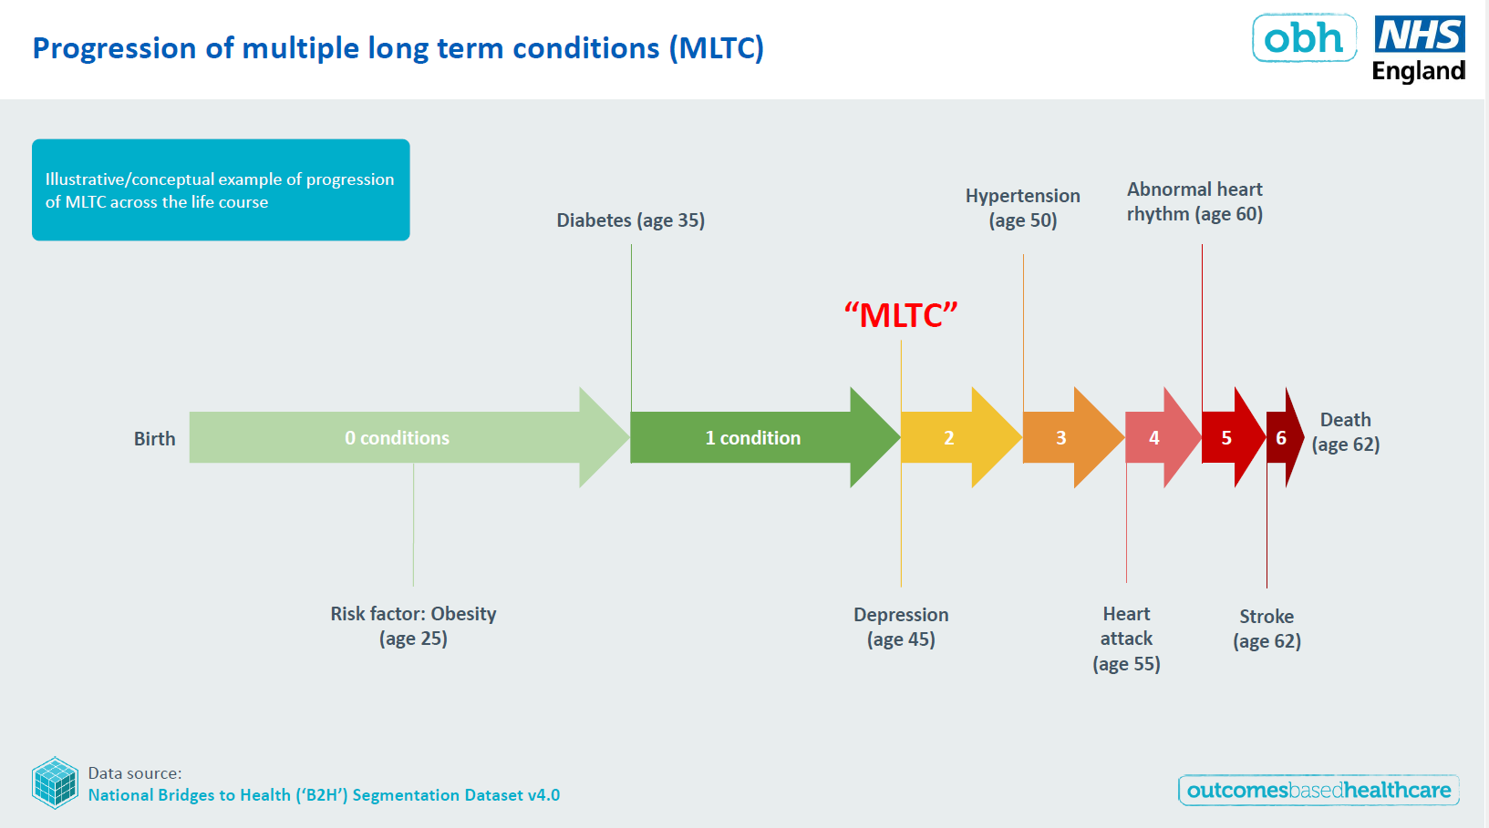
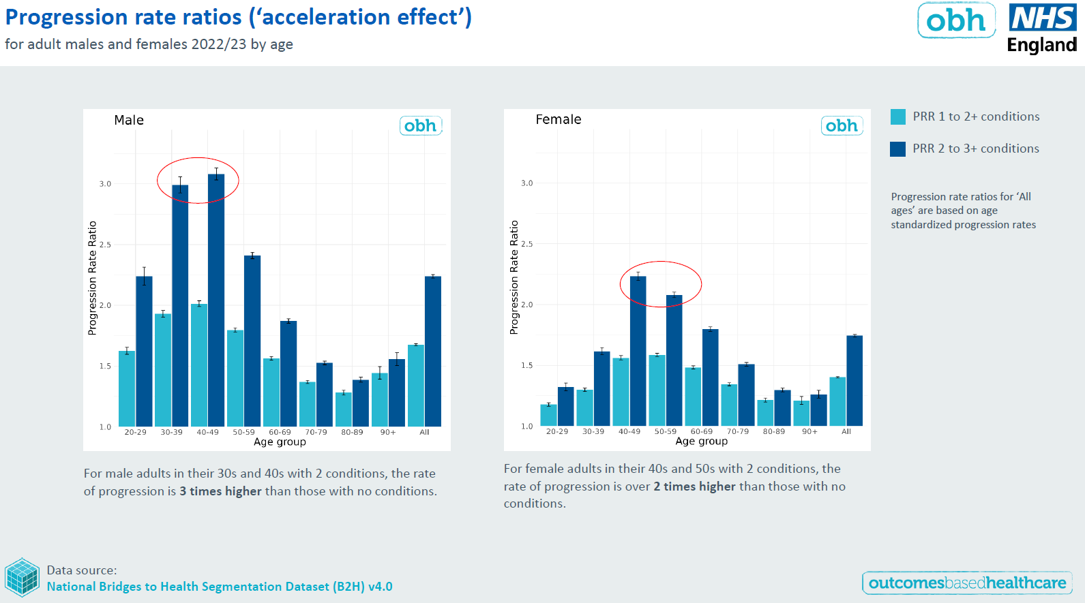
Progression of multi-morbidity is a major driver of future demand: further underlining the need for action now to maintain future NHS performance
80% due to 8 conditions (potential ‘gateway’ conditions): Depression, Hypertension, Cancer, Diabetes, Asthma, Osteoarthritis, Coronary heart disease, Osteoporosis
Progression rates exhibit a strong deprivation gradient among all ethnic groups
Smoking, physical activity, diet and alcohol are potentially modifiable risk factors for almost all of these conditions

Slide 10
The National Neighbourhood Health Implementation Programme
“Since at least 2006, and arguably for much longer, successive governments have promised to shift care away from hospitals and into the community. In practice, the reverse has happened.
Both hospital expenditure and hospital staffing numbers have grown faster than the other parts of the NHS while... key out of hospital components have declined”
Darzi Report
What did we learn from the evaluation of the New Care Models Programme?
Over-optimistic expectations from the national programme
Oversight and performance monitoring, with a narrowing focus on a narrow range of metrics
Difficulties with national processes and regulation not keeping up with the pace of local change
Issues with the availability of high-quality data and data sharing between organisations
Short timescales and a requirement for rapid progress
10

Slide 11


The National Neighbourhood Health Implementation Programme
“rethinking how we work together and how we deliver care to support the health and wellbeing of our communities, recognising that health is wider than healthcare.”
a large-scale change programme that builds on existing knowledge from Places already progressing Neighbourhood Health and seeing results
spreading learning systematically to other Places across the country, while supporting each Place to shape Neighbourhood Health in ways that work for their communities - a “tight-loose-tight” approach
creating the enabling conditions for fulfilling the Government’s commitments to neighbourhood health for all
outcomes and partnership focused – whole person outcomes for a joined-up system response, increasing community agency and integrated working
test bed to shape key ‘hard levers’ with rapid feedback loops e.g. funding flows, technology, MNP and SNP, policy
A cross-government approach unlocking long term public and private investment in neighbourhood health, resourcing community led infrastructure and social prescribing activities essential for prevention and health creation
The NNHIP is unlocking the drive and energy of staff and all partners by reigniting their intrinsic motivation to deliver the change -
141 applications received from 144 Places covering c42M of the population.
11

Slide 12
The NNHIP design day with 300 key stakeholders (engaging NHS and non-NHS partners) alongside 40+ structured interviews with Places progressing neighbourhood health and seeing results produced clear recommendations on how to implement improvements in services.
A consistent ask from all partners is for outcomes to reflect population goals that create a shared purpose for all the workforce and for the centre to devolve power to Place to deliver flexibly.
The National Neighbourhood Health Implementation Programme
High impact actions for adults with long term conditions and high or rising risk of escalating need
Use shared data and local insight to identify adults with one or more long-term conditions and high or rising risk of escalating need. Over the next 12 months maintain a relentless focus on improving outcomes and reducing risk in partnership with people and communities most affected by health inequalities.
Coach practitioners to systematise co-management of long-term conditions with individuals, families and carers and tailor care planning around what matters to them. Move away from single-disease pathways to approaches that work for people with multiple conditions (leveraging the benefits of technology).
Co-ordinate care around individuals and neighbourhoods with a named multi-agency, multidisciplinary ‘team of teams’ who can collaboratively provide 24/7 proactive and reactive whole person support and rationalise overlapping functions.
Build deep community relationships through trusted roles and partners and actively support people to access community-led solutions and strengthen their connection with their community and Place.
12

Slide 13
The National Neighbourhood Health Implementation Programme
Identified “design principles” for Neighbourhood Health include
building shared multi-organisational leadership, purpose, ways of working and accountability to communities
understanding and setting clear actionable goals focused on local challenges
co-design of care and delivery with communities and practitioners, mobilising and strengthening system and community assets
devolving and pooling budgets at Place to achieve shared outcomes and value-based care
implementing enabling mechanisms for people, estates, digital, data and financial flows
empowering teams to work together seamlessly, moving across organisational boundaries, with freedom to test, learn and adapt.
understand the experience of working in other organisations/settings and developing relationships through joint leadership, training and development at all levels
a relentless focus on outcomes, learning and improving in partnership with people and communities.
structures and mechanisms to scale and spread effective approaches and neighbourhood working, shifting resources into the community
Key Outcomes
increase in patient-reported outcomes (PROMs) and patient-reported measures (PREMs)
increase in people’s activation (confidence, skills, knowledge) to manage their long-term conditions
improvement in staff experience
reduction in outpatient activity
reduction in unplanned hospital admissions and Loss
13

Slide 14
Showcasing high functioning neighbourhood working in action
Multiagency teams wrap around care
Wrapping a single multiagency, multiprofessional team around the population cohort providing proactive and reactive whole person care
Co-managing health and wellbeing
Activating the resourcefulness of people with LTCs, their families and communities to co-manage their long-term conditions and wider health and wellbeing, including using technology
Strengthen community assets
Connecting people to and strengthening community led and community owned initiatives, assets and organisations and creating more health and more equity where people live
Impact from Place Examples
Hull Frailty INT
-10% GP appts
-50.6% ED attends
-60.4% EM admissions
Av drugs saving £100pp/yr
BLMK MH Support
-15% GP appts
-34% Sick notes
-30% depression
-58% in onward referrals
75% engagement
Westminster CHWWs
-53% Adult Social Care
-11% EM admissions
-10% GP appts
+82% screening
+90% well being

Slide 15
Social prescribing and neighbourhood health:
Learning from the last six years and looking to the future
Charlotte Osborn-Forde, Chief Executive, National Academy for Social Prescribing

Slide 16
Learning from the last six years and looking to the future
Charlotte Osborn-Forde, CEO

Slide 17





The National Academy for Social Prescribing
NASP is a national charity that champions social prescribing. We support and connect people, communities and organisations so that more people across the UK can enjoy better health and wellbeing.
Connection
Innovation
Investment
Evidence
Awareness

Slide 18
Social prescribing in the NHS
“This is the biggest investment in social prescribing by any national health system and legitimises non-medical community-based activities and holistic support alongside medical treatment as part of a personalised care approach.”
NHS England, 2019

Slide 19
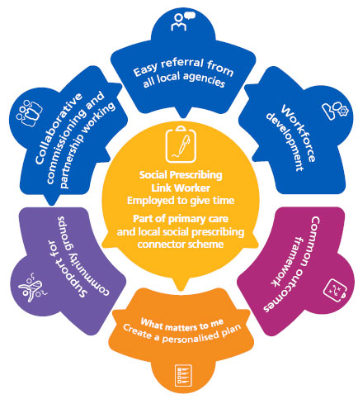

The Social Prescribing Link Worker Model in England
Funding in the GP contract ‘Additional Roles Reimbursement Scheme’ for a link worker’s salary- Band 5 post
NHS Guidance and competency framework ensuring safety, quality and consistency
Link workers should have a relevant level 3 qualification and be skilled in engaging and supporting people with complex needs
Social prescribing is an all-age, whole population approach that works particularly well for people who:
  have one or more long term conditions
  who need support with low level mental health issues
  who are lonely or isolated
  who have complex social needs which affect their wellbeing.

Slide 20





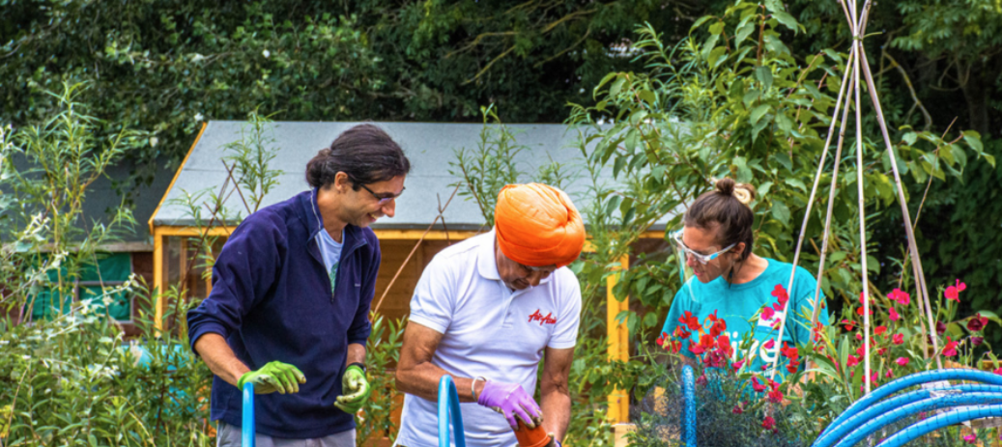
A typical social prescription?
There are 170,000 registered charities in the UK providing incredibly diverse support and services
Thousands more community and neighbourhood groups; tennis clubs to community allotments
Large range of public and statutory services from employment support to leisure centres

Slide 21

What has been achieved in England?
3400 NHS Link Workers employed, all GPs can now access social prescribing for their patients
Social prescribing featured in 9.4 million GP consultations in England from roll out in 2019 to 2023
Robust evidence, on cost effectiveness, impact and practice including cross Government funded initiatives
Around 23% of the public now recognise the term ‘social prescribing’ and 97% GPs are ‘Favourable’ to it
The rapid growth of social prescribing in England: analyses of primary care medical records using data from the Clinical Practice Research Datalink (CPRD) | medRxiv, Exploring perceptions of green social prescribing among clinicians and the public - GOV.UK

Slide 22

UCL Research on the scale of social prescribing
“As of the end of 2023, an estimated 9·4 million GP consultations in England have involved social prescribing codes, and 5·5 million consultations have specifically led to social prescribing referrals. In 2023 alone, an estimated 1·3 million patients were referred to social prescribing”
National roll-out of social prescribing in England's primary care system: a longitudinal observational study using Clinical Practice Research Datalink data

Slide 23


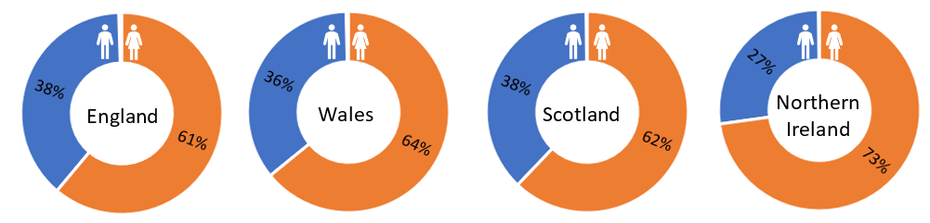
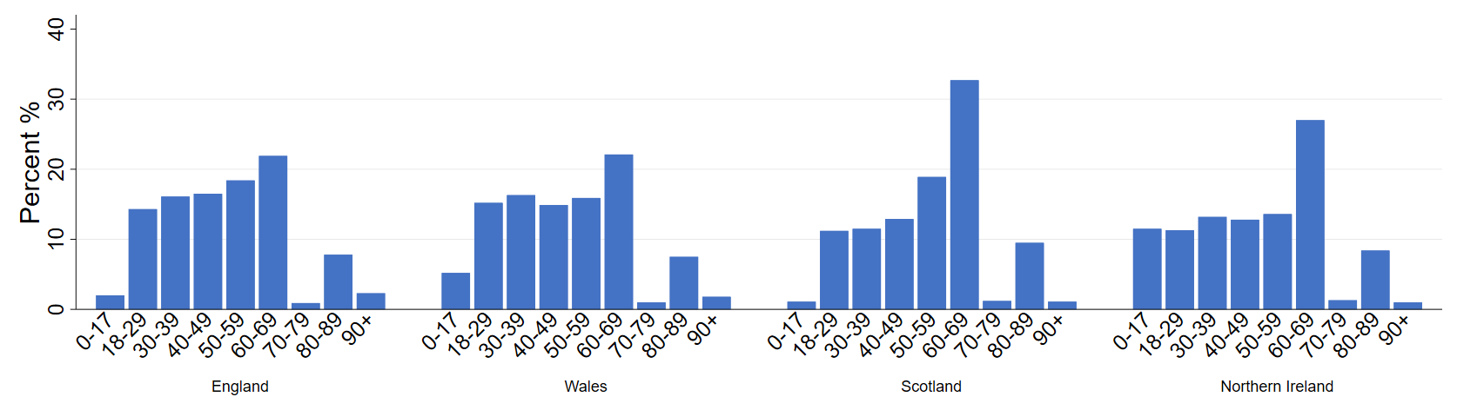
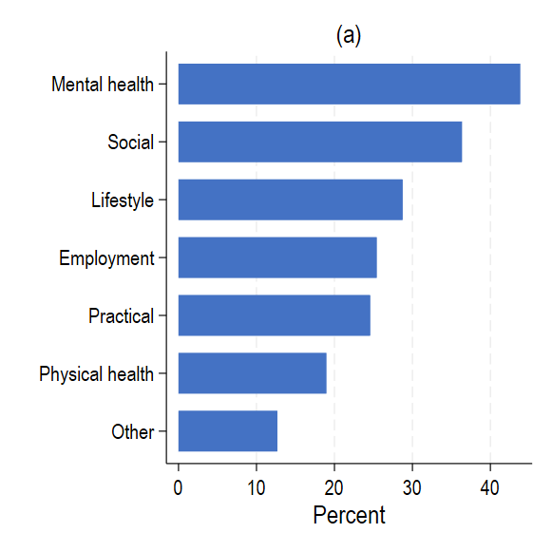
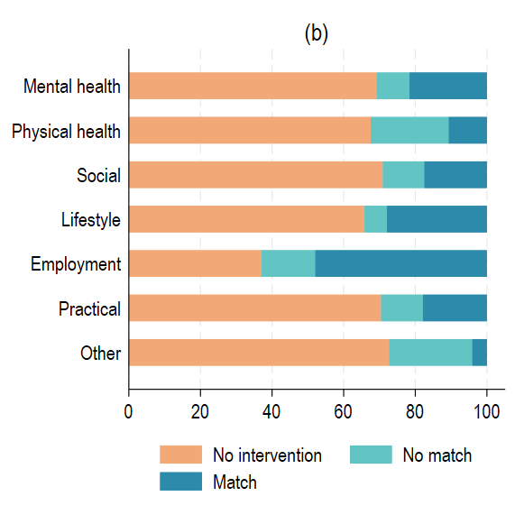
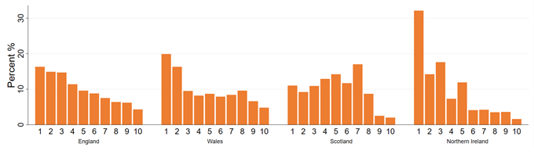
Gender
“Equal, equitable or exacerbating inequalities?
Patterns and predictors of social prescribing referrals
in 160,128 UK patients”
Age
Interventions
Deprivation
Bu & Fancourt (2024) British Journal of Psychiatry
Notes:
Elemental – largest cloud-based platform for tracking SP activities.
Female led services, with good coverage across adulthood but poorer for older adults and for young people
Between 72% and 85% of SP referrals were from medical routes (primary or secondary health care).
While these referrals demonstrate equality in reaching across socio-demographic groups, individuals from more deprived areas, younger adults, men, and ethnic minority groups were reached more equitably via non-medical routes (e.g. self-referral, school, charity).
Also showed some other interesting things:
Mental Health Focus: Mental health is the primary reason for social prescribing referrals, showcasing its significant relevance to psychiatrists and mental health professionals.
Intervention Gaps: Despite 90% of referrals leading to contact with a link worker, only 38% resulted in any intervention. This highlights a shortage in community activities and resources, especially those related to mental health, practical support, and social relationships
Implementation Variability: The study revealed substantial differences in how social prescribing is implemented across the UK in line with differing healthcare design and care needs. In Wales and Northern Ireland, for example, there are higher referrals for children, young people under 18, and individuals from deprived backgrounds, while Scotland and Northern Ireland exhibit higher rates of interventions.

Slide 24
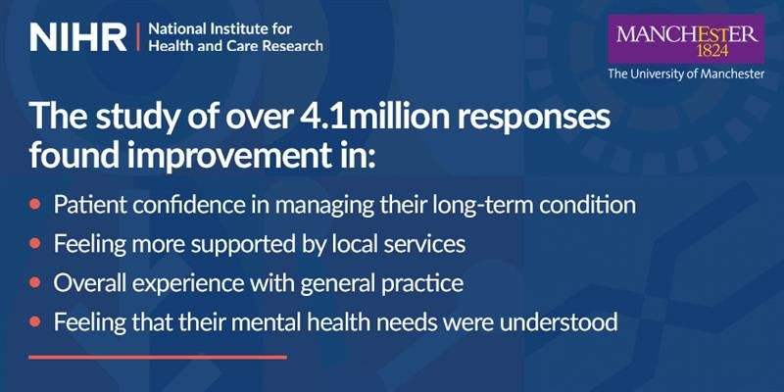
NIHR research published on social prescribing
Multi-region (and multi-level) evaluation of the roll out of social prescribing link workers in primary care. - NIHR Funding and Awards

Slide 25
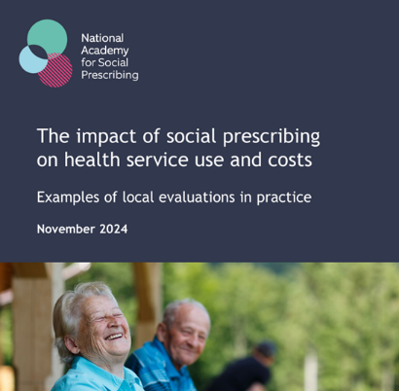
NASP Report on NHS Impact
Headlines – evaluation results from 9 local health systems across England.
Social prescribing can substantially reduce pressure on the NHS, including through reduced GP appointments, reduced hospital admissions and reduced A&E visits.
Reductions in demand for health services were particularly high for frequent service users.
Social prescribing can also have a positive economic impact.
Example- Sussex (Mid Sussex Healthcare)
- 25% reduction GP appointments
- 15% rise in hospital admissions compared to 57% in those starting support
Example- Newcastle
-Secondary care cost per patient was 9.4% (£107 per head) lower than the comparison cohort
The impact of social prescribing on health service use and costs

Slide 26


‘Preventing and tackling mental ill health through green social prescribing’
8,339 people with mental health needs were supported to access
  nature-based activities in their local community.
£5.77m investment for a two-year Green Social Prescribing programme, funded by Treasury and core partners. The programme aimed to test, through seven test and learn sites, how mental ill health can be tackled and prevented through green social prescribing and ran until March 2023.
  57% of participants were from the most socio-economically deprived areas.
  21% of participants were from ethnic minority populations.
  Participants’ wellbeing was measured before and after participation in nature-based activities using ONS4 measures with statistically significant improvements.
  Happiness increased from an average of 5.3 to 7.5, above the national average of 7.4;
  Life satisfaction increased from an average of 4.7 to 6.8 (national average 7.5);
  Feeling that life is worthwhile increased from an average of 5.1 to 6.8 (national average 7.7)
  Levels of anxiety reduced from an average of 4.8 to 3.4 (national average 3.2).
  The economic value of improvements to individual life satisfaction were estimated, with a social return on investment calculated as £2.42 for every £1 invested, and a total value of £14.0 million.
NHS England Green Social Prescribing

Slide 27

Supporting Community Investment
Demand for social prescribing is growing
£100 million spent each year on 3,400 link workers.
NHS Long Term Workforce Plan (2024) estimates 9,000 link workers by 2036/2037.
Investment in community activities and services accessed through social prescribing is inadequate
Strong consensus that addressing the inadequate, fragmented, and short-term funding to build social prescribing capacity is urgently required.
For every pound the NHS invests in social prescribing link workers, we need at least as much investment to increase community capacity.

Slide 28
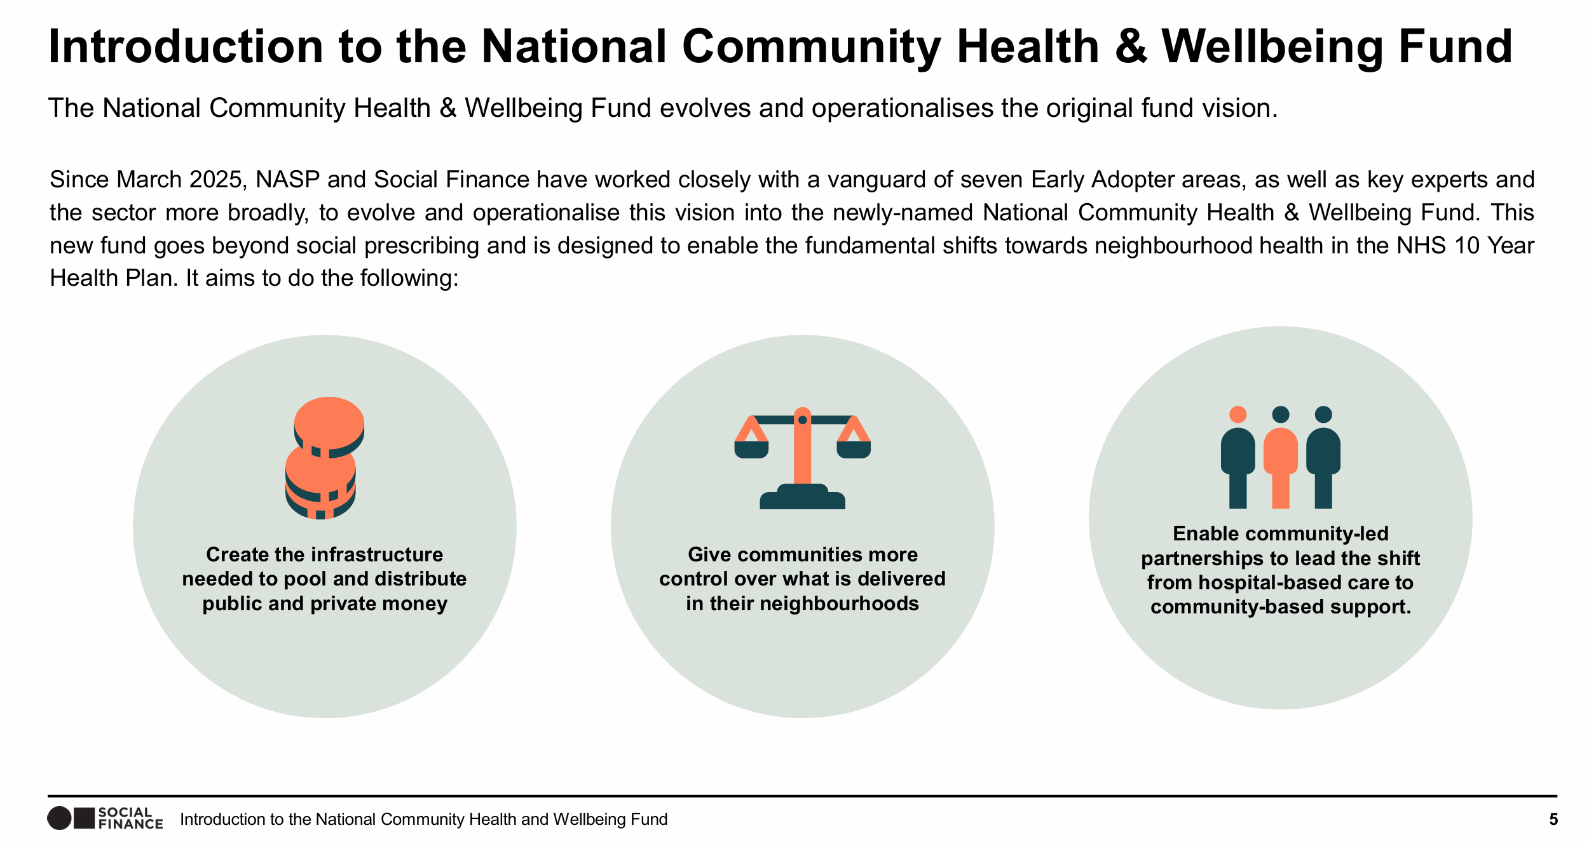

Slide 29
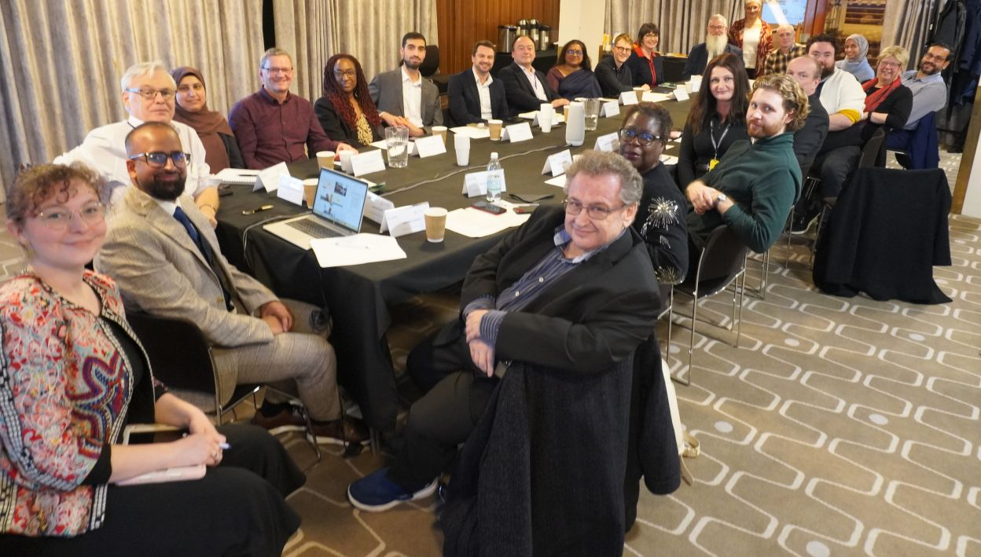

Faith, social prescribing and Neighbourhood Health
Recognising, supporting and connecting faith communities and local provision to health
Convening faith leaders; regular meetings of leaders from the Jewish, Muslim, Sikh and Christian communities with doctors, NHS and community leaders and politicians to collaborate
Report on faith and social prescribing published and endorsed by ministers in parliament
New national strategic role ‘Faith and Social Prescribing’ to drive connection and integration at NASP
Case studies, resources and guides in development
Report---Creating-a-Neigbourhood-Health-Service.pdf

Slide 30

The NHS 10 year plan
Three important shifts;
Hospital to community, Sickness to prevention, Analogue to digital
Social prescribing is critical to the implementation of Neighbourhood Health:
‘expand the talents of neighbourhood teams by scaling new roles by supporting local areas to trial new roles and to adopt existing, proven models’ eg Community Health Workers
‘95% of people with complex needs will have an agreed care plan. We will expect all care plans to be co-created with patients and cover their holistic needs, not just their treatment’.
The government is consulting on the updated NHS Workforce plan. Our projections show the current figure of 9,000 link workers is an underestimate.

Slide 31
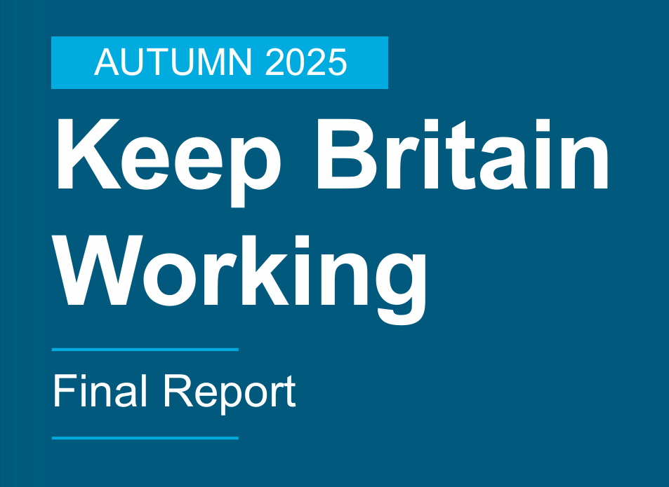
Keep Britain Working
“The Workplace Health Provision would initially build from existing provision already available through social prescribers, NHS work initiatives…”
….In 2024 there were 3,400 Social Prescribers in the UK and the NHS Long Term Workforce Plan targets this to grow by 9,000 in 2036/37”
Other DWP programmes include Connect to Work and WorkWell build on local social prescribing systems.

Slide 32
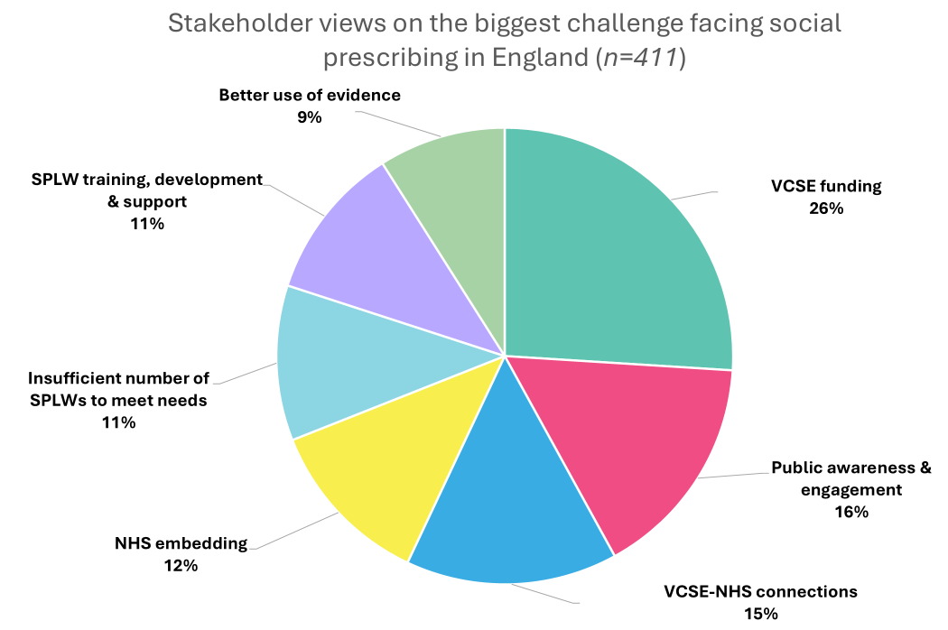
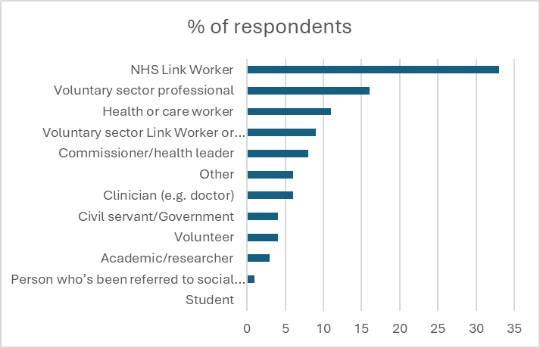
Future of Social Prescribing National Survey
411 respondents to our survey Aug-Sept 2025
Top priorities were funding for charities and community groups (26%), greater public awareness (16%) and connections between charities and NHS (15%)
%
Notes:
Stakeholder were asked: When thinking about the future of social prescribing in England, which of the following do you think is the biggest challenge?
Top priorities were funding for charities and community groups (26%), greater public awareness (16%) and connections between charities and NHS (15%
The most frequently cited challenge is the urgent need for sustainable, long-term funding for VCSE organisations on which social prescribing relies. Stakeholders warn that without secure investment, social prescribing is becoming a model that has shifted responsibility without shifting resources.
Limited public awareness of social prescribing is viewed as limiting uptake. Related to this, limited professional awareness and system wide engagement is viewed as limiting overall referrals and referral quality.
Similarly, integration between the NHS and VCSE partners – and inconsistent embedding of social prescribing within NHS structures – is creating fragmentation, unclear pathways, and a lack of shared ownership across systems.
Workforce challenges add further complexity. SPLWs report high caseloads, inconsistent access to training and supervision, and experiences of isolation and burnout, alongside concern that workforce capacity is insufficient to meet (growing) demand (which would undoubtedly provide additional challenge if increasing public and professional awareness increases referral and engagement).
Although ‘use of evidence’ ranks lower as an explicit ‘challenge’, it underpins every issue stakeholders prioritise. Eg Calls for more funding rely on evidence of impact and demand

Slide 33
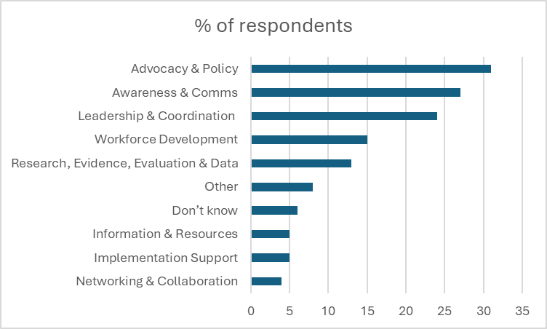
Future of Social Prescribing National Survey
What should NASP do, as the national infrastructure body for social prescribing?
“To legitimise, stabilise, and strengthen social prescribing nationally, NASP must therefore combine advocacy, policy influence, and strategic leadership with workforce development, awareness raising, practical implementation support, and evidence building”
Notes:
Stakeholder were asked: When thinking about the future of social prescribing in England, which of the following do you think is the biggest challenge?
Top priorities were funding for charities and community groups (26%), greater public awareness (16%) and connections between charities and NHS (15%
The most frequently cited challenge is the urgent need for sustainable, long-term funding for VCSE organisations on which social prescribing relies. Stakeholders warn that without secure investment, social prescribing is becoming a model that has shifted responsibility without shifting resources.
Limited public awareness of social prescribing is viewed as limiting uptake. Related to this, limited professional awareness and system wide engagement is viewed as limiting overall referrals and referral quality.
Similarly, integration between the NHS and VCSE partners – and inconsistent embedding of social prescribing within NHS structures – is creating fragmentation, unclear pathways, and a lack of shared ownership across systems.
Workforce challenges add further complexity. SPLWs report high caseloads, inconsistent access to training and supervision, and experiences of isolation and burnout, alongside concern that workforce capacity is insufficient to meet (growing) demand (which would undoubtedly provide additional challenge if increasing public and professional awareness increases referral and engagement).
Although ‘use of evidence’ ranks lower as an explicit ‘challenge’, it underpins every issue stakeholders prioritise. Eg Calls for more funding rely on evidence of impact and demand

Slide 34
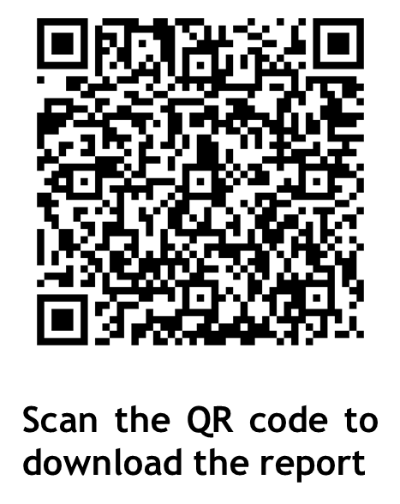
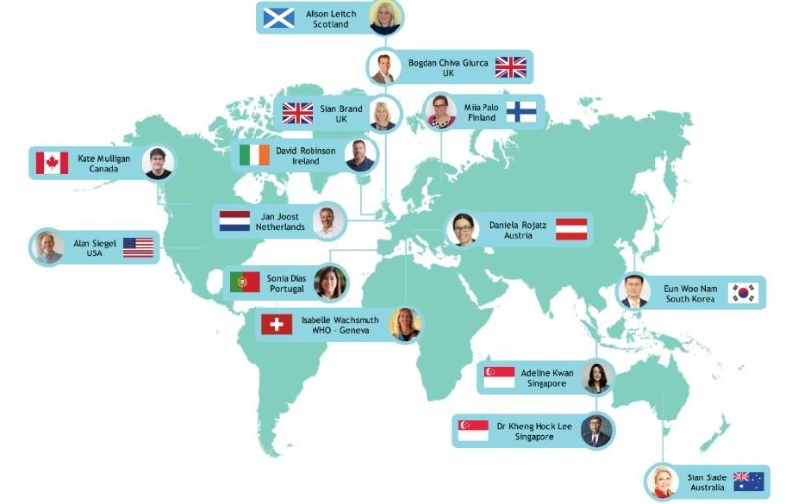
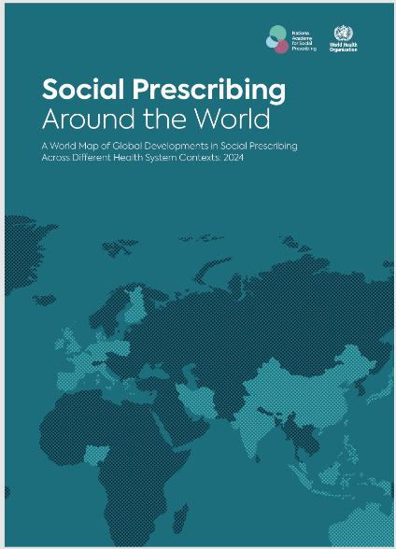
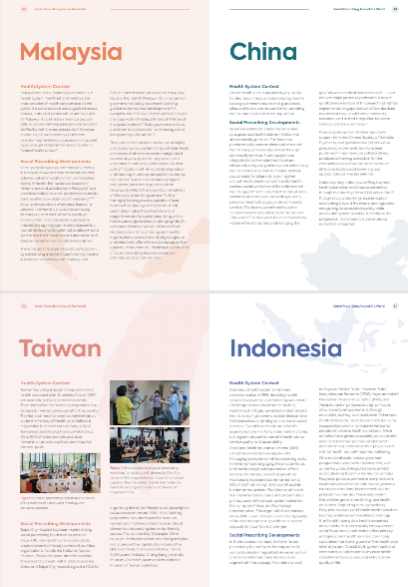
Learning from the rest of the world
Outlining case studies & social prescribing models from 32 countries around the world

Slide 35
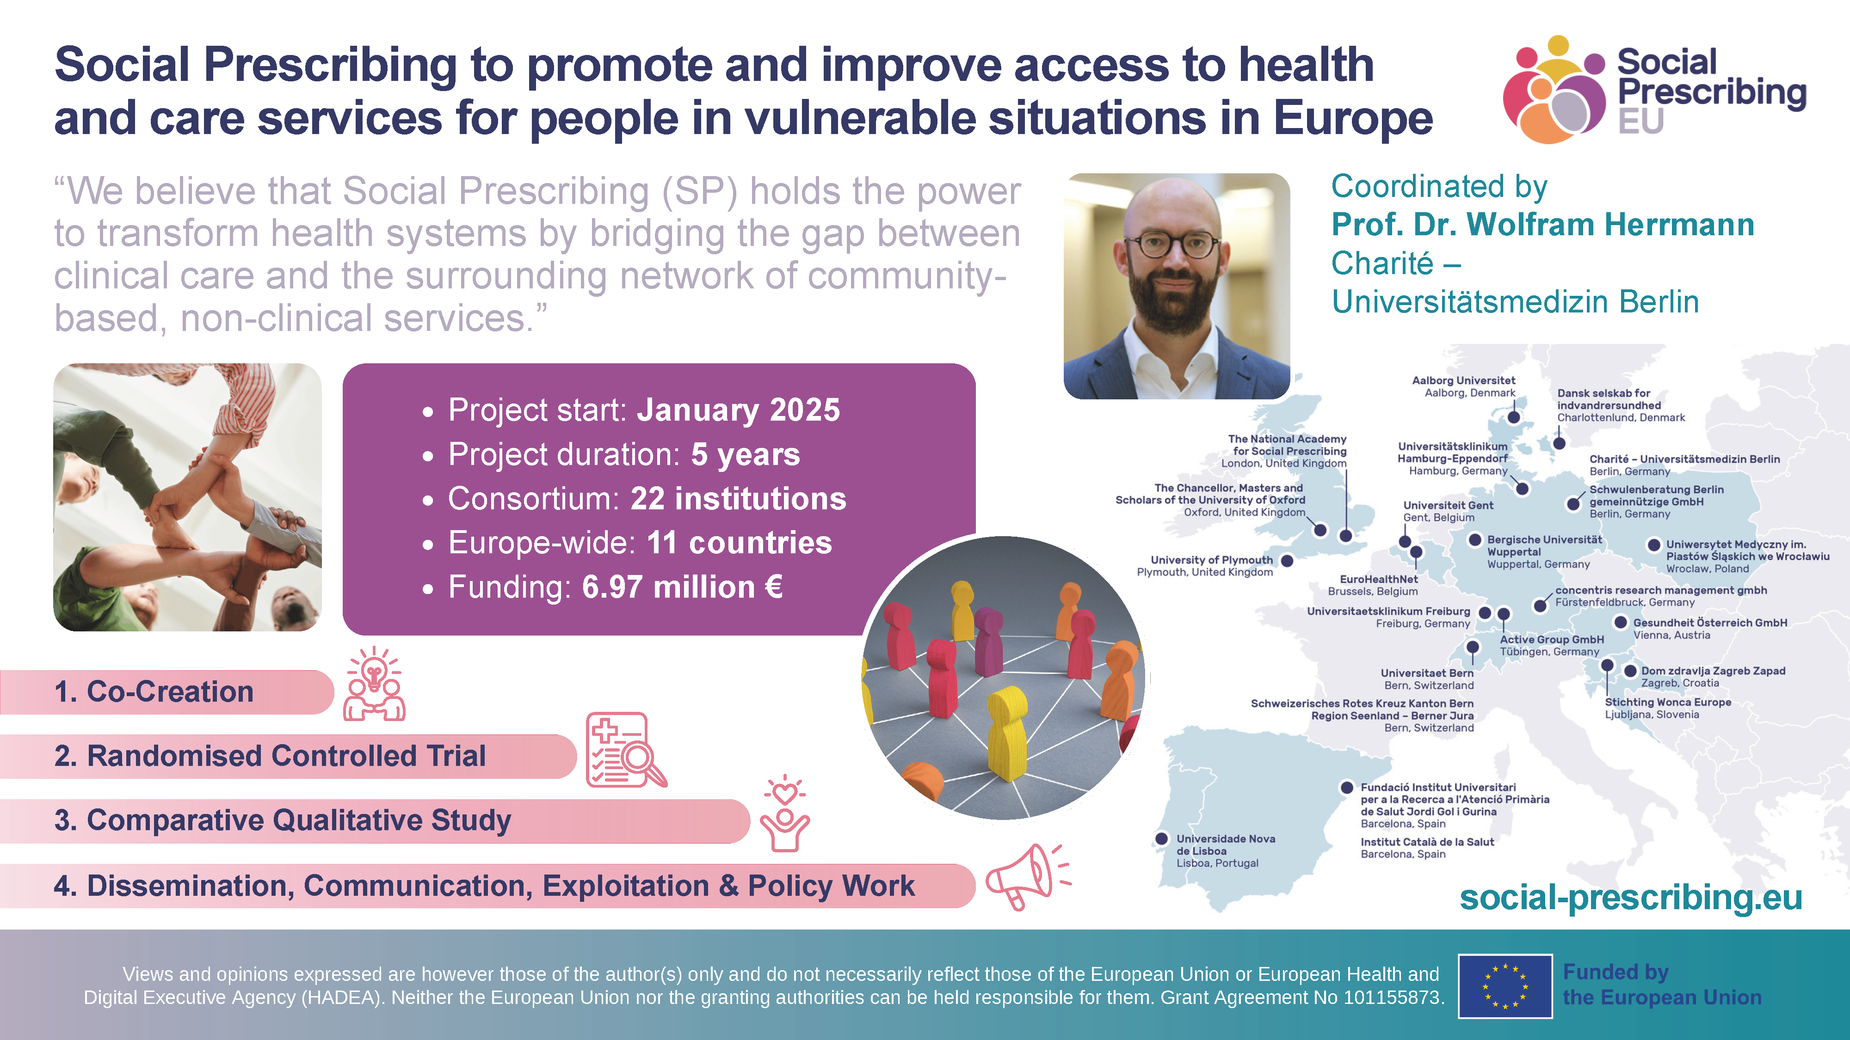

Slide 36
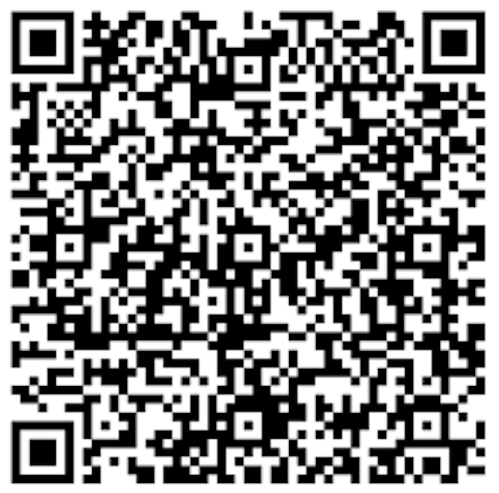
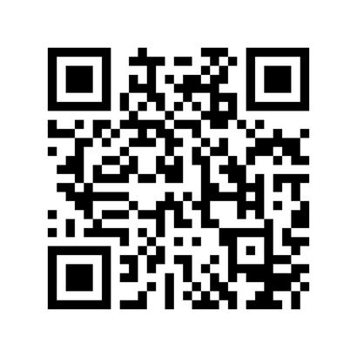
Become a Social Prescribing Champion
Join a network of over 200 NASP Social Prescribing Champions today to help raise awareness and understanding of social prescribing across the healthcare system.
Champions come from both clinical and non-clinical roles across the health system –including GPs, nurses, pharmacists, Allied Health Professionals and personalised careroles. Find out more on the NASP website.
Join the ICB community of practice
This online Community of Practice is for those working in Integrated Care Boards who have a role and interest in social prescribing, its commissioning, quality, sustainability and implementation across communities.
Fill in the form or email workforce@nasp.info to become a member.

Slide 37
Thank you
For more updates follow us on social media or subscribe to our newsletter
socialprescribingacademy.org.uk

Slide 38
Social prescribing and neighbourhood health – what does the data tell us?
Jag Mundra, National Academy for Social Prescribing

Slide 39


The ROI of Social Prescribing and How to Scale It
Jag Mundra

Slide 40
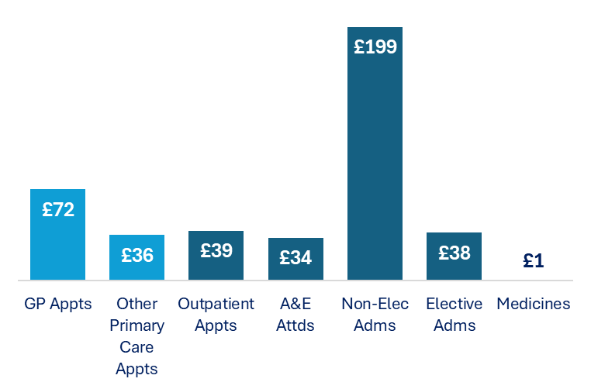
Social Prescribing, a Practical Route to Prevention
Text here
Prevention offers a 14:1 ROI¹ but has proved hard to scale.
Integrated care improves quality, yet the strongest evaluations^{2,3,4} show little net reduction in overall utilisation.
Social prescribing stands out - 19 studies⁵ show £418 NHS benefit per person and a 4:1 return in year one alone.
One of the strongest working examples of community-based prevention already operating at scale.
NIHR, Public health interventions ROI (2017)
Looman et al, Health Policy (2020)
Baxter et al, BMC Health Services Research (2021)
Billings et al, BMJ Open (2019)
NASP, Exploring the Financial ROI of Social Prescribing (2023) - Based on a synthesis of existing UK studies (varying scale and methods). This is a provisional working model focused on patients with prior health system contact. Some groups may show short-term increases where unmet need is identified. The 4:1 estimate reflects link worker salary costs only and excludes supervision and wider infrastructure.
NHS Benefits from Social Prescribing
12-month NHS impact (£ per patient/year), either bankable or workload-reducing. Excludes long-term, cross-provider and wellbeing gains, so true value is likely higher.

Slide 41
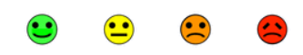

Activation as the Mechanism Behind the ROI
Activation is a person’s confidence in managing their own health
Social prescribing raises activation by supporting behaviour change and removing barriers. Calderdale showed an average 0.5-point increase¹. Link workers are the only ARRS role to improve health confidence at a population level².
A single question³ lets any role talk about activation and capture it routinely.
A one-point rise links to 4 fewer GP contacts and £327 lower NHS demand per year⁴ - it’s arguably the strongest modifiable predictor of utilisation.
Demand reductions are more credible when activation improves.
How confident are you managing your health?
4
Very
3
Quite
2
Not
Very
1
Not at
all
NAPC, Mundra et al., Calderdale Evaluation (2023)
Wilding et al., BJGP Open (2025)
Health Confidence Score, Benson et al.
Barker et al., BMJQS (2018) – based on PAM evidence and a variant activation question used in Calderdale (n=2038)
Notes:
https://r-outcomes.com/measures/

Slide 42
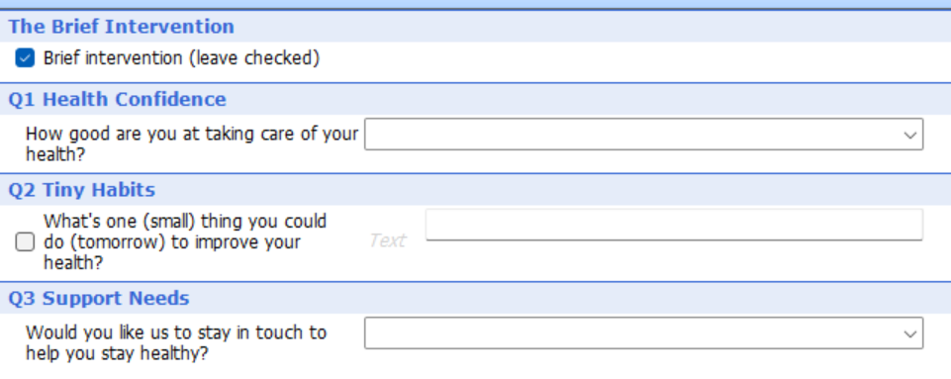
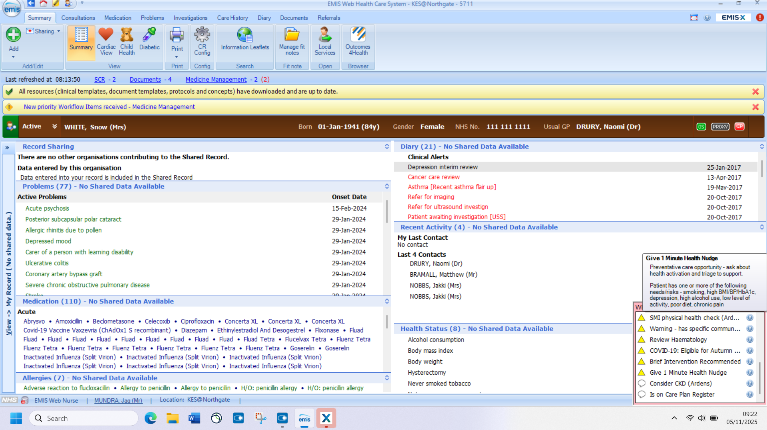
Scaling Social Prescribing and Prevention into Every Contact
Text here
Primary care reaches almost everyone - 95% attend within two years, making it the most practical route into prevention.
We’re building a 1-minute nudge template (“How good are you at taking care of your health?” → “One thing to improve?” → next step) that activates people in routine contacts.
The clinical system flags identify preventable risks and prompt the conversation at the right moment.
Potentially a 10–20:1 ROI as activation scales across the whole population and link workers focus on complex cases.

Slide 43
Three Takeaways
Social prescribing delivers one of the strongest and most scalable ROIs in prevention.
Activation is the mechanism and it’s a clear lead indicator of future demand.
Embedded nudges in existing contacts lets activation improve at scale.
Notes:
“If you remember three things:
First, social prescribing is not a marginal intervention — it’s one of the most credible, measurable routes into prevention that the NHS currently has.
Second, activation is the mechanism that makes the ROI work, and it’s also the safeguard that tells us the savings are real.
Third, we now have a way to scale activation through brief nudges inside EMIS/S1, turning everyday contacts into prevention moments.
For me, this is the first operational bridge between integrated care and genuine population-level prevention.”

Slide 44
Neighbourhood Health Implementation in South-East England
Meena Patel, Senior Lead, Personalised Care, NHS England South-East

Slide 45
Social Prescribing and Integrated Neighbourhoods in the Southeast
December 2025
Notes:
Standard title slide

Slide 46
INTs/NH/Neighbourhood working
Context:
  Health inequalities are widening, with a significant gap in life expectancy between the least and most deprived.
  The health system is largely reactive rather than proactive.
  Claire Fuller’s report emphasised using neighbourhoods as a central organising principle for integration.
Demand and Delivery:
  The Fuller Stocktake outlines the vision for Integrated Neighbourhood Teams (INTs).
  Goals include tackling unwarranted variation and standardising practice.
  Focus on meeting current demand while planning for future needs.
Integrated Neighbourhood Teams (INTs):
  INTs consist of professionals sharing responsibility for a local population.
  Aim to ease the burden on neighbourhoods and reduce hospital-based care.
  Built around core local services with specialist input as needed.
SE Regional Principles for Care Close to Home:
  Proactive: Move resources upstream to reduce health inequalities.
  Preventative: Focus on early detection and management of risk factors.
  Person & Community Centred: Co-production with communities and individuals.
  Collaborative: Multi-disciplinary and multi-agency teamwork.
  Well Organised: Strong local leadership and supportive culture.
Regional Delivery 24/25
  Establishing Care Close to Home Group and regional governance.
  Delivered Regional Care Close to Home Conference in London 165 attendees.
  Developed the INT community of practice now Neighbourhood Health COP.
INT Maturity Matrix:
  Co-producing a regional maturity matrix to baseline neighbourhood health and integrated ways of working for providers.

Slide 47
SE principles for Care Closer to Home
Proactive: Our current system is overly reactive, resources continue to concentrate around emergency and hospital-based interventions, whilst health outcomes lag behind OECD countries¹. We need to move resources upstream, reduce health inequalities, and use connected health and care data to intervene sooner for people most at risk. Proactive care should be a design ethos as well as a way of working for integrated teams.
Preventative: We have an ageing population in the South East, living a growing proportion of their years in poor health, an estimated 40% of activity in the NHS is preventable by addressing the determinants of chronic conditions². Integrated teams should focus on the early detection and management of physiological and behavioural risk factors.
Person & community centred: Communities, individuals and carers are equal partners in supporting wellbeing and independence. Co-production with local community groups and with people helps deliver meaningful interventions and improves the quality and efficiency of care³. Personalised health and care planning tools must be built into community-based services alongside approaches that leverage community assets.
Collaborative: Much closer working between a multi-disciplinary and multi-agency ‘team of teams’ is needed to reduce barriers and improve efficiencies for complex case management and to provide urgent care. This may involve, for example, integrated teams, joint access hubs, shared care records, and/or care-coordinators as well as wider collaboration with more specialist services.
Well organised: Strong local leadership and a supportive culture are essential to empowering integrated teams as they develop. Well organised services will be easier for people to access, offer greater continuity of care (less fragmentation) and be streamlined (through better triage, navigation, earlier access to specialist advice and guidance for example) and will therefore be more efficient.
Mallorie, S., 2023. Comparing the NHS to the health care systems of other countries: five charts. The King’s Fund.
House of Lords, 2017. The Long-term Sustainability of the NHS and Adult Social Care. Select Committee on the Long-term Sustainability of the NHS.
Mukoro, F., 2023. How co-production is used to improve the quality of services and people’s experience of care: A literature review. NHS England.

Slide 48
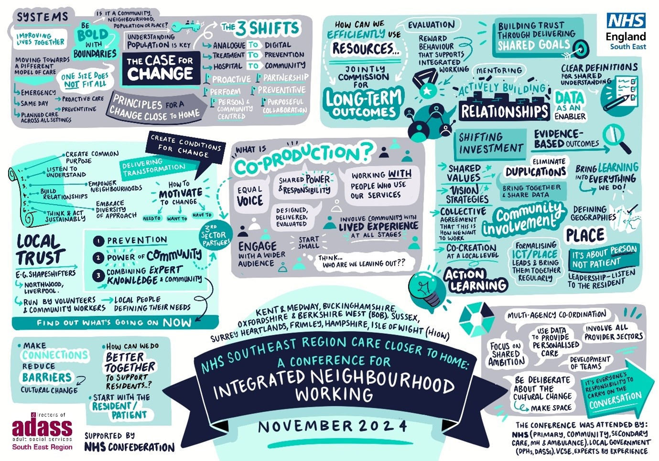

Slide 49
Neighbourhood Health Working Community of Practice
The INT Community of Practice has been successfully running for over a year, focused on the sharing of best practice around the development of neighbourhood teams. It started out as a smaller delivery focused group and has since grown in popularity with a wide membership across ICBs.
With the publication of the Neighbourhood Health guidance, a regional Neighbourhood Health Delivery Group has been established to support ICBs with the delivery of the guidance and alongside this the next steps for the community of practice have been discussed.
Proposal
The community of practice shifts from being regionally-led to regionally convened, with ICBs taking more of a lead role in content and the region continuing to chair
Meeting to be held bi-monthly, with 2-hour meetings held in July, September, November, January and March
Each meeting would have 2 specific topics (1 hour each) with presentations from an ICB/provider with time for discussion
ICBs would be requested to broaden out the invite to wider health and care system partner colleagues depending on the topic for discussion
In this model the CoP could incorporate different aspects of neighbourhood health, including PHM, UCR and CYP if colleagues felt this would be sensible approach
Potential topics/ content / case studies
Frailty – INTs focused on proactive frailty management, alongside their admission avoidance pathways (Kent)
INTs focused on addressing health inequalities – homelessness in Brighton, Southampton City
Children and Young People – INT examples for children and young people
INT workforce – skills passports/ role rotation pilots (Kent)/ successful implementation of ARRS roles/ care co-ordinator role
PHM in practice – CVD pilot BOB, examples from primary and community care (Surrey and Frimley)
Models of delivery for neighbourhood health – SNP/MNHP

Slide 50
Governance – Care Closer to Home Group
The Care Closer to Home Group is envisaged to be the key vehicle to delivering Neighbourhood Health and integrated neighbourhood working. Its focus will be on transformation (‘transform tomorrow’) with day to delivery (‘delivery today’) being delivered elsewhere. The Group will be ICS-led with NHSE providing any support required. Neighbourhood Health draws together multiple existing programmes with separate internal and external governance / support and these will be brought together at a strategic level within Care Closer to Home.
External
Internal
SERET / Joint Committee
SSICG
Neighbourhood Health 6 Core interventions
Population health management Universal community services offer Modern general practice Urgent out of hospital services Intermediate care Integrated Neighbourhood Teams
Care Closer to Home (External)
Purpose: Strategic delivery of Neighbourhood Health and integrated neighbourhood working Frequency: Quarterly Chair: Amy Galea
Regional CC2H Coordination
Purpose: Coordination of internal programmes to deliver CC2H Frequency: 6 weekly Chair: David Radbourne
Primary Care Transformation Group
NH Delivery Group
Related Regional Programmes
Palliative & End of Life Care CYP Mental Health Public Health Primary Care Medical (LTCs, Professional Leadership) UEC Digital WT&E BCF Regional comms / analytics
Regional Communities of Practice
Community SRO meetings
 | INT & Community Team
50 |

Slide 51
Neighbourhood Health Implementation Programmes
To support delivery of the neighbourhood health vision outlined in the 10 Year Health Plan, a national Neighbourhood Health Implementation Programme has been launched in July 2025. Alongside the national programme, regionally we will be running a small complimentary programme alongside NHS Confed, targeting those places who may not meet the criteria for the national programme.
Neighbourhood Health Implementation Programme (NNHIP)
PLACE Teams – 43 nationally, 6 regionally
South-East Neighbourhood Health Accelerator Programme (SE-NHAcc)
Neighbourhood Teams – 6 regionally
Overview
The national implementation programme are looking for 42 places to take part in the programme.
The programme aims to build on the success to date and the new approaches set out in the 10 Year Health Plan, by taking a test, learn and grow approach.
It will work with places and their ICBs who have a willingness to explore new approaches to commissioning neighbourhood health and supporting the development of neighbourhood providers and multi-neighbourhood providers
The programme is overseen by a small joint NHSE and DHSC Task Force, chaired by Sir John Oldham
Application process
Applications for places are due by 8th August 2025 , closed now.
Post-application there will be a regional panel to review the applications, followed by a national panel and final sign off for the successful places by the Task Force
Programme design
A collaboration design event is scheduled for 5th August to co-design the programme structure with the national leads
Each successful place is required to identify a local coach, who will work alongside a national coach from one of the partner organisations (NHS Confed, NAPC and PPL) to deliver the learning approach to change through local and regional sessions, held over a year programme
Overview
This programme has been designed with Louise Wheeler, NHS Confed who will be our delivery partner on the programme, alongside Claire Kennedy, PPL and Dr Mayur Vibhuti and Helen Gillivan from NHS Kent and Medway ICB.
There will be 6 Neighbourhood health teams with 6-8 participants within each team. Participants from Primary & Community, Social care, VCSE, Public Health, MH, Acute, Local Government.
The programme will include frontline healthcare staff, regional managers and senior leaders.
Application process
Applications for places are due by 22nd August 2025.
The application process will be light-touch.
Programme design
The programme will run for 8 months and be a 1 day-per month programme, proposed start from September 2025
The programme will work with neighbourhood teams and undertake an immersive simulation on a particular issue they are experiencing with developing neighbourhood teams.
An action learning approach will then follow the simulation, with 8 sessions planned on topics including population health; systems thinking; digital innovation; quality improvement and culture and behaviour change.

Slide 52
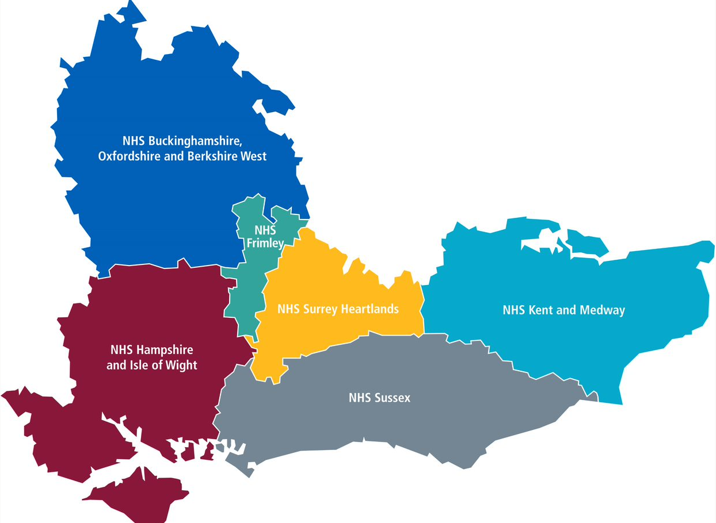
SE Neighbourhood Sites
NNHIP = National Neighbourhood Health Implementation Programme
Regional = Neighbourhood Health Accelerator Programme
NNHIP BOB | SE Accelerator
Buckinghamshire Place | Berkshire West Primary Care Alliance
13 PCNs relatively low deprivation, Aylesbury and High Wycombe, Bucks Council Integrated. Engage those experiencing worst outcomes to co-produce services to reduce inequalities. | Build collective leadership. We will focus on a cohort within a deprived area (IMD 1-2), within the Reading locality who have a diagnosis of heart failure with at least 2 other LTCs.
NNHIP K&M | SE Accelerator
East Kent – Folkestone, Hythe | Medway Council – Central Chatham
High deprivation, ageing population and high inequalities, workforce shortages. Align cultures, break down silos, enable shared delivery. | We are seeking to develop improved co-ordinated care for residents with complex and chaotic health needs, specifically in Chatham Central.
NNHIP Frimley | SE Accelerator
Berkshire East - Slough | Maidenhead PCN
Slough, most deprived area, multi-ethnic, high diabetic, pre diabetic, 3 Las. Each PCN is an Int NH care team. Combine lived experience with data and community insight. | Creating a prevention agenda for the elderly and their carers that focuses on improving independence and preventing crisis support through the winter and key demand points through the year.
NNHIP SHL | SE Accelerator
Surrey East Place - Surrey Downs and East Surrey | West Surrey – Canalside/Sheerwater and Stanwell North/Spelthorne
Relatively low deprivation, growing health together. 12 INTs aligned to PCNs. Relationships, delivery, governance. 7 key neighbourhoods, Mertsham most deprived. | Our vision is to create a neighbourhood health model that is rooted in place, led by community, and focused on tackling deprivation and inequality.
Surrey
National Frailty Pilot
NNHIP HIOW | SE Accelerator
Portsmouth | Gosport Central, HWB Stakeholder Network
Coastal, urban, Highest deprivation wards, COPD, stroke, obesity. 5 INTs around PCN footprints. Build on evolving Portsmouth Provider Partnership. Community based care, delivering holistic and localised care. | 3 key areas Healthy Weights – whole system approach Physical Activity – live longer better, promotion/prevention Cardiovascular Disease – linked to system priorities:
NNHIP Sussex | SE Accelerator
East Sussex | West Sussex - Crawley
Hastings high deprivation, high prevalence of depression and SMI. 20-year life expectancy gap. Significant pressures, new model of NH. 5 ICTs, 12 PCNs | We are prioritising the intersection between financial wellbeing and mental health, particularly in response to the prevalence of debt problems .
24 09 25 KB

Slide 53
Teams Challenge Statements - 1st stage
HIOW (Gosport)
Our challenge is that obesity affects 32.8% of adults in Gosport, leading to a higher prevalence of diabetes, poorer health outcomes, and increased healthcare demand. This happens because the local environment, social norms, health conditions, and economic pressures collectively make healthy choices difficult; with high fast-food density, affordability barriers, low nutritional awareness, limited access to green spaces, and sedentary lifestyles reinforced by the impact of chronic pain and mental health issues that further reduce physical activity and motivation for change.
K&M (Medway)
Our challenge is that residents in Chatham central, aged 20 -50 with complex / multiple disadvantages are experiencing poor health, leading to a higher risk of premature death. This happens because there isn't co-ordinated care to support people with housing, substance misuse, mental health and physical health issues.
Frimley (Maidenhead)
Our challenge is that current support for older people and their carers is not meeting their needs and is not coordinated. This is because we are all different organisations with different priorities and culture. Services are designed around organisations - not people.
BOB (Reading)
Our challenge is that residents living with multiple long-term conditions in areas of Reading with greatest deprivation have a poorer quality of life and shorter life expectation. The universal approach to managing long-term conditions has not worked in this cohort and needs a different approach. To reduce health inequalities, to improve quality of life, to improve mental health, to reduce unplanned admissions.
Surrey (West)
Our challenge is that residents in our most deprived neighbourhoods (e.g. Canalside, Sheerwater, Stanwell North) experience poorer health outcomes and fragmented care, leading to inequalities and higher system demand. This happens because coordination between Integrated Neighbourhood Teams and place-based partners is inconsistent, and community connections are under-developed.
Sussex (Crawley)
Our challenge is that problem debt affects working age men leading to reduced mental wellbeing and distress which can increase anxiety, depression, low self-esteem and increased risk of suicide ideation. This happens because of trauma, unexpected life events leading to loss and addiction, causing social isolation leading to stigma and low uptake of early intervention offers/services.
Notes:
First we have Hampshire and Isle Of Wight project challenge.
In Gosport, obesity affects almost a third of adults, leading to higher rates of diabetes and poorer health outcomes.
The team have highlighted how social norms, economic pressures, local environments and individual health factors — such as pain and mental health —and how they all combine to make healthy choices harder and sustain unhealthy behaviours.
In Kent & Medway, the team focus is on Chatham Central.
In Medway, the focus is on residents aged 20 to 50 who face multiple and complex disadvantages — including housing insecurity, substance misuse, and poor mental and physical health.
The challenge is that care isn’t joined up, leaving people without the coordinated support they need to live healthier and longer lives.
In Frimley, focusing on Maidenhead.
The Frimley team are looking at how older people ‘and their carers’ are supported and their complex care needs.
Currently, services are fragmented and designed around organisations rather than individuals, meaning needs aren’t being met effectively. Their challenge is to create a more joined-up, person-centred approach across partners.
The BOB team focus locality is Reading
In Reading, residents living with multiple long-term conditions in deprived areas experience poorer quality of life and shorter life expectancy. The current “one-size-fits-all” approach to managing long-term conditions isn’t working for this group. The team want to find new, tailored approaches that reduce health inequalities, improve wellbeing, and cut unplanned admissions.
In Surrey
The Surrey West team challenge is that deprivation and poor health outcomes affect residents experiencing multiple barriers to health and wellbeing. This happens because care and prevention efforts are fragmented, physical inactivity is high, and local systems are not yet fully connected through coordinated, community-led neighbourhood models.
And this leads to reduced life expectancy and higher use of acute services.
They are focused on strengthening coordinated care by improving connections between Integrated Neighbourhood Teams and local place-based partnerships — this is aimed at helping services to work together more effectively for residents.
Sussex (Crawley)
In Crawley, the team are exploring how financial wellbeing and mental health intersect. They’re looking to better understand and address how money worries and poor mental health can reinforce each other and affect overall wellbeing.

Slide 54
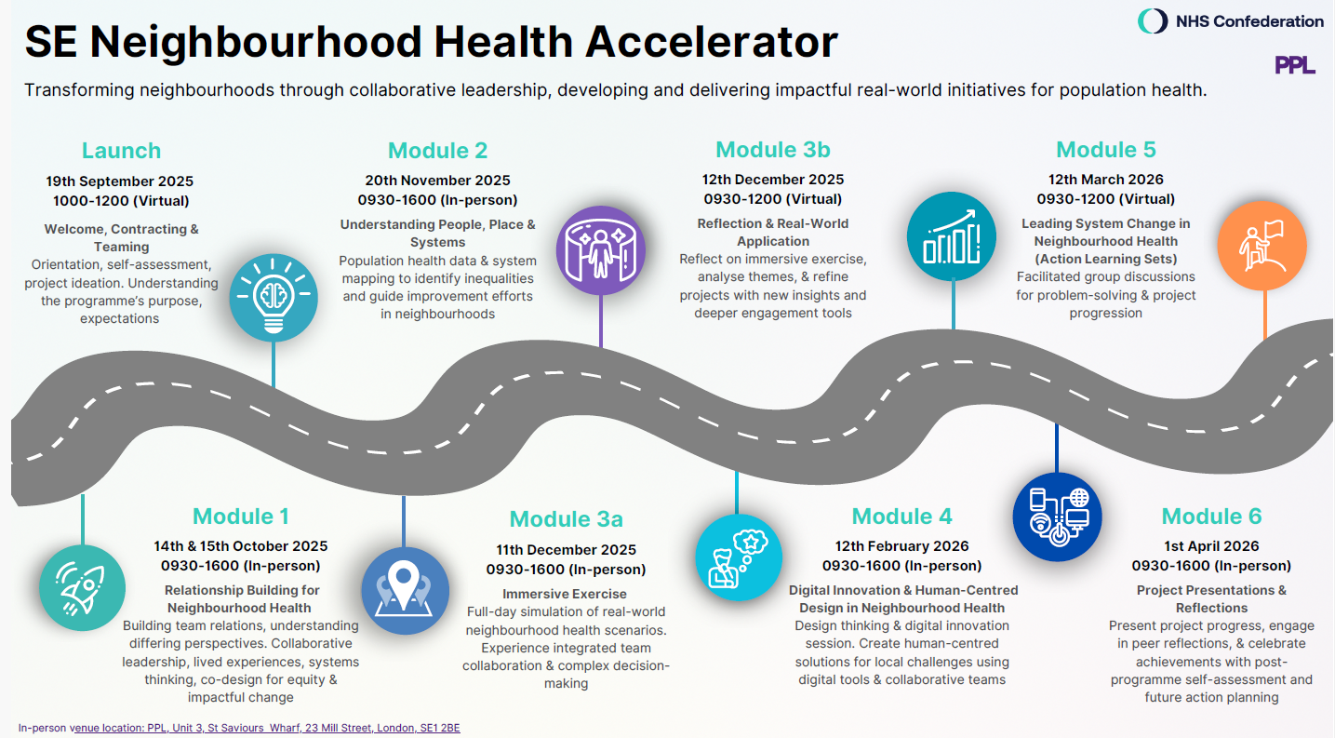

Notes:
Programme Overview

Slide 55
Maturity Matrix v6 Sept 25 - Background to the tool
Purpose of the tool
To help local clinical and managerial leaders understand their neighbourhood team's development journey
To support place and system-level partners in providing the right support at the right time
To strengthen local partnership working by creating shared language and goals
Target audience
Primary audience: Clinical and managerial leads working locally to develop/implement neighbourhood teams (including but not limited to providers)
Secondary audience: Commissioners, ICB/place-based leads, and others supporting neighbourhood development
Use case
As a facilitated discussion tool, ideally in conversation with a range of local stakeholders and partners
Not a performance management or benchmarking tool — intended for self-assessment and reflection
To support baseline assessments by autumn 2025, with optional repeat use to track progress over time
Quantitative indicators may be useful within each domain to support more objective tracking
Proposed benefits
Supports collaborative planning and prioritisation across partners
Helps teams identify development needs, opportunities, and enablers
Builds shared understanding of what integrated, community-based neighbourhood working looks like
Encourages a reflective, supportive, and person-centred approach to transformation
Additional Useful Information
Development of the tool – this matrix draws on national NHS guidance, published research on integration and community services and it was developed jointly by NHS England SE Region and our 6 ICBs, including local examples of maturity matrices.
Time to complete – hopefully the matrix builds on existing discussions and can be completed as part of an existing meeting with stakeholders. It may make sense for one person to lead the process and bring it to stakeholders for discussion so that it can be agreed as part of a regular meeting.
How will results be shared – local teams will have the choice as to how much information they share with ICB and regional teams, for example, to help inform support offers or identify common issues.
Available support – system and regional support offers are available to support integrated neighbourhood working, please do get in touch at:
England.SEINT@nhs.net
or
(insert ICB mailbox)

Slide 56
SE Maturity Matrix v6 Domain | Emerging | Developing | Maturing | Embedded
Shared purpose and local leadership | Stakeholders have informal or fragmented connections. There is limited clarity about the purpose of neighbourhood working. Leadership is seen as top-down. | A shared ambition is being articulated. Partners are starting to meet regularly, and informal local leadership is emerging. System/PCN leaders are exploring how to devolve power. | A common vision, values, and outcomes framework has been agreed locally and is clear on how inequalities will be tackled. Leadership approach is identified & agreed. Governance is in place and includes the VCFSE, Social Care and residents. | Neighbourhood leadership is shared, trusted, and responsive. Decision-making reflects local priorities and inequalities. The team works as a 'team of teams' with shared accountability and resident participation.
Integrated teams and local assets | Team working is siloed, no shared identity. There is limited awareness of who is working in the neighbourhood or what community resources exist. Resource limitations. | Workforce and asset mapping is used to develop services and pathways. Informal integrated teams exist around specific individuals. The value of the VCFSE and community connectors is increasingly recognised. | Integrated teams have clear membership, regular contact, and co-ordinated workflows. Teams include health, care, VCFSE, and community roles. Asset mapping informs practice and future planning. Staff feedback measuring integration in day-to-day work. | Teams work as a single system across organisational boundaries. Local resources are embedded in care models. Teams flex and adapt based on community needs and identified inequalities. Shared induction and supervision structures are emerging. Impact of integrated working on the workforce.
Preventive and proactive, data informed, care (inclusive of Core20PLUS5) | Local teams rely on anecdotal knowledge. There is limited use of data to understand the neighbourhood population. | Population segmentation and risk stratification are being trialled. Insight is drawn from both data and experience but used inconsistently. Interventions are being developed along with a proactive care approach. Some embedding of health equity and community voice into analysis. | Population health data and soft intelligence from all partners is routinely shared. The team plans around population groups and tackling inequalities, not just caseloads. Disparities are identified and addressed around CORE20PLUS5 approaches. Building relationships with other partners who can support with wider determinants of health. | Linked data that is triangulated and is used proactively to identify inequalities and drive action. Resident insight, community surveys, and shared business intelligence shape service delivery. Digital dashboards are available at neighbourhood level. Health inequalities are known and addressed with other partners. Interventions and approaches are standardised where possible across the INTs.
Personalised, coordinated care | Care is reactive and episodic. Information is not routinely shared across teams. People navigate the system alone. | Joint personalised care and support planning and care navigation/coordination are available for specific cohorts/pathways. Teams communicate regularly but remain structurally separate. | Shared care plans are standard for complex needs. Inclusion of carers essential. Information flows between teams. People experience coordinated support and know who to contact. | People receive proactive, joined-up care tailored to what matters to them. Roles like care coordinators and social prescribers are embedded. Digital tools support shared care records and communication. Increased levels of patient activation.
Working with people & communities | Engagement is reactive or limited to consultation on specific services or plans. Participation is not representative. Participation is limited participation due to resource constraints. | Strategic vision for developing & embedding community-centred ways of working emerging. Structured engagement is underway. Specific community groups are involved in service design. | Co-production is embedded in governance and planning. Communities help shape priorities. Trust is being built across groups including VCFSE, community partnerships and care-coordinators. What matters to you conversations. | Communities are equal partners in planning, delivery, and evaluation. Power is shared. Processes are inclusive, sustained, and reach underserved groups ensuring equity of provision of services for those who need it the most.
Education, learning culture and impact | Evaluation is occasional. Teams rarely review what works. Learning remains individual or siloed and is not informed by development plans. No consideration of educational placements. | Teams are beginning to reflect together. Feedback from people is collected and sometimes acted on. Some QI/Change management methods are in use. There is a reactive response to staff development and educational placements. | Improvement activity is routine. Data and user feedback inform service changes including workforce planning. Partners share learning. Outcomes including equity of impact are tracked over time. Multi/ interprofessional learning and growth in educators are central to future planning. | INTs as learning environment with education seen as a strategic enabler. Joint OD, learning from each other, sharing best practice and improving ways of working. They regularly evaluate and adapt to improve impact and reduce inequalities. Improvement through a continuous feedback cycle is co-produced with staff and residents.

Slide 57
SE Maturity Matrix v6 Domain | Reflective Questions | Suggested Evidence
Shared purpose and local leadership | Who holds leadership in our neighbourhood? Is it inclusive? Do we have a shared story of what we're here to do? How is equity embedded into our vision and plans? Which model; partnership of community assets, lead provider, accountable care organisation, etc. | Documented shared vision and outcomes framework Governance structure with multi-sector representation Meeting minutes showing joint-decision making and community input
Integrated teams and local assets | Who makes up our team and do we all know each other? Do we make use of all local strengths, including community assets? Are we considering the role of residents and volunteers in integrated neighbourhood development? | Staff directorates and shared workforce maps Co-produced asset maps used in team planning Case studies of joined-up support from cross-sector MDTs Health & Care teams with skills passports and opportunities for rotational posts/portfolio working or placements
Preventive and proactive, data informed, care (inclusive of Core20PLUS5) | Do we know who lives here and who is most at risk? For example; are we considering the needs of specific groups – LD, autism, Carers, CYP, MH, older people Are decisions shaped by data and lived experience? Do we have an agreed approach to proactive care? Have we developed interventions to address local needs and inequalities? Have the interventions been standardised across INTs where possible? Do we have a process in place to evaluate the impact of the interventions, including on reducing inequalities? | Local population profiles and segmentation reports Health equity analysis by population group Use of linked data to identify care gaps and population cohorts to target for proactive care Using PNG data/segmented approach to support workforce planning Documented approach to proactive care, developing & agreeing interventions, evaluating impact Patient experience and outcome measures (PROMs}
Personalised, coordinated care | Would patients say our care is joined up? Can we see and respond to changing needs over time? Are treatment targets achieved? | Uptake of personalised care plans Continuity of care in place - named contacts, share care plans Friends & Family test results. Reduction in hand-offs.
Working with people & communities | Do we include all voices within the community or just the easiest to reach? Are communities able to influence decision making, care & priorities? Is the workforce motivated & competent in involving communities? Have community assets been mapped? | Co-produced neighbourhood delivery plans Citizen and patient panels and inclusion in governance Engagement reviews and logs by demographic Framework in place for shared accountability & governance with communities & trusted VCSE representatives Quantitative data routinely overlain with qualitative community insights Routine feedback to communities on how their views have influenced neighbourhood working
Education, learning culture and impact | Are we open and reflective on what we've learned? Do we use insights to adapt and improve? Do we understand our impact on inequalities? Is education and training of the existing and future workforce part of planning? Is our culture one of constant self-reflection, service improvement and mutual support? | Evaluation reports showing impact of neighbourhood working Quality improvement plans with measurable goals & impact Lessons learnt, i.e. Newsletters shared across INT. Novel / innovative approaches to increasing capacity Executive leadership team includes individuals that are accountable for workforce, education and training

Slide 58


SE Healthy Communities Network:
Embedding community-centred approaches in Neighbourhood Health
Working draft

Slide 59
About this resource: what has been developed and why?
This resources is likely to be of interest to anyone involved with and/or wanting to support the development of neighbourhood health, particularly NHS, local authority & VCSE partners with a responsibility for strategic development of neighbourhood health
Building healthy, resilient, connected and empowered communities is an important way of improving the health of the population and tackling health inequalities, as set out in the Community-centred public health: taking a whole system approach framework.
To raise awareness of the importance of community-centred approaches and support them to be embedding in emerging approaches to Neighbourhood Health, the South East Healthy Communities Network* has developed a logic model.
It suggests a road map to support local implementation of neighbourhood health, describing the rationale & policy context, inputs, activities & outputs to achieve intended outcomes and impact.
The task & finish group developing this resource is also developing a set of ‘descriptors’ or process measures that set out the types of activities, processes, structures and mechanisms required to embed community-centred approaches in neighbourhood health. These can be used to baseline current position & consider opportunities for further development.
The resources will be hosted on the SE Neighbourhood Health futures platform and are working drafts for testing locally so feedback would be welcomed: nicky.Saynor@dhsc.gov.uk
* The SE Healthy Communities Network is made up of 180 local authority & NHS stakeholders with an interest in scaling and embedding community-centred approaches to health and wellbeing

Slide 60
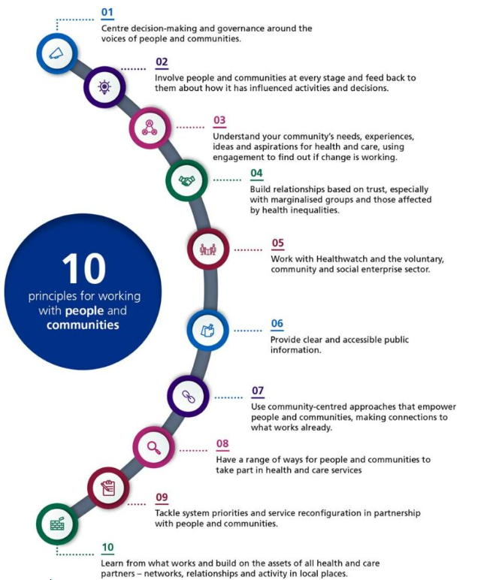
A road map for embedding community-centred approaches in neighbourhood health: what’s the rationale?
Neighbourhood health is central to the Government’s health strategy, including the 10 Year Health Plan, which aims to deliver care closer to home, improve access and outcomes, reduce inequalities, and ensure sustainable health and social care.
In developing neighbourhood health, there is an expectation that ICBs will develop a comprehensive understanding of population need, informed by deep engagement with patients and the public.
Co-designing services and support with communities and delivering with, through and by communities, can help:
  Improve access & health outcomes
  Shift the focus to the assets and strengths of individuals and communities
  Build community agency, autonomy and resilience
  Tackling health inequalities
The Neighbourhood Health Guidelines are flexible, encouraging locally tailored solutions co-developed with local authorities, communities, and voluntary, faith, and social enterprises.
NHSE statutory guidance - Working in partnership with people and communities

Slide 61
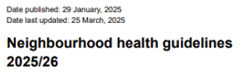

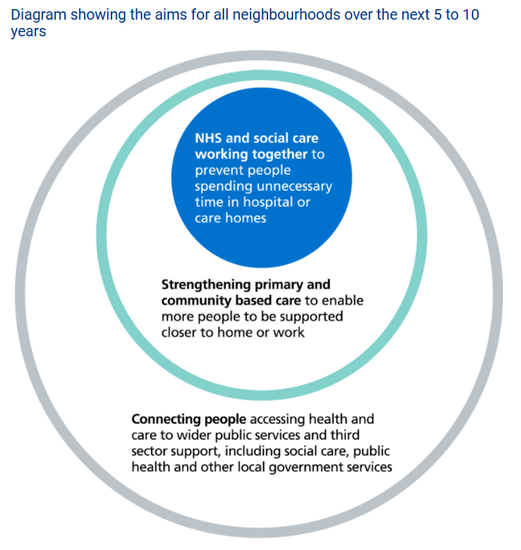
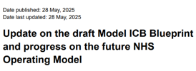
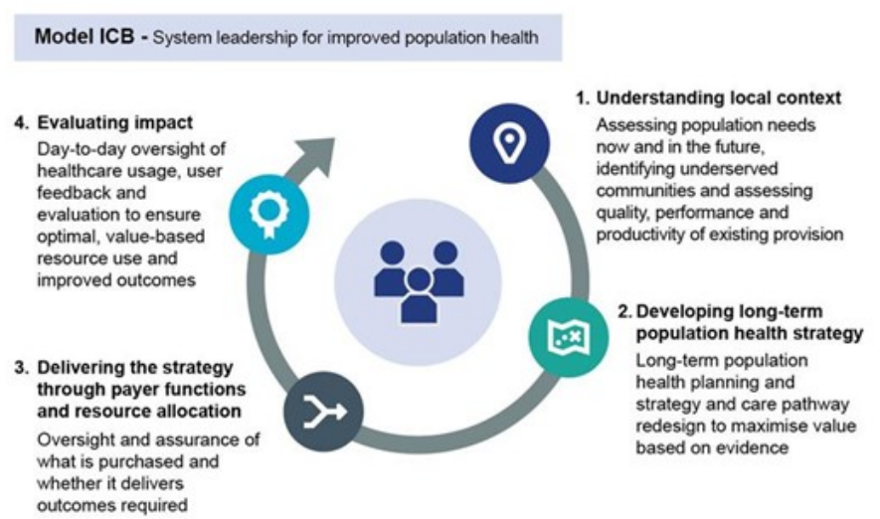
A road map for embedding community-centred approaches in neighbourhood health: what’s the policy context?
Local partnerships with VCFSEs and underserved groups are key to prevention, tackling inequalities, and improving outcomes (NHG s2,3,6,16,18; ICB Model Blueprint s3 & 4)
User involvement, user-led design and deliberative dialogue are growing ICB priorities, shifting communities from passive recipients to active shapers (ICB Model Blueprint) p3, 9, 10, 12, 16)
Community-centred approaches can help identify barriers and priorities for increasing equity of access to health services, improve health and tackle health inequalities through gaining insights and coproducing solutions, mobilising assets and reducing public service demand (Health Foundation, Kings Fund, NHG s7, 13, 11, 14)
For services to truly meet the needs of communities, people must be involved from the start of planning through to implementation and review (NHSE Strategic commissioning framework s34.5)

Slide 62
Logic model overview: a road map for greater involvement of communities in neighbourhood health
Inputs
Activities
Community-centred approaches integrated into ways of working & governance design
Outputs
Community-centred approaches:
Outcomes
Workforce competent, confident & engaged
Impacts
Improved health outcomes
Reduced health inequalities, including narrowing the healthy life expectancy gap between regions
Whole system expertise & capacity
Funding
Involvement infrastructure
Coproduction of community engagement strategies & plans
Training & workforce development - frontline & strategic
Community assets mobilised
Sustainable participation infrastructure
Priorities & outcome frameworks coproduced
Qualitative & quantitative data routinely combined
Delivery & take up of training
Reduced reliance on statutory services
Equitable access to services & support
People & communities experience less fragmentation
Increased community capacity and resilience
More engaged & resilient individuals & communities
Policy levers
Greater financial sustainability
- integrated into pathways
- supporting delivery of C20+5

Slide 63
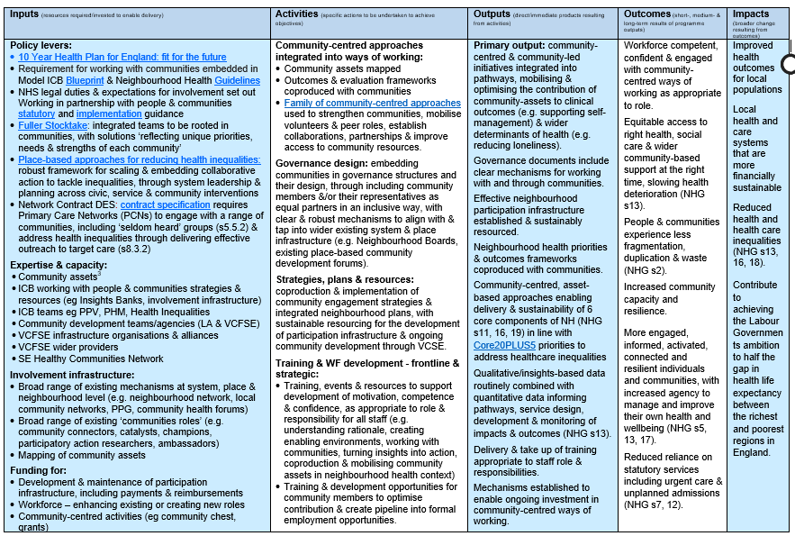
Full logic model: a road map for greater involvement of communities in neighbourhood health (working draft v1.8)
The logic model & related resources are available on the SE Neighbourhood Health futures platform – feedback welcome (nicky.Saynor@dhsc.gov.uk)

Slide 64
Opportunities & Challenges
Opportunities | Challenges
Recent survey of ARRS roles in region found a high level of support for SPLWs in future models of integrated neighbourhood health teams Several NH teams include SPLWs as core part of multi-agency/professional teams Join up at Place level, between health/care and VCSE alliances, communities and NH teams Learning from Regional Accelerator Programme: Multi professional/agency teams coming together to develop shared purpose Teams are keen to learn how people with lived experience and VCSE colleagues can feed into design of NH Beginning to create shared priorities/language around what is valued and how they want to work together ‘in service of communities not services’ | Tension between immediate v longer term goals and aspirations – although social prescribing (and Personalised Care more broadly) is an enabler in all settings/situations Funding pressures and risk averse cultures Working across multi-professional teams requires very different ways of thinking/working – aligning purpose, language, trust and accountability – it takes time!

Slide 65
Community Health and Wellbeing Workers
Dr Connie Junghans Minton, GP

Slide 66
The Community Health and Wellbeing Worker Programme:
Building Primary Care and Community Infrastructure
Dr C Junghans Minton

Slide 67


250,000 Community Health Workers¹
37,000 teams¹
95% of municipalities¹
70% of population served¹
Geographical outreach to 150 households monthly
Relationship building with residents
Supporting their own community
Part of the medical team
Ambulatory care sensitive hospitalizations ↓ 13%²
Cardiovascular disease mortality ↓ 36%³
Cerebrovascular disease mortality ↓ 31%³
Reduced horizontal and racial inequity
¹Macinko and Harris. NEJM 2015; ²Macinko et al Health Affairs 2010; ³Rasella et al BMJ 2014;
⁴Rocha and Soares. Health Econ. 2010; ⁵House of Commons Briefing paper, October 2019

Slide 68
What does a CHWW provide?
CHU I
Comprehensive Holistic health and wellbeing support including health promotion, chronic disease support, social support and advocacy | Hyperlocal Each CHWW serves 120-150 households (around 500 residents) in a defined locality where they also live.
Universal to all residents regardless of demographic (all-age) | Integrated as part of the wider team of local GP practices embedded in the wider neighbourhood team and the local community

Slide 69
How is it different from what we have?
Traditional System | CHWW Model
Reactive and service-led. Help only reaches people once they’re already unwell. Fragmented roles and duplication across services. Focus on deficits: what’s wrong, not what’s strong. Short, transactional contact with no time to build trust. Barriers to access and low engagement in prevention. | Proactive and person-centred. Support reaches every household early. Single, trusted point of contact connecting all services Asset-based: builds on strengths within people and communities. Relational continuity. Consistent monthly contact and long-term trust. Promotes equity, early intervention, and prevention.

Slide 70







Health Promotion
Monitoring & Prevention
Encourage uptake of vaccines and NHS health checks
Support Cancer screenings and explain red flag symptoms
Take and record blood pressures, promote medicine adherence.
Help residents self monitor LTC like diabetes or COPD
01
Community Building
06
02
Early Identification
Brings residents together through local events like coffee mornings.
Encourages neighbour to neighbour connection and shared support.
Spot signs of cognitive decline, poor mental health or domestic abuse.
Detecting housing issues such as cold, mould or damp before they worsen.
05
03
Emotional Support
04
Connection & Advocacy
Provide a trusted, regular contact, someone who listens without judgement.
Checks in during crisis, reducing isolation and anxiety.
Link residents to other services available in their locality eg talking therapies or social prrescribers.
Accompany residents to GP or hospital appointments
Notes:
© Copyright PresentationGO.com – Free Templates & Infographics for PowerPoint and Google Slides

Slide 71
What is the impact of CHWWs?
Decrease in reactive activity
Increase in proactive activity
↓ 10% unplanned hospital admissions
↓ 7% A&E attendance
↓ 40% Community Trust services use
↓ 7% unscheduled GP appointments
↑ 90% wellbeing score
↑ 82% likely screening and health check
↑ 2.2% Chronic disease GP reviews
↑ 47% likely vaccinations

Slide 72
How do CHWWs fit in with Social Prescribing?
Social Prescribing as activity vs Social Prescribing Link Worker as a role
What happens when you meet a Social Prescriber?
CHWWs are socially prescribing too, proximity to services and locality
no need for referrals, longitudinal
Synergies: working alongside: warming up, hand back and continuity
Working with: Senior SPLWs as team leaders
It’s a team effort!

Slide 73
CHWWs activity: social prescribing at the door step
Relationship and persistence:
South team visited 1357 unique households (2862 residents) of 1800 households allocated at least once in the last 19 mns, delivering 4435 households i.e. 233 visits per month.
5 cases of homelessness prevented, 105 residents supported into welfare and benefit access they were entitled to, 26 helped into volunteering, 18 helped into employment, 28 into education, 12 quit smoking, 26 took up physical activity, 21 safeguarding concerns raised and followed up, 131 housing issues addressed successfully.
Early interventions and spotting problems not recognised as such by residents, multiple conversations over time, whole family intervention

Slide 74
Signposting versus Hand-holding
Some case studies
What happens when you have a case load vs households – the commercial plant nursery vs tending to a fixed community garden
Can we imagine a front shop to the community garden where integrity and care matter more than throughput
The big picture: turning off the tap of demand (buying stressed plants, not looking after them, needing more to replace them every year vs tending to a garden that thrives more year on year)

Slide 75
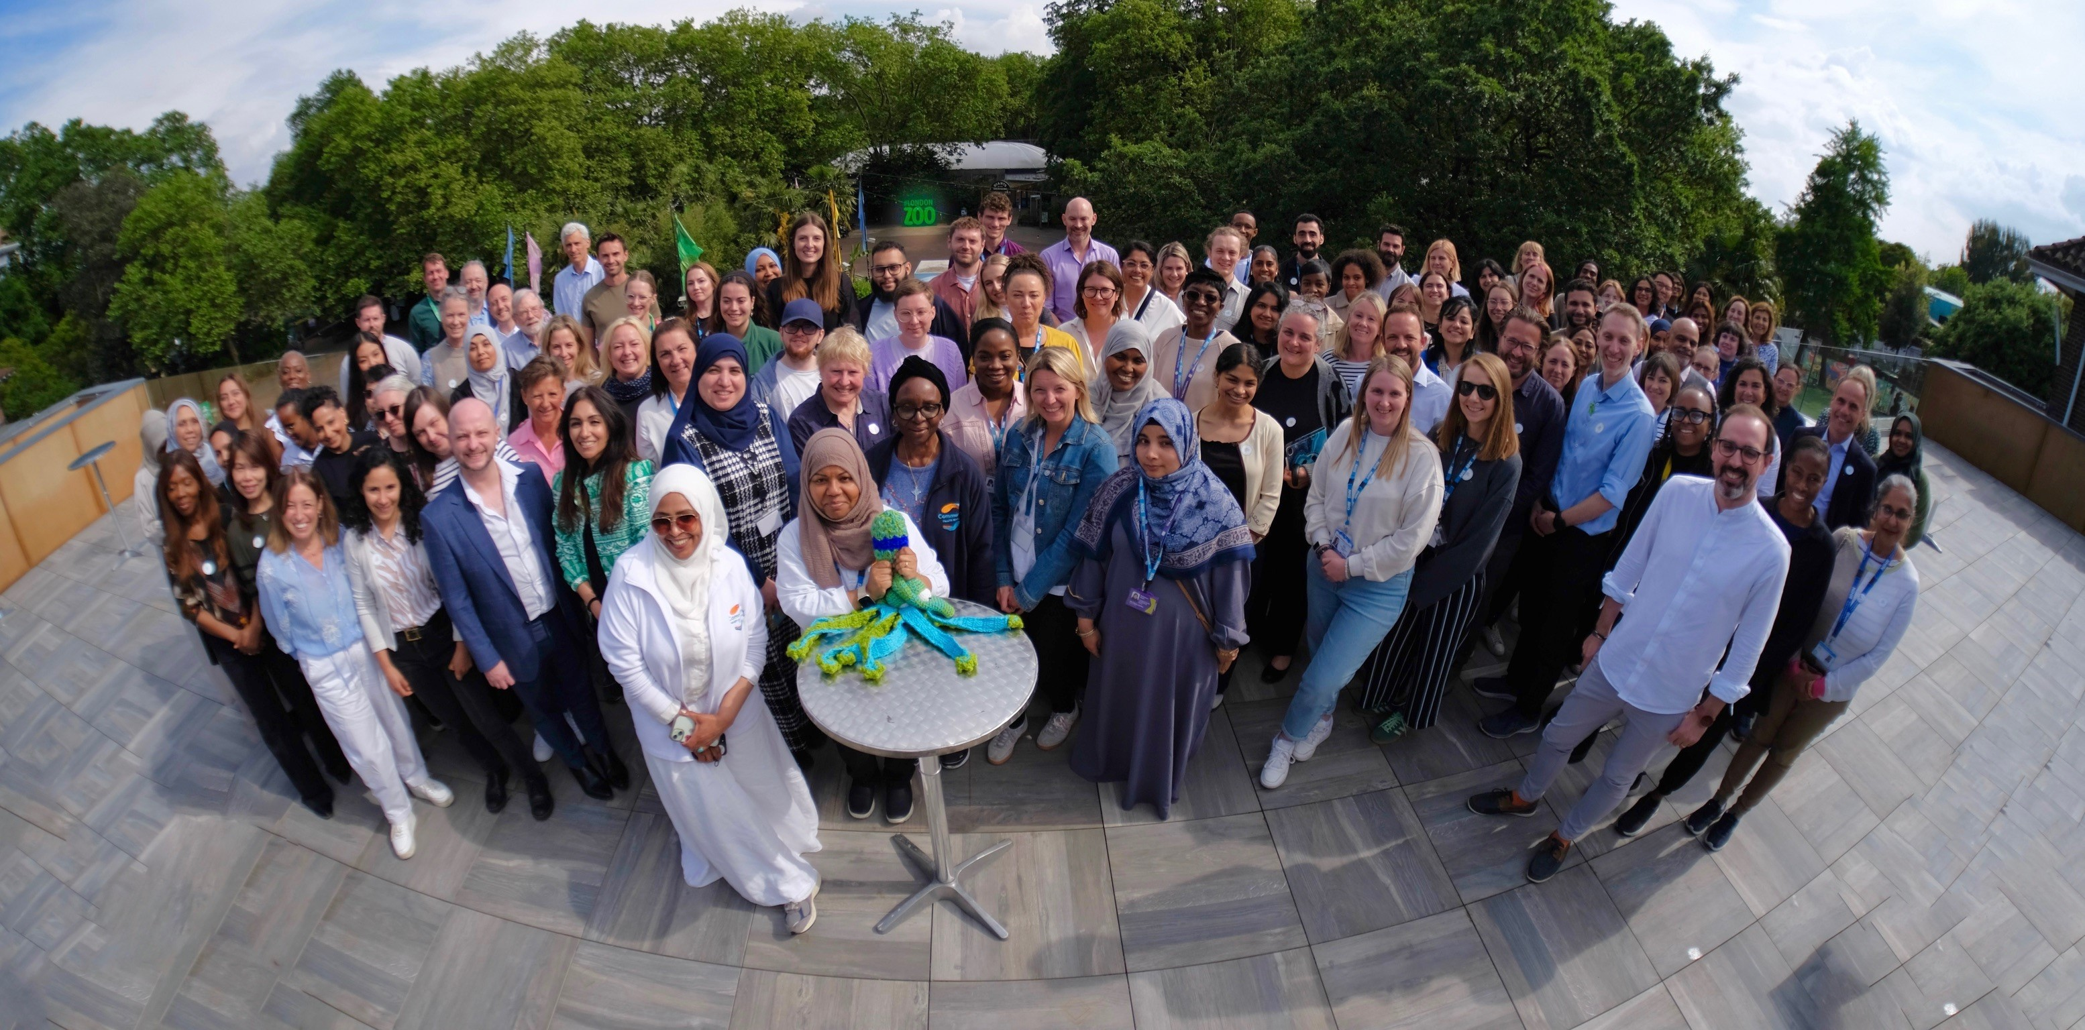
The Eco system

Slide 76
Current CHWW National Picture
Spread: Over 200 CHWWs across 28 sites in England & Wales
Evaluation: Ongoing RCT by Imperial College, London and the George Institute due to report in Sept 2026
Funding: Piecemeal and non-recurrent and a risk in almost every site and the main barrier to widespread adoption of the programme
Exemplar: Described in the 10 Year Health Plan as a case study for best practice effective neighbourhood working
National Programme: Ready to roll out rapidly at scale

Slide 77
More information:
Evidence and research database: CHWW Publications - National Association of Primary Care
NAPC website: Community Health and Wellbeing Workers (CHWWs) - National Association of Primary Care
Contact NAPC: marcus.mcalister@napc.co.uk

Slide 78


Q&A
Q&A chair: Professor Kamila Hawthorne, Chair, National Academy for Social Prescribing
Speakers: Gay Palmer, Social Prescribing Link Worker, Southwark
Joe Fraser, London Region Head of Healthcare Inequalities Improvement, Prevention & Personalisation, NHS England
Matthew Walker, Chief Executive, National Association of Primary Care

