Slide 1
NASP Webinar Series: Social Prescribing in Secondary Care
Thank you for joining us. The webinar will begin shortly.

Slide 2


Housekeeping
Please note we are recording this webinar (you will be sent the slides and the link to the recording, and they will be on NASP's website too.)
Please submit questions via the Q&A function. We will hold a Q&A session at the end of presentations.
Please use the chat function for introducing yourself and networking. If you have any technical issues, please raise these in the chat, and a member of the NASP team will assist.
Closed Captions are available (turn these on at the bottom of your screen)

Slide 3

Overview
Chair:
Joelle Bradly, Deputy Director of Evidence and Impact at the National Academy for Social Prescribing
Speakers:
Prof. Marcello Bertotti & Emmanuela Osei-Asemani - Findings from Systematic Review on Social Prescribing in Secondary Care
Dr Johann Cailhol - Implementing Social Prescribing in Secondary Care in France
Dr Tara Mastracci - Integrating Social Prescribing in Cardiovascular Secondary Care Pathways (UK Context)

Slide 4
Social prescribing in secondary care: Evidence from a systematic review
Marcello Bertotti, Professor in Community Health
Emmanuela Osei-Asemani, Research assistant, Institute for Connected Communities, University of East London

Slide 5

Social prescribing in secondary care: Evidence from a systematic review
7th July 2025 – NASP webinar
Marcello Bertotti, Professor in Community Health
Emmanuela Osei-Asemani, Research assistant
Institute for Connected Communities
University of East London
m.Bertotti@uel.ac.uk
Notes:
Thanks for the opportunity to present today

Slide 6
Why social prescribing in secondary care?
Tackling health inequalities: those experiencing health inequalities are more likely to use secondary care and use it for longer and health inequalities make it more difficult to deliver clinical care (Imran, et al., 2022; Tinelli et al. 2022; Wheeler et al, 2024 and Edward et al., 2023)
Financial Barriers to Care: financial burden and stress experienced by patients and their families as a result of the cost of medical care (financial toxicity). E.g. loss of income, extra care costs, travel to appointments. Marginalised populations are at higher risk. Wheeler et al. 2024 and Edward et al., 2023 discuss this in relation to cancer care and SP.
Fragmentation between health and social care: health systems operate in silos and are very rigidly structured. Post-discharge care pathways supporting people are not sufficient for specific groups, e.g. traumatic brain injury patients (Rosario et al., 2017), and homeless (Tinelli et al., 2022). → higher re-admissions and longer hospital stays

Slide 7









The Current Study: Research Questions
Using a narrative synthesis approach, the systematic review sought to answer the following questions:
What is the effectiveness and cost-effectiveness of social prescribing in secondary care
01
03
How do the outcomes of social prescribing interventions vary across populations and geographic locations?
What is the global distribution of social prescribing in secondary care research.
02
04
What are the barriers and facilitators of implementing social prescribing interventions in secondary care settings?

Slide 8




















The Current Study: Inclusion Criteria
Population
Intervention:
Outcomes:
Study Design:
Patients referred to community-based services from secondary care institutions.
Patient-reported measures, healthcare utilisation, cost-effectiveness and barriers/facilitators to implementation.
SP interventions: direct referrals through link workers, care navigators, or similar roles to community and VCSE organisations.
RCTs, cohort studies, Implementation studies, Economic evaluations Qualitative studies, and mixed-methods research
01
02
03
04

Slide 9





Results: Screening Outcomes & Study Selection
1,641 STUDIES IDENTIFIED
79 STUDIES FULL TEXT SCREENING ELIGIBILITY
Database Search: 1,639 studies
Scopus (249), Ovid (489) and Pubmed (904)
Manual Search: 2 studies
Reference List of relevant studies
35% double screened
8 Studies Included
Published between: 2017 and 2025
Quality appraisals:to be performed using the CASP Checklists for Economic Evaluations, Cohort Studies, Cross sectional studies and the MMAT for Mixed Methods studies

Slide 10
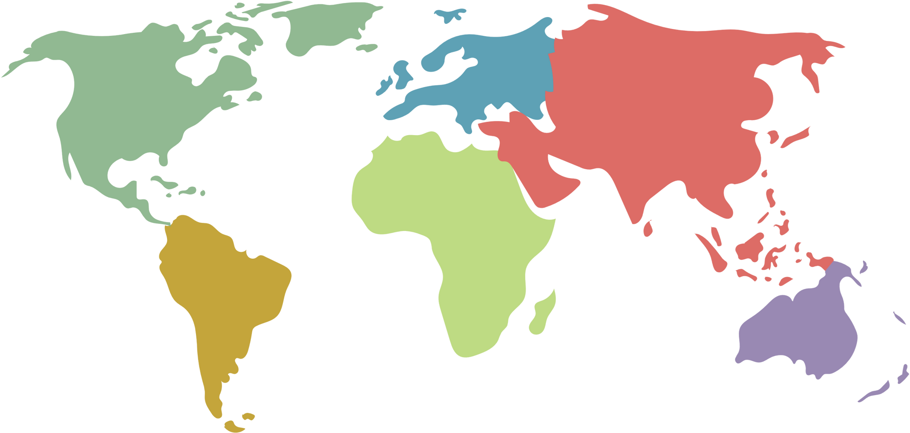
Results Summary: Overview of sample size and studies published by region
Europe
Europe
North
America
North America
3 studies
Asia
5 studies
N=3065
N= 150,929
0 studies
Africa
0 studies
South
America
0 studies
Australia
0 studies
Total (N): 152,948

Slide 11
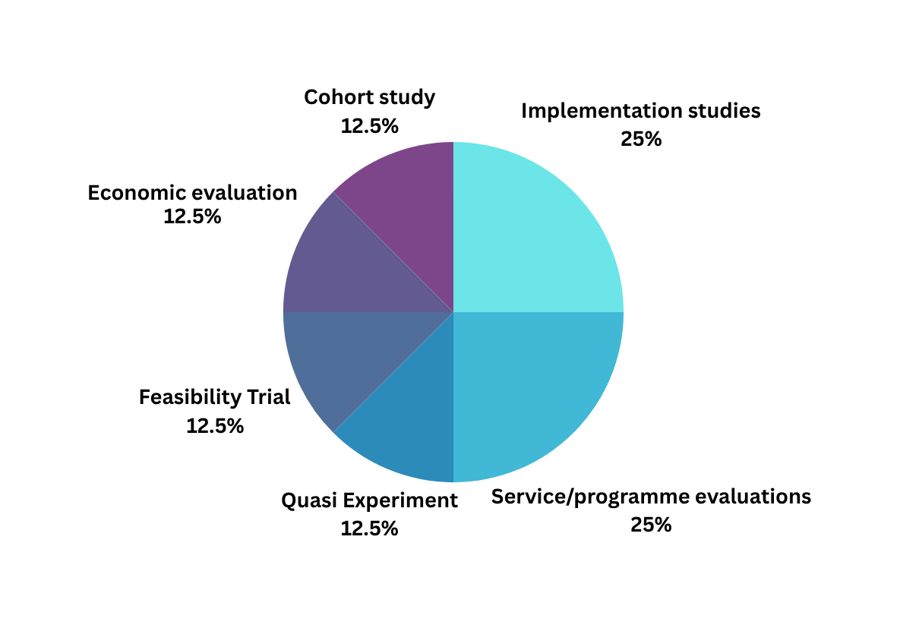
Results Summary: Population and Methodology
Target Group: 100% (8/8) of all the included studies involved target groups who are classed as vulnerable due to having one or more long term conditions or people from disadvantaged or marginalised backgrounds
Follow-up period: 75% (6/8) of the included studies included a follow up period ranging from 1-24M (M=9.8M).
Comparison group: 75% (6/8) included a comparison group/control group

Slide 12
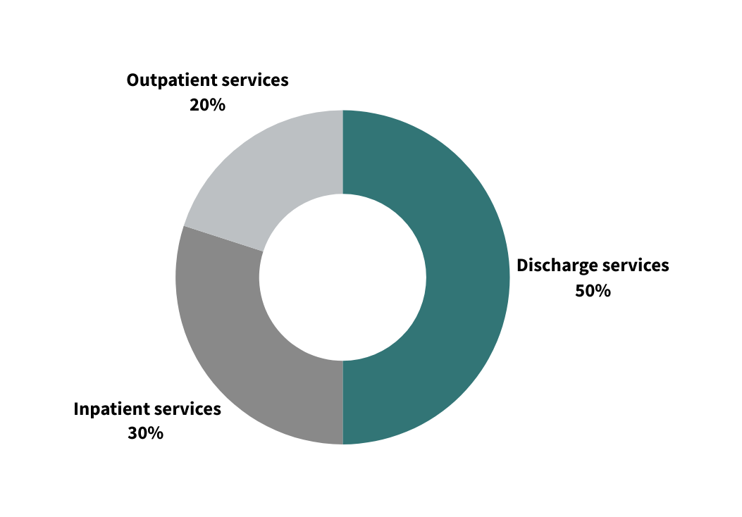
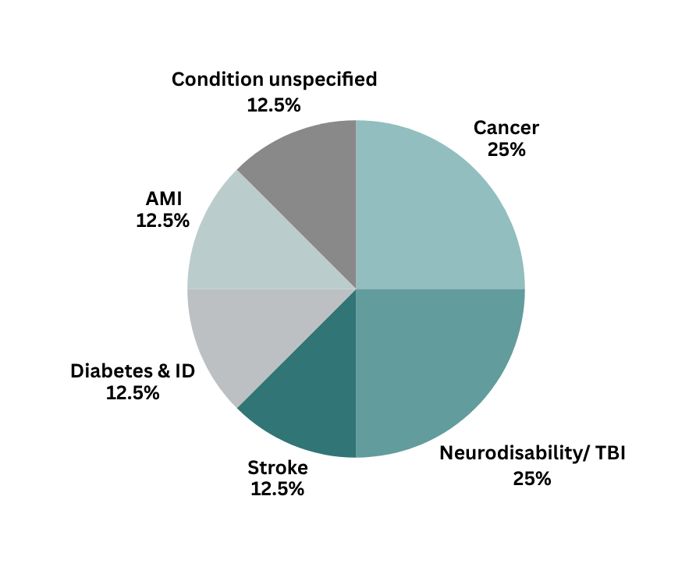
Results Summary: Health Concerns and Screening Pathways

Slide 13


Results Summary: Effectiveness (Health Outcomes)
Improved Mental health and well being
QALY Gains
Reduced Financial Toxicity
Feasibility & Acceptability
of SP
20%-43%
0.09-0.29
18%-53%
74%-95%
(3/4 studies)^{1,3,8}
(1/1 study)⁷
(2/2 studies)^{1,6}
(4/4 studies^{)1,3,5,6}
*Mental health and wellbeing assessed using the Warwick-Edinburgh Mental well-being scale (WEMWBS), Well being star, Patient health Questionnaire (PHQ-9).
*Financial Toxicity was measured with the Comprehensive Score for Financial Toxicity (COST) scale
Other outcomes: Significant reduction in disability level⁴, Mortality rate², fall rate⁴, community reintegration⁴, improved medication adherence/ management^{3,4}, caregiver burden^{1,3, 6} SDoH².

Slide 14

Results Summary: Cost Effectiveness Parameters
Decrease in Readmission Rates (*)
Cost of Delivery (**)
SROI ratio
ICER
5%-24%
£1,525.21 - £2,232 pp/y
£1: £2.75
£8000-£24,000
(3/5 studies)^{4,2,7}
(3/3 studies)^{3,5,7}
(1/1 study)³
(1/1 study)⁷
IAPT: £770-£1,200***⁹
£1: £2.30-£3.42¹⁰
NICE: £20K-£30K
*Readmission rates: 12-24 months averages;
**Cost of delivery reflects the costs to run the various interventions including overhead costs, training
schemes and other intervention related costs; children with neuro-disability and homelessness; *** Early pathfinder services
Notes:
Incremental cost effectiveness ratio (ICER)
Cailhol et al: No sig change of readmission rates
Calvert et al: Increased recurring stroke readmissions

Slide 15
Limitations and Gaps
    Longitudinal versus rapid studies
    Did not yet include grey literature
    Issues discussed in the papers
      In a few cases despite identifying people as being eligible to receive support a significant number of people refused the extra support
      Interruptions due to COVID 19
      Small scale in nature

Slide 16

Final Thoughts
    Although limited, the evidence from this SR demonstrates some positive impact of SP in secondary care.
    However, more rigorous studies are needed, preferably with comparison groups and longer term follow ups
    All these studies essentially attempt to answer: Does SP work? However, we need to have evaluations that look at how SP works, for whom and under what circumstances. Realist evaluation
    Cost-effectiveness/cost-utility: additional approach. Need to demonstrate cost avoided by using SP. E.g. £150K cost to hospital was avoided by social prescribers supporting the removal of mould for one child's house costing £150. (Anna Basu, Clinical Senior Lecturer and Honoary Consultant Paediatric Neurologist, Uni of Newcastle)

Slide 17
Reference List: Included Studies
Wheeler, S. B., Manning, M. L., Gellin, M., Padilla, N., Spees, L. P., Biddell, C. B., Petermann, V., Deal, A., Rogers, C., Rodriguez-O’Donnell, J., Samuel-Ryals, C., Reeder-Hayes, K. and Rosenstein, D. L. (2024) ‘Impact of a Comprehensive Financial Navigation Intervention to Reduce Cancer-Related Financial Toxicity’, Journal of the National Comprehensive Cancer Network, 22(8), pp. 557–562. DOI: 10.6004/jnccn.2024.7030.
Imran, A., Rawal, M. D., Botre, N. and Patil, A. (2022) ‘Improving and Promoting Social Determinants of Health at a System Level’, Joint Commission Journal on Quality and Patient Safety, 48(8), pp. 376–384. DOI: 10.1016/j.jcjq.2022.06.004.
Gordon, L., Hastry, M., Bate, A., Gordon, K., Greaves, E., Dimitriadou, S., Rapley, T. and Basu, A. P. (2025) ‘Hospital in-reach family-centred social prescribing pilot for children with neurodisability: mixed methods evaluation with social return on investment analysis’, BMC Health Services Research, 25(1), 176. DOI: 10.1186/s12913-025-12329-0.

Slide 18
Reference List: Included Studies
Rosario, E. R., Espinoza, L., Kaplan, S., Khonsari, S., Thurndyke, E., Bustos, M., Vickers, K., Navarro, B. and Scudder, B. (2017) ‘Patient navigation for traumatic brain injury promotes community re-integration and reduces re-hospitalizations’, Brain Injury, 31(10), pp. 1340–1347. DOI: 10.1080/02699052.2017.1325937.
Cailhol, J., Bihan, H., Bourovali-Zade, C., Boloko, A. and Duclos, C. (2024) ‘Quality Improvement Intervention Using Social Prescribing at Discharge in a University Hospital in France: Quasi-Experimental Study’, JMIR Formative Research, 8, e51728. DOI: 10.2196/51728.
Edward, J. S., McLouth, L. E., Rayens, M. K., Eisele, L. P., Davis, T. S. and Hildebrandt, G. (2023) ‘Coverage and Cost-of-Care Links: Addressing Financial Toxicity Among Patients With Hematologic Cancer and Their Caregivers’, JCO Oncology Practice, 19(5), pp. e696–e705. DOI: 10.1200/OP.22.00665.

Slide 19
Reference List: Included Studies
7. Tinelli, M., Wittenberg, R., Cornes, M., Aldridge, R. W., Clark, M., Byng, R., Foster, G., Fuller, J., Hayward, A., Hewett, N., Kilmister, A., Manthorpe, J., Neale, J., Biswell, E. and Whiteford, M. (2022) ‘The economic case for hospital discharge services for people experiencing homelessness in England: An in-depth analysis with different service configurations providing specialist care’, Health & Social Care in the Community, 30(6), pp. e6194–e6205. DOI: 10.1111/hsc.14057.
8. Calvert, B., Bayakly, R. and Newsome, T. (2024) ‘Stroke Prevention and Management in Rural Georgia: Evaluating the Effectiveness of a Community Paramedicine Program’, Journal of Public Health Management and Practice, 30, pp. S32–S38. DOI: 10.1097/PHH.0000000000001951.
9. https://www.transformationpartners.nhs.uk/wp-content/uploads/2017/11/IAPT-LTC-Building-the-Business-Case.pdf?utm_source=chatgpt.com
10. Polley et al. (2023): https://socialprescribingacademy.org.uk/media/wemjbqtw/building-the-economic-case-for-social-prescribing-report.pdf

Slide 20
Social prescribing experience in a University Hospital in France: results and perspectives
Dr Johann Cailhol

Slide 21
Social prescribing experience in a University Hospital in France: results and perspectives
J Cailhol, H Bihan, C Bourovali-Zade, A Boloko & C Duclos
NASP webinar, July 7th, 2025

Slide 22
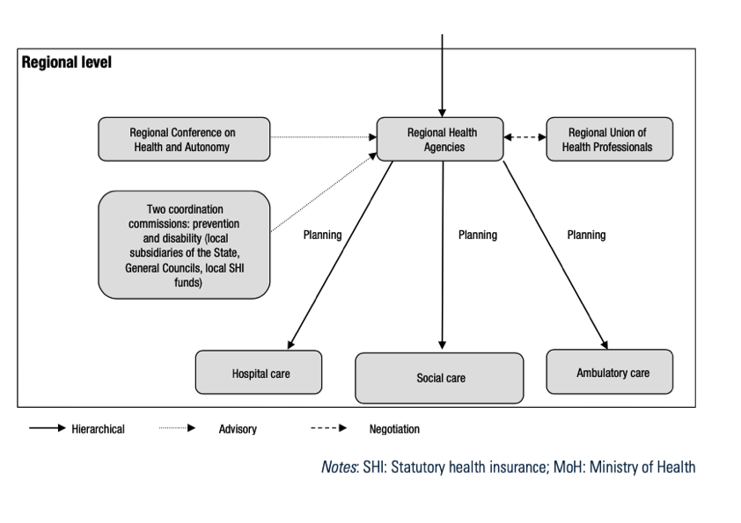
Overview of the French health system
Source: https://iris.who.int/bitstream/handle/10665/371027/9789289059442-eng.pdf?sequence=4&isAllowed=y

Slide 23
Social prescribing: still experimental in France
Social and healthcare divide (+ ambulatory/private)
Social care mainly offered by CSOs and municipalities or other adminstrative levels (departements)
Limited social care at hospital level (only for access to healthcare and rehab)
Long history of health mediation (or navigation), starting from HIV sector
Health mediation could be seen as a proxy for social prescribing, but with much larger missions and less structured
https://www.santepubliquefrance.fr/en/conditions-for-the-success-and-the-feasibility-of-health-mediation-for-healthcare-use-by-underserved-populations-a-scoping-review

Slide 24
COSMED study
University hospital of a disadvantaged suburb of Paris
Hypothesis of enormous social needs (never assessed systematically at discharge point / unit scale)
2019-2021
Quasi-experimental design: intervention (discharge coordination +/- social prescription) versus no intervention
Primary endpoint: unplanned readmission rate by D30

Slide 25
COSMED: a quasi-experimental design
All patients discharged from
2 units
Between 01/10/2019 and 30/09/2021
Excluding COVID19 related diagnosis
Intervention N = 223
Discharge coordination + social prescring questionnaire
Coordination de sortie + social prescribing
N = 98
Discharge coordination only
N = 125
No intervention
N = 2095
Post discharge follow-up
N = 77
No follow-up
N = 22
Primary endpoint: Unplanned readmission rate by day 30 ➔ NS

Slide 26
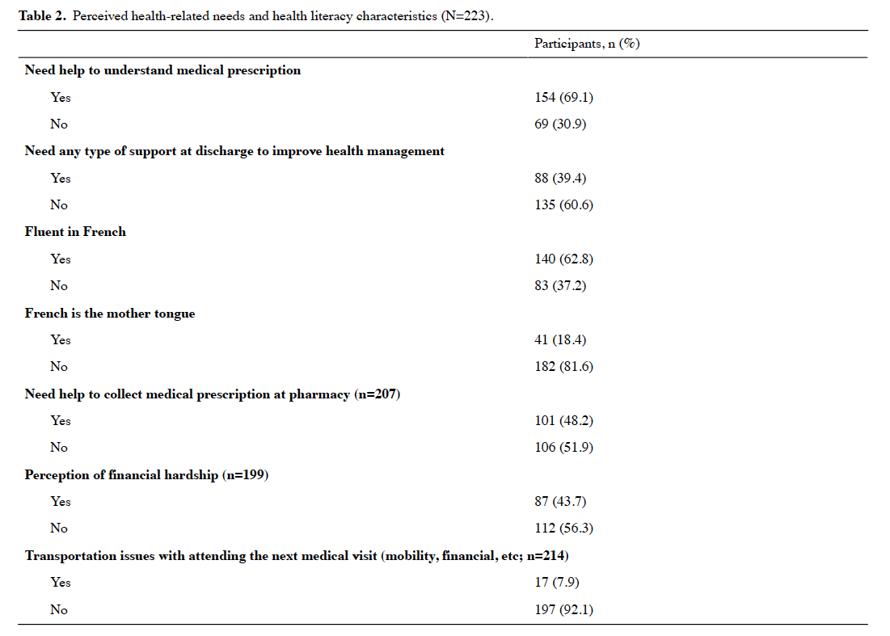
Patients’ characteristics (N = 223)
Representativeness +++

Slide 27
Types of social prescribing
Basic discharge coordination (N = 125)
Social prescribing (N = 98 patients, but 119 interventions), amongst which:
  Referring towards social services
  Referring towards NGOs or community-based activities / faith-based
  Helping or referring for administrative procedures
  Referring towards non medical clinicians (dietetician, adapted exercice coach, psychologist, tabacologist…)

Slide 28
SP for who and by whom
The disadvantanged area of our hospital proved to be a good location to roll-out SP, with no difference between 2 units
The discharge coordinator
  Central role of trust between the link worker (here the nurse) and both the medical staff and the patient
  Her ethnic background was a major advantage
Currently SP experiences at primary health care level

Slide 29
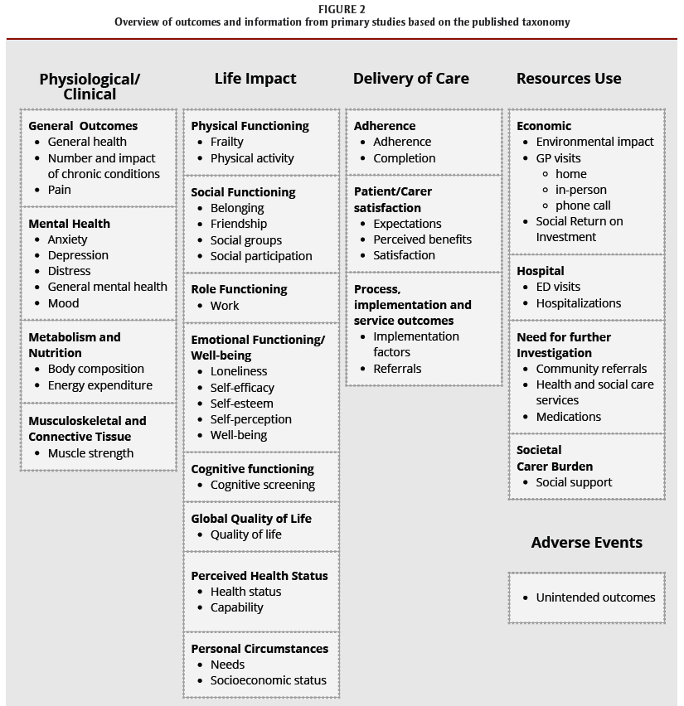
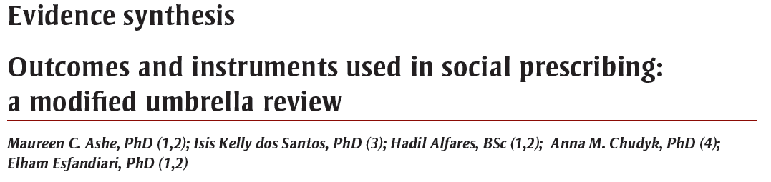
Concluding remarks
Commonalities between SP and health mediation:
  Primary goal : addressing social determinants of health
  Personalized care and referrals
  Lack of evidence on cost-effectivenenss
  Central role of social connectiveness

Slide 30
References
COSMED study: Cailhol J, Bihan H, Bourovali-Zade C, Boloko A, Duclos C; Quality Improvement Intervention Using Social Prescribing at Discharge in a University Hospital in France: Quasi-Experimental Study JMIR Form Res 2024;8:e51728 doi: 10.2196/51728
Health mediation: https://www.santepubliquefrance.fr/en/conditions-for-the-success-and-the-feasibility-of-health-mediation-for-healthcare-use-by-underserved-populations-a-scoping-review

Slide 31
The Role of Social Prescribing in Cardiovascular Disease: Barts Heart Centre Social Prescribing Pathway
Dr Tara Mastracci

Slide 32
The Role of Social Prescribing in Cardiovascular Disease:
Barts Heart Centre Social Prescribing Pathway
TM Mastracci, St. Bartholomew’s Hospital, London UK
on behalf of
Remi Omisore-Adjei, Sian Barlow, Ina Wyatt Gosebruch, Michelle Hayes, Layla Shirreh, Ruth Roberts​, Naomi Meade

Slide 33


Disclosures
Grateful for funding by
Barts Charity, NEL Personalised Care Intervention
Grateful for the partnership and support of
Bromley By Bow Centre and Transformation Partners in Health and Care
Grateful for the hard work of our AMI Nurses and Pharmacists:
Oliver Casey-Gillman, Rocel Santos, Simon Cook, Geena Paul, Lizzie Moore, Annabelle Clarke, Michelle Hayes
Grateful for our Social Prescribers
Remi Omisore-Adjei, Sian Barlow and Ina Wyatt Gosebruch

Slide 34
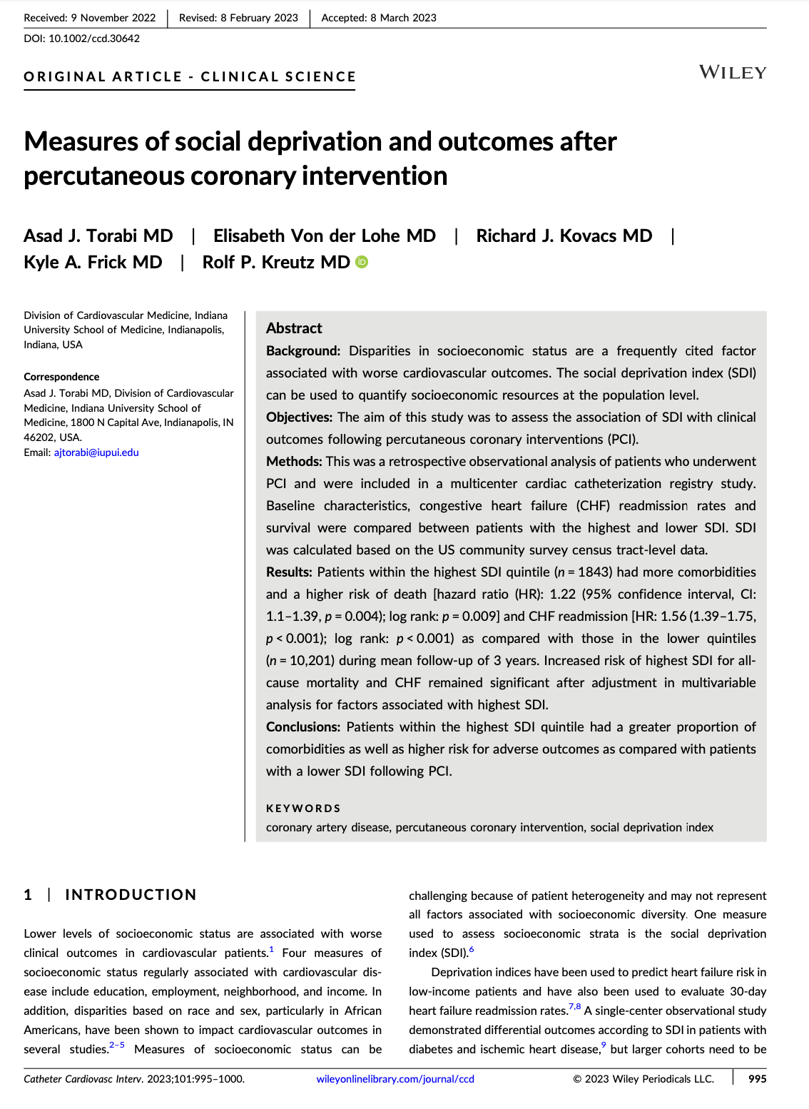
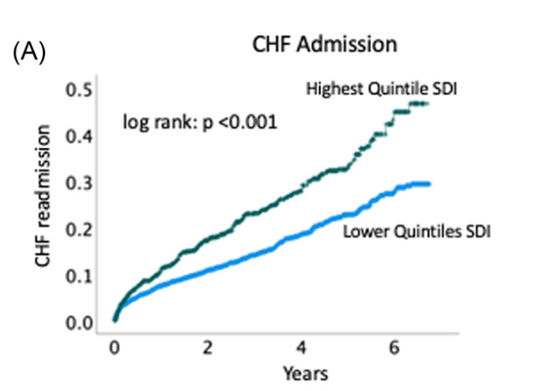
Post Coronary Intervention Outcomes
53% higher risk of all cause death
58% higher risk of readmission
Torabi et al, CCI 2023

Slide 35
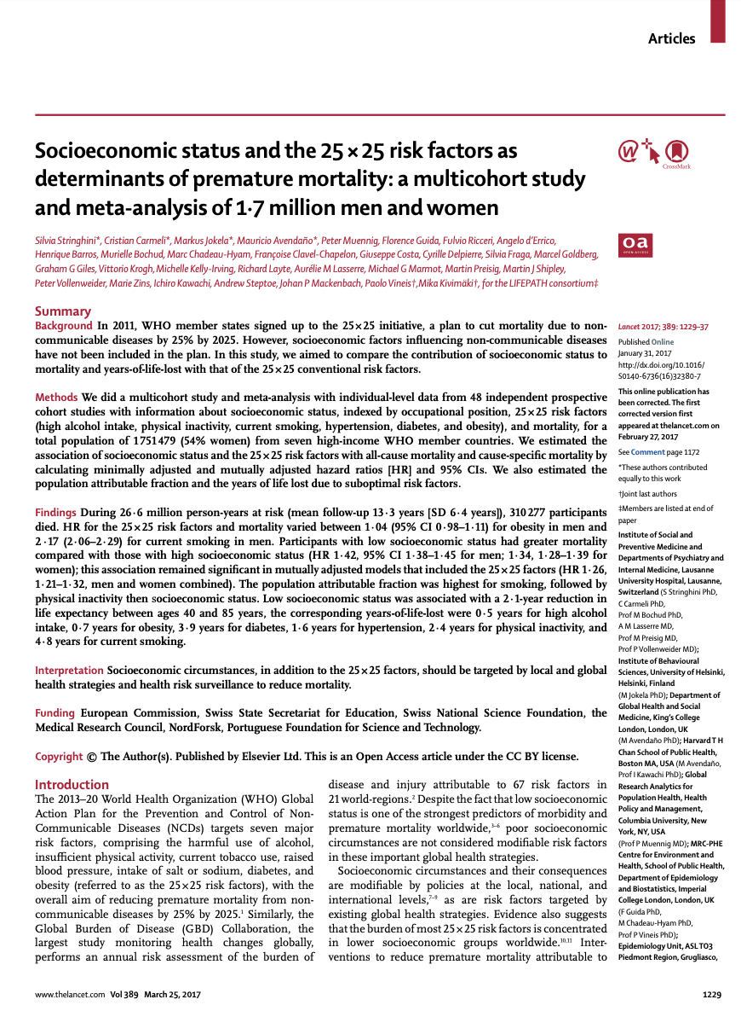
Low SES is a Risk Factor for Mortality
Stringhini et al, Lancet 2017

Slide 36
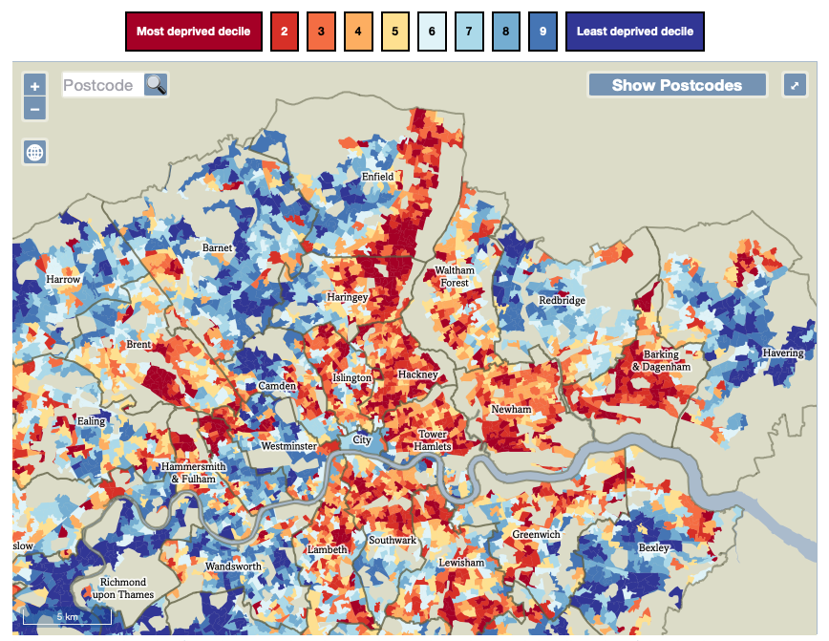
The reality of East London

Slide 37
Volume of patients presenting to Barts Heart Centre, by IMD Quintile (2022-2023)

Slide 38
Average age of patients presenting to Barts Heart Centre, by IMD Quintile (2022-2023)

Slide 39
% patient with diabetes presenting to Barts Heart Centre, by IMD Quintile (2022-2023)

Slide 40
Elective Versus Urgent/Emergent Presentation to Barts Heart Centre, by IMD Quintile (2022-2023)

Slide 41
Focus groups for Co-design
Scheduled 2x annually to invite feedback about the programme
Offered as in-person (with lunch) or individually by phone
Most recent group focusing on the introduction of physical activity into the project

Slide 42
What can we do?

Slide 43
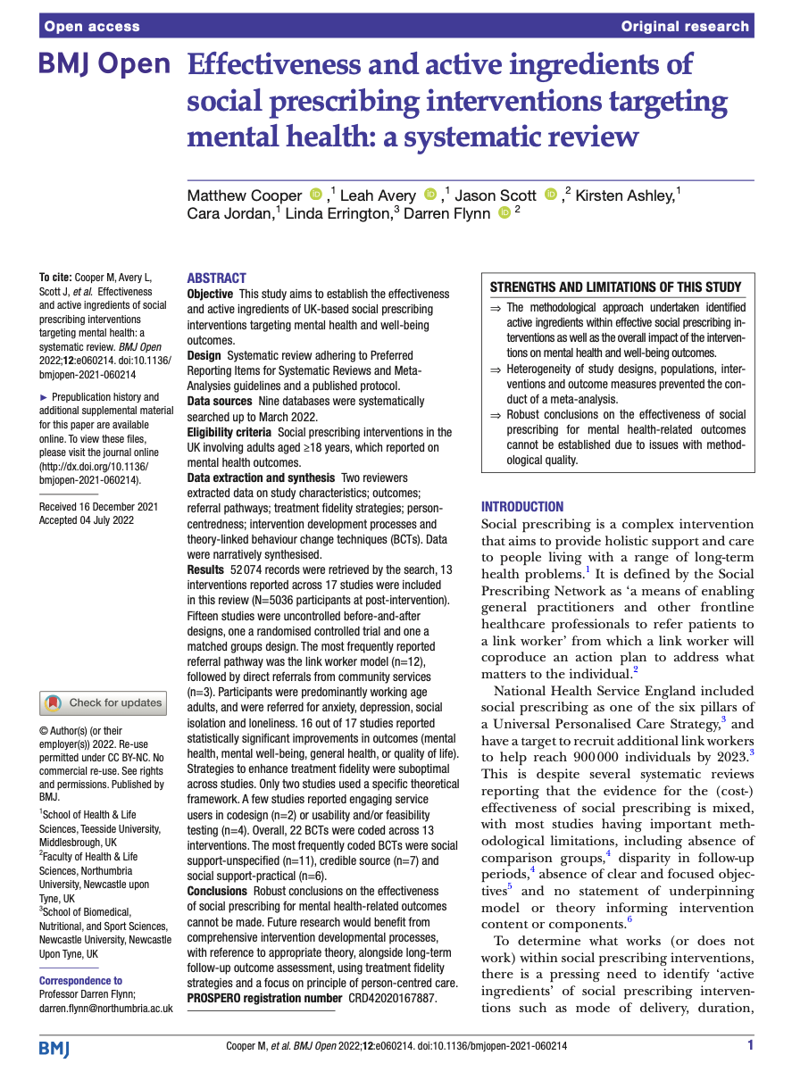
SP in Secondary Care
?
Very limited literature
Not generalisable
Outcomes poorly defined
NO ECONOMIC ANALYSIS

Slide 44
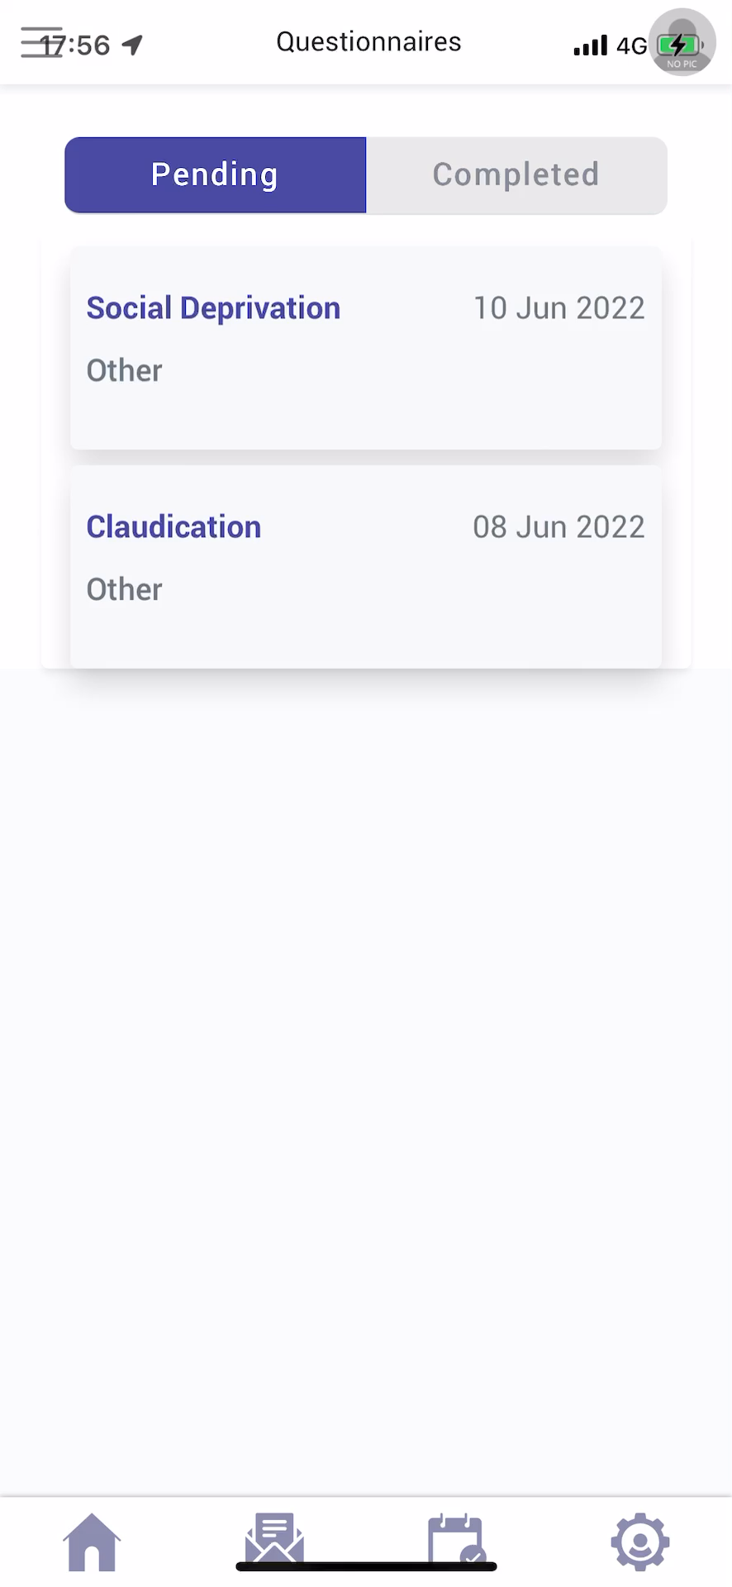
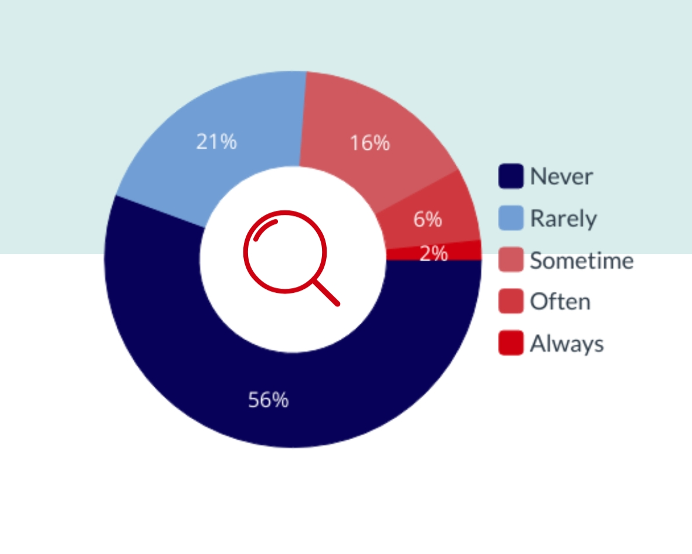
Barts Experience:
Proof of Concept: Screening
Do you have difficulty making ends meet?
Digital questionnaire sent to patients with aortic dissection and pre op cardiac surgery in our practice
Mastracci, Das 2023: Credit to Ortus

Slide 45

Well Newham
Cardiology Wellbeing Study
TM Mastracci, M Khanji, R Patel, S Waite, Y Hawkings
 | Questionnaire Item | Possible responses | Reference source
1 | Do you have difficulty making ends meet at the end of the month? | Yes/No/ I don’t want to answer | Brcic, V., Eberdt, C. & Kaczorowski, J. Development of a Tool to Identify Poverty in a Family Practice Setting: A Pilot Study. International Journal of Family Medicine 2011, 1–7 (2011).
2 | Do you ever have to miss a meal because you don’t have food? | Yes/No/ I don’t want to answer
3 | In the past 2 months, have you been living in stable housing that you own, rent, or stay in as part of a household? | Yes/No/ I don’t want to answer | Chhabra, M. et al. Screening for Housing Instability: Providers’ Reflections on Addressing a Social Determinant of Health. J GEN INTERN MED 34, 1213–1219 (2019).
4 | If you were in trouble or felt alone, do you have family or friends you can rely on for support? | Yes/No/ I don’t want to answer | Escalante, E., Golden, R. L. & Mason, D. J. Social Isolation and Loneliness: Imperatives for Health Care in a Post-COVID World. JAMA 325, 520 (2021).
5 | Do you ever feel unsafe? | Yes/No/ I don’t want to answer
6 | Do your personal health issues impact your role as a carer | Yes/No/ I don’t want to answer | Focus group, Barts CVD patients 2023
7 | (Optional if any flags in the first 6 items) Do you want to talk to someone who may be able to help? | Yes/No/ I don’t want to answer | Consultation, Lewisham Social Prescribing Team
Notes:
Bengali
romanian
Urdu
arabic

Slide 46
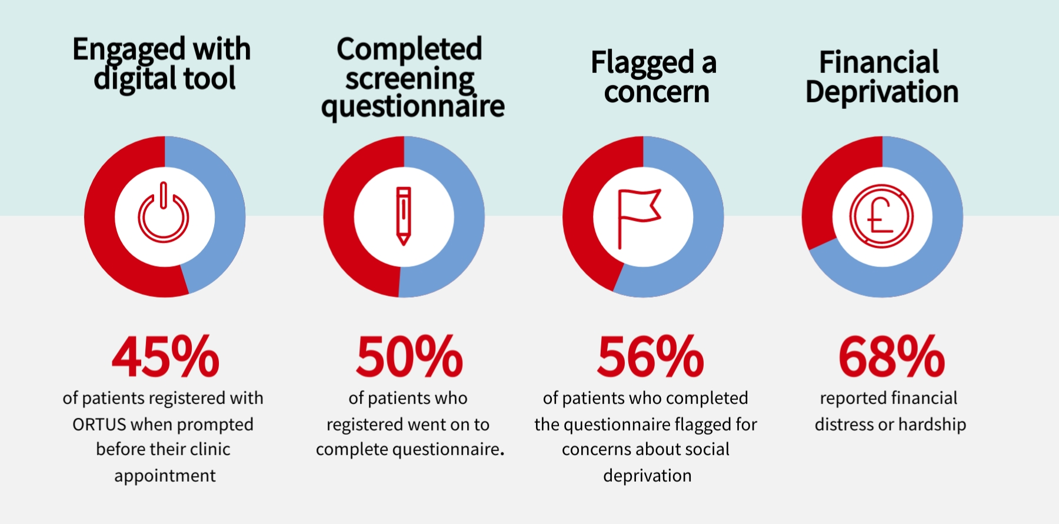
Well Newham
Cardiology Wellbeing Study
150 patients at outpatient cardiology clinic in Newham
Proved: We need a human interface to make this work!
Mastracci, Khanji 2023

Slide 47
Acute Phase
Subacute Phase
Long-term Phase
Patients followed up as per protocol and at 12 month remote review
Patients not meeting inclusion criteria
Acute MI
Patient appointments at 1, 4 and 8 weeks post MI. Patients identified at 8 week apt by ACPs using screening tool.
Screen
Negative
Direct Access MI Pathway patients to AMI Clinic
ACPs screen patients
DNA patients called by SP
DNA Patients
Social Prescriber (SP) triages patient referrals
Screen Positive
Patients seen by SP and followed up
Patients Meet inclusion Criteria
Referred to SP
Patients referred elsewhere by SP information on referral captured
Legend
Social Wellbeing score
EQ5D
Health and Lifestyle
Reason for referral
MyCAW Score
Information
Captured
Demographics
Clinical Stuff
Social Wellbeing score
EQ5D
Health and Lifestyle
CRS
Social Wellbeing score
EQ5D
Health and Lifestyle
SP/LW
ANP

Slide 48
The simple question we ask:
These days some people are having difficulty meeting their basic needs and in some cases we may be able to help.
Do you have difficulty making ends meet / meeting basic needs at the end of the month ?
  This may include difficulty putting food on the table, finding a place to sleep at night, feeling safe in your home, having a job, or fulfilling your role as carer?
  Yes/No/Prefer not to talk about it
Do you want help?
  Yes/No

Slide 49
Our approach
To reduce life's stresses so people can start making lifestyle change​. It requires time to build relationships and create safe spaces for people to open up about what they need and what's challenging.
Initial call
Gather key concerns
Introduce services
MYCAW & EQ5D
First appointment booked
Confirmation email/text sent
Reminder text sent
Framework for support
6-8 sessions
+3 months
Referrals and coaching
Urgent/immediate referrals made
MYCAW & EQ5D
Slide Courtesy of Remi Omisore-Adjei and Sian Barlow

Slide 50
Total Patient Encounters and Weekly Screening Volume
Mastracci et al, Unpublished

Slide 51
Do you have difficulty making ends meet?
20%
Yes
Mastracci et al, Unpublished

Slide 52
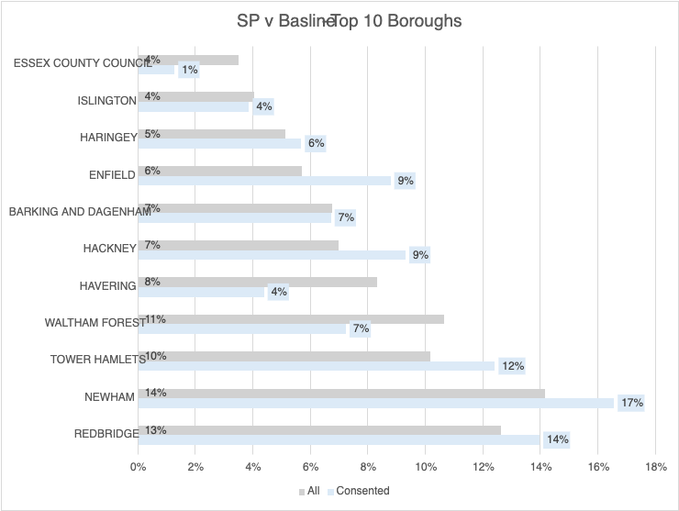
Our Catchment Population
Mastracci et al, Unpublished

Slide 53
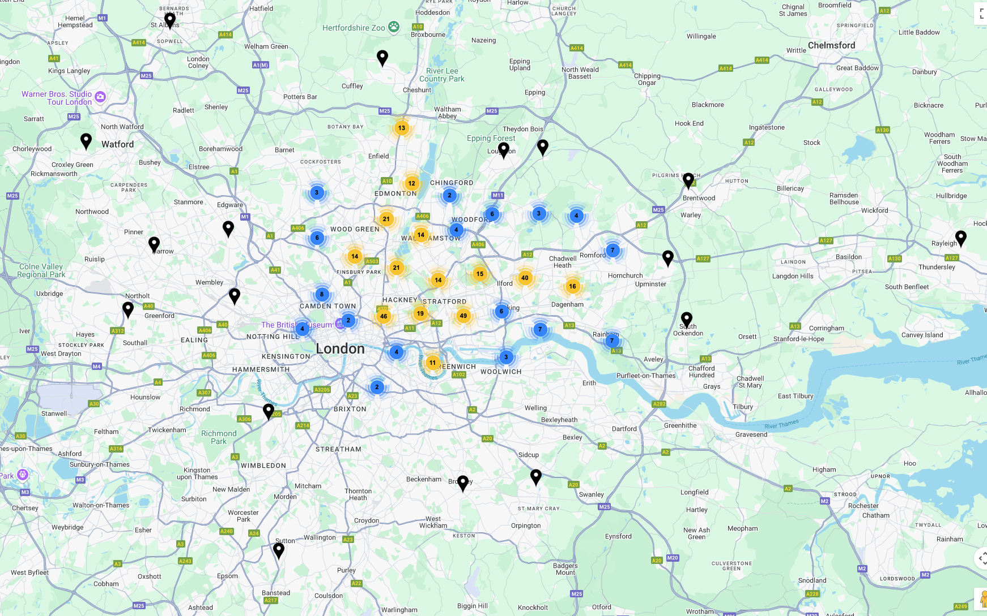

Slide 54
What Support Do We Provide?
Mastracci et al, Unpublished

Slide 55

What we’re learning: Population
This may be a unique and complementary population
Top areas of concern
  Employment/Money
  Food
  Fuel
  Housing
  Carer Role
81%
74% of AMI patients are men
Mastracci et al, Unpublished

Slide 56


What we're learning: Population
Patients are engaging with financial and welfare assistance but are less keen to engage in healthy behaviour change or psych support
Employment support is challenging due to language barriers and duration of time out of employment
Men are keen to engage with other people in their stage of healing
Mastracci et al, Unpublished

Slide 57
Are we making a difference?

Slide 58
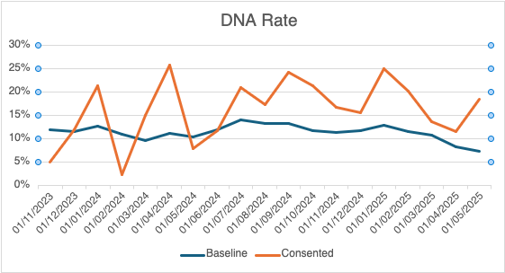
DNA Rate

Slide 59
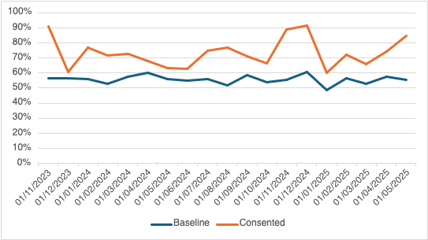
Emergency Admissions

Slide 60
What we’re learning: Readmissions

Slide 61
MyCAW Score: Are we making a difference
MYCaW (Measure Yourself Concerns and Wellbeing)
MYCaW is a person-centred outcome measure, which enables a person to designate their concerns, rate the severity of them and their well-being. At follow-up the concerns and well-being are rated once more to enable statistical analysis of score changes to be carried out.
Jolliffe R, Collaco N, Seers H, et al. Support Care Cancer 2019; 27:1901–9
Jolliffe R, Seers H, Jackson S, et al. Integr Cancer Ther 2015; 14:26–34
Seers HE, Gale N, Paterson C, et al. Support Care Cancer 2009; 17:1159–67
Polley MJ, Seers HE, Cooke HJ, et al. Support Care Cancer 2007; 15:963–71
Data: Mastracci et al, Unpublished March 2025.

Slide 62
EQ5D Changes: Quality of Life
EQ5D
Mobility
Self-Care
Usual Activities
Pain/Discomfort
Anxiety/ Depression
Overall wellbeing
https://euroqol.org/wp-content/uploads/2016/10/Sample_UK__English__EQ-5D-5L_Paper_Self_complete_v1.0__ID_24700.pdf
Data: Mastracci et al, Unpublished March 2025.

Slide 63
What more have we learned?

Slide 64
Focus groups for Co-design
Scheduled 2x annually to invite feedback about the programme
Offered as in-person (with lunch) or individually by phone
Most recent group focusing on the introduction of physical activity into the project

Slide 65
Focus Group Feedback
What are the barriers and opportunities to support physical activity during recovery?
Barriers
Fear
Other conditions
Need for guidance
Suitability of classes
Travel
What has worked
Group work and group support- cardiac rehab
Supportive family and friends
The right advice
Social prescribing supporting with other factors
Ideas
Group exercise
Live stream sessions
Connection to others
Promoting opportunities to connect

Slide 66
“The social prescriber came into my life like an angel. I was very depressed and stressed and felt pain.”

Slide 67

Patient Peer Support
Set up at the request of patients – wanted a forum to understand people on a similar path
Held ‘in person’ and at set intervals to give people a chance to plan
Many apologies due to sickness, including hypertension (!), but very well received

Slide 68
Cardiovascular Disease Peer Support Group:
Learning
Created because we were hearing people wanting a space to talk with others who have gone through a similar thing
Has been jointly developed with a group from the beginning - attendees set timing, regularity and group rules - once a month, first Wednesday of the month
Identified with the group a list of topics they want to cover in future sessions
Started to move towards a structured format, where there's some time to connect with each other and then time to discuss a topic
Next phase is to bring in specialists to discuss some of those topics that have come up. This started with a relaxation and wellbeing specialist, who came in and did some self-reflexology and breathing and this was well received.
We've held 4 so far and we have a small regular group of attendees now in a Whatsapp group
Looking to trial activities to influence our activity schedule and gather insights into what they need to continue to support their recovery
Initial engagement and feedback from people joining has been very positive, people feel this is an important source of support for them.
- Sian Barlow, SP for the BBBCxBHC team

Slide 69
Future Plan
More Drop in activity sessions at different times of the day to be more accessible
Try to geographically diversify the offering
Live session about what physical activity is allowed after AMI

Slide 70
Lessons from the Journey

Slide 71


Case finding in secondary care doesn’t mean intervention in the hospital
Case finding in secondary care doesn’t mean intervention in the hospital

Slide 72

Heart Attacks Happen to Families

Slide 73
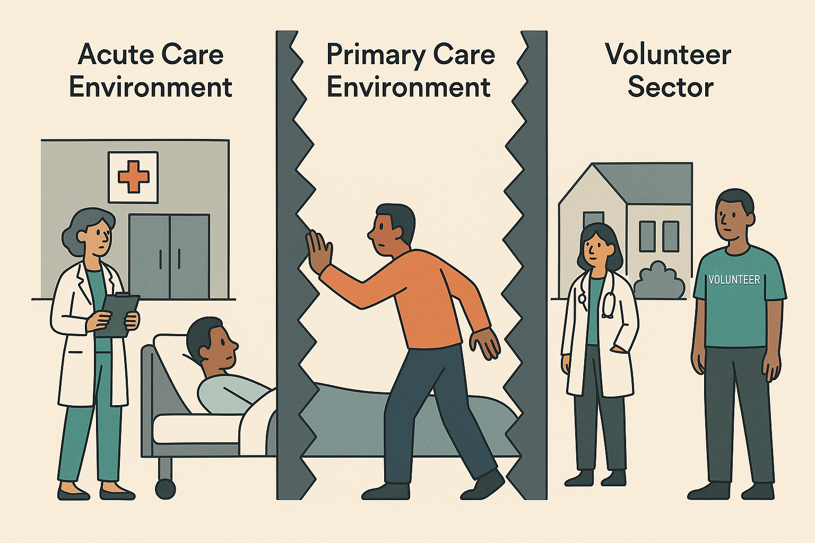
Barriers to reducing inequalities in the NHS are self imposed

Slide 74
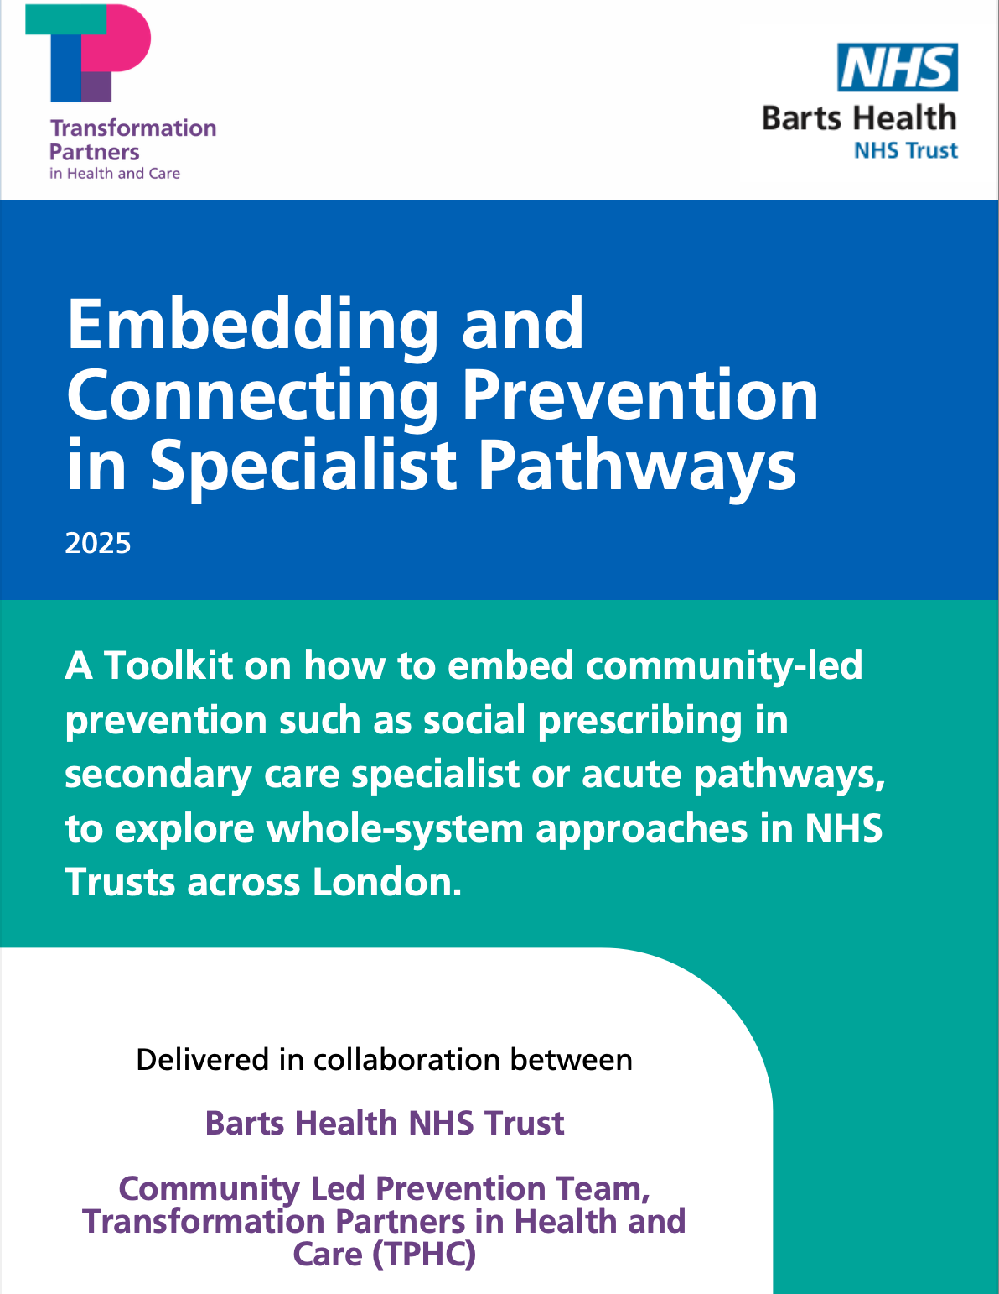
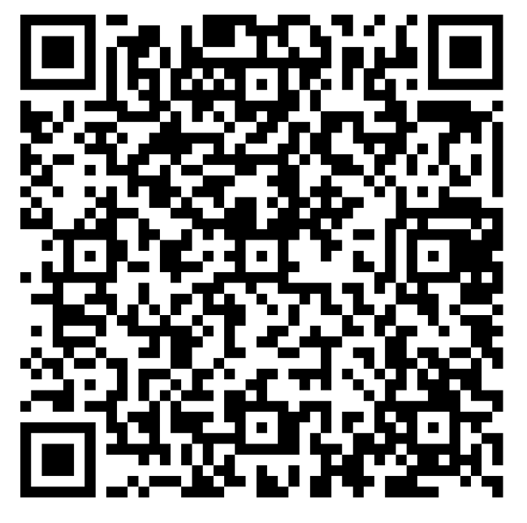
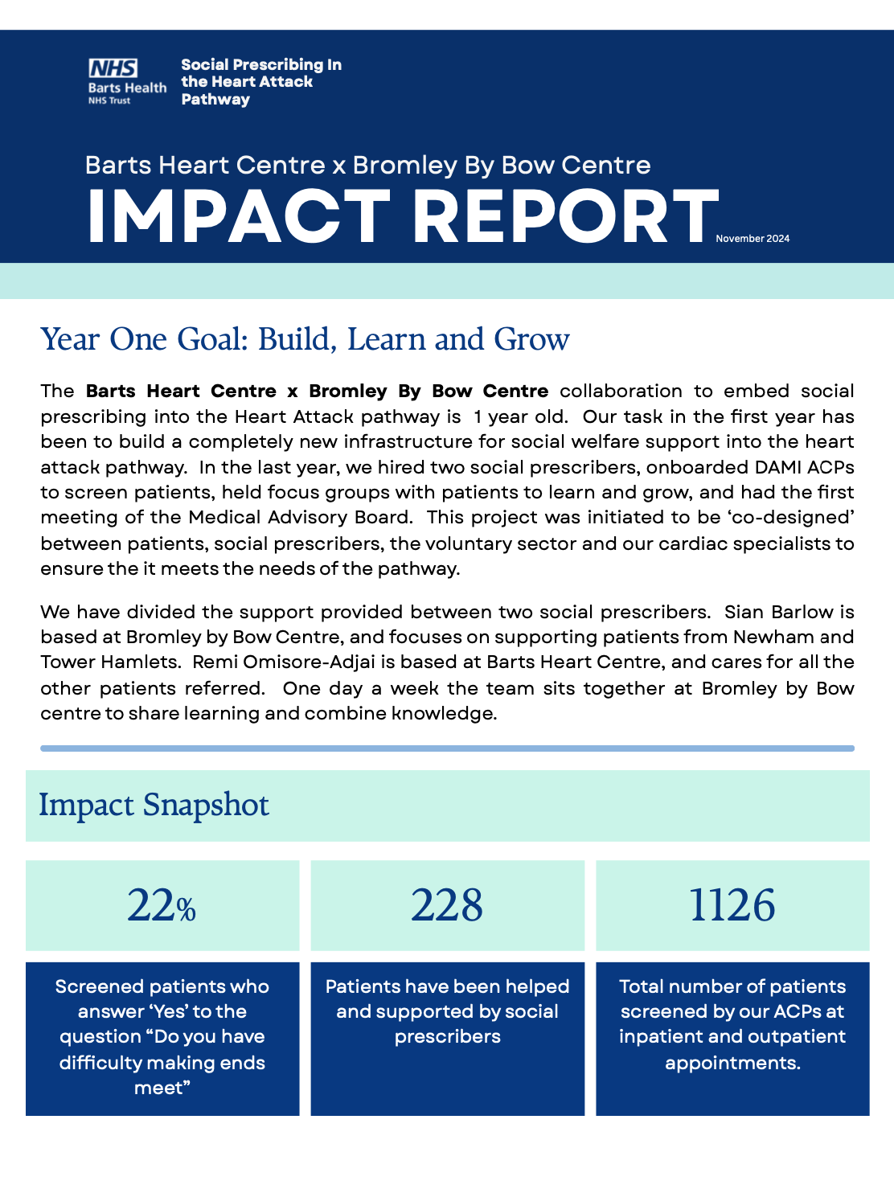
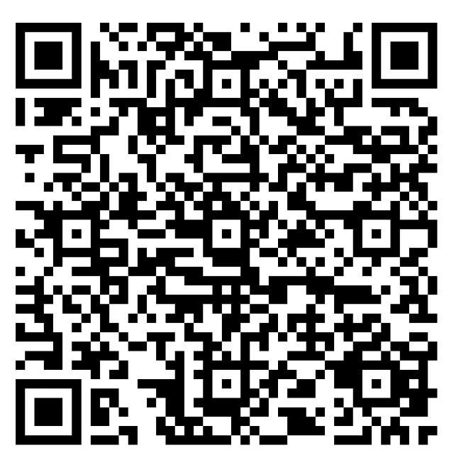

Slide 75
Questions? bartshealth.socialprescribing@nhs.net

Slide 76




Get in touch
socialprescribingacademy.org.uk
@NASPTweets
@NASP_insta
Q&A

