Slide 1
NASP webinar: A multi faith exploration into social prescribing
Jim Burt, Executive Director Strategy, NASP
Zainab Bibi, Strengthening Families & Welfare Services Lead, Nishkam Civic Association
Nasim Abrahim, Spiritual Mental Health Meditator and Principal of Faizan E Islam, Waltham Forest Islamic Association
Raisel Byrne, Core Services Manager and Osnat Ritter, Community Development Coordinator, Jami UK

Slide 2
Housekeeping
Please note we are recording this webinar (you will be sent the slides and the link to the recording, and they will be on NASP's website too.)
Presentations, then a Q&A session at the end.
Please submit questions via the chat.
Please use the chat for introducing yourself and networking.
Please stay on mute and camera off.

Slide 3
Accessibility
Closed Captions are available – turn these on at the bottom
of your screen
BSL interpretation is available – the interpreters will be spotlit
Please put any technical questions into the chat

Slide 4
Overview of session
Jim Burt, Executive Director Strategy, NASP - Chair
Zainab Bibi, Strengthening Families & Welfare Services Lead, Nishkam Civic Association
Nasim Abrahim, Spiritual Mental Health Meditator and Principal of Faizan E Islam, Waltham Forest Islamic Association
Raisel Byrne, Core Services Manager and Osnat Ritter, Community Development Coordinator, Jami UK
Q&A session – 30 minutes

Slide 5
Zainab Bibi
Strengthening Families & Welfare Services Lead
Nishkam Civic Association

Slide 6
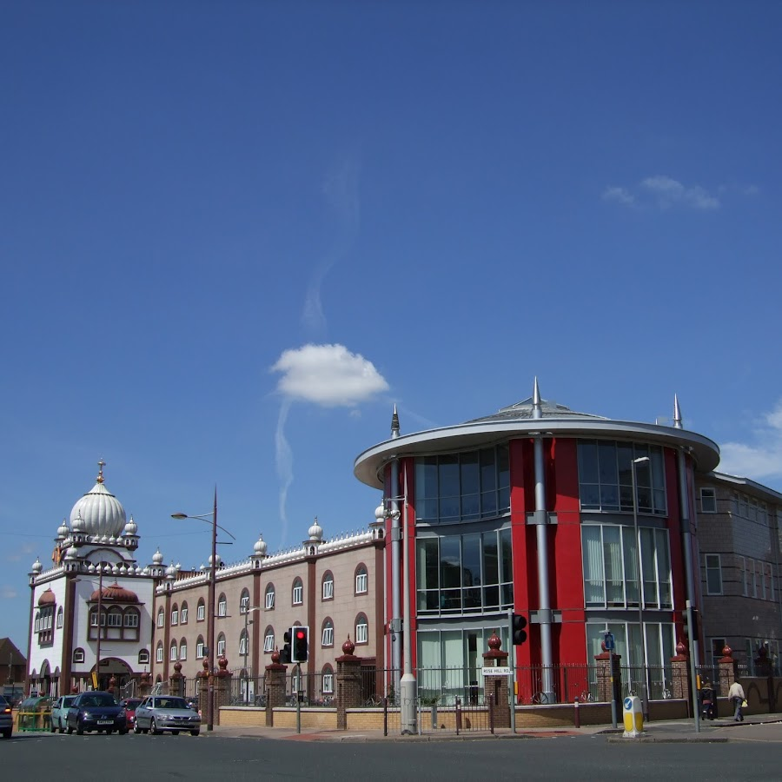
https://ncauk.org/
Notes:
The Nishkam Civic Association (NCA), fondly known as the Nishkam Centre, is a unique organisation charged with the task of developing a dynamic Sikh faith inspired civic agenda, located on Soho Road, Birmingham. It is one of the key Centres for Excellence founded by Guru Nanak Nishkam Sewak Jatha, a Sikh faith-based organisation dedicated to nishkam sewa (active, selfless volunteering) to serve the common good. It is part of Nishkam Organisations that is made up of the spiritual centre (the Gurudwara), the economic cooperative – MSS (Marg Sat Santokh, meaning ‘path of truth and contentment’), the Nishkam School Trust and Nishkam Healthcare Trust.

Slide 7
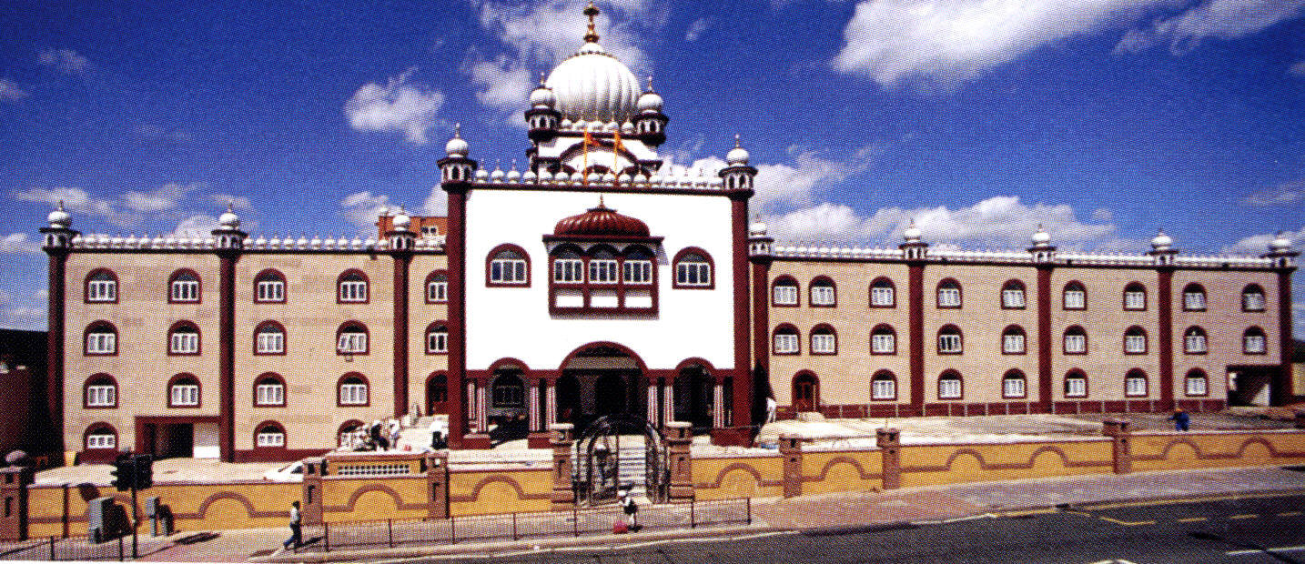
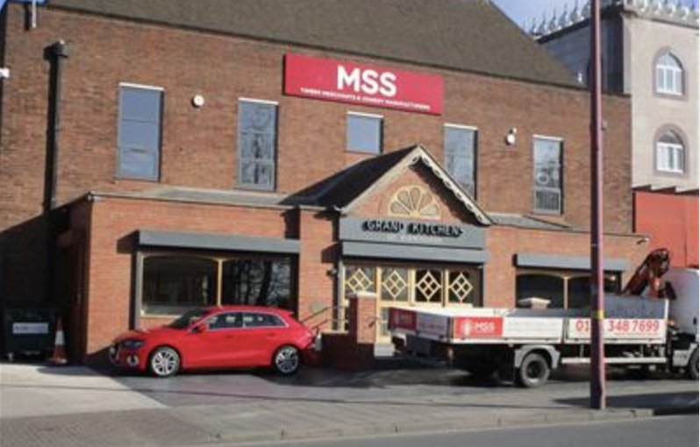
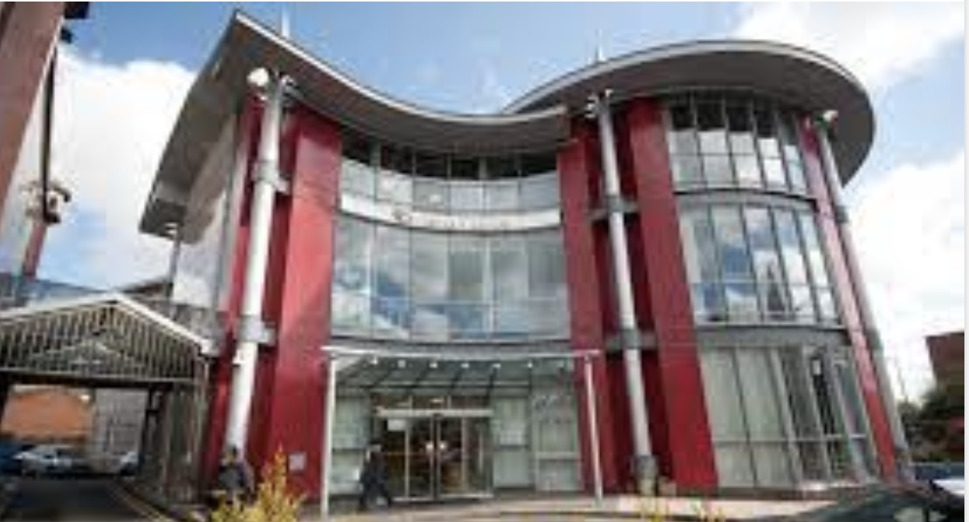
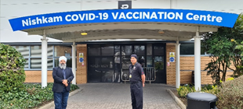
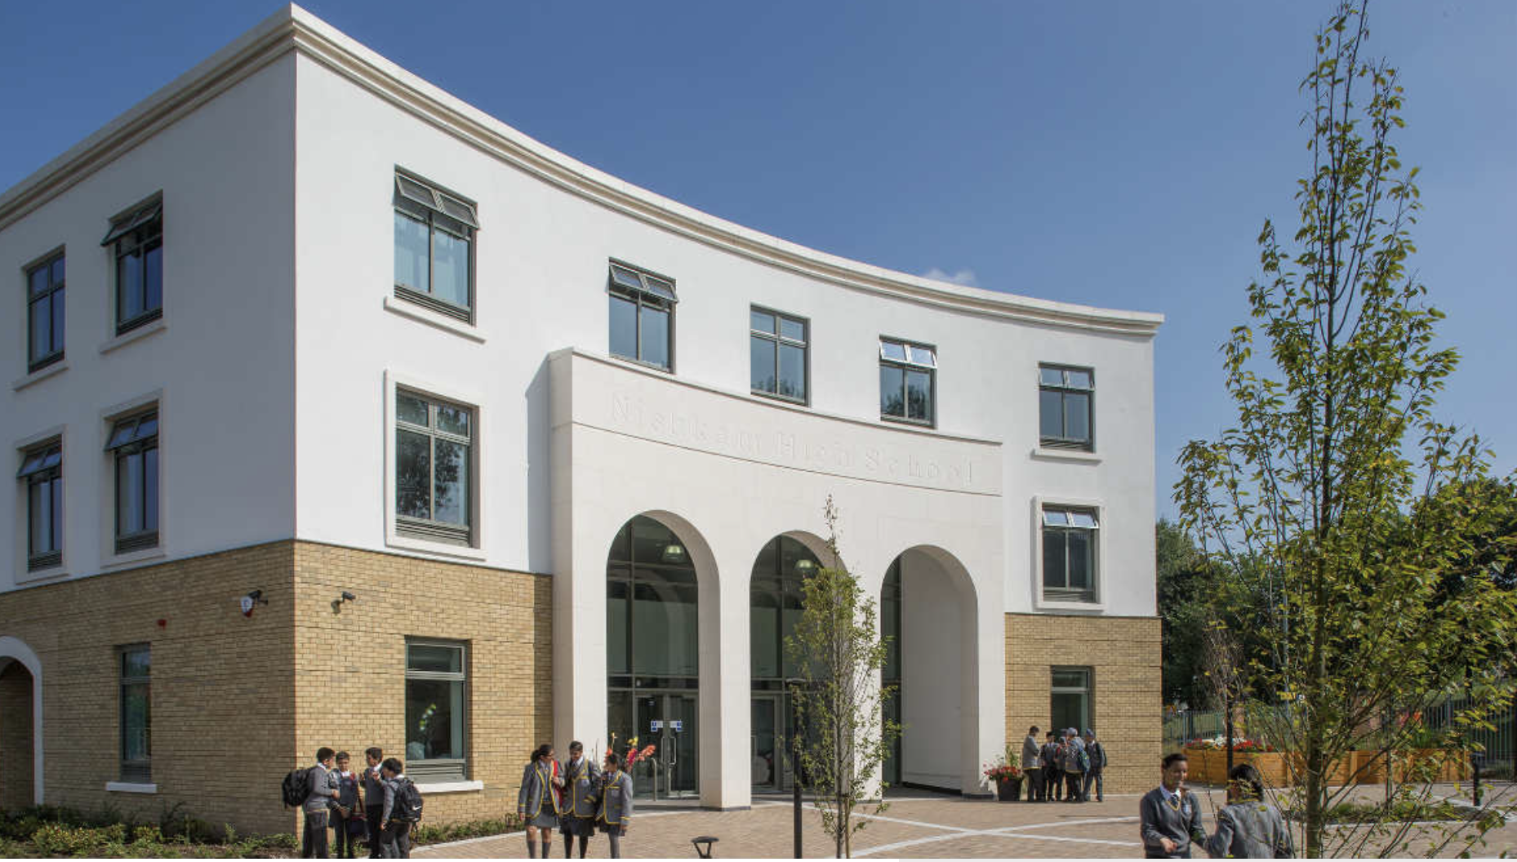
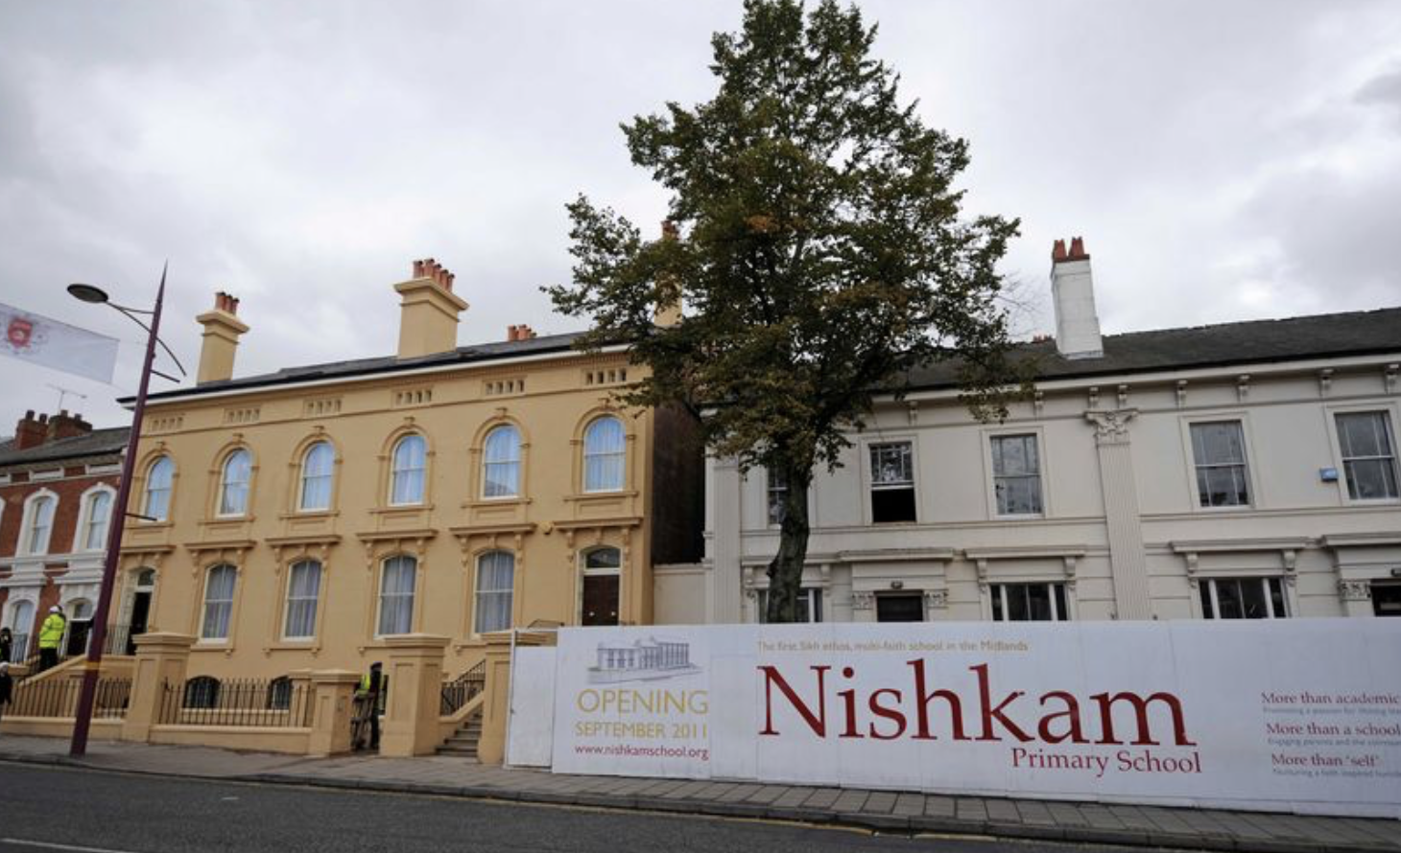
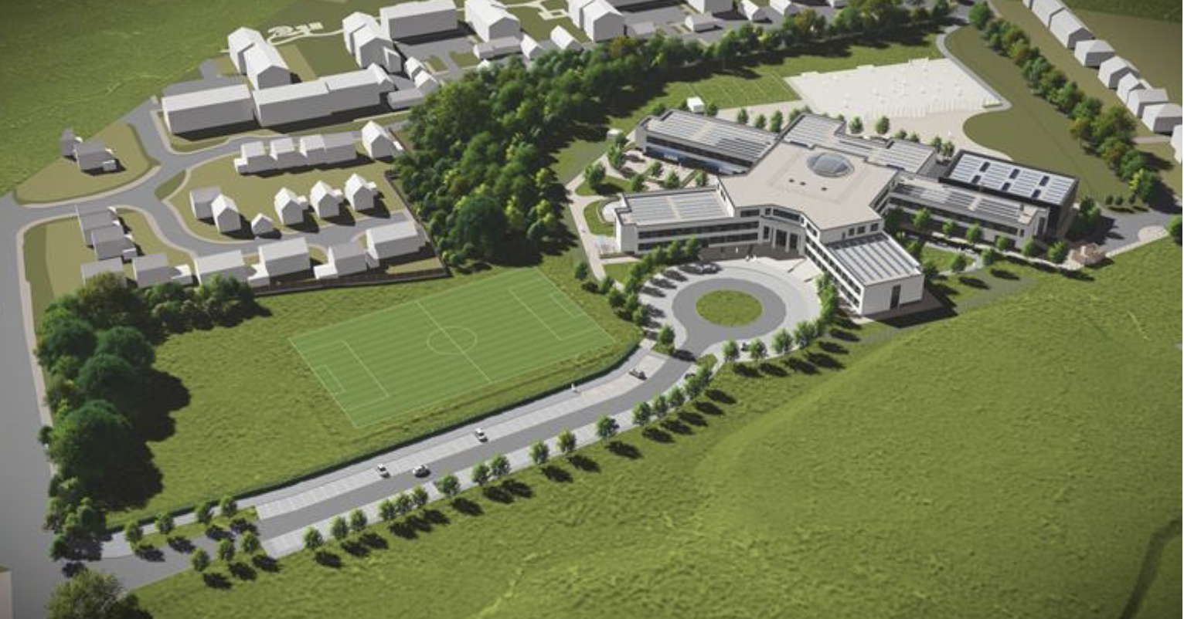
Who are we and our mission: Independent Charities and part of the Nishkam Group
Mission and meaning of “Nishkam”: Selfless service to humanity without seeking reward or recognition.
GNNSJ: Place of worship
MSS: A Co-operative serving construction sector
Nishkam Civic Association (NCA): Civic and community engagement
Nishkam Healthcare Trust
Nishkam Nurseries in Birmingham, Wolverhampton and Leeds
Nishkam School Trust: Primary Schools in Bham and W’ton; High School in B’ham and All-through 4 -19 School in West London: Ofsted rated Good or Outstanding

Slide 8
The Nishkam Civic Association (Nishkam Centre) was constituted in 2002 and is a Faith Inspired and values-led organisation.
Our mission is to facilitate personal, community, civic and sustainable transformation, guided by the practice of selfless service, for the wellbeing of communities, the environment, and all creation.

Slide 9
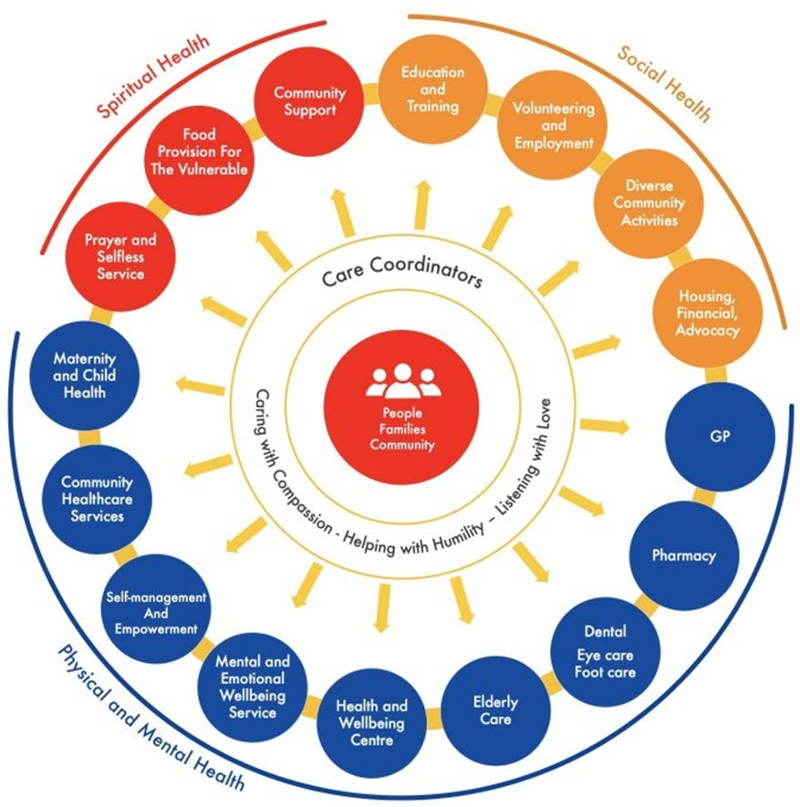

Slide 10
Community Safety Net
The Community Safety Net (CSN) Project was established in December 2021 to address inequalities, reduce barriers, empower and increase self-sufficiency of our clients, to strengthen families and improve overall wellbeing. We are doing this by delivering an essential information, advice and guidance (IAG), hands-on service to members of diverse communities in Handsworth and residents within 1.5 miles of NCA (B21 9BH

Slide 11
Overview of CSN Service
Nishkam Centre has been providing advice services since 2012 and has an established track record
CSN project is well established with existing clients and partner organisations alike that can confidently refer to us with the knowledge that new clients will be seen
Assistance is provided face to face, via Telephone and online. We tutor in depth information through appointments such as PIP descriptors. We assist with debt, housing and welfare benefits up to Tribunal level.
For vulnerable and less able clients that do not have internet/unable to use a phone, we assist through face-to-face appointments, approximately 41% are casework and 59% are deemed self-help through self-help support pathways.

Slide 12
CSN Project – 2022-2023 Figures
Target (Annual)
Open 400 Cases
Financial Outcome Target:
£600,000
Achieved
108 Windrush Claims completed
858 Household Support Fund Cases
534 Welfare Cases opened
Total: 1500 people supported
Achieved £1,032,189.51 in direct financial outcomes for our clients

Slide 13
Community Safety Net Case Study: https://ncauk.org/services/strengthening-families-and-welfare-services/zahids-story/
Notes:
Link will be accessible from the 12th of September

Slide 14
SOUTH ASIAN FAMILY SUPPORT HUB

Slide 15
South Asian Family Support Hub
The South Asian Family Supports Hubs aim is to strengthen families, develop structures for long term stability and promote peace, harmony, compassion in family routines and family environments. Happy, stable, strong families make happy, stable, and strong communities.
Our experience has shown that there are numerous factors which lead to family relationship breakdown e.g., illness, environment, financial hardship, trauma, social media and being unable to access the services that people require to meet their needs. We act as advocates, mediators, and advisors to help people overcome these barriers.

Slide 16
South Asian Family Support Hub
Build positive family relationships
Reduce parental conflict
Improve educational, attendance, punctuality and attainment
Support emotional and mental wellbeing
Signposting to specialist support services- Domestic abuse, Substance abuse etc
Reduce risk of anti-social behaviour and crime
Safeguarding children and vulnerable adults
Early Intervention

Slide 17
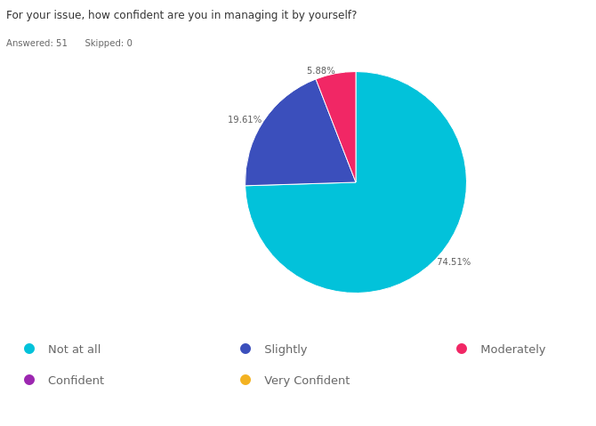
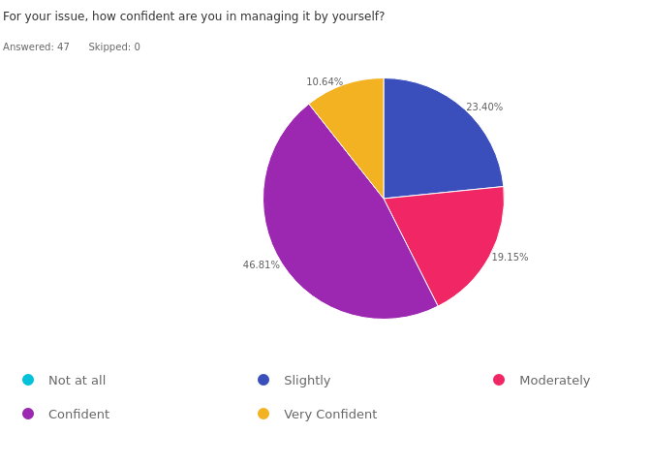
Measuring the Intangibles through technology
Pre services survey
Post services survey

Slide 18
Case Study SAFSH
Primary school Case Study:
Summary: We have several families whom we have identified as needing support but may not qualify for help from CASS/MASH. Those who are offered help have at times waited a long time for any provision. We were particularly mindful that since COVID19 and school closures, our pupils may not have had the chance to communicate with the numerous adults they are usually exposed to. These families would normally have been offered early help.
Early help, also known as early intervention, is given to a family when a problem first emerges.
Early help services can be delivered to parents, children or whole families, but their focus is to improve outcomes for children.
Providing timely support is vital. Addressing a child or family's needs early on can reduce risk factors and increase protective factors in a child's life (Early Intervention Foundation (EIF), 2018).

Slide 19
Case Study SAFSH page 2:
Issue to be resolved :Additional support needed for pupils and families:
displaying disruptive or anti-social behaviour.
being bullied or bullying others.
having poor attendance at school.
being involved in, or at risk of, offending.
having anxiety, depression or other mental health issues
having poor general health
affected by martial separation
affected by drug and alcohol abuse
who have been bereaved

Slide 20
Action taken by South Asian Family Support Hub (SAFSH) page 3
I have referred 5 families to SAFSH so far. However, I would like to highlight the initiatives for two families that are either underway or being planned:
Family 1 – currently transitioning through marital breakdown with a history of alcohol abuse. The support hub has:
Provided mum with counselling
Offered mum a 24/7 help line at times where she may feel threatened or worried about contact from dad
Supported mum in Team Around Family agency meeting
Signposted mum to other agencies.
Action for Family were particularly impressed with SAFSH’s planned interventions for mum.
Family 2 – Following concerns around child’s behaviour and mental health we raised concerns with Forward Thinking and Sandwell Childrens Services. Sandwell asked the school to seek mediation within the school resource.
Child had daily 1:1 meetings with HT and interventions were implemented to discuss behaviour concerns.
We then had a disclosure from child alleging that dad had hit him, this then led to further disclosure of alcohol abuse and DV at home. Police and Social Workers visited the school. They met parents, asked them to consider their behaviours and then scheduled a multi-agency Child in Need meeting.
This meeting was held 7 weeks after the initial allegation.
SAFSH however has been involved with the family since the school first raised the concern, providing parents with behaviour strategies and signposting them to relevant organisations. SAFSH’s engagement with this family has been helpful, as they were able to provide an immediate action plan.
Notes:
Impact: SAFSH’s understanding of school’s cultural demographic is a huge asset. Past referrals to early help tend to cause upset with parents as they feel judged and sometimes resentful towards the school. In both the examples above there are other agencies involved but SAFSH provides that first stepping stone out of school and into a place of safety. The feedback above continues to state that the added layer of interventions will: • protect children from harm
• reduce the need for a referral to child protection services and improve children's long-term outcomes

Slide 21
Social prescribing Case Study showing Nishkam Integrated Care and Connectivity project; to provide a wraparound service that provides support, focusing on early help within various sectors – https://ncauk.org/services/strengthening-families-and-welfare-services/mrs-pyari-case-study/
Notes:
Link will be accessible from the 12th of September

Slide 22
Energy Redress Project

Slide 23
Formal partnership with Witton Lodge, the Lead organisation, AGE Concern Birmingham, NewHope Global, Birchfield Big Local to deliver the Energy Redress Project, to help vulnerable people to recover from the economic and social impacts of the Energy Crisis, through advice and advocacy interventions, measurable energy/financial savings.
Offering practical help to alleviate rising fuel poverty, help fuel poor households through reduced fuel consumption, income maximisation, debt alleviation and leveraging of funds.

Slide 24
Wrapround support and sustainability
Apprenticeship provider
Learning and development
Digital inclusion
Aasra Hub (project for the elderly)
Start of life Care project for pregnant mums
Health & Wellbeing
Conference & Events

Slide 25
I am very thank you and I appreciate all the help and support I received from my caseworker. I was receiving standard rate PIP when I should have been eligible for Enhanced rate. I was unable to dispute this with PIP even after the Mandatory Reconsideration PIP refused me. Through HMCTS referral I had excellent assistance from Nishkam Centre who referred me to Emotional wellbeing at the Nishkam Health Centre. I was very stressed while I waited for the outcome of my court hearing - this helped me while I was waiting. My caseworker assisted me with my SSCS1 and advised me of the court hearing process and what medical evidence I will need to give. The court has awarded me with enhanced rate both components. I thank my caseworker a lot.
Notes:
Example of integrated services

Slide 26
Challenges:
Prioritise investment in early help and prevention led strategies
Sustainable Long-Term Funding to support service provision
"long term challenges required innovative and long-term strategies"
Investment in IT Infrastructure/Intergration to support client journey
Vertical Infrastructure with primary and secondary healthcare
Bridging the Gap between the "Third Sector" and "Healthcare Sector" to deliver community-led solutions
Notes:
Example of integrated services

Slide 27
Social prescribing Case Study showing Nishkam Integrated Care and Connectivity project; to provide a wraparound service that provides support, focusing on early help within various sectors – https://ncauk.org/services/strengthening-families-and-welfare-services/mrs-pyari-case-study/
Notes:
Social prescriber case study in action

Slide 28
Nasim Abrahim
Principal of Faizan E Islam
Spiritual Mental Health Meditator
Waltham Forest Islamic Association

Slide 29
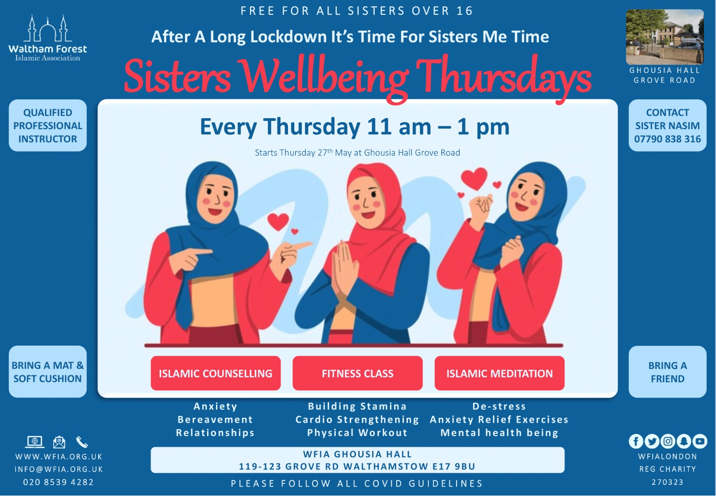

Slide 30
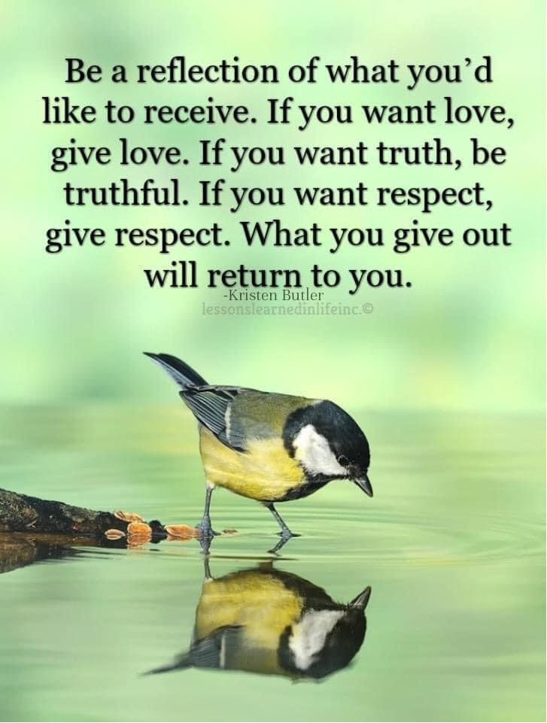
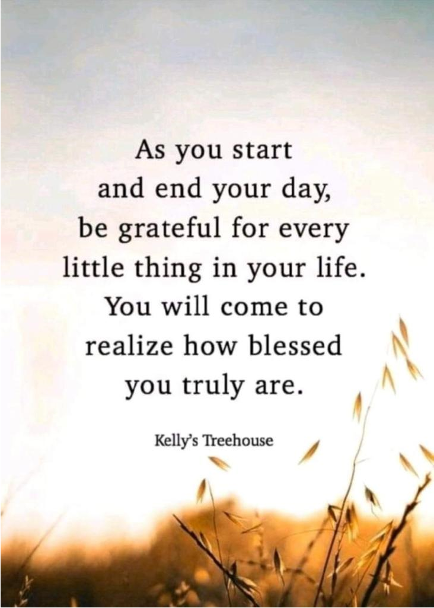
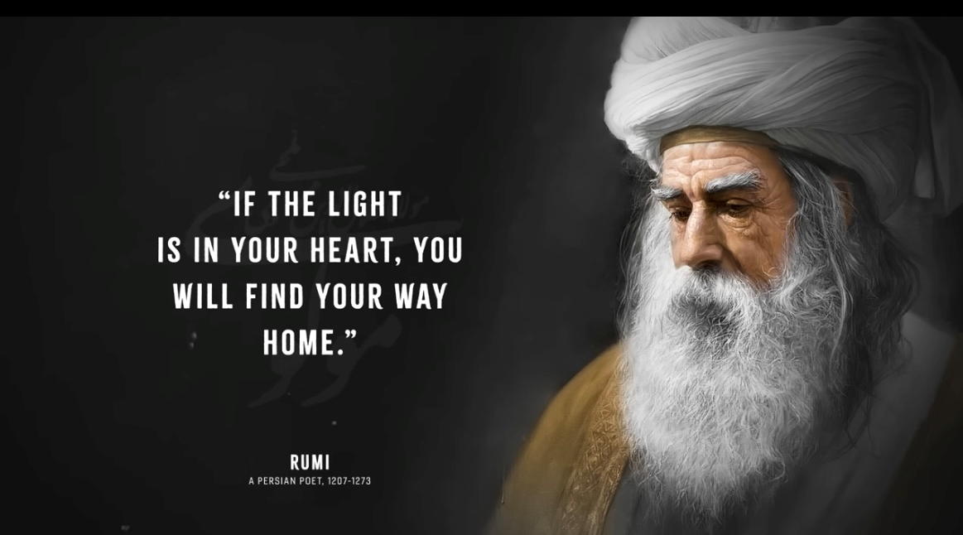

Slide 31
Raisel Byrne and Osnat Ritter
Core Services Manager and Community Development Coordinator, Jami UK

Slide 32
Jami’s Social Prescribing Services
September, 2023

Slide 33
Who are Jami?
A Jewish Community Mental Health Charity.
Established in 1989, founded by parents, relatives and friends of people experiencing mental health problems

Slide 34
Our 3 pillars:
We advise and advocate
Guiding people through the challenging journey of navigating mental health services and providing emotional support and expert advice from the moment someone contacts Jami
We provide treatment and support
Providing professional, person-centred, peer support services and a supportive community, for young people and adults with mental illness and distress as well as their families and carers.
We educate and campaign
Providing education and training, developing collaborative partnerships, reducing stigma and building mutually supportive relationships across the wider community.

Slide 35
Our Services
Community Mental Health Teams (Adult and CYP)
Talking Therapies
Hubs, Social Engagement & Compeer Befriending
Carer and Family Support​
Education and Suicide Prevention
Vocational Support
Headroom Café
Notes:
Take referrals from people, their families, GP’s, Social prescribing link workers, Other NHS professional, Private sector and other voluntary sector agencies
MDT – OT/SW/PSW

Slide 36
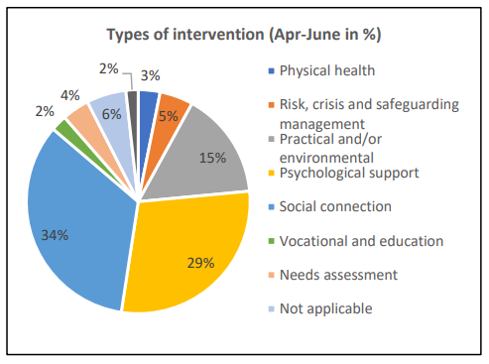
Types of Support
Notes:
Note, a large proportion of need for people living with MH issues is social connection

Slide 37
Building mutually supportive communities
Head Room Café – Peer and community led groups, easy access with no referral process, gateway to other services and signposting.
Head Room Cafe

Slide 38
Faith, Culture and Mental Health
Belonging to a faith group and having a shared culture can be a protective factor for our mental health
Faith communities can provide a strong sense of belonging and support
Jami provide support for people across the Jewish community, services are designed to support religious and cultural needs
Mental Health Awareness Shabbat promotes inclusive and accessible faith communities
Notes:
Explain the diversity of Jewish community
Explain interplay between faith and culture
Examples of how services are designed to support religious and cultural needs (food, shabbat, Jewish holidays)

Slide 39
Impact: the power of social prescribing
People feel less alone in their experiences
Mutual support and gaining a sense community
Social connection
Sense of safety
Increased sense of purpose
Increasing confidence
learning practical coping strategies
Source: Jami Impact Survey

Slide 40
Impact of Social Prescribing: Voice of our Service Users
“I feel much more empowered and in control of my life”
“I was in a very dark place in my life and because of Jami I have regained my life and am enjoying once again”
“I feel less alone. I can talk to someone who actually knows what it's like to struggle with mental health (as opposed to mental health workers or doctors that often don't seem to truly understand).”
“I used to have a lot of social anxiety, after I started going to Jami I found it a safe place to socialise and it brought me out of my shell”

Slide 41
Impact of Social Prescribing: Voice of our Service Users
“Through my conversations with Jami I have managed to talk about my problems in confidence and it has allowed me to think about my experiences in a more positive light and has allowed me think more openly about what I am experiencing and how I can best go about improving myself and stopping it from happening in the future.”
“Without Jami I wouldn’t still be here! Have friends now & people I can talk to regularly”
“The service is vital, there’s nothing worse than being at home on your own for your mental health. This place is somewhere to go to”

Slide 44
Any Questions?

Slide 45
Get in touch
socialprescribingacademy.org.uk
@NASPTweets
@NASP_insta

