Slide 1
NASP Webinar: Thriving in a neighbourhood team - How link workers strengthen integrated care
Thank you for joining us. The webinar will begin shortly.

Slide 2


Housekeeping
Please note we are recording this webinar - you will be sent the slides and the link to the recording, and they will be on NASP's website too.
Please submit questions via the Q&A function. We will hold a Q&A session at the end of presentations.
Please use the chat function for introducing yourself and networking. If you have any technical issues, please raise these in the chat, and a member of the NASP team will assist.
Closed Captions are available (turn these on at the bottom of your screen.)
Everyone comes with different experiences and viewpoints. Let’s keep an open mind and learn from one another.

Slide 3

Overview
Chair:
Monica Boulton, Strategic Lead for Neighbourhood Health at National Academy for Social Prescribing
Speakers:
Minal Bakhai MBE, Deputy CEO and Chief Clinical and Strategy Officer at Blinx Healthcare, Practicing GP
Andrew Mawer, Social Prescribing Link Worker, Bridlington Primary Care Network

Slide 4
Minal Bakhai MBE,
Deputy CEO and Chief Clinical and Strategy Officer at Blinx Healthcare,
Practicing GP

Slide 5
Andrew Mawer, Social Prescribing Link Worker, Bridlington Primary Care Network

Slide 6

Connecting the Neighbourhood
How Social Prescribing helps deliver the shift from referral to prevention
Andy Mawer
Health and Wellbeing Lead / Social Prescribing Link Worker
Bridlington Primary Care Network (Dr’s Reddy and Nunn)
Notes:
Hello everyone, and thanks for having me. I am Andy Mawer, Health and Wellbeing Lead and Social Prescribing Link Worker with Bridlington Primary Care Network, linked with Drs Reddy and Nunn.
I want to tell you a bit about what we have learned here in Bridlington. This is not a list of everything a social prescriber does. It is about how link workers can help a neighbourhood work better together, get support closer to people and move from waiting for a referral towards earlier, more preventative help.
I want to say early on that we would not have got this far on our own. The interest and commitment shown by our public health colleagues, the Integrated Care Board, our primary care clinical lead and our Primary Care Network manager have been a big part of getting social prescribing properly included in this work.
They did more than say it was a good idea. They brought us into conversations early, listened to what we were hearing from local people, and trusted the Primary Care SPLW team to help shape projects, get them off the ground and learn from what happened.
That matters because no one service can build a neighbourhood team by itself. It takes people opening doors, partners being willing to share the work, and link workers being ready to bring local knowledge, relationships and practical delivery into the room.
The simple message running through this talk is that social prescribing can help turn a collection of local services into a joined-up neighbourhood response. We connect people with support, of course, but we also join up local data, what residents are telling us and what partner organisations know. That helps us understand not only what is happening on our patch, but why.

Slide 7
Integration begins with Trust, Inclusion and Relationships
Public Health
Social Care
Primary Care
Secondary Care
Integrated Care Board
VCFSE Sector
Education
Community
The distinctive SPLW contribution is connecting people, community insight, local data and partner knowledge, helping the neighbourhood understand not only what is happening, but why.
Notes:
Early doors, we wanted to move past collaboration and push for integration as a key driver for the neighbourhood partners. Integration does not happen just because we put a lot of organisations on one diagram. It starts with trust, inclusion and proper working relationships.
Here in Bridlington, the neighbourhood includes public health, adult social care, primary and secondary care, the ICB, education, the voluntary and community sector, and, most importantly, the voice of local people themselves. Everyone sees a different bit of the picture and everyone is carrying different pressures.
The particular value of a link worker is that we can join those bits of the picture together. We bring what people tell us, what we know about the community, what the data shows and what partners are seeing. Quite often, that helps everyone understand not just what is going on, but why.
The trust shown to our SPLW team has been key. We have been invited in before everything is already decided. What we know about the community has been taken seriously. We have been trusted to help lead delivery, keep partners connected and contribute to evaluation.
And it works both ways. Public health brings population health and evaluation skills. The ICB links local work to the wider system. Adult social care understands statutory duties, independence and Care Act processes. Clinical leaders bring clinical knowledge and continuity. PCN leadership gives the work room to happen. Community organisations bring specialist knowledge, trusted relationships and local reach.
Those relationships also help us understand where the pressure is. Something that looks like one service not doing its bit may actually be about eligibility, capacity, staffing, communication or demand somewhere else. Once people know each other and can have an honest conversation, we are less likely to point fingers or simply pass the pressure further down the line.

Slide 8
From quiet voices to neighbourhood intelligence
Learned Experience
Health Intelligence / Data
Lived Experience
Local data: What patterns can we see?
Quiet voices and lived experience: What context is missing and who is not being heard?
Interpretation: How do health literacy, service knowledge and system pressures shape the evidence?
Inclusion health intelligence: What have SPLWs learned about exclusion, access and unmet need?
Collective action: What must partners redesign, strengthen or evaluate?
Notes:
Good neighbourhood working needs good local intelligence. Data matters, but it does not explain itself.
The figures might show a pattern in referrals, access or outcomes. Link workers can put some local colour around those figures by bringing in lived experience, learned experience and knowledge of Bridlington. That helps us check our assumptions before we rush off and design the answer.
One of the most important things we do is listen for the quiet voices in the community. By that, I mean people whose views may never reach a formal meeting, a survey or an online feedback form.
Some people have less confidence, find health information difficult to navigate, face communication barriers, do not trust services, or simply have not been asked. Our job is not to put words in anyone’s mouth. It is to make sure those experiences have a fair chance of being heard and included in decisions.
Understanding where a voice is coming from is not about judging it. It is about recognising that health literacy, previous experiences, language, confidence and access to information all shape how people tell their story and how services hear it.
Because we have these conversations day in and day out, we build learned experience too. We start to notice the same barriers cropping up: digital access, transport, cost, eligibility, capacity, stigma or simply not feeling comfortable walking through a particular door.
That is the journey on this slide. Start with the data. Add what quieter voices and lived experience tell us. Make sense of it in the local context. Turn it into useful neighbourhood intelligence. Then do something with it.
The value is not only in hearing one story. It is spotting when the same barrier keeps coming up and making sure the right people hear about it and act on it.

Slide 9
From Contribution to Shared Neighbourhood Leadership
Understand
Design
Implement
Evaluate
Improve
Analyse Local Data alongside lived and learned experience
Identify neighbourhood priorities together
Bring quiet and under-represented voices into the design
Connect clinical, statutory and community partners
Understand pressures and different system points
Evaluate collaboratively and adapt as learning emerges
The SPLW team was not simply asked to receive referrals. It helped create and test the neighbourhood response.
Notes:
When trust, evidence and relationships come together, link workers can do much more than sit at the end of a referral pathway.
The cycle here is simple: understand, design, implement, evaluate and improve. Our Primary Care SPLW team has been involved all the way round it.
We look at local data alongside lived and learned experience. We agree priorities with partners. We bring quieter and under-represented voices into the design. We connect clinical, council and community partners. We help everyone understand where the pressures sit. Then we look together at what worked, what did not and what needs changing.
We see that as shared neighbourhood leadership. It is not social prescribing trying to do everything. Different partners bring different knowledge, authority, data, relationships and resources. Our part is helping to join those assets up around local people.
The key point is that we were not simply handed a finished project and asked to take referrals. The team helped build it, try it out and learn from it.
That helps with continuity as well. Continuity does not mean one person doing everything. It means useful information does not disappear between organisations, people understand the wider picture and somebody notices whether the next step actually happened.
Put simply, joined-up care should not depend on the resident having to hold all the pieces together.

Slide 10
Neighbourhood working in practice: Example Partnership Projects
Integration built through repeated partnership working, not single a single initiative
Olinda Road | Proactive social prescribing in a defined neighbourhood, informed by the CCHW model | ICB and Public Health
Warm and Well | Connecting health, housing, energy and prevention around residents at risk during winter | Yorkshire Energy Doctor and VCSE partners
Befriending | Ongoing work to strengthen social connection and coordinate local community support | ERYC place-based project teams, Age UK, Red Cross and ERYC Active Communities
Fit note / MED3 | Connecting health, work and community employment support through a joined-up pathway | DWP, ERYC place-based project team, Public Health and VCSE employment support
Adult Social Care and Primary Care – Front door integration | Early integrated working to bridge gaps around Care Act assessments and improve understanding of cross-organisational pressures | Adult social care, Primary care (GP) and the Primary Care SPLW team
Notes:
This slide gives five examples from Bridlington. I will not give you a full project report on each one. Together, they show that integration is built by working together time and again, not by one shiny initiative. And when I say “we” here, I mean the Primary Care SPLW team.
Olinda Road is proactive social prescribing in one defined neighbourhood, informed by the CCHW model and run alongside the ICB and public health. Instead of waiting for referrals to land, we ask who we are not reaching, what is getting in the way and how we take support closer to local people.
Warm and Well is alongside Yorkshire Energy Doctor and other community partners. In a coastal town, cold homes and energy costs are not side issues. They affect people’s health and their ability to manage long-term conditions. The project joins up health, housing, energy advice and winter prevention around local residents.
Our befriending work brings together ERYC place-based teams, Age UK, the Red Cross and ERYC Active Communities. Each partner reaches people in a slightly different way. This particular project is yet to bear fruit but it has shown that as we celebrate success together we also reflect on disappointments as a team and look to find ways overcome barriers.
The Fit Note or MED3 work joins up health, work and local employment support. We work with DWP, the ERYC place-based team, public health, combined authority and VCSE employment support. It will hopefully help us look at the whole picture rather than assuming a fit note, one referral or one organisation is the full answer.
The fifth example is our role as a pilot and early adopter of front-door working between adult social care and primary care. The aim is to bridge gaps around Care Act assessments and help both sides understand what the other is dealing with.
When somebody’s needs cross organisational boundaries, the SPLW team can help keep the thread. We can clarify what is happening and spot where handovers, eligibility, capacity or communication are causing delay or uncertainty. It also gives primary care and adult social care a better understanding of each other’s pressures and responsibilities.
These projects look quite different, but the method is much the same. Get the right people round the table, agree the problem, bring different expertise, involve the SPLW team early, listen to local people and learn as we go.
We do not own every intervention, and nor should we. Our role is to connect clinical knowledge, local data, community relationships, lived experience and partner expertise. That gives us a fuller picture and stops us jumping to the wrong conclusion.
The bridge runs both ways. We help people move from primary care into community support, but we also bring what the community is telling us back into clinical, public health and planning conversations. That includes what is working, what is hard to access, where services are stretched and whose voice is still missing.

Slide 11

Five actions for Social Prescribing Link Workers
1. Be present early
2. Build reciprocal relationships
3. Understand pressure across the system
4. Connect data with quiet and under-represented voices
5. Share evidence and close the learning loop
Notes:
I will finish with five straightforward things link workers can take back to their own patch.
First, be there early. Get into the conversation before everything is already decided.
Second, build two-way relationships. Know what partners bring, what matters to them and what pressure they are under – be the match maker.
Third, understand pressure across the system. The blockage you can see may have started somewhere else.
Fourth, put the data alongside quiet and under-represented voices. Ask whose experience is in the room, whose is missing and what context we have not heard.
Fifth, share what you are learning and close the loop. Bring recurring themes back, agree what needs doing and check whether the change actually helped.
Our Bridlington experience shows what can happen when public health, the ICB, clinical and PCN leadership, adult social care and community partners trust link workers and give us a real chance to contribute.
Social prescribing is not the whole neighbourhood model. But without the connections link workers bring to local people, community assets and the wider things affecting health, it can stay too clinical and too far away from everyday life.
Thank you and I’ll pass you back to Monica

Slide 12


Get in touch
socialprescribingacademy.org.uk
Q&A

Slide 13
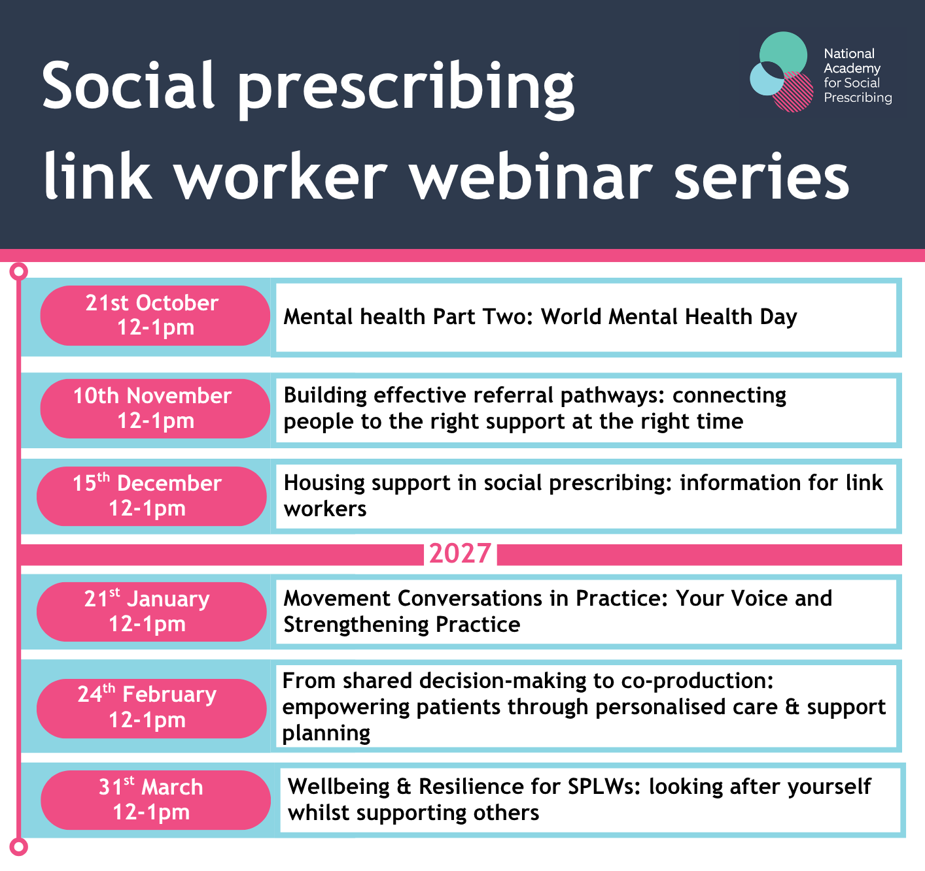
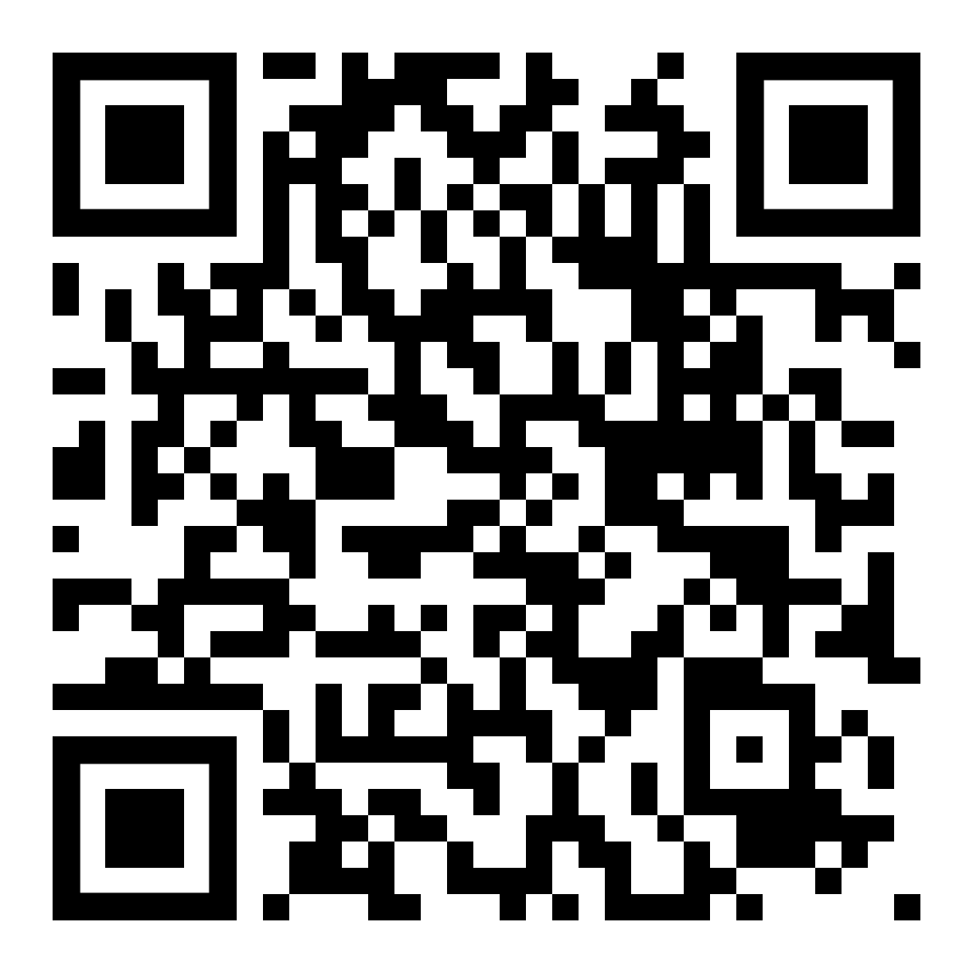
Events | NASP

