Slide 1
NASP Webinar: Embedding EDIB and cultural safety in everyday practice
Thank you for joining us. The webinar will begin shortly.

Slide 2


Housekeeping
Please note we are recording this webinar - you will be sent the slides and the link to the recording, and they will be on NASP's website too.
Please submit questions via the Q&A function. We will hold a Q&A session at the end of presentations.
Please use the chat function for introducing yourself and networking. If you have any technical issues, please raise these in the chat, and a member of the NASP team will assist.
Closed Captions are available (turn these on at the bottom of your screen.)
Everyone comes with different experiences and viewpoints. Let’s keep an open mind and learn from one another.

Slide 3

Overview
Chair:
Monica Boulton, Strategic Lead for Neighbourhood Health at National Academy for Social Prescribing
Speakers:
Hannah Beck, Strategic Projects Manager: Innovation & Culture, NASP
Shabana Hussain, Social Prescriber, Greater Derby PCN
Raquel Cerezo Martín, Social Prescribing Link Worker for Cranbrook Primary Care Network in the London Borough of Redbridge, North East London

Slide 4
Hannah Beck, Strategic Projects Manager: Innovation & Culture, NASP

Slide 5

From Access to Belonging ...
Equity
Diversity
Who faces barriers to access? What would reduce or remove them?
Social Prescribing - Equitable Approach
Who is present? Who is missing or isn’t represented?
The Link Worker role is built around an equitable principle - a personalised approach. However, it can still reproduce inequality if assumptions shape opportunity, barriers aren’t validated and power isn’t recognised.
Inclusion
Belonging
Who can participate, be heard and influence what happens?
Who feels safe, respected, valued and able to be their authentic self?
Access available is not the same as being accessible | Being present is not always the same as the same as participating | Participating is not necessarily the same as feeling safe or that you belong.

Slide 6
Assumptions
Shape Opportunity
This is my thinking, does what I’ve said feel accurate? What else is useful for me to know?
Assumptions are not always obvious stereotypes. They can be small conclusions we make about:
  What someone will want
  What they can manage
  What will feel relevant
  What their experience is
  How much support they will need
When an assumption creates a decision, we narrow someone’s opportunities before they have had the chance to shape them.
Is there anything you haven’t had chance to tell me yet, that you’d like to share?
How do you feel about the current direction? This is one option, Is there anything you’d like to change?
Can you help me better understand xyz? What do you think about support with xyz?

Slide 7
Barriers Need Validation, Not Just Solutions
They name it | Listen without immediately reassuring or reframing. | Reflect back what they’ve said, acknowledge the impact. | Let the barrier influence what happens next. Ask before moving into solutions.
You identify it | Make the potential barrier visible without assuming. | Understand the impact and help position the barrier accurately. | Agree the type of response they’d like to explore with you.
It can’t be removed | Be honest about the limitation and name where it sits. | Return control to the individual on what they’d like to happen next. | Expose structural issues and surface the barrier.
Validation = “This is real, it matters, and I see it”

Slide 8
Cultural Safety: Power in Practice
Power Exists:
Recognising Power:
Cultural safety focuses on recognising the power imbalances and privileges between places, people and policies.
It’s about self-reflection and self-awareness of the potential impact of our own culture on others.
  Navigational literacy
  Records and documentation
  Emotional regulation
  Representing the system
  Explain your role, limits & processes
  Agree and confirm what is recorded
  De-shame and normalise
  Explain your role, limits & processes
Power that is recognised can be shared. Power that is denied remains hidden.

Slide 9
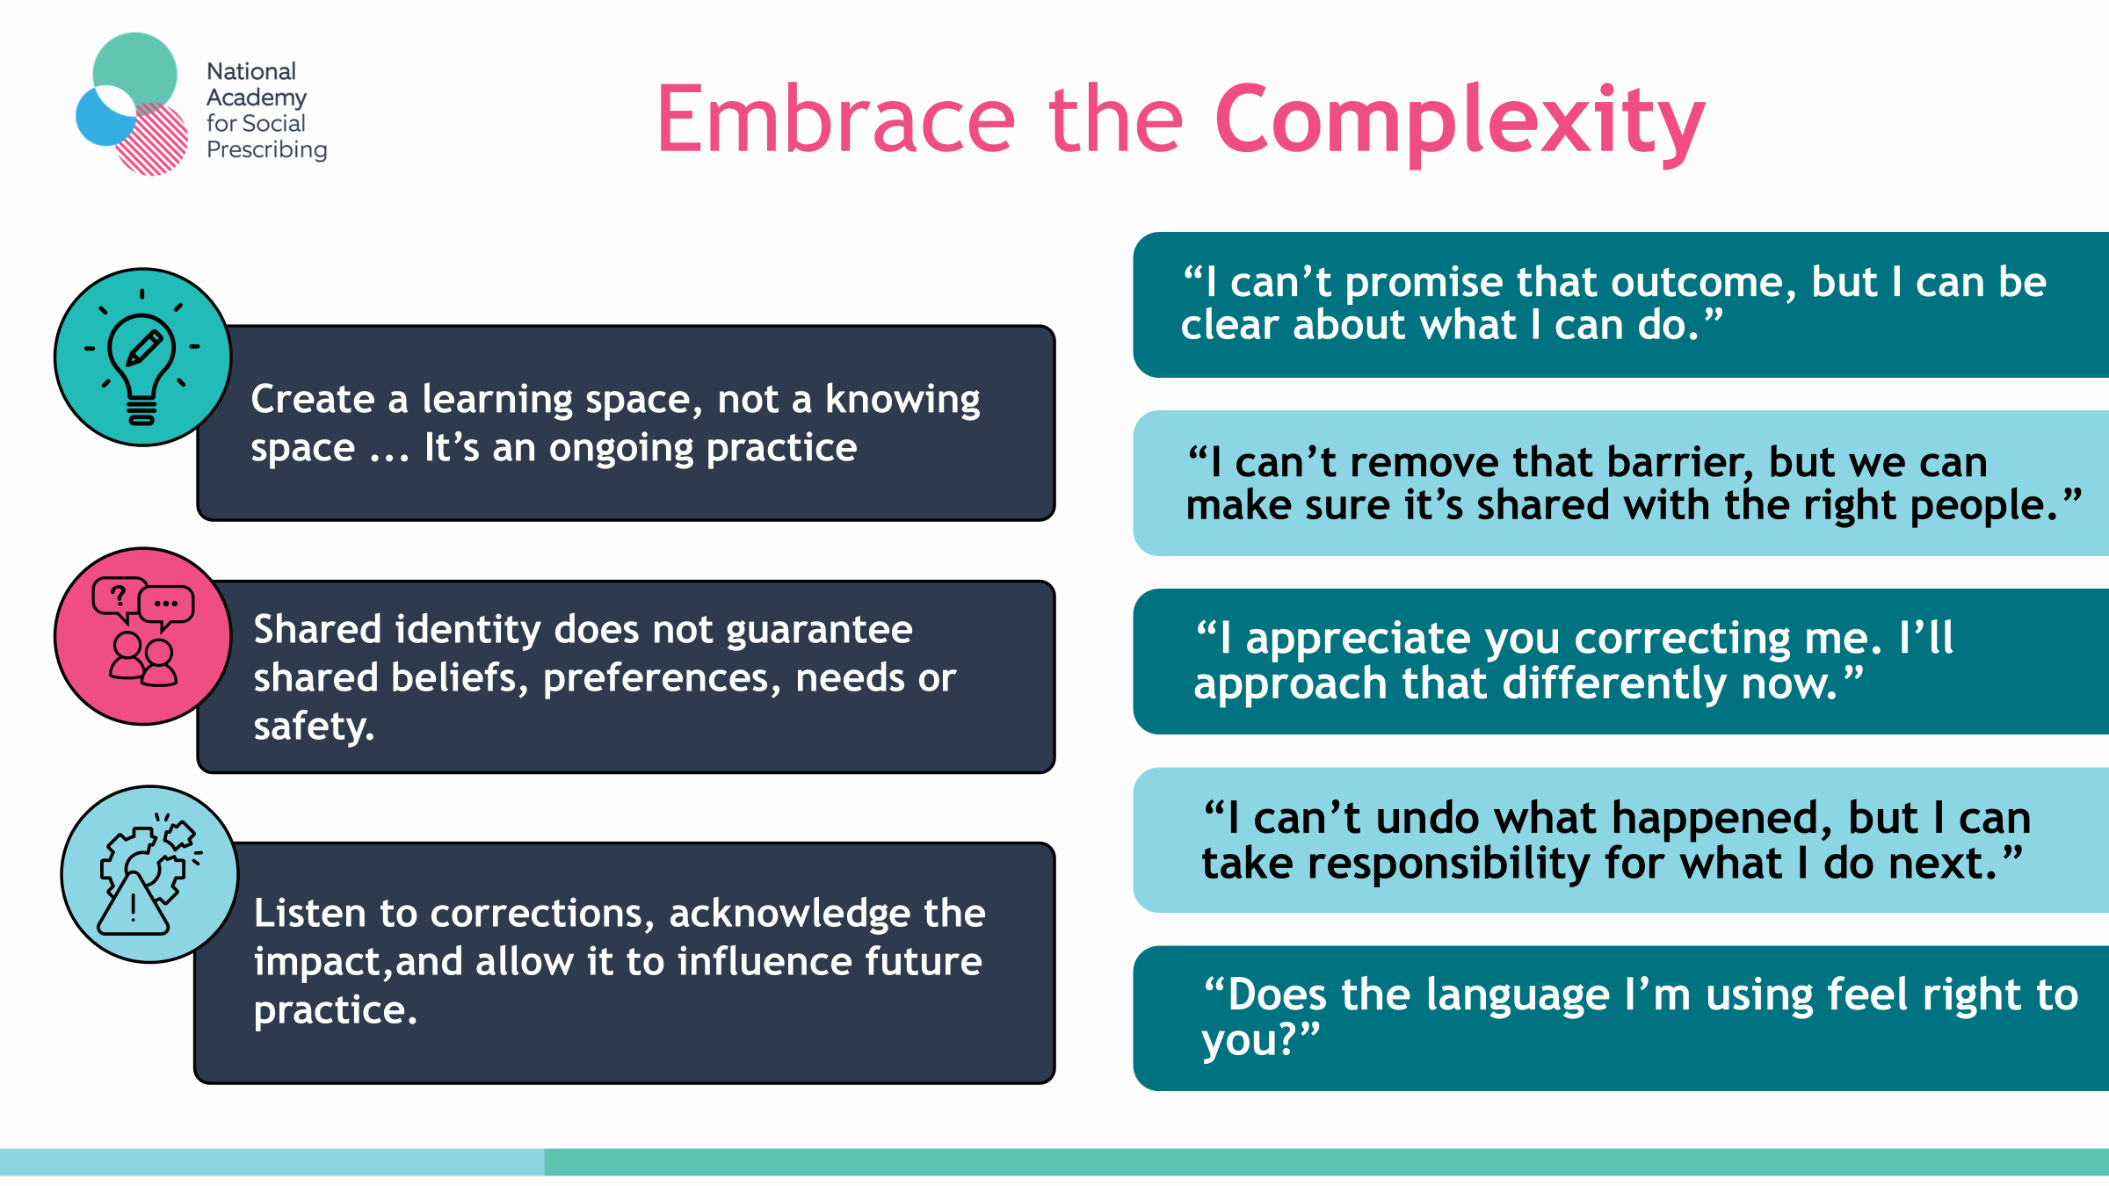

Slide 10
Quiet Activism: Equity to Social Justice
Notice
Name
Navigate
Nudge
Recognise repeated barriers, unequal experiences and whose needs aren’t met.
Be specific about what is happening, who is affected and which part of the process is contributing.
Find where influence sits, identify where adaptions can be made, translate routes.
Small, realistic actions that create movement. Shout about positive changes so they can be spread.
1
2
3
4
You aren’t expected to create structural change. You already can create the evidence, permission and momentum that make structural change possible.

Slide 11
You Already Hold The Foundations
Intention
Reflection
Collaboration
Inclusive, culturally safe practice is not an add-on to your role. It is your existing practice made more intentional.
Engage with continuous self-reflection, and identify where you can de-centre the system.
Co-create mechanisms for change, shine the light on challenges and engage with collective action.

Slide 12
Shabana Hussain, Social Prescriber, Greater Derby PCN

Slide 13

Cultural Competency & Co-Production
Shabana Hussain
Social Prescriber

Slide 14

What is culture?
From an anthropology point of view
‘culture is the learned and shared way of life of humans, it’s all encompassing and dictates not just art or traditions, but how basic biological needs are fulfilled like eating etc’
From a sociology point of view
‘the shared system norms, values, beliefs guiding people and shaping social interaction’
Culture can be defined as
‘a learned, shared system of meaning that dictates human behaviour’
How does it work?
It is learned - ‘you are not born with it, you learn it from, family, friends and wider society, including where you work, from TV and even from standing in a shopping queue at a supermarket ’
It is shared - ‘it belongs to a group, not just to one person’
It changes - ‘it changes over time, growing and adapting as society faces new ideas and technologies’

Slide 15

Cultural Competency
Being able to effectively understand, communicate and interact with people from different cultural, ethnic or social backgrounds. This involves recognising and accepting your own personal biases. Adapting your behaviour and attitude to nurture positive and inclusive relationships respecting diverse beliefs and values.

Slide 16
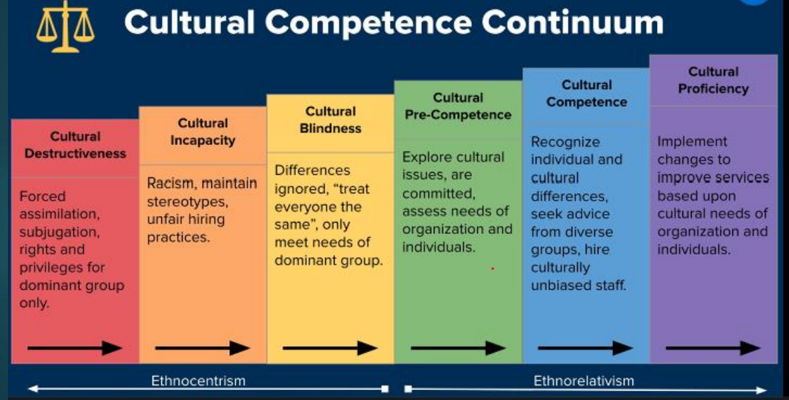
Cultural Competence Continuum

Slide 17
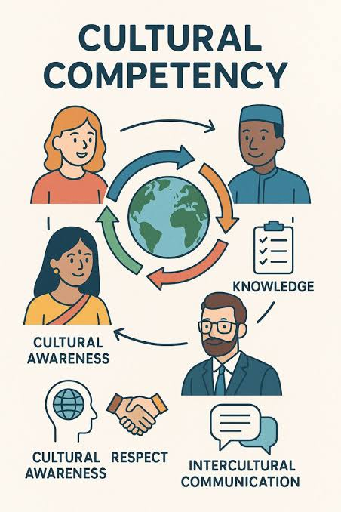
Achieving cultural competence in your role
4 key components to enable cultural competency
1.Awareness – what are your frames of reference; values, beliefs
- What are you patients/clients backgrounds, beliefs, attitudes to your service
2.Attitude - inclusive or exclusive, bridging gaps, professional curiosity
- Do your patients/clients feel accepted, listened, understood, included
3.Knowledege – current level of understanding of diversity, open to learn
Do you validate, thoughts, feelings & beliefs, have you had constructive conversations
4.Cross Cultural Skills – listening to polarised views, adapt methods of communication
- Have you considered cultural empathy, unconscious bias, stereotypes, racial trauma

Slide 18
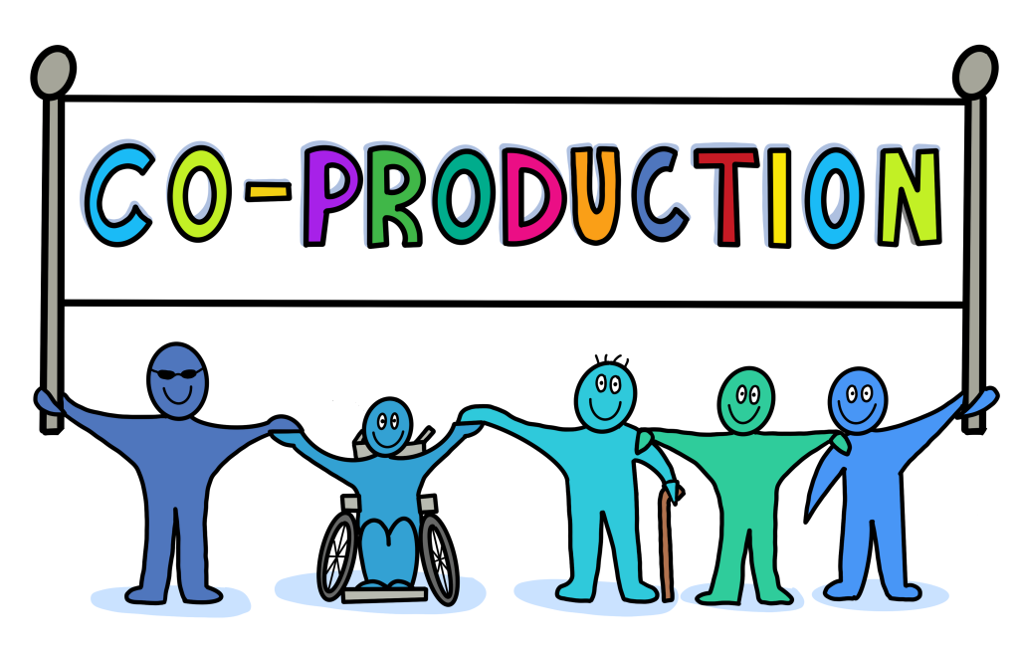
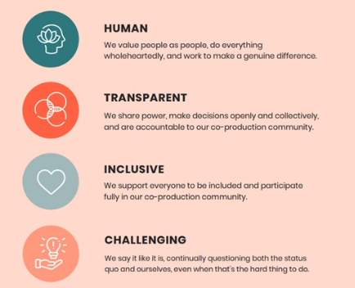
Co-Production
Co-Production is essentially a collaborative way of working between people who provide the service and those who access the service. Where power and responsibility is shared, from beginning to end.
Points to consider:

Slide 19
Raquel Cerezo Martín, Social Prescribing Link Worker for Cranbrook Primary Care Network

Slide 20
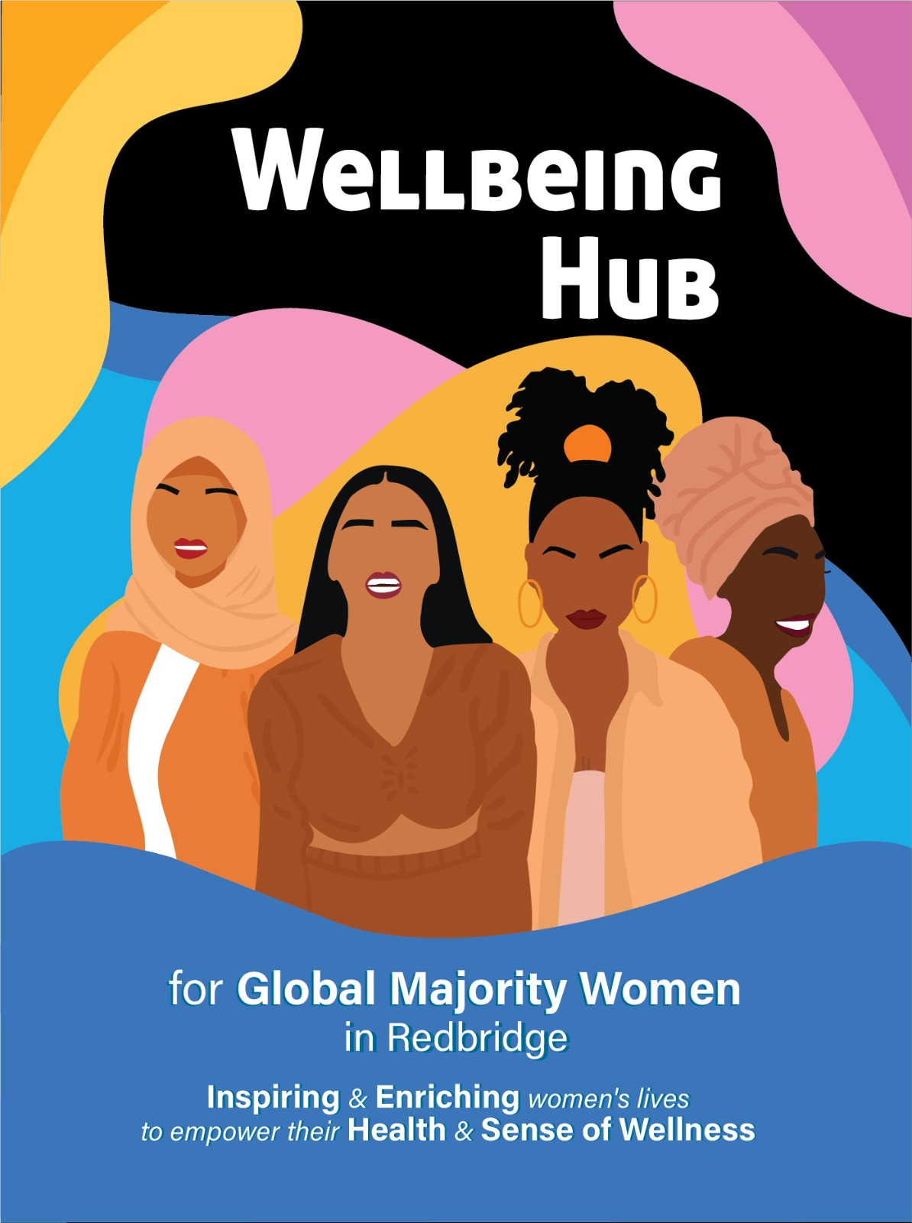
Wellbeing Hub for Global Majority Women in Redbridge: Funded by NHS NEL ICB 2023-26
The gap was not only “somewhere to signpost”.
It was somewhere to belong
Relationship-led partnership
Trust, lived experience and belonging at the center
EDIB and cultural safety in everyday social prescribing
Notes:
1.5 mins
Working as a Social Prescribing Link Worker in Redbridge, I kept meeting women experiencing low mood, loneliness, caring pressures, migration experiences, financial stress, housing difficulties and health inequalities.
Many services already existed.
The problem wasn't always access.
The problem was that many women did not feel they belonged.
They didn't always see themselves reflected in existing spaces, and some carried experiences of discrimination, judgement or exclusion.
The question became:
What would it look like to create a space where women could bring their whole selves, not just one part of their identity?
Then I met Cherrill…

Slide 21
Lived experience first
“You cannot create services that truly meet people’s needs without listening to the people they are intended to support.
“Equity goes deeper than treating everyone equally.
It recognises that we do not all start from the same place.”
• Co-production is part of the conversation, not a final consultation
• Feedback is not paperwork — it is how the space changes
• Community knowledge sits alongside professional knowledge
• Accountability means listening, adapting and sharing power = equity!
In practice, equity means noticing the barriers created by bias, discrimination and inequality, then adjusting the offer so everyone has a genuine opportunity to take part.
Notes:
2 mins
I want to bring in something Cherril shared with me, because it goes to the centre of culturally safe practice. For her, and for us, the importance of lived experience cannot be underestimated. You cannot create services that truly meet people’s needs without listening to the people they are intended to support.
Co-production can be an afterthought; it has to be the start. Be part of the conversation: nothing about us, without us. That was how we tried to develop the Wellbeing Hub. We listened to the women, learned from their experiences, asked for feedback and adapted the approach with them as we learned and grew together.
Equity also matters here. Equality gives everyone the same offer. Equity recognises that we do not all start from the same place, and that some communities face additional barriers because of bias, discrimination and inequality.
So when we asked, “did today feel representative and respectful?” or “what would make this space feel safe and supportive for you?”, those were not random questions. They were practice questions. They helped us understand who felt included, who was quiet, who needed a different invitation, and what had to change. This was the hardest part, letting women take space, speak openly and use their feedback meaningfully.

Slide 22
Cultural Safety & Co-Production
Culturally safe practice is not a script.
It is listening, acting and sharing the power to make change happen.
Cultural safety is not something we provide, it is something people experience
Cultural competency can give us useful knowledge.
Cultural safety asks how the person feels when they enter the space.
• Do I feel seen, heard and understood?
• Can I speak openly without judgement?
• Are assumptions being made about me?
• What would make this space feel safe and supportive?
Notes:
1.5 mins
Cherril also named a useful distinction between cultural competency and cultural safety. Cultural competency can help us build knowledge. It can make us more aware of culture, history, faith, identity and inequality.
But knowledge alone is not enough. Cultural safety asks how the person actually feels when they enter a space or access a service. Do they feel seen, heard and understood? Can they speak openly without being judged or having assumptions made about them?
In the Hub, we tried to make this very practical. Sometimes the most important thing we could ask was: what would make this space feel safe and supportive for you? And then we had to be prepared to listen, act and share the power to make change happen.
This is where everyday social prescribing matters. It is in the first phone call, the wording of the invitation, the way we ask about culture or faith, the way we explain confidentiality, the way we check whether something actually felt helpful, and whether we are willing to change our approach based on what people tell us.

Slide 23
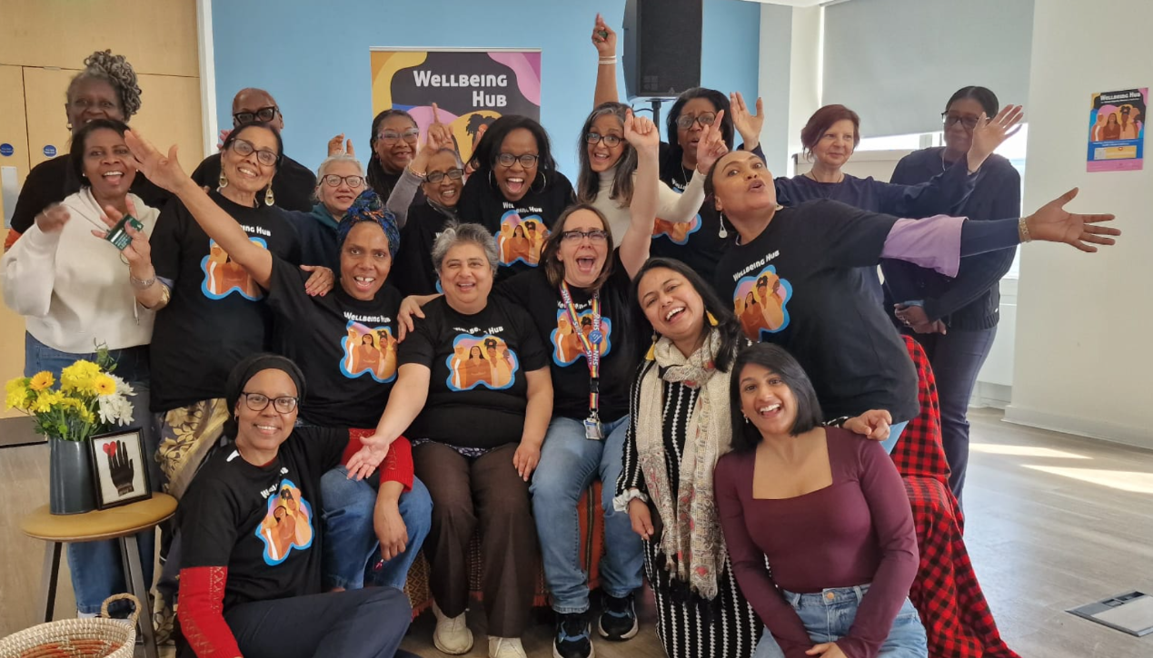
When people are seen, they lead
Community assets are not only buildings, directories or organisations.
People are community assets too!
• Redbridge Major Community Award
• Black Legacy Health and Wellbeing Award
• Voices in Harmony Book — stories, recipes and poems
• Unheard Now Spoken theatre performances created from the book
• International Women’s Day portrait exhibition at SPACE Ilford
• Women continue meeting after funding ended
Notes:
2 mins
What I love about this story is that the outcomes were much bigger than all the numbers. Through Black Woman Kindness Initiative, Cherril’s experience, her mental health background, the relationships we built and different funding avenues, the women created things that I still find unbelievable. When women felt safe enough to participate fully, incredible things happened.
We received awards. We published a book, then took this to the stage, our portraits featured an IWD exhibition…
These outcomes happened because people were not treated only as recipients of support. They were seen as women with experiences. creativity, culture, knowledge, humour, history and leadership.
This, to me, is the ultimate test of social prescribing: 'What remains when we leave? Here, the legacy was community, what we actually build was belonging!

Slide 24
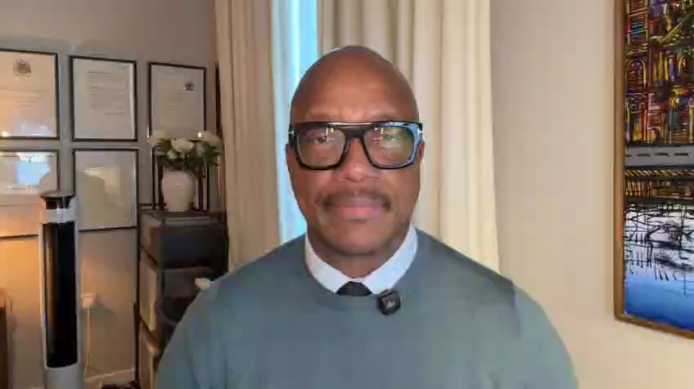
Take away messages for SPLWs – ATTENTION
From isolation to connection
From receiving support to contributing
From needs to strengths
Reflect on your caseload, spot gaps
Look for strengths, not just needs
Build relationships before pathways
Practice cultural curiosity
Co-produce rather than prescribe
Measure the quiet outcomes
Think about legacy from the start
Create community culture rather than convenience culture
Notes:
2 min +
Let's finish with a few messages we can reflect on and take back into everyday social prescribing.Attention!!!
First, protect some of your working hours to look at your community and work! Speak to your manager! You may be surprised!
Second, be curious about people’s abilities, experience, strengths!
Third, Look at the gaps in your workload and in the system, then look for the community leaders and organisations who are already trusted. Partnership should not begin only when funding appears.
Fourth, ask humbly about culture, faith, identity and family life. We do not need to know everything, but we do need to make room for the person to tell us what matters.
Fifth, use feedback as co-production, not evidence collection only. Ask what felt relevant, what was missing, what should change, and who should be shaping the offer.
Sixth, measure impact sure! although a spreadsheet may not fully capture someone leaving the house regularly, speaking in a group for the first time, sharing a skill, or beginning to see herself as a contributor rather than a burden. Those changes are also wellbeing.
Seventh, plan the legacy from day one. Never even thought about this one! What are you leaving behind?
Eight, be transparent and honest. Empowerment sometimes means having difficult conversations when people become comfortable with support, helping them recognise their own strengths and take ownership of the next steps rather than creating dependence on a service.
Social prescribing is not only about connecting people to what already exists.
Sometimes it is about noticing what does not exist yet, creating the conditions for it to grow, and stepping back so the community can make it its own
My closing message would be this: culturally safe practice is intentional. When people feel heard, seen, represented and valued, they do not only attend or use a service. They help create belonging, inclusion, community.
Only if there is time, an inspiring video from Prof. Kevin Fenton, re: our work that I trust will motivate you too!
Thanks for having me and feel free to contact me if you have a question ☺

Slide 25


Get in touch
socialprescribingacademy.org.uk
Q&A

Slide 26
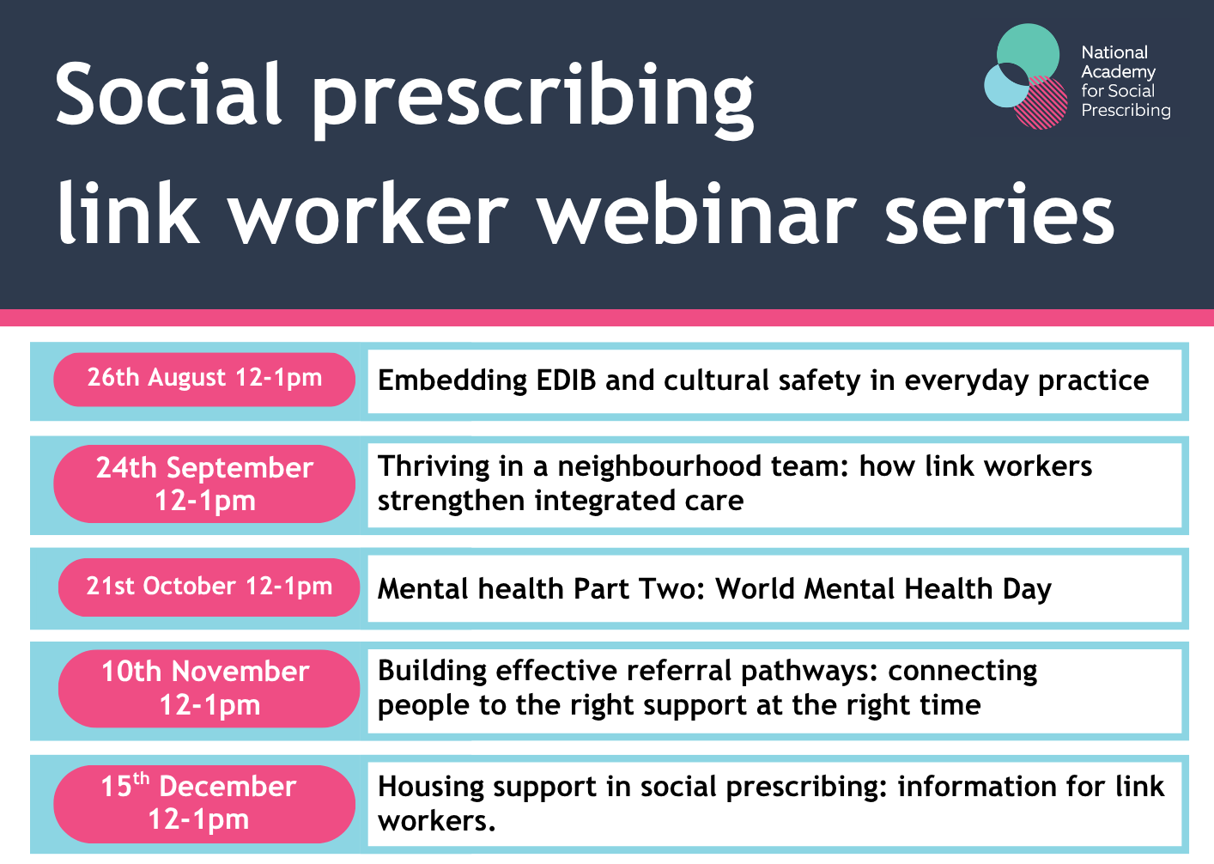
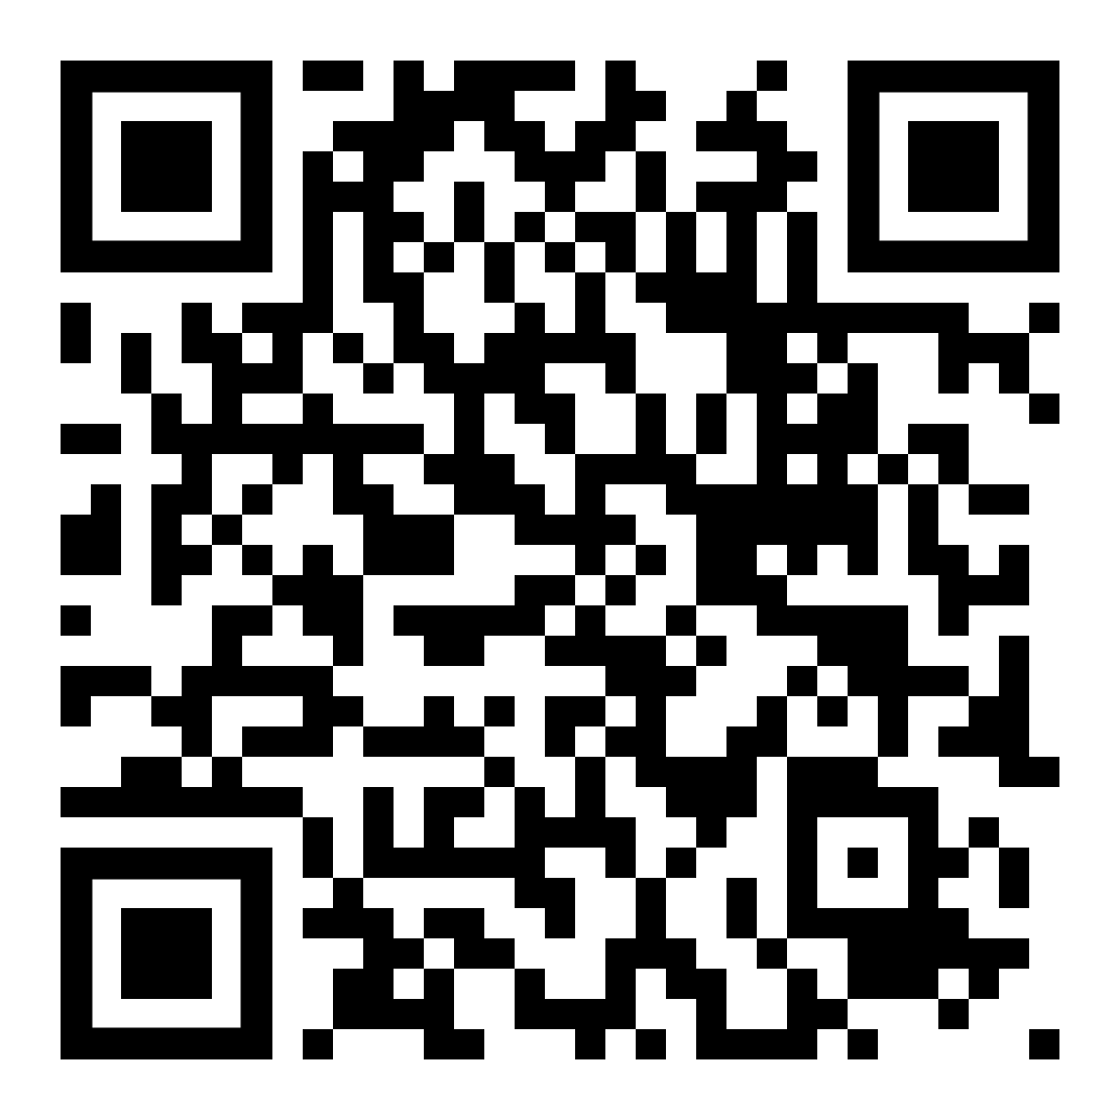
Events | NASP

