Slide 1
Simple Ways to Measure and Improve Population Health
Jag Mundra
Feb 26
j.mundra@nhs.net

Slide 2
Each Measure Drives the Next
Activity >1 Month Track uptake rates Good is > 20% | Behaviour 3+ Months Activation, mood, diet, activity & loneliness Good is > 10% change
Demand 12+ Months GP visits, outpatients, admissions Good is > 5% change | Health 6+ Months BMI, HbA1c, and blood pressure. Good is > 7% change
The aim is to find out if what we’re doing is working in the shortest possible time
j.mundra@nhs.net

Slide 3
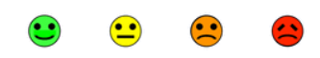
A Simple Behaviour Metric… Citizen Activation
Activation is a person’s confidence in managing their own health
A single question¹ lets any role talk about activation and capture it routinely
A one-point rise links to 4 fewer GP contacts and £327 lower NHS demand per year²
Demand reductions are more credible when activation improves
Capture in clinical system via SNOMED code - 962851000000103 | Patient Activation Measure Level (observable entity) |
How confident are you managing your health?
4
Very
3
Quite
2
Not
Very
1
Not at
all
Health Confidence Score, Benson et al.
Barker et al., BMJQS (2018) & NAPC, Mundra et al., Calderdale Evaluation (2023)
j.mundra@nhs.net
Notes:
https://r-outcomes.com/measures/

Slide 4
A Simple Health Metric… EQ-VAS
Very easy to ask and answer routinely (EQ-VAS, part of EQ-5D)
Can be used to estimate QALYs¹ (quality-adjusted life years) or how much money it costs to give someone one extra year of life in good health.
Links outcomes to cost-effectiveness and value for money using the gold-standard approach²
NICE’s implied NHS opportunity cost is ~£13,000 per QALY³ - If your intervention is below this, it is high-value
Capture in clinical system via SNOMED code 736535009 | EuroQol visual analogue score (observable entity) |
How good or bad is your health today?
0 = the worst health you can imagine
100 = the best health you can imagine
Mapping to Obtain EQ-5D Utility Values, Longworth and Rowen (2013)
The Green Book: appraisal and evaluation in central government, HM Treasury (2024).
Methods for the Estimation of the NICE Cost-Effectiveness Threshold, Claxton et al. (2015)
j.mundra@nhs.net

Slide 5

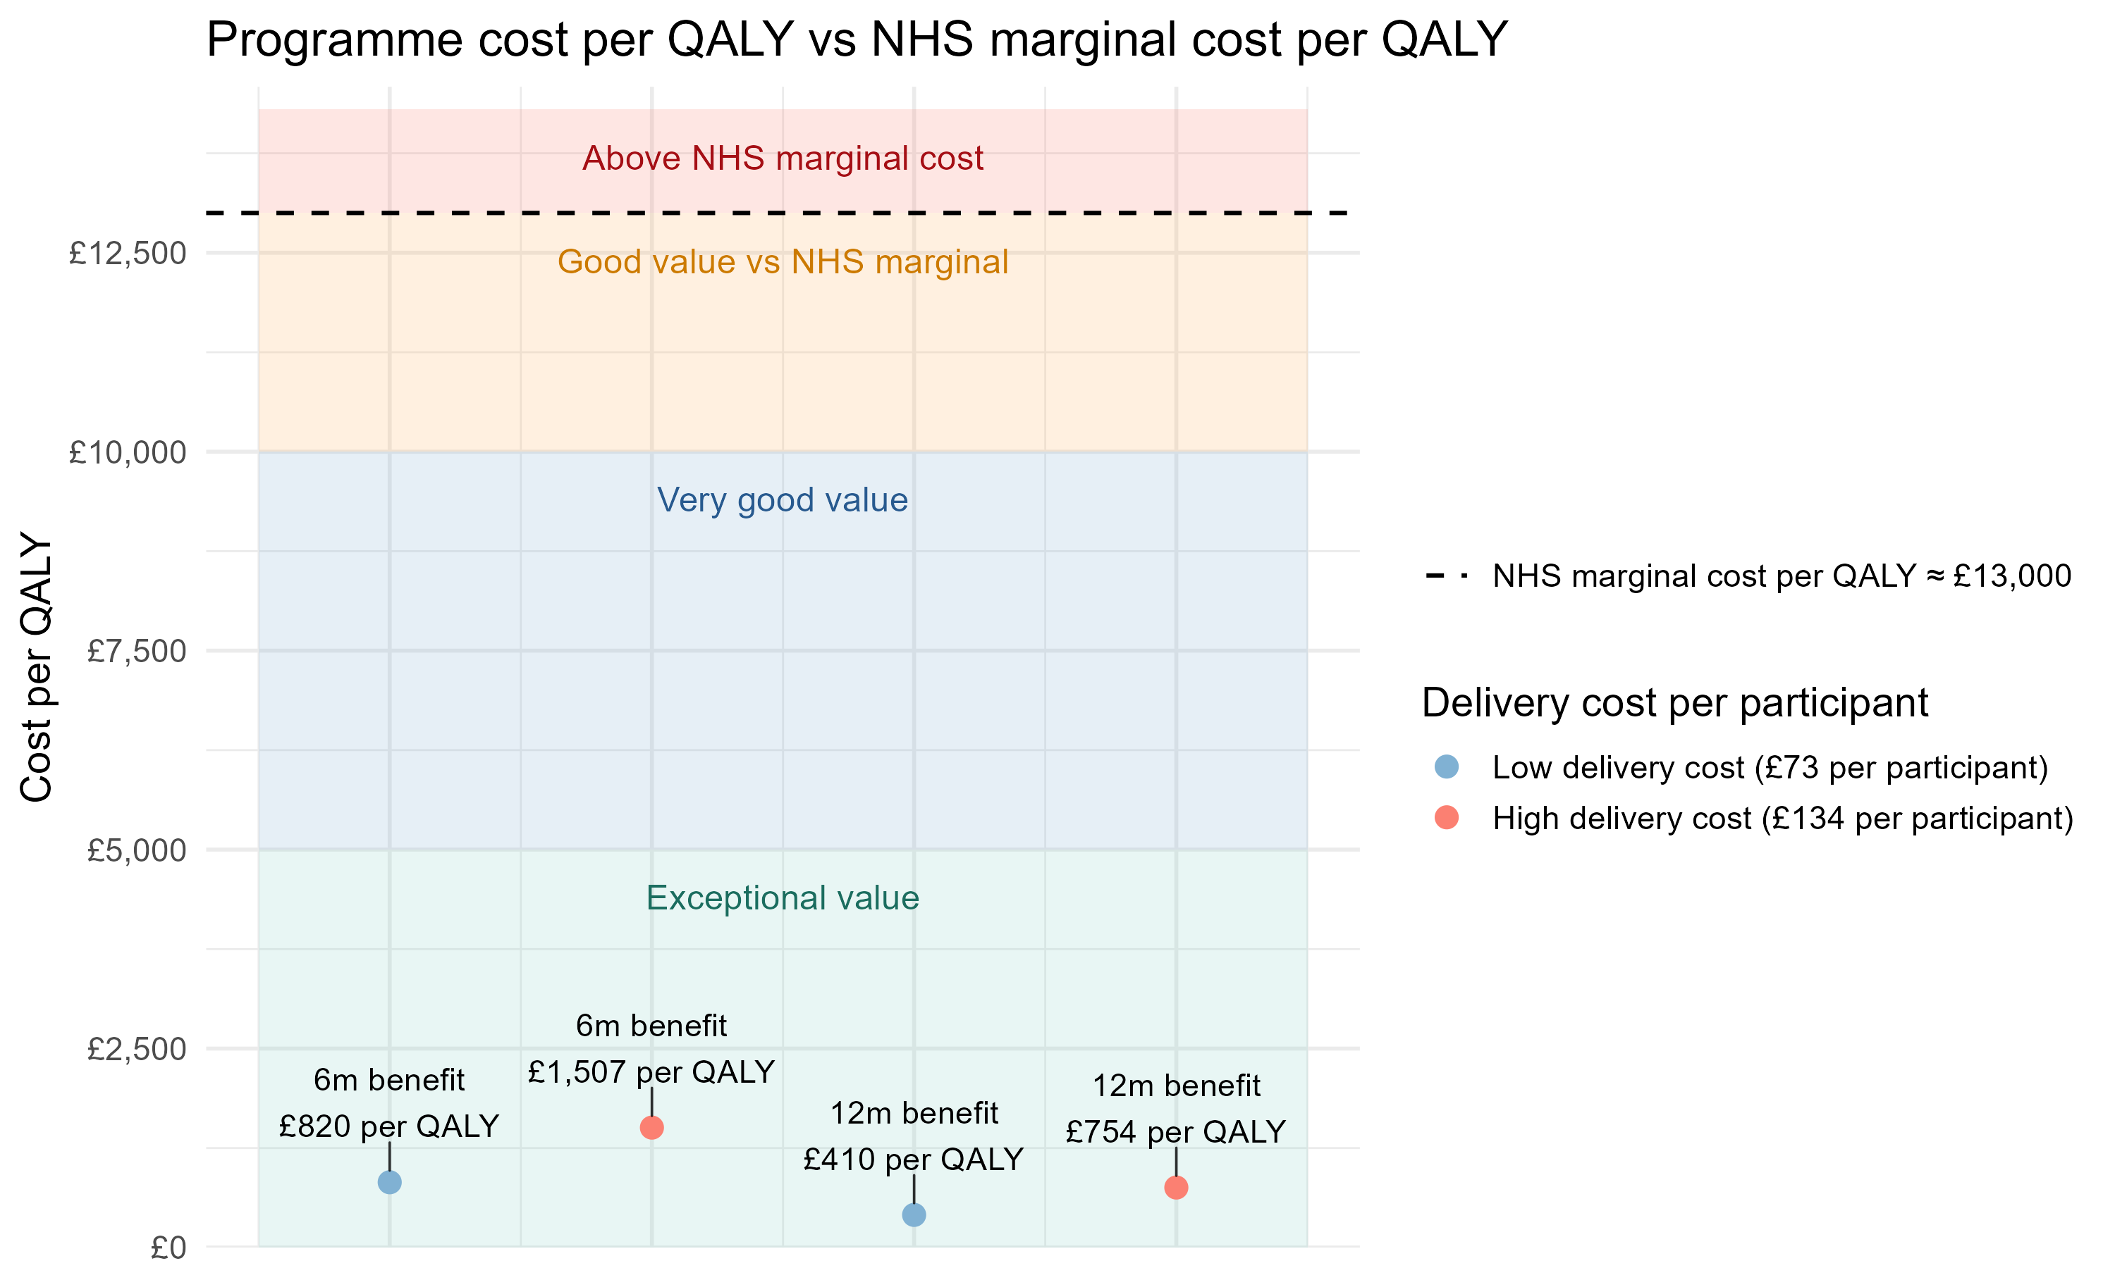

Programme Cost per Quality Adjusted Life Year
Text here
A QALY is how much it costs to generate one year of good-quality life.
The NHS delivers about £13,000 per QALY, so lower costs indicate strong value.
If benefits last 12 months the cost per QALY is £410 - about 32 times lower than the NHS benchmark.

Slide 6
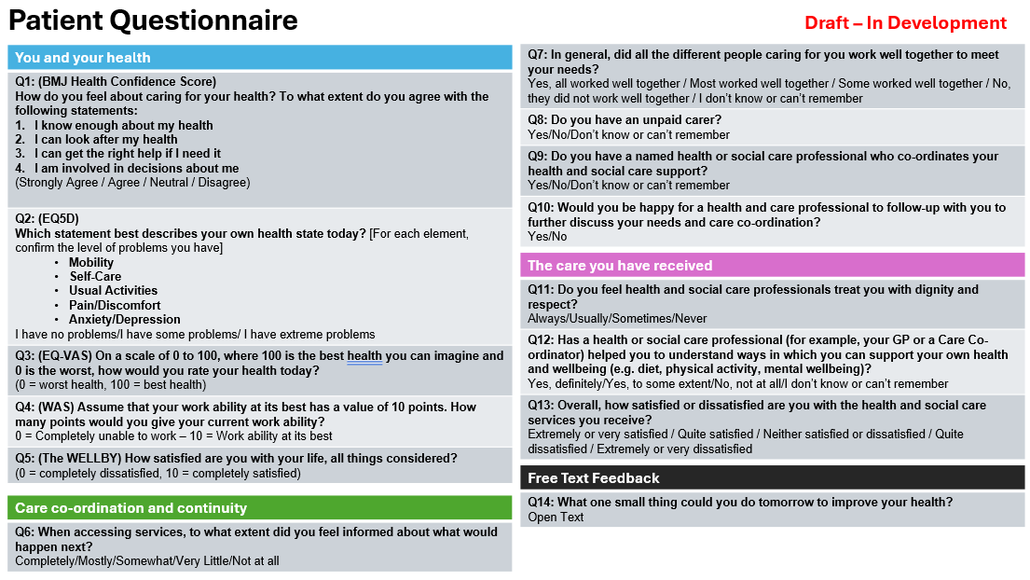
NNHIP Neighbourhood Index – Patient Questionnaire

Slide 7
Core Questions to Measure Impact and Value
Text here
For the full spreadsheet and references contact - jag.mundra@nasp.info

Slide 8
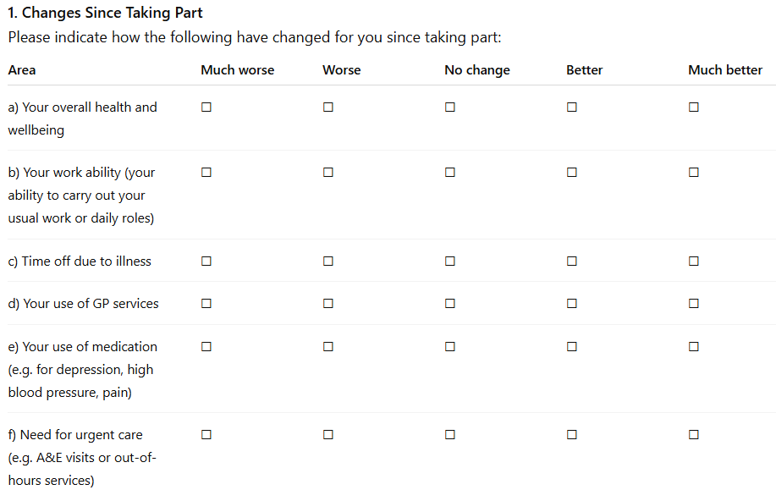
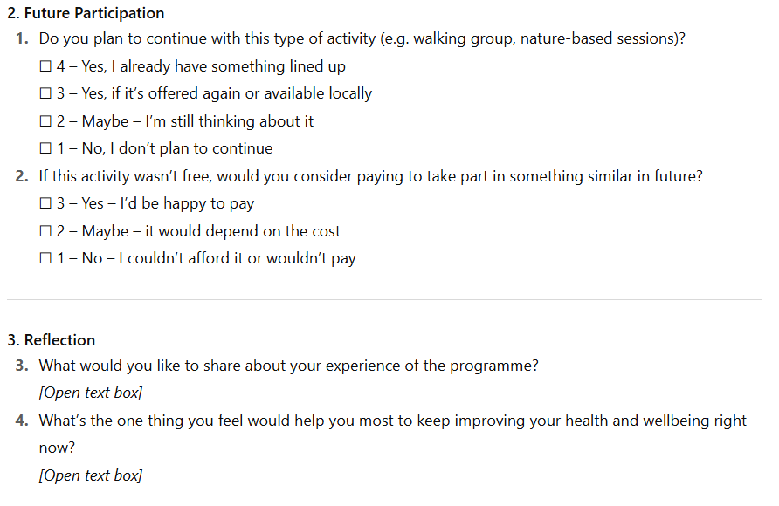
Post-Survey Questions to Evidence Impact and Value
Text here
People reporting less healthcare use or time off sick shows real impact and can be used to forecast likely savings.
High intent to continue or pay shows lasting behaviour change and potential for greater, self-sustaining ROI.

Slide 9
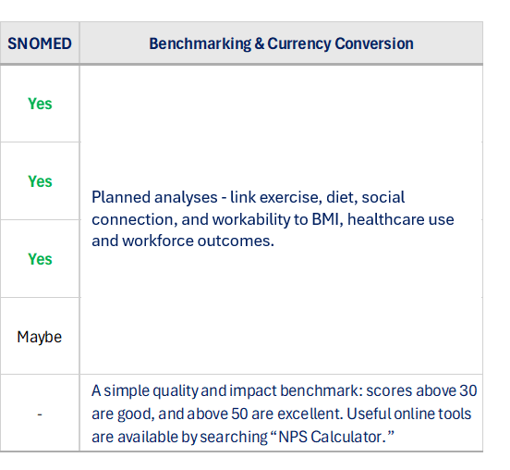
Additional Questions to Measure Impact and Future Value
Text here
Planned analyses - link exercise, diet, social connection, and workability to BMI, healthcare use and workforce outcomes.

Slide 10
How to Measure Health Gain (and Cost per QALY) Using One Simple Question
What this is about?
A QALY = one year of perfect health (a quality adjusted life year)
The Treasury and the NHS uses cost-per-QALY to judge value.
Why this matters?
The NHS typically spends £13,000 to gain one QALY.
If your programme is £1,000 per QALY, that’s about 13× better value than the NHS average.
This lets you show its impact and value using the NHS’s own framework.
How to estimate QALYs using EQ-VAS
(one quick health question)
Ask one question - “How good or bad is your health today?
(0 = worst health you can imagine, 100 = best)”
Get two scores - Before = 60, After = 80
Convert to ‘out of 1’ health - 60 → 0.60, 80 → 0.80
Find the improvement - Difference = 0.20
How long does the benefit last - 6 months = → 0.20 × 0.5 (years) = 0.10 QALYs
Work out cost per QALY – e.g. if the cost per person is £100, then divide by 0.10 = £1,000 per QALY
Note: EQ-VAS can estimate QALYs, but it’s an approximate second-best method versus EQ-5D
EQ-VAS can approximate for QALYs - https://www.sciencedirect.com/science/article/pii/S1098301512041617
Each £13,000 spent by the NHS yields one QALY - https://www.journalslibrary.nihr.ac.uk/hta/HTA19140
Notes:
Use full EQ-5D scores (all 5 questions) to get a more accurate QALY estimate - https://score.awellhealth.com/calculations/eq5d_5l?

Slide 11
How to Measure Wellbeing Gain (and Cost per WELLBY) Using One Simple Question
Text here
What this is about?
A WELLBY = a one-point increase in life satisfaction sustained for one year.
The Treasury’s Green Book now uses WELLBYs in cost-benefit analysis.
Why this matters?
Government guidance values 1 WELLBY at roughly £13,000
If your programme produces WELLBYs for £400, that is ≈30× better value than the benchmark.
WELLBYs let you show wellbeing return on investment, not just health impact.
How to estimate WELLBYs using ONS4
(one quick wellbeing question)
Ask one question - “Overall, how satisfied are you with your life nowadays?” (0 = not at all, 10 = completely)
Get two scores - Before = 6.5, After = 7
Find the improvement - 7.0 − 6.5 = +0.5
How long does the benefit last - 6 months = → 0.5 × 0.5 (years) = 0.25 WELLBYs
Work out cost per WELLBY – if the cost per person is £100 then divide by 0.25 = £400 per WELLBY
Using WELLBYs for economic value - https://www.gov.uk/government/publications/quantifying-and-valuing-the-wellbeing-impacts-of-culture-and-sport
The Treasury values 1 WELLBY at £13,000 - https://www.gov.uk/government/publications/green-book-supplementary-guidance-wellbeing

