Slide 1
NASP Webinar
Supporting Community Development:
Helping the social prescribing ecosystem thrive
Thank you for joining us. The webinar will begin shortly.

Slide 2


Housekeeping
Please note we are recording this webinar - you will be sent the slides and the link to the recording, and they will be on NASP's website too.
Please submit questions via the Q&A function. We will hold a Q&A session at the end of presentations.
Please use the chat function for introducing yourself and networking. If you have any technical issues, please raise these in the chat, and a member of the NASP team will assist.
Closed Captions are available (turn these on at the bottom of your screen.)

Slide 3

Overview
Chair:
Monica Boulton, Strategic Lead for Neighbourhood Health at National Academy for Social Prescribing
Speakers:
Sam James, Integrated Care System Lead, NAVCA
Helen Allen, Programme Director, Community Catalysts
David Grimmer, Team Leader, Connect for Health, Shaw Trust
Jane Majidzadeh, Wellbeing Team Manager, Meon Health Practice

Slide 4
Supporting Community Development
By the end of this session, participants will be able to:
Understand who the key stakeholders are in your local community.
Feel confident using asset-based community development (ABCD) approaches.
Understand how to effectively map services in your local area.
Recognise the importance of co-production in social prescribing.
Explore how to set up peer support groups within a PCN.

Slide 5


Social Prescribing Link Worker Competency Framework
Competencies to...
Engage and connect with people
Enable and support people
Enable community development
For safe and effective practice

Slide 6

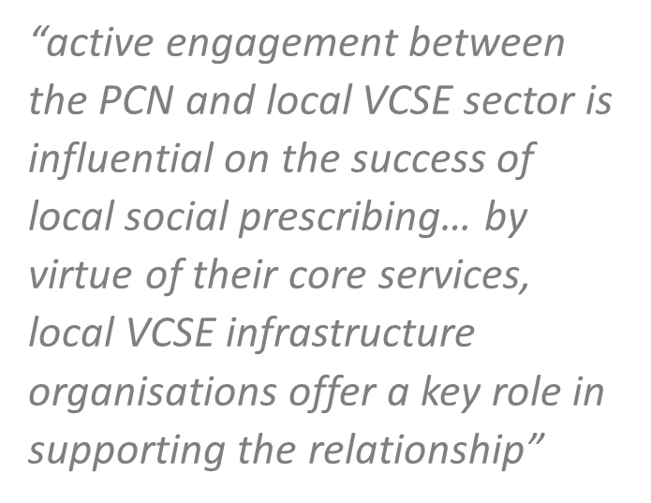

Enable community development
Collaborate with existing organisations when supporting community development in order not to duplicate
Take time to understand the landscape & build relationships
Don't feel you need to do it all yourself – networking is key!
Apply the knowledge you have learnt through your patient interactions
Apply the ABCD approach, supporting community resilience
Volunteering opportunities are a huge asset to the social prescribing ecosystem

Slide 7

The synergy between SP and ABCD is powerful. SP seeks to connect individuals back to their communities; ABCD focuses on growing communities from within. When integrated, SP becomes more than a referral tool – it becomes a vehicle for catalysing collective agency. Individuals are not only referred to community groups but supporting into community life. Link workers operating within an ABCD framework move beyond case management to facilitation of connection, co-production, and citizen-led action.
Reimagining social prescribing through an asset-based community development lens
Lee, Kheng Hock et al.
The Lancet Regional Health – Western Pacific, Volume 0, Issue 0, 101634

Slide 8
Community micro-enterprise - a community development approach that can support social prescribers in their role
Helen Allen, Programme Director, Community Catalysts and David Grimmer, Team Leader, Connect for Health, Shaw Trust

Slide 9




Community micro- enterprise - a community development approach that can support social prescribers in their role
Helen Allen Community Catalysts
David Grimmer

Slide 10
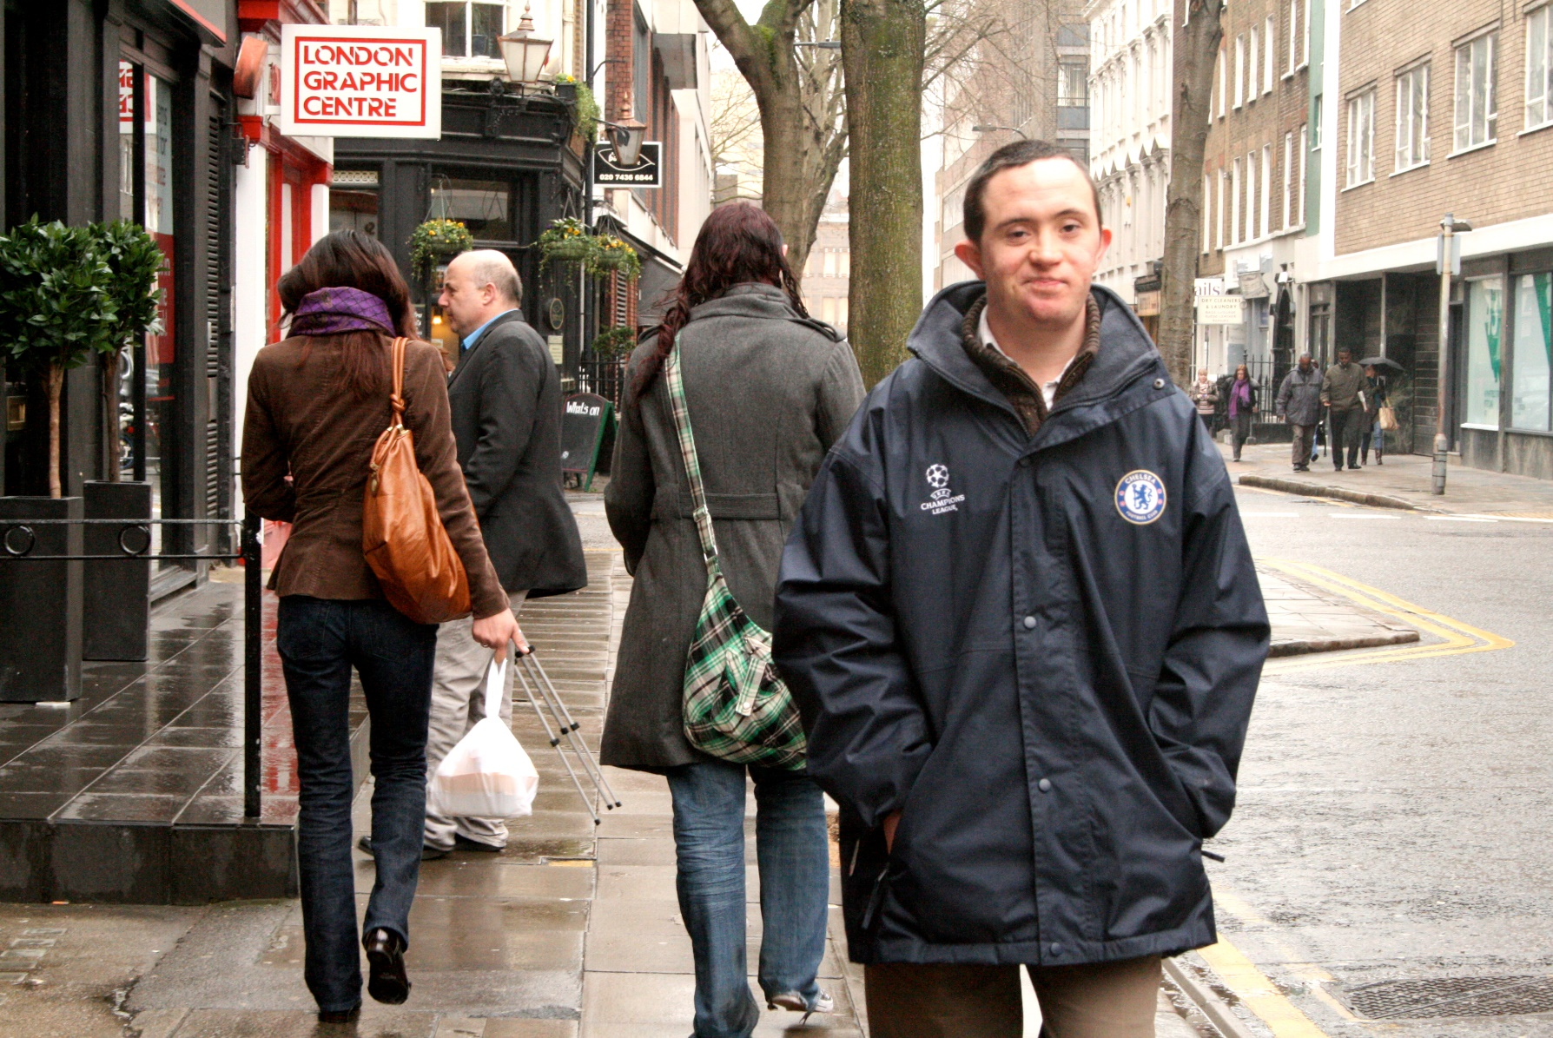
Helping to bring the vision for neighbourhood health to reality: from hospital to community, sickness to prevention

Slide 11
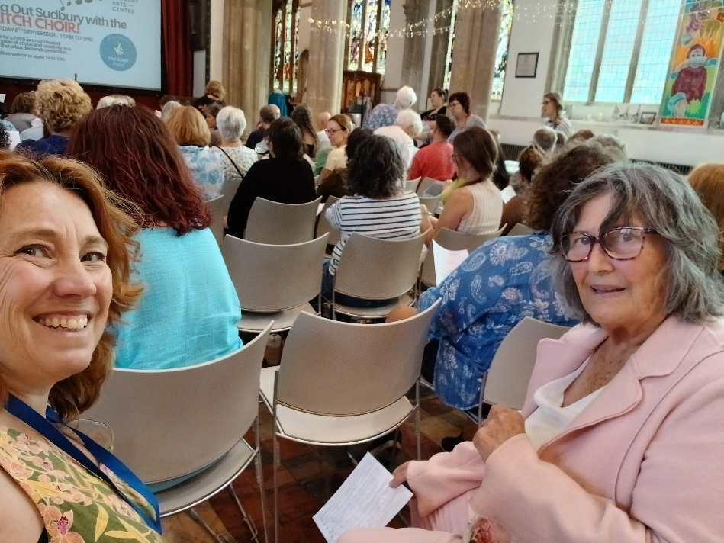
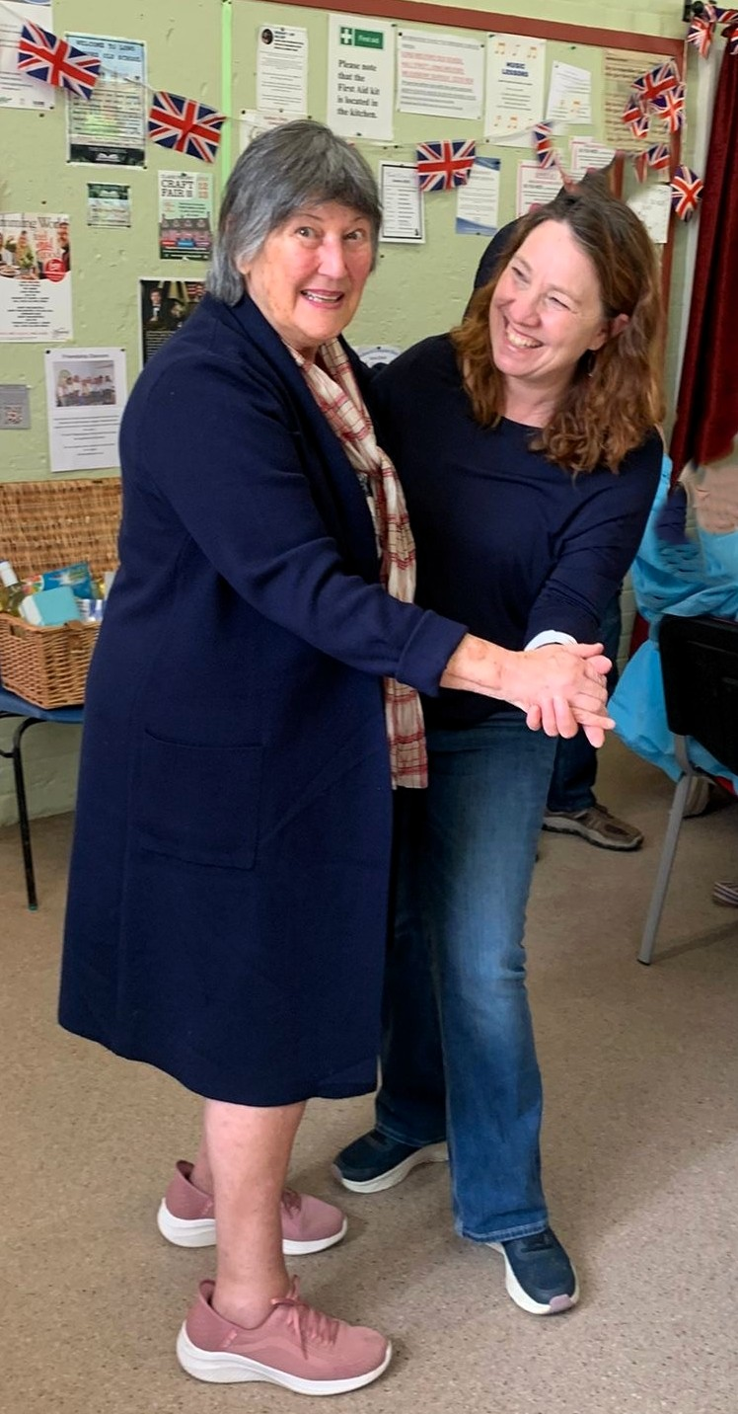
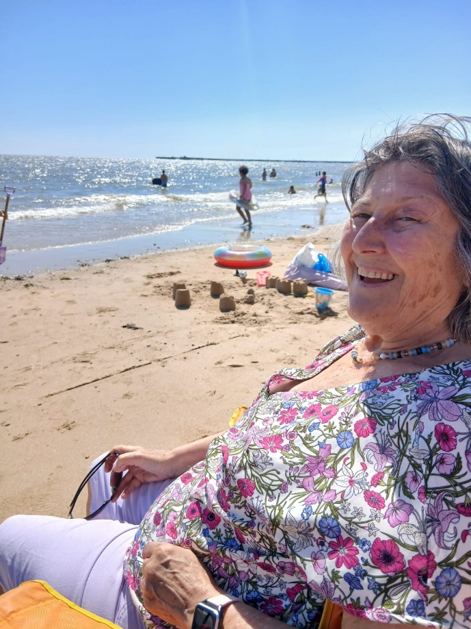
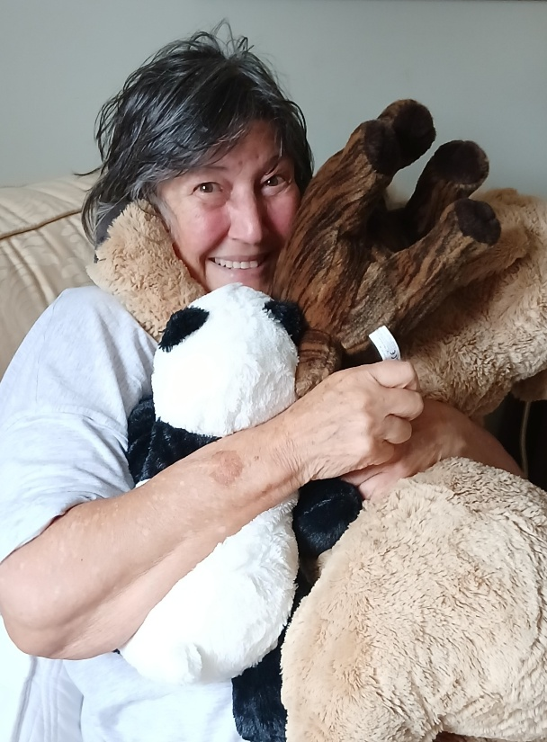
Lenka supports Rosi

Slide 12

National capacity building organisation: help local people set up sustainable community micro- enterprises that offer care and support for other local people. Help VCFSE sector to diversify.
Result: older people and people with a disability have a real choice of great services and supports : great alternatives to domiciliary care / care home/ day care
Lenka is an example of a micro- provider supported by Community Catalysts in Suffolk. Commissioned by Suffolk County Council. Part of a network of 180 providing
Our Doing It Right Standards support this workforce to run safe, quality enterprises
We are linked in with the ICB/ INT’s/ Social prescribers
We help to influence the system change needed for the enterprises to emerge and thrive- especially around Direct Payments: can fund many enterprises/ VCFSE sector
Over 2,000 micro- providers on our directory Small Good Stuff caring for people across England and Wales. Support self funders, people with a Personal Budget/ Personal Health Budget. There for you to use
We support people with hurdles themselves- family carers, people with a disability, mental health challenges, older people, people on benefits to set up an enterprise- can we bring our learning here to social prescribers?

Slide 13
The 3 shifts
Hospital to community: the range of care/ support helps people to remain at home, with those they love around them, reducing reliance on hospital- based provision and support hospital discharge. Personalised care that is built on relationships and is trusted .Some of this workforce can be trained in Delegated Health Care Tasks.
Sickness to prevention: enterprises provide an alternative to home care/ care home. They support people earlier, keep people well, can reduce common issues such as frailty, falls. The enterprises support people with their mental health and well - being: alternatives to day centres- people keep doing what they love in their neighbourhood, reducing loneliness and isolation
Analogue to digital: enterprises are flexible and can help people to use online services. Online directory Small Good Stuff helps people to choose local care and support.

Slide 14

The wider value of this workforce
Neighbourhood led- not neighbourhood based
Integrate health and social care naturally ( people don’t live their lives in boxes)
Care is personal and tailored
They make things happen with and not for people (co-produced)
Services and support are flexible and responsive to change
They create real choice for people
Cheaper - money goes further
Environmental benefit of everything staying local – low ‘care miles’
Flexible work for people who find employment a challenge – like parents, carers or disabled people

Slide 15
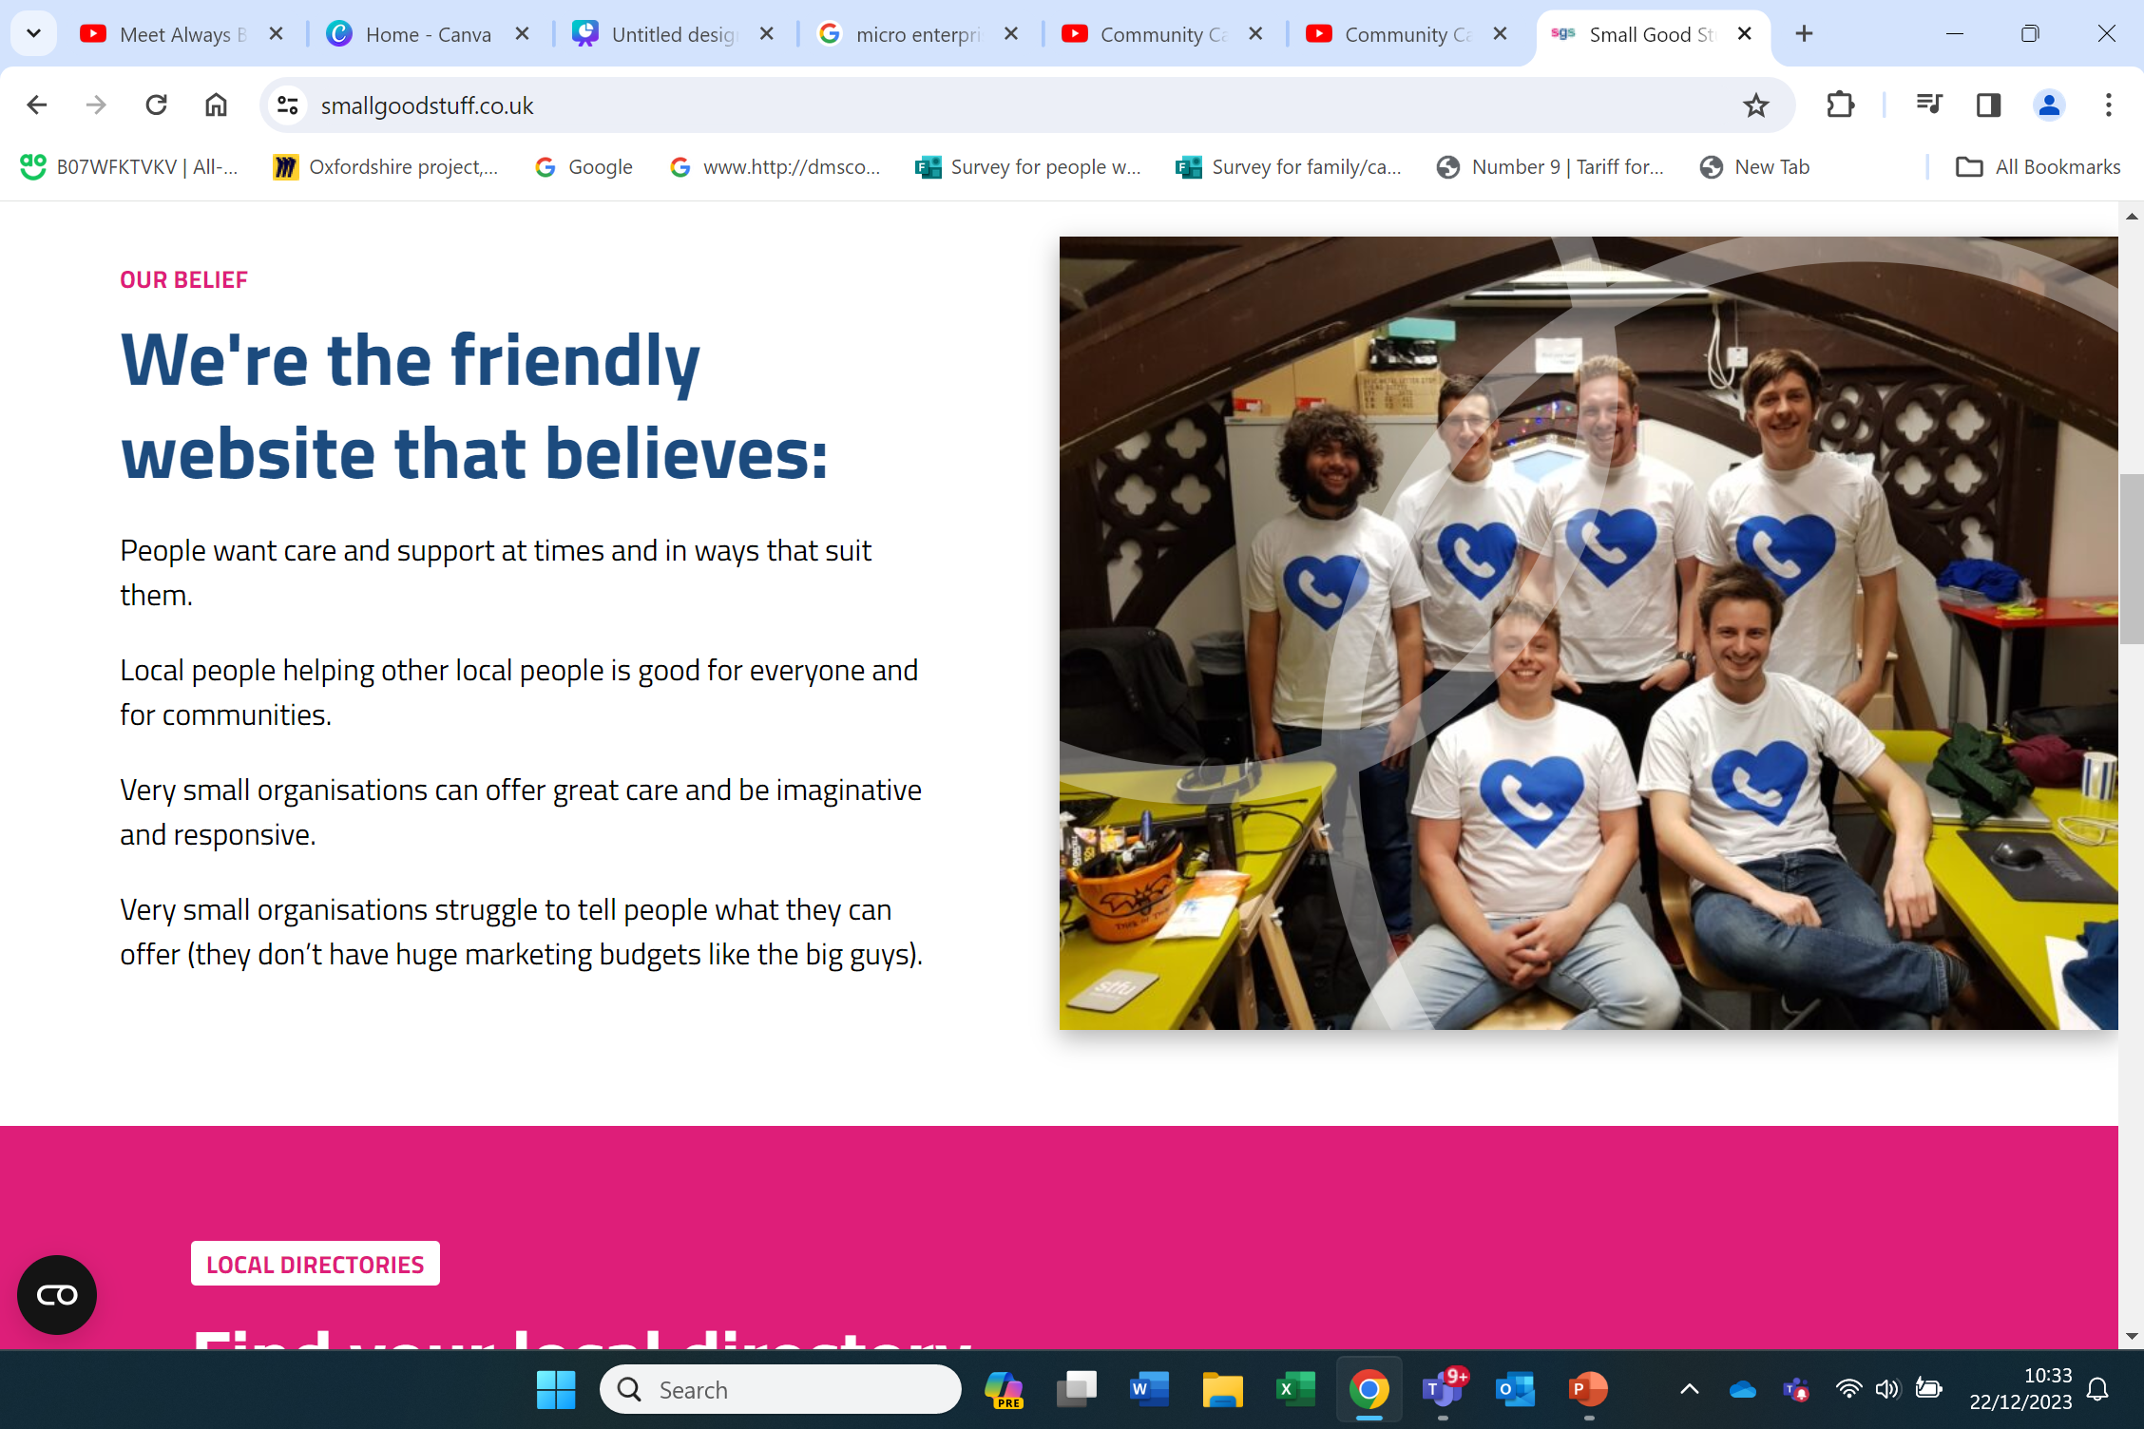
www.smallgoodstuff.co.uk

Slide 16
Small Good Stuff in Suffolk- quick demo.
How the community micro- enterprises/directory have helped Dave’s Connect For Health Team/ people supported https://www.communitycatalysts.co.uk/smallgoodstuff/subsite/suffolk

Slide 17

Part of the Link worker role:
Support local groups to become sustainable, increase their capacity and have basic safeguarding processes for vulnerable individuals.
Identify gaps in local community provision and contribute to developing new groups and networks to fill gaps.
This is our bread and butter! We can bring our approach to other teams and contexts- plus our knowledge of social care /new funding ops to the fore.

Slide 18
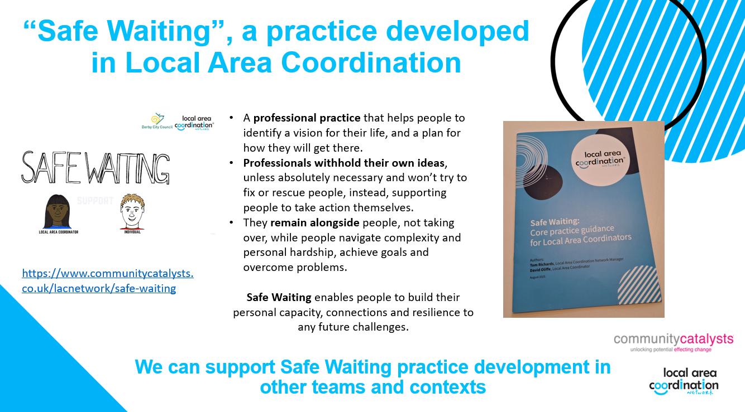

Slide 19

helen.allen@communitycatalysts.co.uk
07912842552
www.communitycatalysts.co.uk

Slide 20
Mapping Services & Developing Peer Support
Jane Majidzadeh, Wellbeing Team Manager, Meon Health Practice

Slide 21
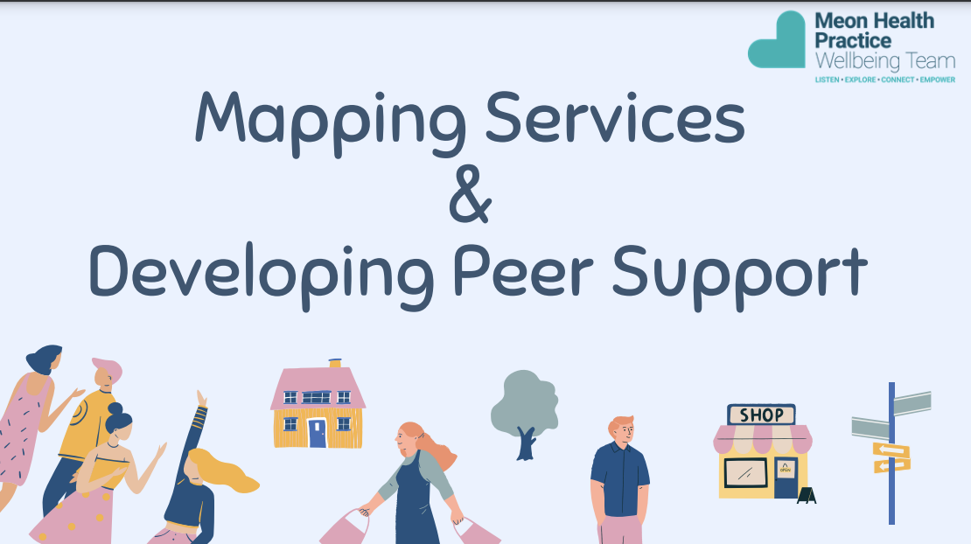

Slide 22
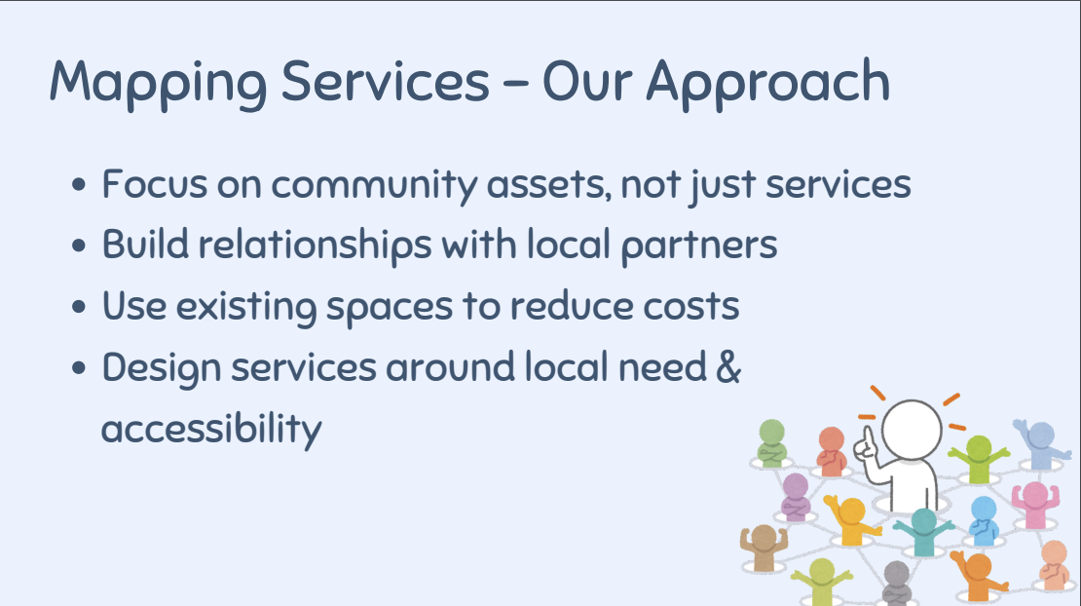

Slide 23
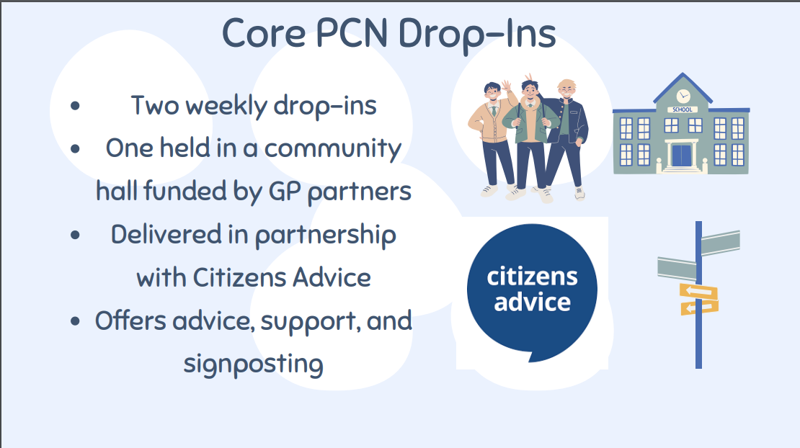

Slide 24
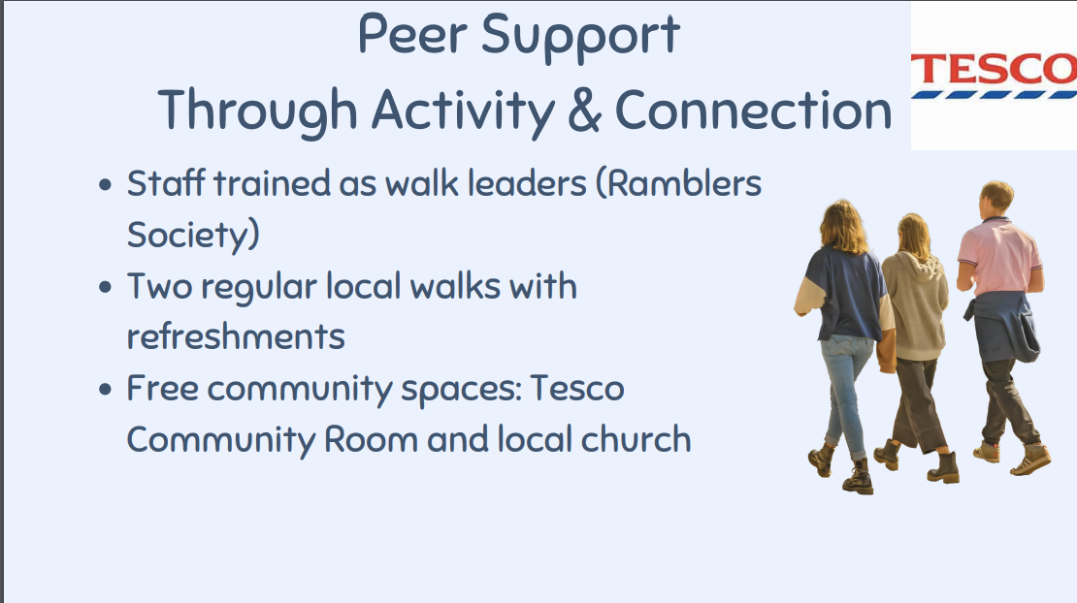

Slide 25
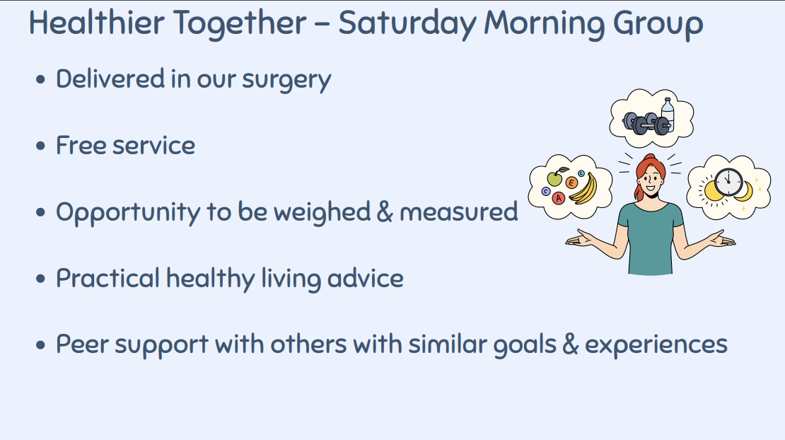

Slide 26
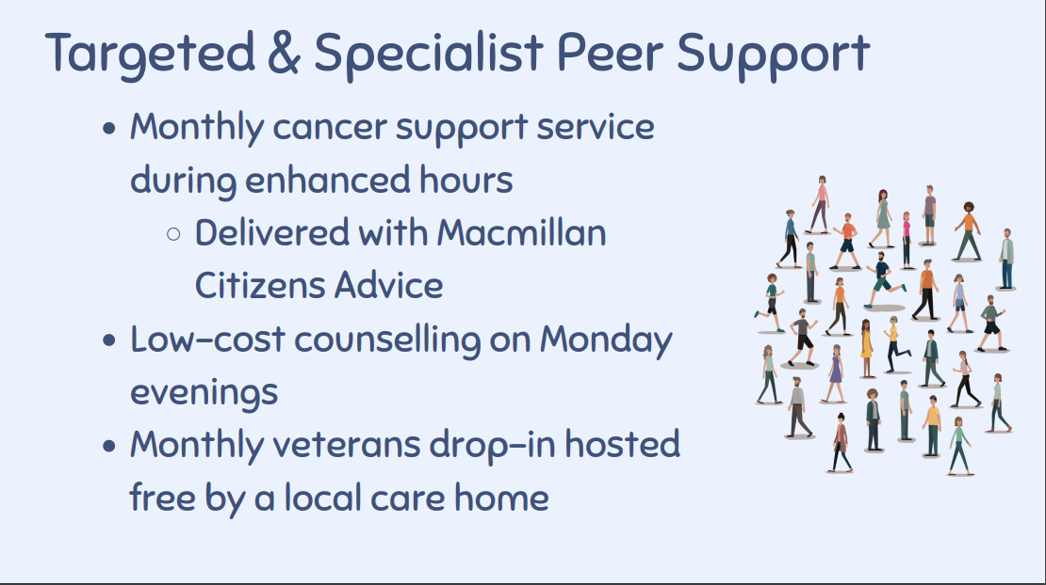

Slide 27
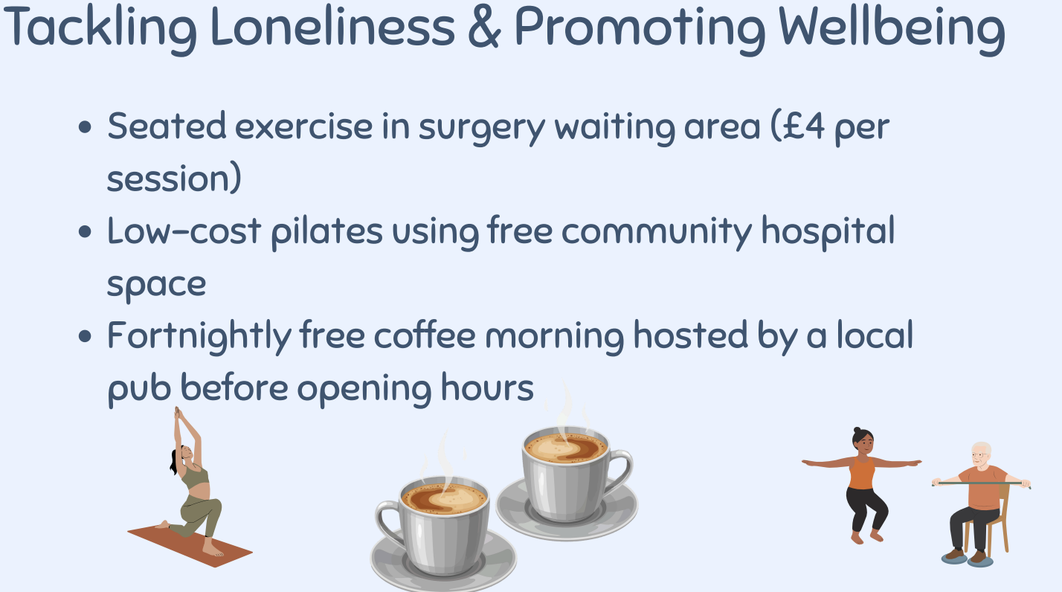

Slide 28
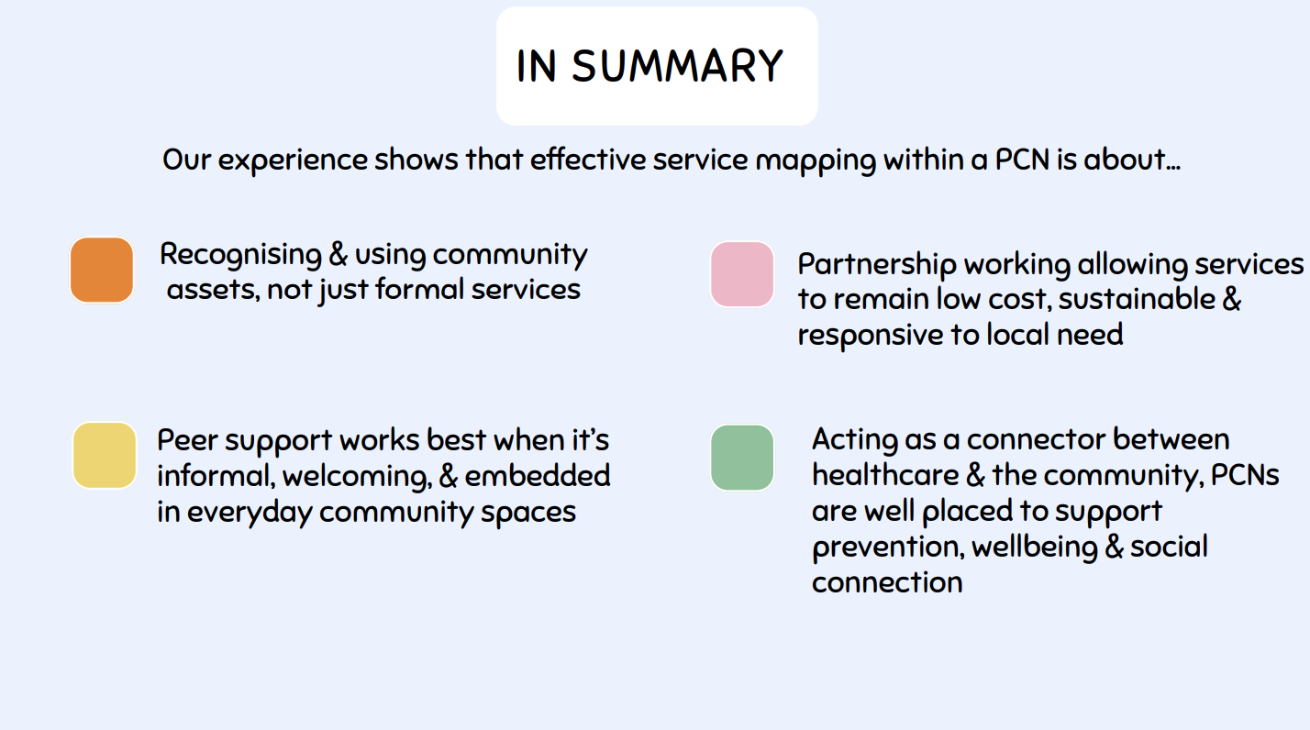

Slide 29


Slide 30


Get in touch
socialprescribingacademy.org.uk
Q&A

Slide 31
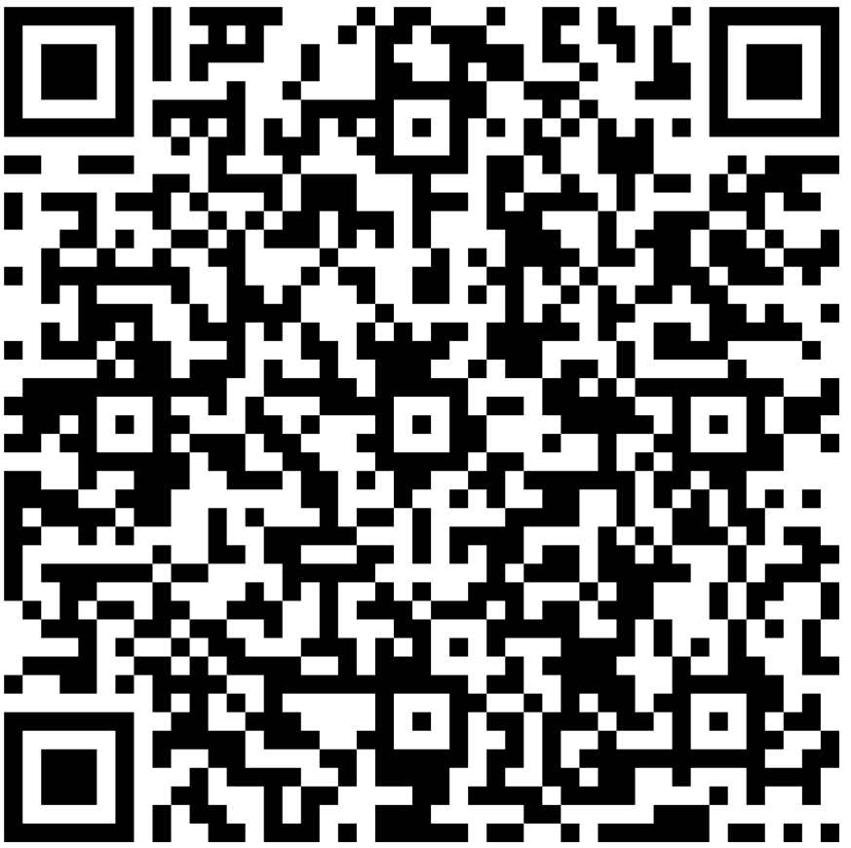
Link Workers – Tell us What Matters to You!
2026 LINK WORKER SURVEY
This is an opportunity for you to tell us more about your day-to-day experiences. Your responses will help to inform and shape our future work.
The survey is open to all Social Prescribing Link Workers based in England.
All responses are anonymous and the results of the survey will be shared later this year.
It should only take you 30 minutes to complete and there’s a chance to win one of ten £25 M&S vouchers.
https://forms.office.com/e/5nEKt3x789
The survey will close on March 11, 2026

