Slide 1




Welcome to NASP's Green Social Prescribing Process Journey Series
Addressing Inequalities and Improving Accessibility for Refugees with ParkBathe Mindful Walks CIC

Slide 2

Welcome to NASP's Green Social Prescribing Process Journey Series
Housekeeping
Please introduce yourself in the chat.
There will be a Q&A after the talk - please enter questions into the Q&A feature.
The session will be recorded and available afterwards.
Closed captions are available.
There will be a quick poll at the end; we’d love to hear your thoughts.

Slide 3

NASP's Green Social Prescribing Process Journey Tutorial Series
This tutorial is the second in our GSP Process Journey & Tutorial Series, a legacy of the national cross-government Green Social Prescribing programme.
The Process Journeys and accompanying tutorials explore practical insights from three organisations delivering GSP in their communities.
Notes:
2

Slide 4

CALL TO
ACTION
Our GSP Process Journey Collection will be published on 18th March, and we’d love for you to be part of it.
  Do you have learning to share around improving accessibility to GSP?
    Please use the QR code to share your experience or a top tip
Your insight could help shape our final national resource.
Notes:
3

Slide 5
12:05pm:
ParkBathe Process Journey
12:35pm:
Wider Discussion & Questions
12:55pm:
Close & Poll
Today’s Agenda

Slide 6
Vanessa Potter
(ParkBathe Founder/Director)

Slide 7
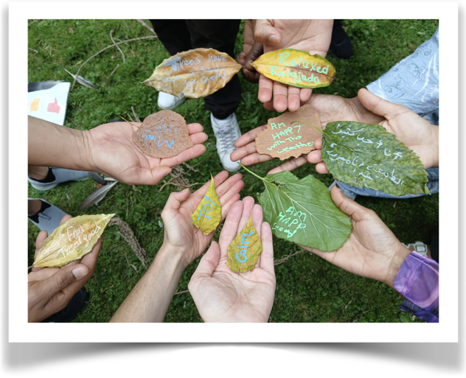
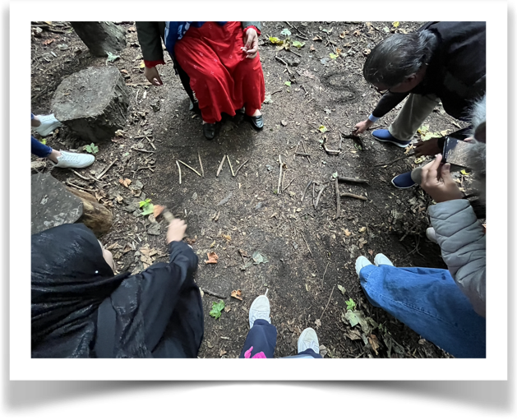
Building Trust - slowly…

Slide 8
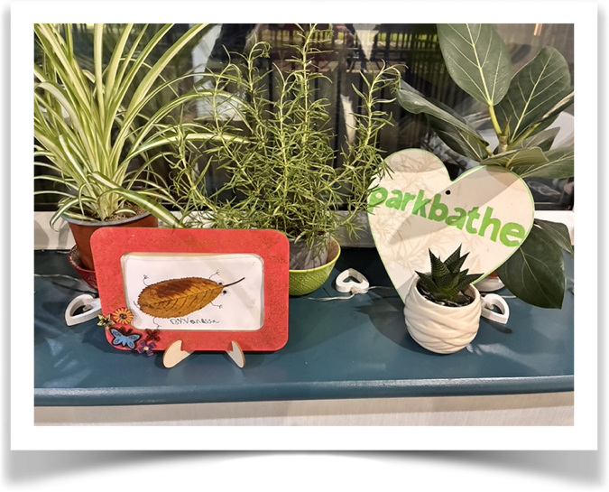
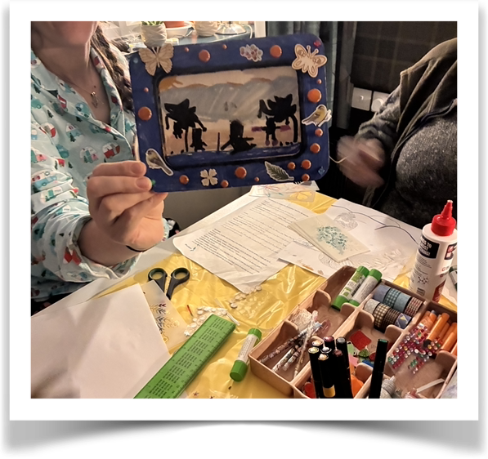
Connecting with confidence and creativity…

Slide 9
Over to You:
Discussion & Q&A 💬
What have other organisations found to be the biggest challenges when supporting asylum seekers?
What support or engagement have organisations experienced from local services in delivering work with refugees?

Slide 10
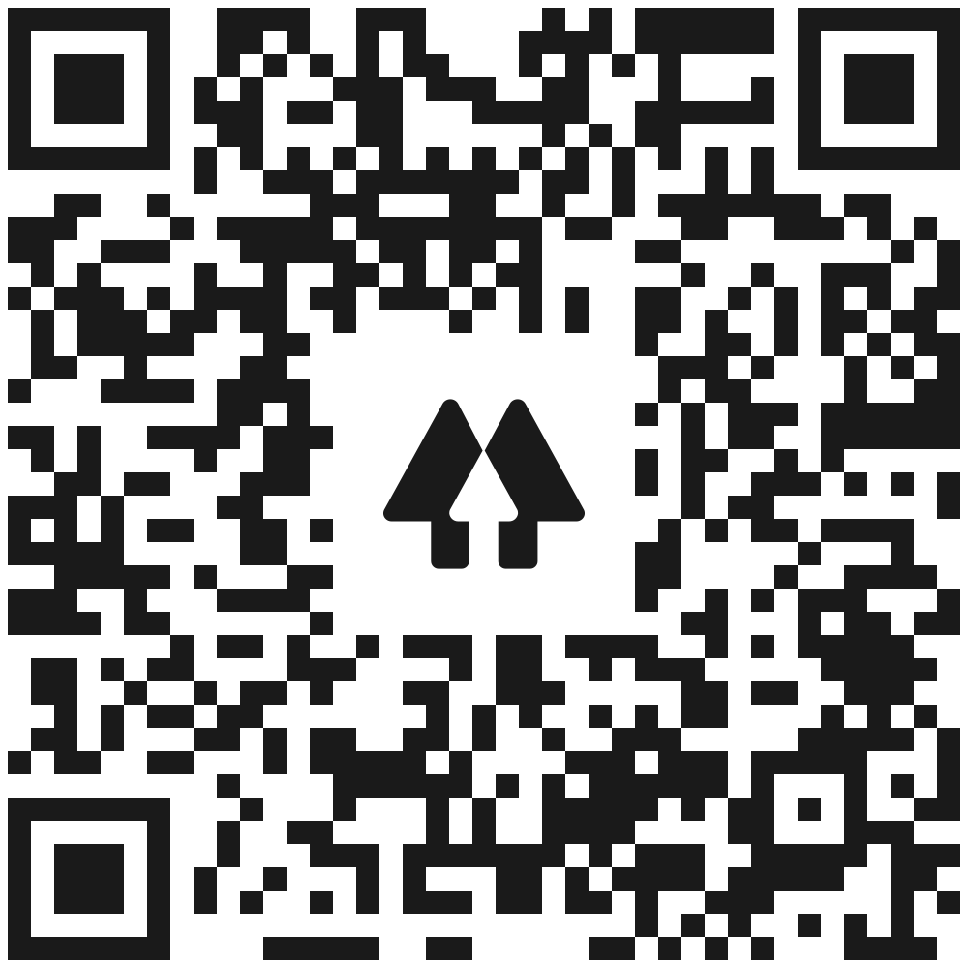
Want to get involved with Parkbathe?
parkbathe@gmail.com
Linktr.ee/parkbathe
ParkBathe Mindful Walks CIC
Next Steps
Upcoming GSP Community Event
Delapre Abbey: Capturing data for Green Social Prescribing – 12th March at 12pm
Process Journey Collection out 18th March

Slide 11
Want to contribute your example to the GSP Process Journey Collection?
Let us know here or scan the QR code
Next Steps

