Slide 1
NASP Webinar: Mental health Part Two: World Mental Health Day
Thank you for joining us. The webinar will begin shortly.

Slide 2

Housekeeping
Please note we are recording this webinar - you will be sent the slides and the link to the recording, and they will be on NASP's website too.
Please submit questions via the Q&A function. We will hold a Q&A session at the end of presentations.
Please use the chat function for introducing yourself and networking. If you have any technical issues, please raise these in the chat, and a member of the NASP team will assist.
Closed Captions are available (turn these on at the bottom of your screen.)
Everyone comes with different experiences and viewpoints. Let’s keep an open mind and learn from one another.
Content note: This webinar includes a speaker's personal experience of social prescribing, with a brief, non-graphic mention of sexual assault. We will provide advance notice of when this will be discussed during the webinar so that you can decide how you would like to participate. Please feel free to step away and rejoin whenever you need to.

Slide 3

Overview
Chair:
Monica Boulton, Strategic Lead for Neighbourhood Health at National Academy for Social Prescribing
Speakers:
Joelle Bradly - Deputy Director for Evidence and Impact at NASP
Ben Barlow – Social Prescribing Link Worker at Newport & Central PCN
Jackie Hardy - Lived experience contributor

Slide 4
Joelle Bradly, Deputy Director for Evidence and Impact at NASP

Slide 5
Social Prescribing and Mental Health Evidence
Joelle Bradly, Deputy Director of Evidence & Impact, National Academy for Social Prescribing

Slide 6





Who are the audiences for evidence and what are their needs?
Government
& Gov Bodies
Community Groups & Patients
Clinicians
Practitioners
Departments, NHS England, Elected Officials
Good practice; professional development (e.g. working with different patient groups, or interventions for specific conditions)
Impact of investment at scale (economic impact; service usage)
Impact of investment at sub-regional/local scale, and against local needs
Impact of activity (“is it working?”)

Slide 7

What is the social prescribing evidence landscape?
WHERE WE STARTED
WHERE WE ARE
WHERE WE NEED TO GO
Social Prescribing started organically in the UK, with many local initiatives designed to suit local need
Large investment from Department of Health and Social Care in 2019
Changed context of delivery
NASP collaborated with a large range of academics to identify research gaps and commissioned 15 evidence reviews
NASP have partnered on or supported a number of new research projects in key priority areas
NASP have collated various local evaluations of the economic impact of social prescribing
There is a growing body of evidence, particularly on the benefits of SP activities
Support development of national data driven system for social prescribing
Ensure that research and evaluations can inform policy and practice
Notes:
Wealth of qualitative evidence, but we need more than this for commissioners & policy
The context changed to being more focused on the health sector and health related outcomes
NASP are supporting & Sharing Research: Blogs summarising new evidence, monthly themed evidence newsletters (Qual studies, Older people, Canadian research, employment, LTC, CYP, Economic, Men, Poverty, Faith), briefing papers and webinars. We are also currently supporting 8 research studies in 25/26: 3 CYP, 1 dementia, 1 secondary care, 1 creative health, 1 LW roll out, 1 VCSE workforce.

Slide 8

Who is accessing social prescribing?
Analysis in 2024 looking at who gets referred to social prescribing (n=160,128) found that, in England:
61% of referrals were female
Over 20% were aged 60-69
People referred were more likely to live in deprived areas.
85.3% were referred via medical routes
The most common reasons for referral were mental health and wellbeing (33.5%), practical support (26.1%) and social relationship (22.5%).
Bu, F., Hayes, D., Burton, A., & Fancourt, D. (2024). Equal, equitable or exacerbating inequalities? Patterns and predictors of social prescribing referrals in 160,128 UK patients. medRxiv (Cold Spring Harbor Laboratory). https://doi.org/10.1101/2024.03.26.24304896
This Photo by Unknown Author is licensed under CC BY

Slide 9
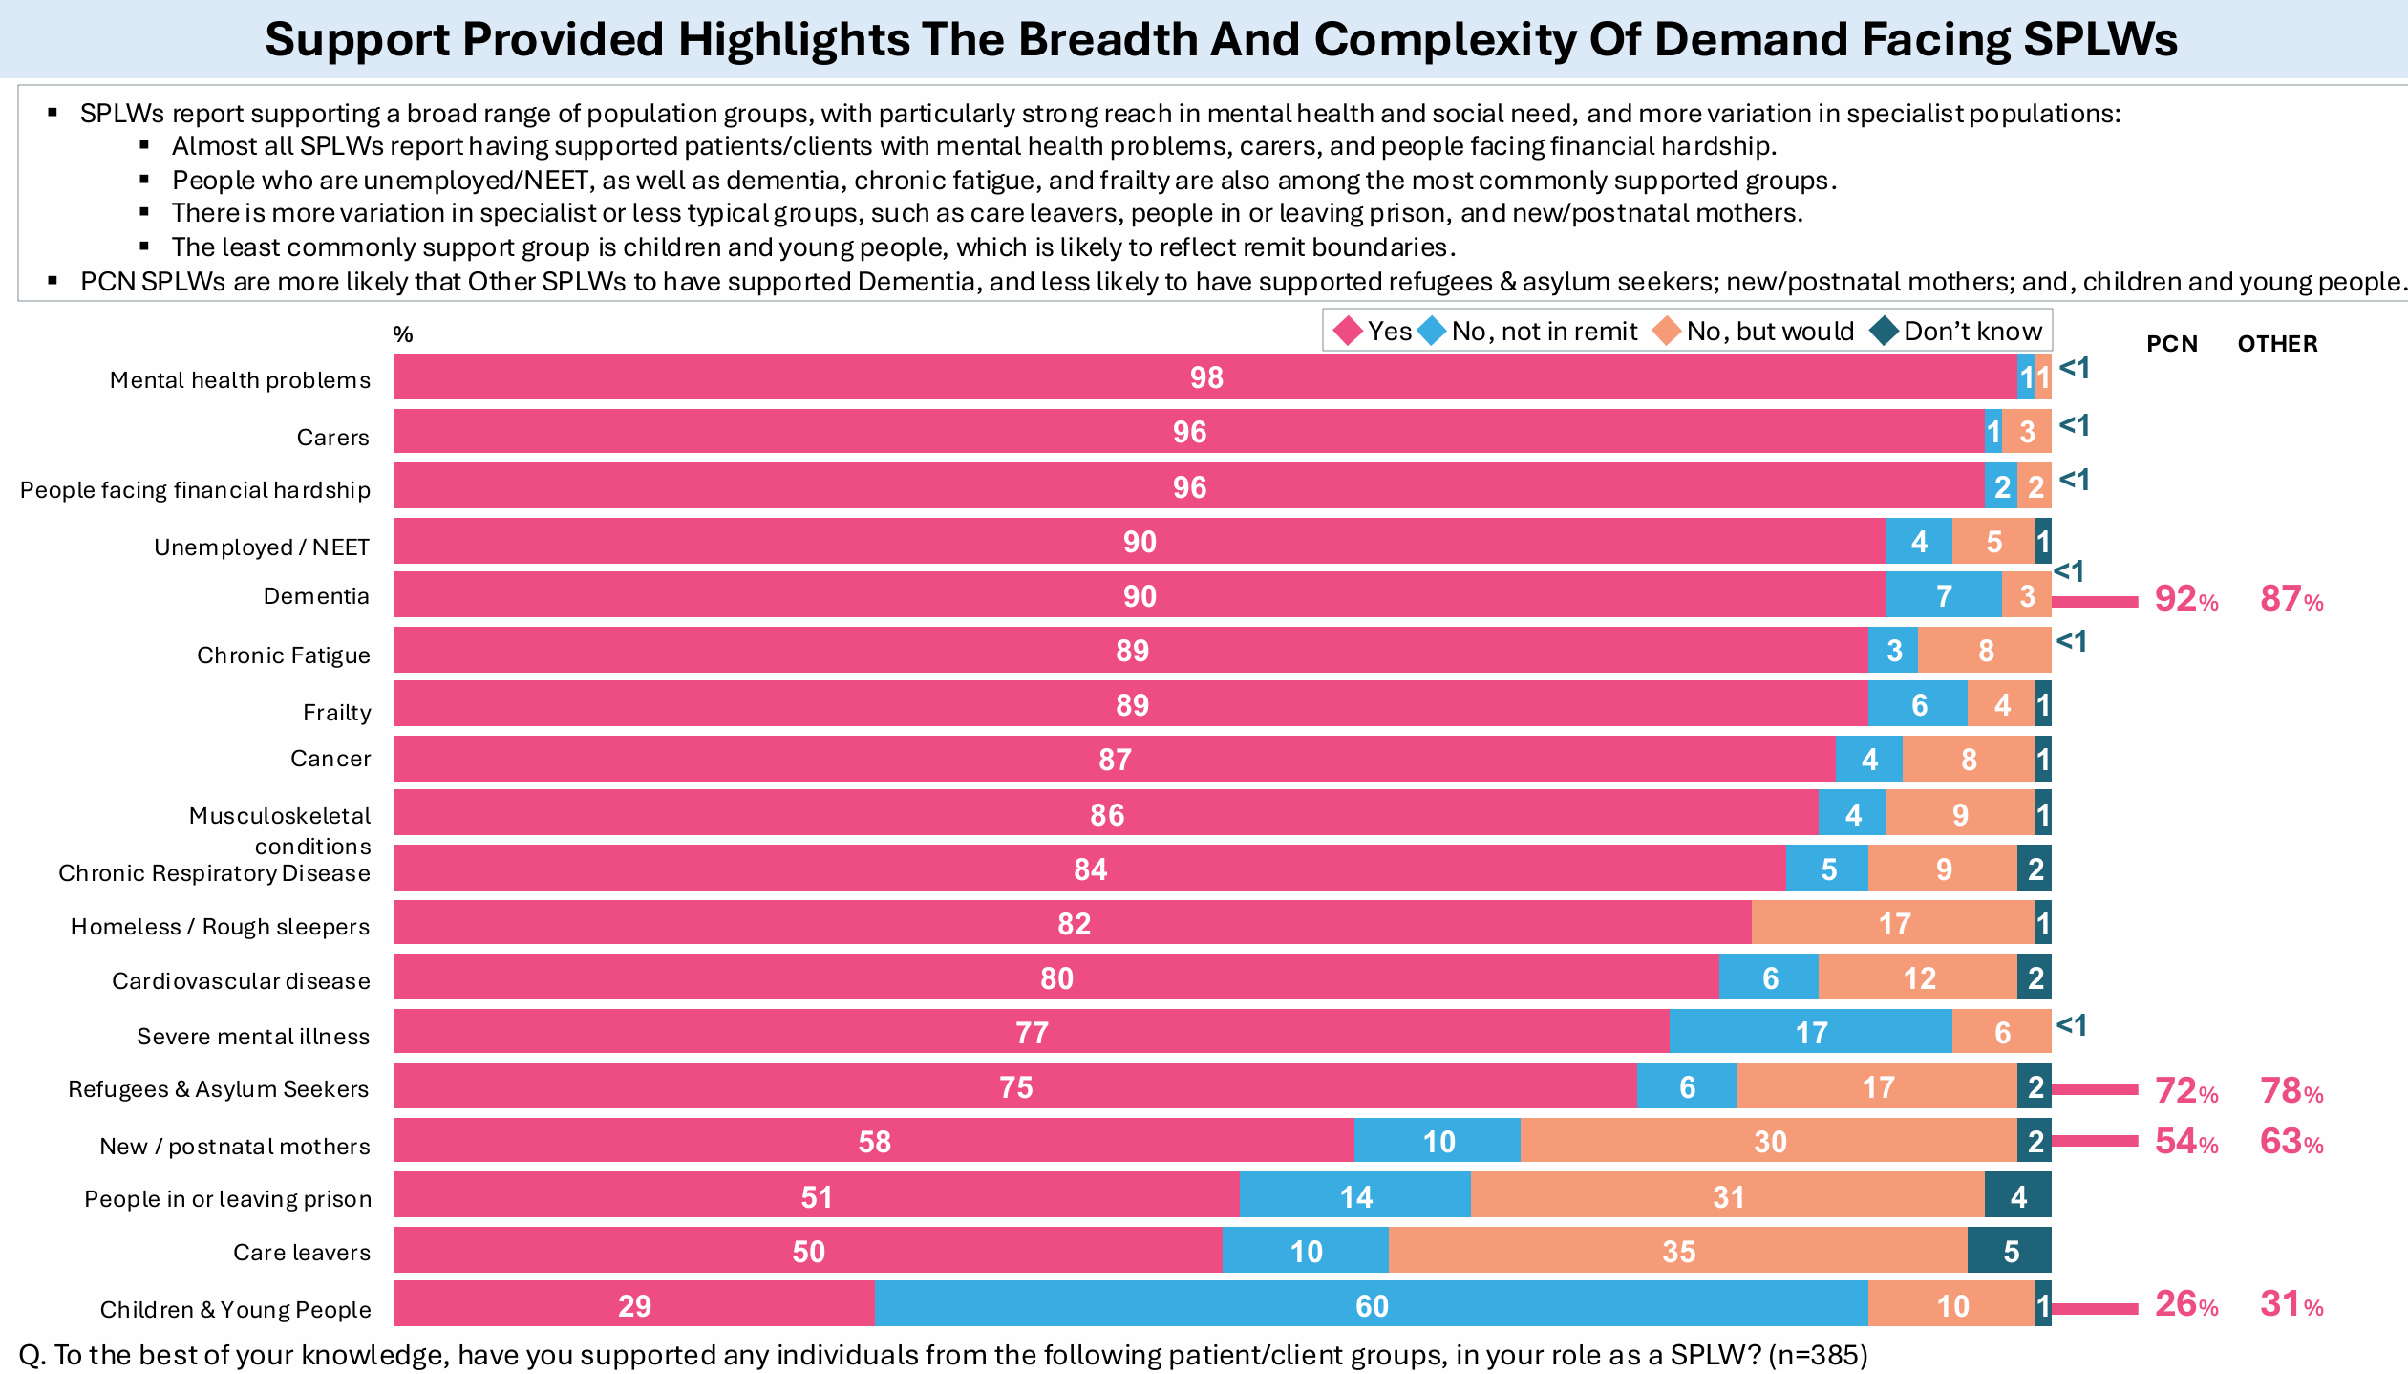
Notes:
98% supporting patients with MH problems, 77% supporting patients with SMI. New analysis of CPRD data also suggests that, among 112,334 patients with SMI, 0.8% received a social prescribing consultation in 2019 increasing to 9.5% in 2023 Social prescribing for patients with severe mental illnesses: an English primary care longitudinal observational study | medRxiv

Slide 10

Impact of the rollout of the national social prescribing link worker programme on population outcomes: evidence from a repeated cross-sectional survey | British Journal of General Practice
Anna Wilding, Efundem Agboraw, Luke Munford, Matthew Sutton, Stewart W. Mercer, Chris Salisbury, Morgan Beeson, John Wildman and Paul Wilson
June 2025

Slide 11
This study estimated the impact of ARRS-funded social prescribing link workers on population outcomes and found that the rollout of link workers was associated with small improvements in patient experience and slightly better outcomes for population groups specifically targeted for social prescribing.
An additional full-time equivalent link worker per 50,000 patients was associated with
higher probabilities of having confidence in managing long-term condition(s) and having enough support from local services, for respondents with long-term conditions
a higher probability of having their mental health needs understood, for respondents with mental health needs
a higher probability of having a good experience at their general practice, for all respondents
Notes:
This is the first study to quantitatively estimate the impact of the national rollout of social prescribing link workers in England, with a large sample size of over four million individuals from 2018 to 2023, addressing previous concerns regarding small sample sizes, lack of counterfactuals and uncontrolled studies with short time frames. The inclusion of data on all ARRS funded roles in the model supported the findings that impacts were due to the number of social prescribing link workers rather than an increased number of roles within primary care. Although the study did not use self-reported measures of physical or mental health, the paper suggests that findings of patients having increased confidence in managing conditions may also be associated reduced healthcare utilisation, as reported in other research studies.

Slide 12
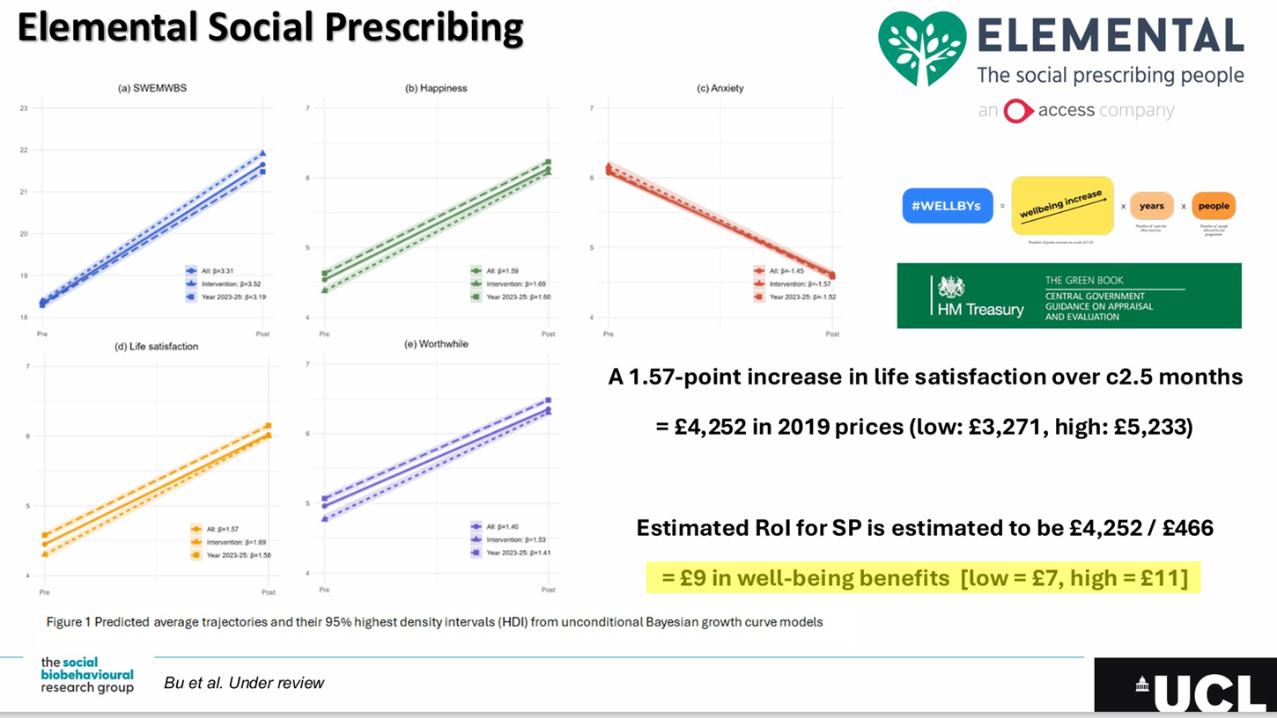
Notes:
UCLs analysis of elemental data- and the life satisfaction Q (ONS4) which can beer converted into a WELLBY – the value to the individual, as recommended by the treasury. They found £9 in wellbeing benefits for every £1 invested.

Slide 13


National Evaluation of the Preventing and Tackling Mental Ill Health through Green Social Prescribing (GSP) Project
March 2021 to June 2023
Commissioned by Department for Environment, Food & Rural Affairs (Defra)
Research consortium: Universities of Sheffield, Sheffield Hallam, Exeter & Plymouth

Slide 14
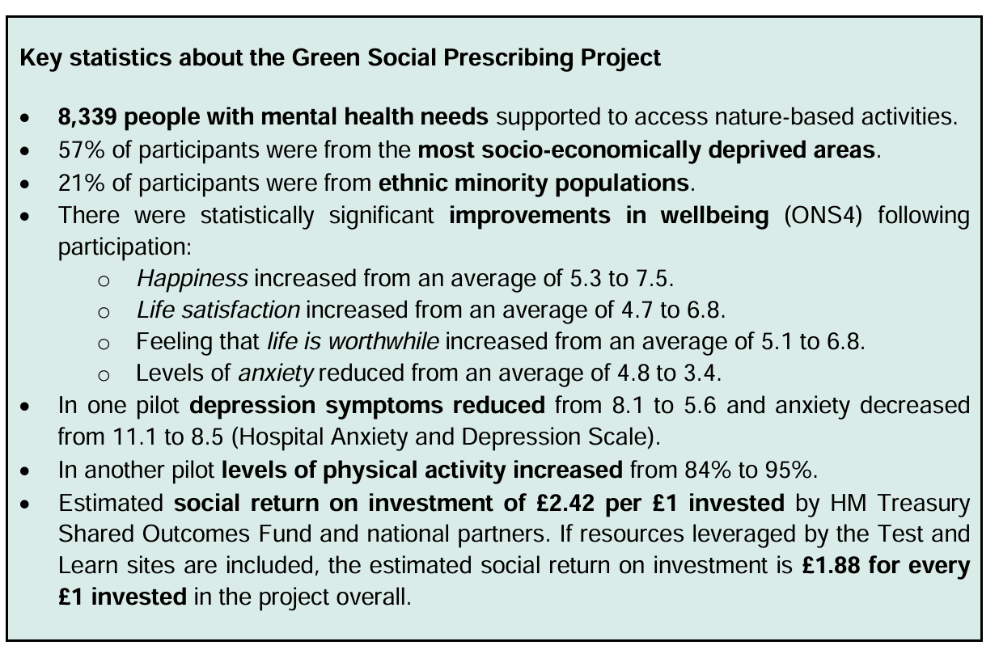
Notes:
The majority of post outcome measures were collected between six weeks and 12 weeks following referral.
The evaluation of the GSP programme found that, across seven pilot sites, there was a statistically significant improvement in wellbeing after accessing nature-based activities through the GSP Project. The authors estimated a social return on investment of £ 1.88 for every £ 1 invested in the project overall.

Slide 15
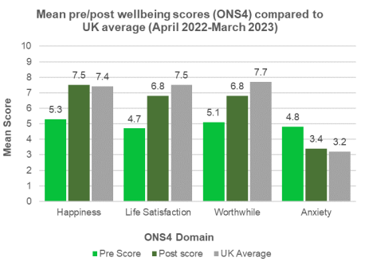
GSP had a positive impact on participants' mental health and wellbeing
National Participant Demographics:
  8,339 individuals participated across T&L sites.
  57% from socio-economically deprived areas
  21% from ethnic minority populations
National Wellbeing Benefits (ONS4):
  Happiness: Increased from 5.3 to 7.5.
  Life Satisfaction: Increased from 4.7 to 6.8.
  Feeling Life is Worthwhile: Increased from 5.1 to 6.8.
  Anxiety: Reduced from 4.8 to 3.4.
Mental Health Benefits (1 pilot site used Hospital Anxiety and Depression Scale):
  Depression: Reduced from 8.1 to 5.6.
  Anxiety: Reduced from 11.1 to 8.5.
Notes:
Main Message: GSP had a measurable, positive impact on participants' mental health and wellbeing.
The majority of post outcome measures were collected between six weeks and 12 weeks following referral.
The evaluation of the GSP programme found that, across seven pilot sites, there was a statistically significant improvement in wellbeing after accessing nature-based activities through the GSP Project. The authors estimated a social return on investment of £ 1.88 for every £ 1 invested in the project overall.

Slide 16

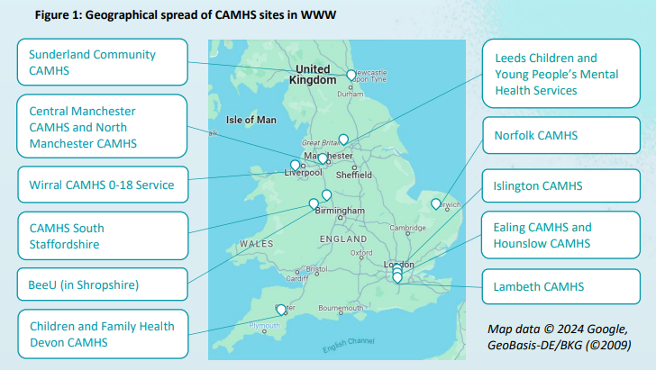
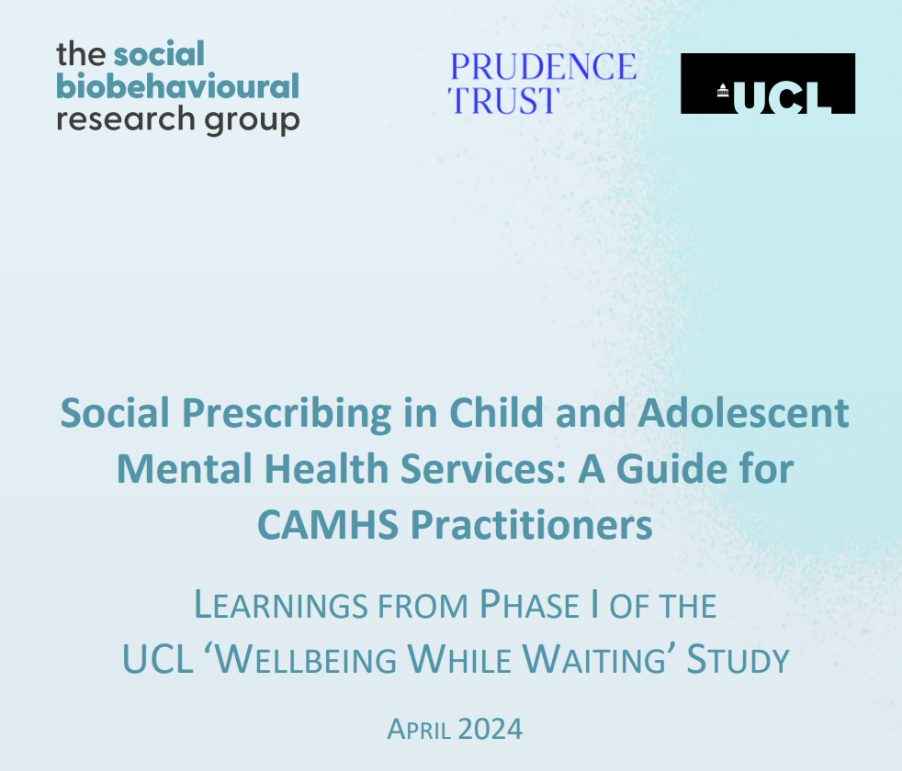



Wellbeing While Waiting
Fancourt et al. 2023 BMC Psychiatry
Notes:
We also continue to support UCL with their research on CYP – one of NASP's priorities. This study is of YP on the CAHMHs waiting list and how SP can support the in terms of resilience.

Slide 17
The Wellbeing While Waiting research programme by UCL (Hayes, 2026) enrolled 558 young people aged 11–18 years referred to CAMHS, between May 2023 and March 2025 (225 usual care; 333 social prescribing).
Results showed that, compared with usual care, no significant differences were observed for those receiving social prescribing in anxiety or depression symptoms. However, participants receiving social prescribing demonstrated significant improvements in total emotional and behavioural difficulties over six months, driven by reductions in conduct difficulties, hyperactivity and peer problems. Significant improvements for those receiving social prescribing were also found for prosocial behaviour and resilience.
The findings are consistent with positioning youth SP as a relational, strengths-based intervention that can stabilise young people and strengthen protective resources during waiting, while reinforcing the need for equitable delivery models and integration with timely access to specialist mental health care.

Slide 18
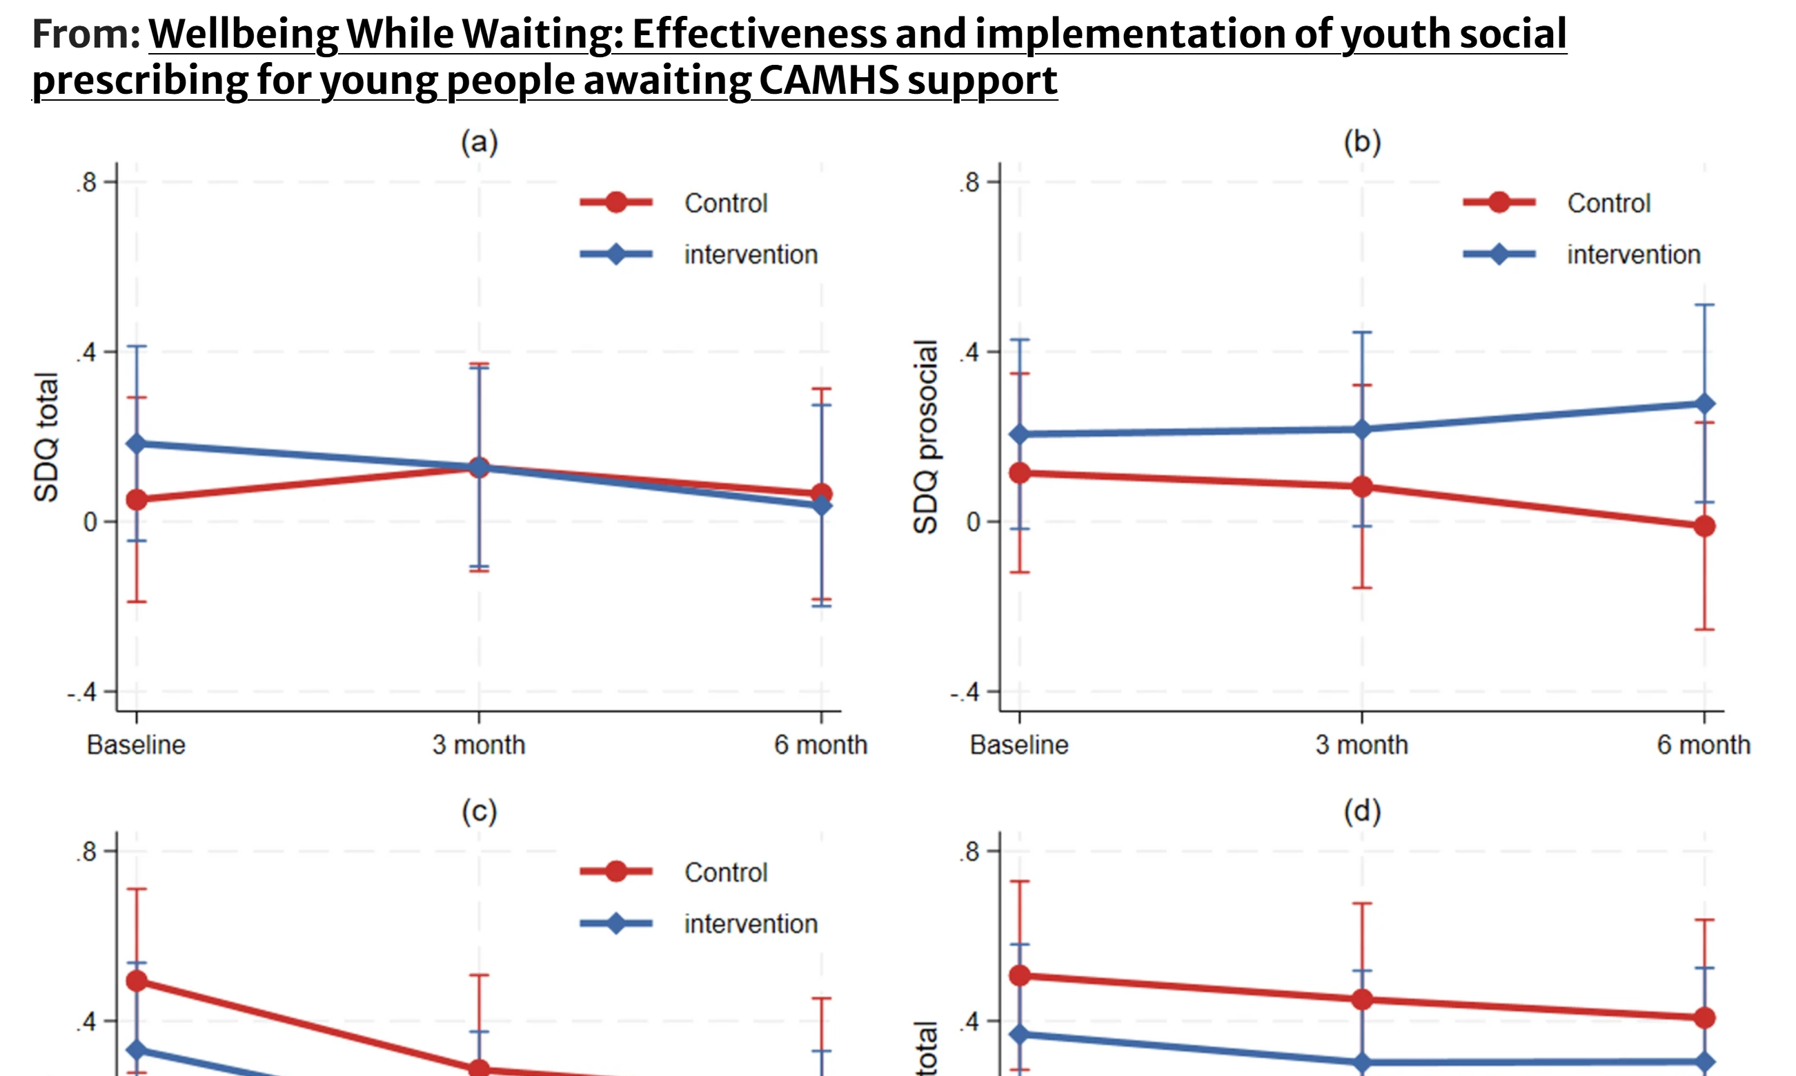
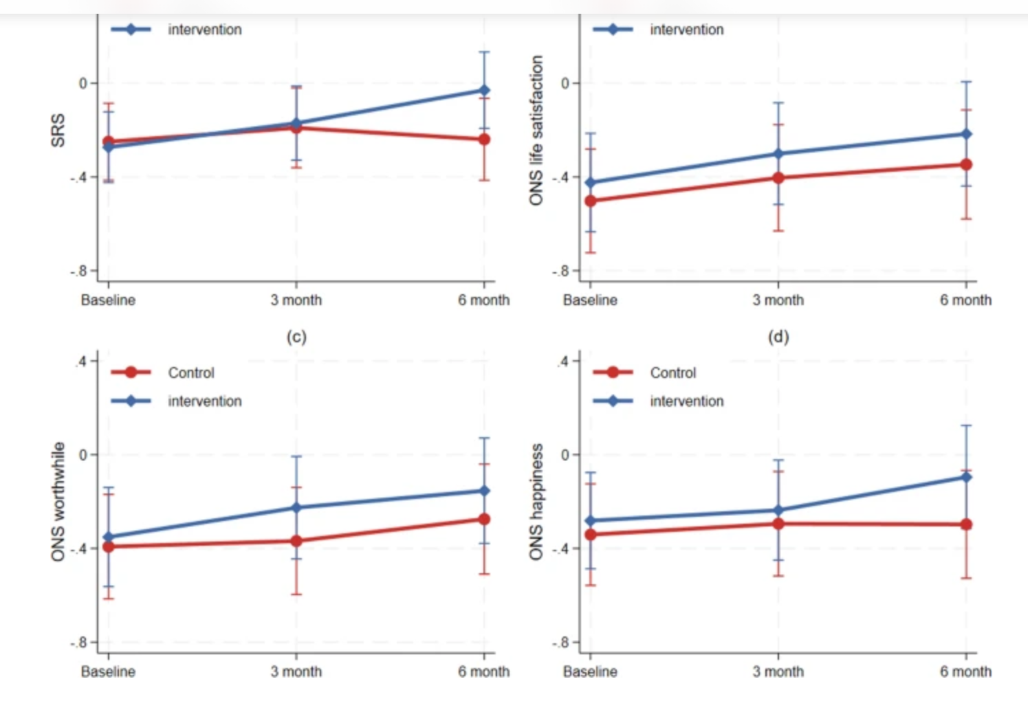

Slide 19
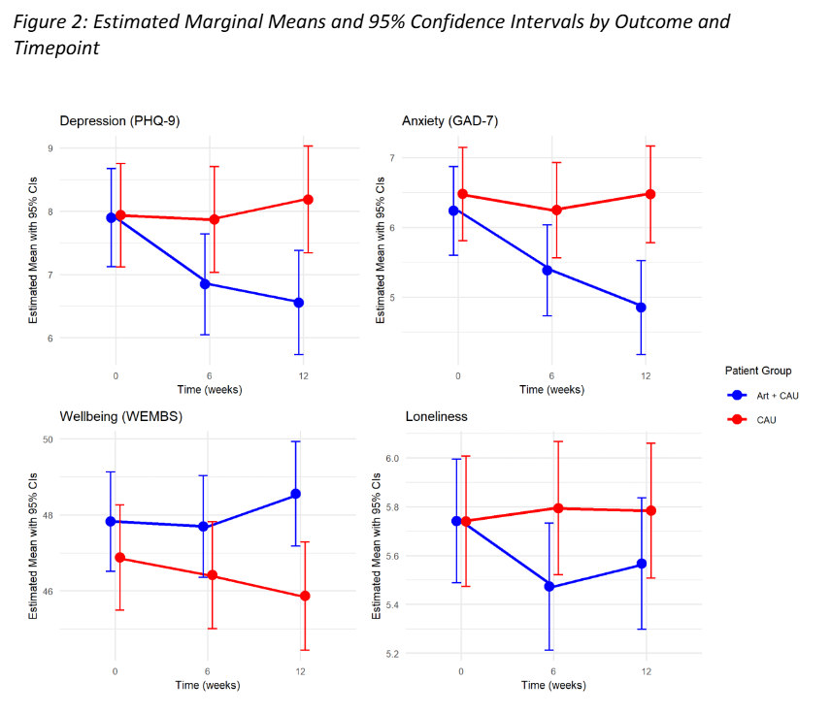
Severe Mental Illness
New Randomised Control Trials in Greece (Stefani, 2025) have been able to determine the effects of 3-months of art exposure on individuals with various mental health disorders (925 participants of RCT, 25% had schizophrenia, 14% depressive disorders, 13% anxiety disorders, 12% other psychotic disorders). Art exposure involved theatre, dance, visual arts, music, cinema, and museums. Outcomes of art exposure showed improvements in wellbeing, and reductions in depression, anxiety, and loneliness.
Notes:
An ethnographic study in England (Aughterson, 2024) on social prescribing for people with mental health problems focussed on four different community groups. The participants had moderate-to-severe mental health conditions, and the groups consisted of a reading, gardening, singing and football group. The study focused mostly on individuals with severe mental illness and explored 'mechanisms' underlying the mental health benefits of these groups.
Psychological mechanisms: increased self-confidence and self-esteem, increased purpose/meaning, increased sense of achievement, experience of pleasure;
Social mechanisms: increased social support, formation of friendships and reduced loneliness, enhanced sense of community and belonging;
Behavioural mechanisms: increased independence and openness to experience, reduction in addictive behaviours and building healthier habits, increased work-seeking behaviour, and provision of structure and routine.

Slide 20
Challenges
Complexity of cases / high caseloads
Part of a joined-up system with clear pathways for patients, and with clarity around roles and responsibilities.
Good quality training and supervision to support staff confidence and capacity.
Sustainable funding for community groups to follow referrals.
Notes:
Wider evidence of activities
There is also a strong evidence base for many of the activities that people may be connected to through social prescribing – including physical activity, nature (including nature-based activities for long term conditions and links between natural environment and mental health), creative health approaches (including WHO scoping review) and heritage projects.

Slide 21
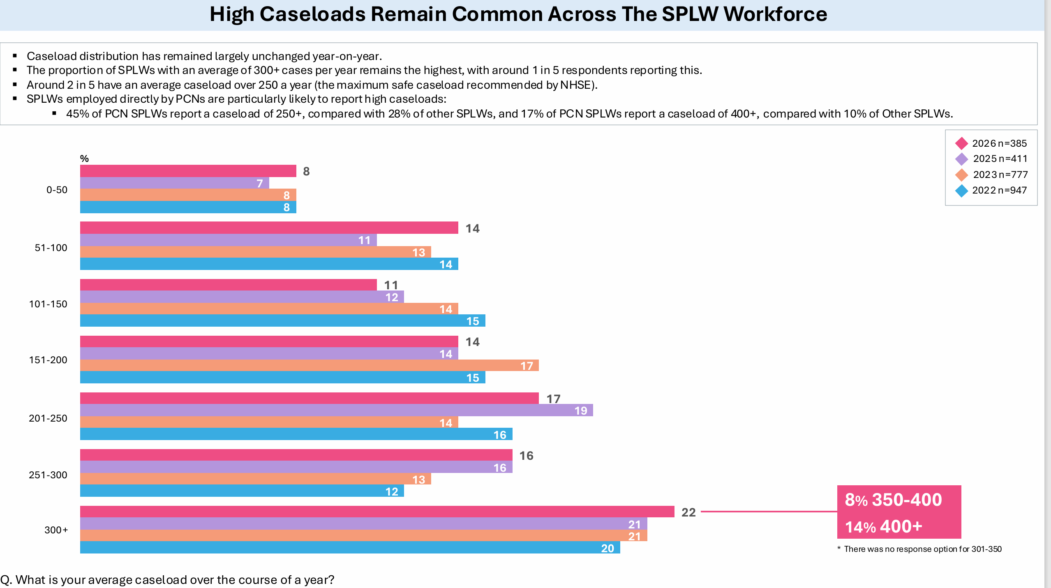

Slide 22
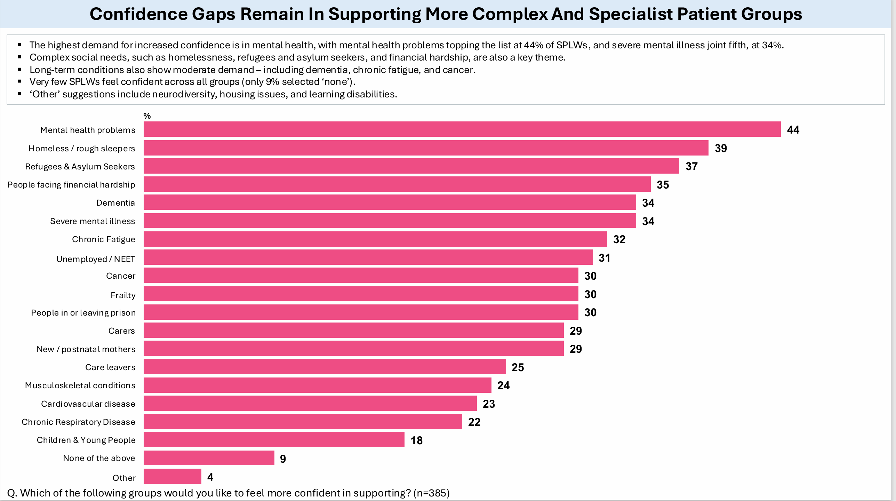

Slide 23
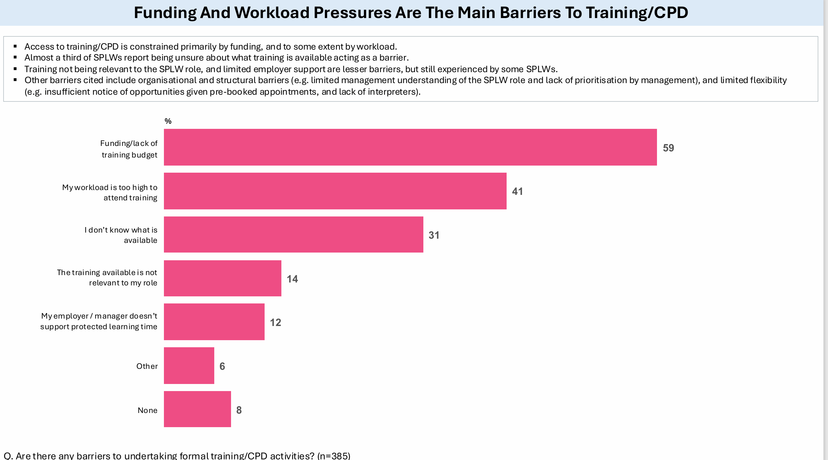

Slide 24
Summary
Growing body of evidence that SP improves mental health and wellbeing
Link workers are already supporting people everyday
The support is making a meaningful difference
It complements (doesn't replace) clinical care
There is emerging evidence around Severe Mental Illness
We need to also consider existing challenges around training, supervision, caseloads

Slide 25
Ben Barlow - Social Prescribing Link Worker at Newport & Central PCN

Slide 26


The remit of Social prescribing in Mental Health & the importance of working in partnership
-Ben Barlow-Beck
NASP Webinar: Mental health Part 2
World Mental Health Day: “Lived experiences heard: real voices, real change”

Slide 27
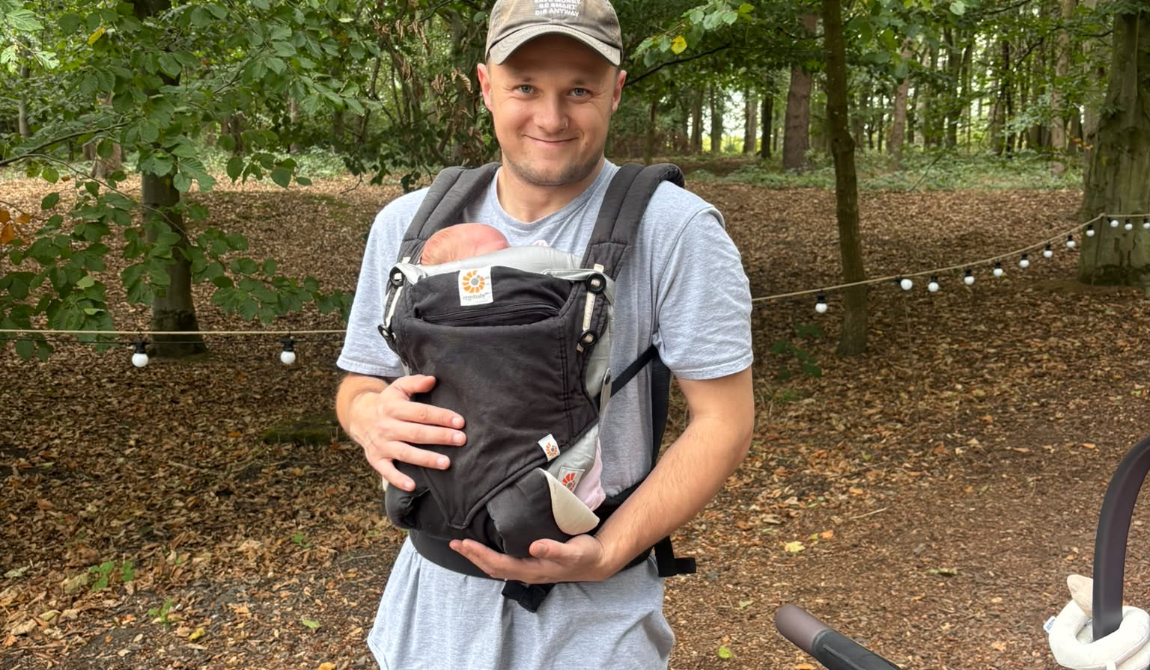


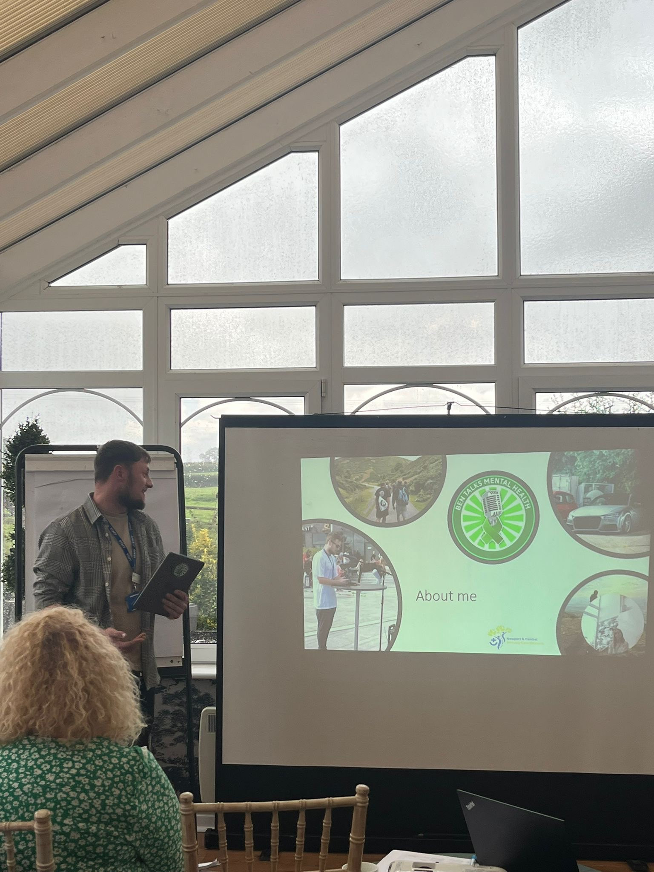


About me
Notes:
So im going to start todays talk off with a little about me
I'm Ben, A SP working for Newport PCN based at DMP.
I’m a wannabe hiker (joke here) I’m a car enthusiast, a dog lover, a gamer and I’m also human like the people we see day to day with day to day issues.
Why have I told you this when this has nothing to do with men’s mental health or social prescribing is what your thinking but I’d challenge this view
Within my own journey with mental health and in the work I do as a social prescriber Connection is pivotal.
And today I’m going to delve into this a little deeper from my own experiences and practice so hopefully if you take anything away from today, its that you value the umportrance if building strong connections with your patients as its the most significant anchor for a positive outcome for a patient.
I know it was for me.

Slide 28
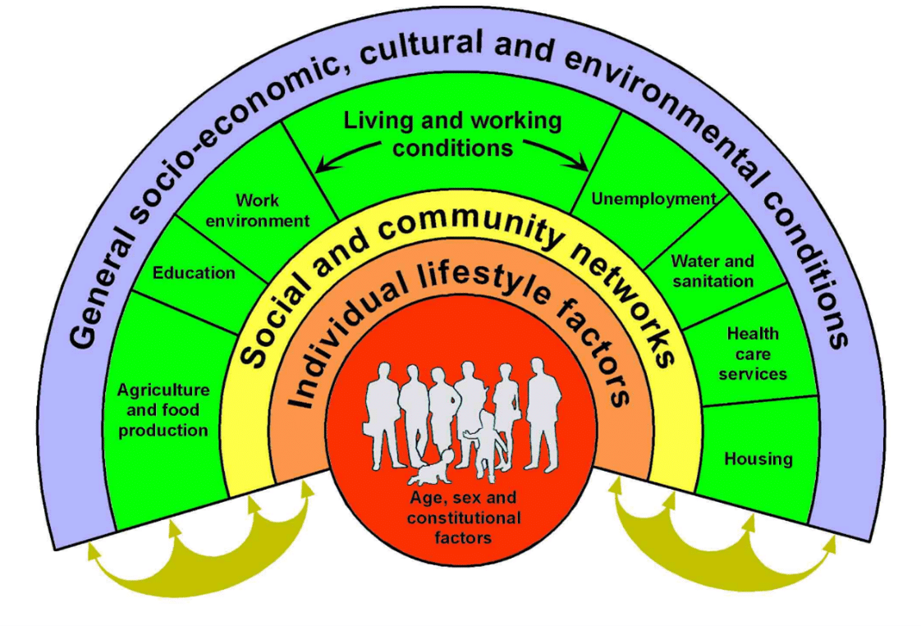

The Wider Lens:
What do you see?
"Curiosity and questions will get you further than confidence & answers."
-Maxime Lagacé

Slide 29

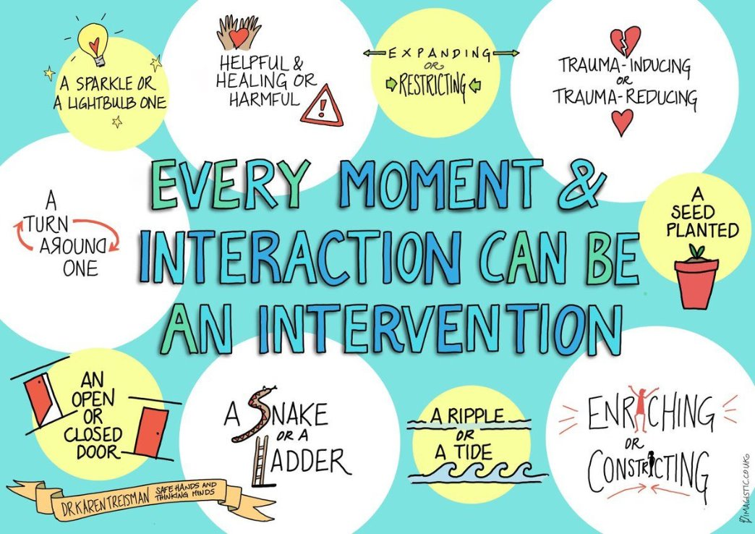
What matters to you?
One question
Infinite responses
“Adopting this strengths‑based view doesn’t mean pretending challenges don’t exist. It means reframing them. Instead of asking ‘What’s wrong with me?’ you get to ask ‘What are my unique strengths? What do I need to thrive? What kind of support would actually help?’” — Ronen Dancziger

Slide 30

We don’t need to solve everything
Supporting mental health is:
Keeping the question ‘what matters to you?’ At the heart
Giving time and space
Building trust
Being relatable
Picking up on their interests
Being curious
Notes:
“I define connection as the energy that exists between people when hey feel seen, heard and valued; when they can give and receive without judgement; and when they derive sustenance and strength from the relationship”
Brene Brown

Slide 31
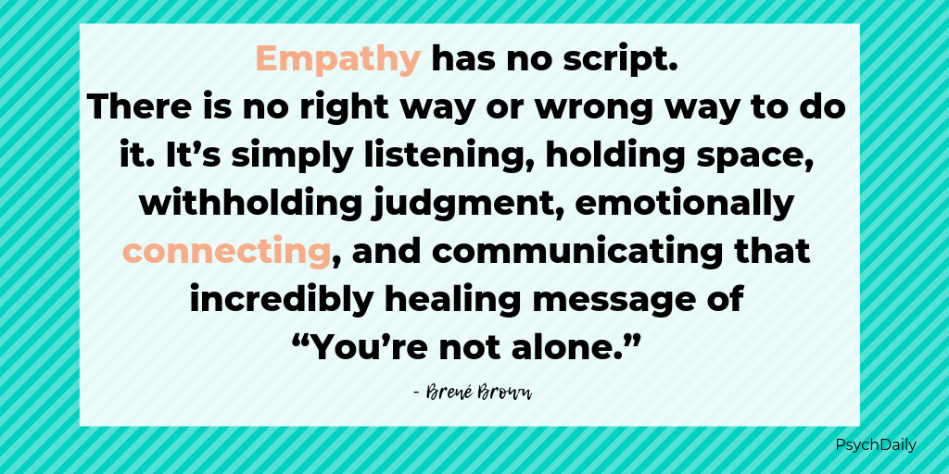



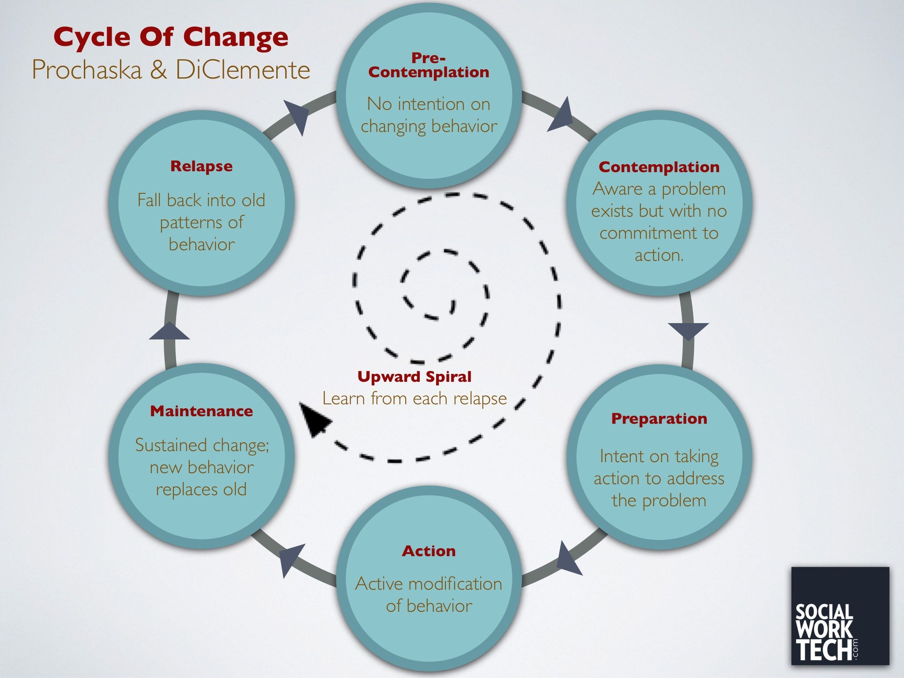
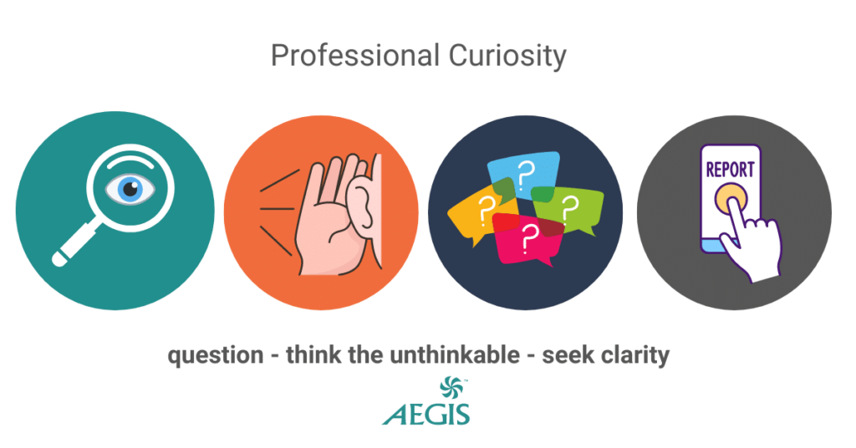
What supports our work?

Slide 32







We can't do this alone

Slide 33
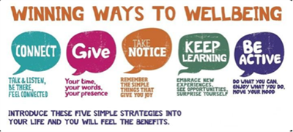
Thank you

Slide 34
Jackie Hardy - Lived experience contributor

Slide 35
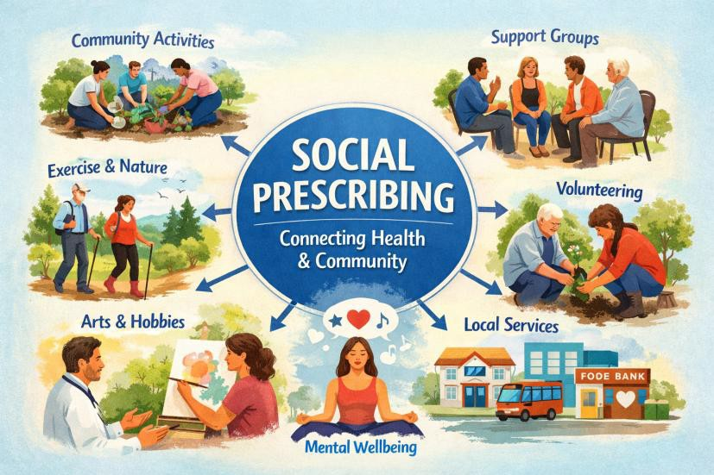
Lived Experience:
My social prescribing journey
Presented by: Jackie Hardy, Lived Experience Contributor

Slide 36

Why I was referred for social prescribing
I visited my GP after experiencing social isolation following the breakdown of a relationship and after a sexual assault. This was also during the period of emerging from the pandemic, when feelings of loneliness and disconnection were heightened.
As I was receiving other help, the GP felt social prescribing would help rebuild confidence, reconnect with my community, and find supportive activities that could improve my wellbeing and aid my recovery journey.
Please remember to signpost people to other services if they need additional support.

Slide 37

Meeting with Link Worker
Glad they took time to know me first.
Discussed a variety of things, but especially feelings of
loneliness and disconnection.
Looked at options in the community, including a coffee club that met weekly.
The Link Worker gave me the contact details and checked that I felt comfortable calling the person who ran it, which I did.

Slide 38

Felt nervous
Alice, whom I spoke to regarding the coffee club was very friendly and person-centred in her approach with me. I shared that I was nervous about coming, but she reassured me she would meet me at the top of the road.
Helped the person met me and then brought me to meet others.
Nice, friendly group and all women, so that helped.

Slide 39

Patricia, the Link Worker, phoned to check how it went.
We talked about the challenges around feeling nervous, and I explained how Alice met me at the top of the road and walked with me, which really helped.
I said that I enjoyed it and that being around others with lived experience of different life events and mental health difficulties helped me feel at ease.
Patricia asked if I would be going again, and I said I would. We arranged another time to speak.

Slide 40

What it helped me to do
It made me aware of a group I hadn’t known about
before.
It got me out of the house each week, and the WhatsApp group meant I had daily connection too.
Over time, we started going out together to social events - plays, singers, jazz nights, dinner and dance.
We celebrated our birthdays and even went out for a Christmas meal as a group.

Slide 41
Ways of working used by link worker
At the time, I felt very isolated and unable to see a way forward. I liked that they:-
Getting to know me
They took time to understand me as a person - what I used to enjoy and who I was
before becoming very unwell. This felt essential, because you can’t support someone
meaningfully without knowing them.
Person-centred and empathetic approach
They worked alongside me, not ahead of me. Their empathy and steady presence made
the journey feel shared, not something I had to face alone.
Wellbeing and goal-setting plan
When I couldn’t think clearly or organise things myself, they helped me identify what I wanted to change and break it into small, achievable steps. Having a written plan made everything feel more manageable.
Check-ins
Regular check-ins helped me stay connected and gave me space to talk about how things were going.
Endings
They were clear about the number of sessions and prepared me for the ending. Even
though it was hard, it mattered. They reminded me how far I’d come and said they were
proud of me - which meant a lot.

Slide 42
Difference social prescribing has made to me
Having someone alongside me made me feel less alone, and gradually I began to:
-regain confidence
-their support helped me move from feeling scared and stuck to feeling able to take steps forward and reconnect with others.
Lessons learnt from it I still use now. Therefore, long-lasting and impactful.

Slide 43
Moved a year ago and felt lonely/isolated as new area and did not know anyone
Because of my experience with social prescribing I used the same wellbeing/goal setting approach link worker used.
I mapped my local community and found some social cafes and tried four and liked two of them.
I feel social prescribing helped me think about what is in the community and try things. But I still feel nervous before go to anything. I learnt that being honest about this helps and that I can see what support I can receive.

Slide 44
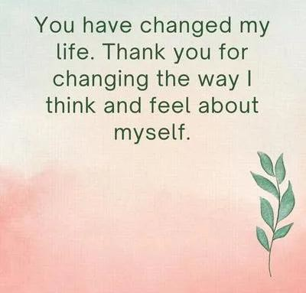
Thanking for making a difference

Slide 45


Get in touch
socialprescribingacademy.org.uk
Q&A

Slide 46
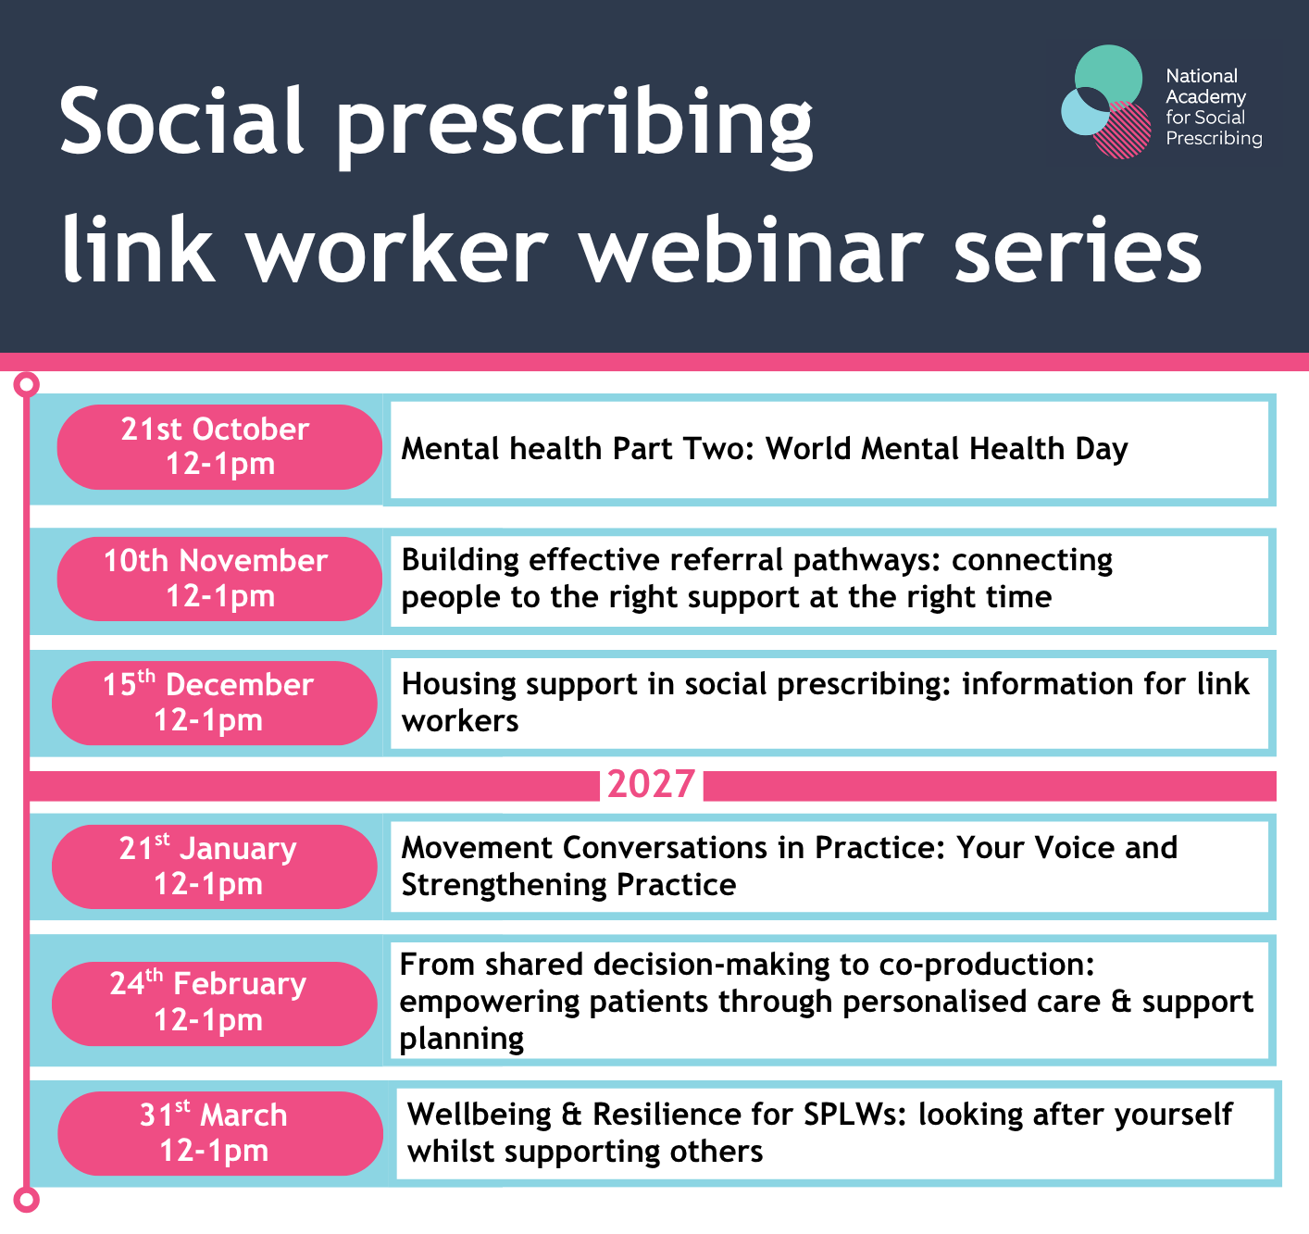
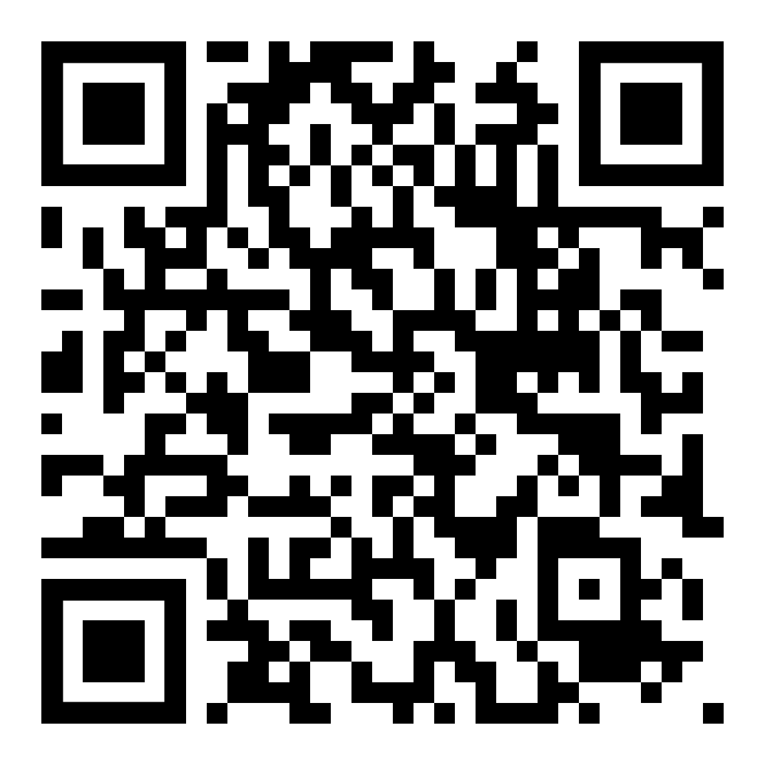
External Support for sexual assault:
Rape Crisis England & Wales
SARSAS home
thesurvivorstrust.org/
Mental health support:
contact-samaritan/
Mental health helplines, text and online chat | Mind
https://hubofhope.co.uk/
SANEline services - SANE
https://www.getselfhelp.co.uk/
https://menssheds.org.uk/
https://www.thecalmzone.net/suicide-prevention-helpline
​
LGBTQ community: ​
mindout.org.uk/ ​
www.stonewall.org.uk
Events | NASP

